Slide 1
Planetary landforms
A visual introduction to planetary geomorphology
EROSION, WHEATHERINg, PATTERNED GROUND,
MASS WASTING
HENRIK HARGITAI
2019
csplanetolg17em
FÖL/1/075E
Definitions in the Notes section

Slide 2
EROSIONAL FORMS

Slide 3
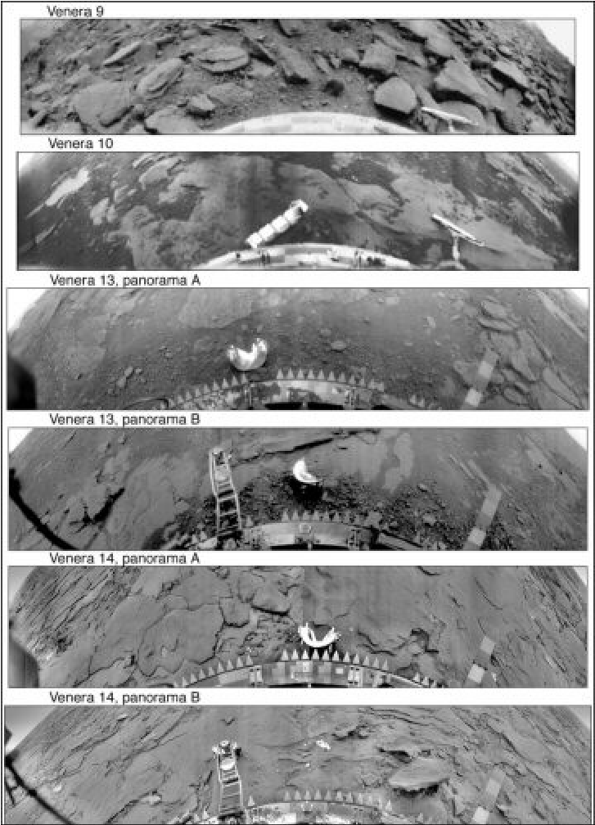
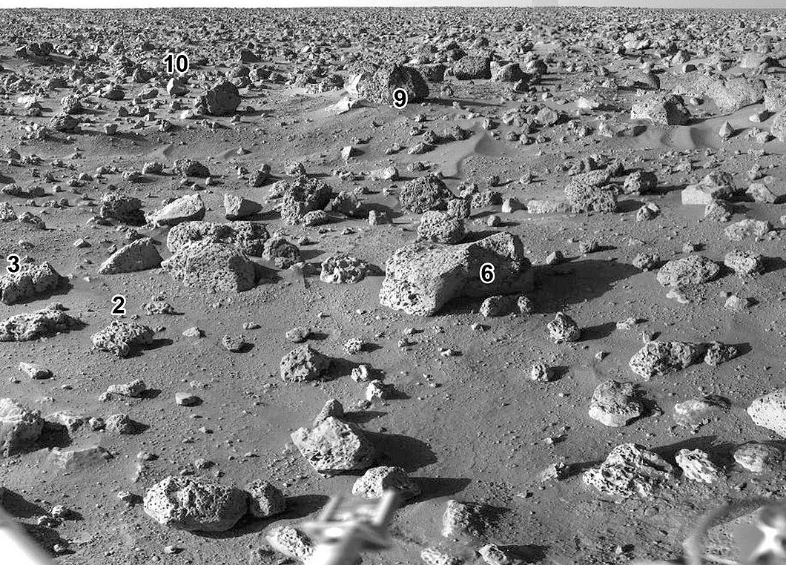
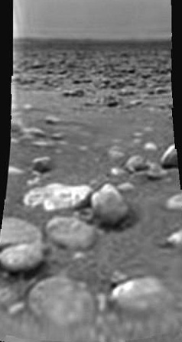
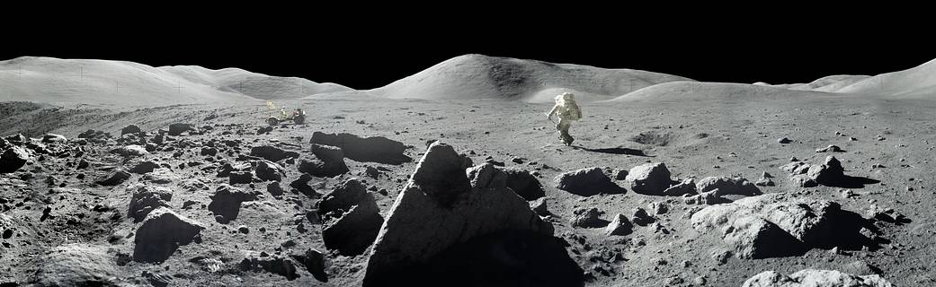
Erosional forms > Boulder field

Slide 4
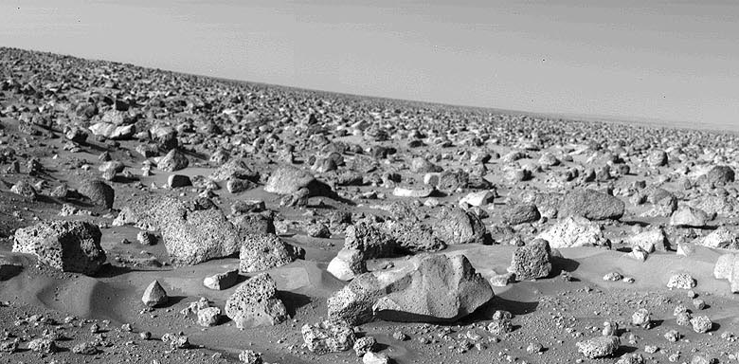
Erosional forms > Lag deposit

Slide 5
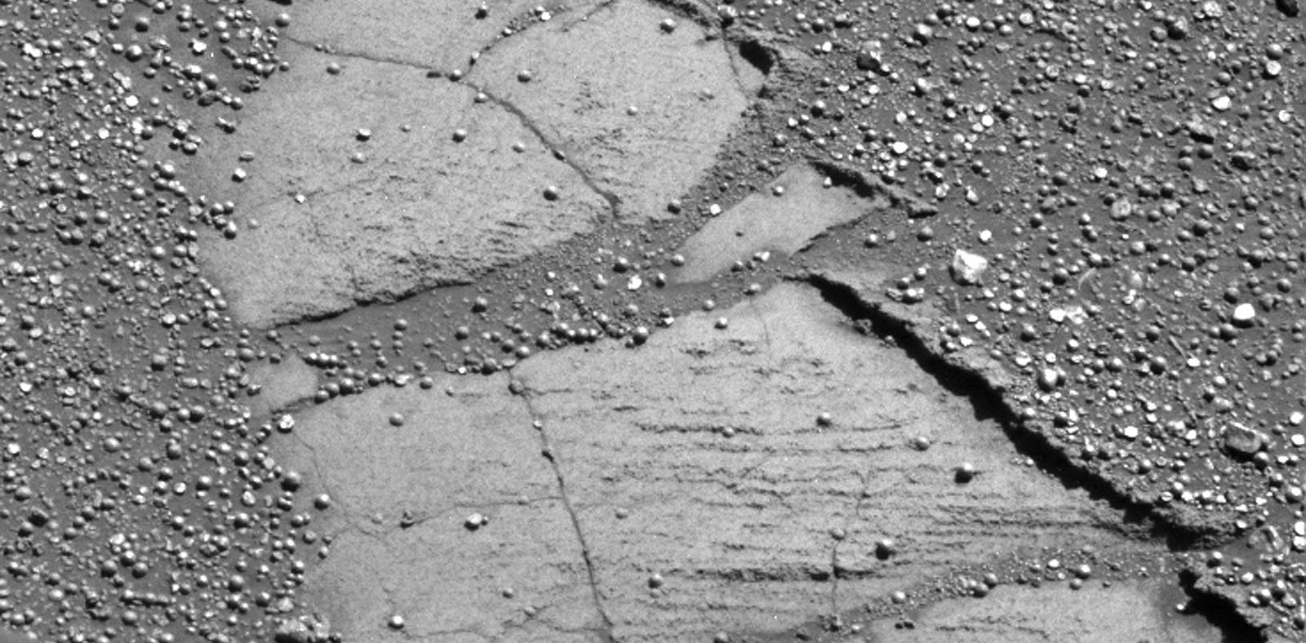
Erosional forms > Surficial crust

Slide 6
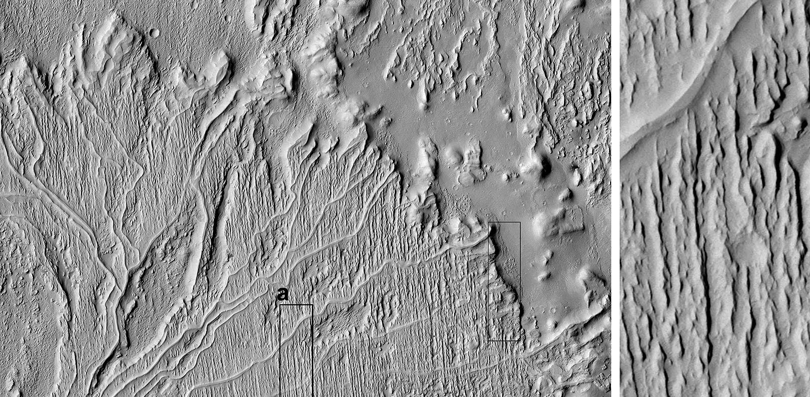
Erosional forms > Inverted channel

Slide 7
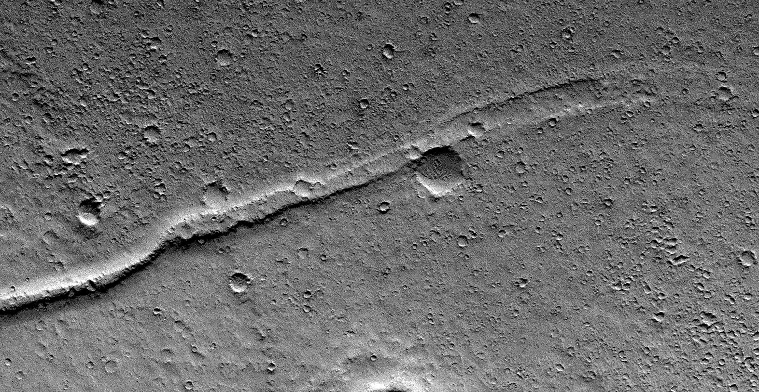
Erosional forms > Serpens

Slide 8
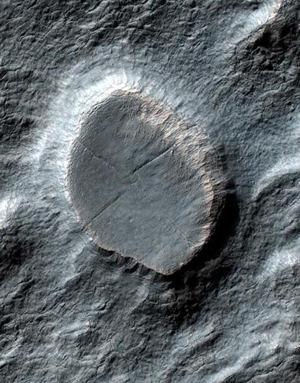
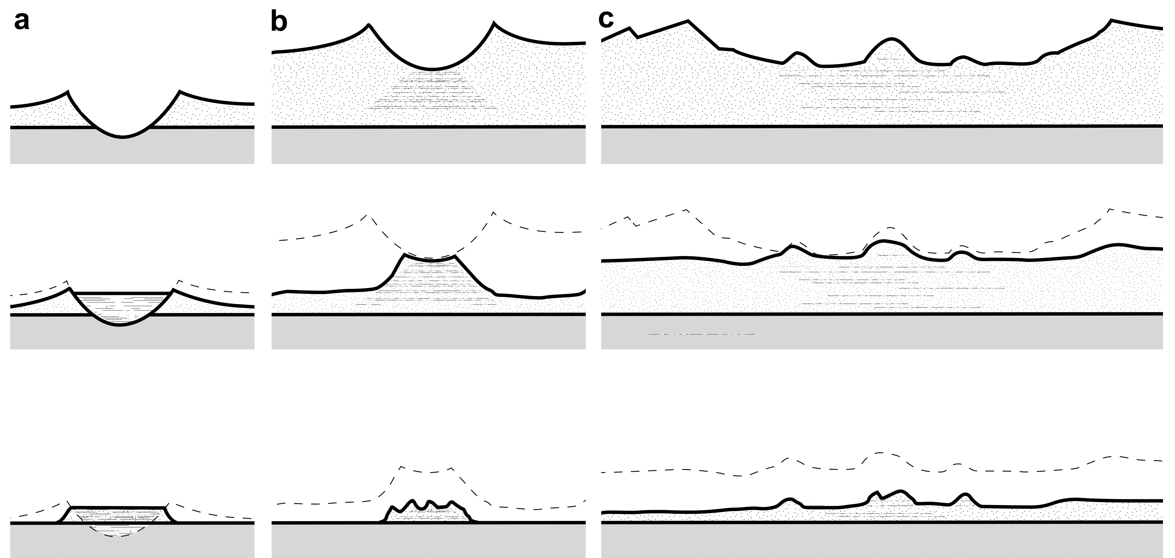
Erosional forms > Inverted crater

Slide 9
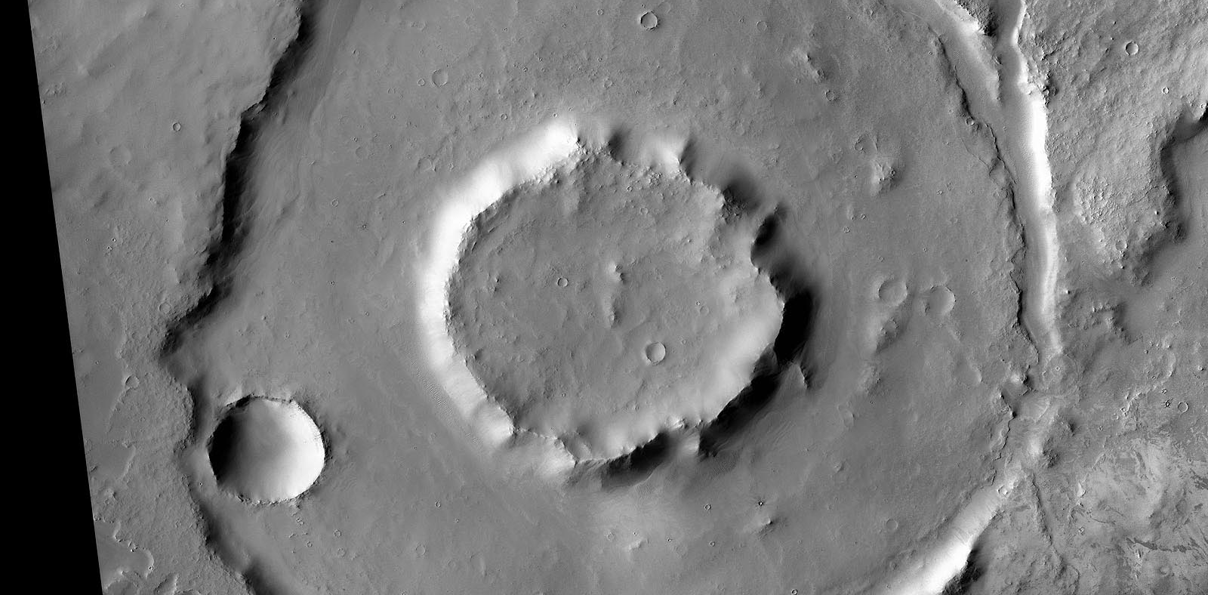
Erosional forms > Ring furrow

Slide 10
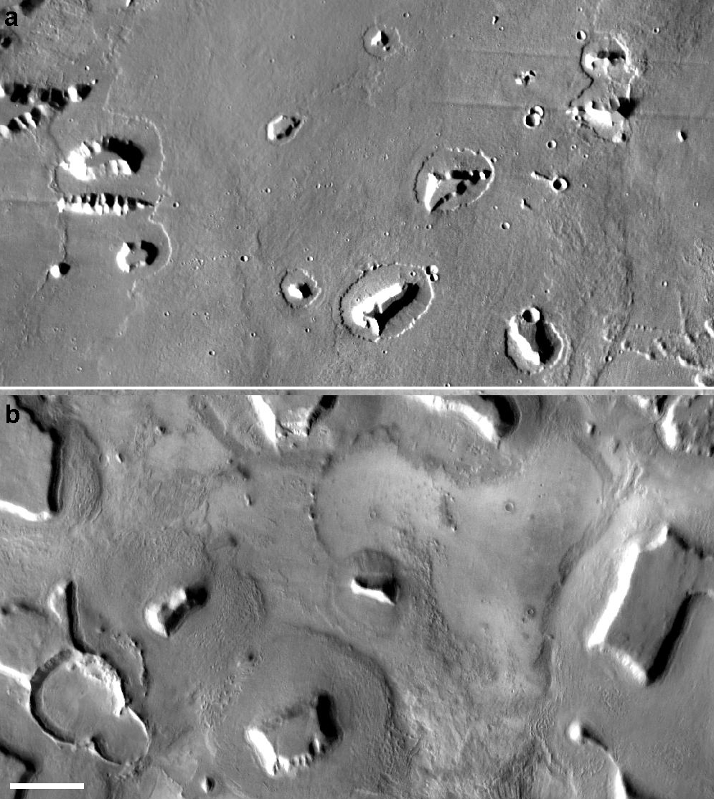
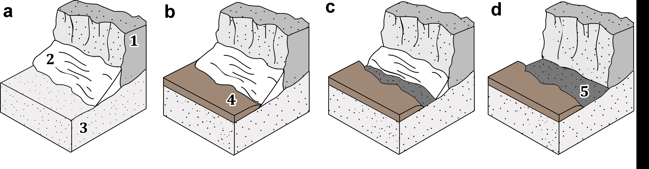
Hauber et al. 2007, 2008
Erosional forms > Moat = Circumferential depression

Slide 11
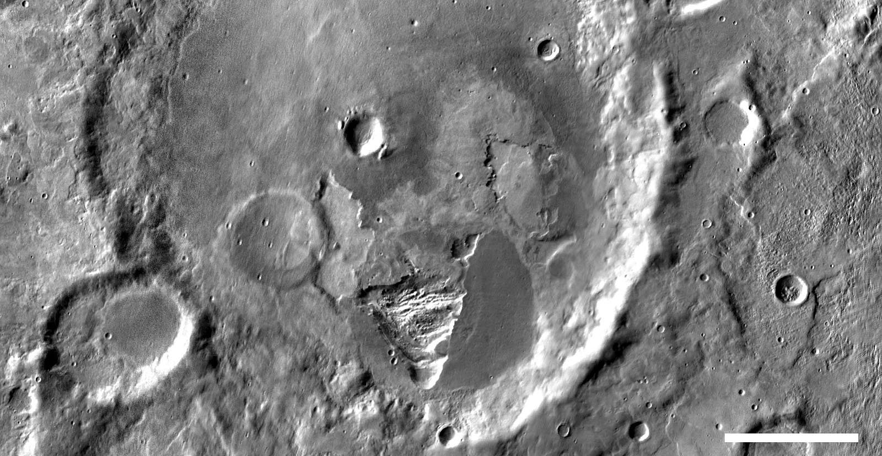
Erosional forms > Irregular depression

Slide 12
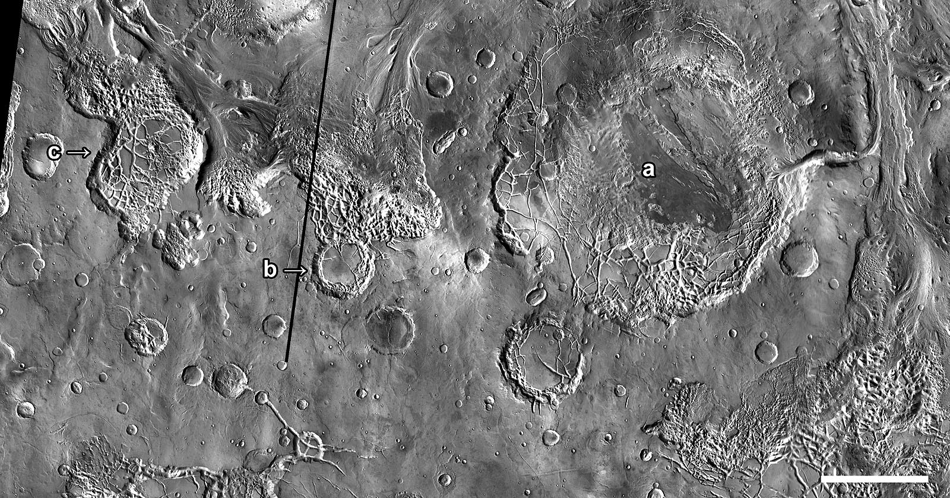
Erosional forms > Chaotic crater floor

Slide 13
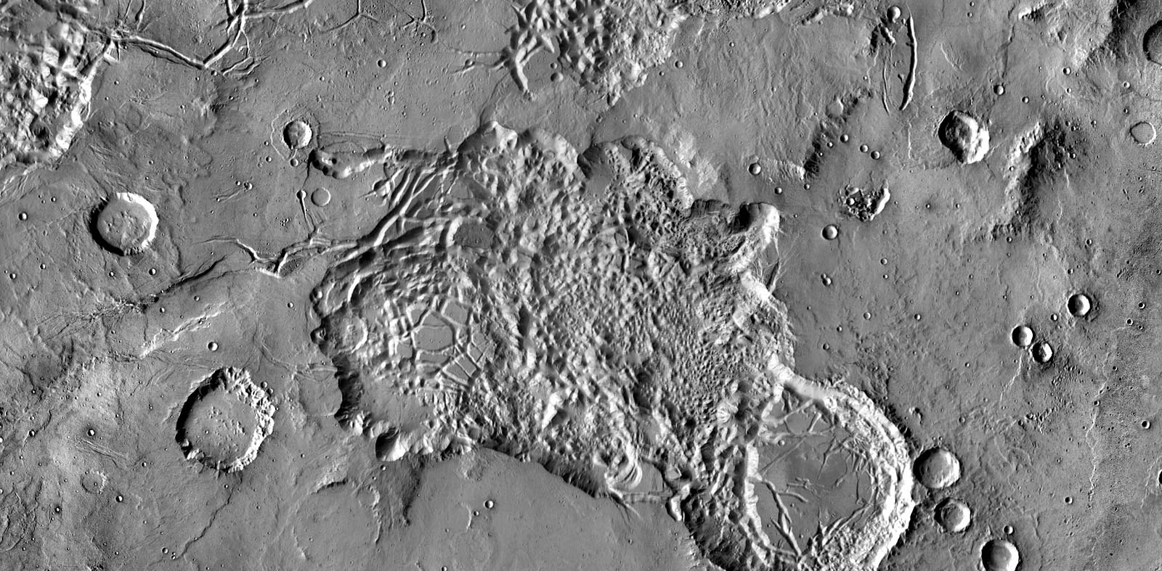
Erosional forms > Chaotic terrain Mars

Slide 14
Key concepts
Erosional features form as surface material is removed either completely (exhumation) or selectively

Slide 15
WEATHERING FEATURES

Slide 16
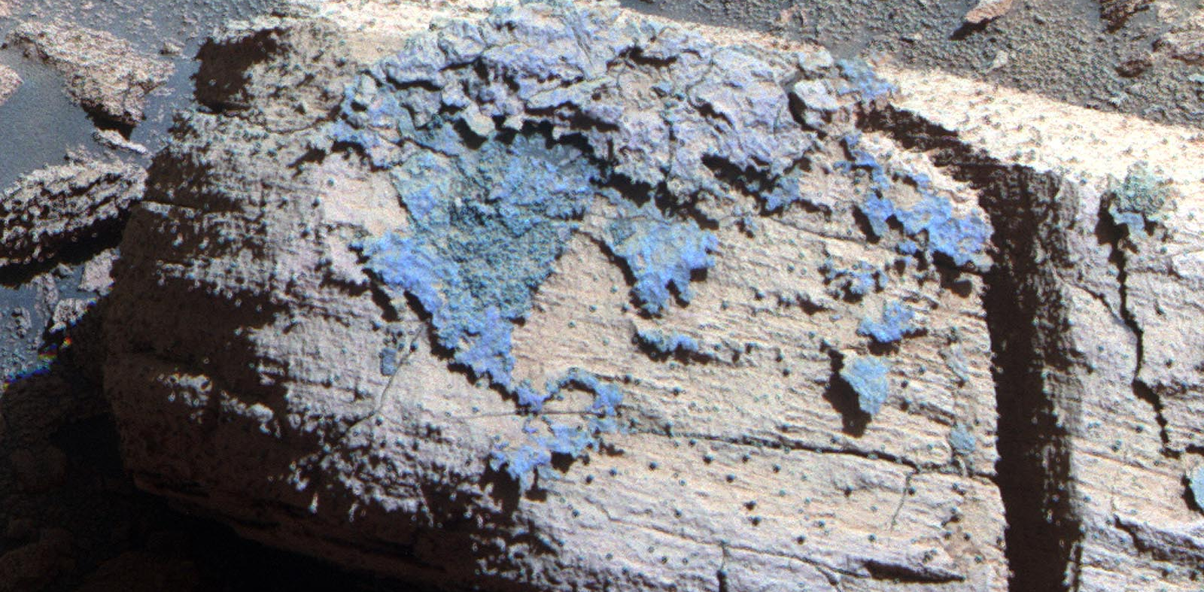
Weathering > Case hardening

Slide 17
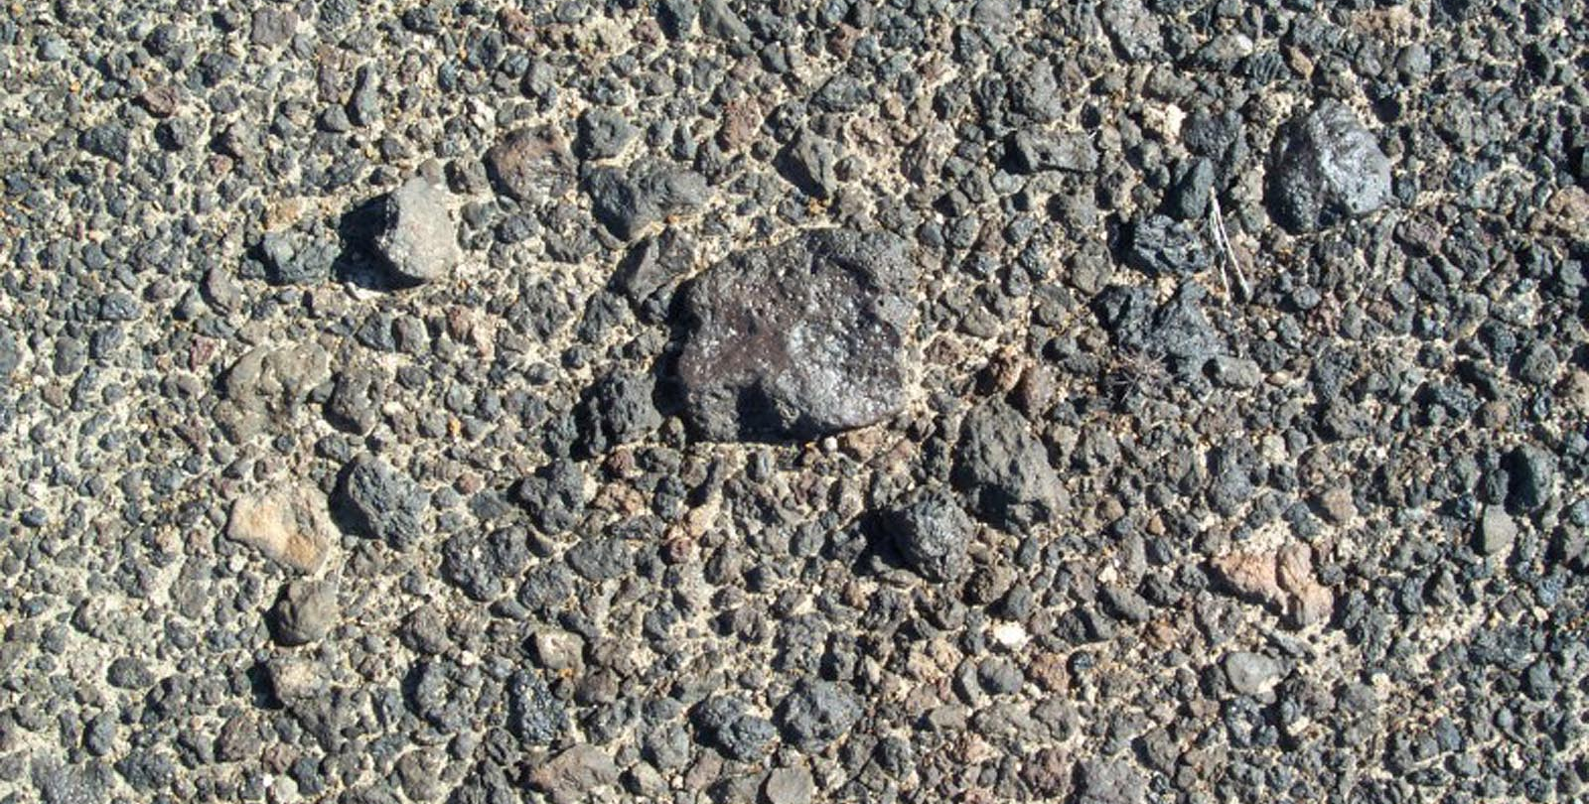
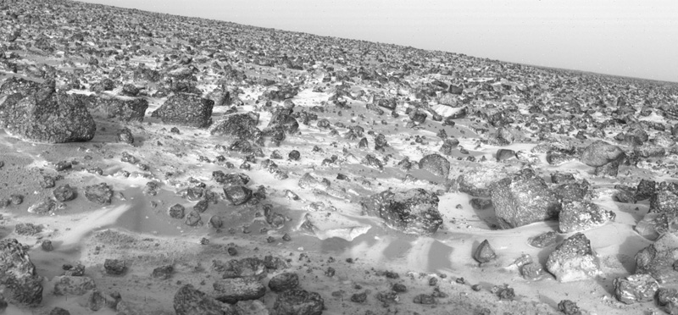
Weathering > Desert pavement

Slide 18
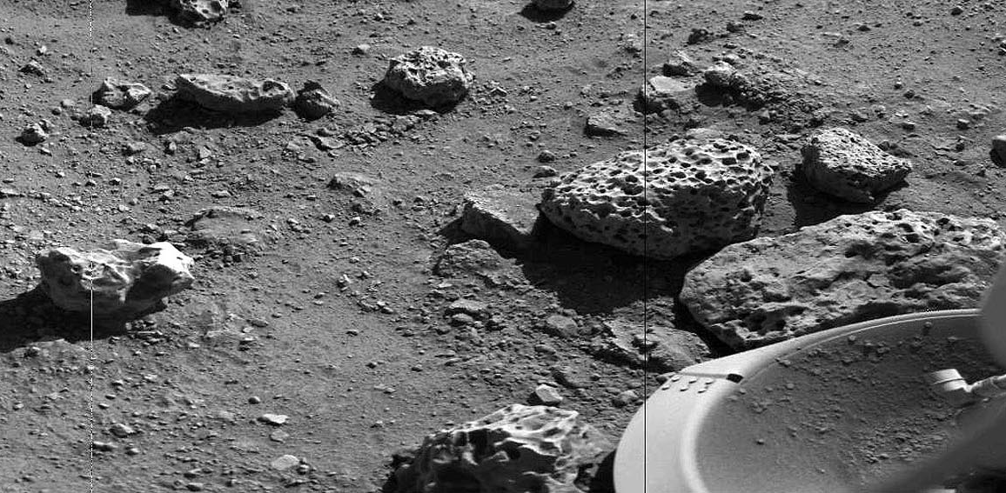
Weathering > Cavernous weathering

Slide 19
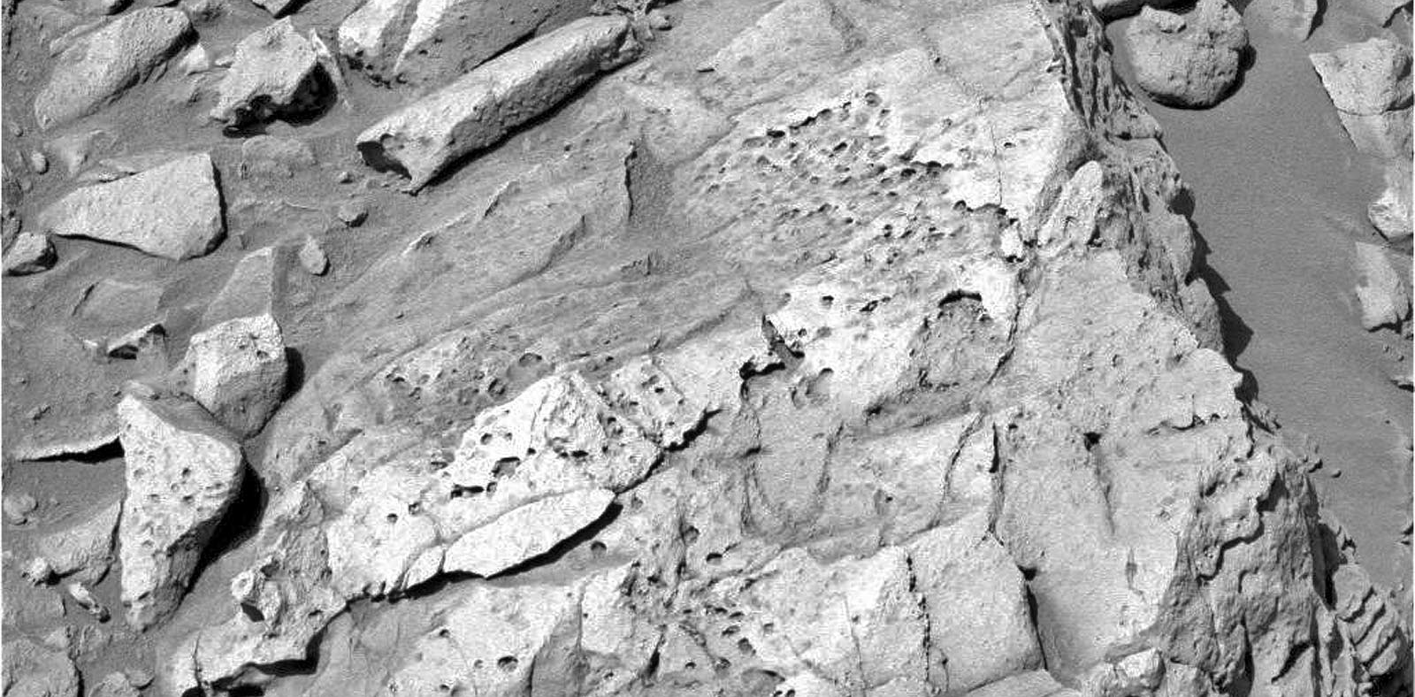
Weathering > Honeycomb weathering

Slide 20
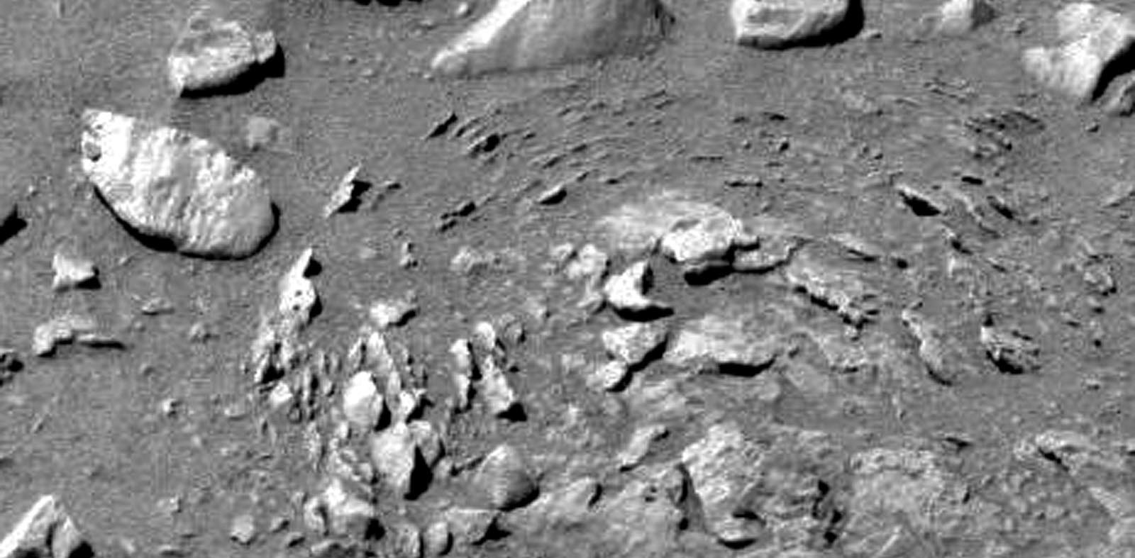
Weathering > Onion skin weathering

Slide 21
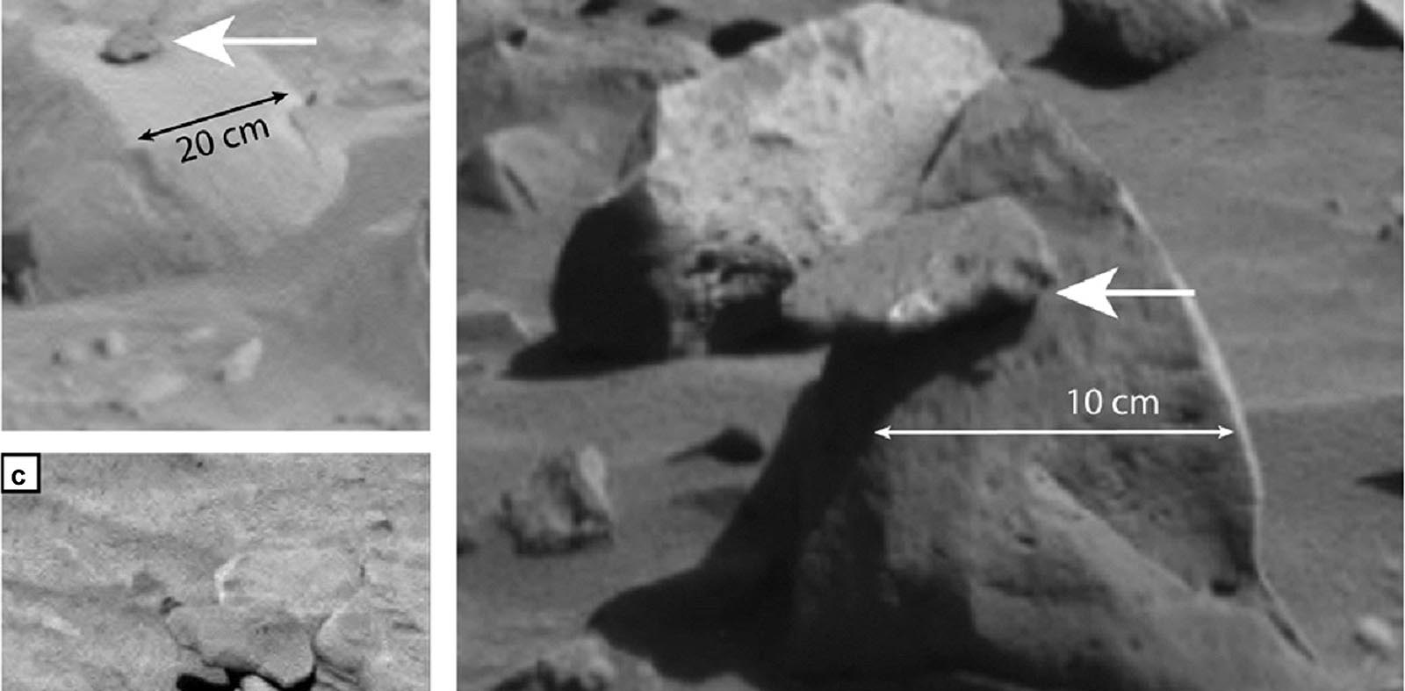
Erosional forms > Balanced rock

Slide 22
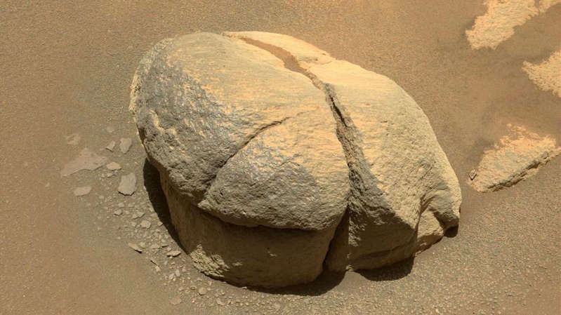
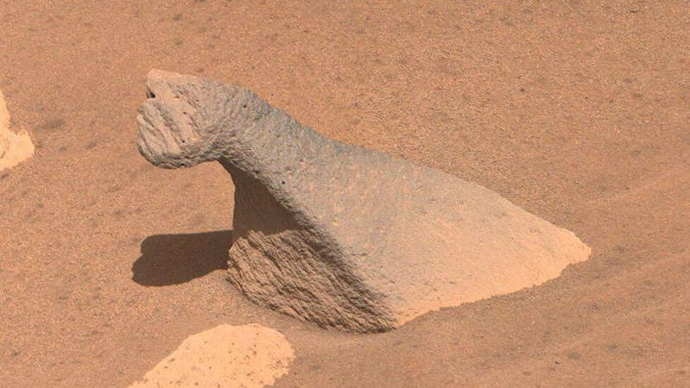
Erosional forms > Mushroom rock

Slide 23
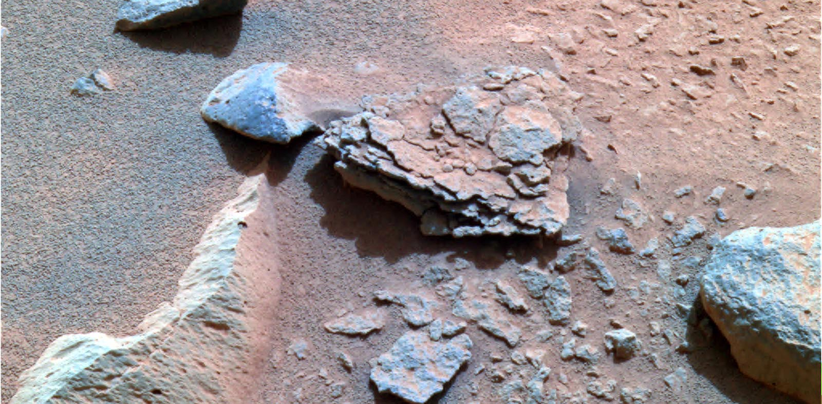
Weathering > Rock flakes

Slide 24
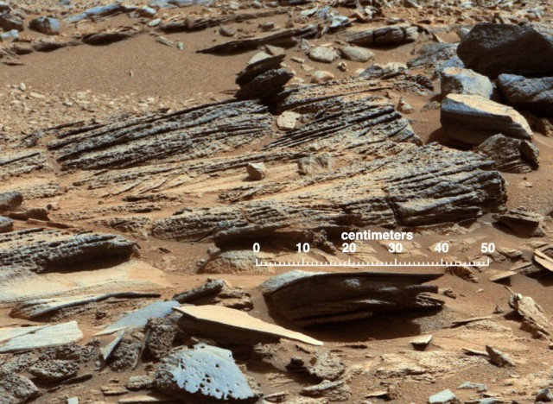
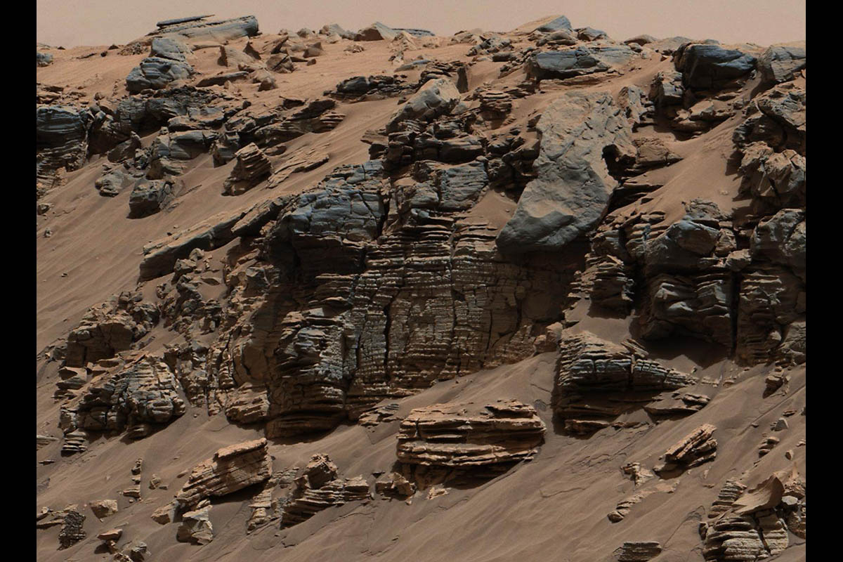
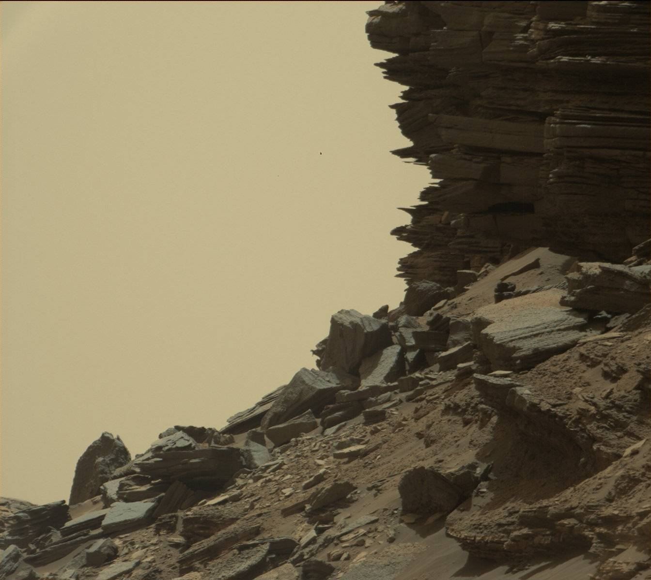
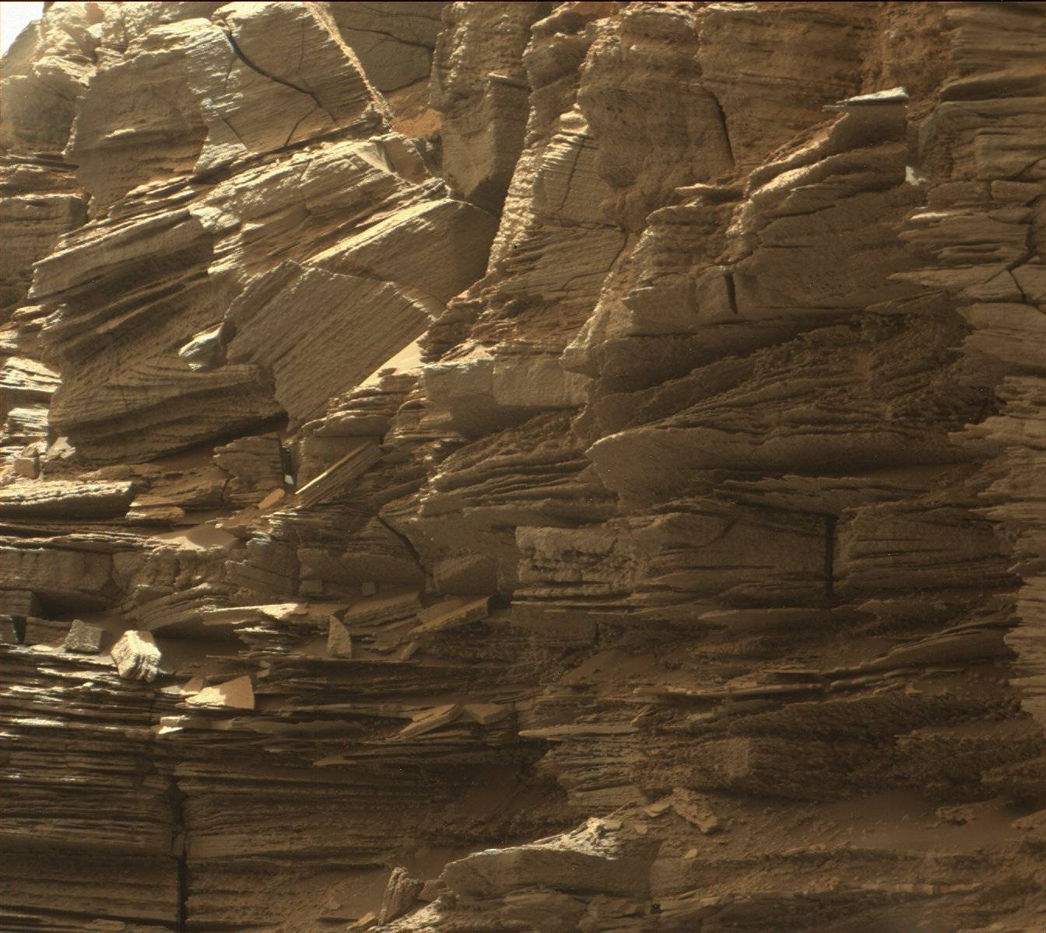
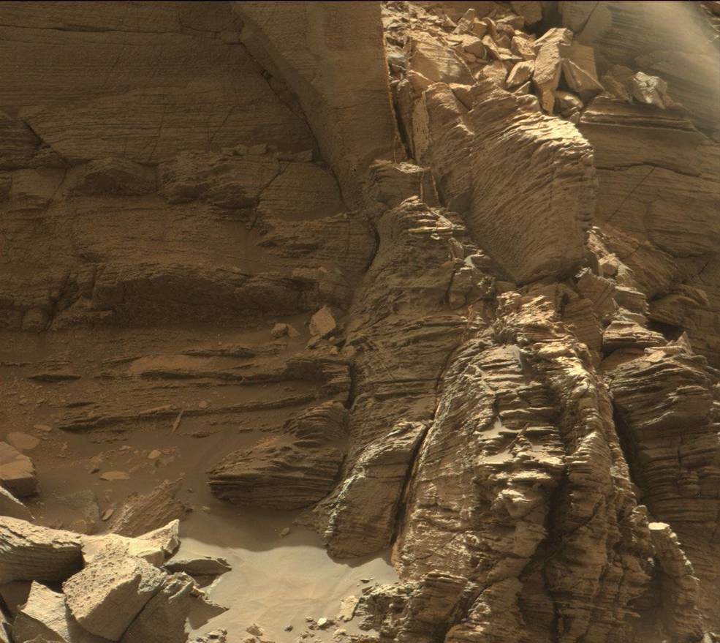
Weathering > Lamella and layered rock

Slide 25
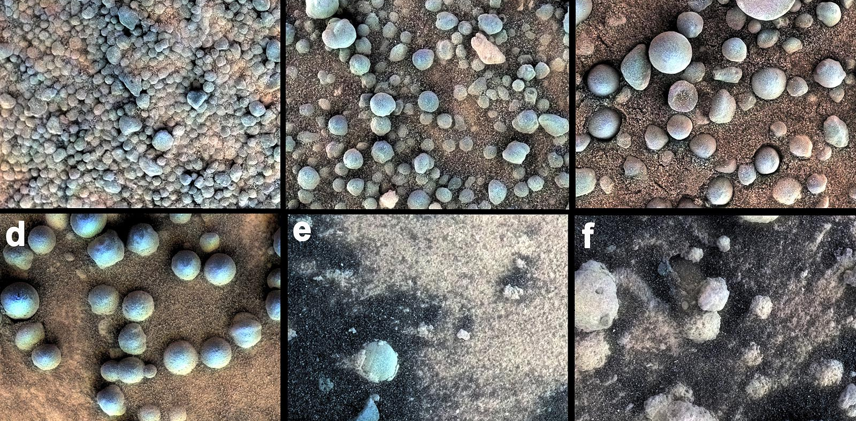
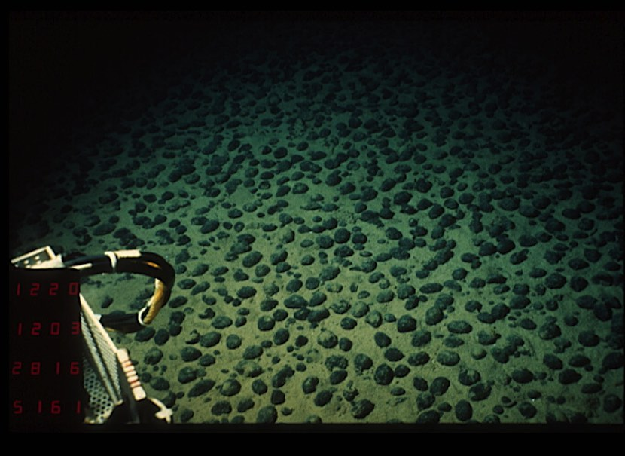
Weathering / Subsurface > Spherules

Slide 26
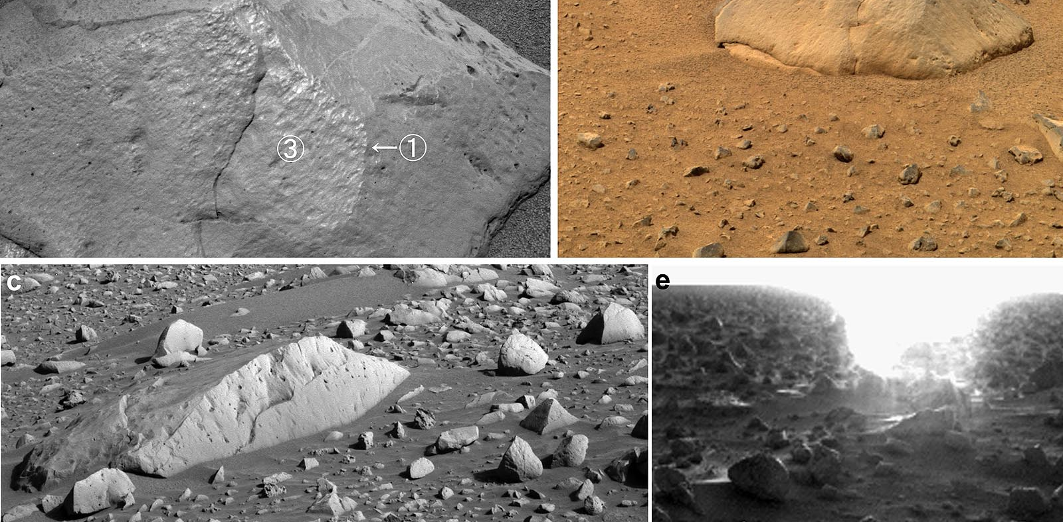
Weathering / Aeolian > Ventifact

Slide 27
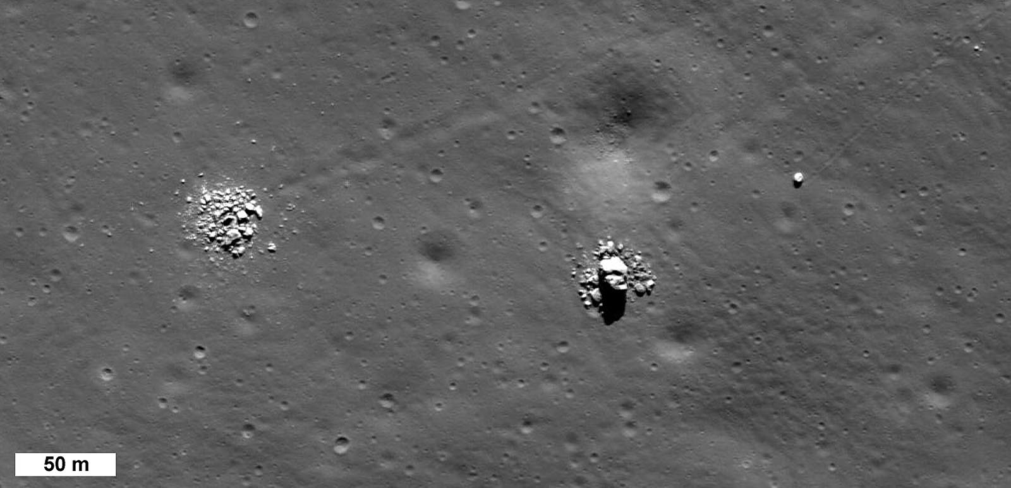
Weathering > Split rock

Slide 28
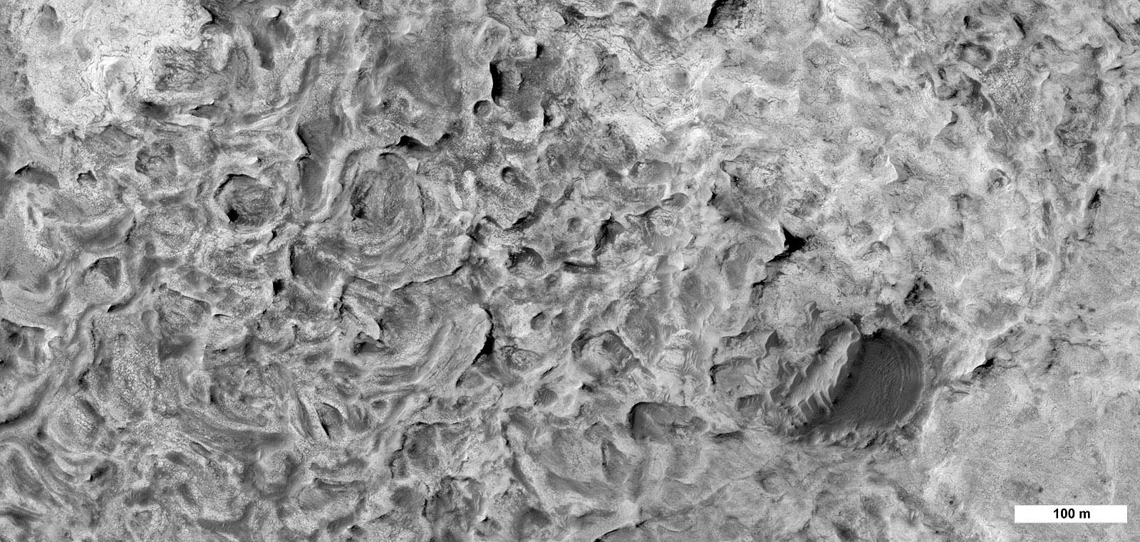
Karst like features

Slide 29
Key concepts
Features that result from the destructive process or groups of processes constituting that part of erosion whereby materials on planetary surfaces are changed in character with little or no transport of the loosened or altered material
Types include physical, chemical, biological and space weathering

Slide 30
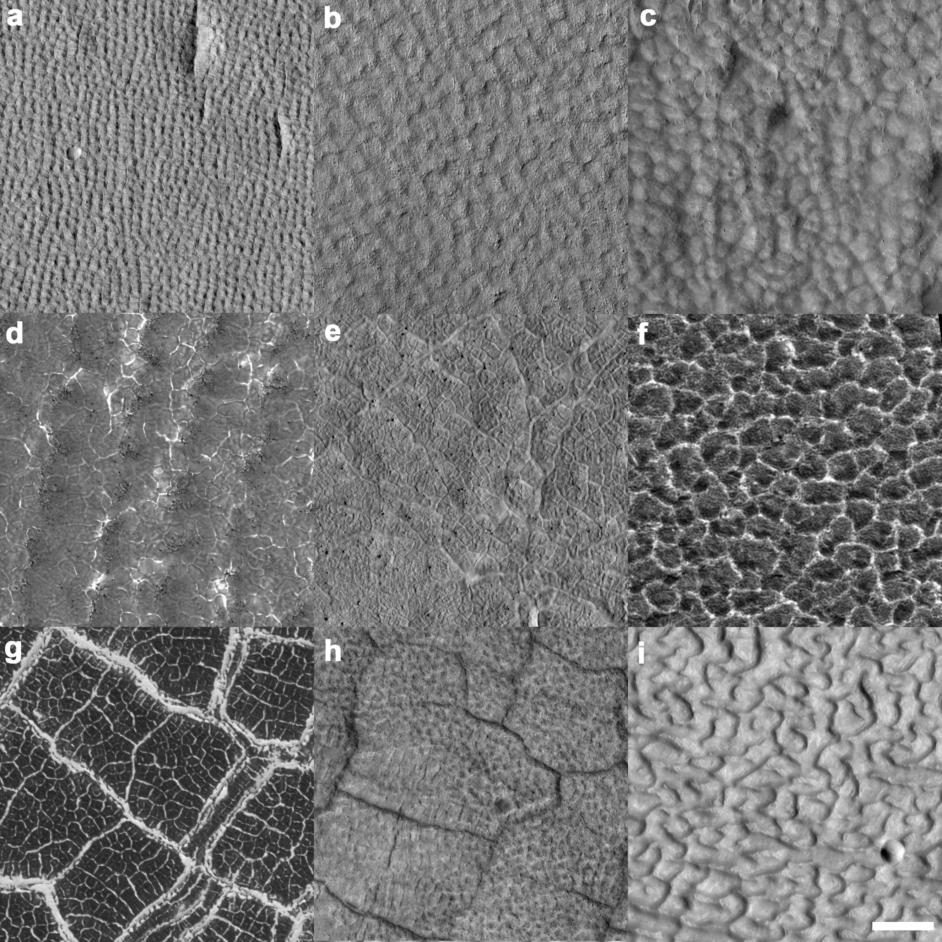
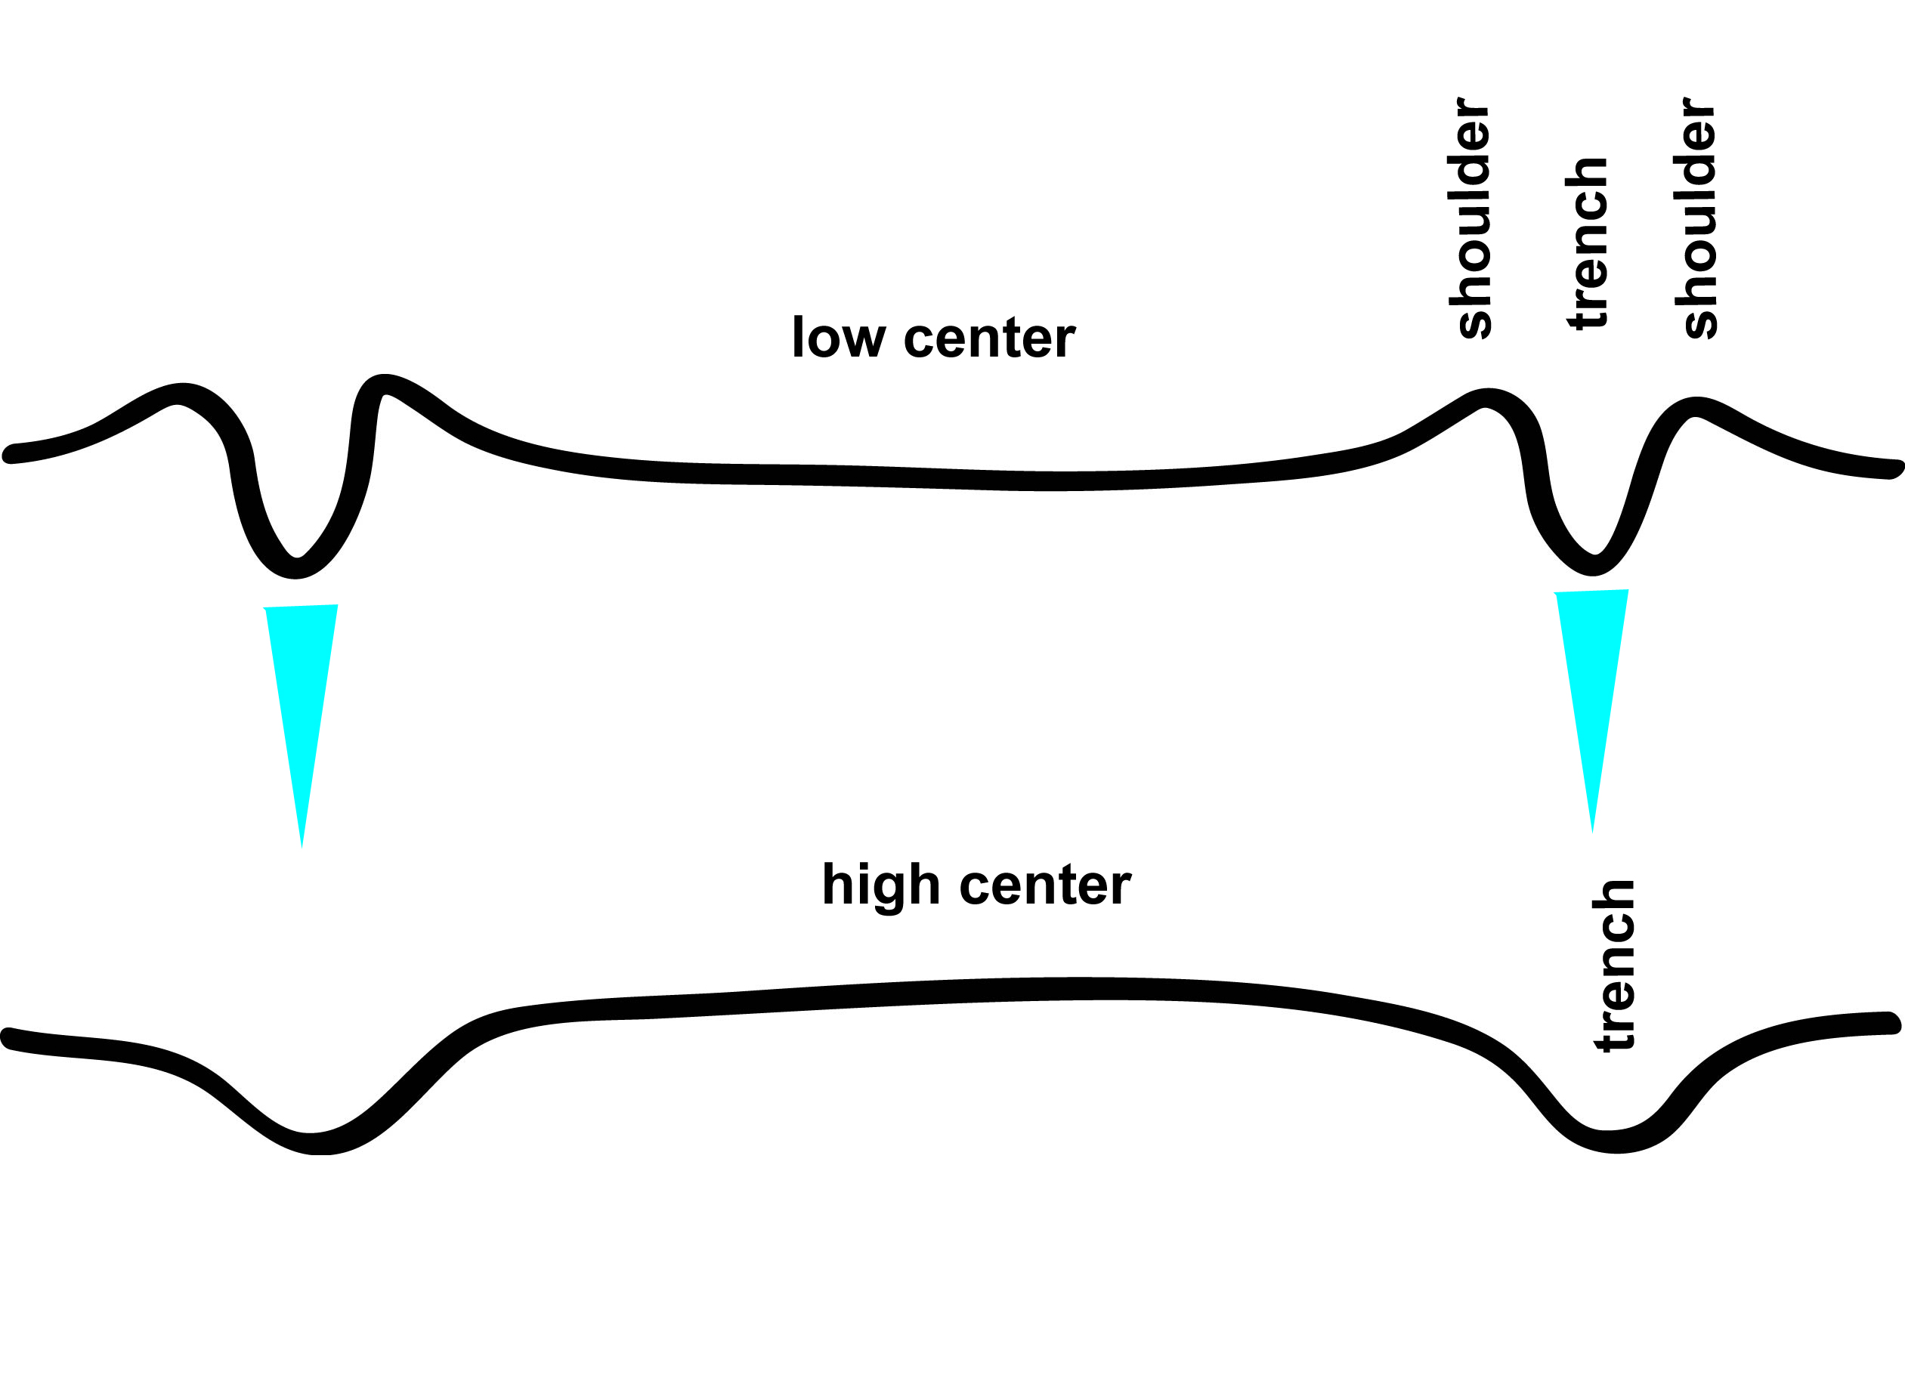
Patterned ground

Slide 31
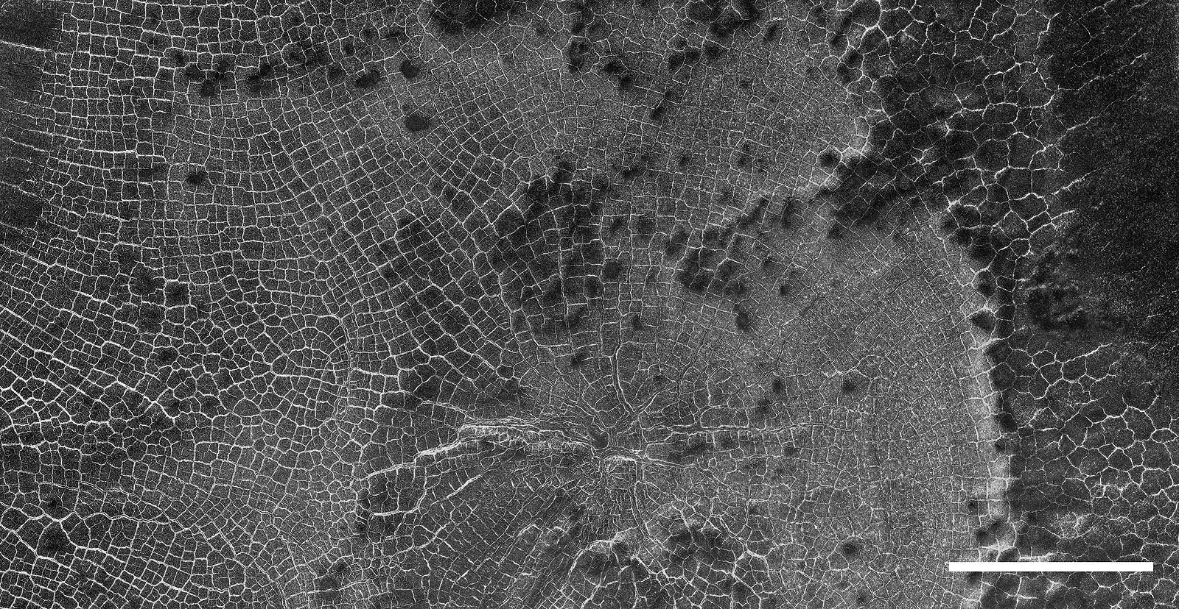
Patterned ground >

Slide 32
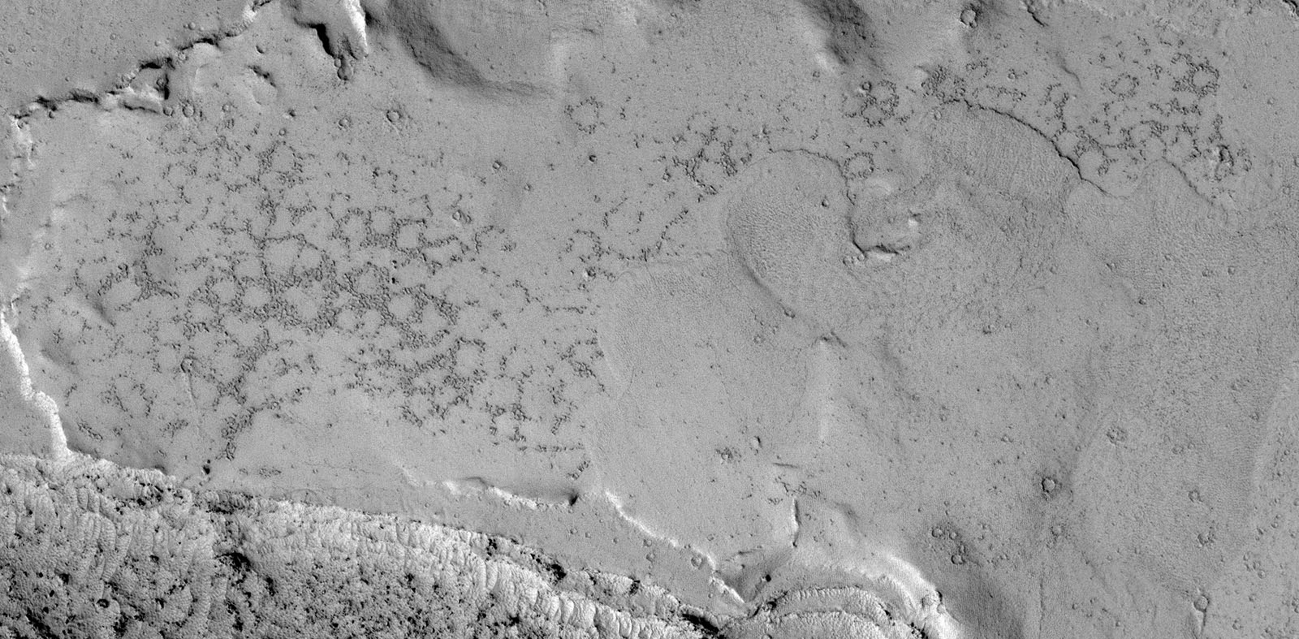
Patterned ground > Sorted patterned ground

Slide 33
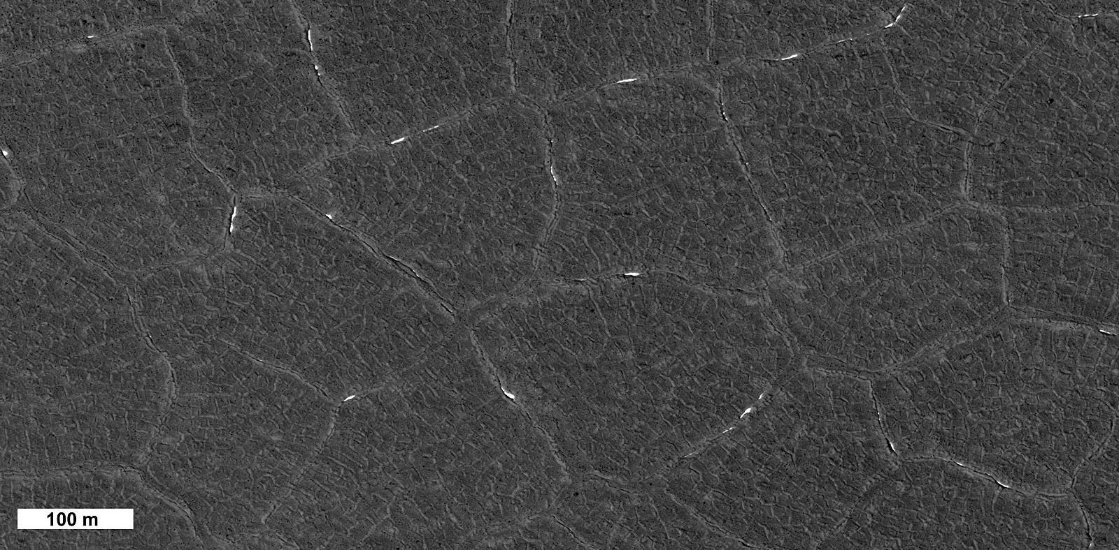
Patterned ground > Polygonal patterned ground

Slide 34
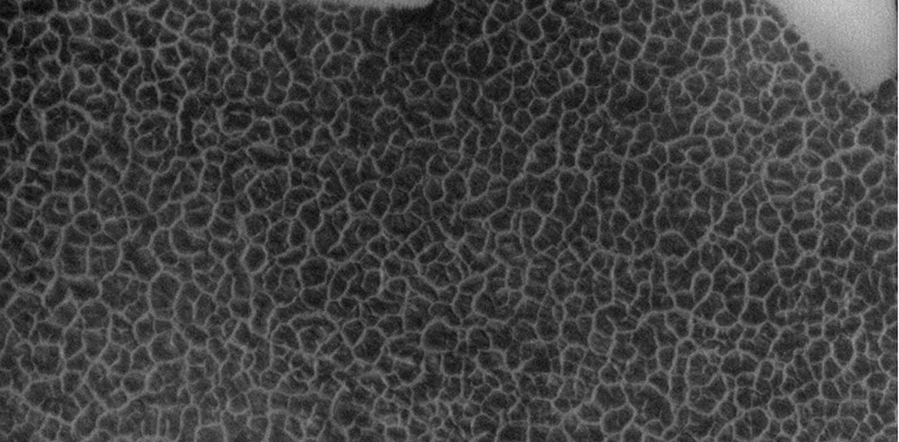
Patterned ground > contraction crack polygon

Slide 35
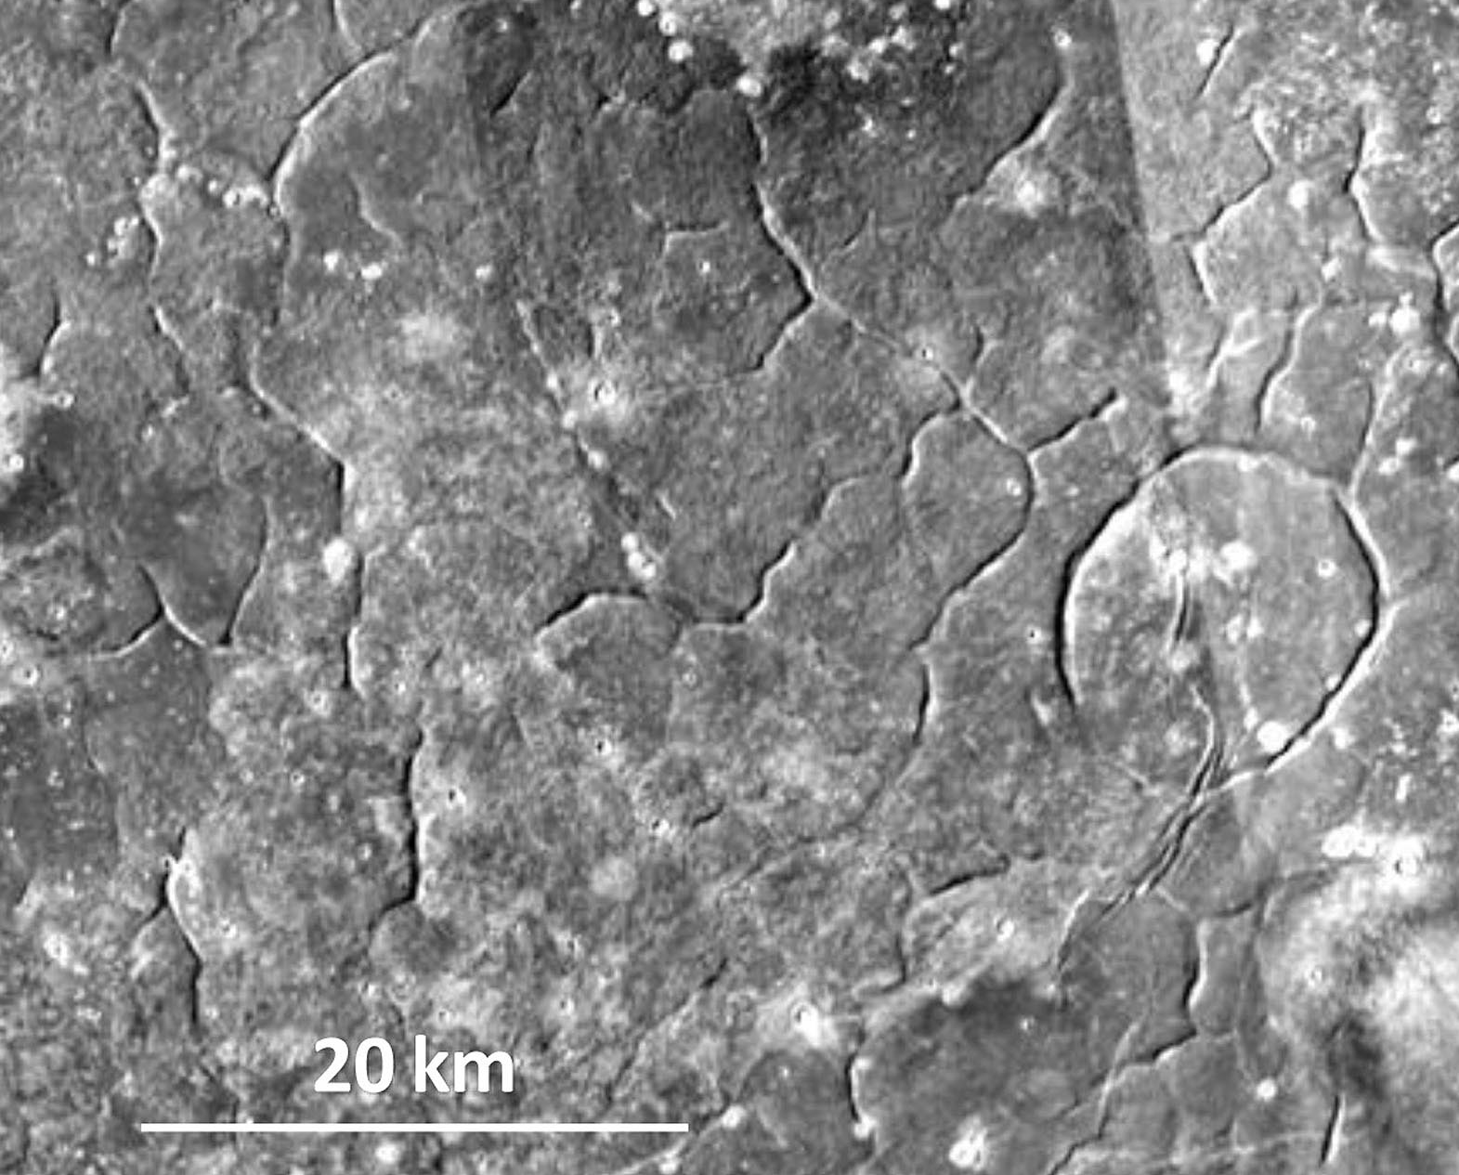
Patterned ground > giant polygon

Slide 36
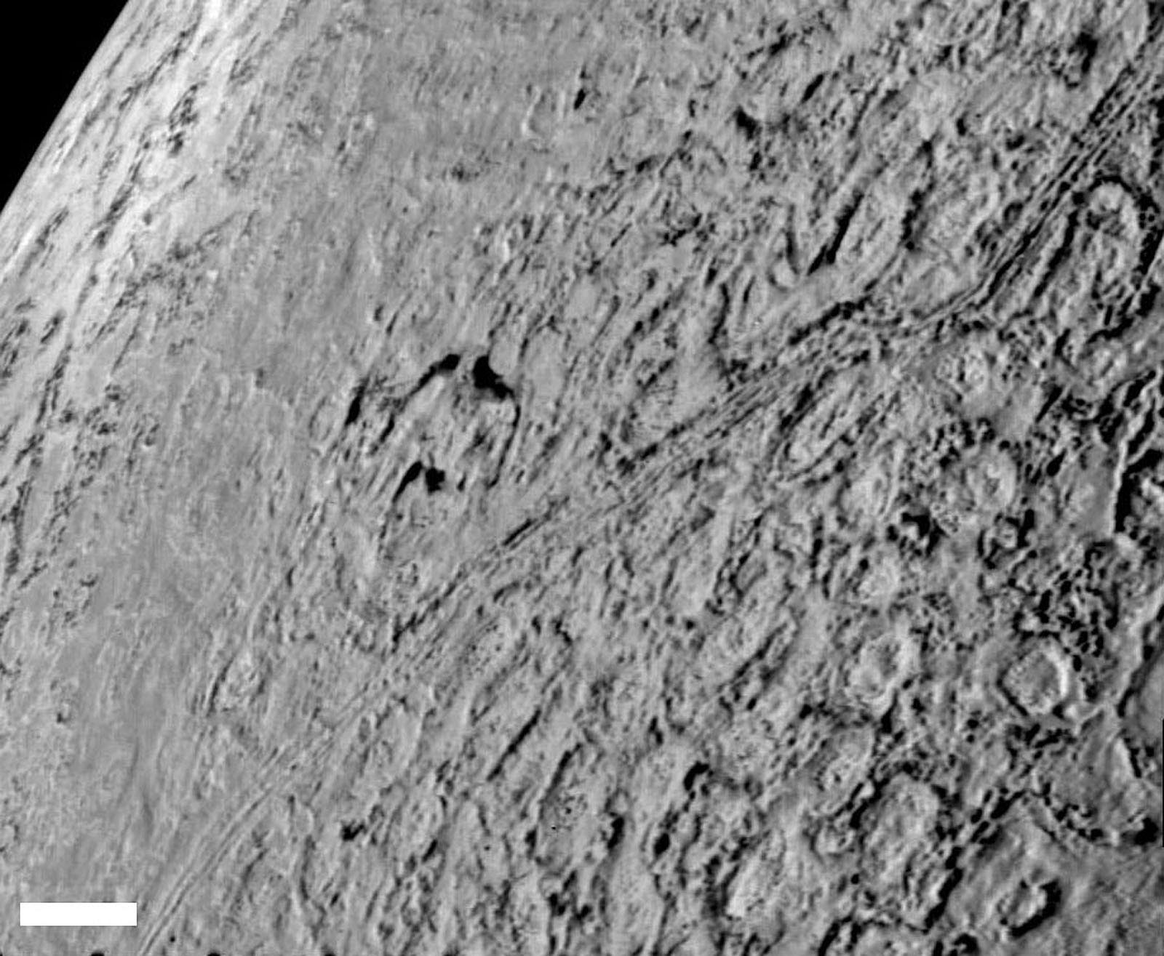
Patterned ground > Cantaloupe terrain

Slide 37
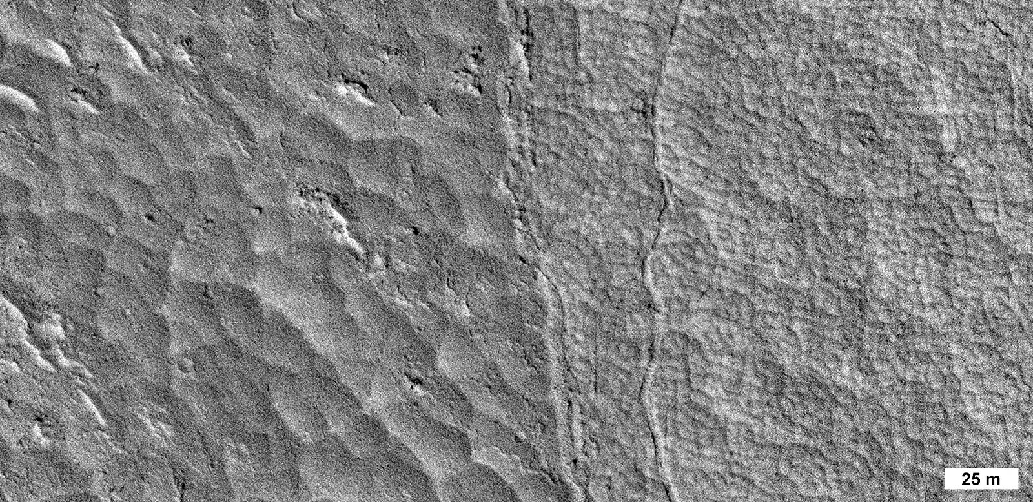
Patterned ground > small Lava polygons

Slide 38
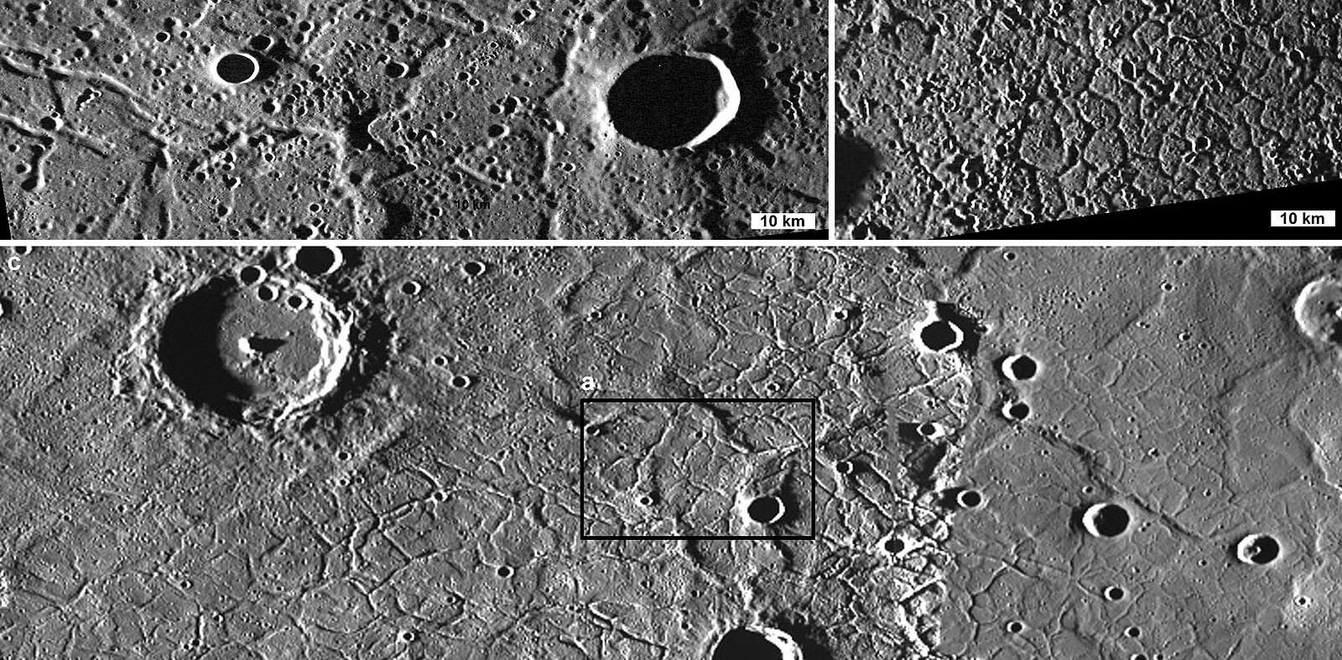
Patterned ground > large lava polygons

Slide 39
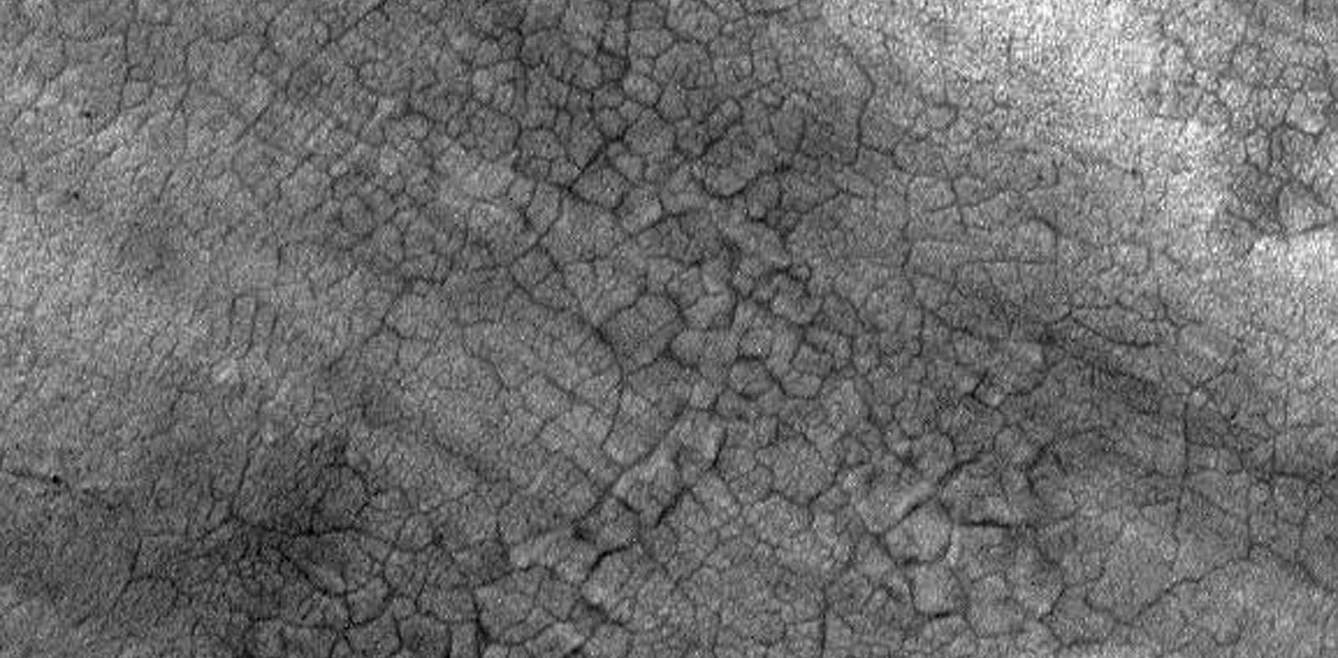
Patterned ground > Sand wedge polygon

Slide 40
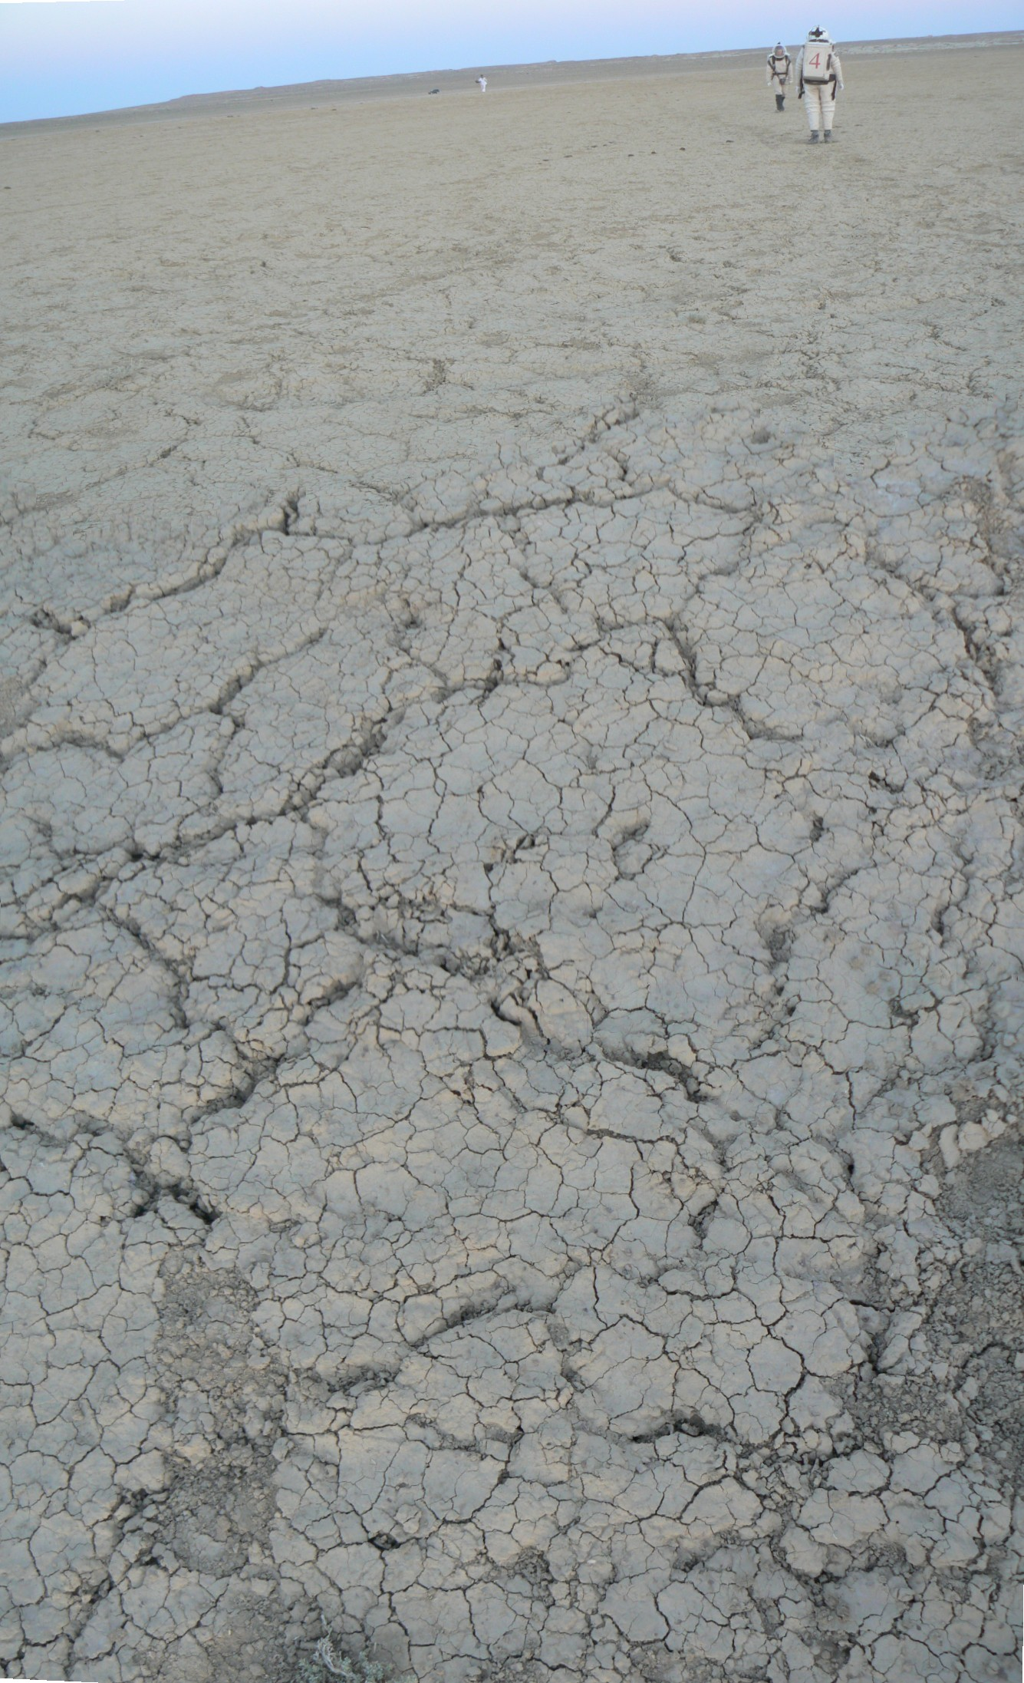
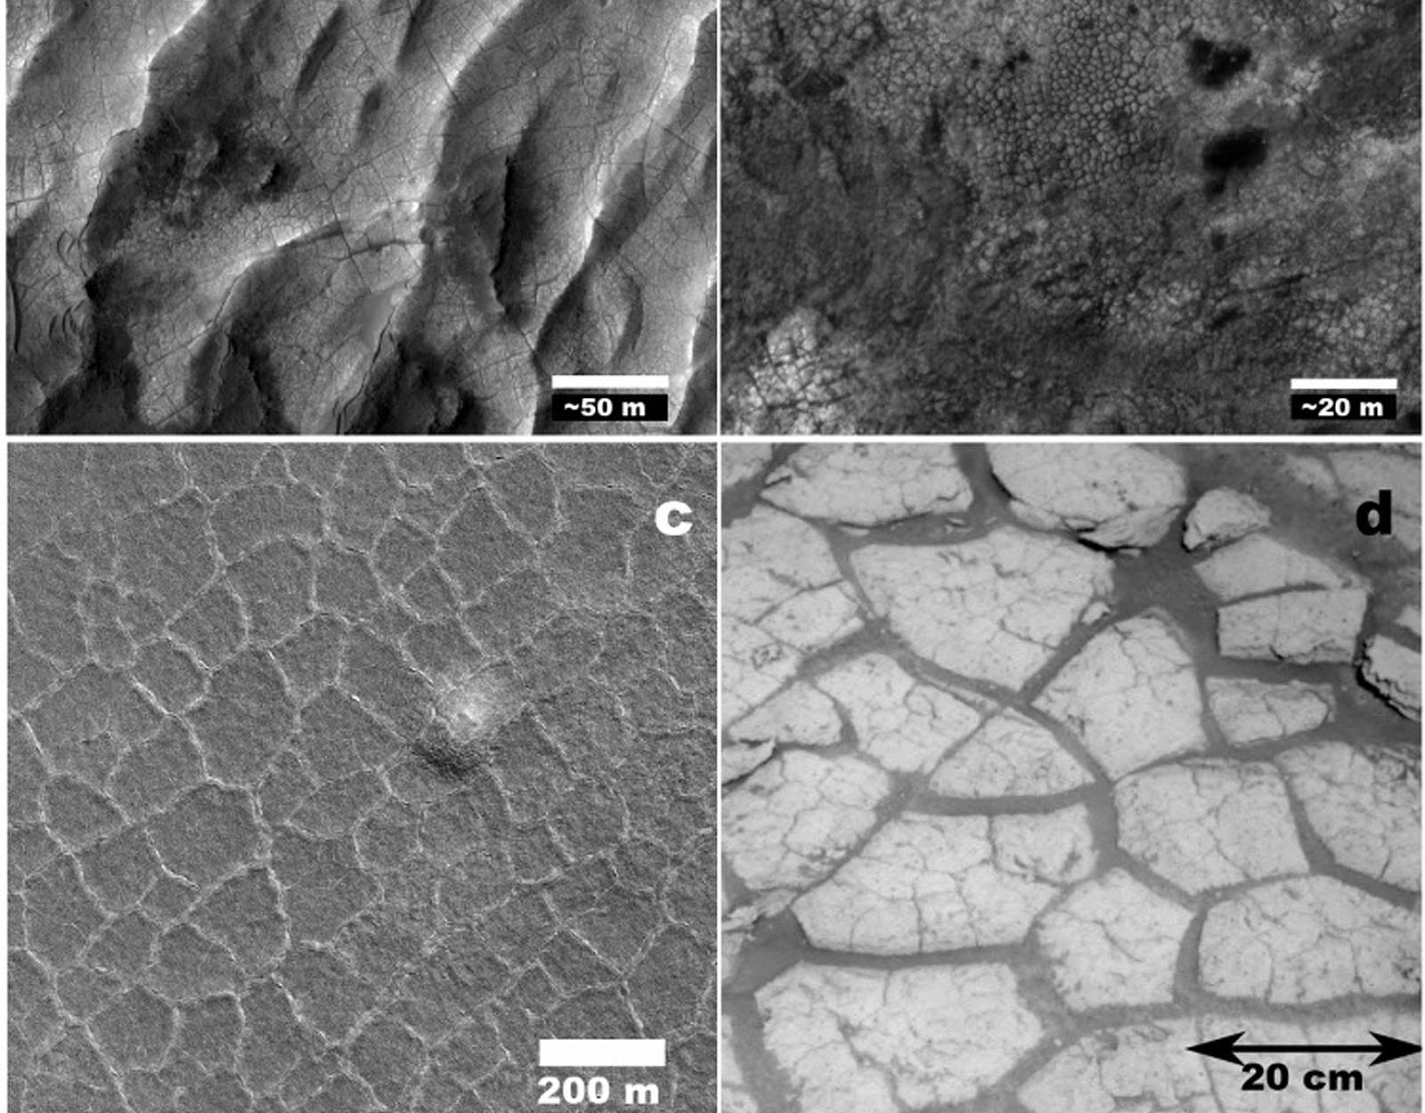
Patterned ground > Desiccation crack polygon

Slide 41
Key concepts
Patterned ground is a spatially self-organized geomorphic system (Hallet 1990) in the form of circles, polygons, irregular networks, or stripes (Wahsburn 1950, Ballantyne 2007).
Processes essential for initial cracking include
(1) desiccation cracking (contraction by drying),
(2) dilation cracking (stretching of subsurface materials by subsurface expansion),
(3) salt cracking,
(4) seasonal frost cracking (due to thermal contraction of frozen ground e.g., in the active layer of the permafrost),
(5) permafrost cracking (due to thermal contraction of the perennially frozen ground),
(6) frost action along bedrock joints (frost wedging and frost heaving). Processes not depending on initial cracking include
(7) primary frost sorting (the separation of stones from fines by repeated freezing and thawing), etc.

Slide 42
MASS MOVEMENT FORMS

Slide 43
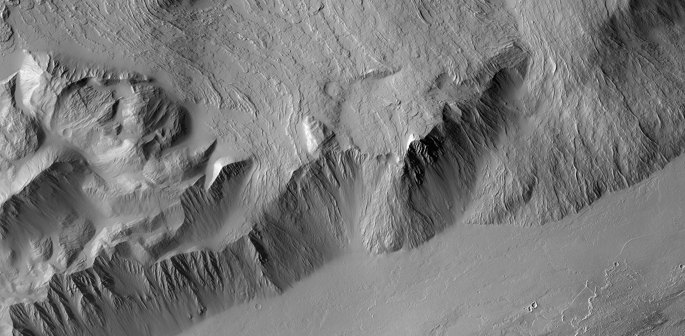
Mass movements > Basal scarp

Slide 44


Mass movements > Colluvial deposit

Slide 45

Mass movements > Fall

Slide 46

Mass movements > Rock avalanche

Slide 47

Mass movements > Retrogressive thaw slump

Slide 48

Mass movements > Drainage, Trojans (Saturn)

Slide 49

Mass movements > Lateral spread

Slide 50

Mass movements > Boulder track

Slide 51

Mass movements > Ploughing boulder

Slide 52

Mass movements > mesa

Slide 53

Mass movements > Slide

Slide 54


Mass movements > Terraced crater

Slide 55

Mass movements > Peripheral peak ring crater

Slide 56

Mass movements > Slope streak

Slide 57

Mass movements > triangular scar

Slide 58


Mass movements > crater wall flow

Slide 59

Recurring slope lineae

Slide 60

Mass movements > solifluction lobes

Slide 61

Mass movements > Spur-and-gully

Slide 62

Mass movements > striped terrain

Slide 63

Mass movements > Flank terrace

Slide 64

Mass movements > Lobate debris apron

Slide 65

Mass movements > rock bridge

Slide 66
Key concepts
A broad class of features formed by the movement of rock or debris (on Earth, soil) downslope controlled by gravity.
Transport of rock or debris by a transporting medium (fluid; wind, water, ice) is not included but flows with high fluid content where the pore-fluid mediates (but does not completely dominate) grain-to-grain interactions are included in this category.
Dry sand may flow like liquid

