Slide 1
Planetary landforms
A visual introduction to planetary geomorphology
ICE AND SNOW
HENRIK HARGITAI
2019
csplanetolg17em
FÖL/1/075E
Definitions in the Notes section

Slide 2
Glacial forms

Slide 3
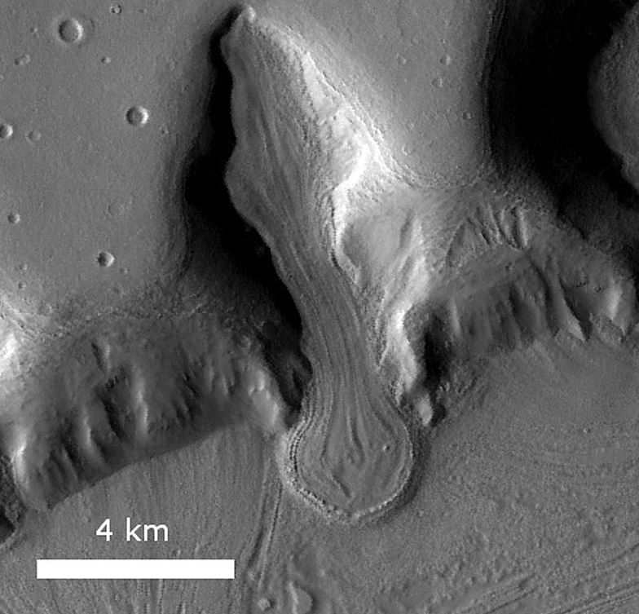
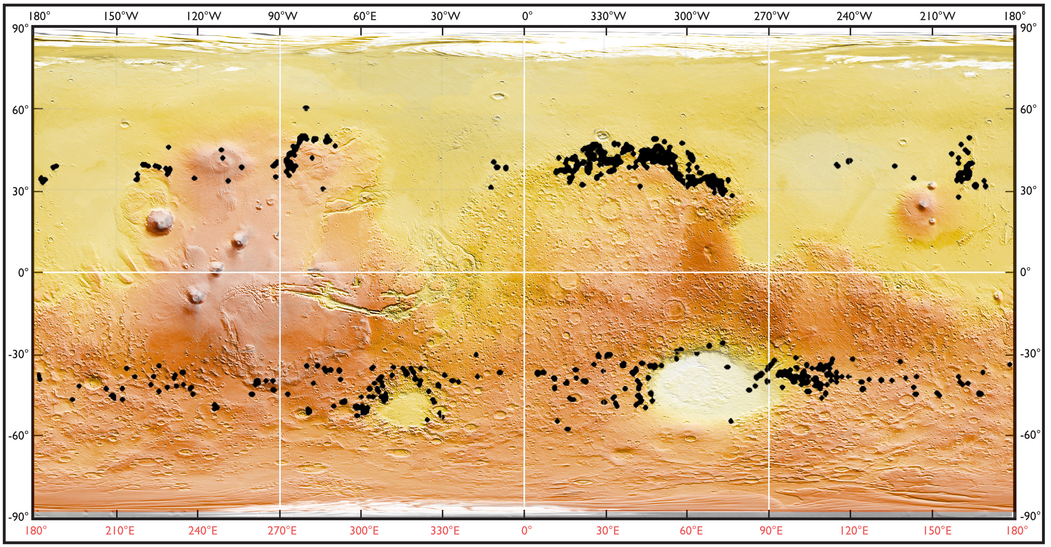
Souness et al. 2012
Glacial forms > Glacier like form

Slide 4
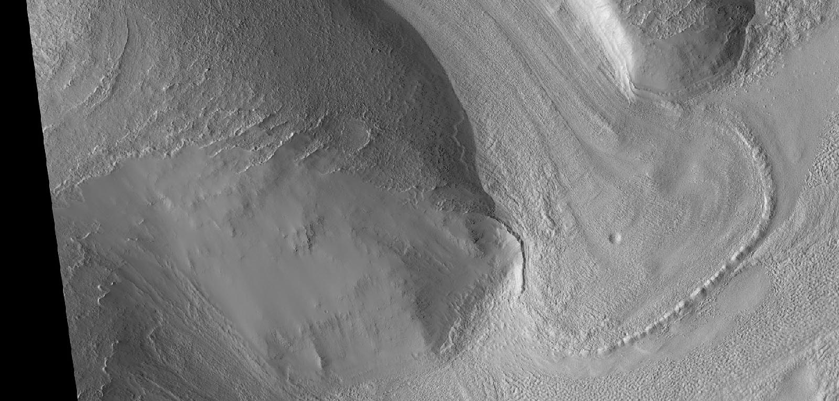
Glacial forms > Piedmont glacier

Slide 5
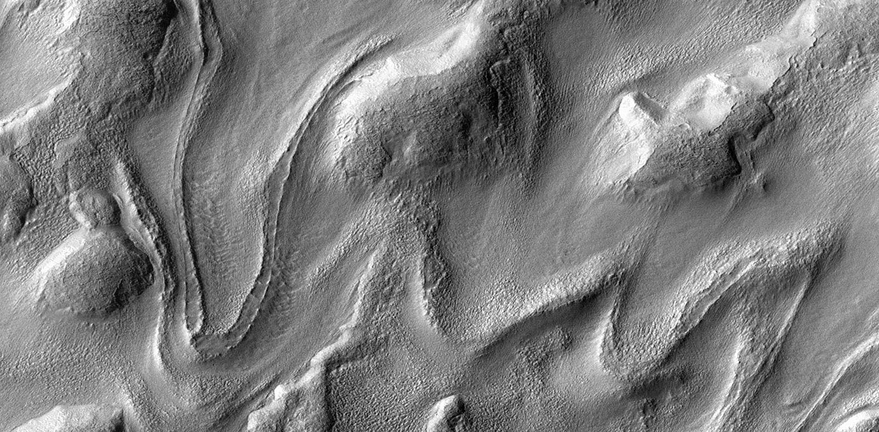
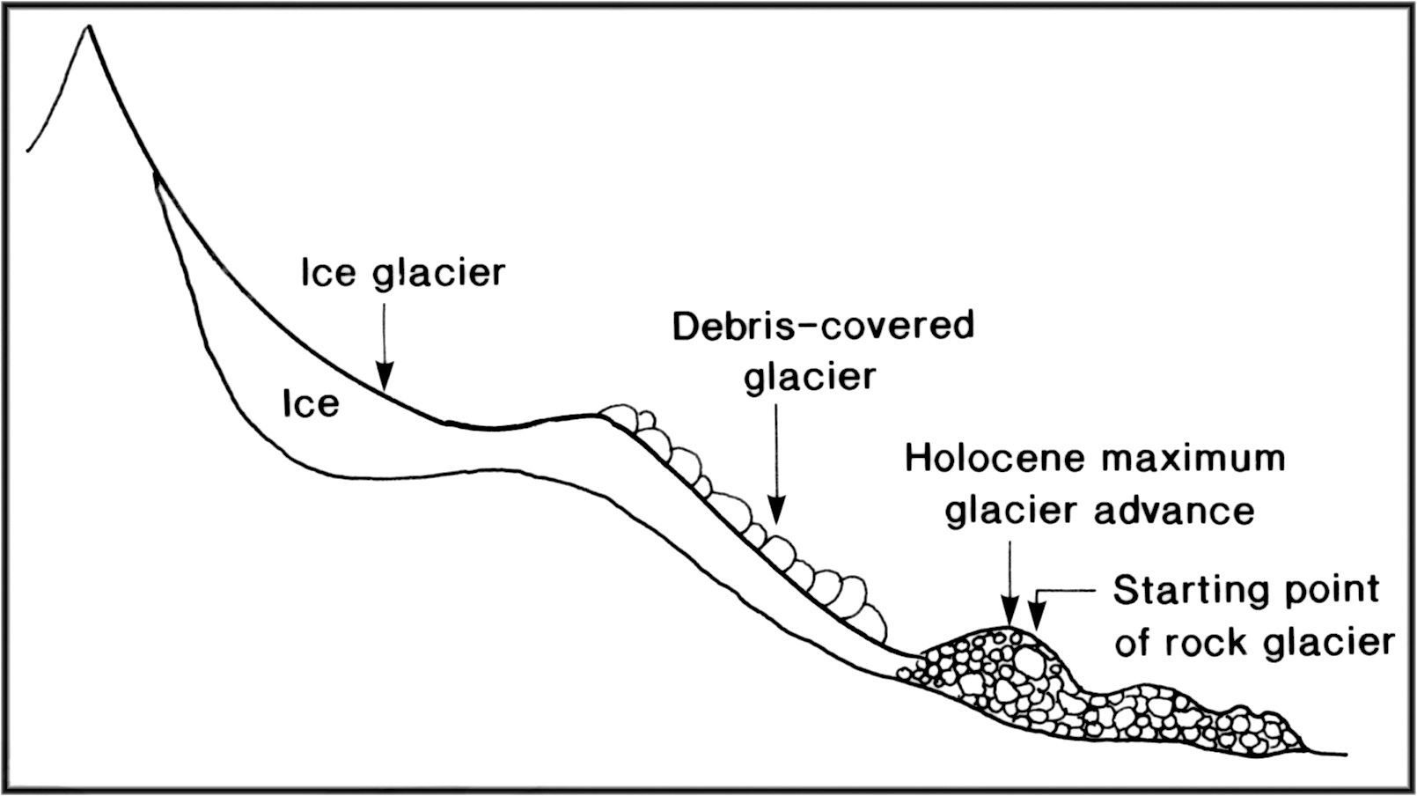
Barsch and King, 1988
Glacial forms > Viscous Flow Features / Rock glacier

Slide 6
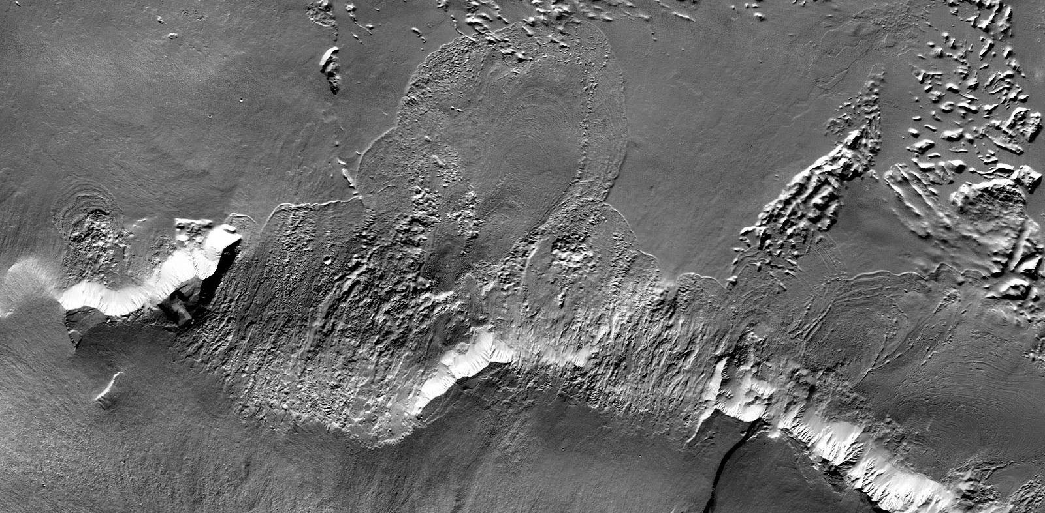
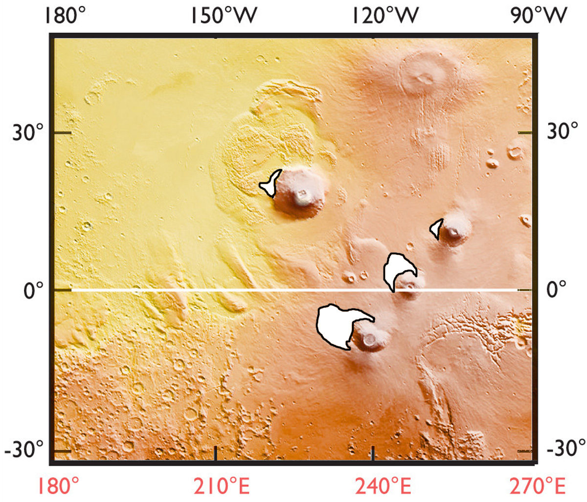
Other > “Fan shaped deposit” (circum-Tharsis)

Slide 7
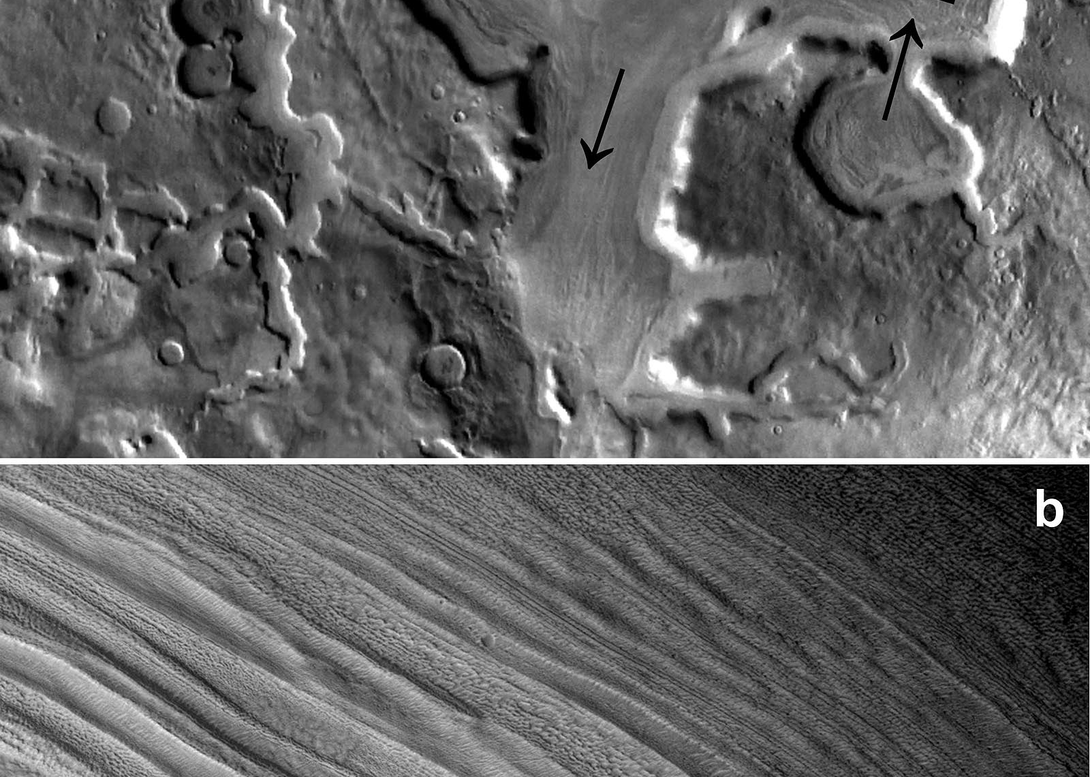
Glacial forms > Lineated valley fill

Slide 8
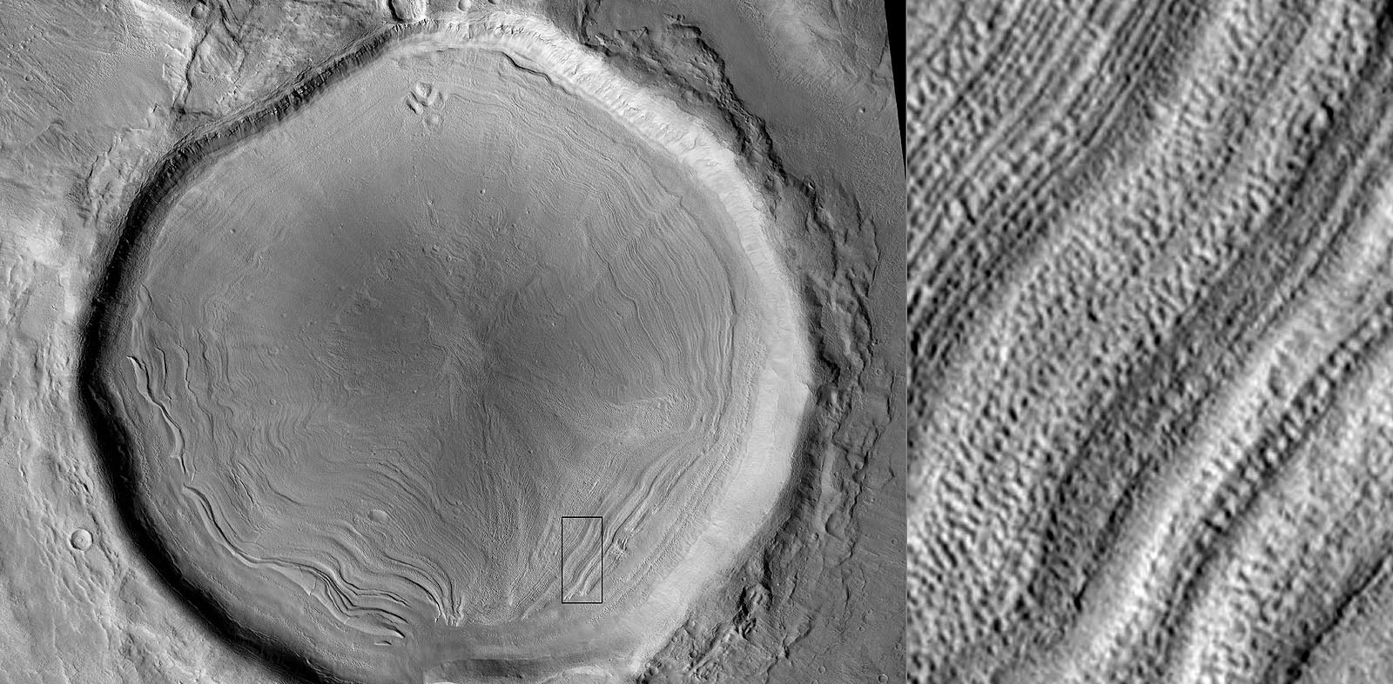
Glacial forms > Concentric crater fill

Slide 9
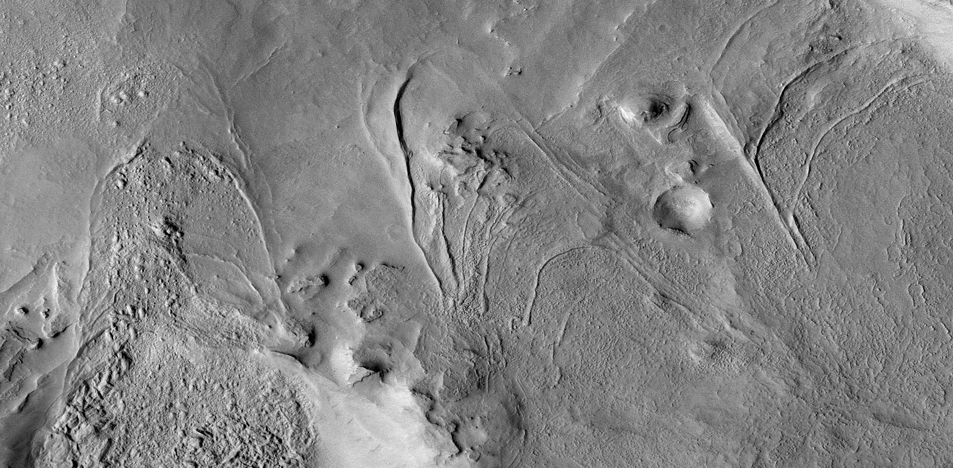
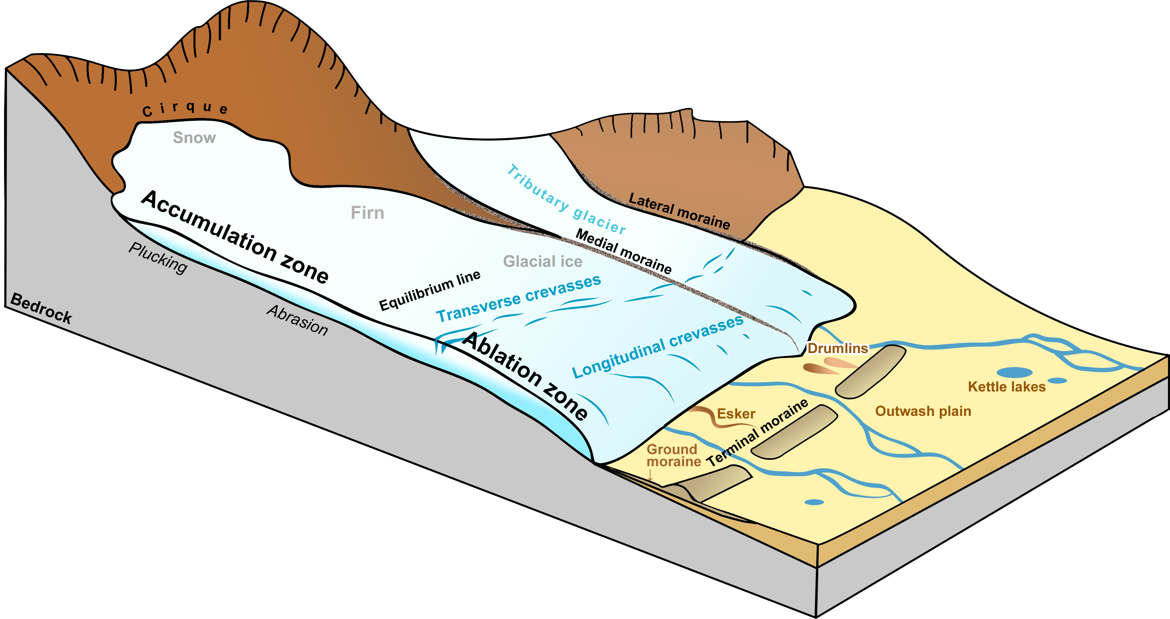
Glacial forms > Arcuate ridge set

Slide 10
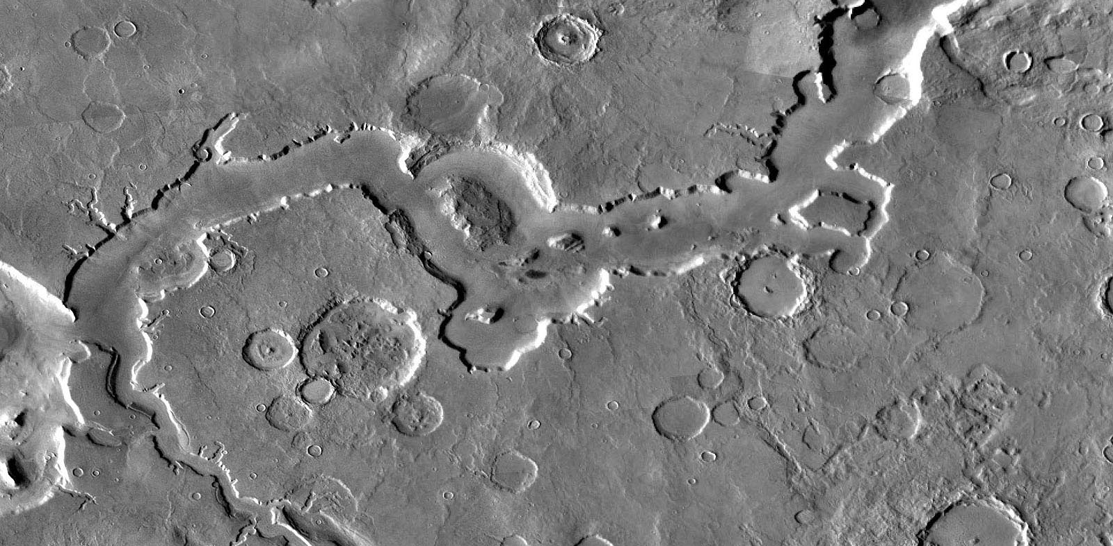
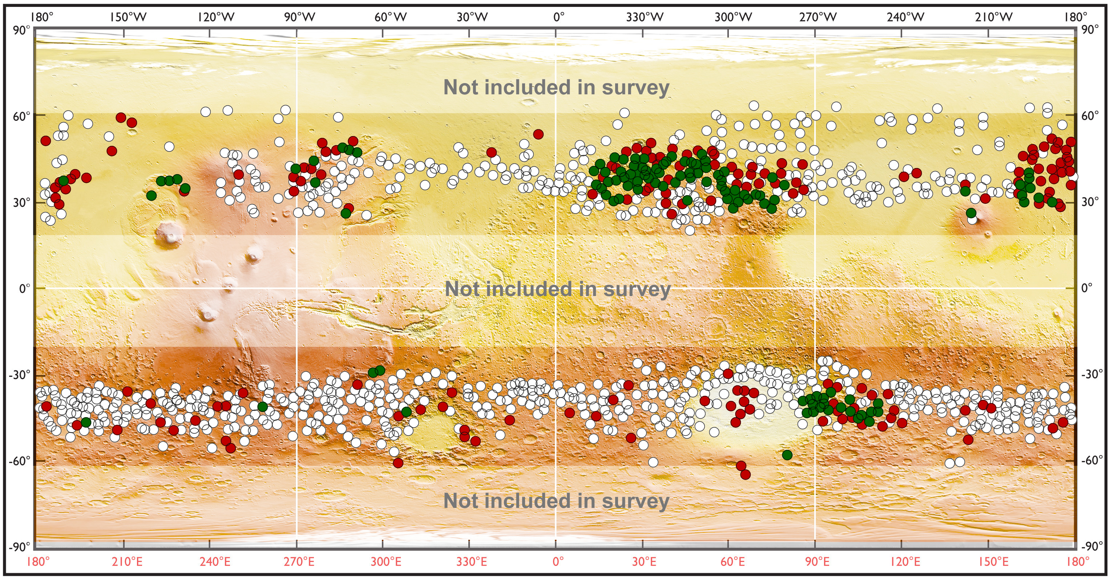
Glacial forms > Fretted channel

Slide 11
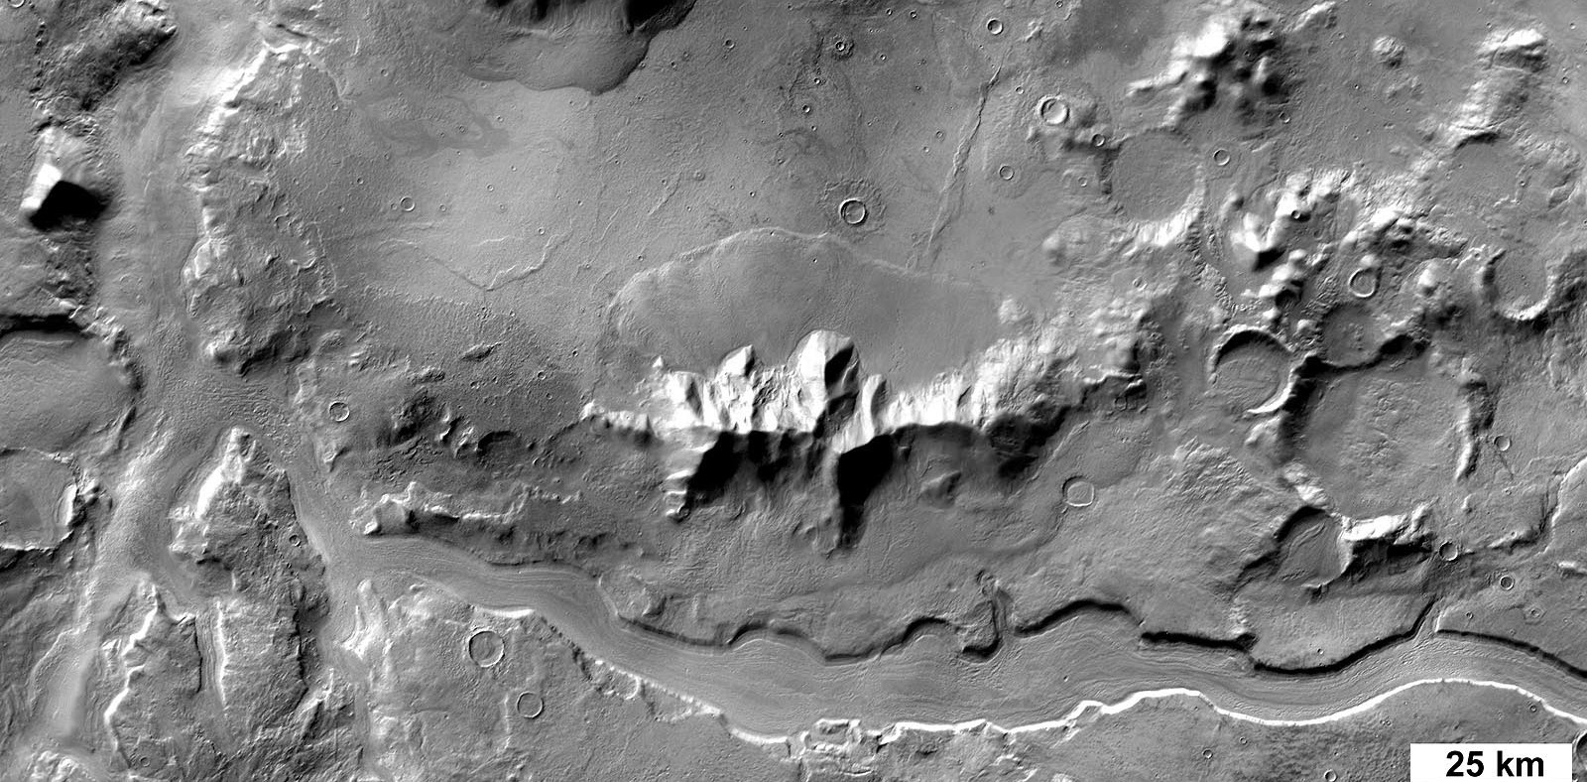
Glacial forms > Fretted terrain

Slide 12
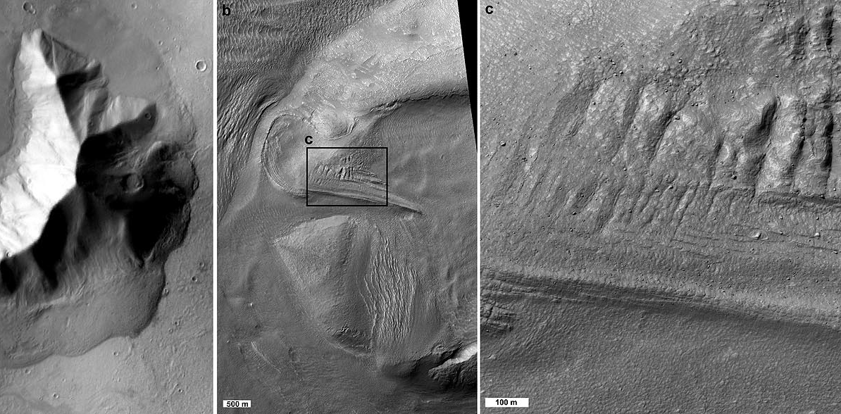
Glacial forms > crevasse

Slide 13
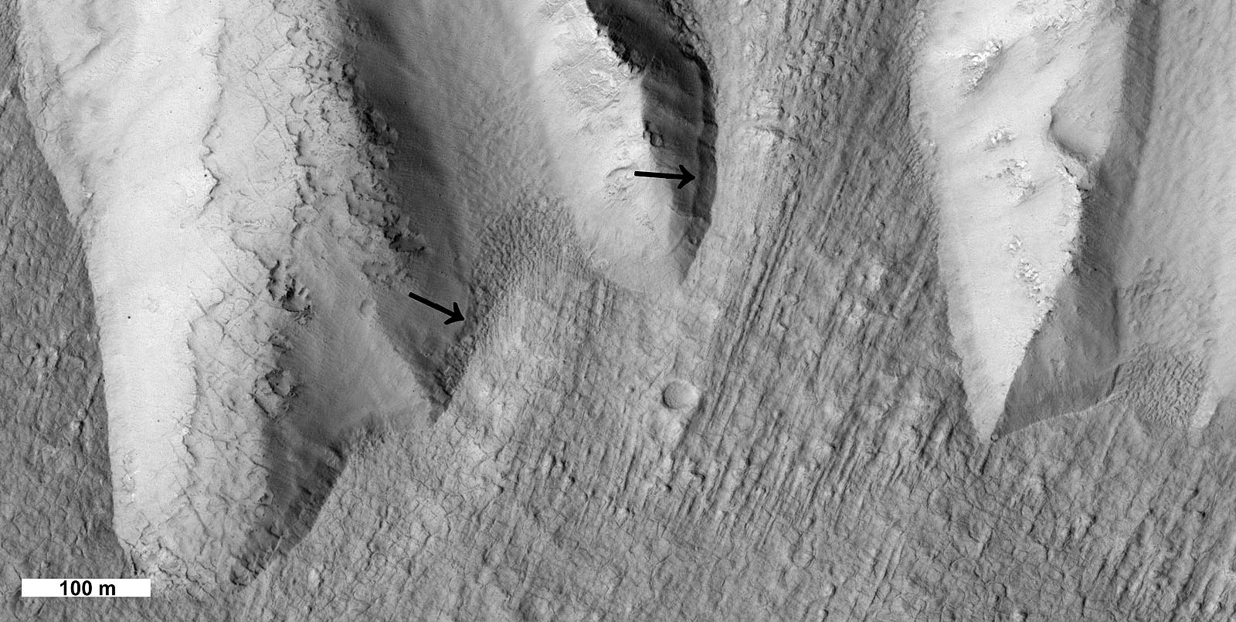
Ice > Trim line

Slide 14
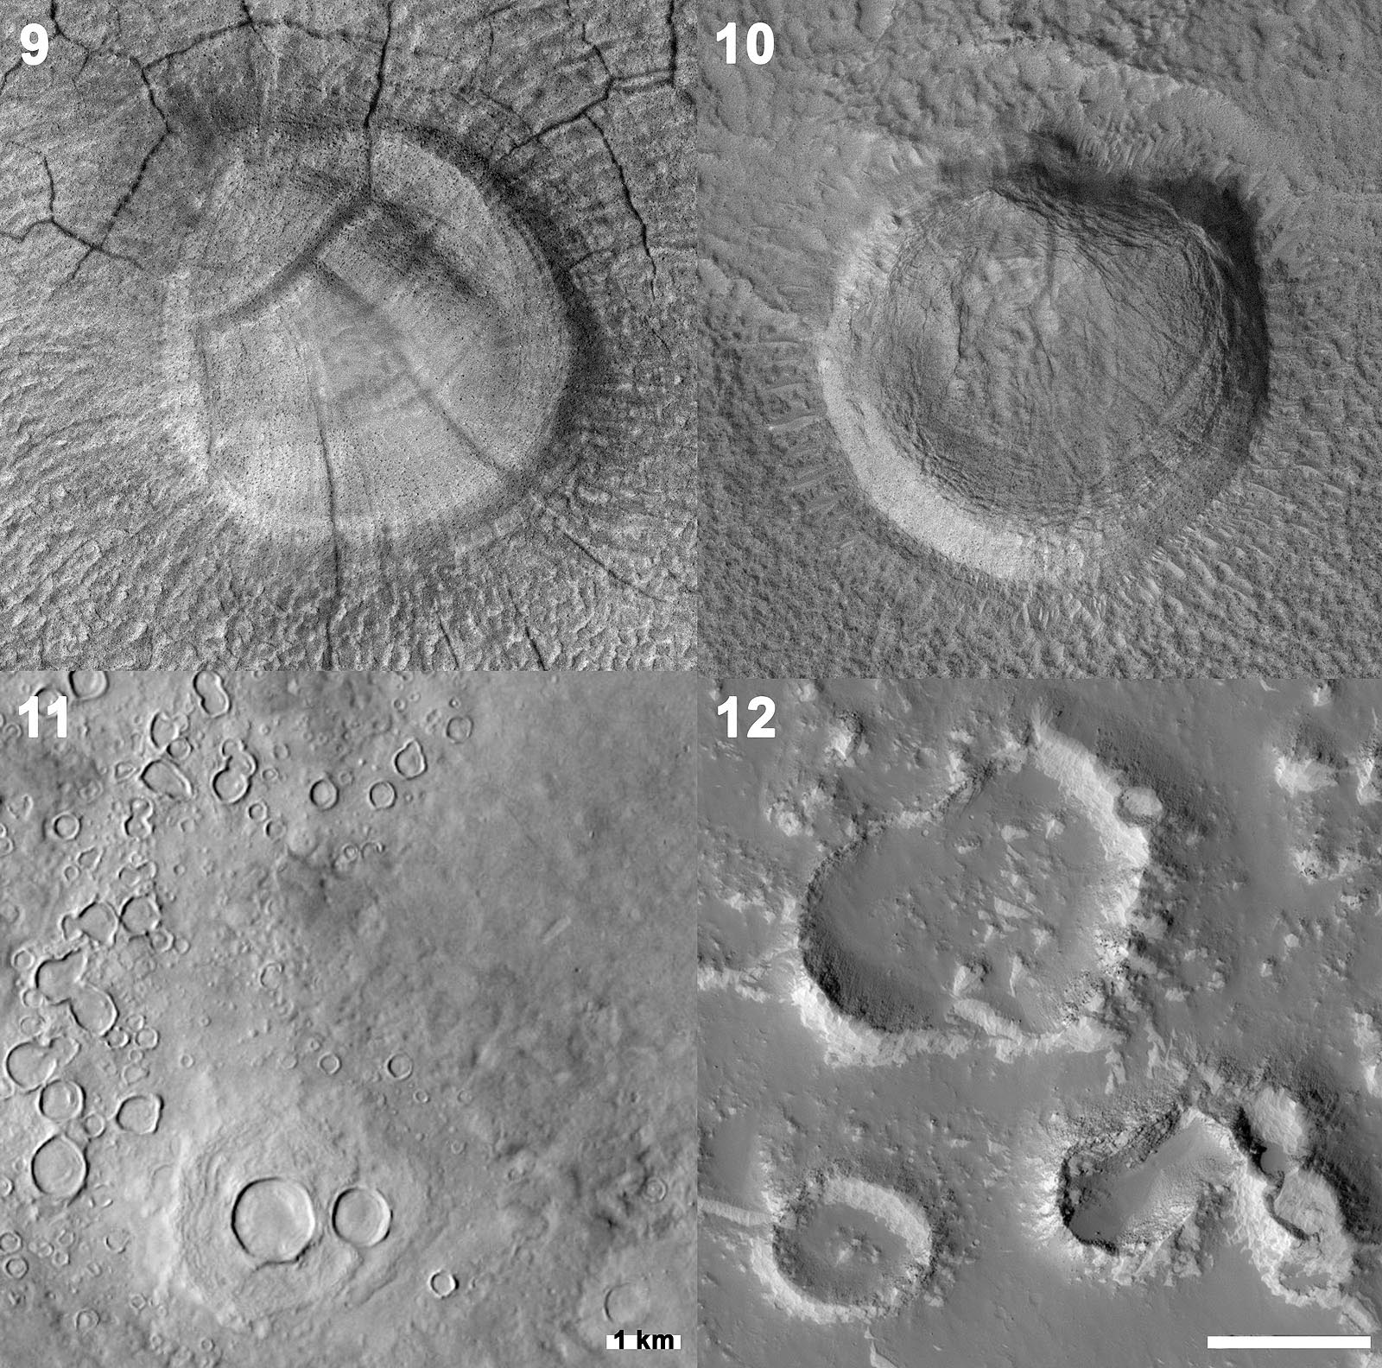
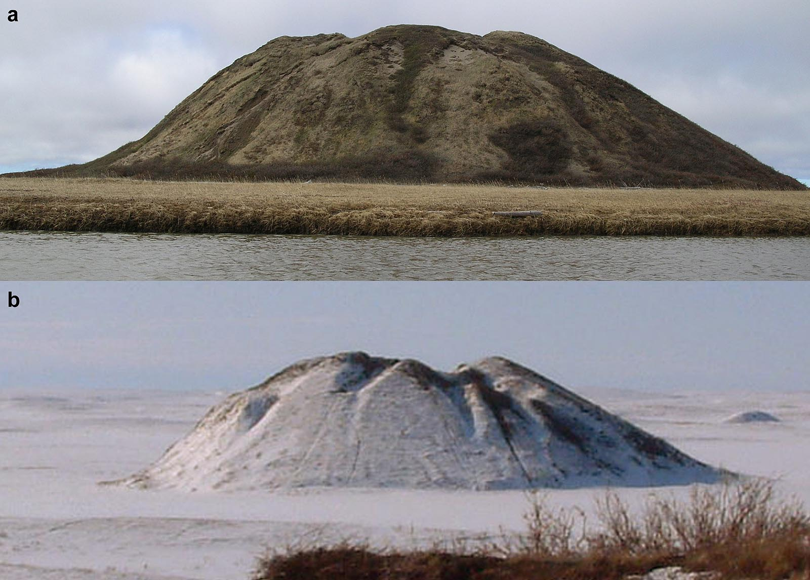
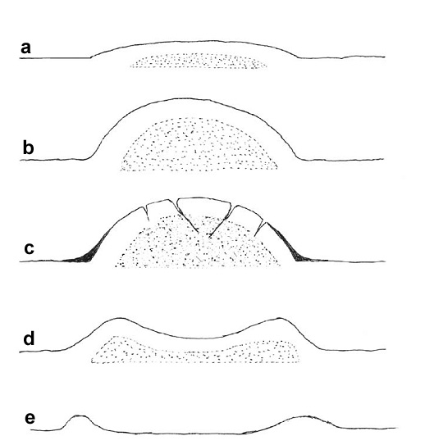
Ice > Pingo

Slide 15
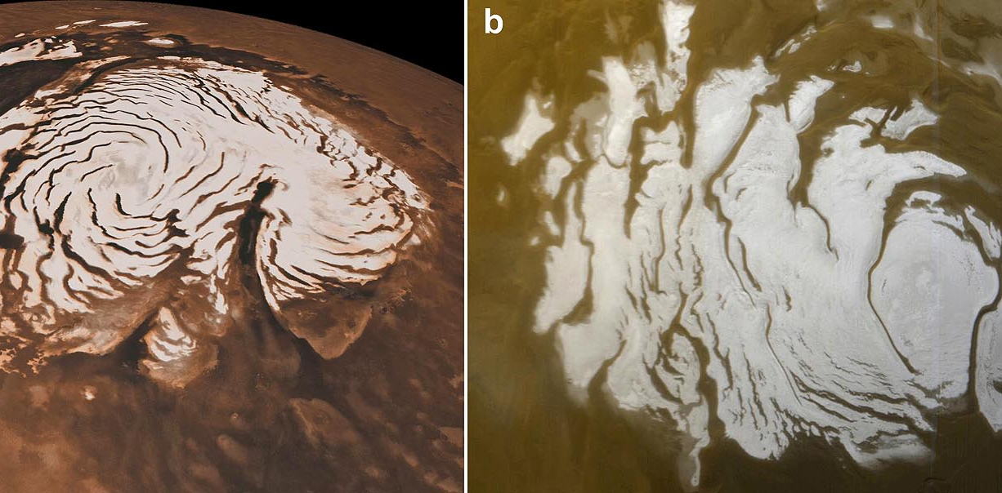
Ice >Polar spiral trough

Slide 16
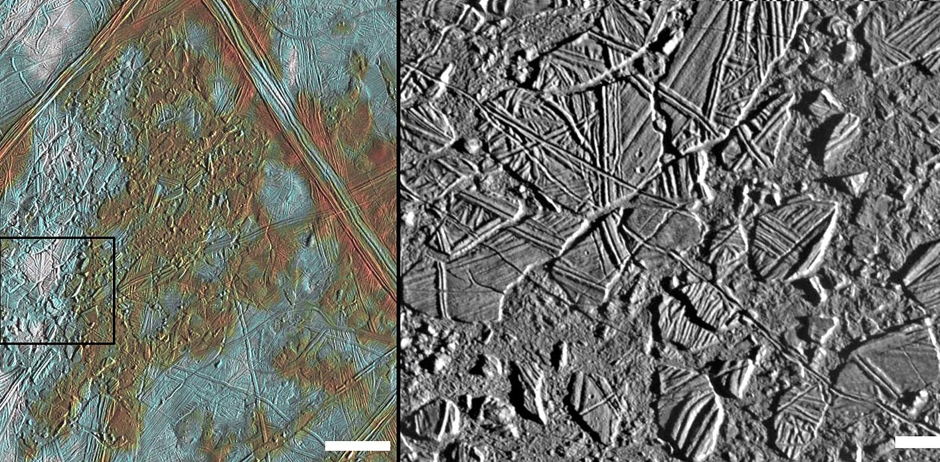
Ice related forms > Chaos, Europa

Slide 17
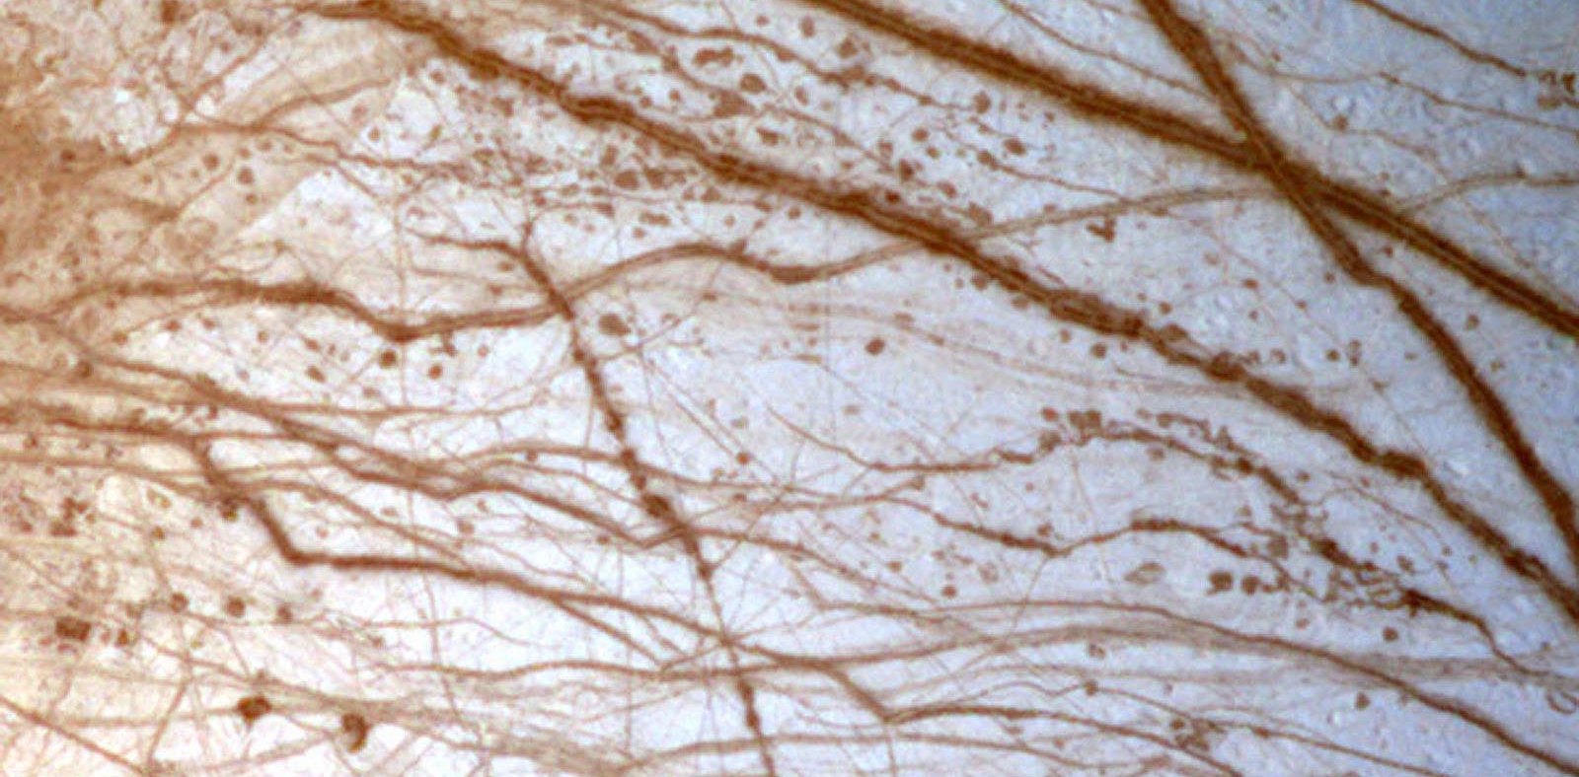
Ice related forms > Lenticula, Europa

Slide 18
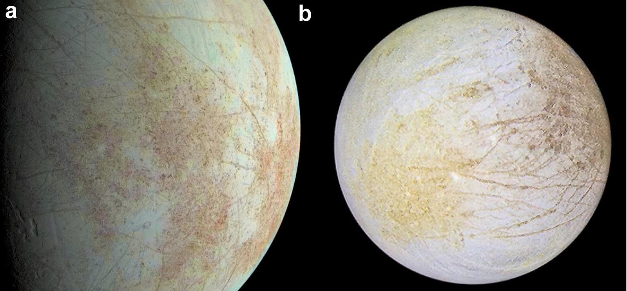
Ice related forms > Mottled terrain

Slide 19
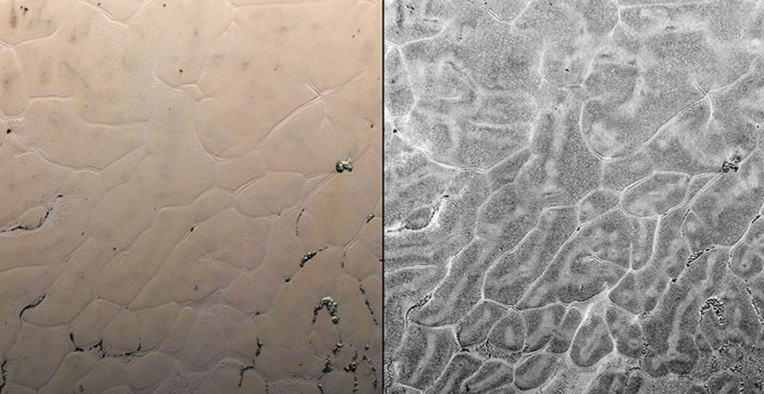
Cellular plains

Slide 20
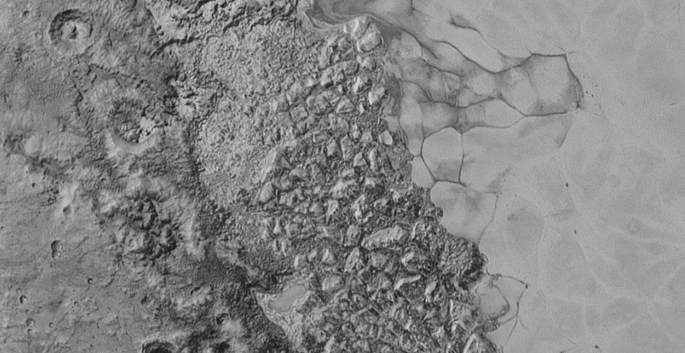
Chaotic terrain Pluto

Slide 21
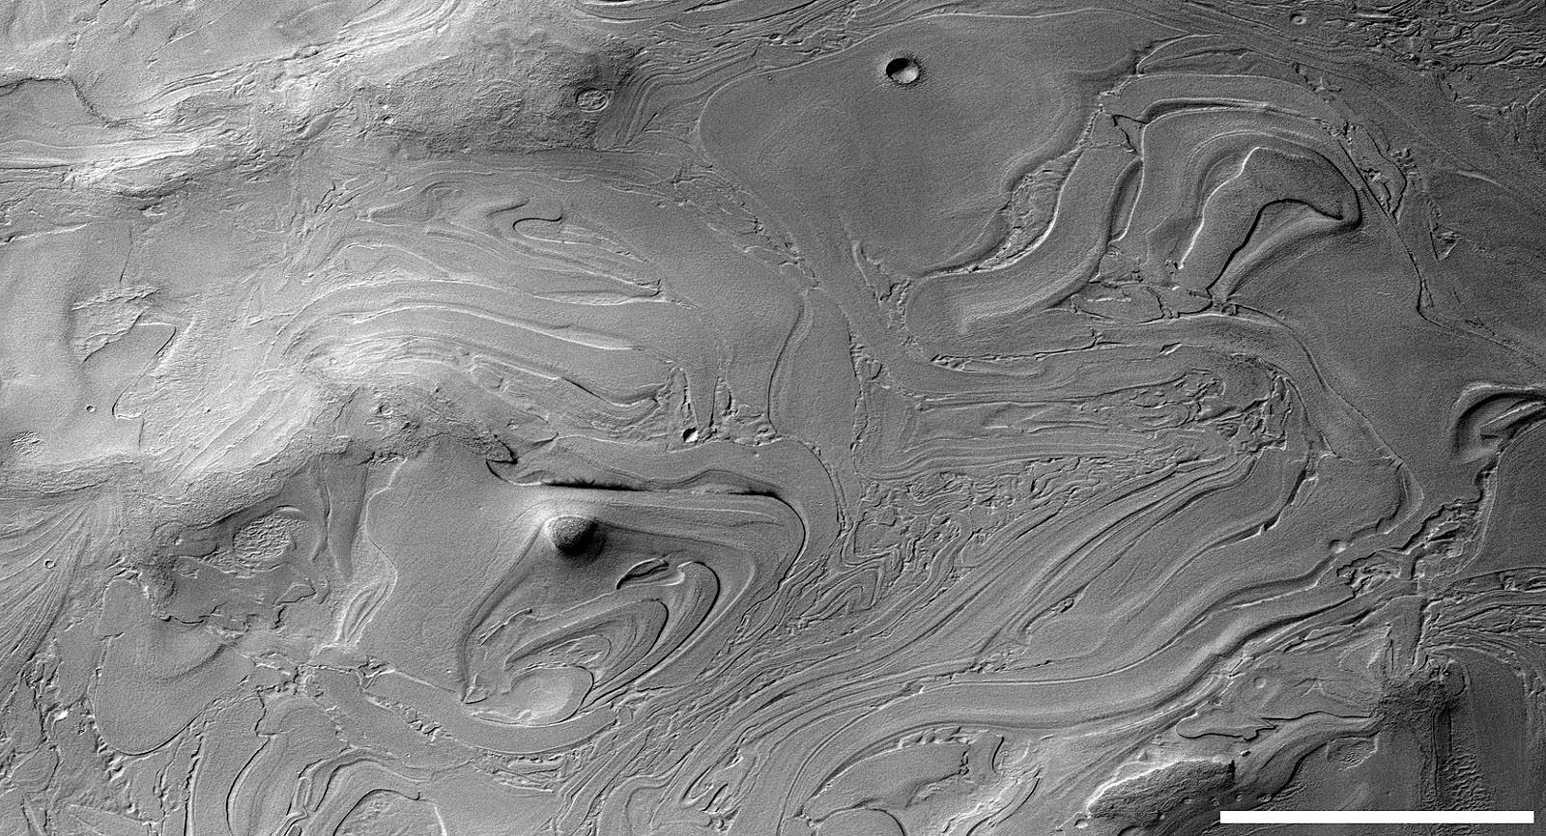
Banded terrain

Slide 22
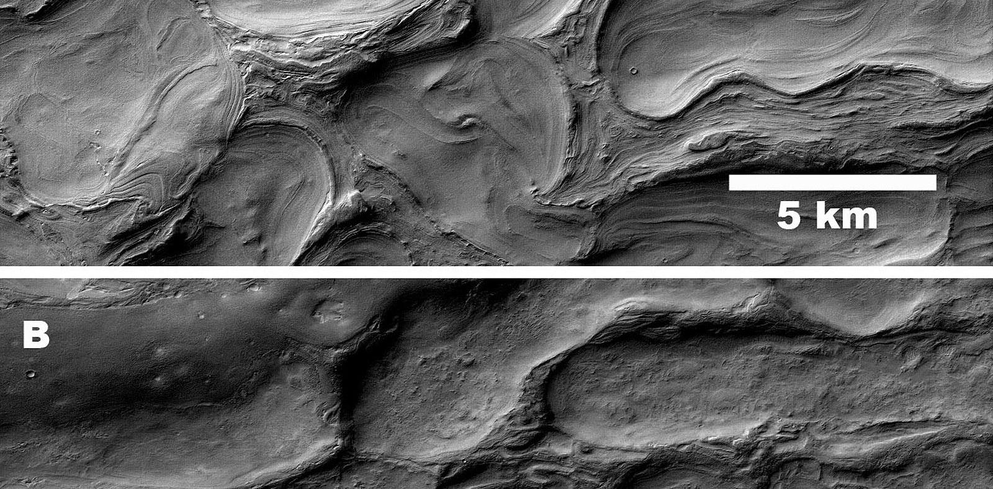
Honeycomb terrain

Slide 23
Key concepts
Viscous-looking features may not be made of ice.
Ice may be present on the surface or subsurface.
It may flow or sublimate.
Ice but not glacial:
  Cryovolcanoes are ice-volcanic - lava
  H2O on icy bodies are solid rock
Glacial forms are composed of “ice”
  Ice is a one-component viscous material, not necessarily frozen H2O

Slide 24
Defrosting and sublimation forms

Slide 25
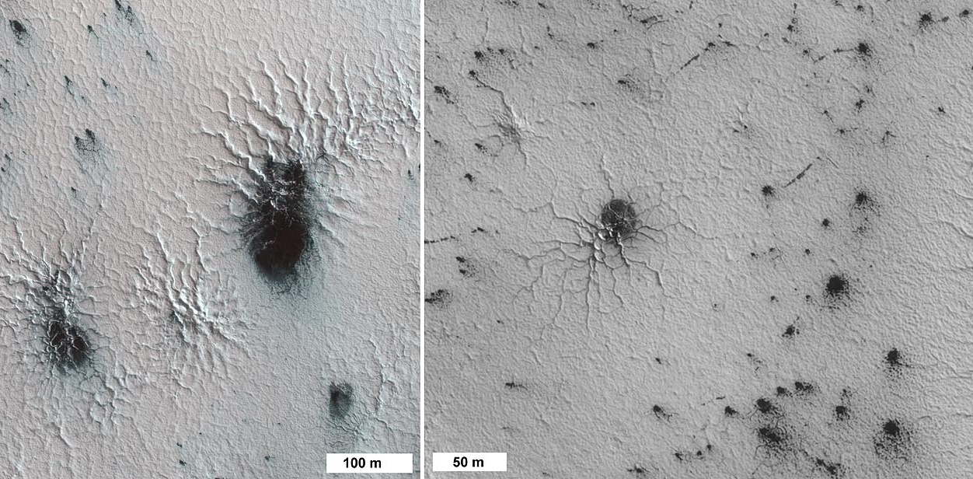
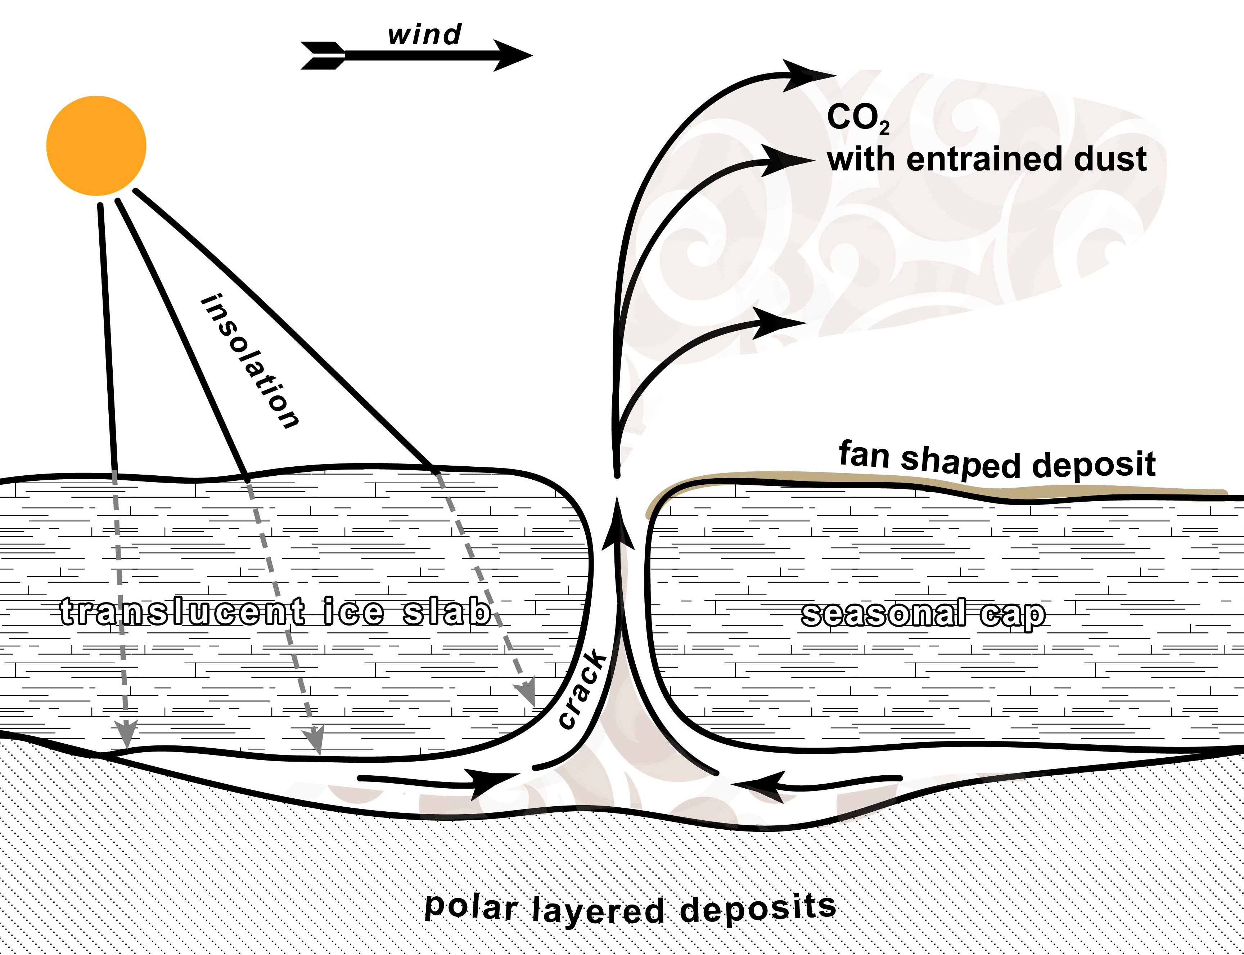
Snow and denivation > Spider

Slide 26
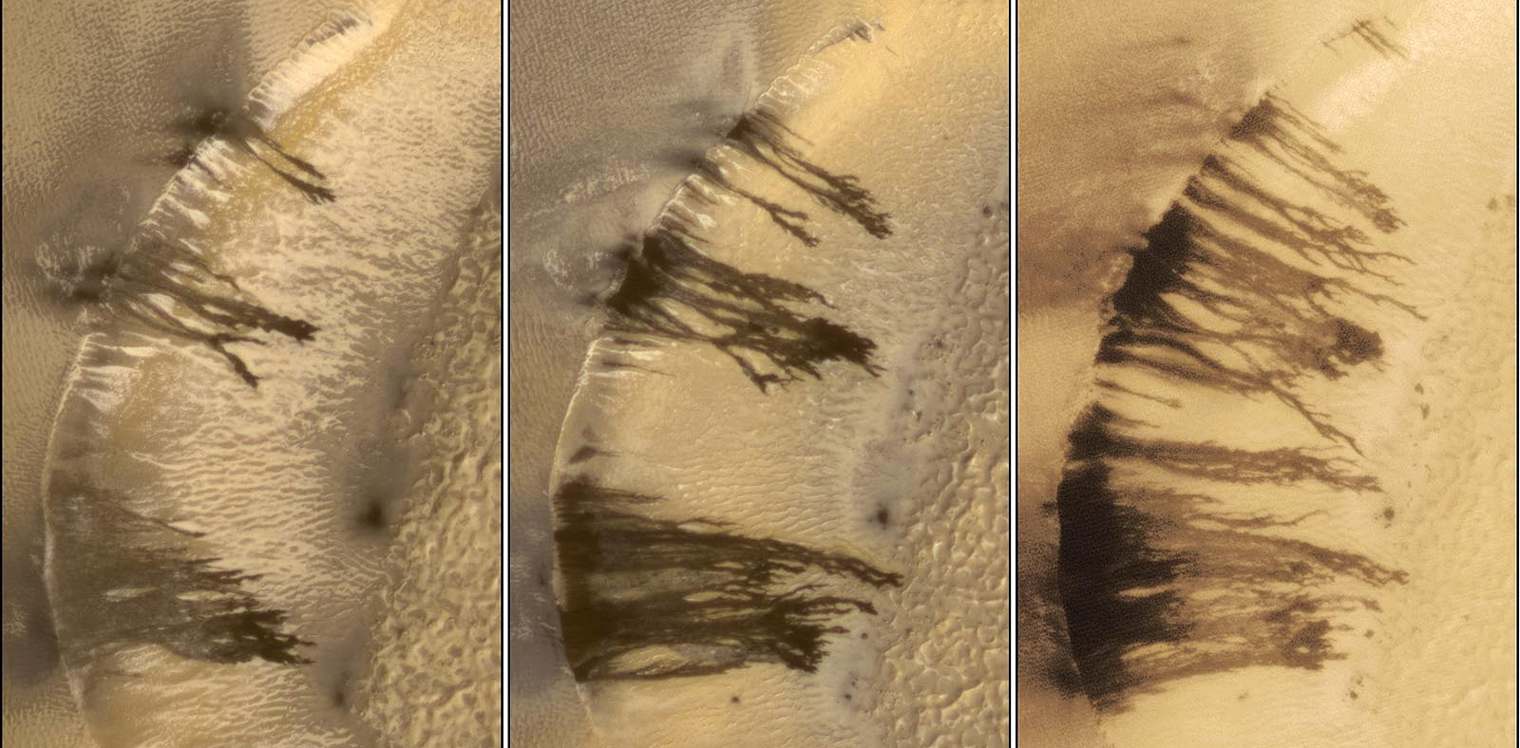
Defrosting > Dark dune flow

Slide 27
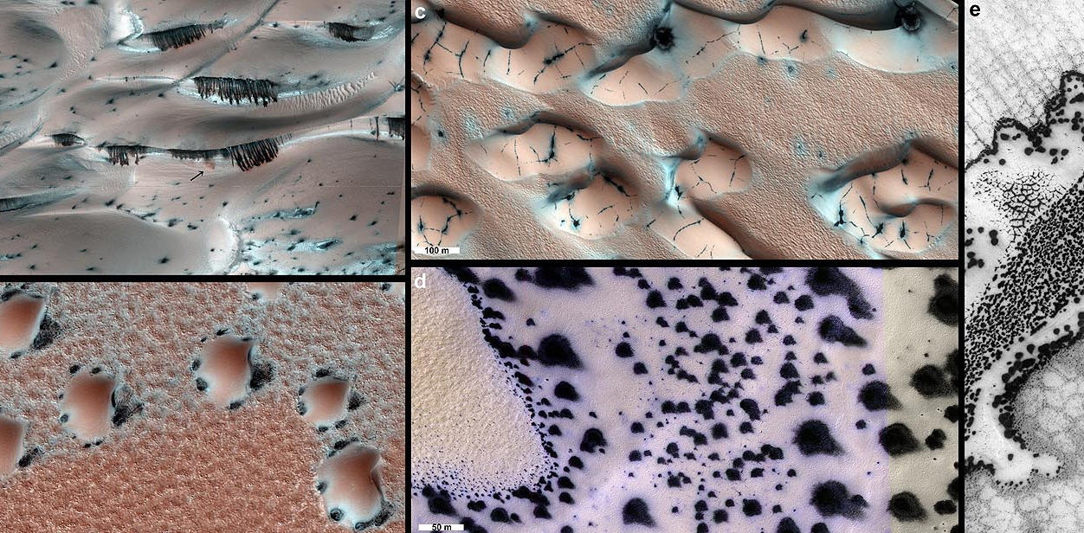
Defrosting > Dark dune Spot

Slide 28
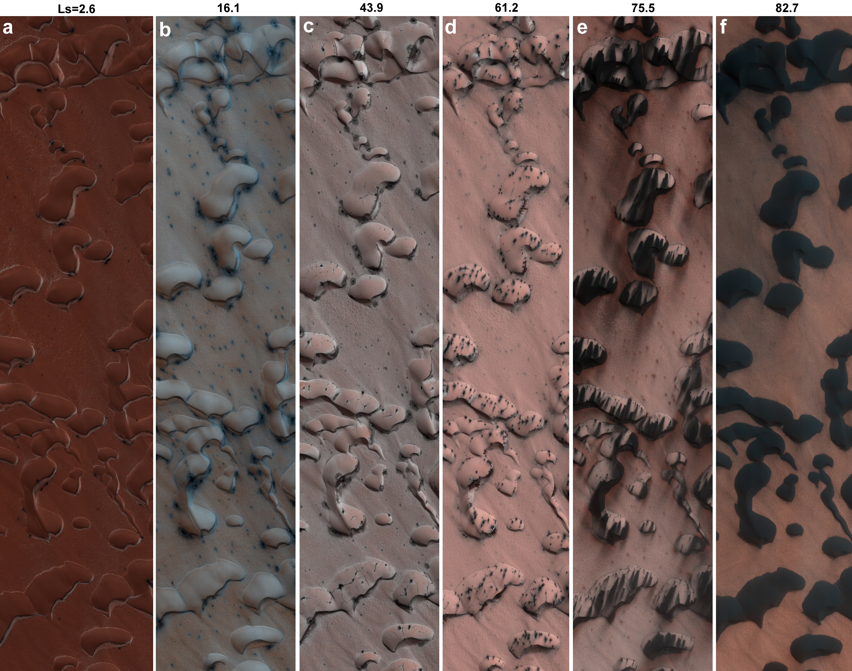
Defrosting > Dark dune Spot

Slide 29
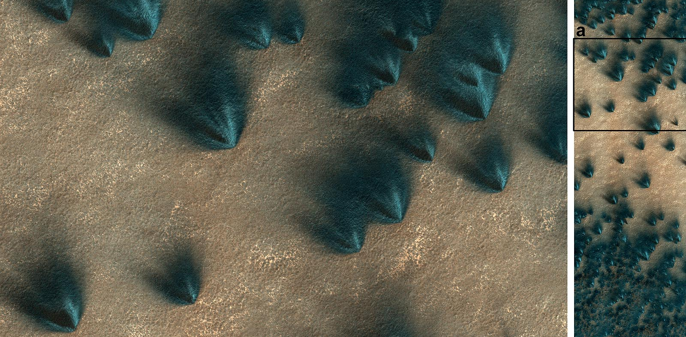
Ice related forms > Seasonal polar fan shaped features

Slide 30
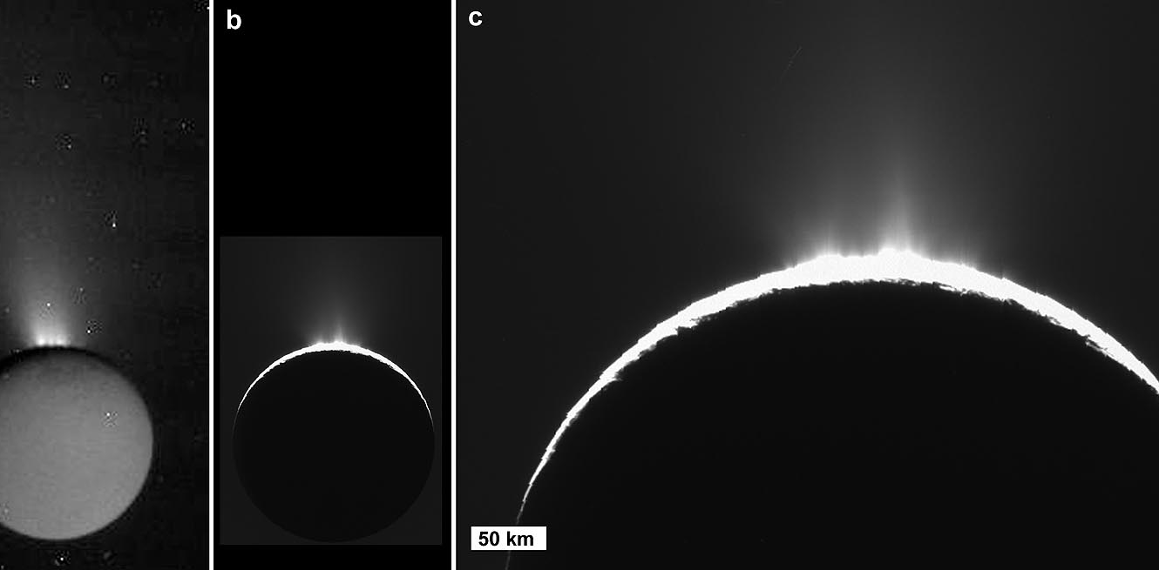
Ice related forms > Geyser

Slide 31
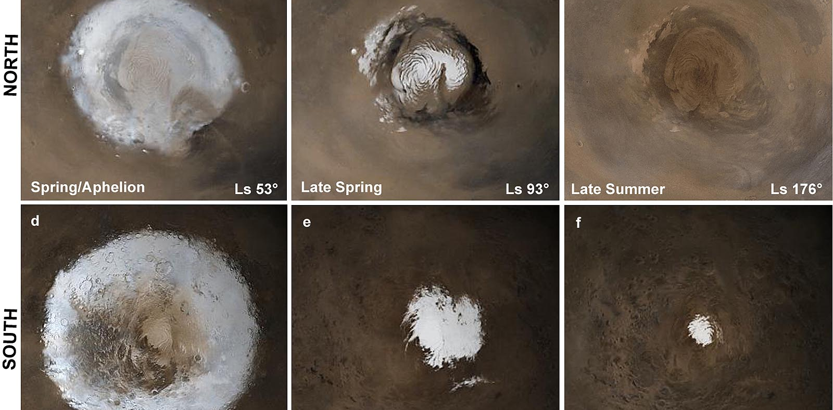
Ice > Polar cap

Slide 32
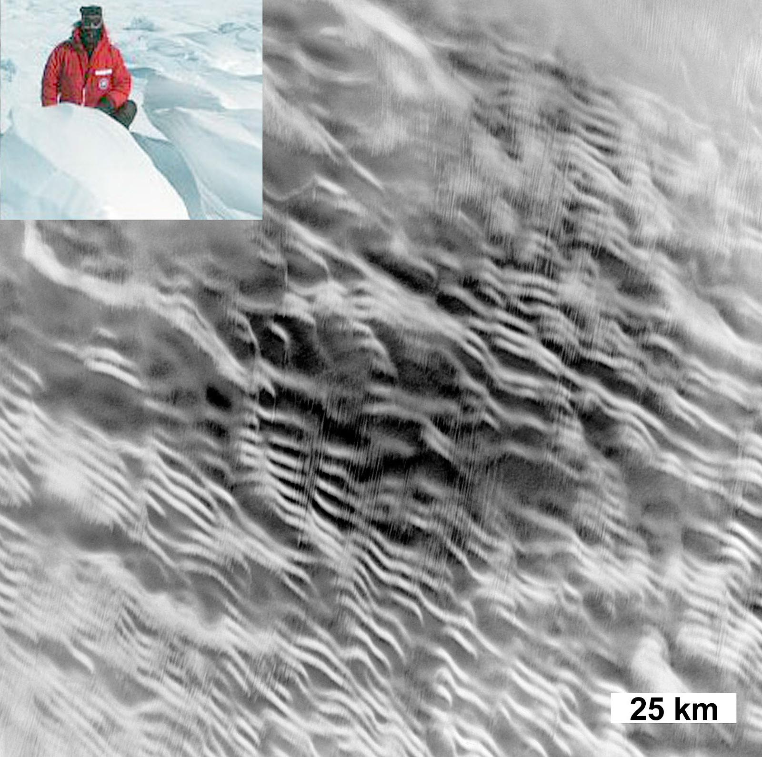
Snow and denivation > sastruga

Slide 33
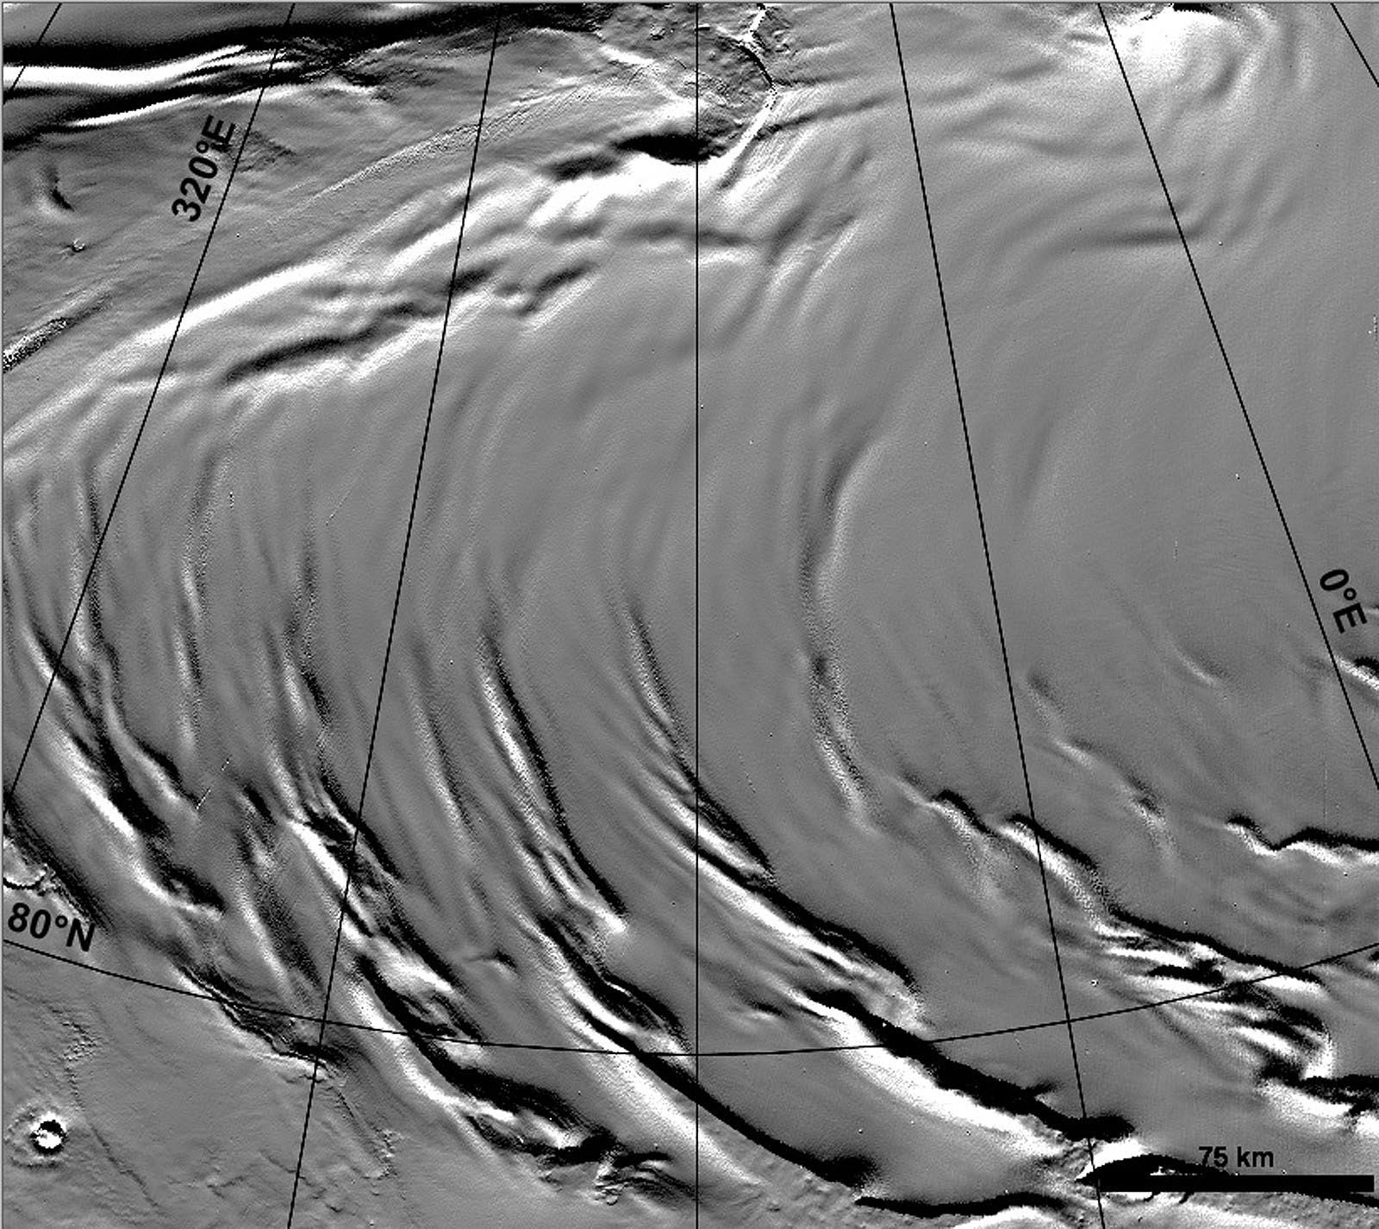
Snow and denivation > Polar undulation

Slide 34
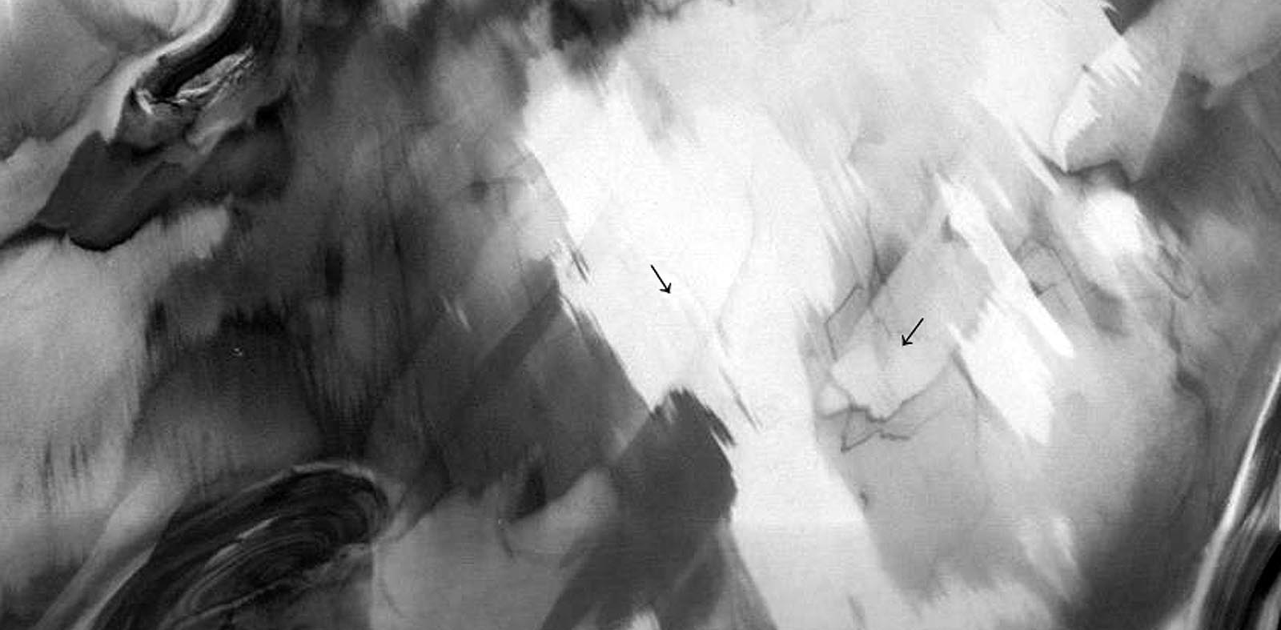
Snow and denivation > Frost streak

Slide 35
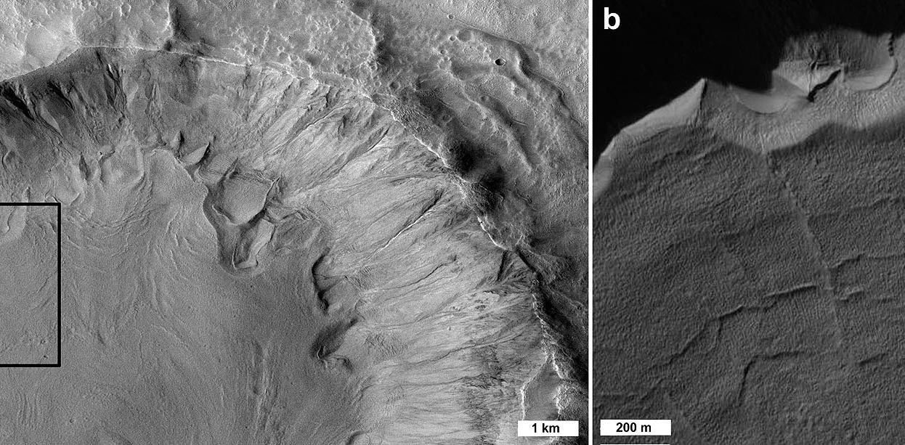
Snow and denivation > Protalus lobe

Slide 36
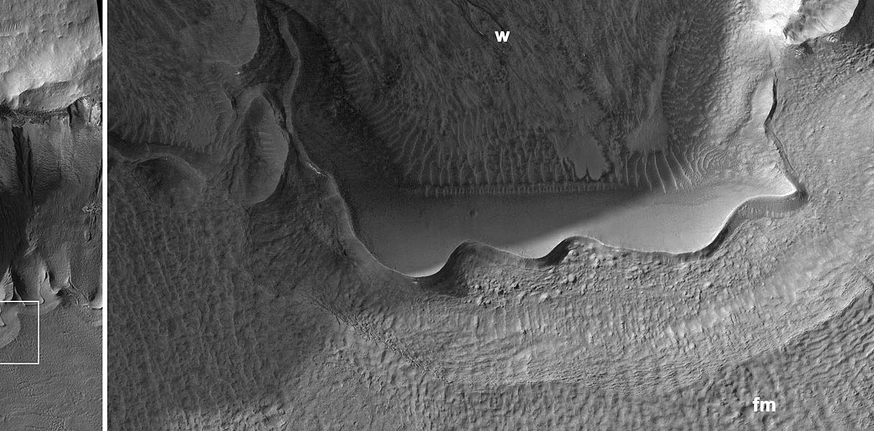
Glacial forms > Tongue ridge

Slide 37
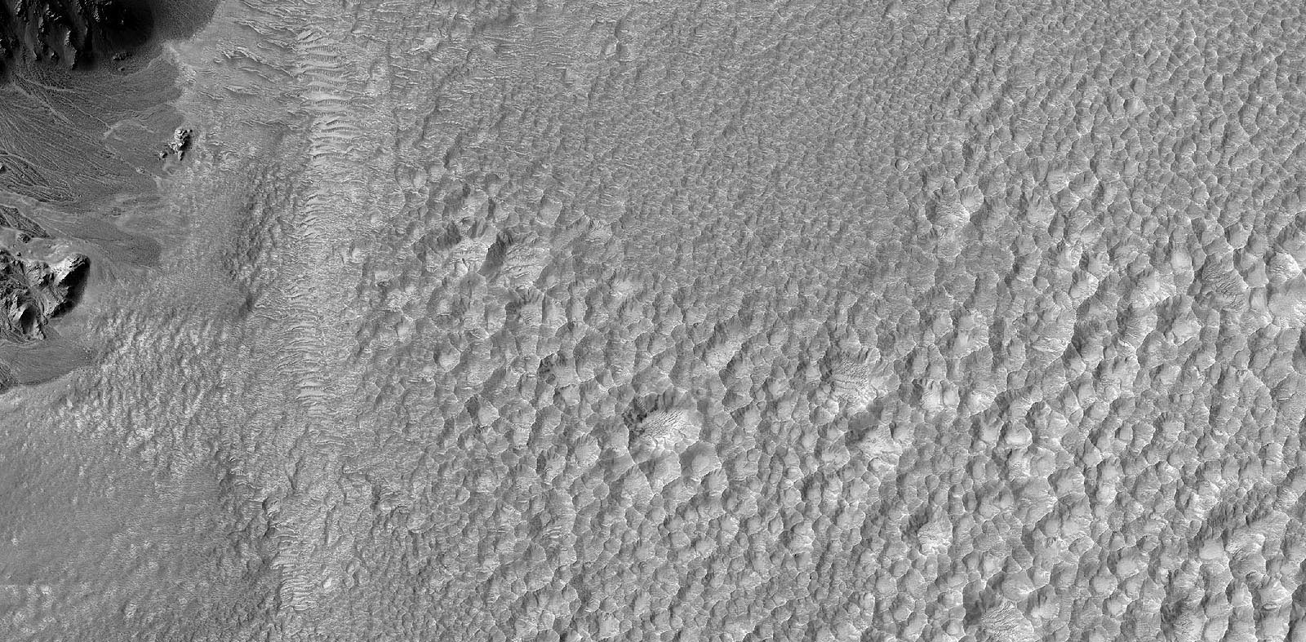
Sublimation forms > Ablation hollow

Slide 38
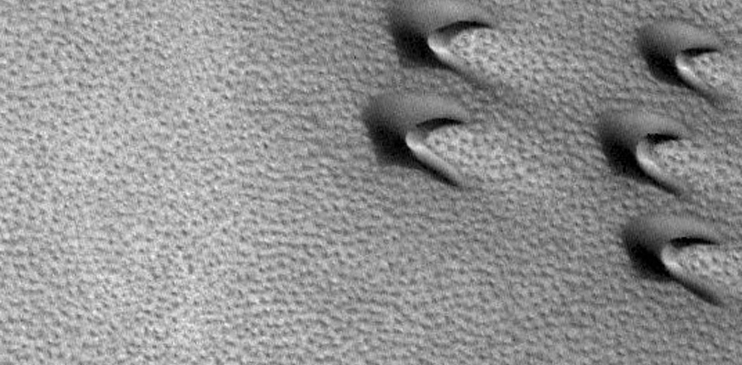
Sublimation forms > Basketball terrain

Slide 39
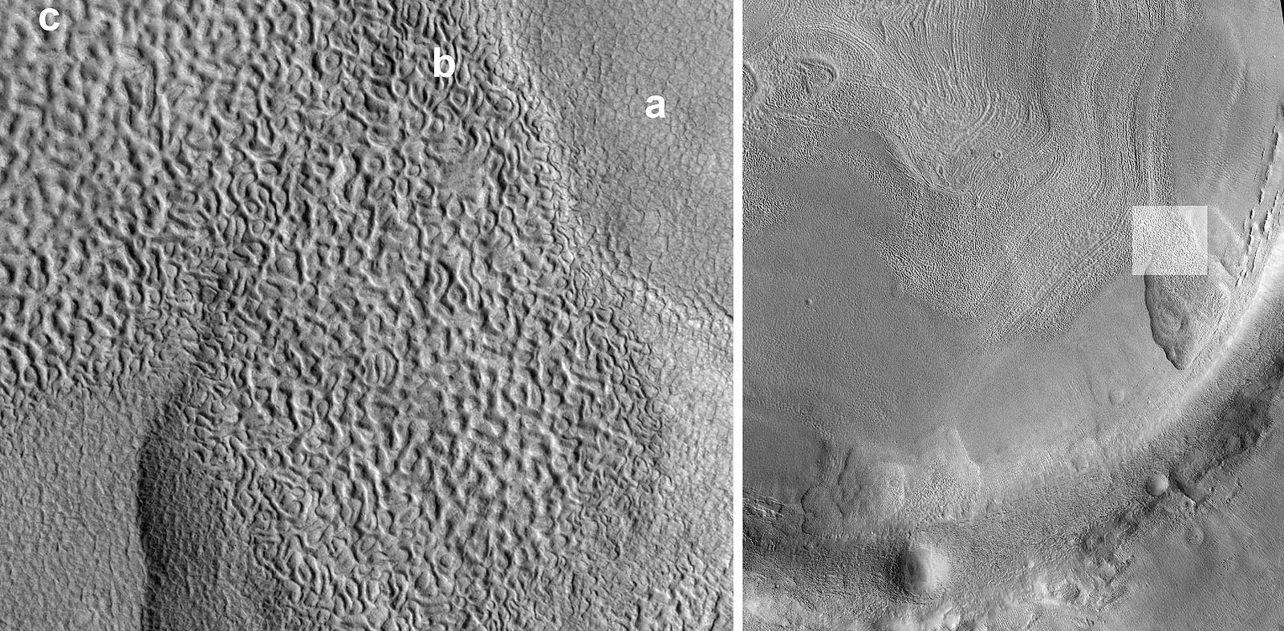
Sublimation forms > Brain terrain

Slide 40
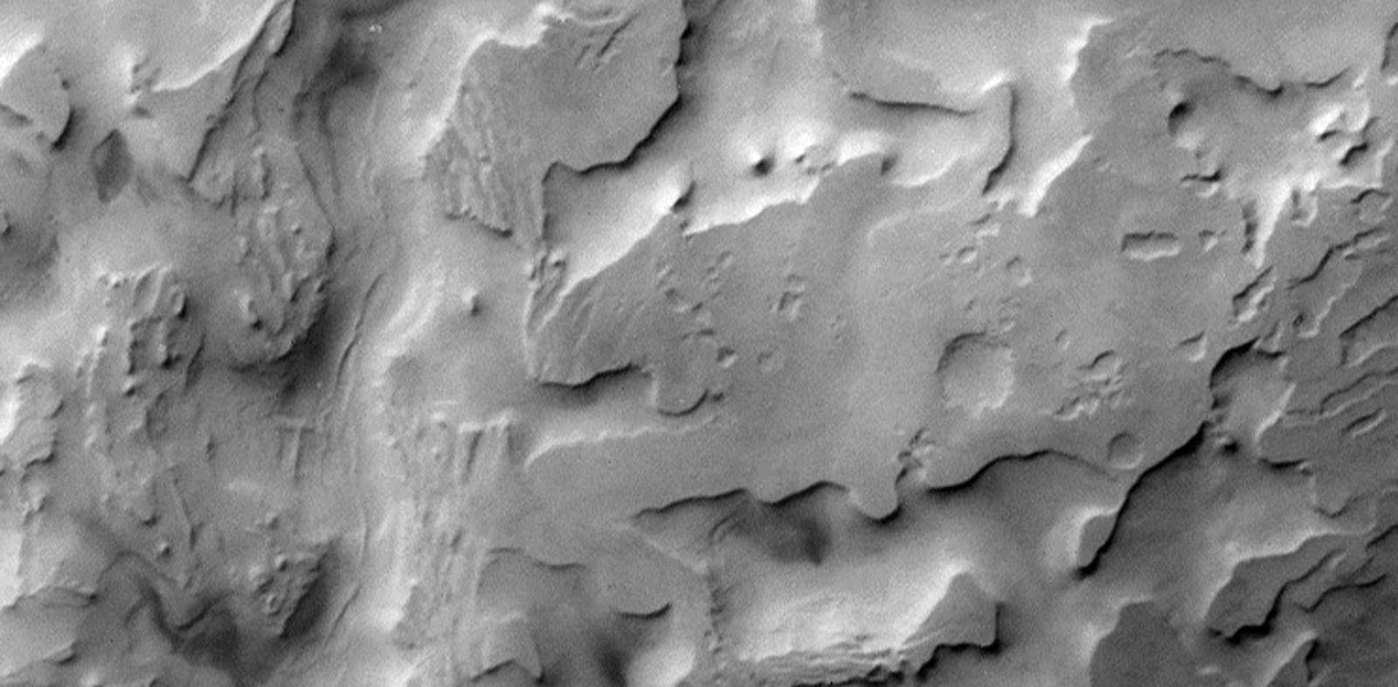
Sublimation forms > cavi

Slide 41
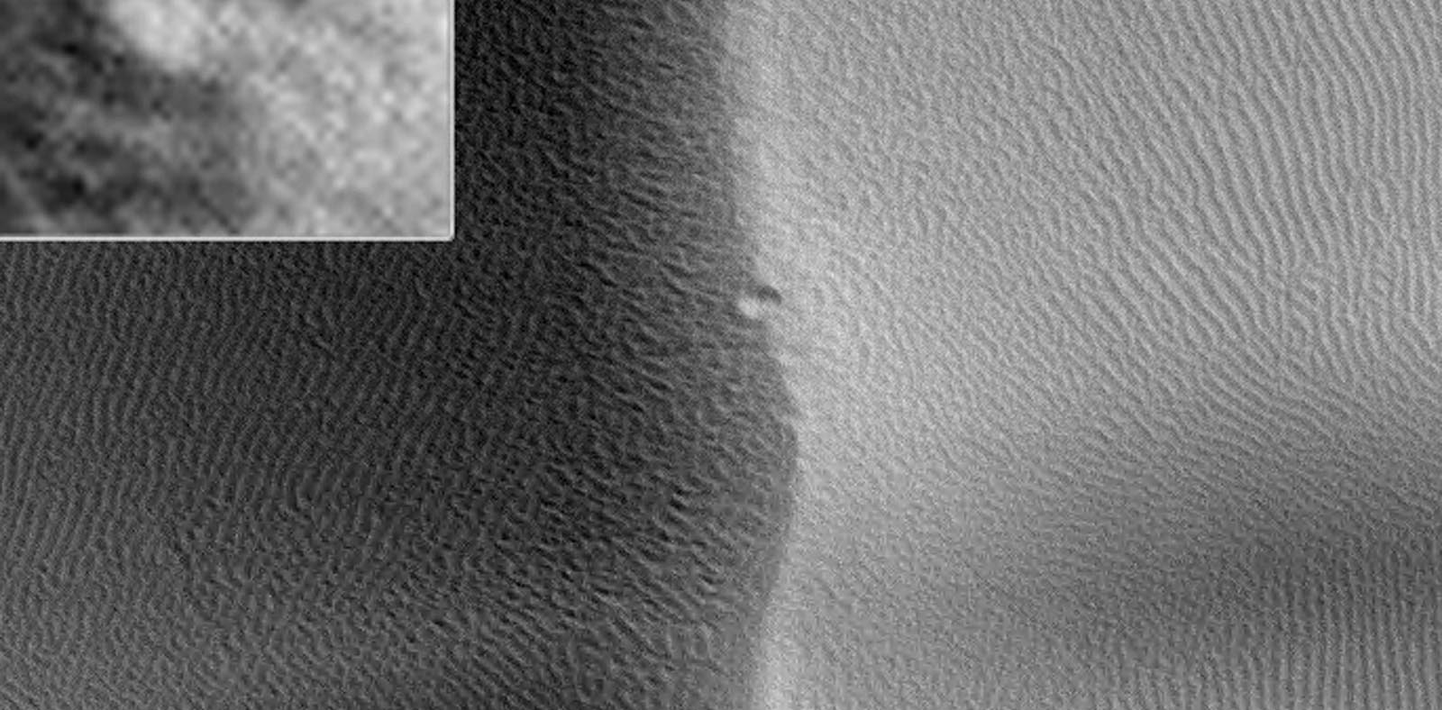
Glacial forms > Dune crestline pit

Slide 42
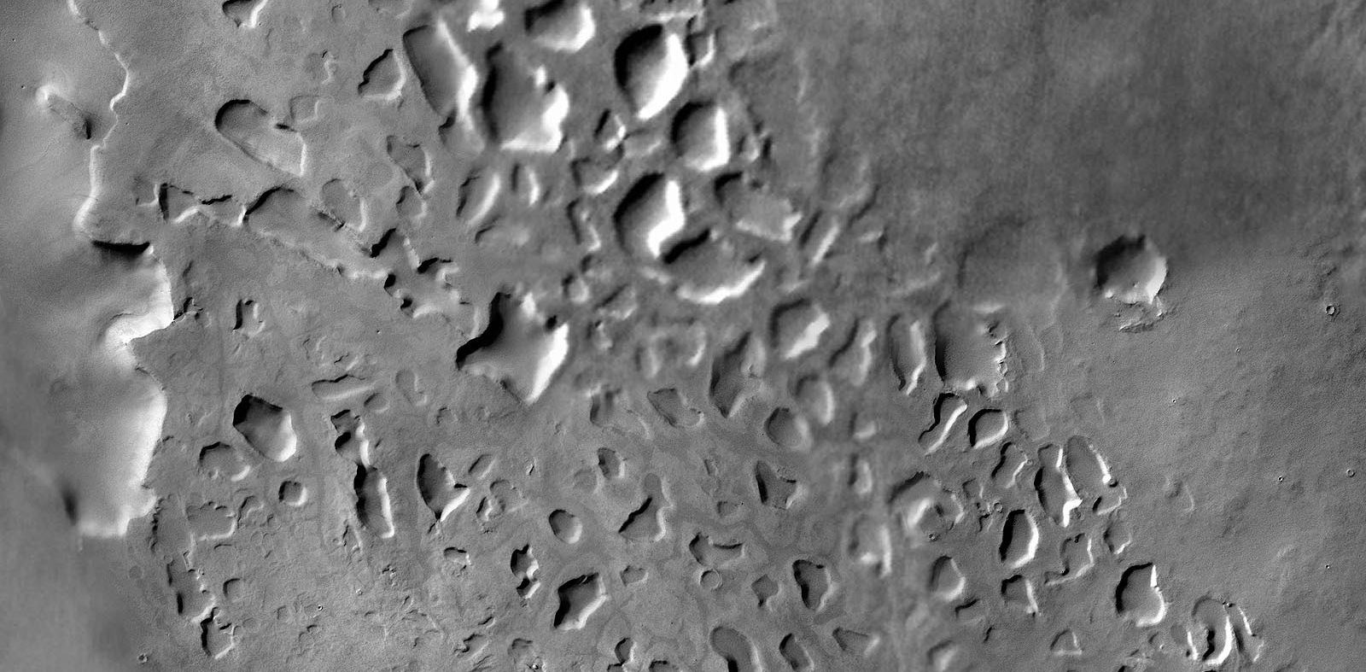
Glacial forms > Kettle hole

Slide 43
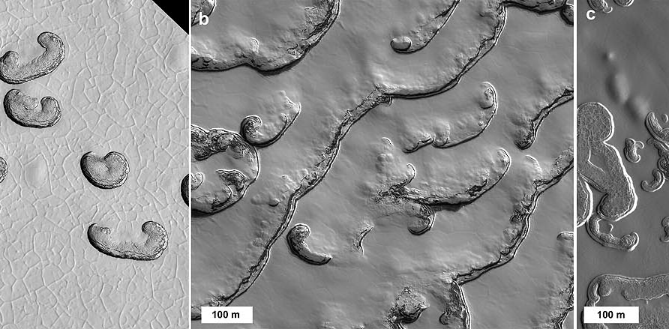
Sublimation forms > Residual cap (curly)

Slide 44
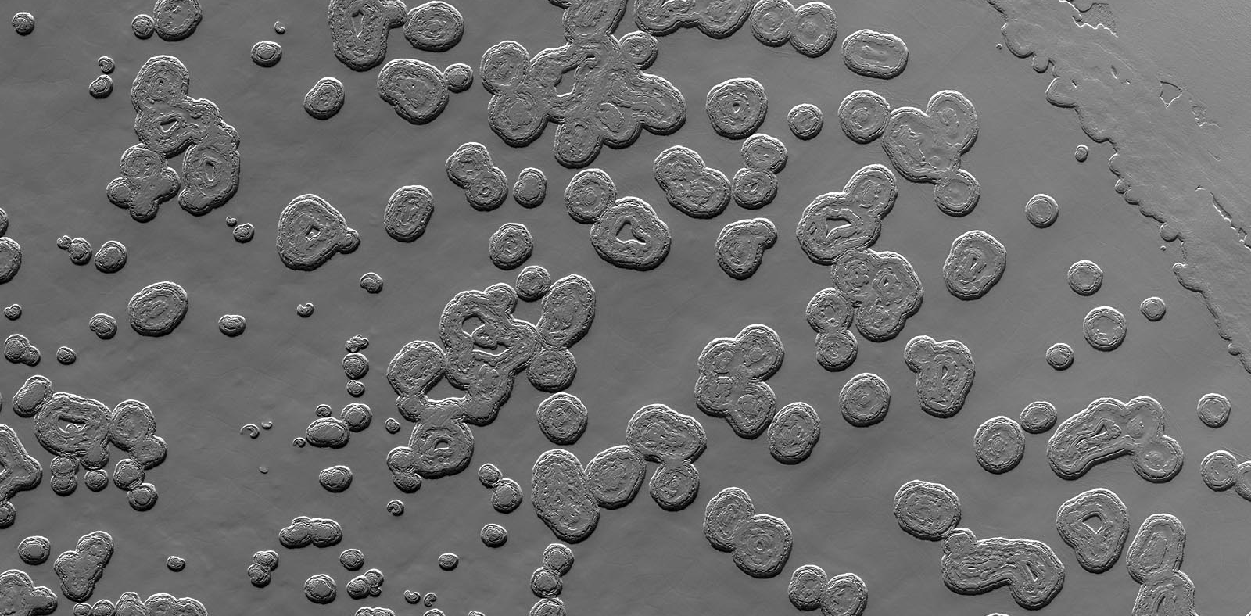
Sublimation forms > residual cap (swiss cheese)

Slide 45
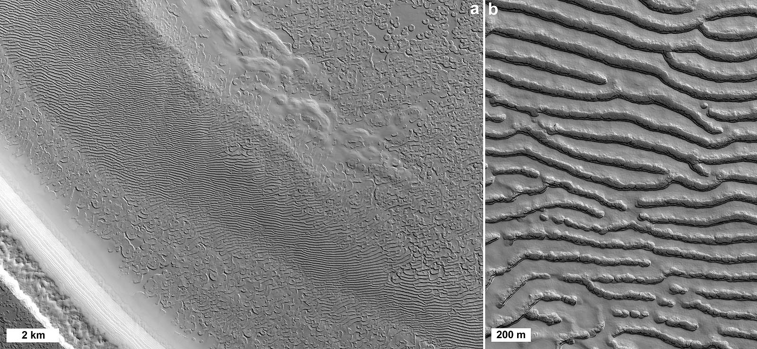
Sublimation forms > residual cap (thumbprint)

Slide 46
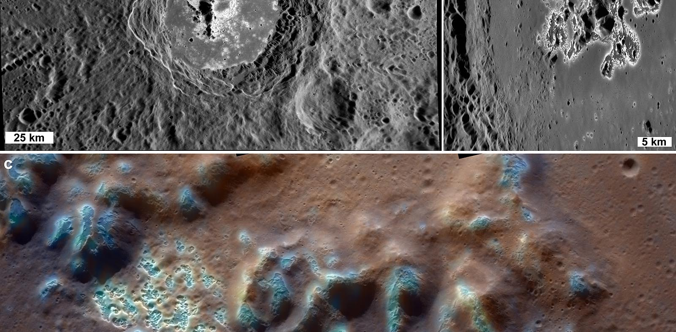
Sublimation forms > hollows

Slide 47

N Ice sublimation? > Gutta

Slide 48

Sublimation forms > Scalloped terrain

Slide 49

Ice tectonics > Ice cauldron

Slide 50

Bladed terrain

Slide 51

Callisto peaks

Slide 52
Key concepts
Nival forms are made of snow
Snow is sometimes aeolian, other times glacial
Nival features include those formed by accumulated snow
Defrosting features are formed in the spring as the thin frost layer sublimates
Denivation features are generated by the melting and/or sublimation of snow and ice incorporated into surface sediments, most commonly in aeolian bedforms
These are ephemeral/seasonal features

