Slide 1
Planetary landforms
A visual introduction to planetary geomorphology
FLUVIAL, LACUSTRINE, DEPOSITS
HENRIK HARGITAI
2019
csplanetolg17em
FÖL/1/075E
Definitions in the Notes section

Slide 2
FLUVIAL FEATURES

Slide 3
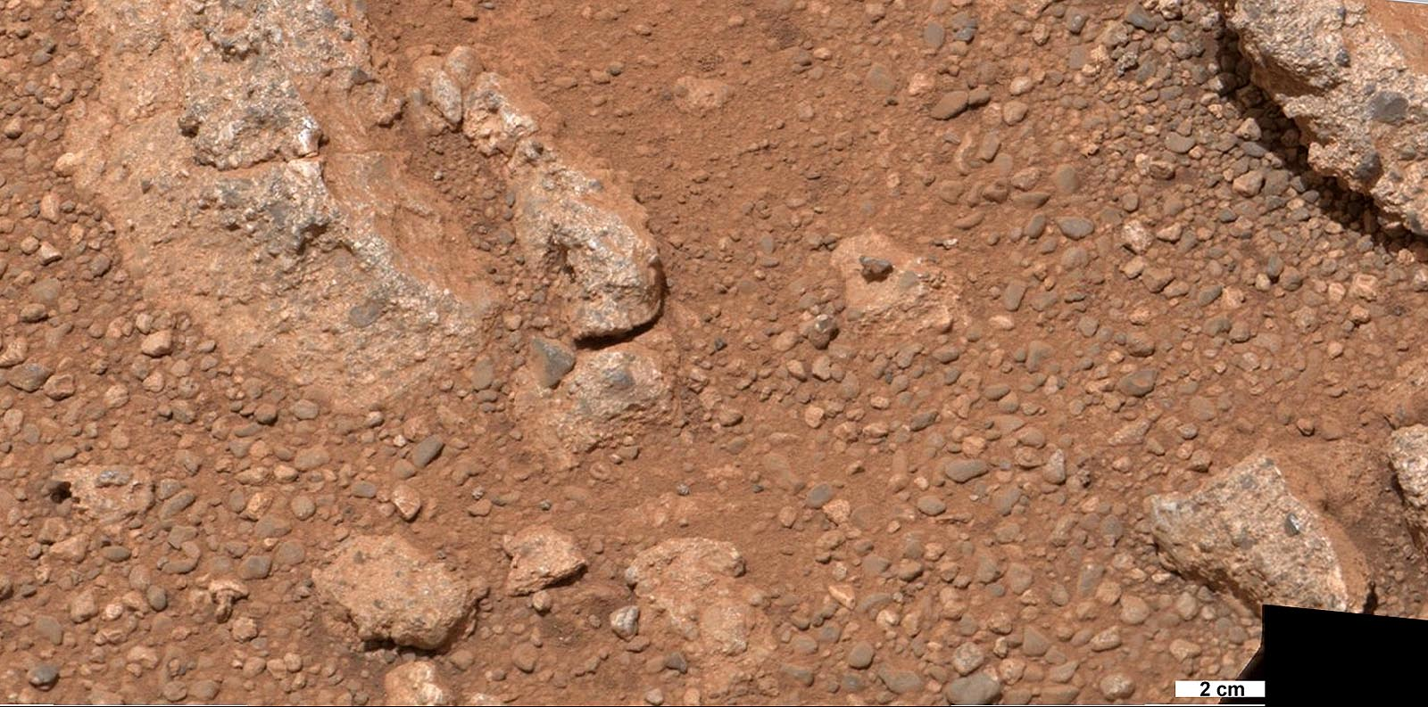
Sedimentary > Fluvial clast

Slide 4
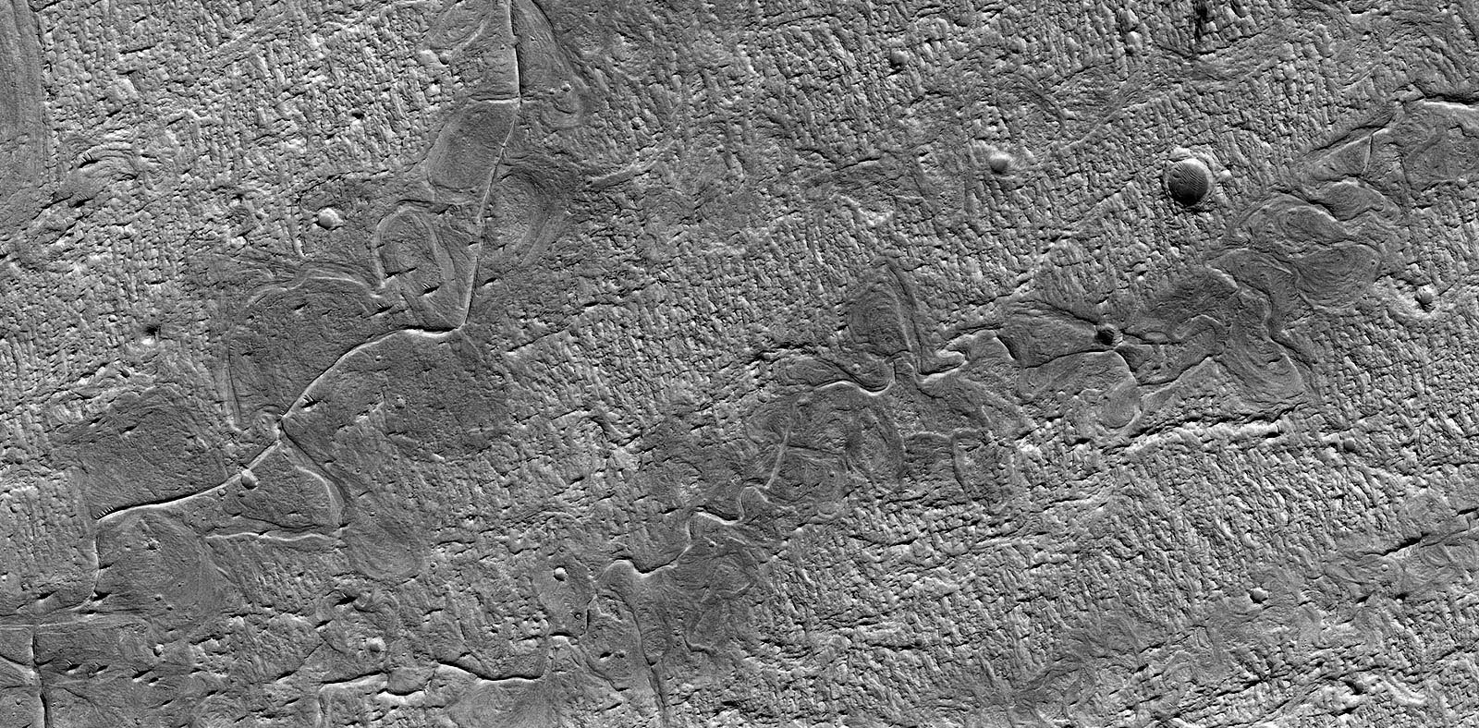
Fluvial deposits > floodplain

Slide 5
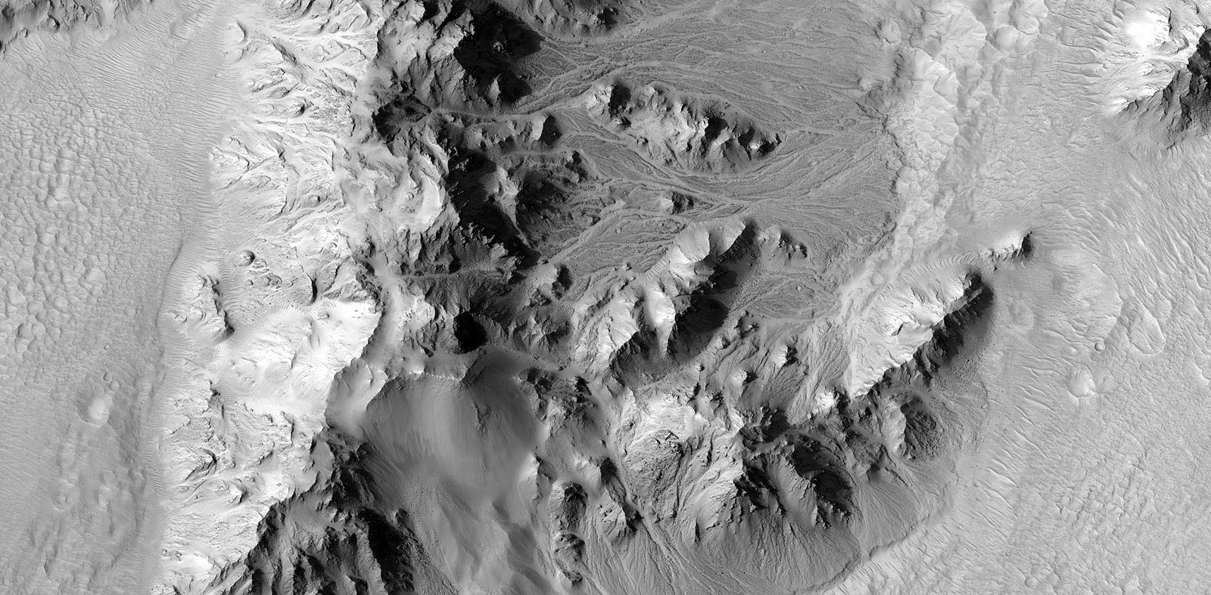
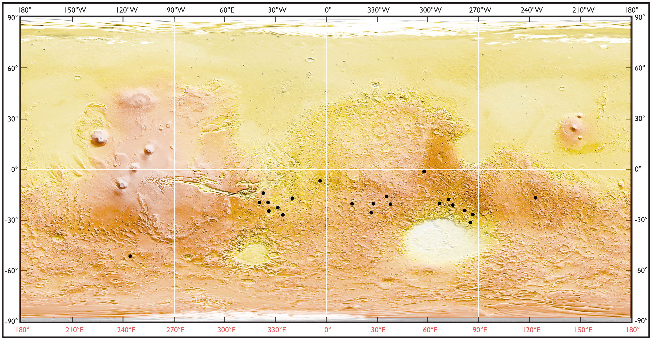
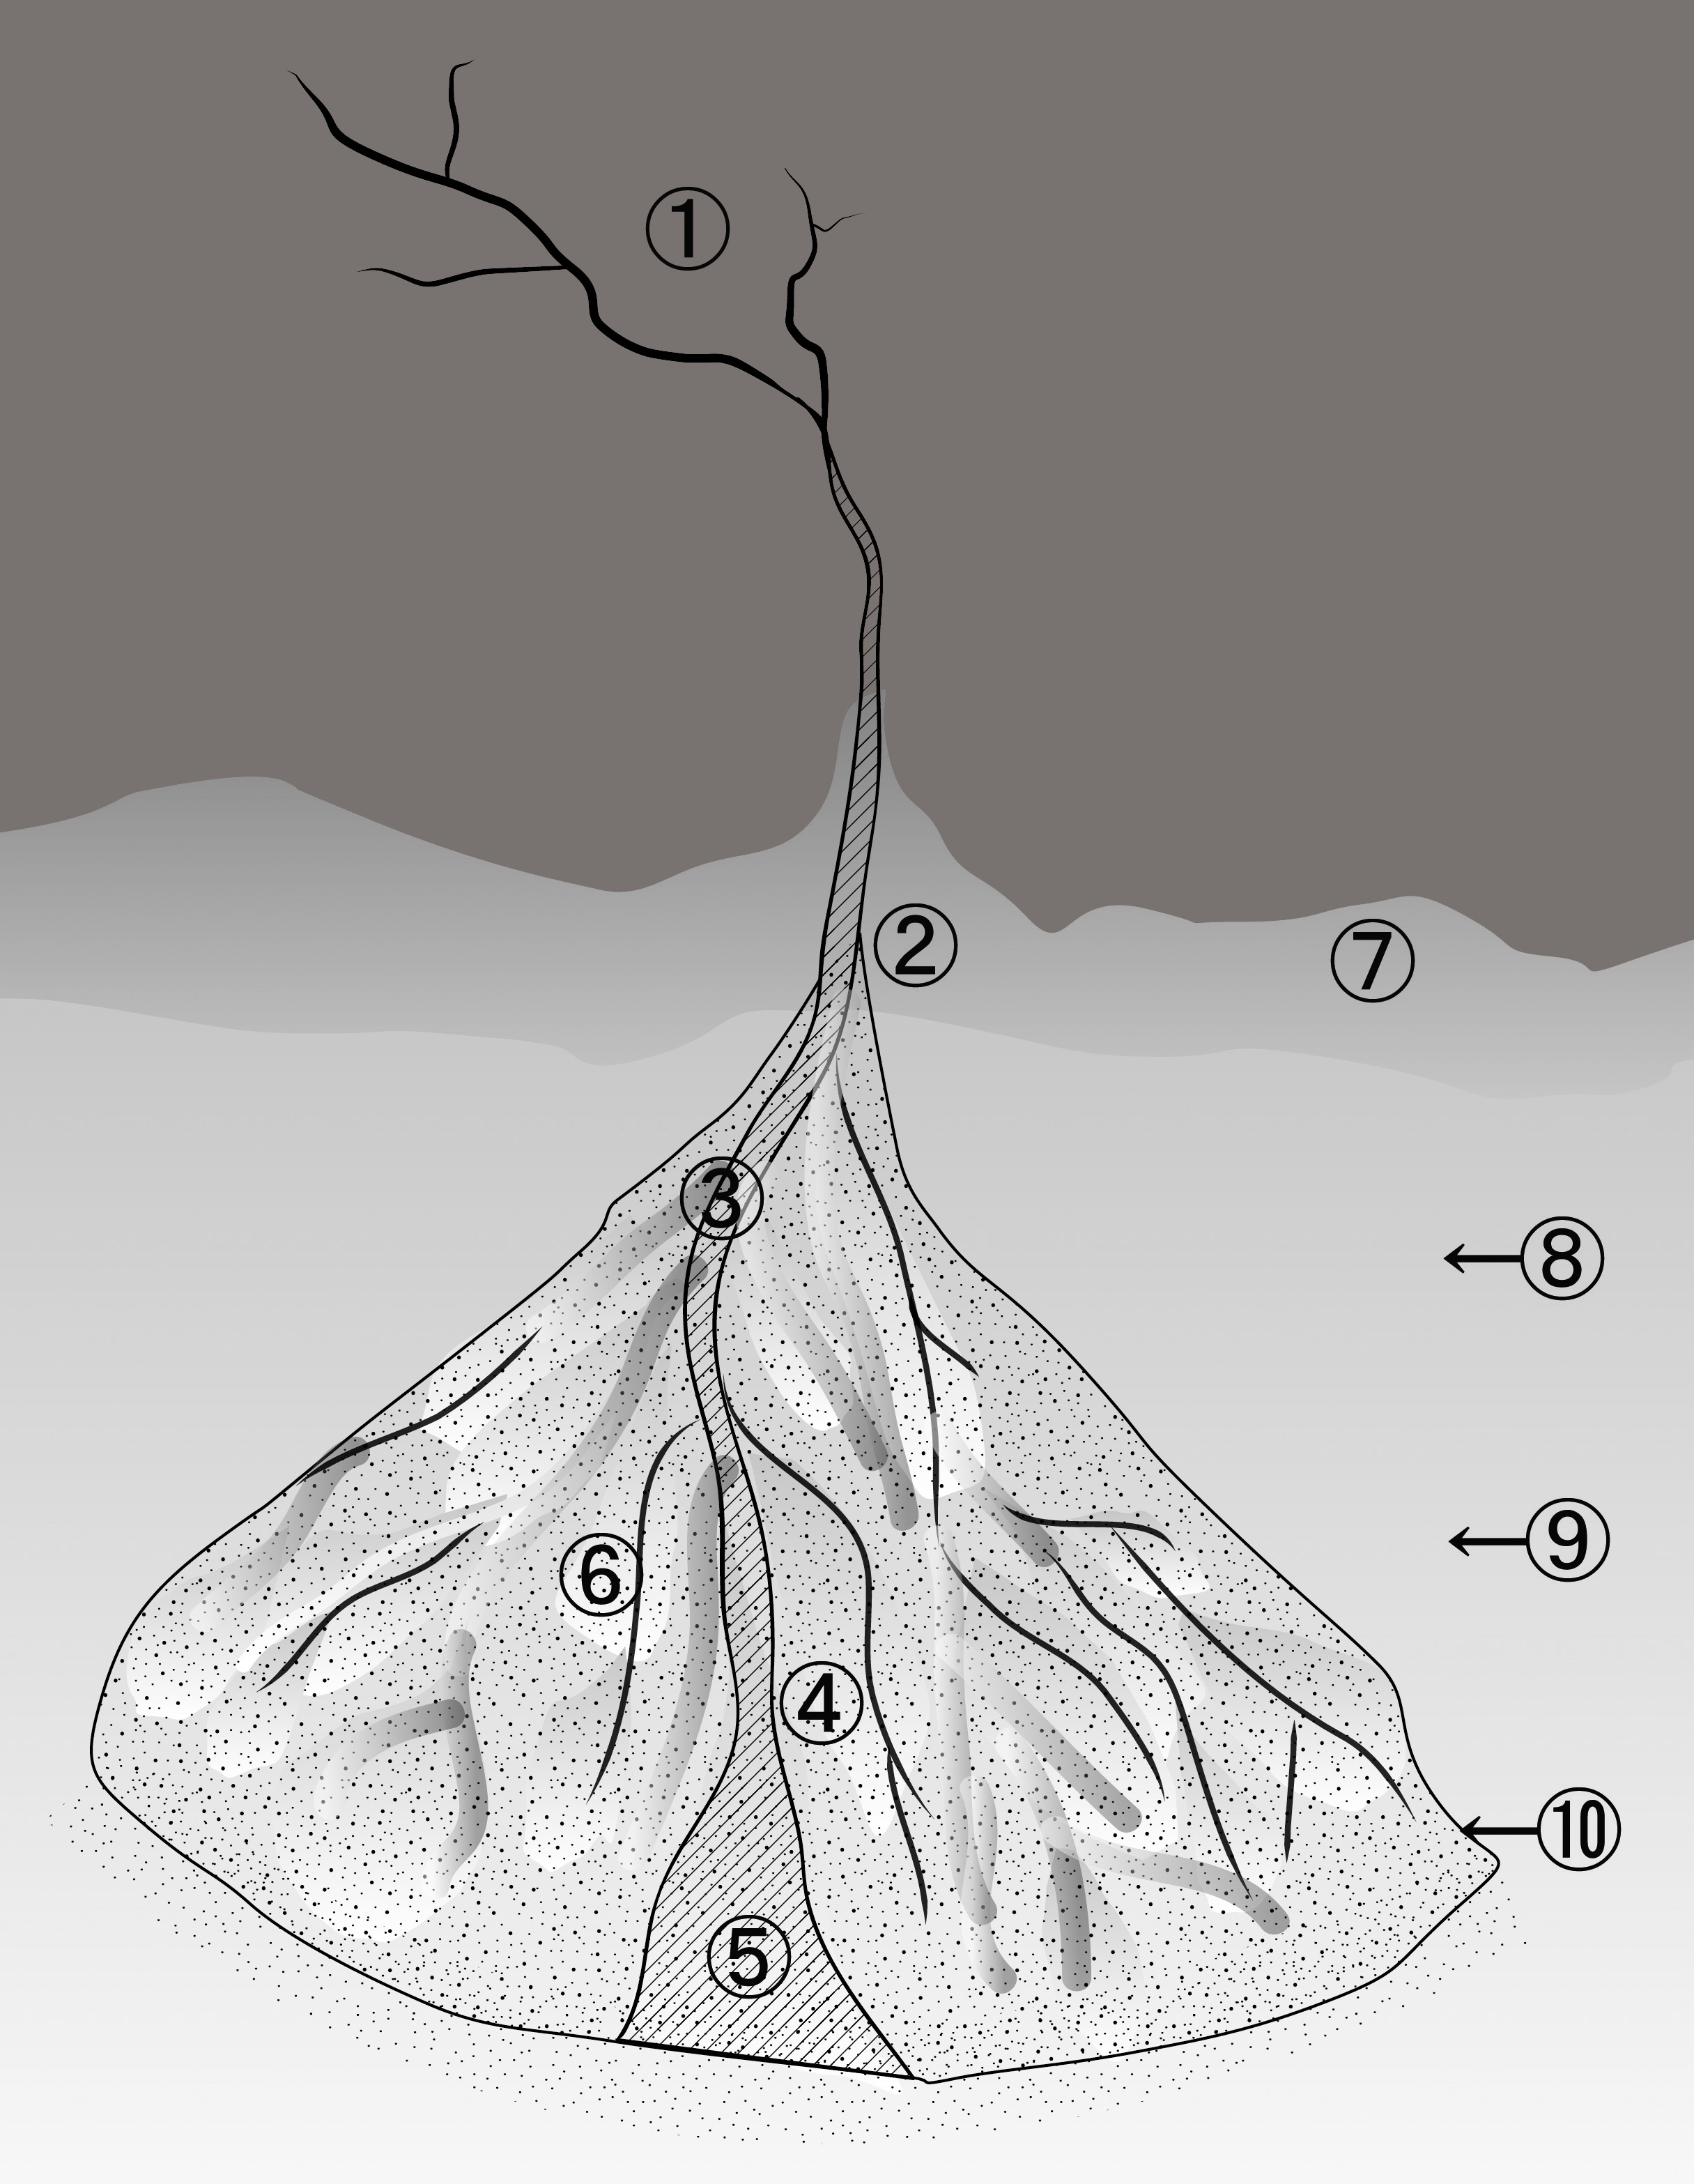
Fluvial deposits > alluvial fan

Slide 6
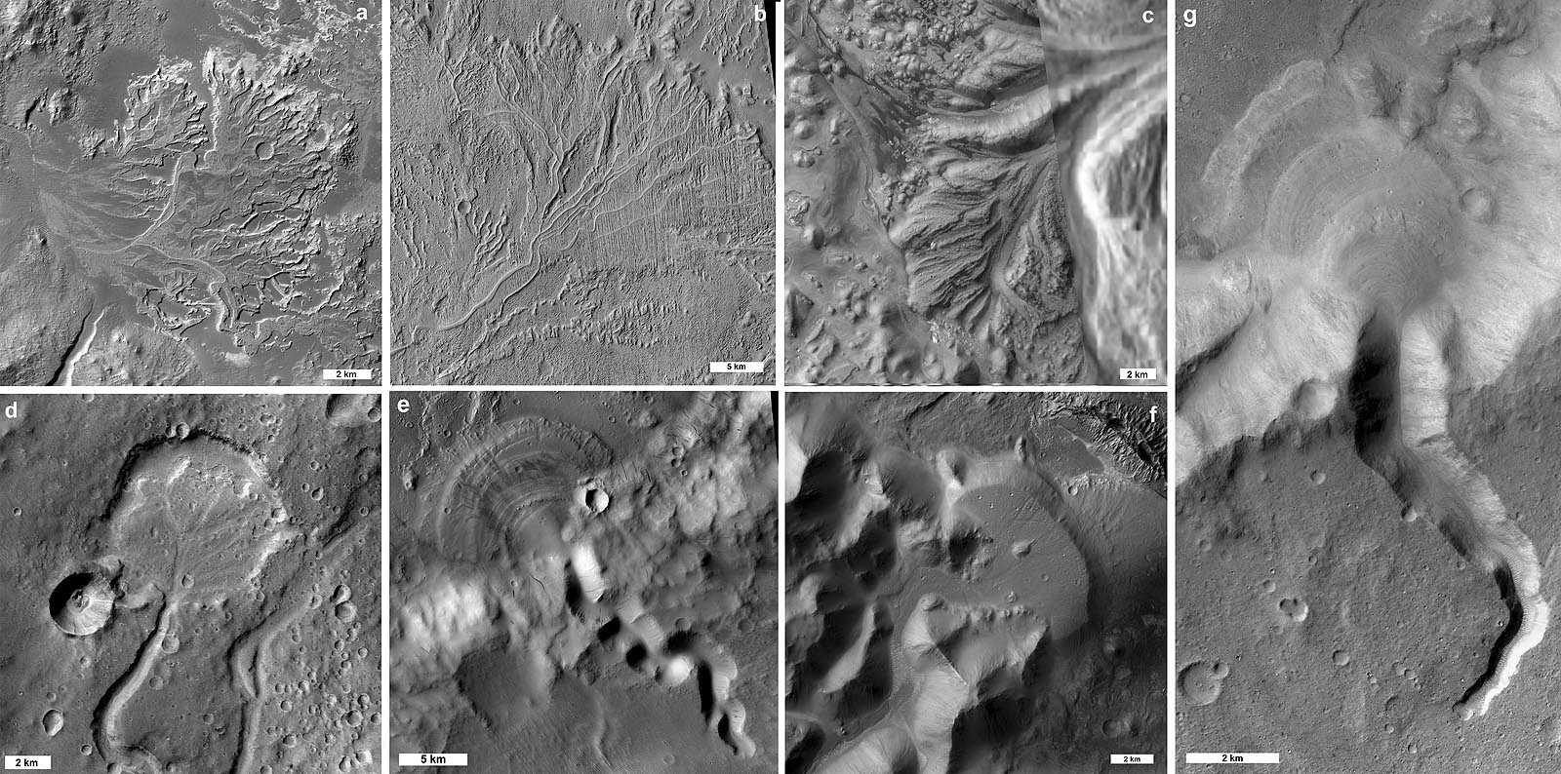
Fluvial deposits > delta

Slide 7
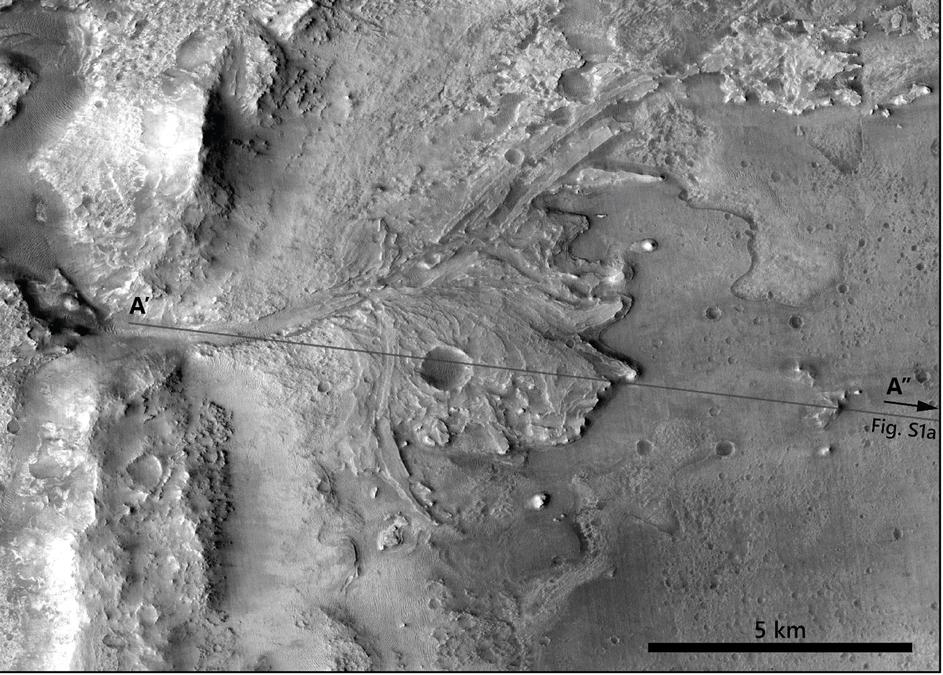
Fluvial deposits > delta

Slide 8
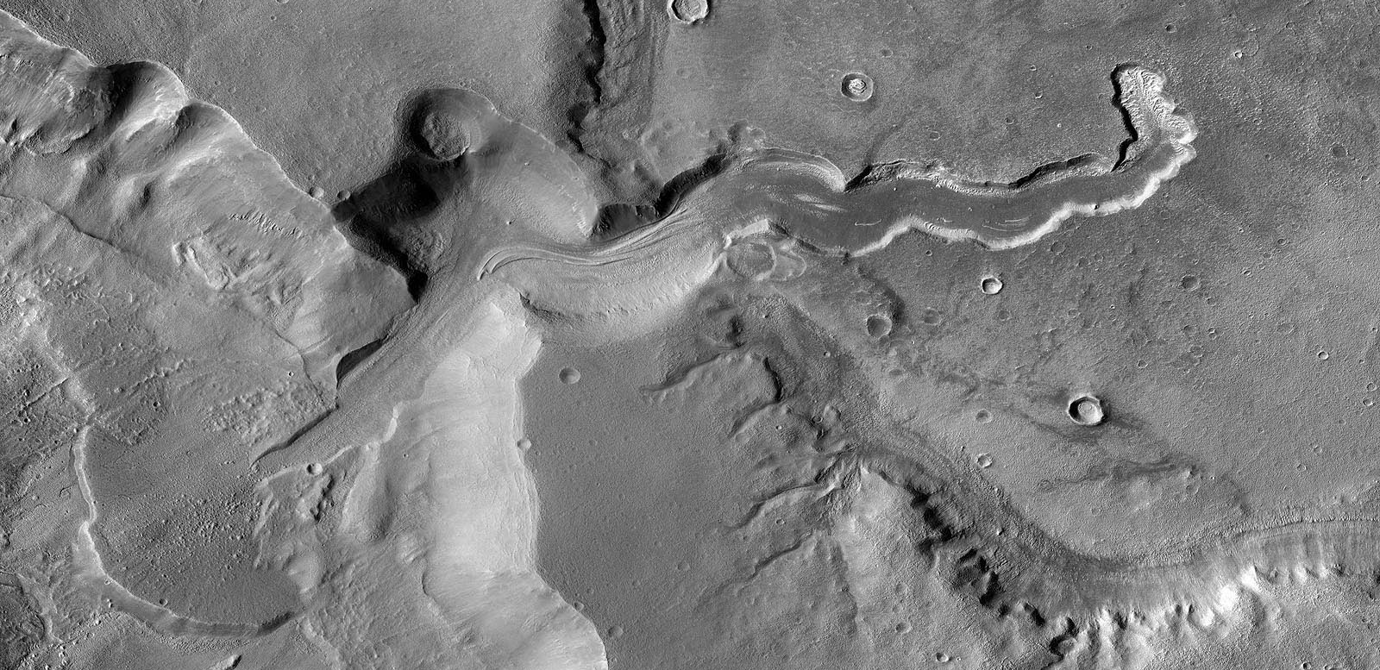
Fluvial deposits > kame delta

Slide 9
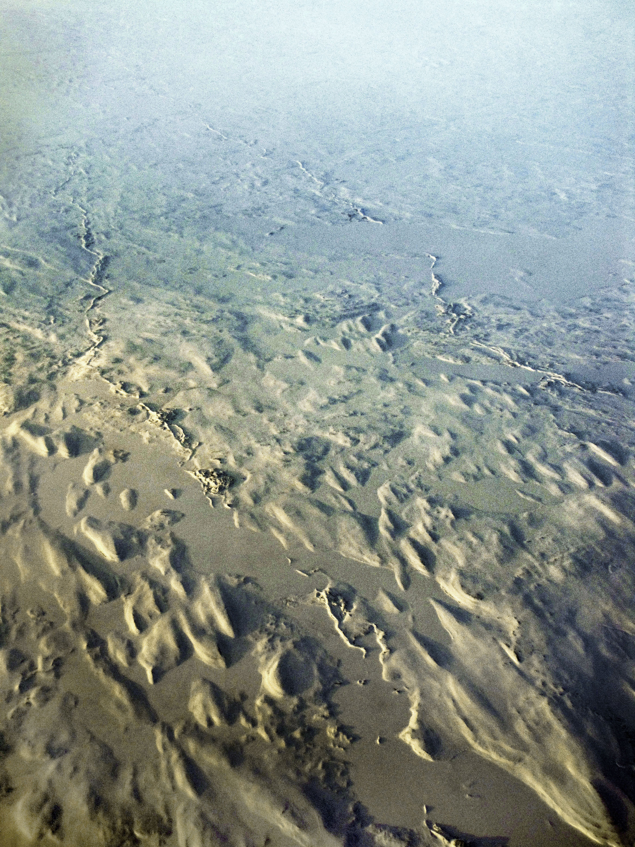
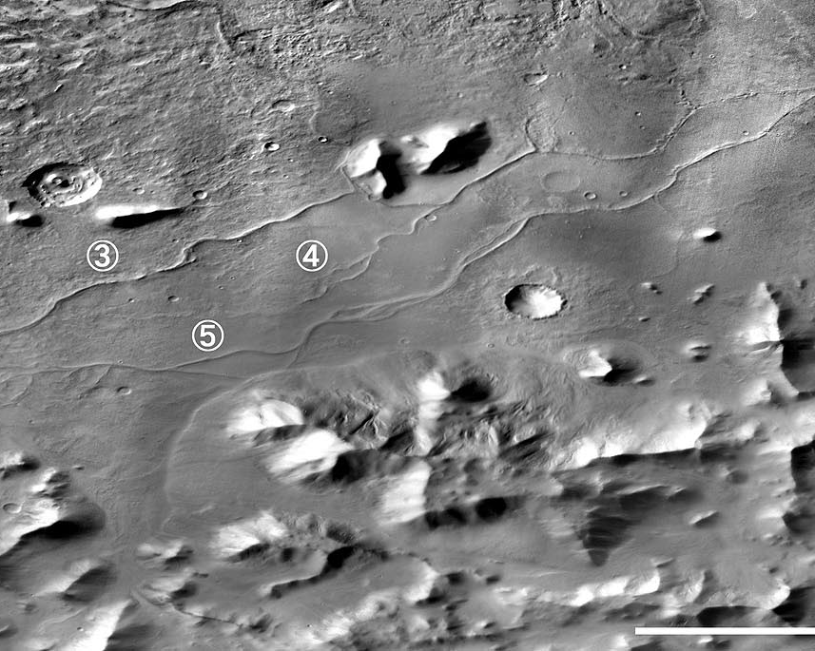
Fluvial deposits > sinuous ridge vs Esker

Slide 10
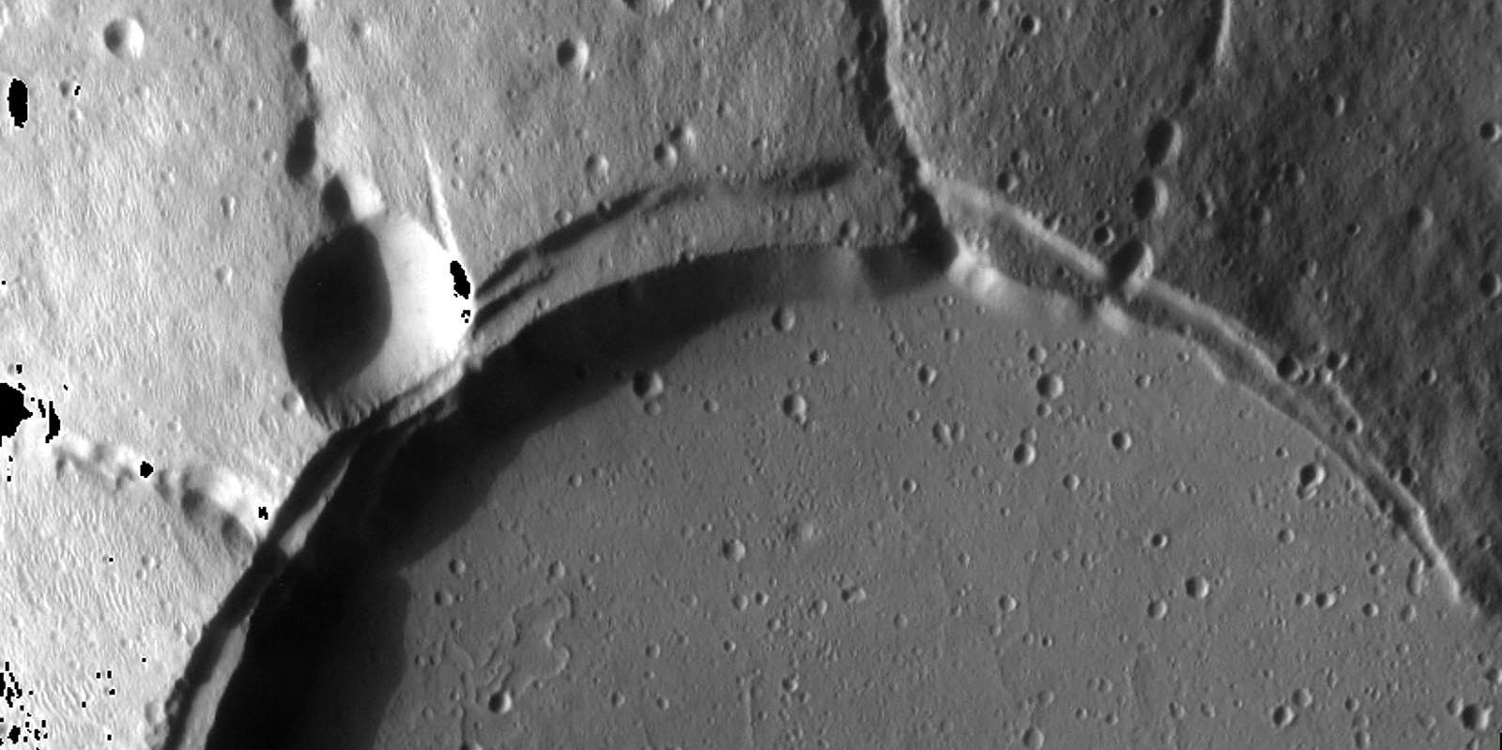
Fluvial deposits > crater breach

Slide 11
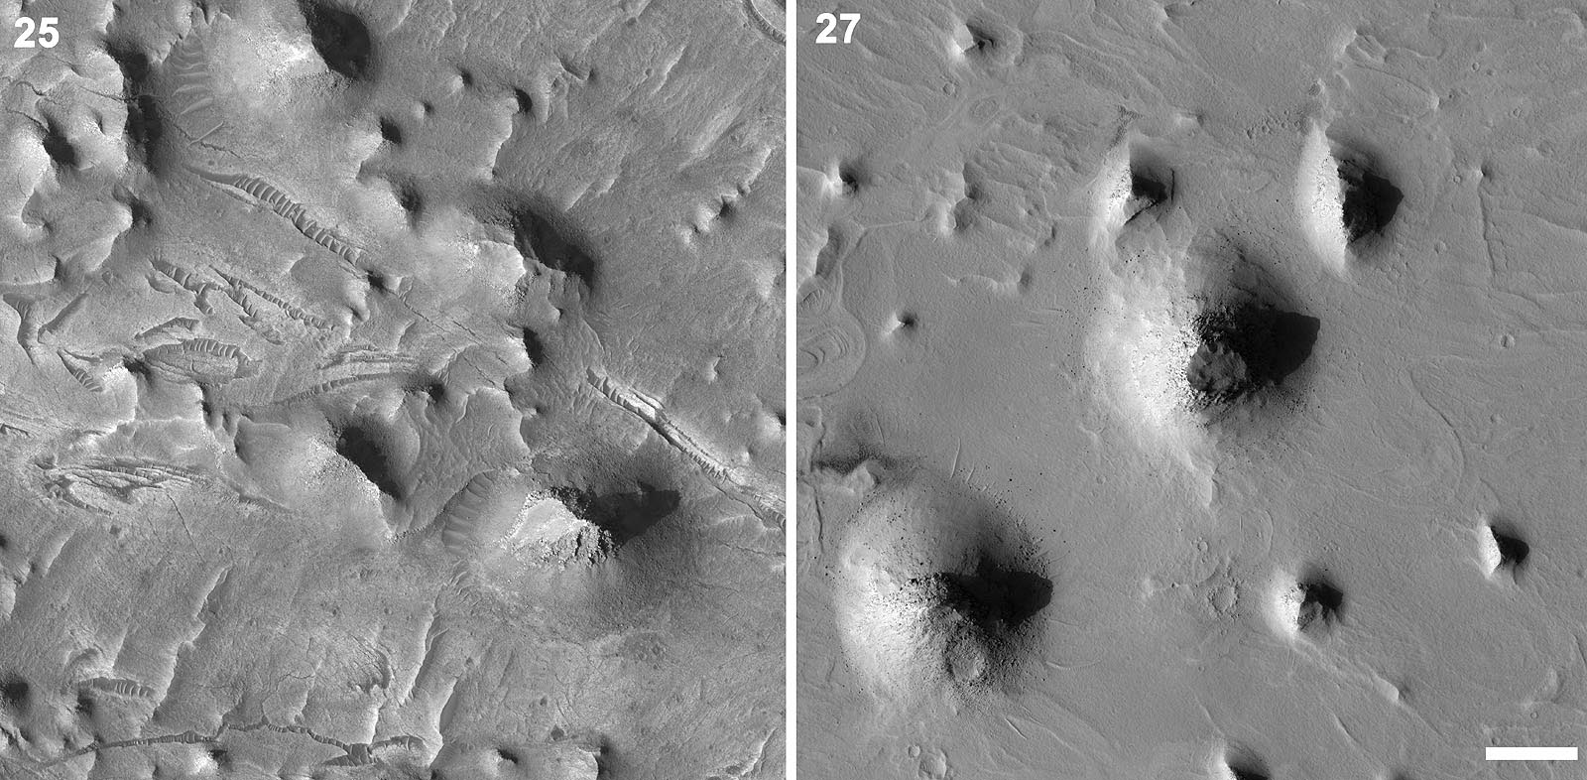
Spring mound

Slide 12
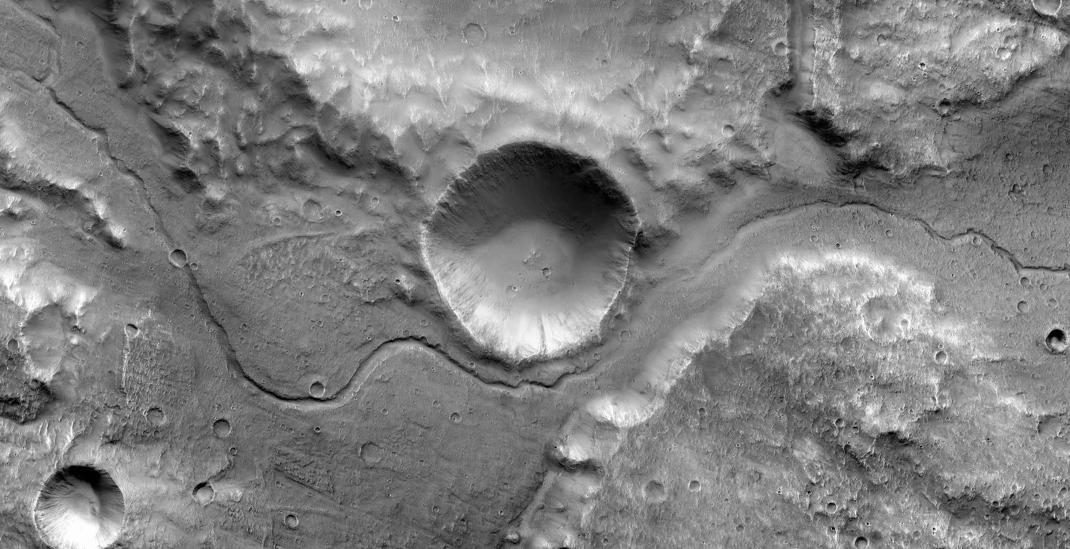
Fluvial > Channel

Slide 13
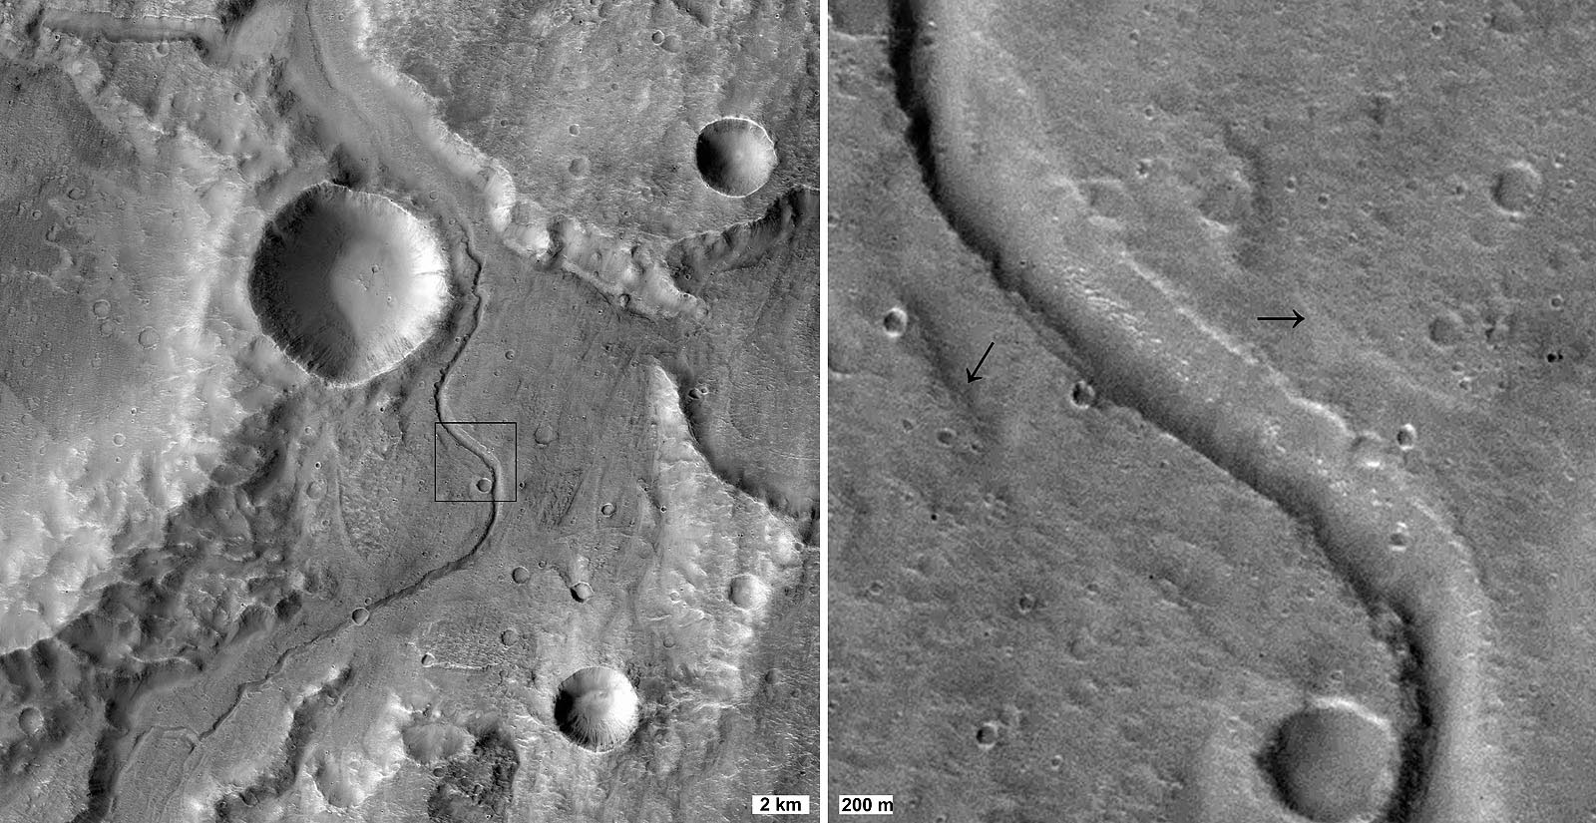
Fluvial forms > valley terrace

Slide 14
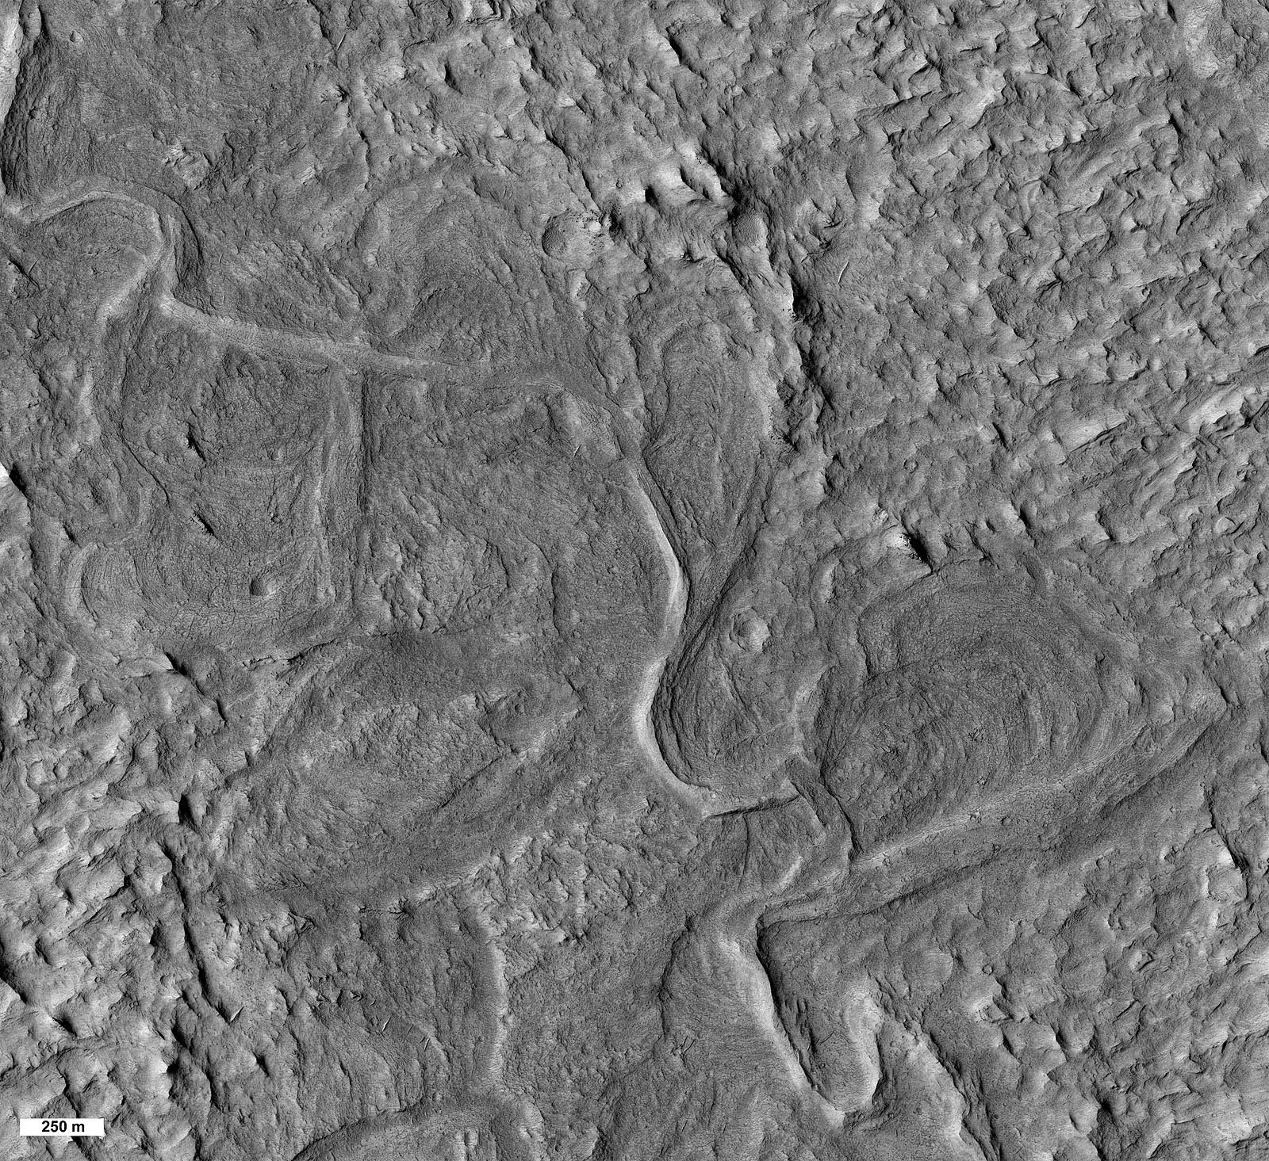
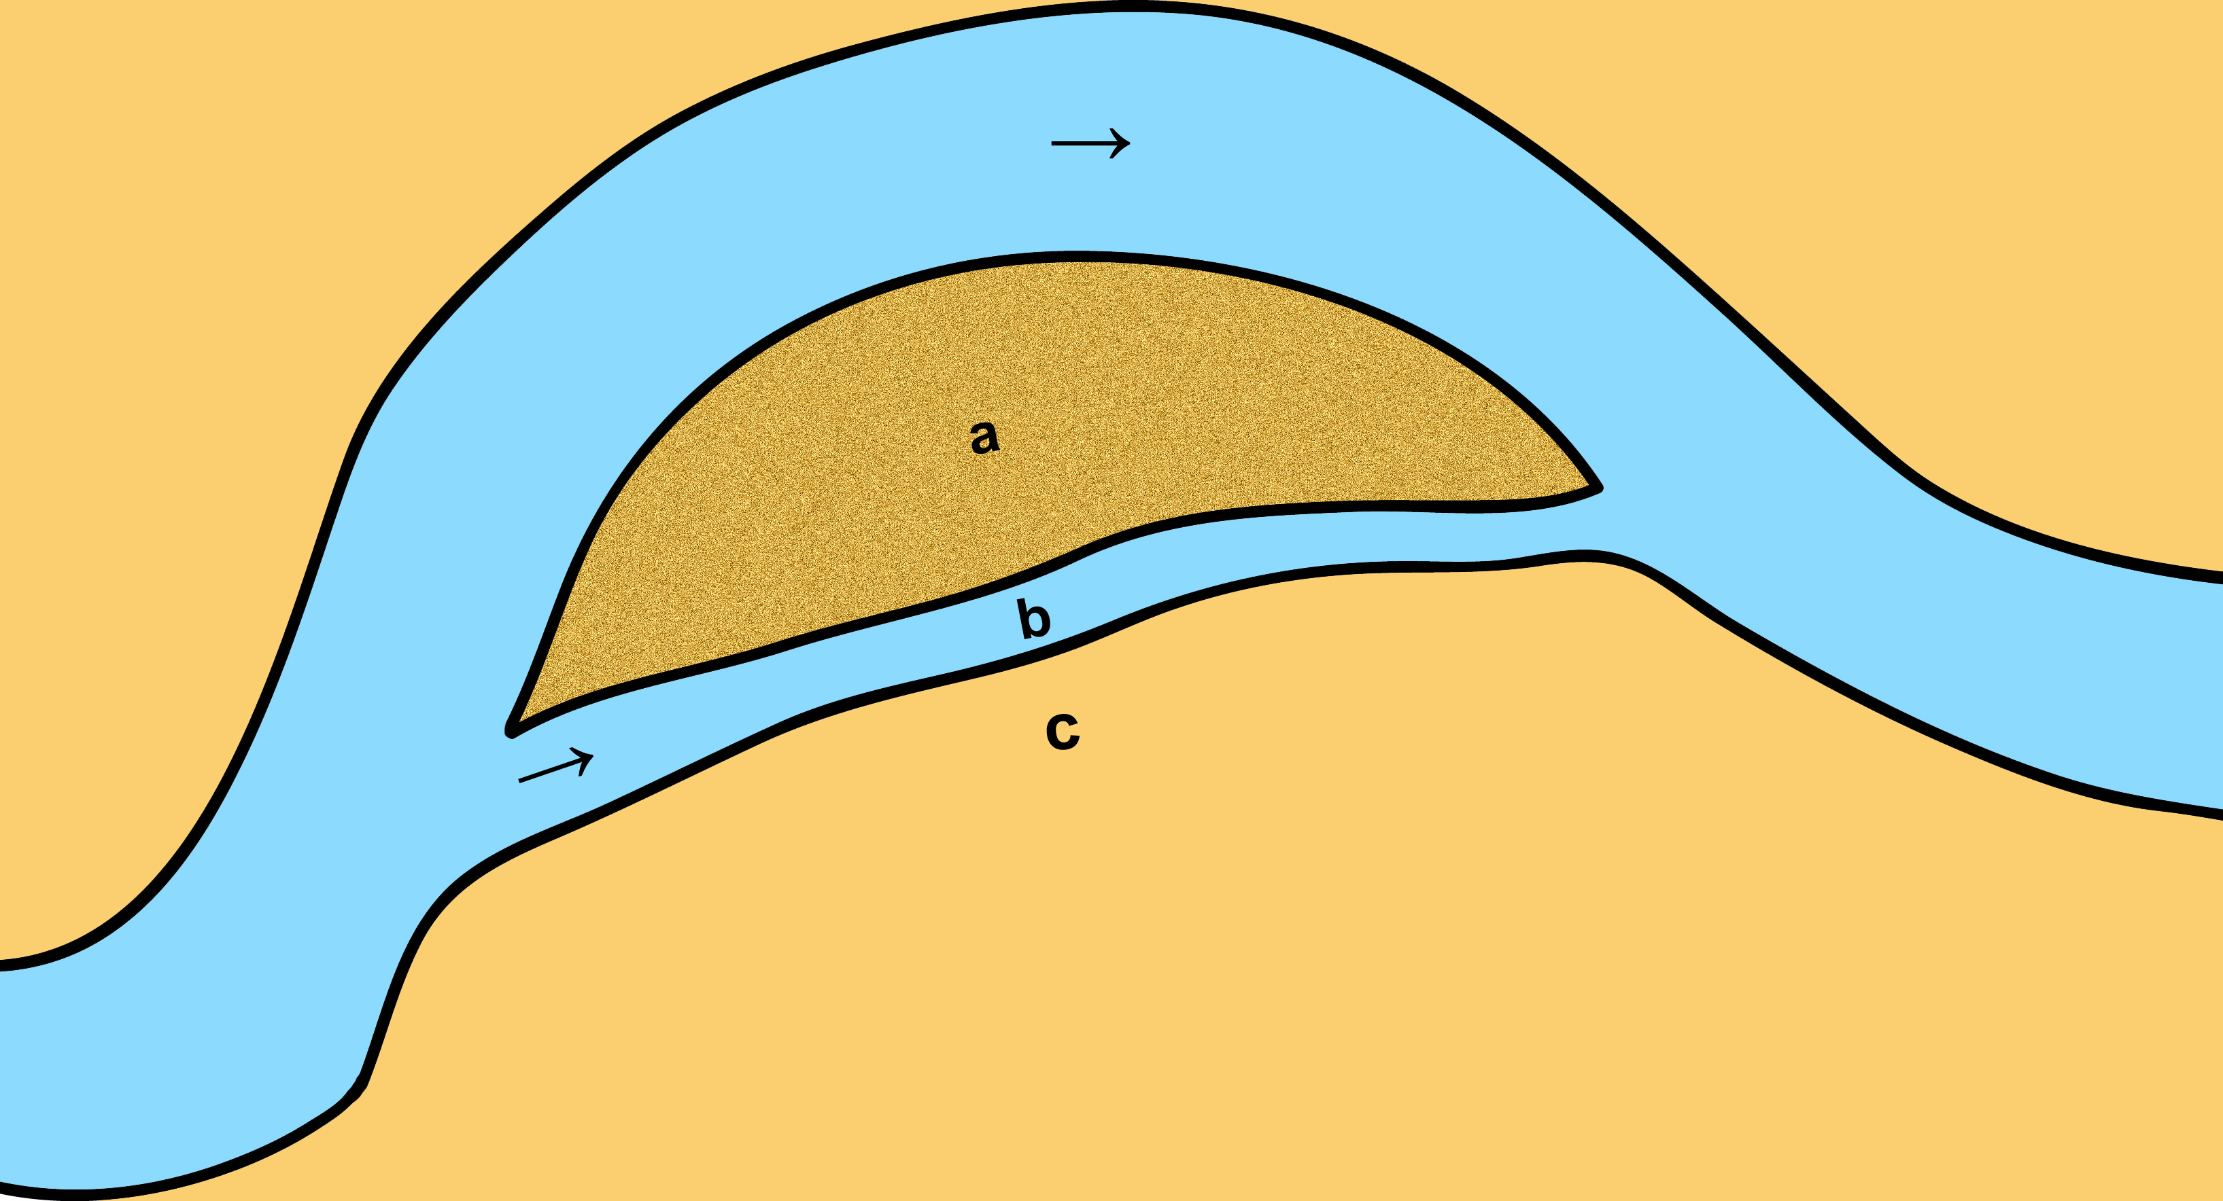
Fluvial forms > cutoff chute

Slide 15
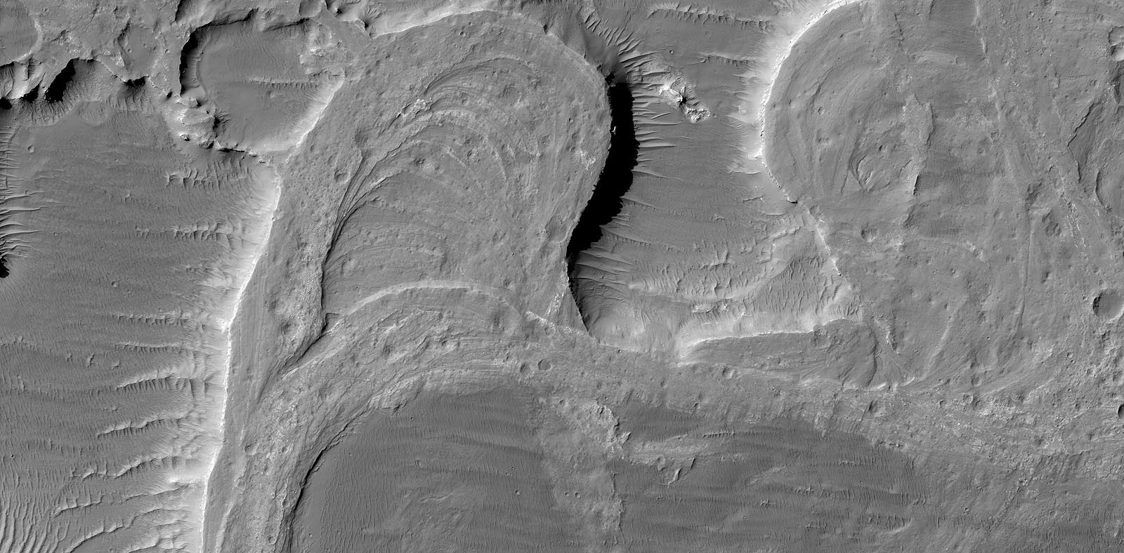
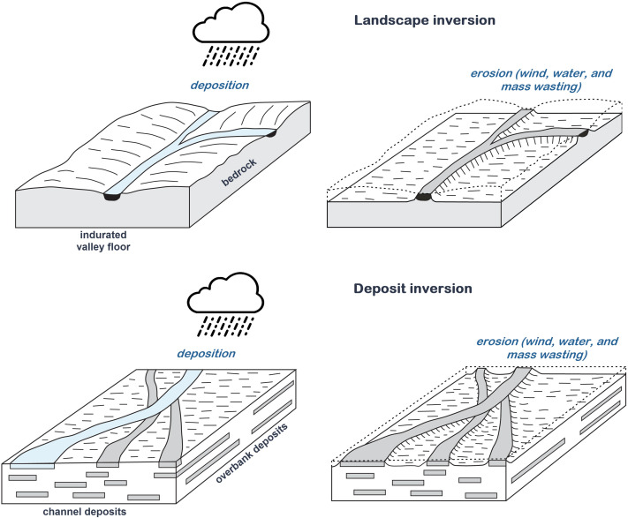
DiBiase et al. 2013
Fluvial forms > meander bend cutoff

Slide 16
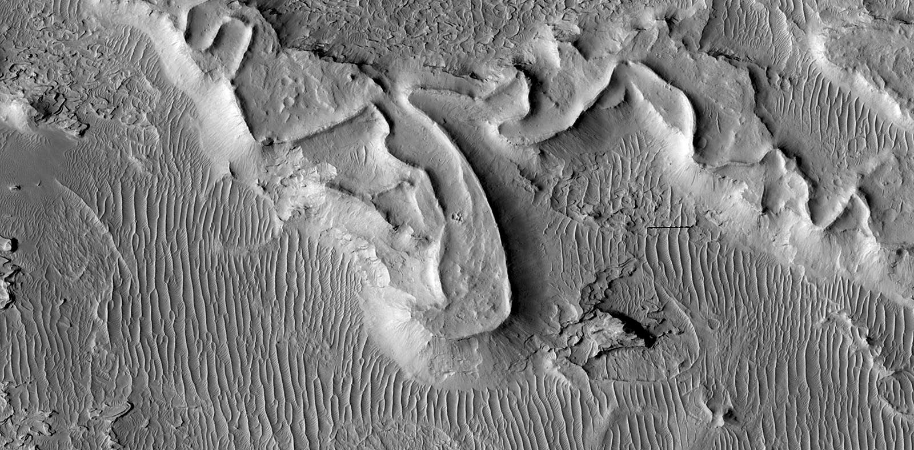
Fluvial forms > meander

Slide 17
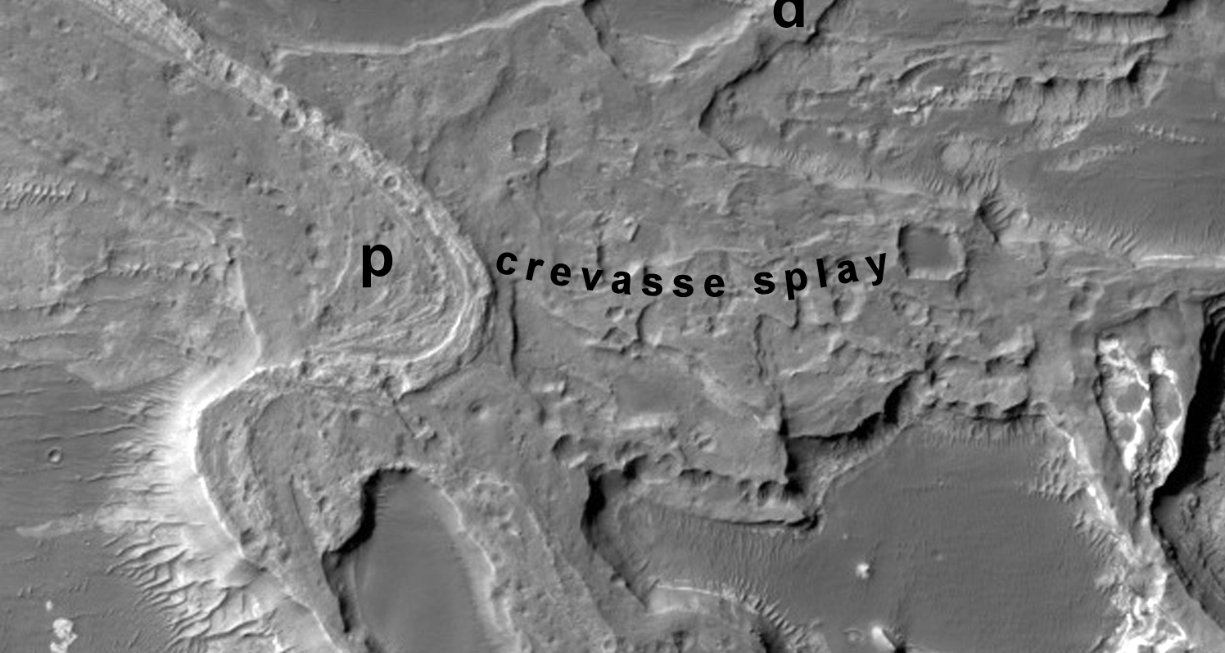
Fluvial forms > Crevasse splay

Slide 18
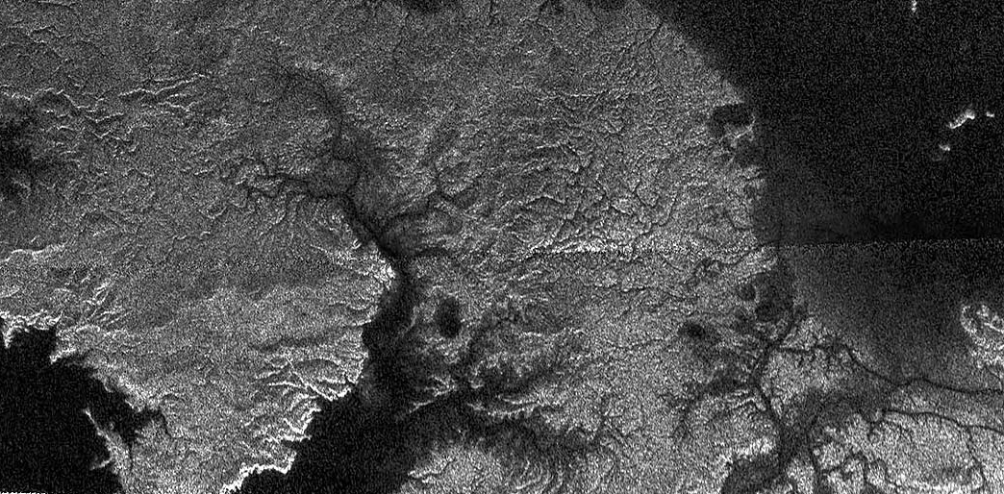
Fluvial channels > Valley network Titan

Slide 19
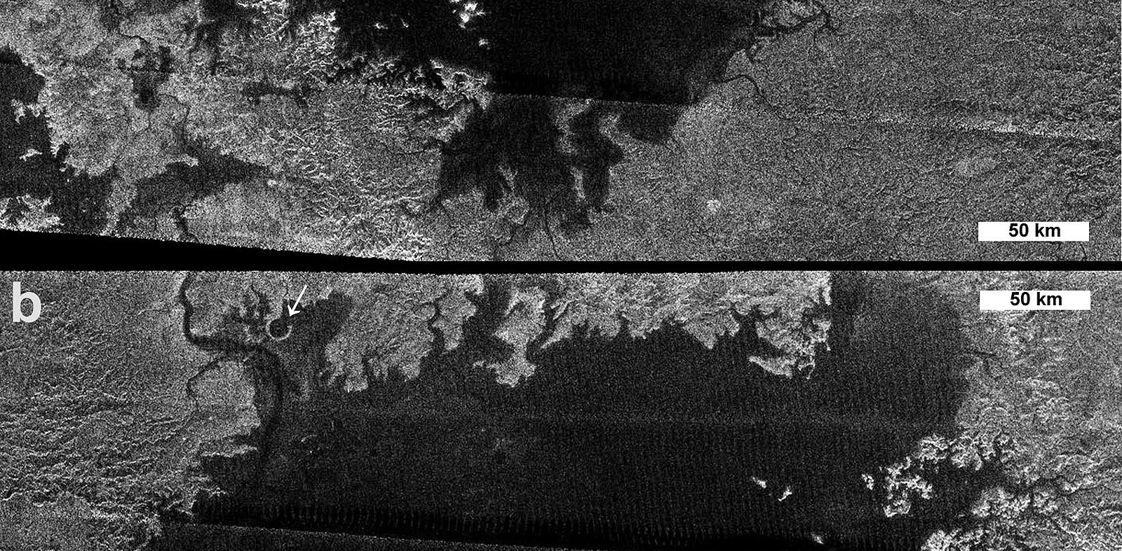
Fluvial forms > flooded valley

Slide 20
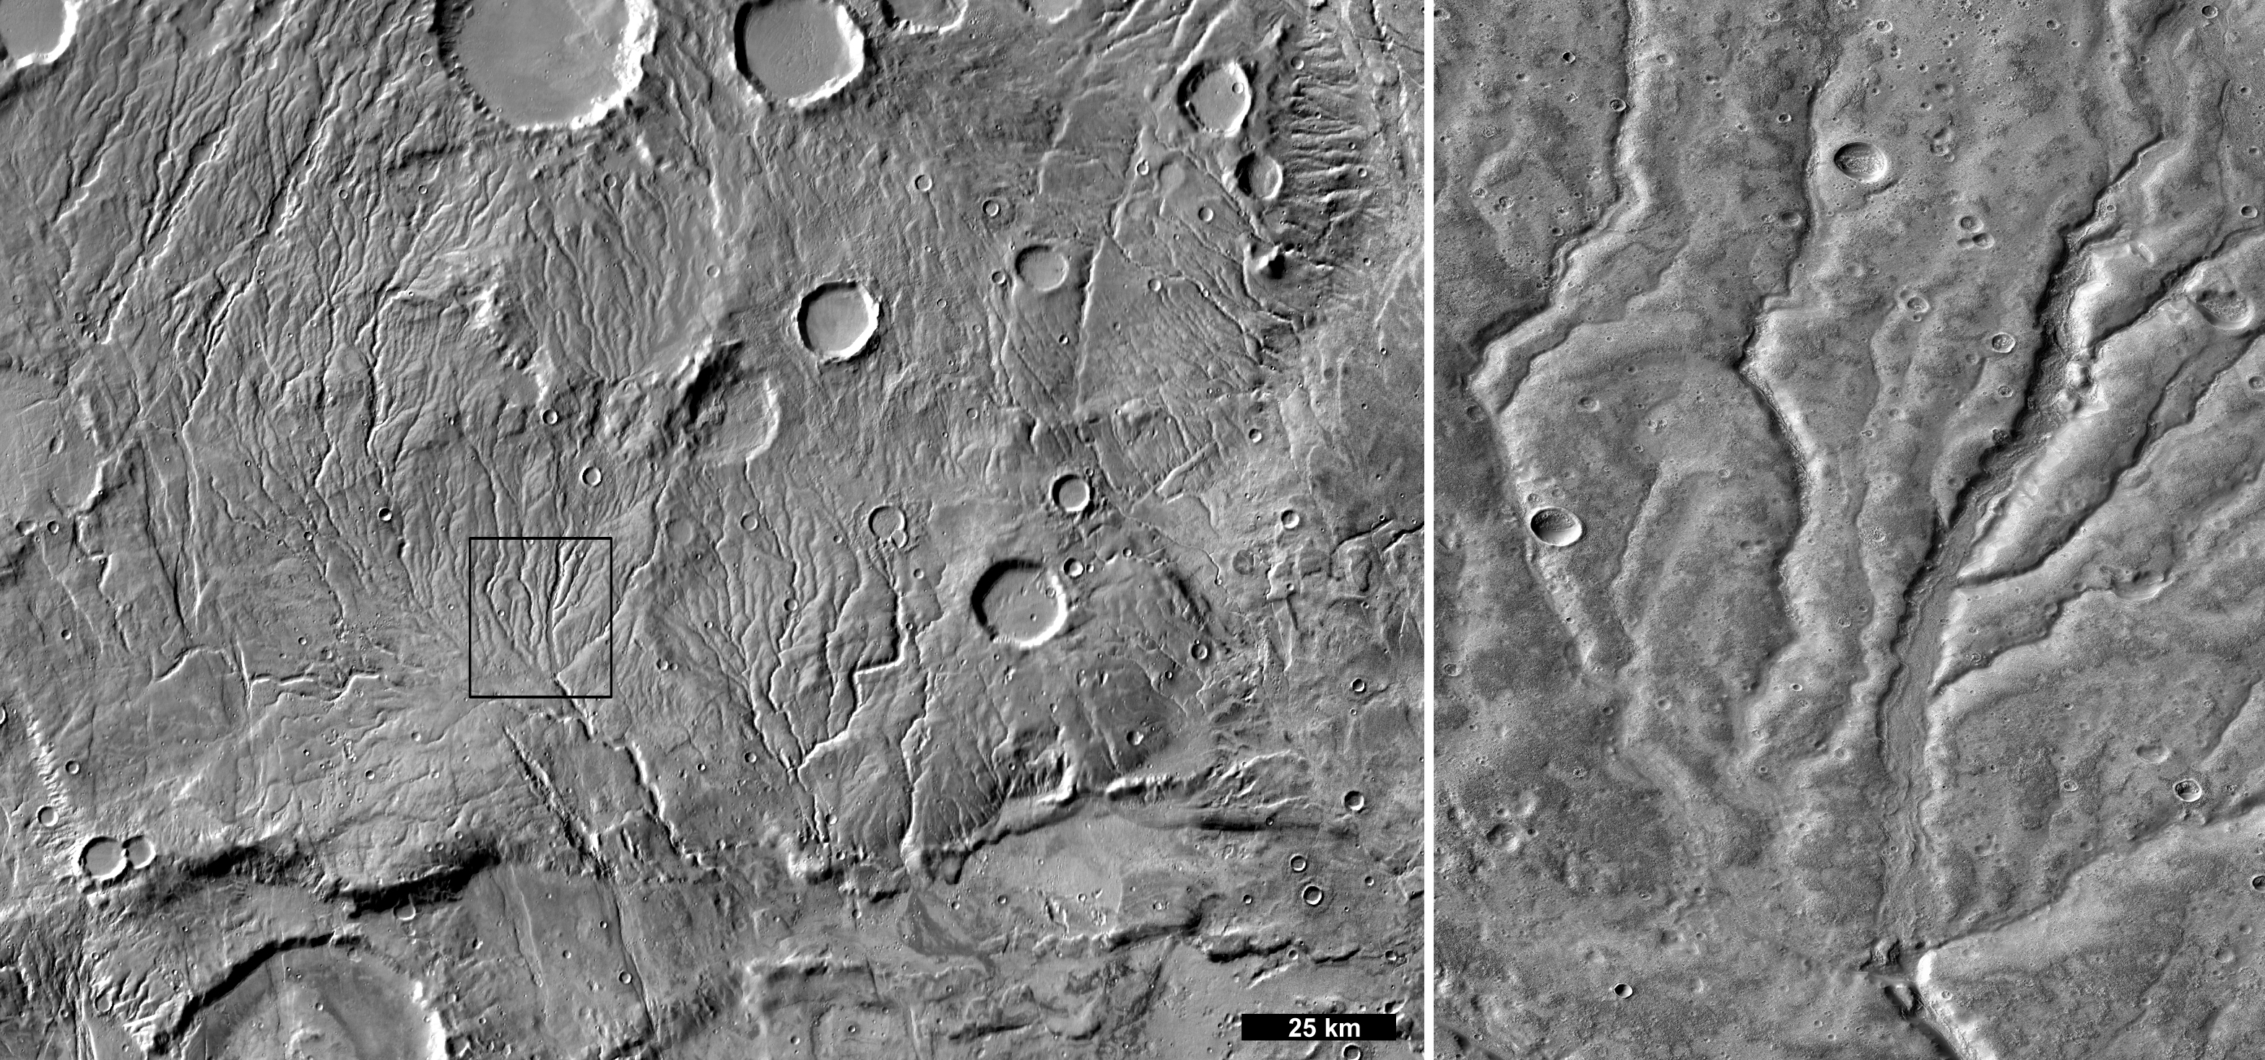
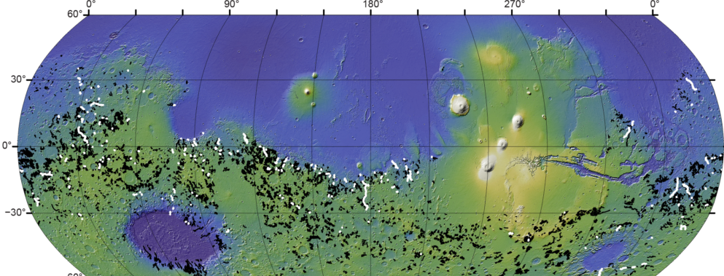
Fluvial channels > valley network Mars

Slide 21
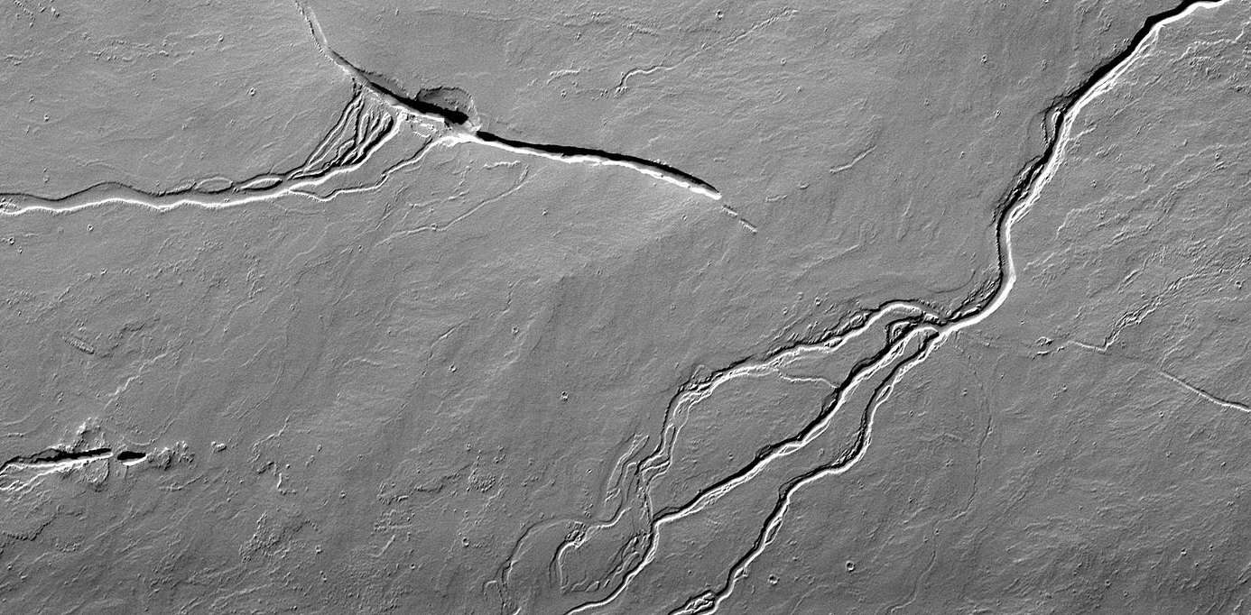
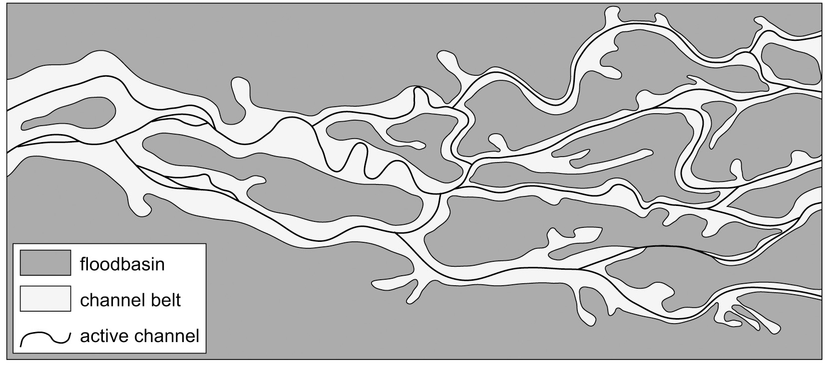
Fluvial channels > Anastomosing valley

Slide 22
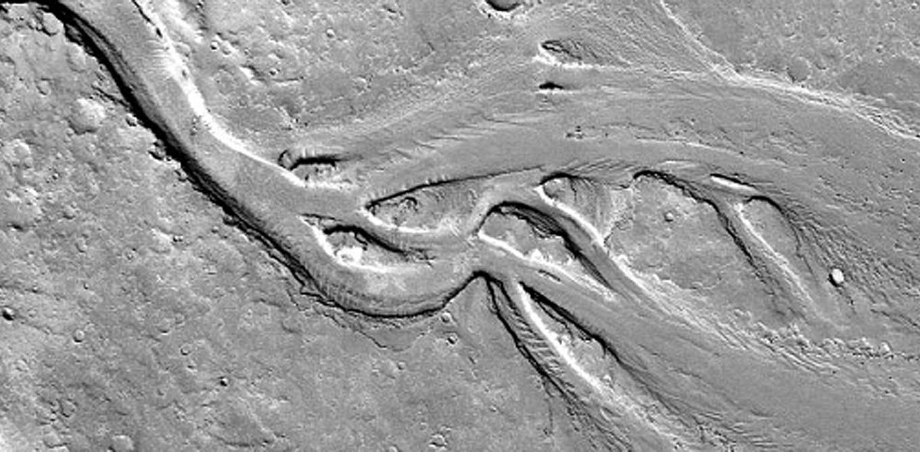
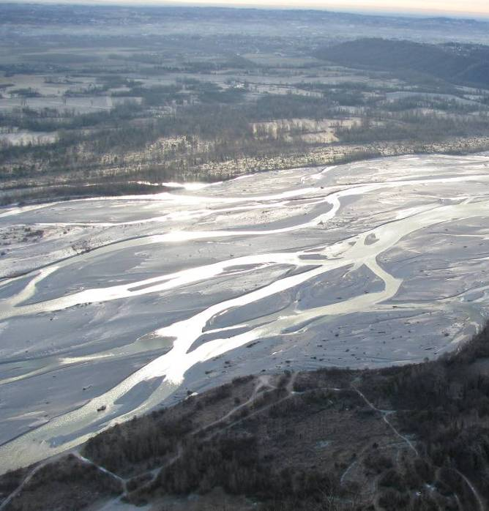
Fluvial channels > Braided channel

Slide 23
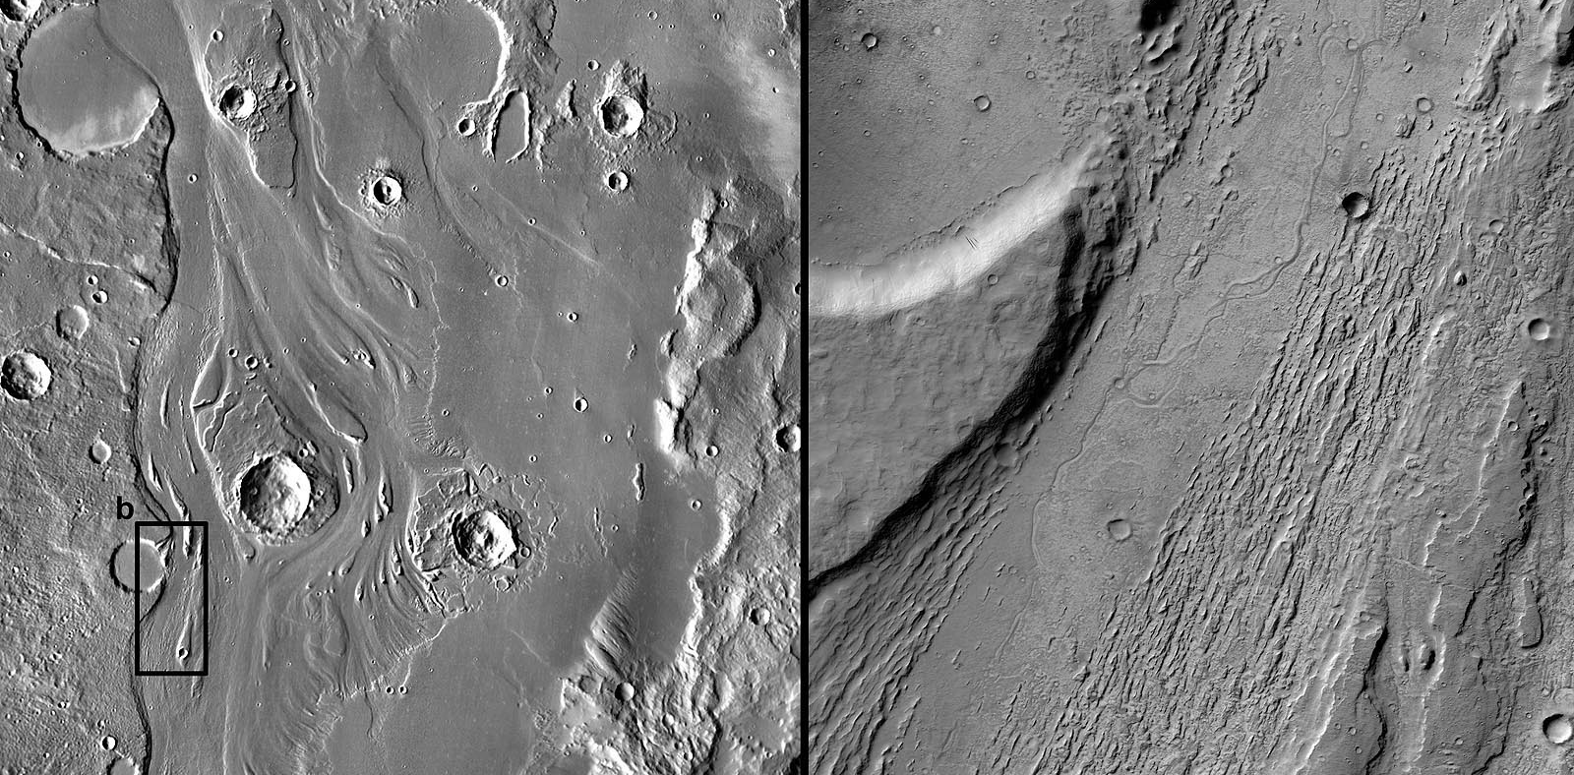
Fluvial > Outflow channel with islands and scours

Slide 24
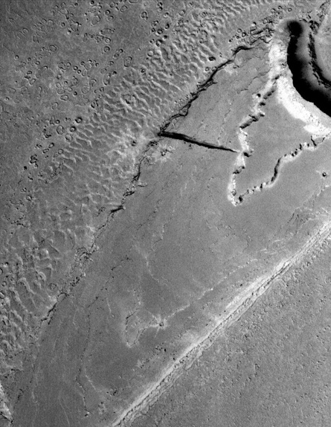
Burr (2004).
Fluvial > Outflow channel with subaqueous dunes
Burr (2004).

Slide 25
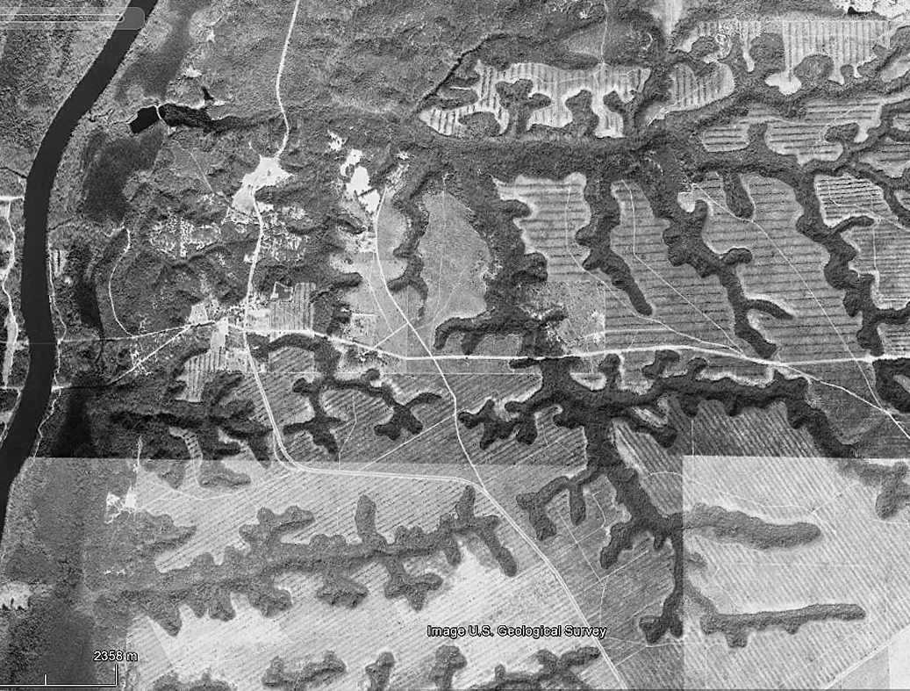
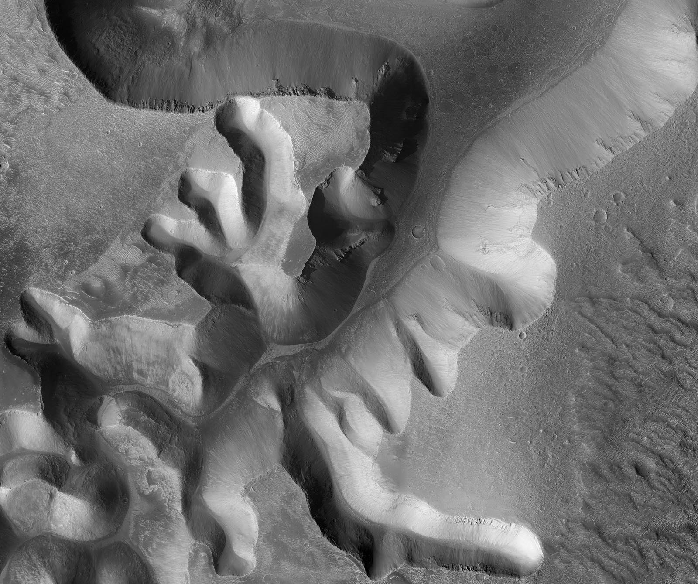
Fluvial > Theater headed valley

Slide 26
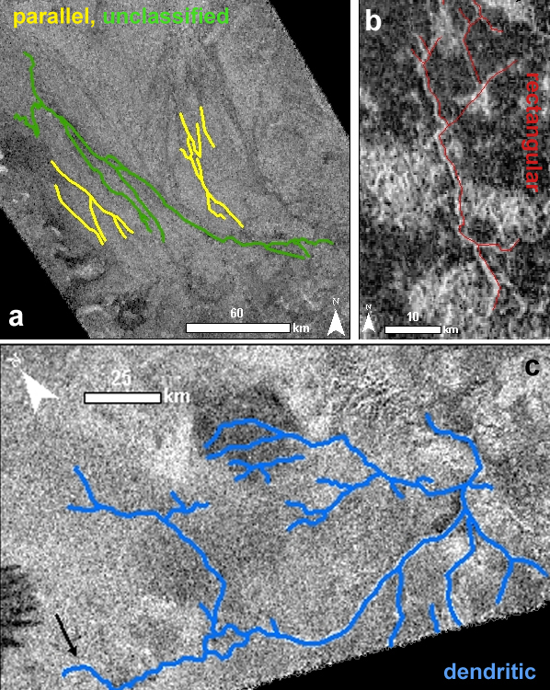
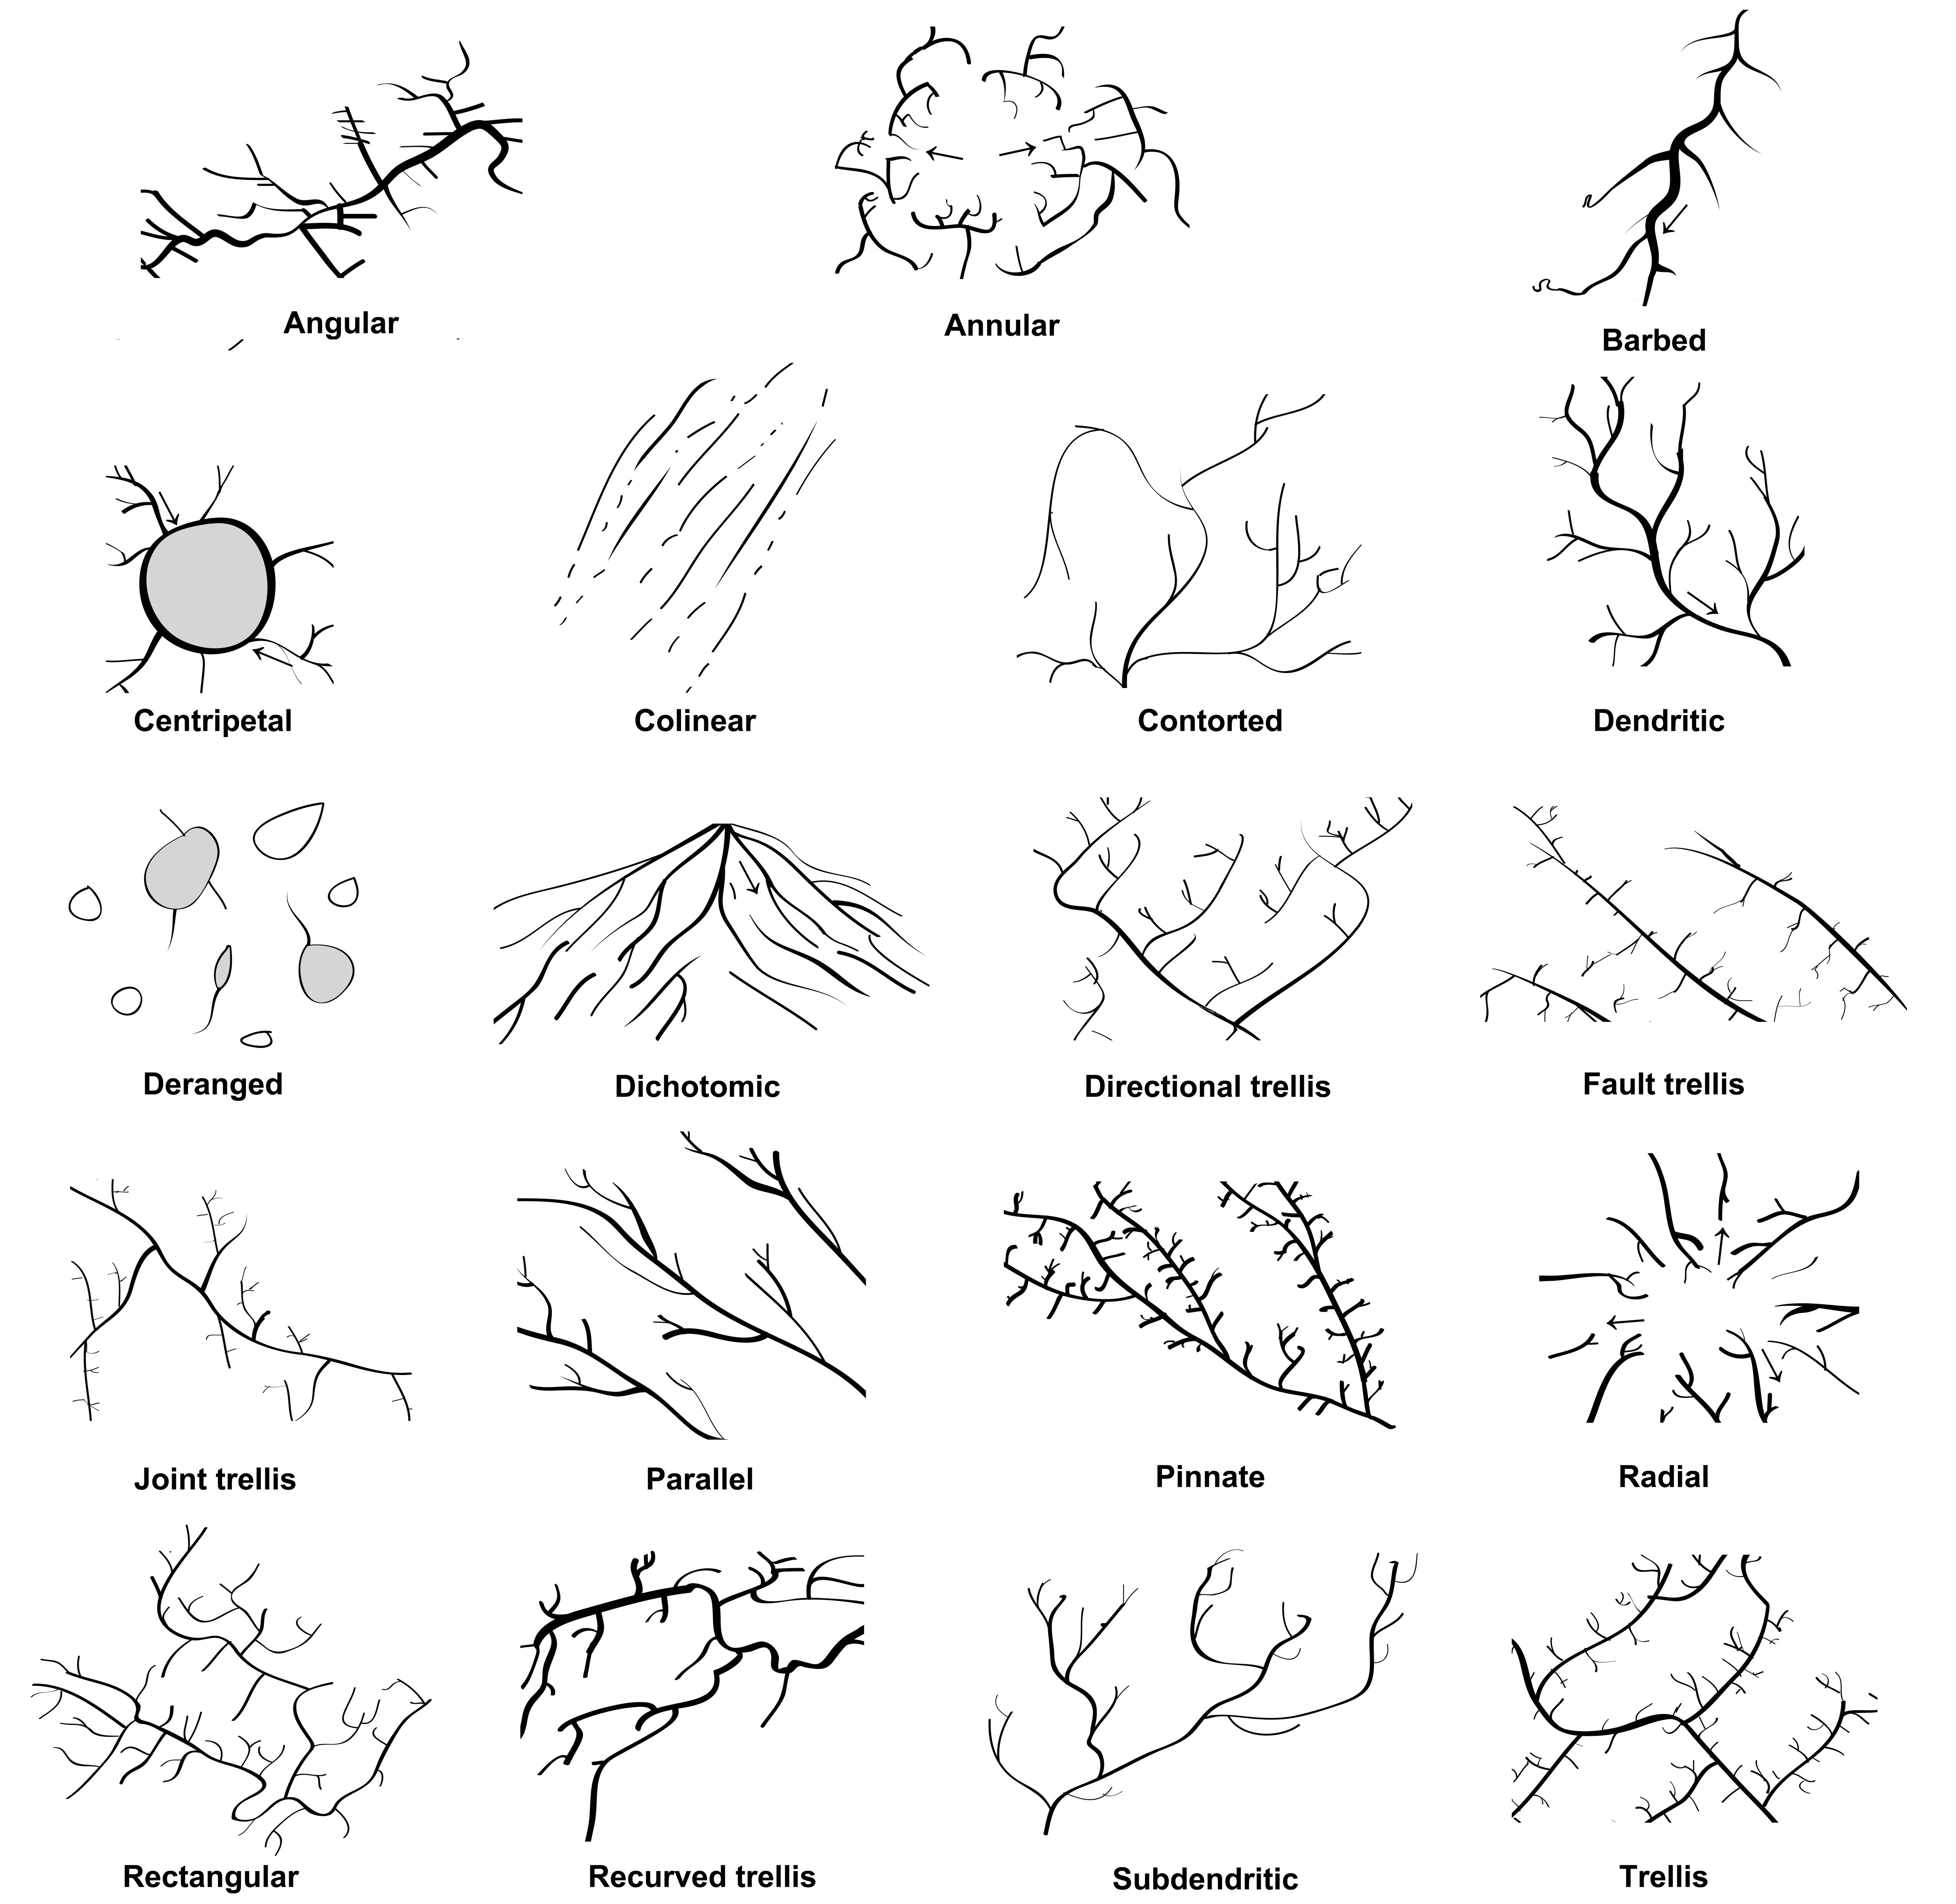
Fluvial > Drainage patterns

Slide 27
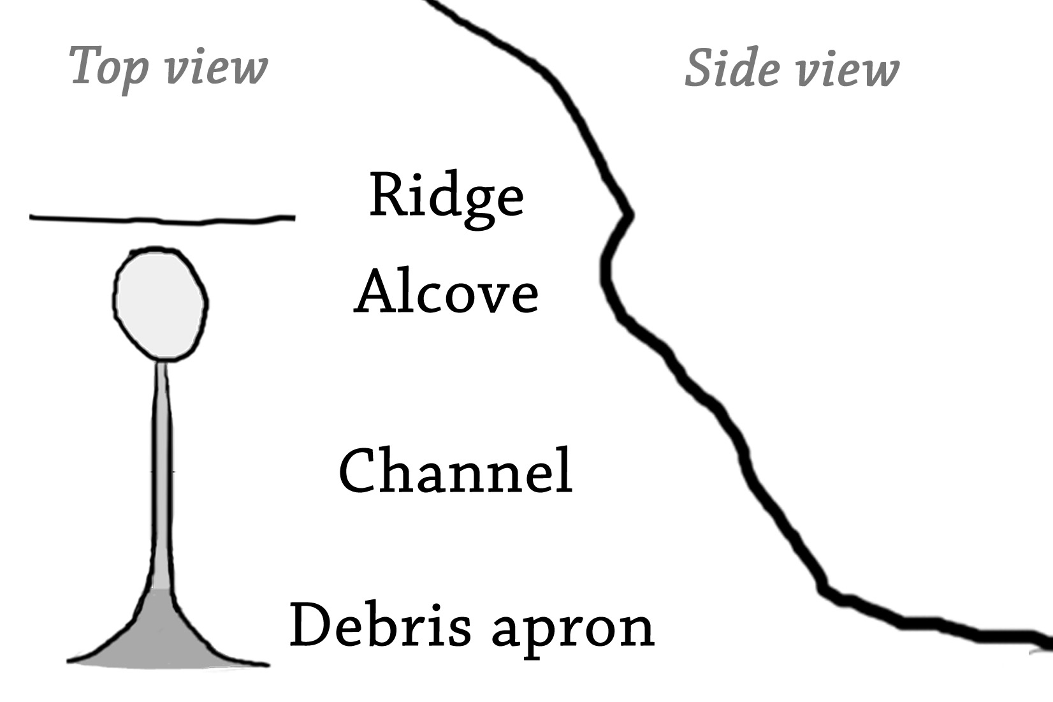

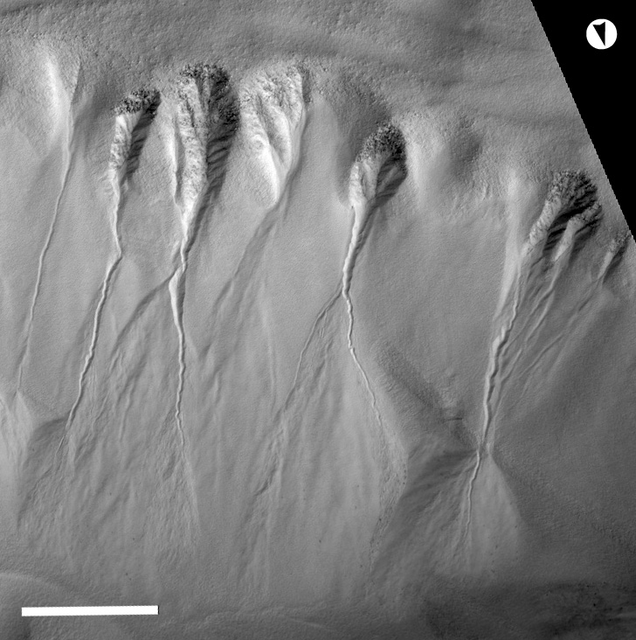
Fluvial channels > Gully

Slide 28
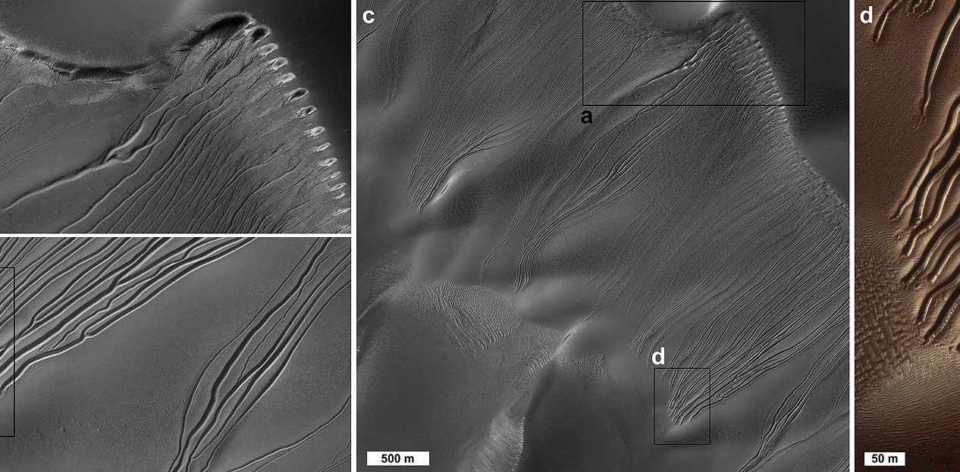
Fluvial channel forms > Linear gullies

Slide 29
Key concepts
Fluvial features include
  negative forms (channels, valleys)
  positive forms (deposits: deltas, fluvial dunes, alluvial cones)
    Or (partial) ridges by geomorphologic inversion and
  flat forms (alluvial plains)
Sinuous single channels may not be fluvial

Slide 30
LACUSTRINE FEATURES

Slide 31
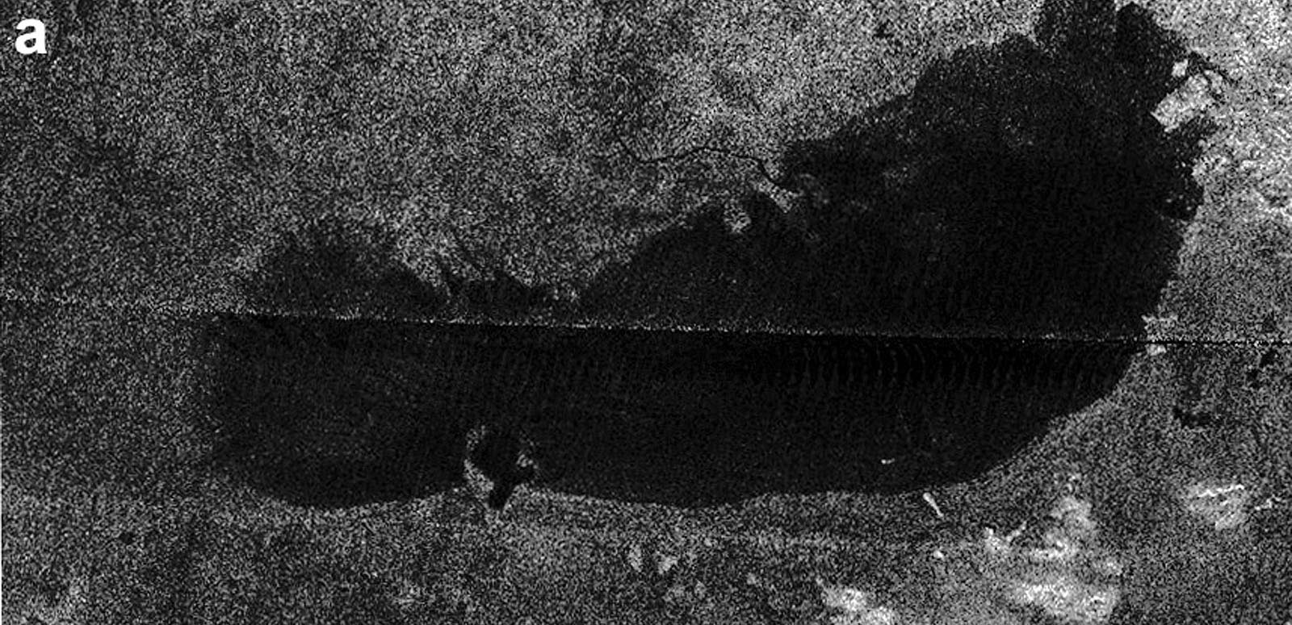
Ponding liquid > Lake

Slide 32
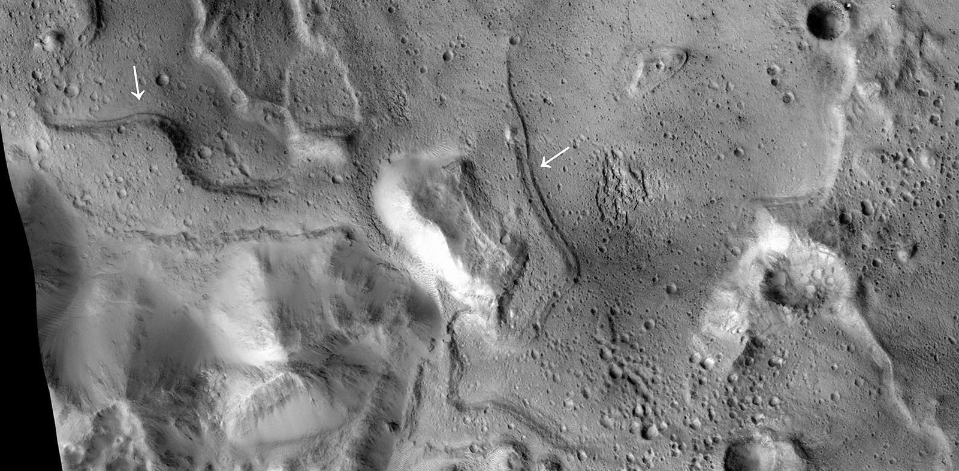
Ponding liquid > Paleoshoreline

Slide 33
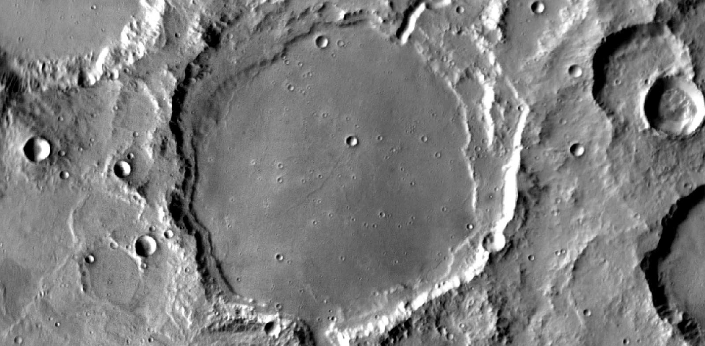
Ponding liquid > Crater lake (bathtub line)

Slide 34
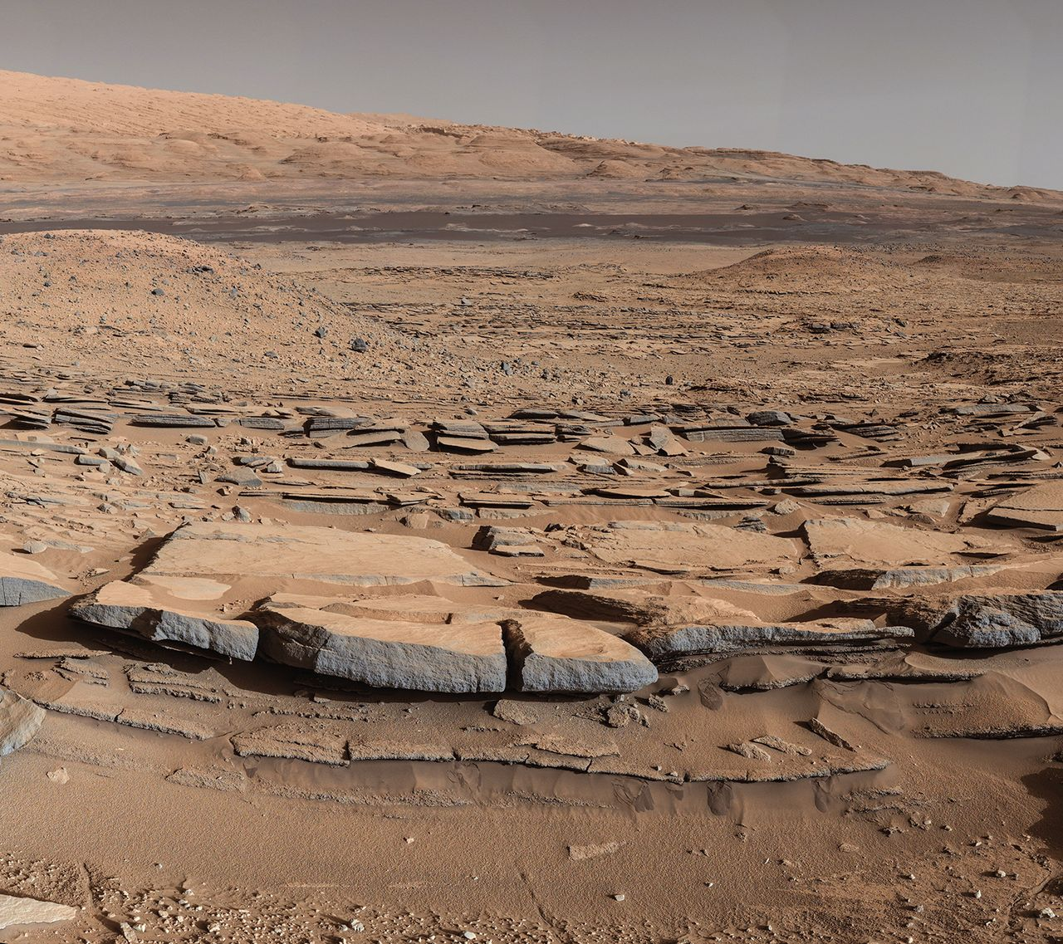
Ponding liquid > Delta/ Lacustrine deposit

Slide 35
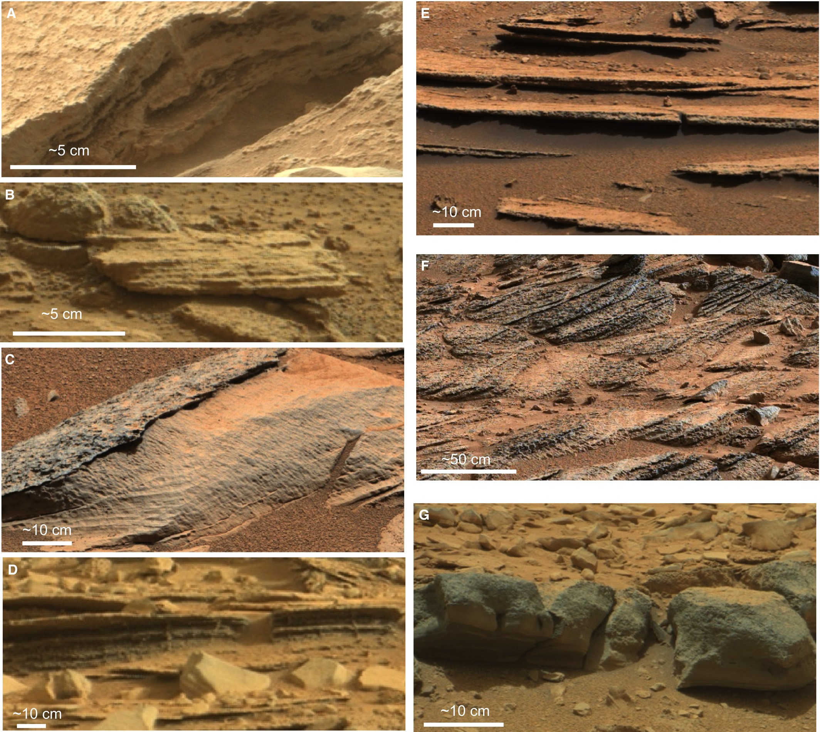
Ponding liquid > Cross stratified subaqueous bedforms

Slide 36
DEPOSITS

Slide 37
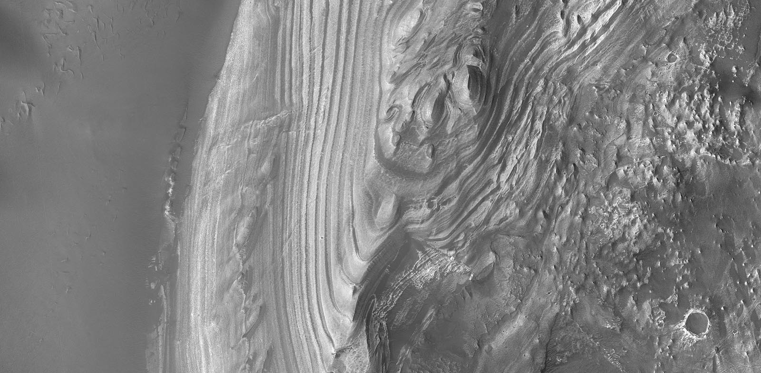
Sedimentary > Interior layered deposit

Slide 38
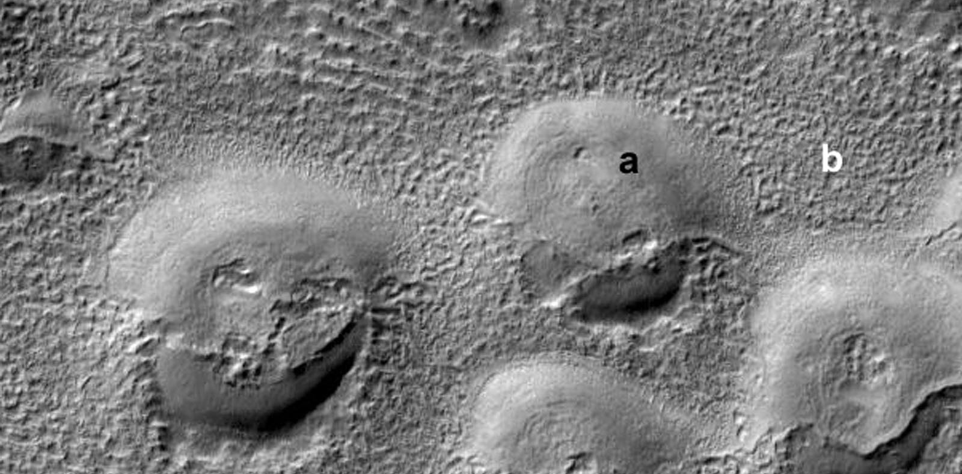
Sedimentary > Latitude dependent mantle

Slide 39
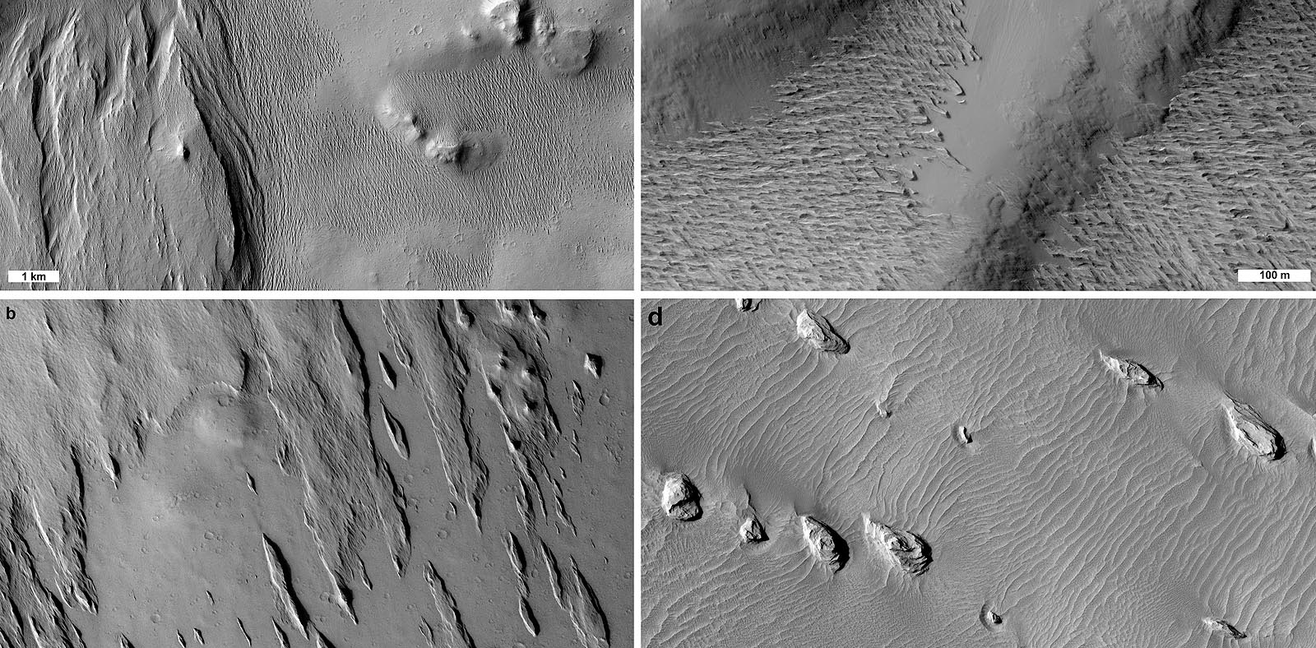
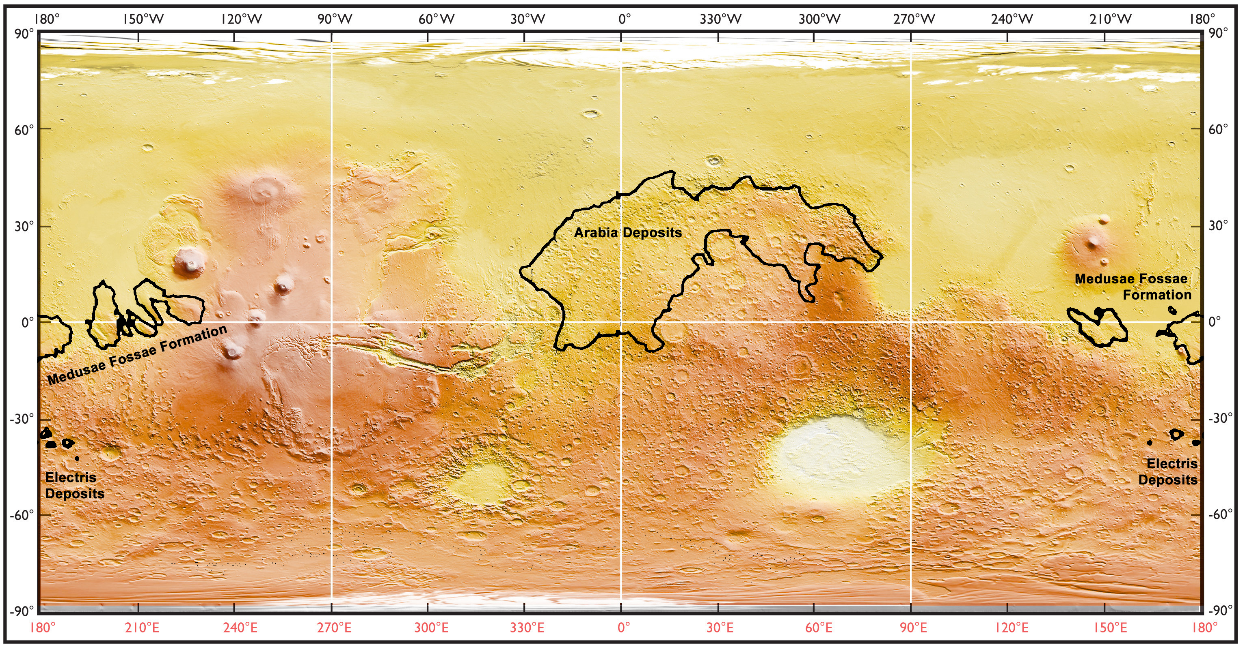
Sedimentary > Friable layered deposit

Slide 40
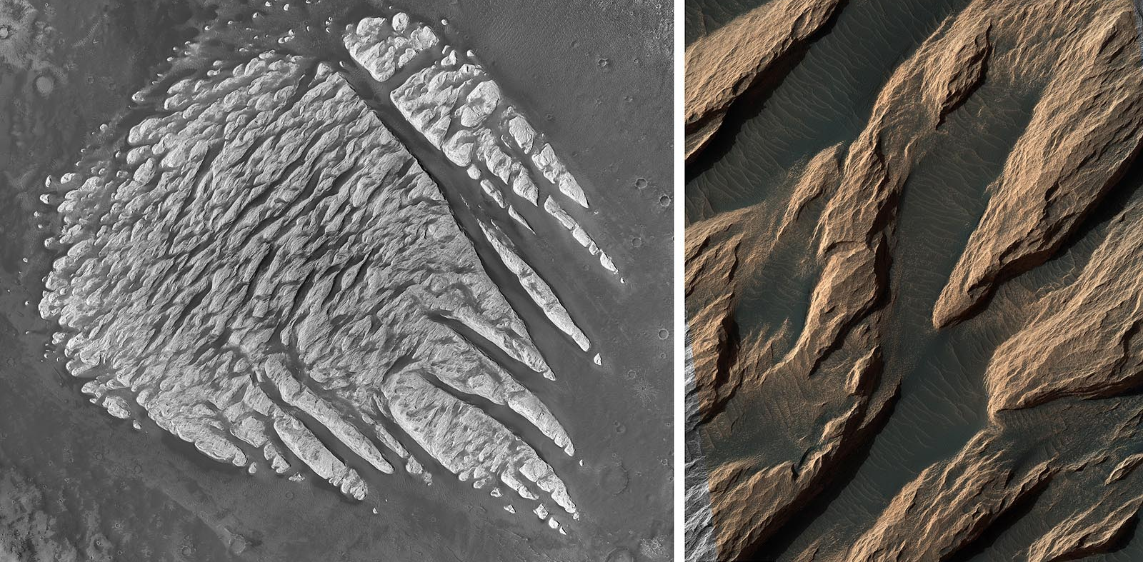
Sedimentary > Light toned deposit

Slide 41
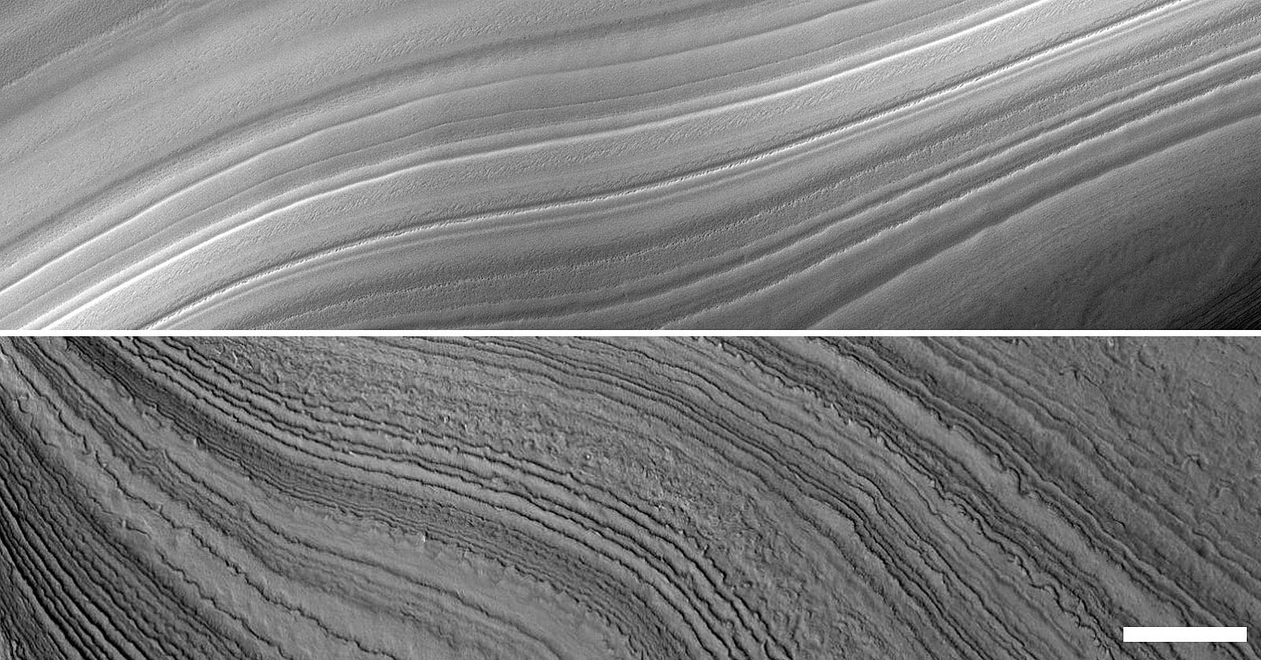
Sedimentary > Polar layered deposit

