Slide 1
Planetary landforms
A visual introduction to planetary geomorphology
CURRENTS, AEOLIAN, OTHER
HENRIK HARGITAI
2019
csplanetolg17em
FÖL/1/075E
Definitions in the Notes section

Slide 2
CURRENT-PRODUCED FEATURES

Slide 3
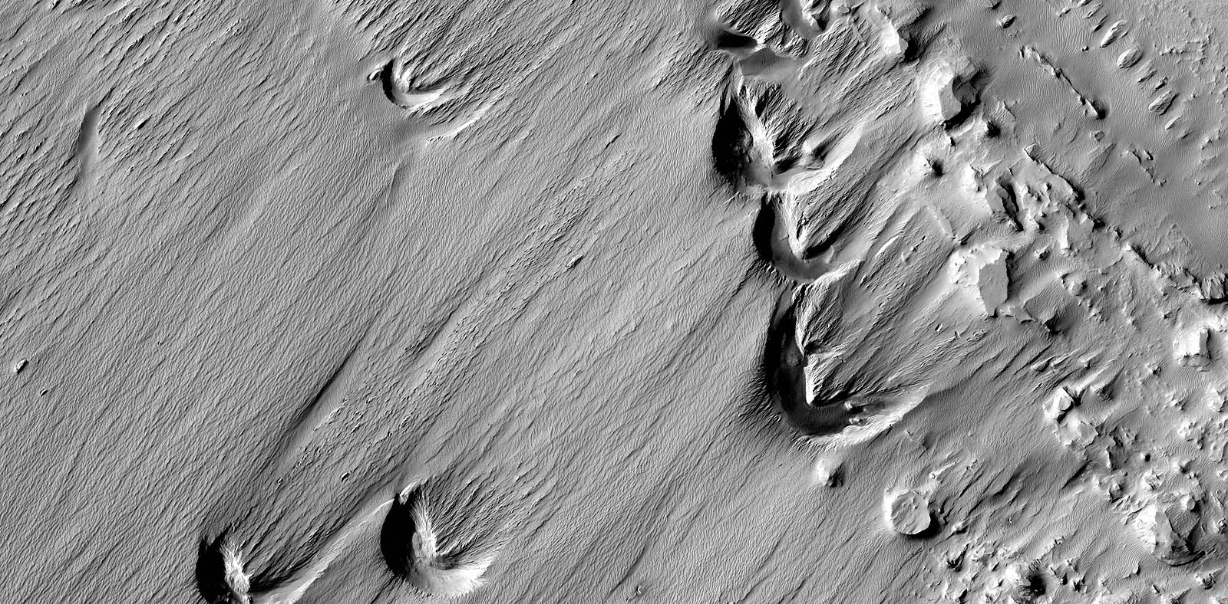
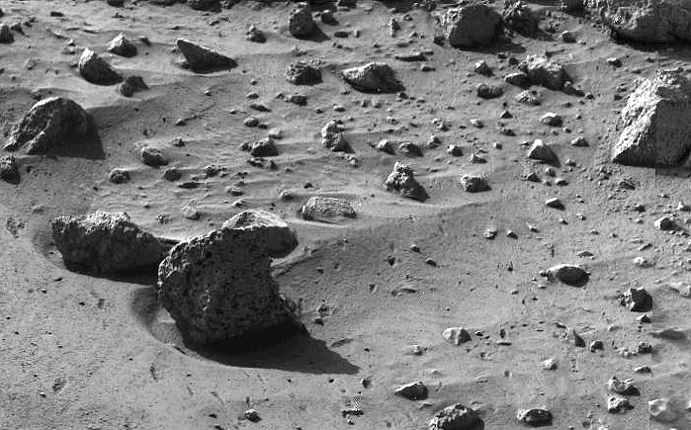
Currents > Current crescent

Slide 4
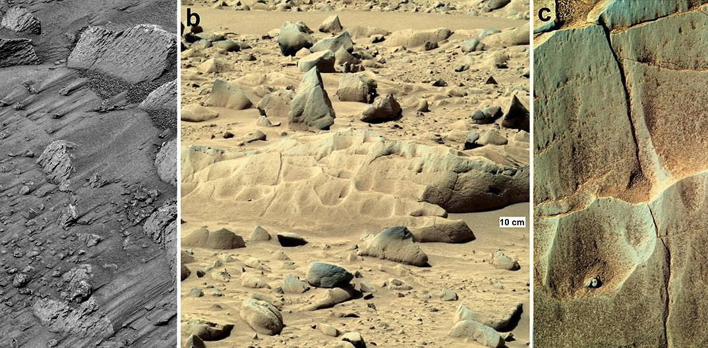
Currents > Scour mark

Slide 5
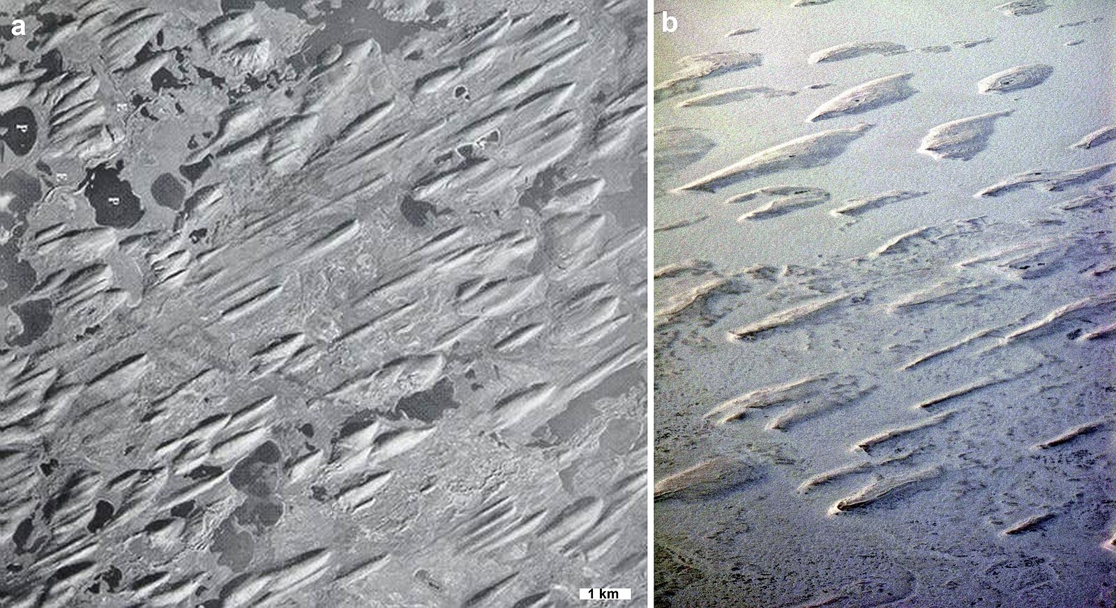
Currents > Drumlin

Slide 6
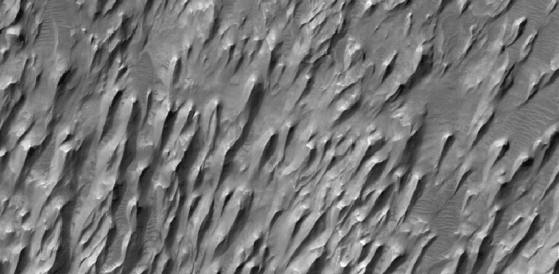
Currents > Yardang

Slide 7
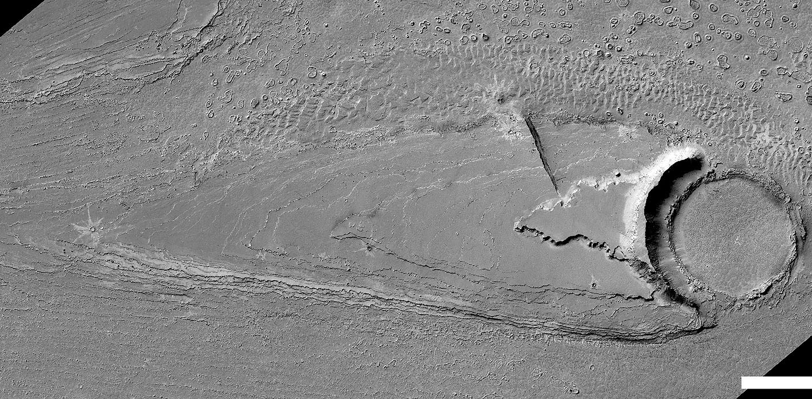
Currents > Streamlined island

Slide 8
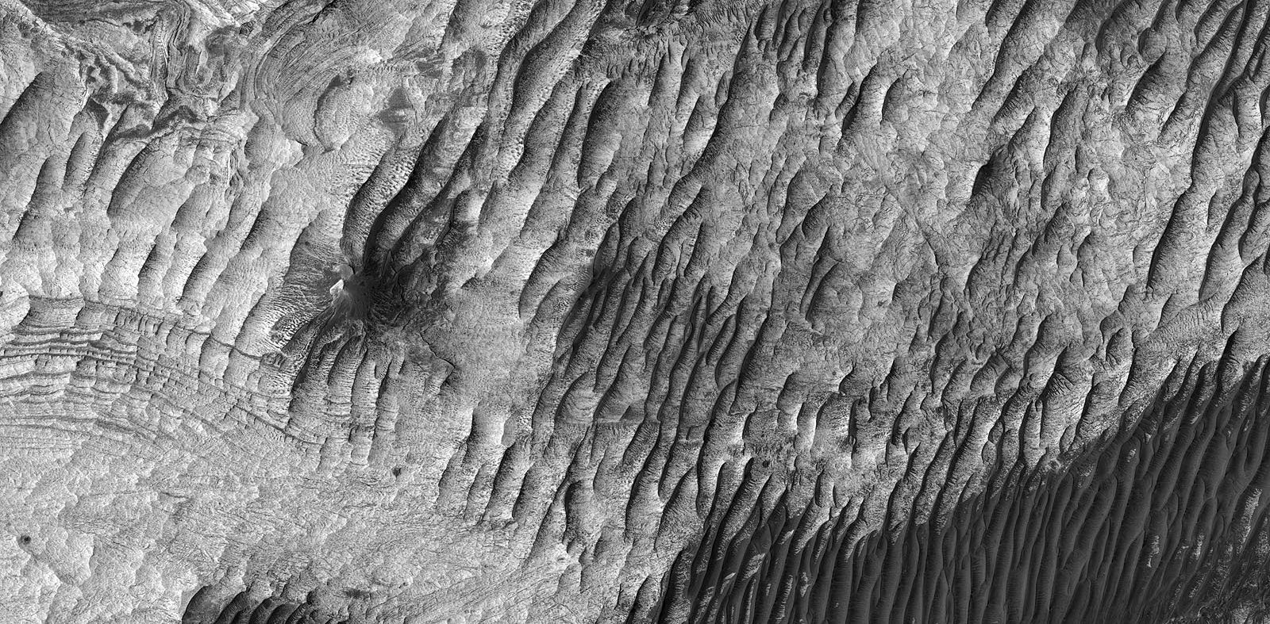
Currents > Periodic bedrock ridge

Slide 9
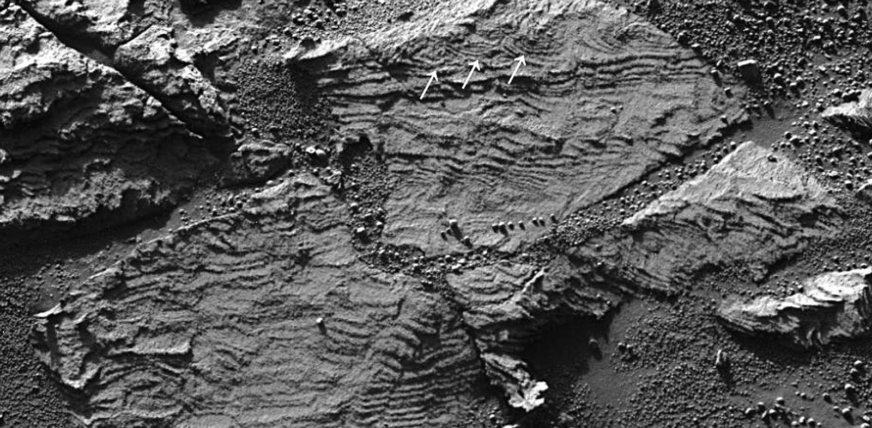
Currents > Festoon, sedimentary

Slide 10
Key concepts
Currents produce streamlined forms
They may be fluvial, volcanic or winds

Slide 11
AEOLIAN FEATURES

Slide 12
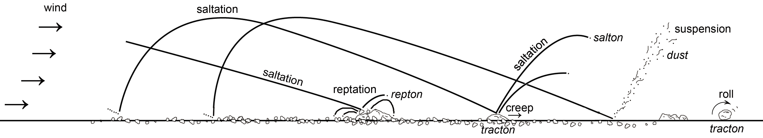
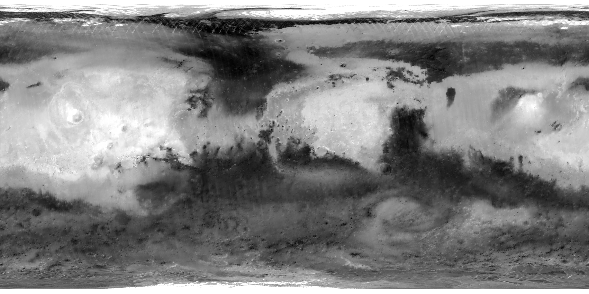
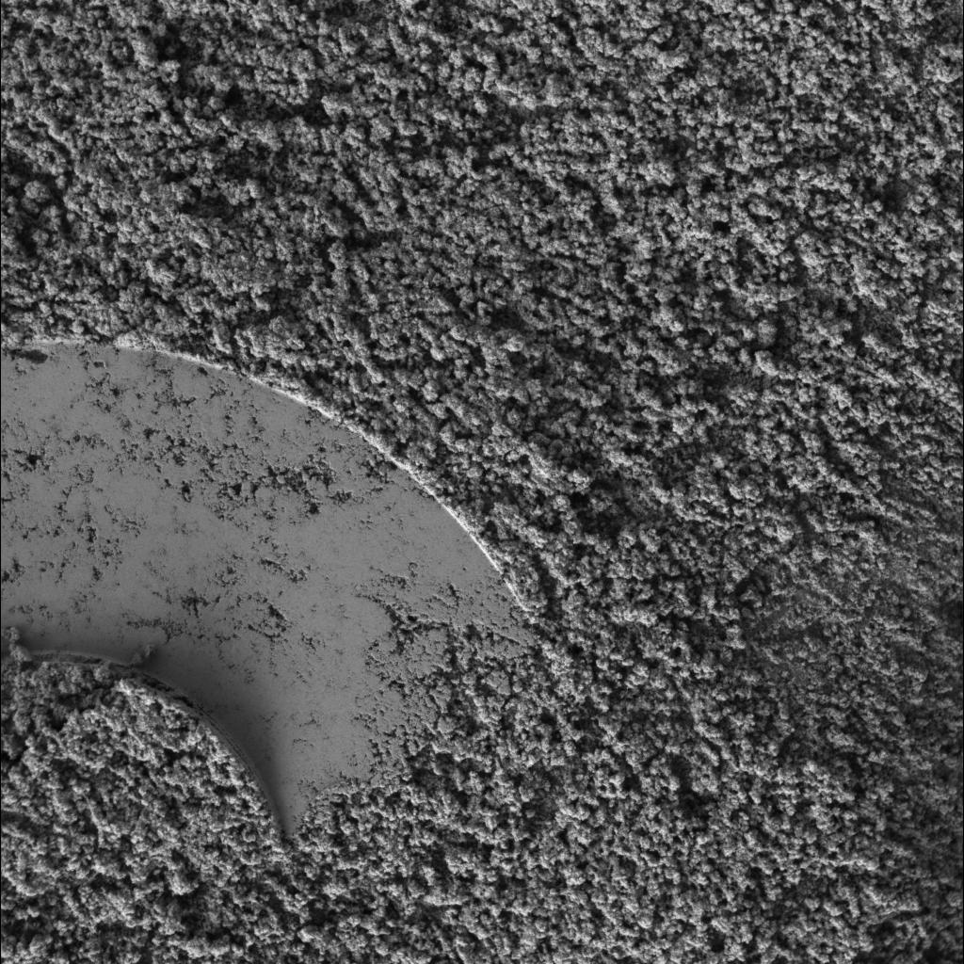
Dust

Slide 13
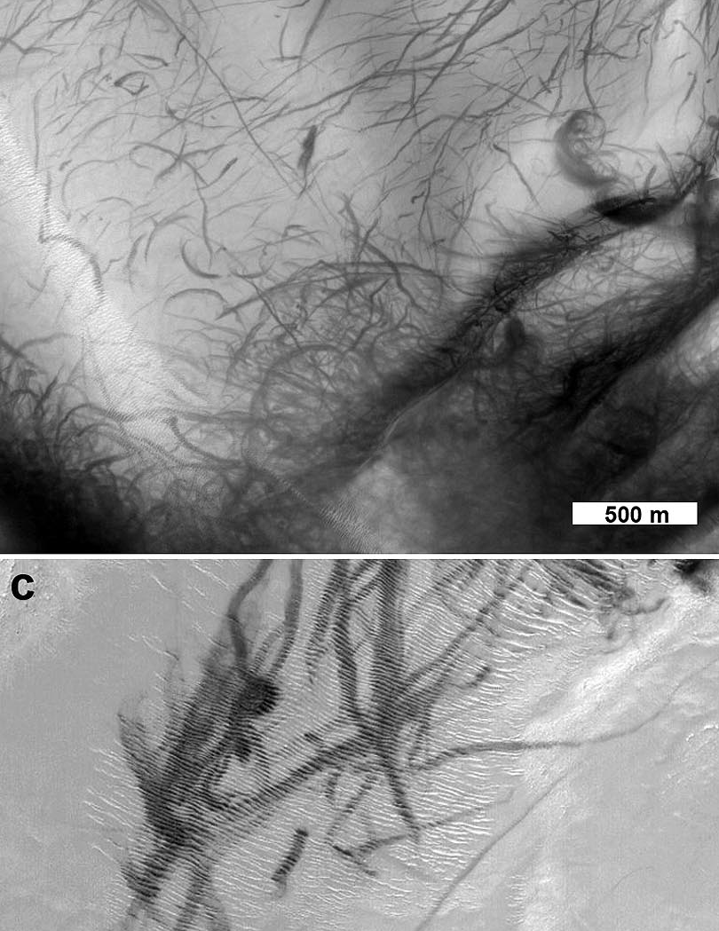
Dust > Dust devil track

Slide 14
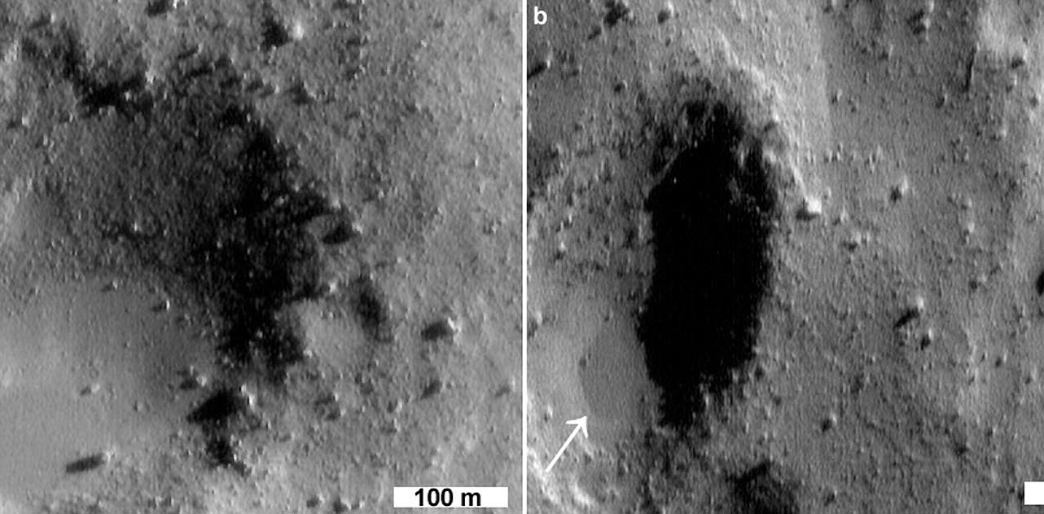
Dust > Dust pond

Slide 15
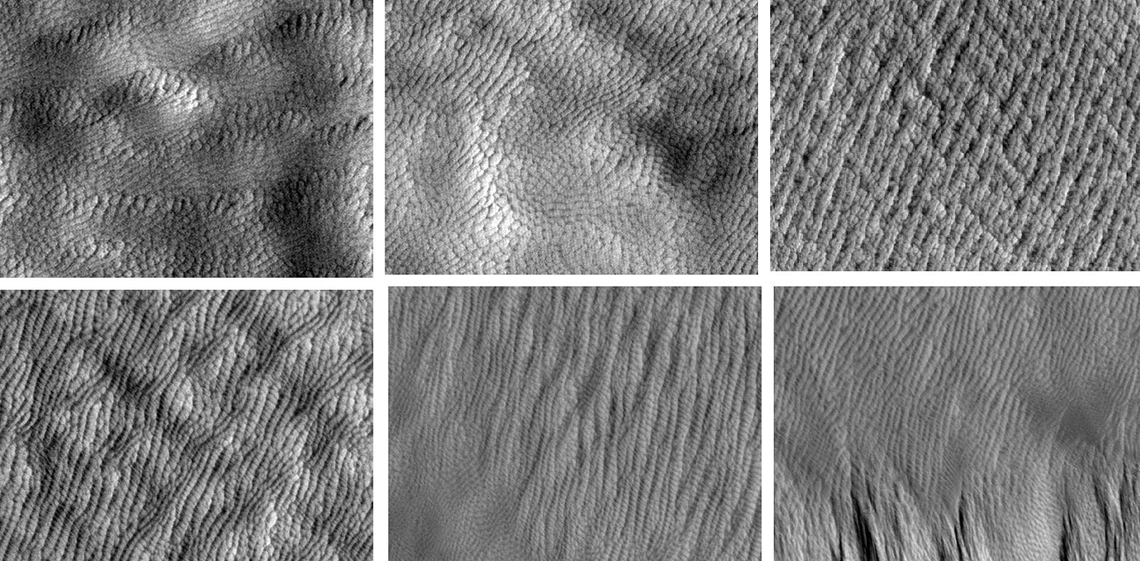
Dust > Reticulate ridge

Slide 16
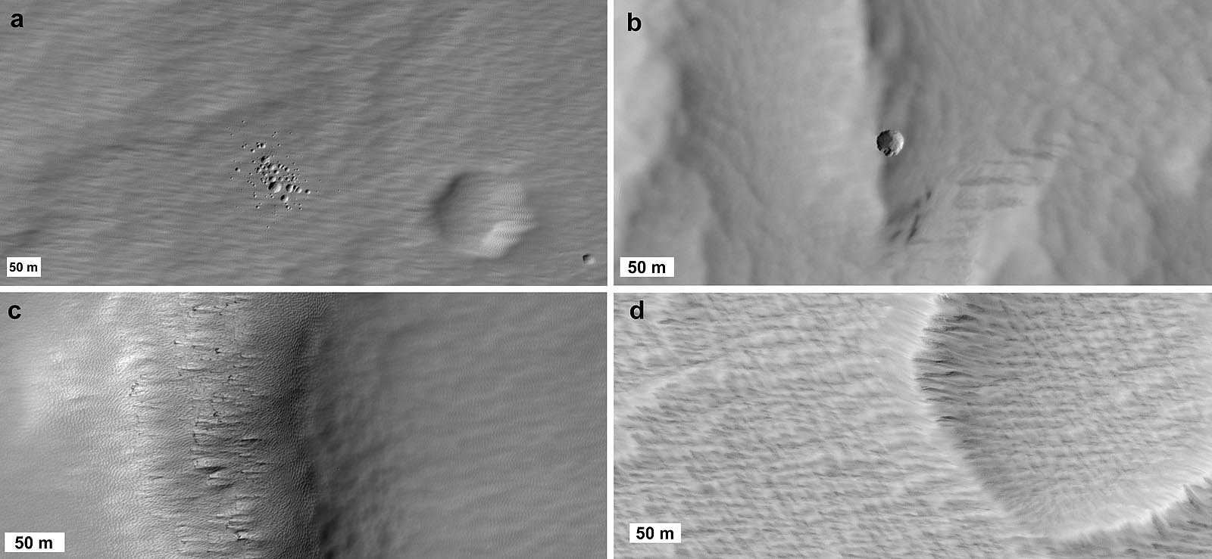
Dust > Fuzzy terrain

Slide 17
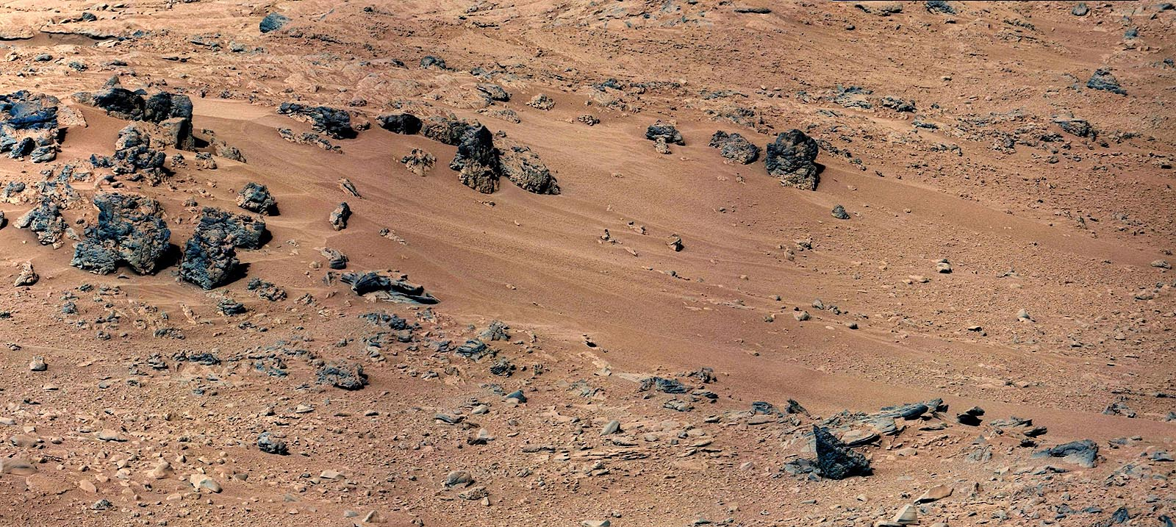
Aeolian sand > Drift deposit

Slide 18
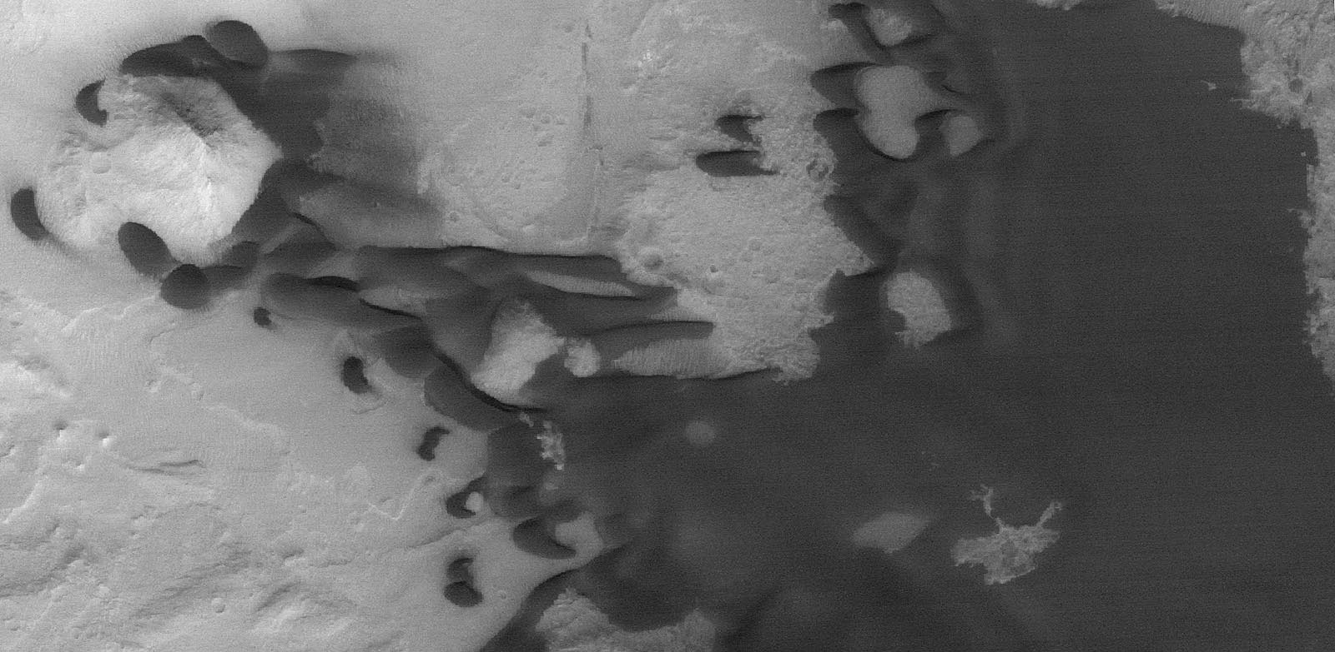
Aeolian sand > Sand sheet

Slide 19
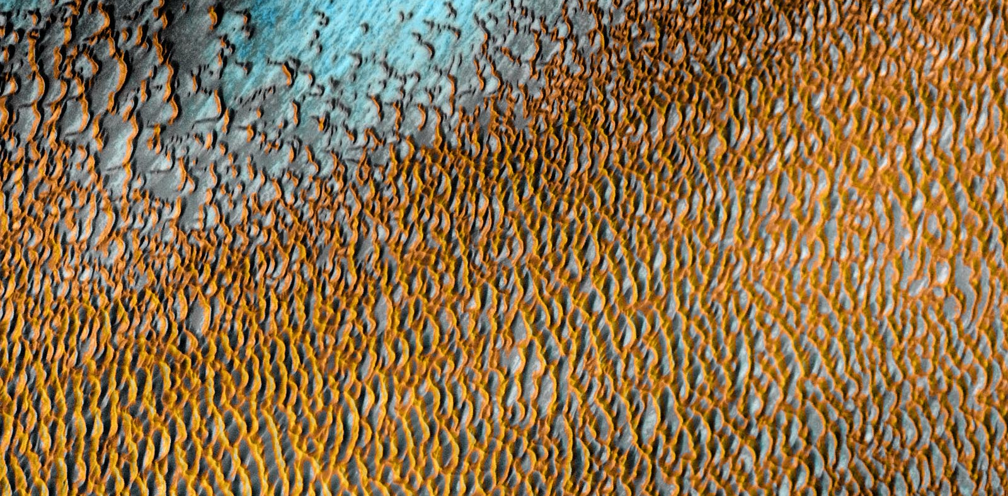
Aeolian sand > Erg

Slide 20
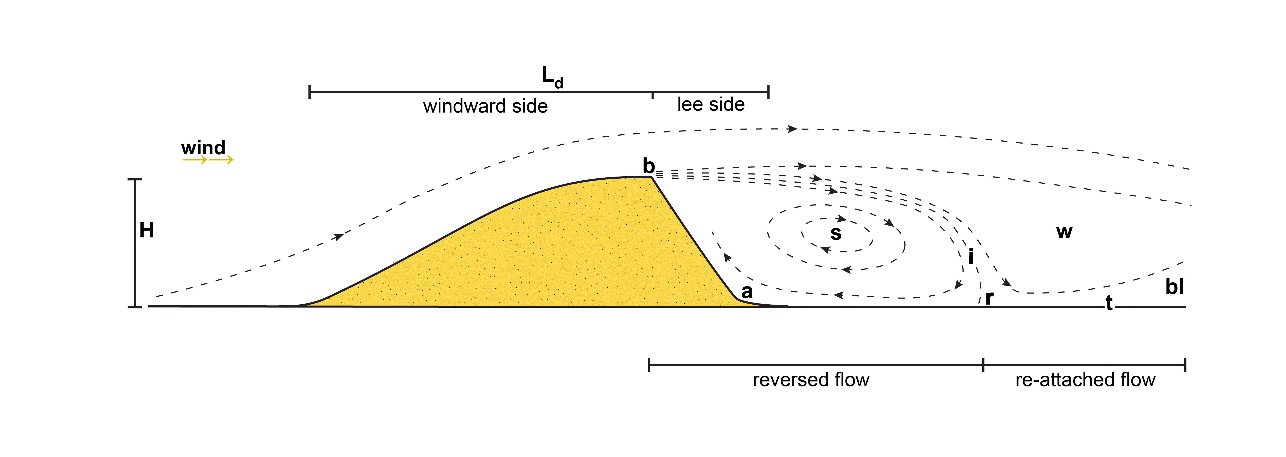
Aeolian sand > Dunes

Slide 21
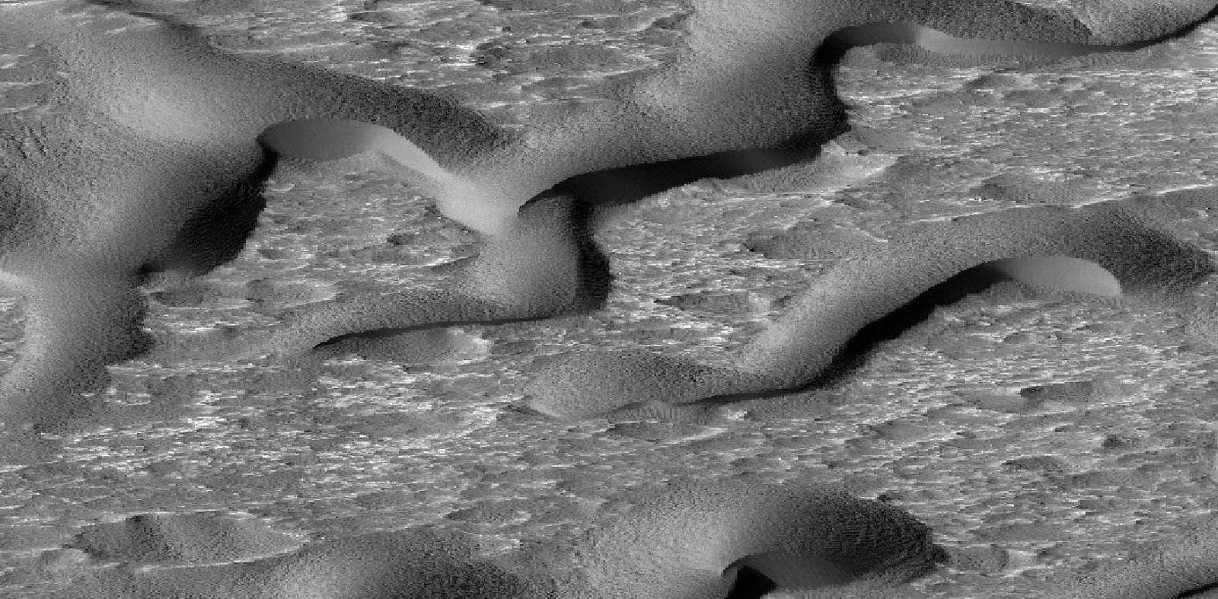
Aeolian sand > Large dark dune

Slide 22
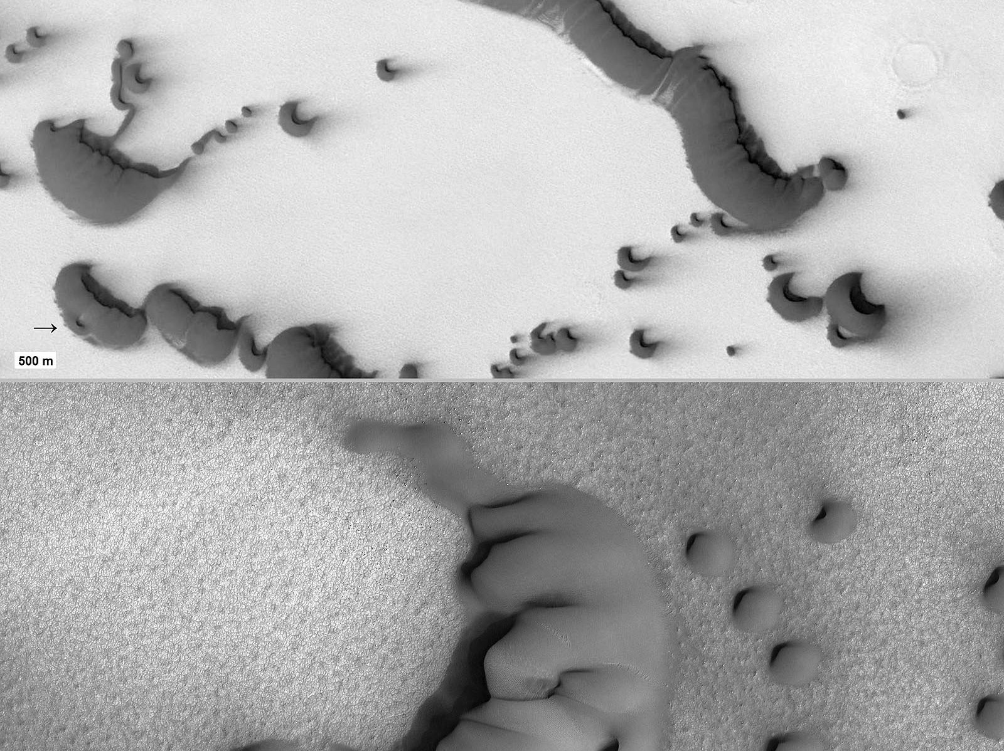
Aeolian sand > Megabarchan

Slide 23
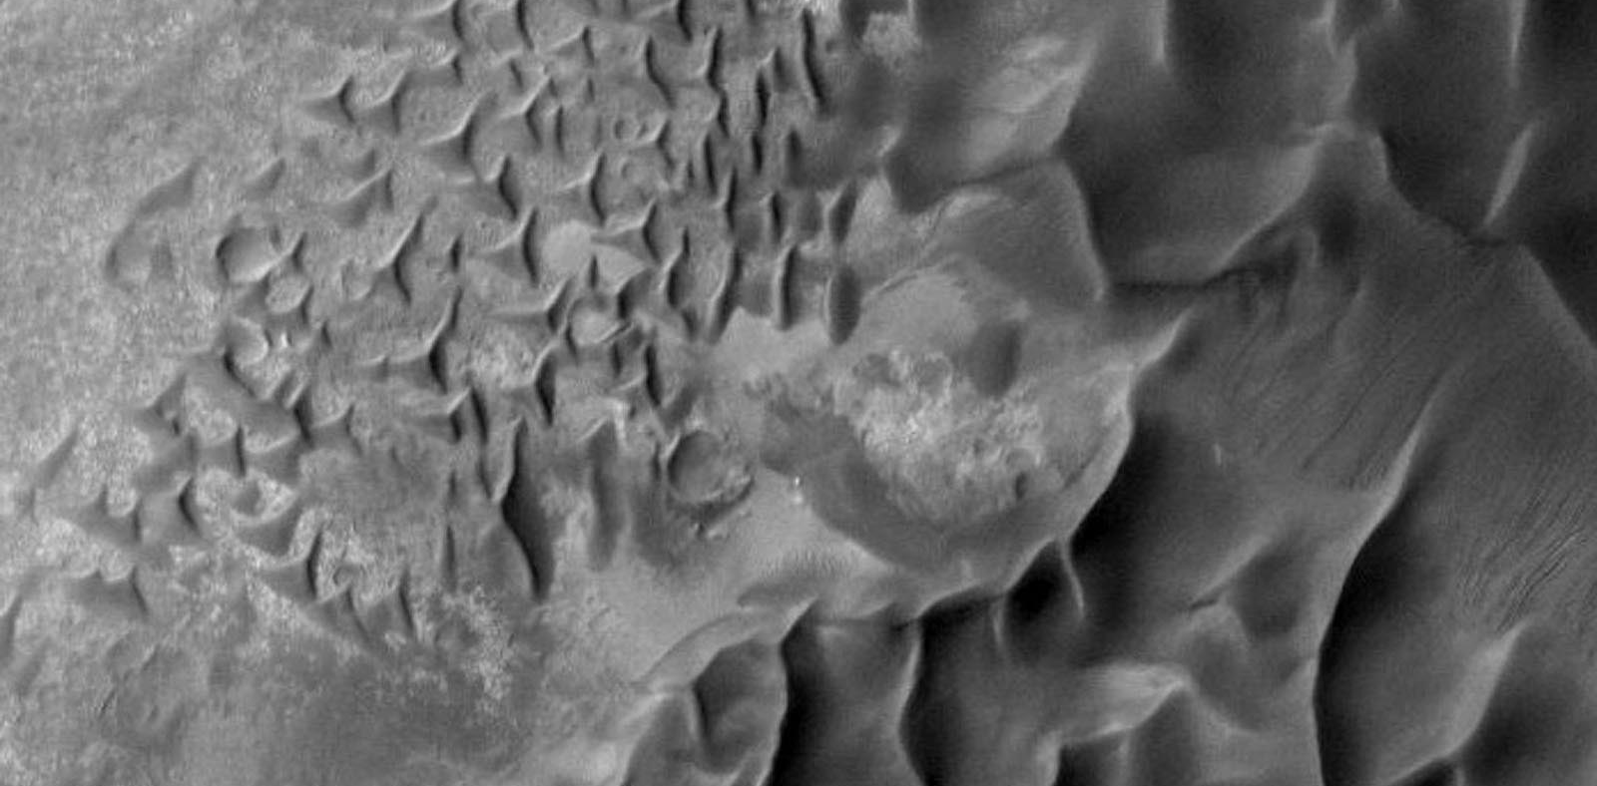
Aeolian sand > Megadune

Slide 24
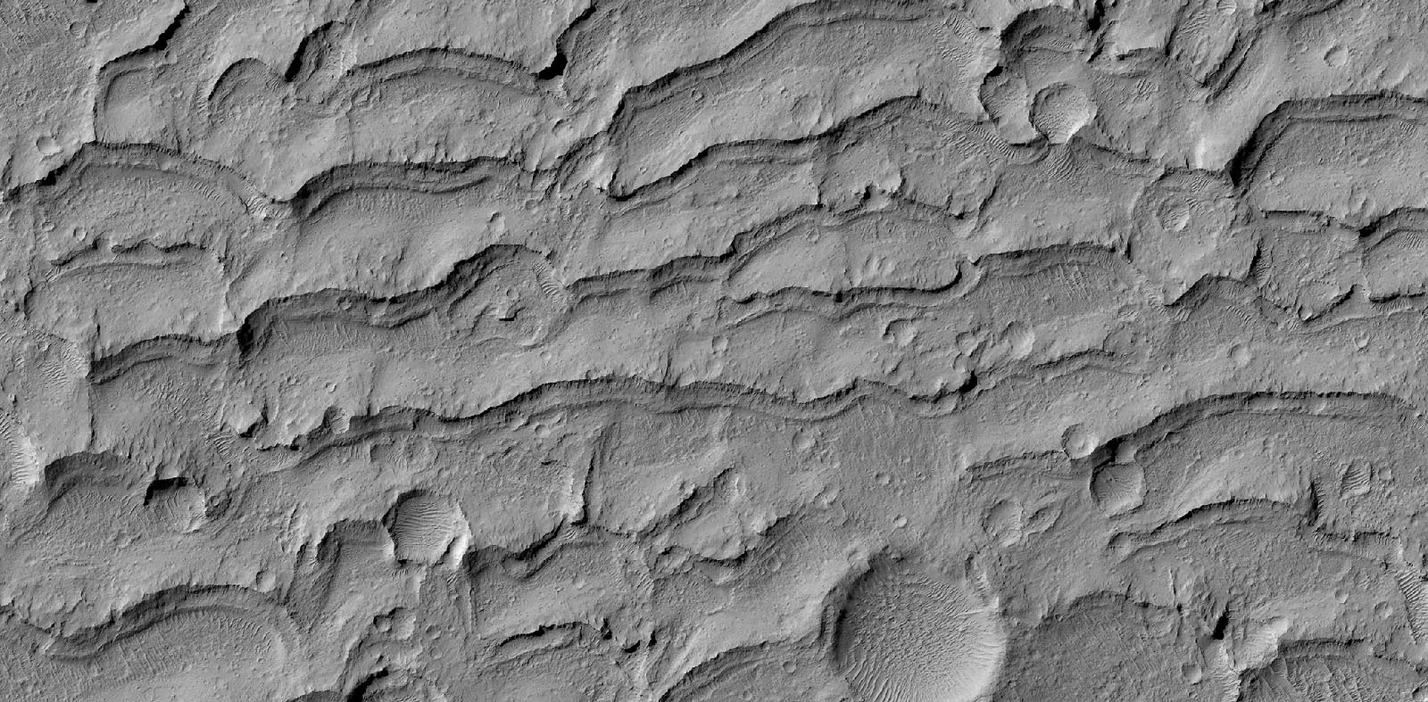
Aeolian sand > Indurated dune

Slide 25
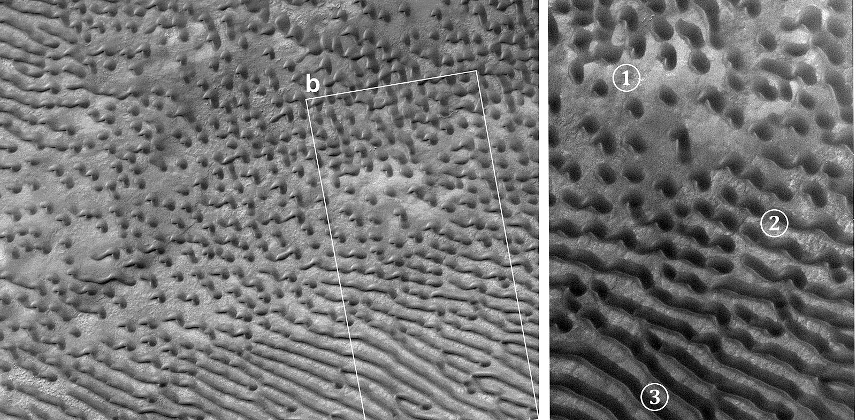
Aeolian > Transverse dune

Slide 26
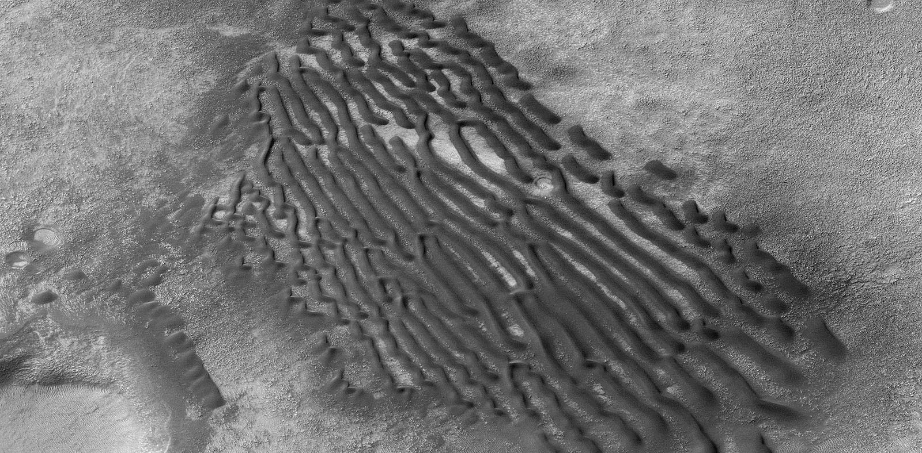
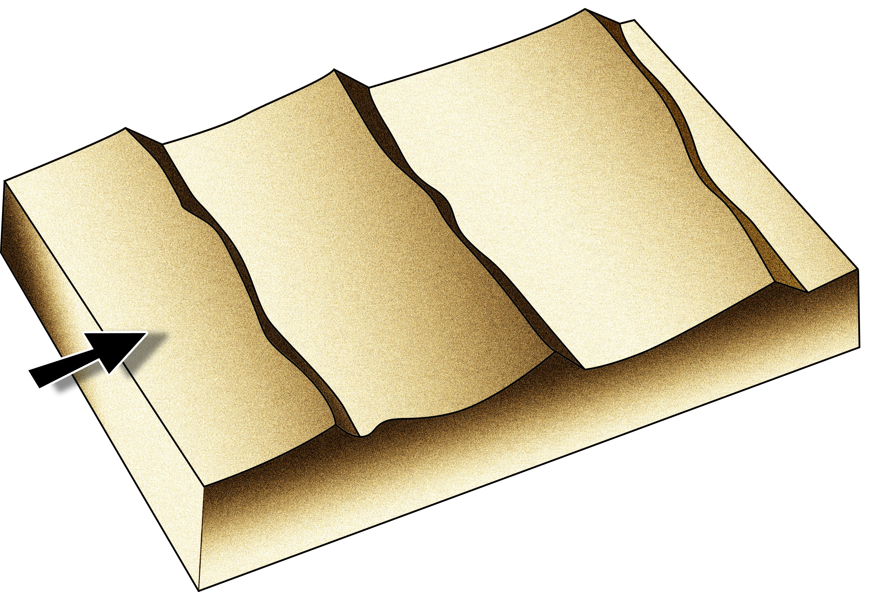
Aeolian > transverse ridge

Slide 27
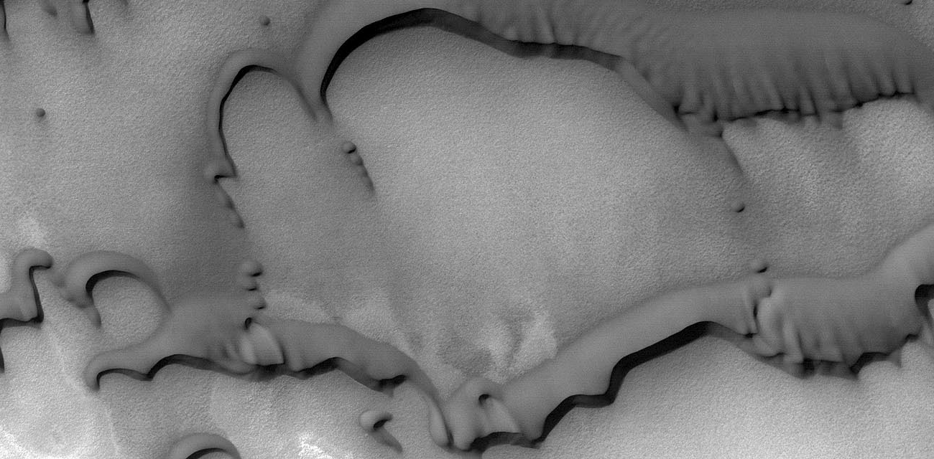
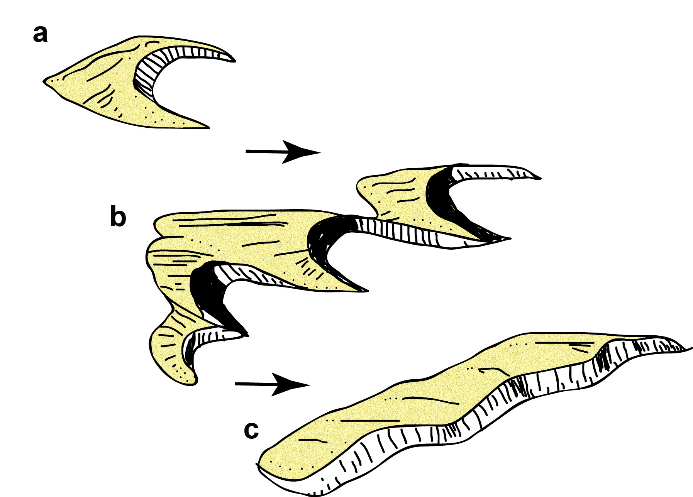
Aeolian > Barchanoid ridge

Slide 28
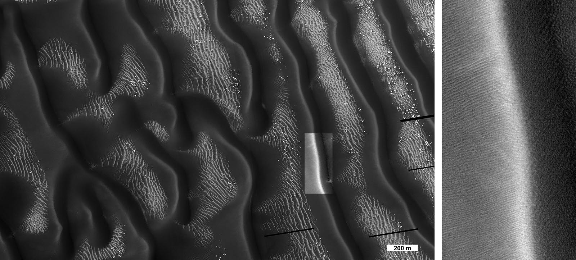
Aeolian > Reversing dune

Slide 29
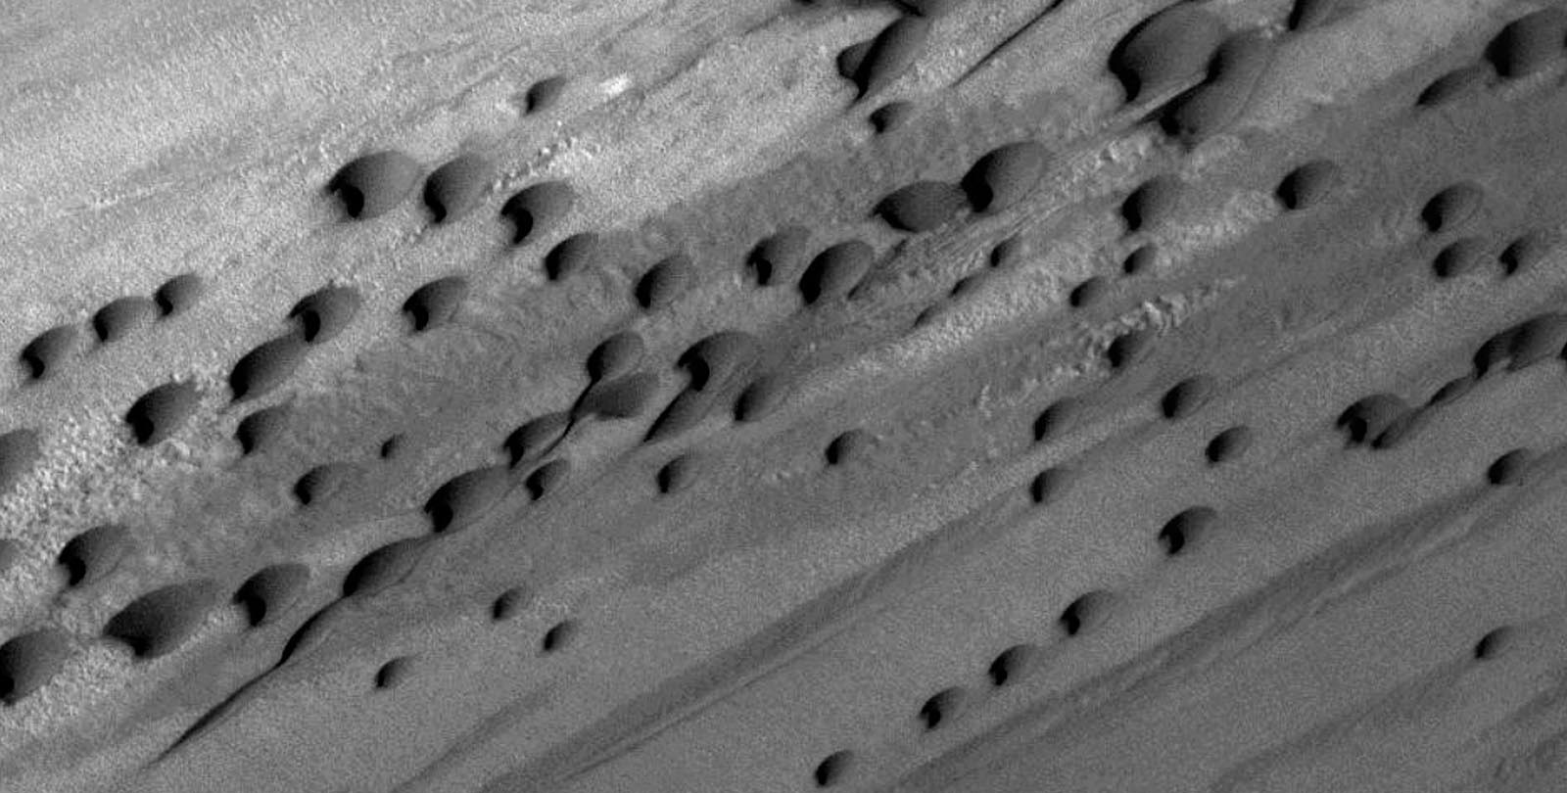
Aeolian > Dome dune

Slide 30
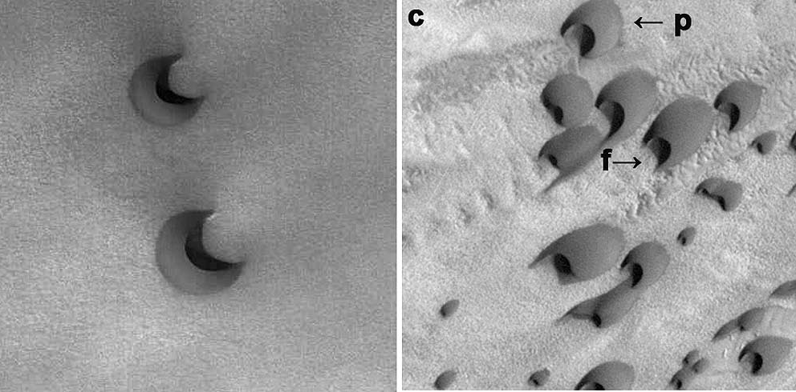
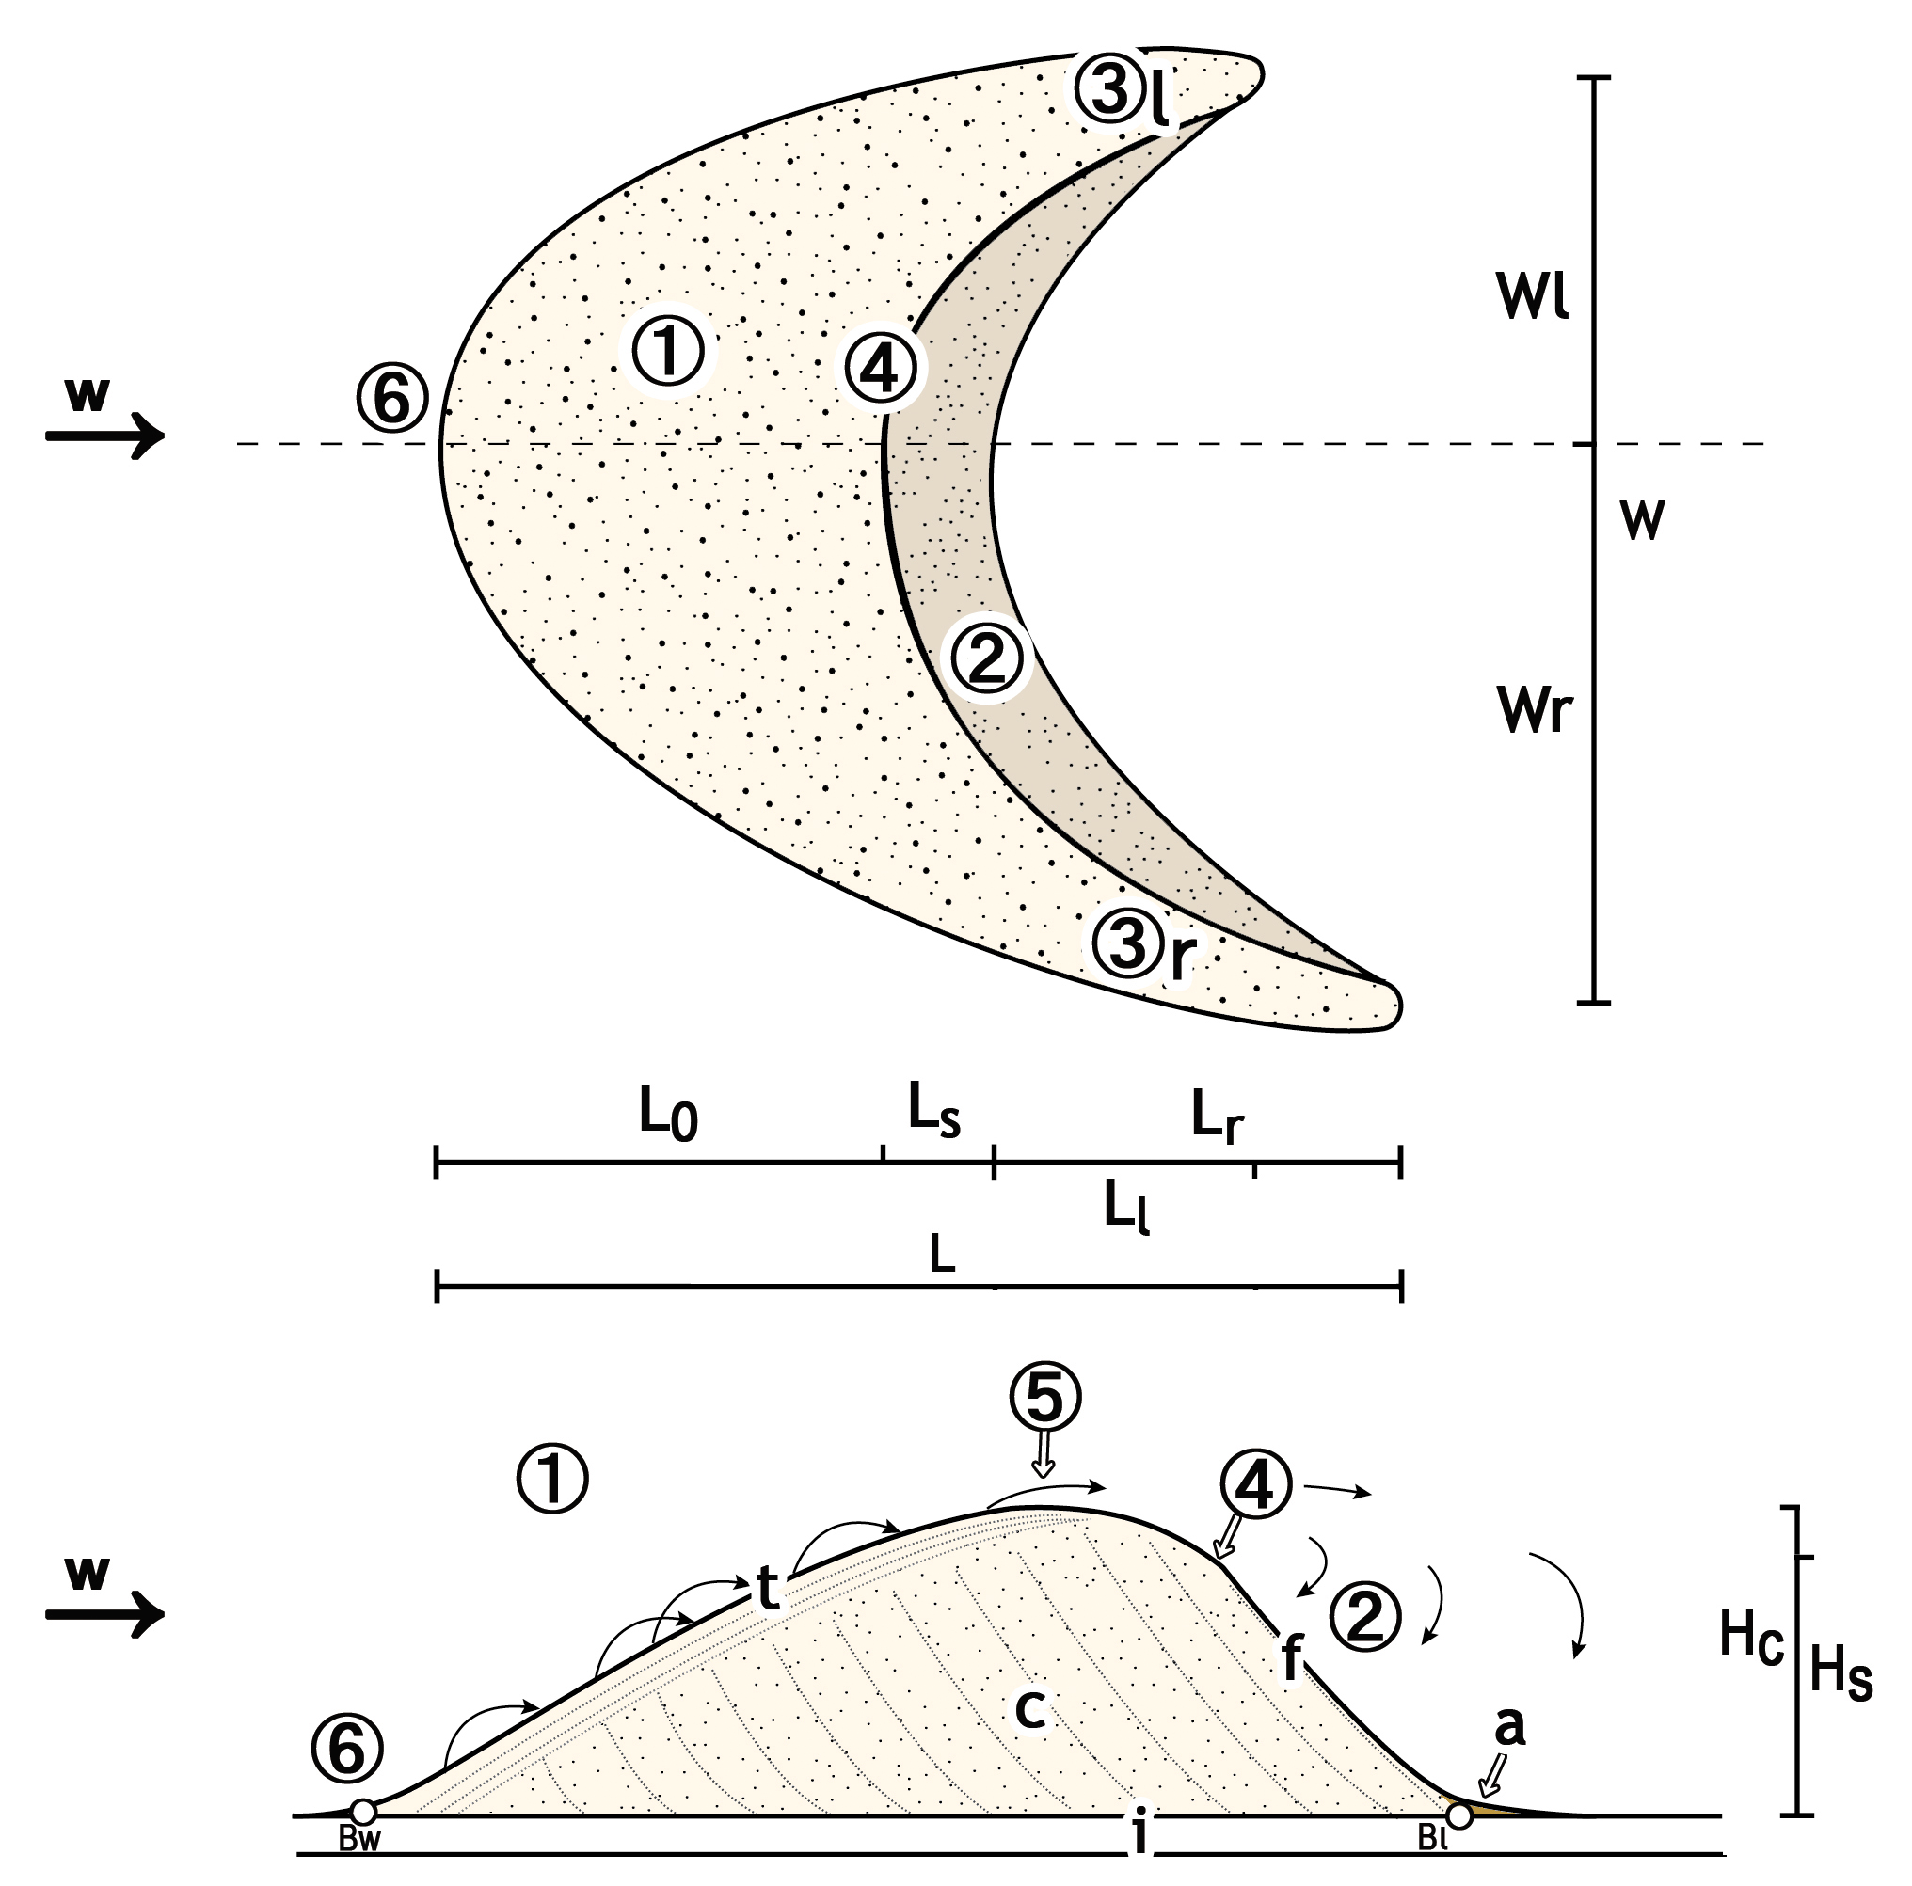
(1) Windward side, (2) Slip face, (3) Horns (3r: right, 3l: left), (4) Brink, (5) Crest, (6) Windward toe.
Aeolian > Barchan

Slide 31
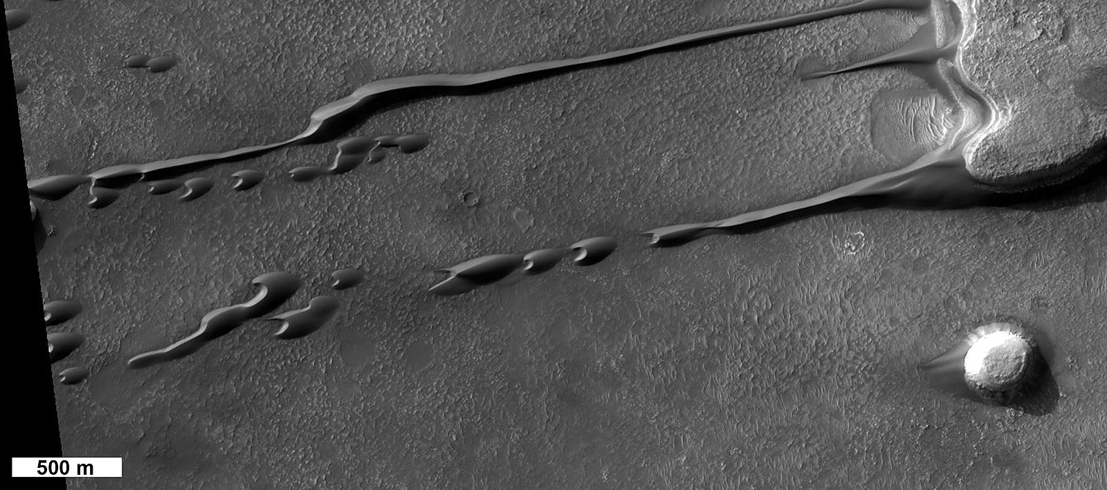
Aeolian > Dune convoy

Slide 32
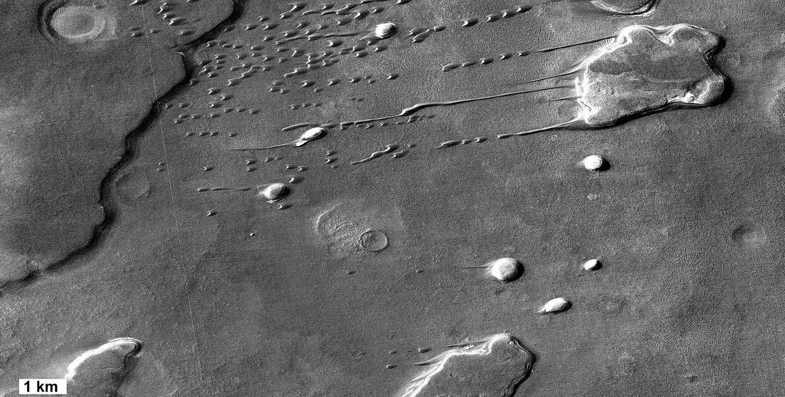
Aeolian > Lee dune

Slide 33
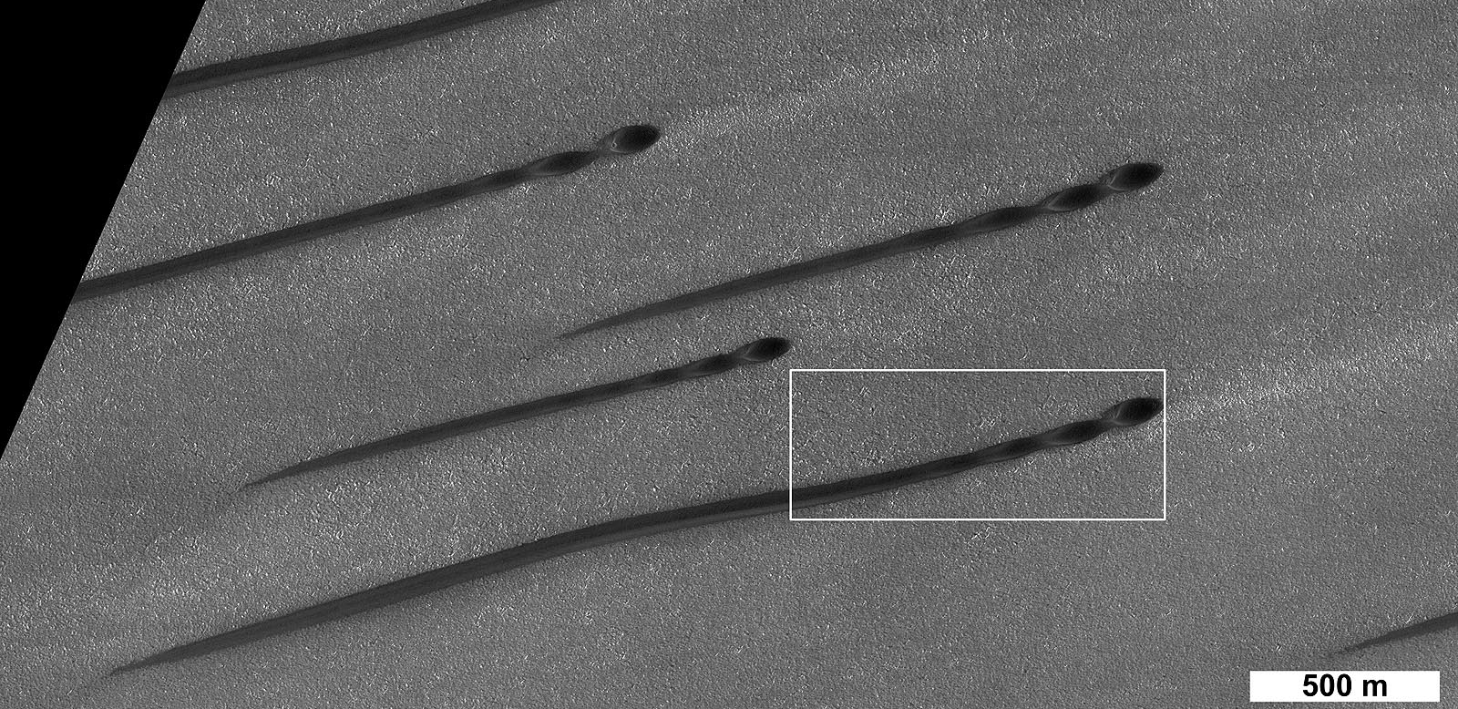
Aeolian > Rectilinear dune

Slide 34
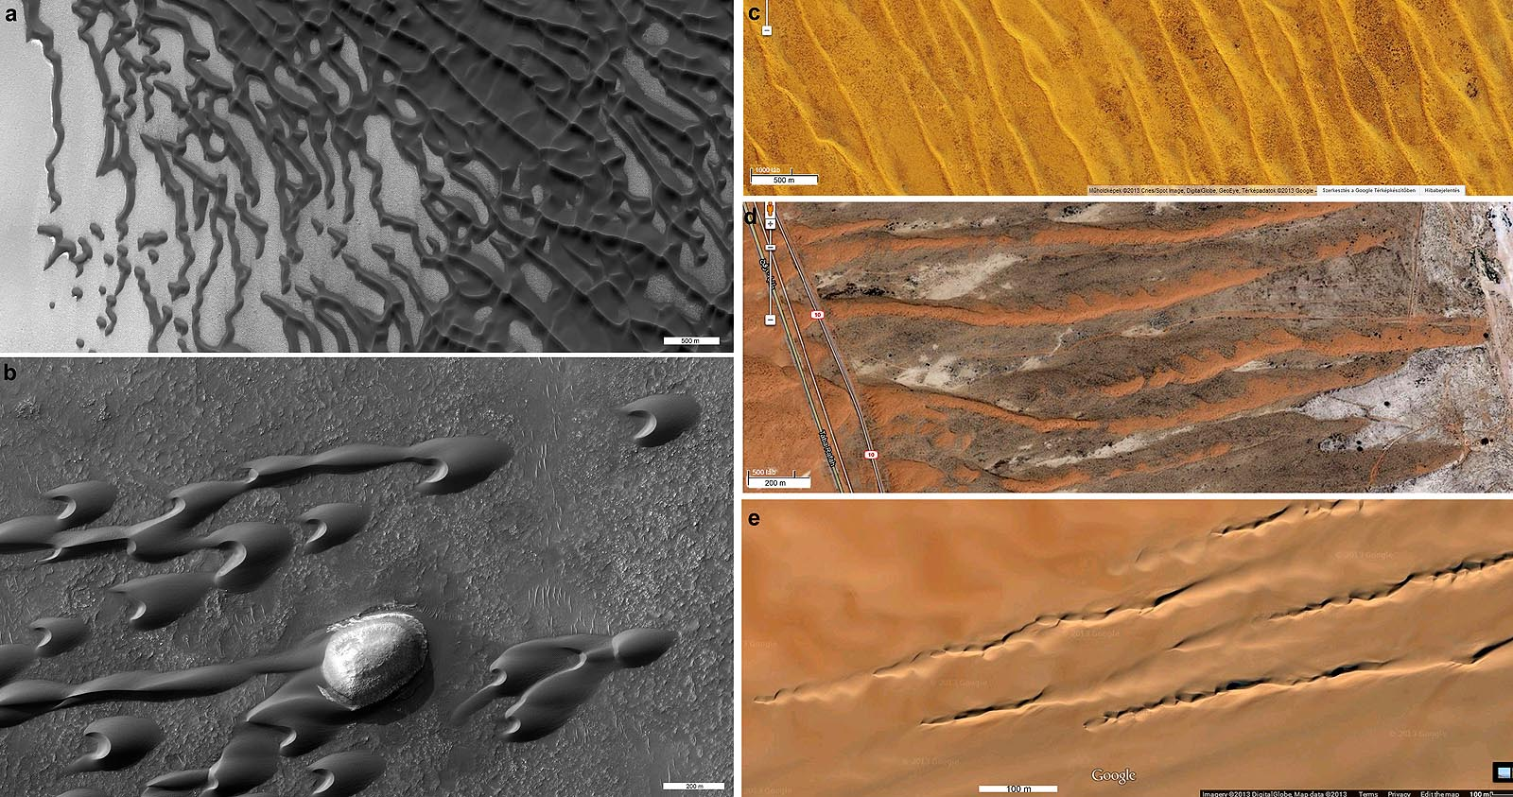
Aeolian > Seif

Slide 35
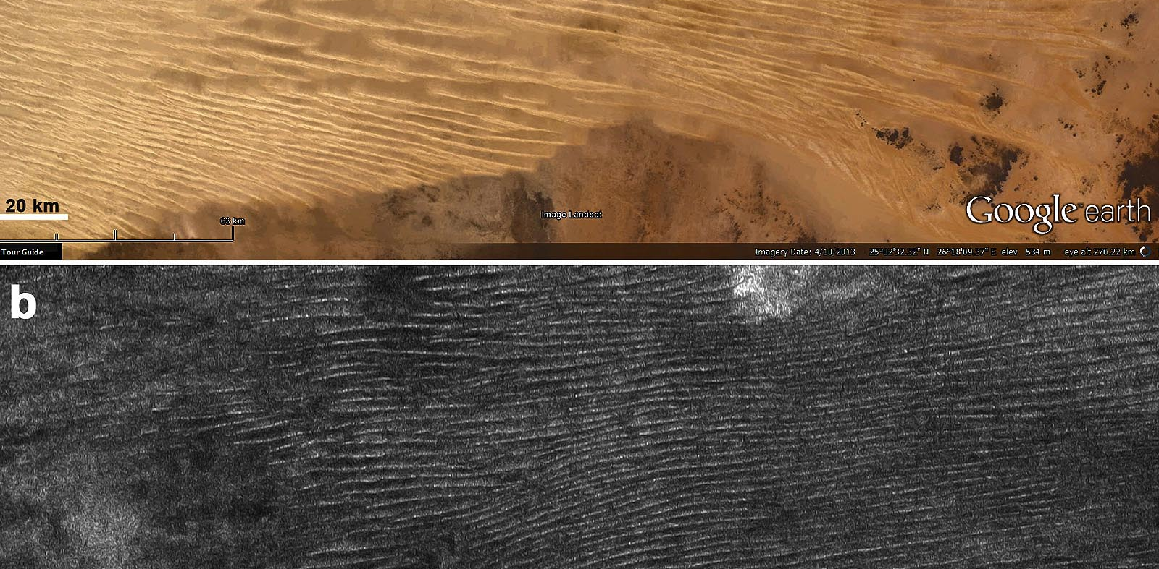
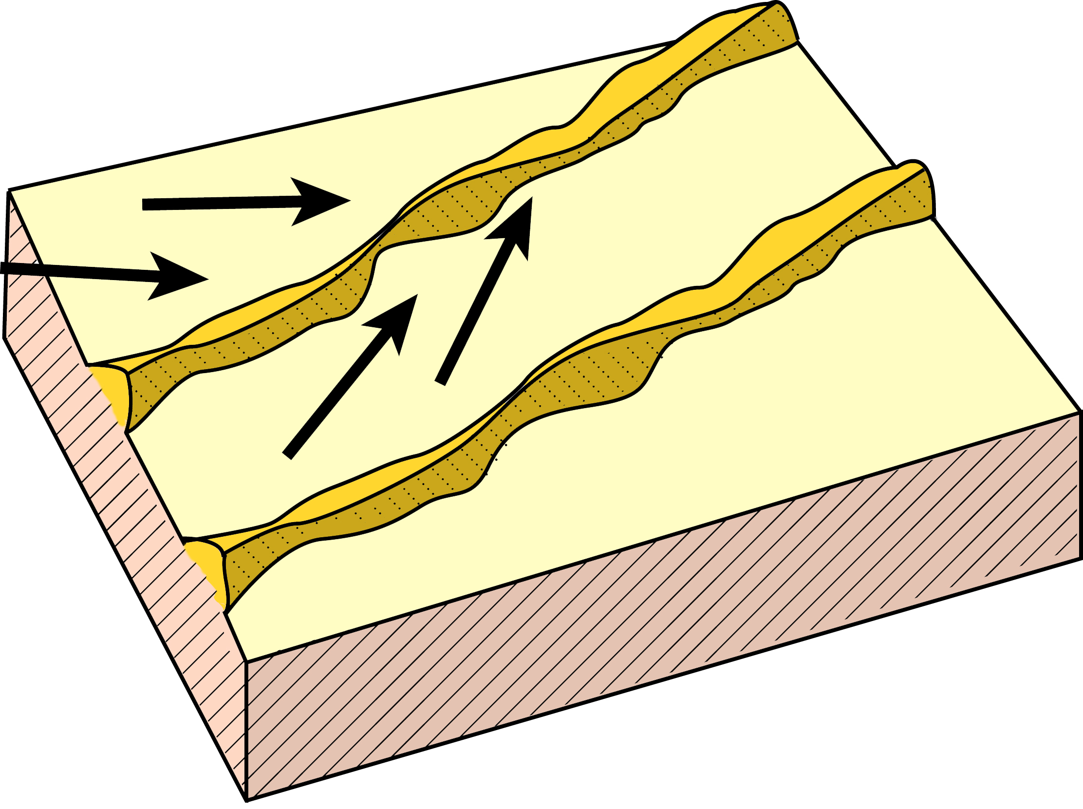
Aeolian > Linear dune

Slide 36
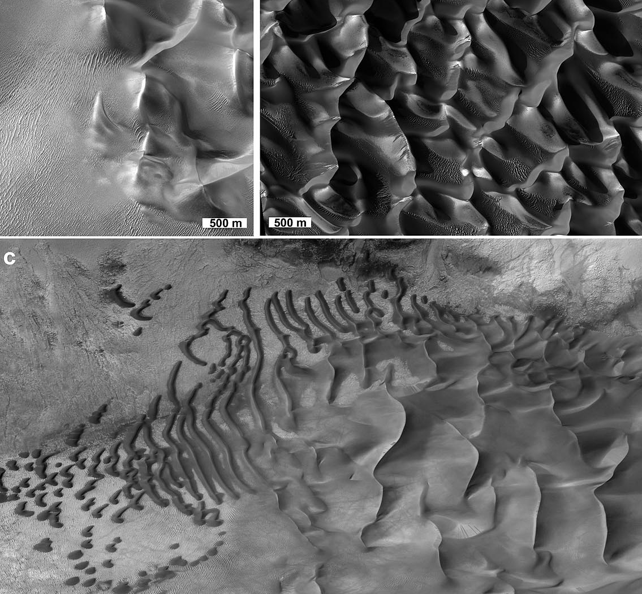
Aeolian > Star dune

Slide 37
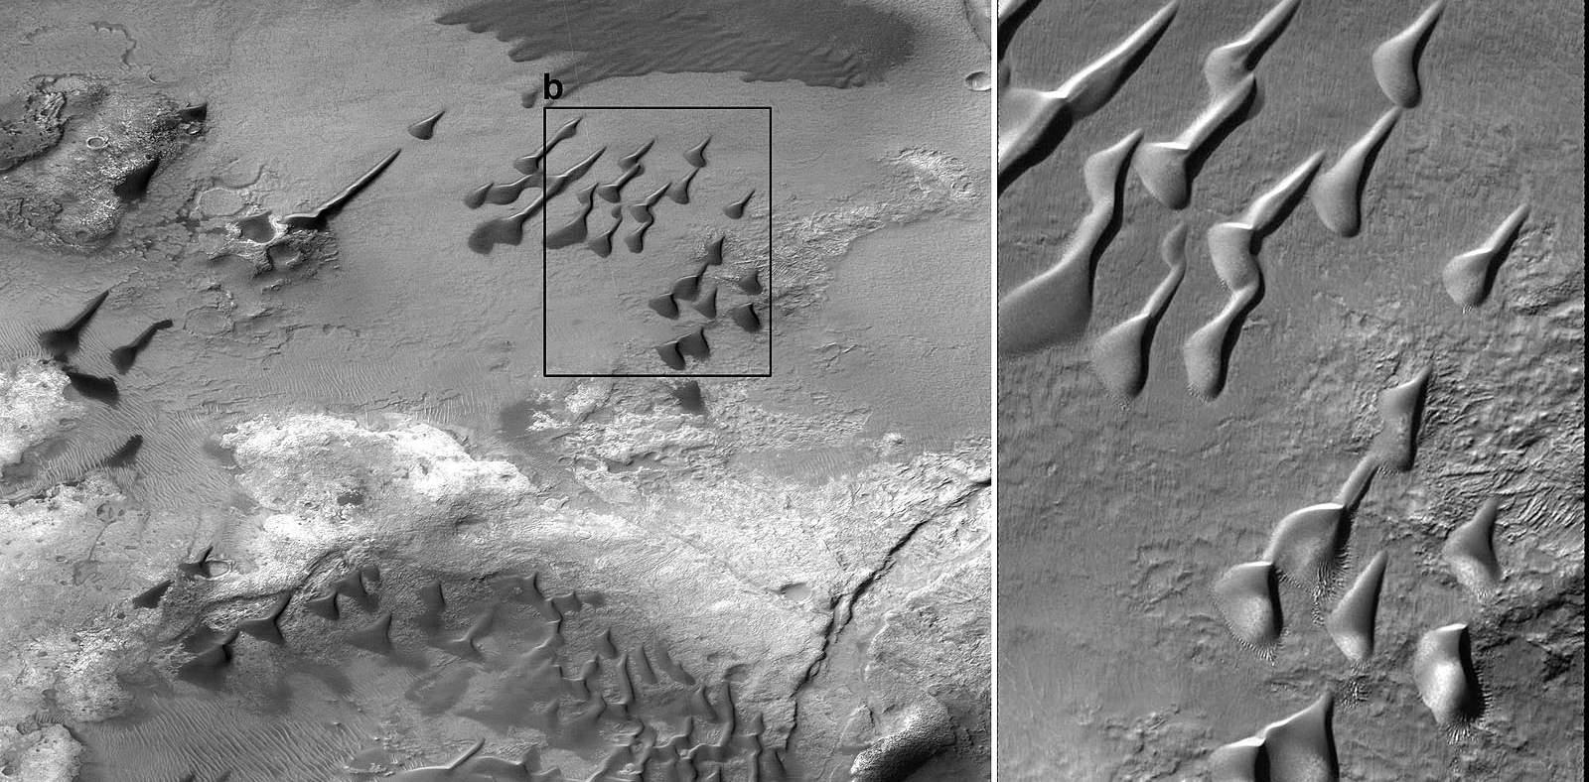
Aeolian > Drop dune

Slide 38
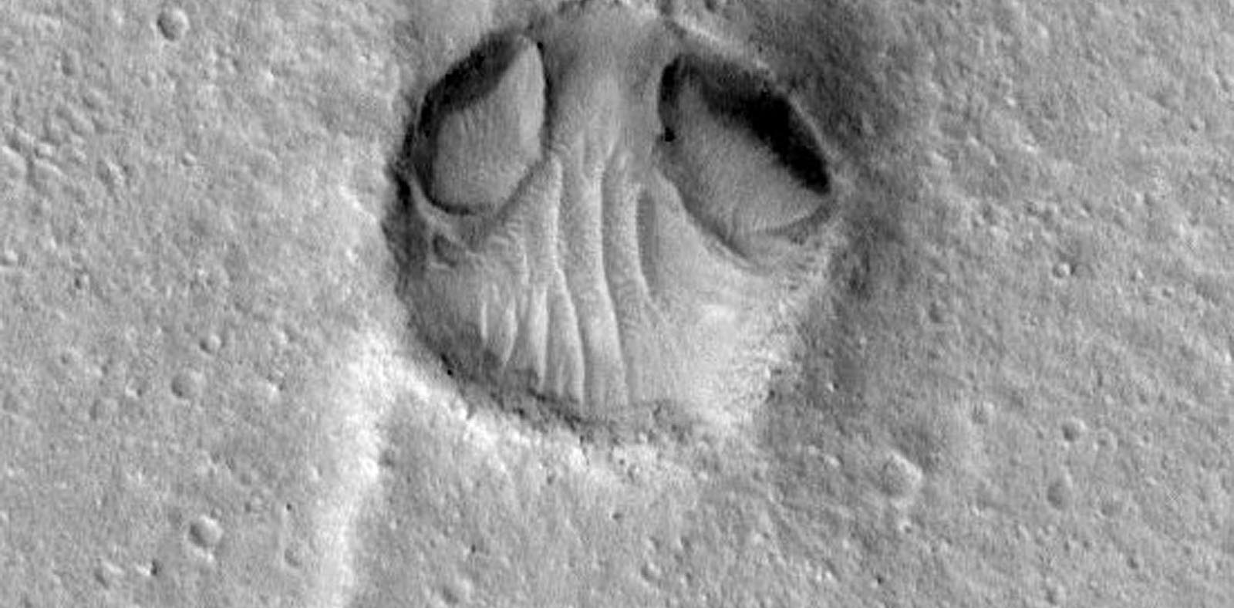
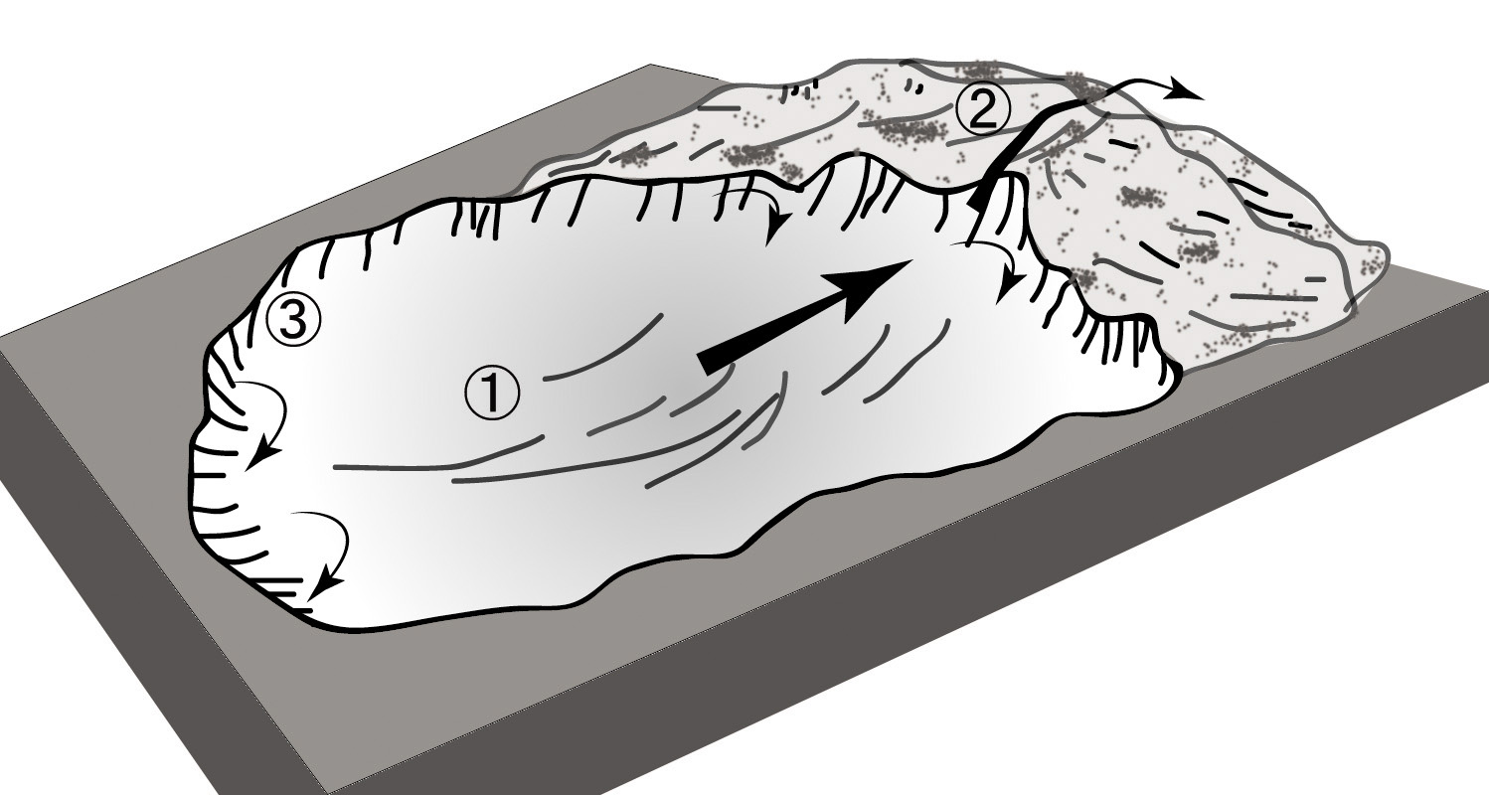
Aeolian > Blowout dune

Slide 39
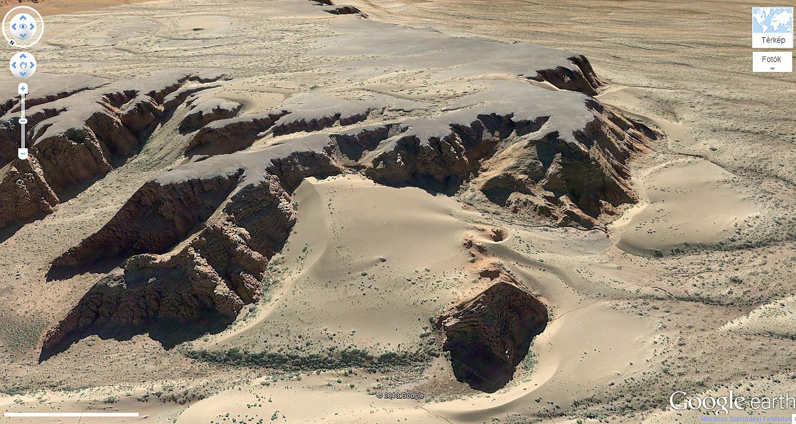
Aeolian > Echo dune

Slide 40
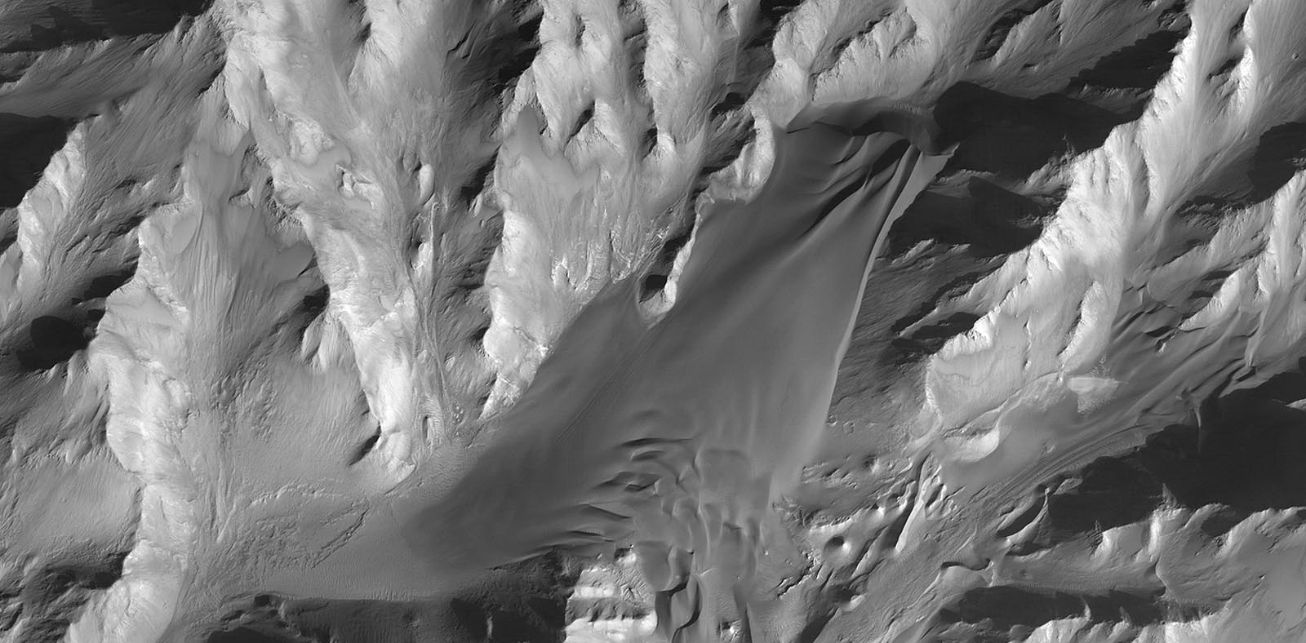
Aeolian > Climbing dune

Slide 41
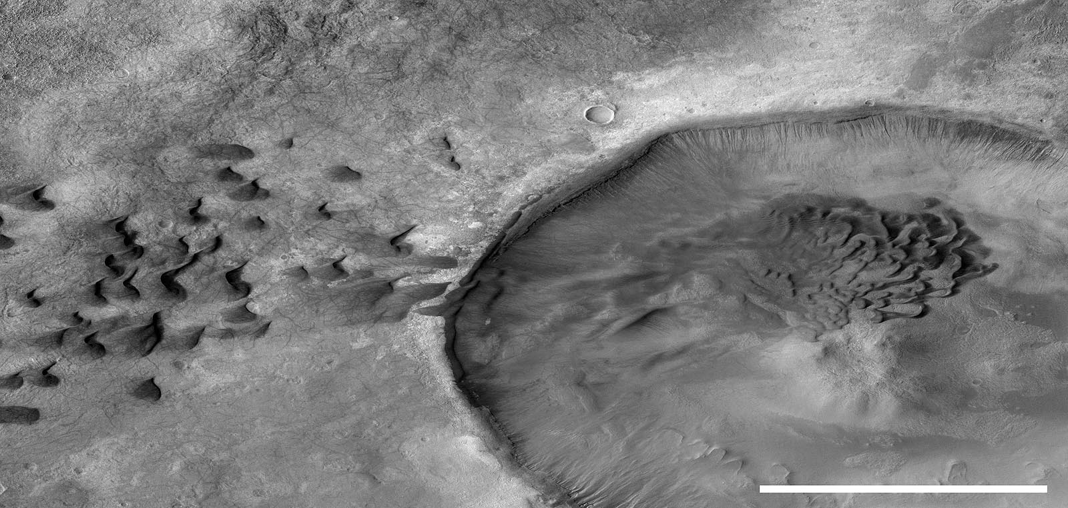
Aeolian > Falling dune

Slide 42
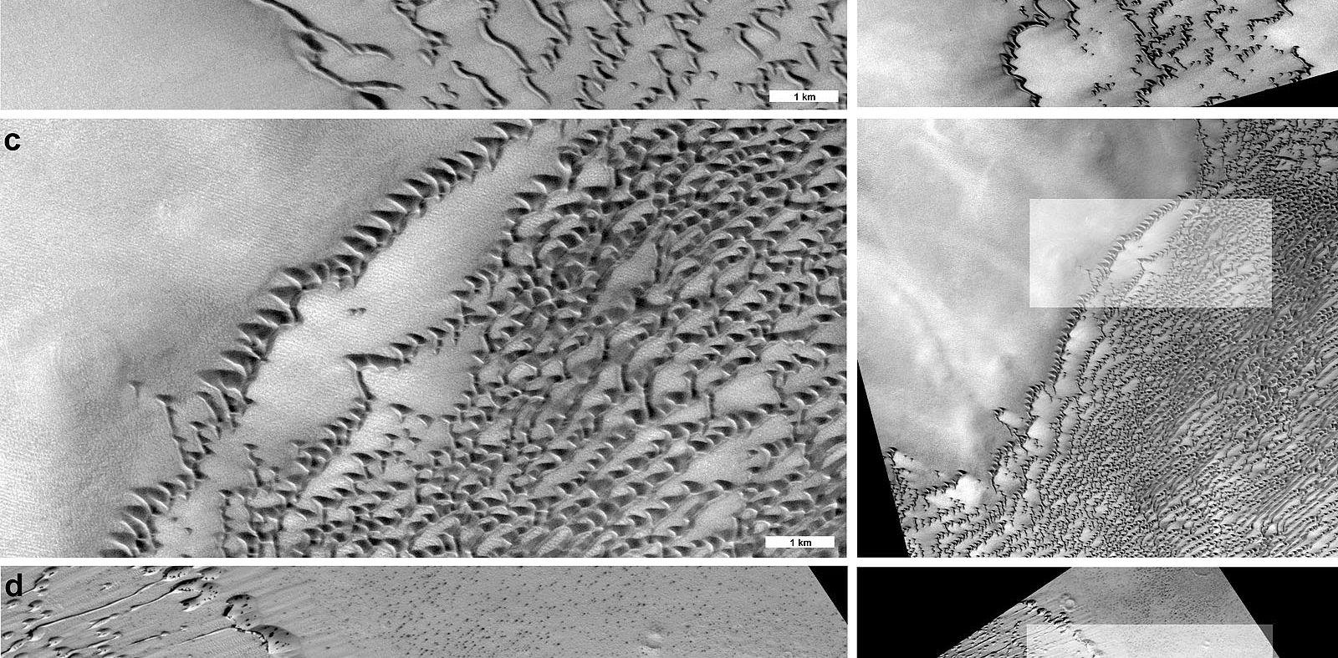
Aeolian > Frame dune

Slide 43
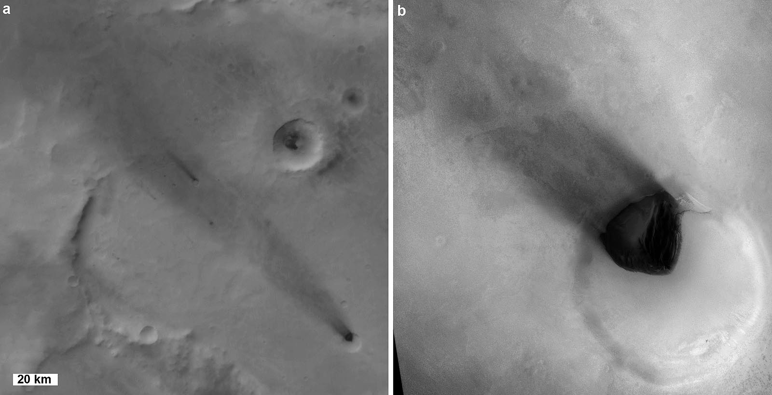
Aeolian > Wind streak

Slide 44
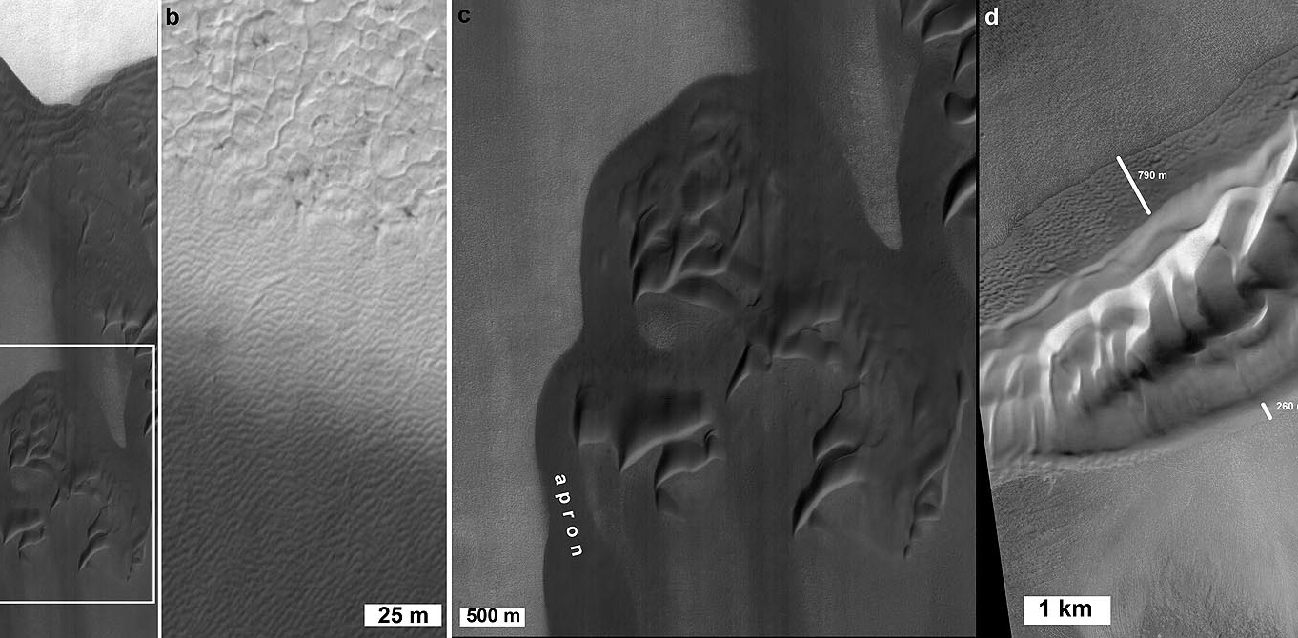
Aeolian > Dune apron

Slide 45
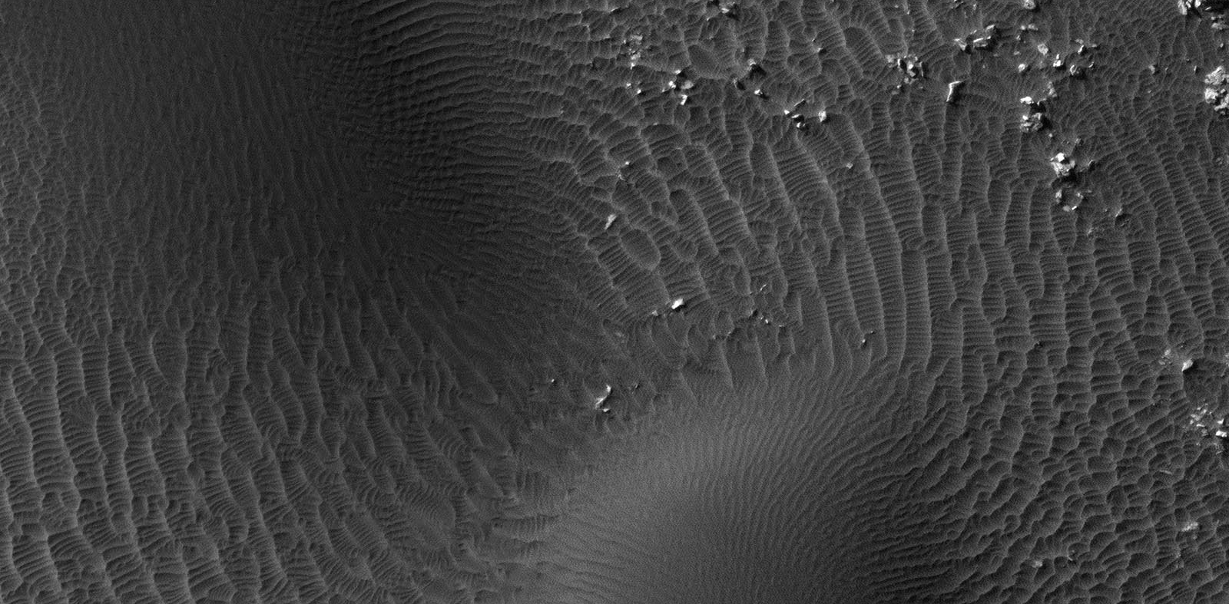
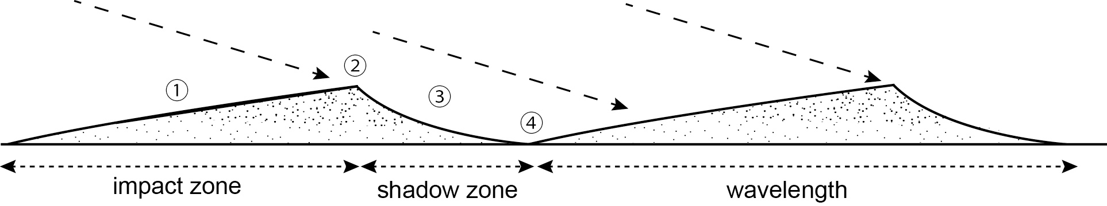
Aeolian > Ripple

Slide 46

Aeolian > megaripple

Slide 47

Aeolian > Transverse Aeolian Ridge

Slide 48
Key concepts
Aeolian features are Wind-transported and deposited particulate material
Airfall is not aeolian
Aeolian includes features formed by
  sand (sheets, dunes, riipples)
  dust (typically mantling)
Wind-blown deposits on planetary surfaces may be
  unconsolidated (loose) or
  indurated (cemented, lithified).
Material is transported by
  Creep and roll
  Saltation
  Reptation
  Suspension

Slide 49
OTHER FORMS

Slide 50

Other > Swirl

Slide 51

Other > Knobby terrain

Slide 52


Equatorial ridge

Slide 53


Atlas
Rhea
Equatorial Feature

Slide 54
Equatorial ridge

Slide 55
Equatorial ridge

Slide 56
Source
Hargitai and Kereszturi (eds): Encyclopedia of Planetary Landforms 2015

