Slide 1
Planetary landforms
A visual introduction to planetary geomorphology
VOLCANISM
HENRIK HARGITAI
2019
csplanetolg17em
FÖL/1/075E
Definitions in the Notes section

Slide 2
Volcanic forms

Slide 3
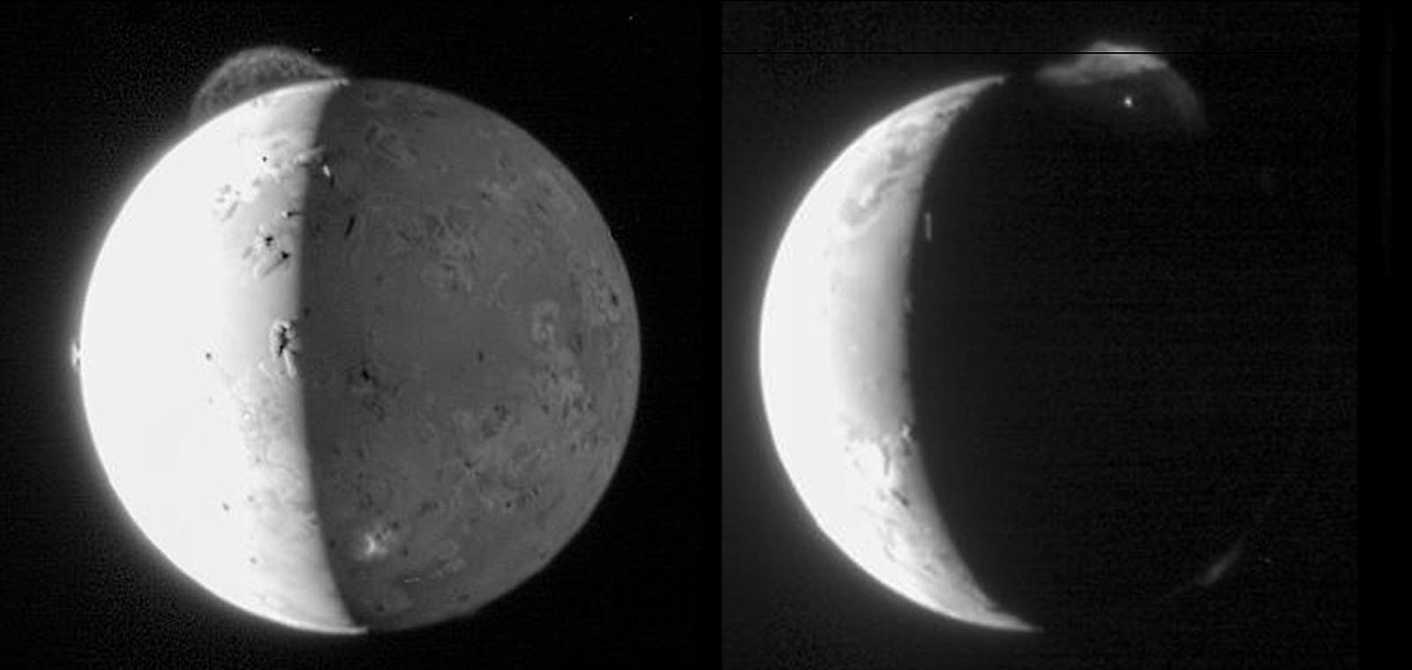
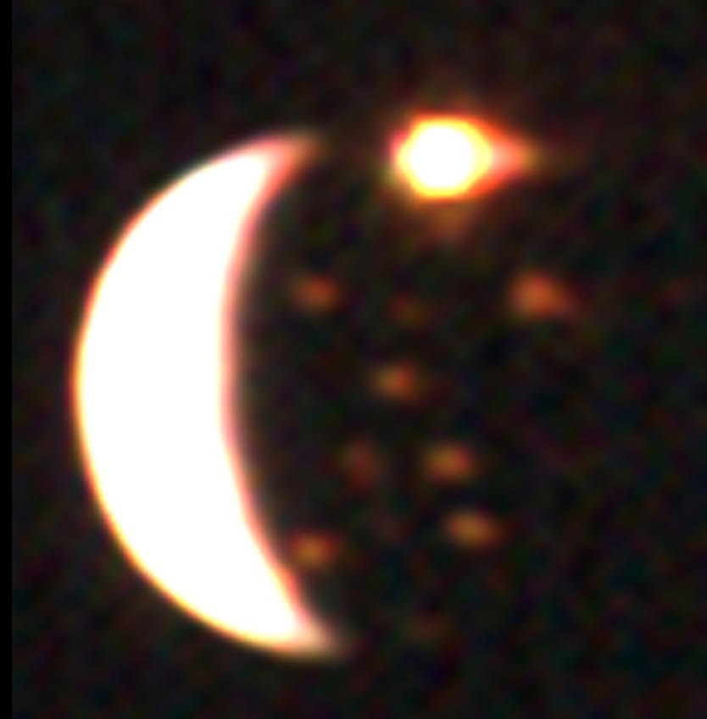
Volcanic constructs > Eruptive center

Slide 4
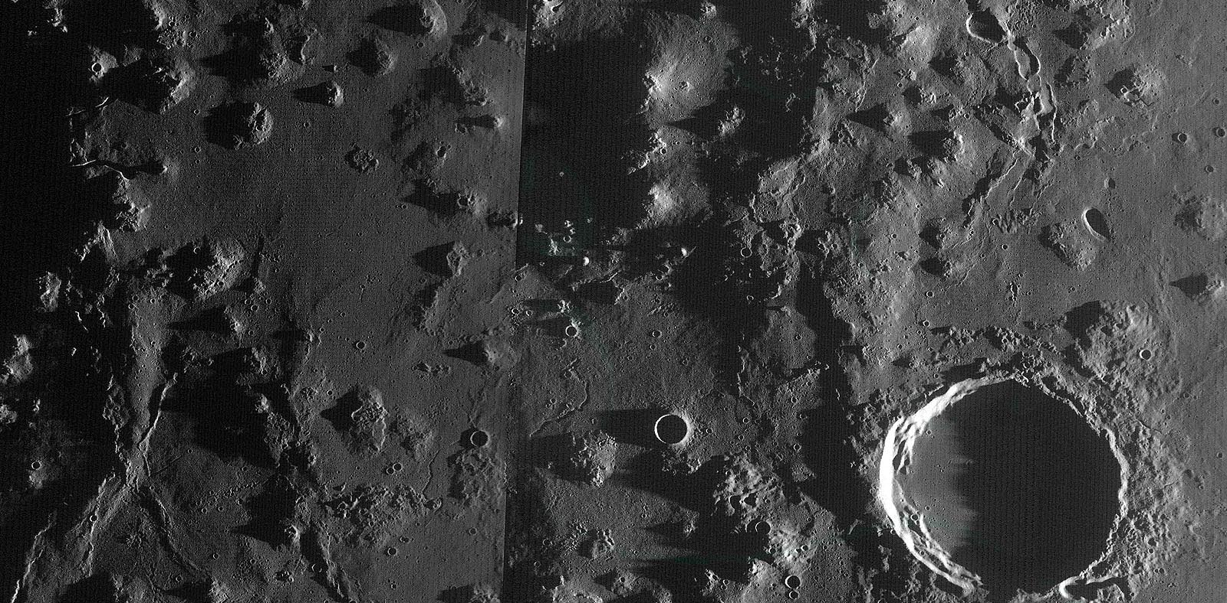
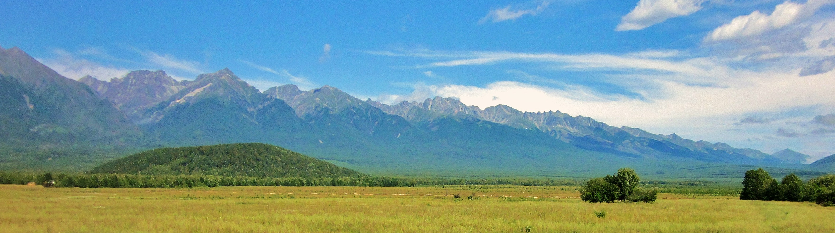
Volcanic constructs > Dome

Slide 5
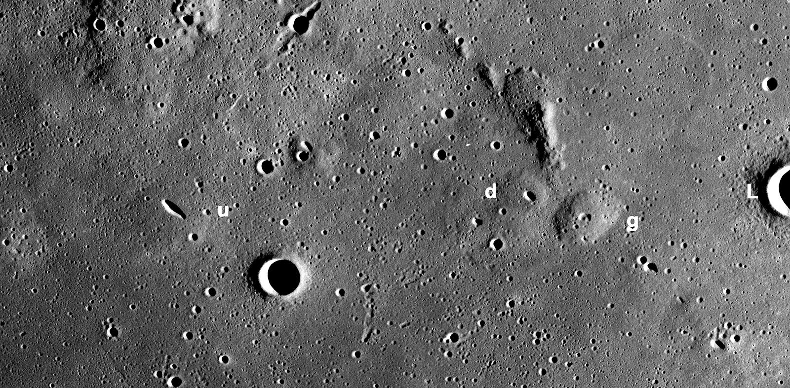
Volcanic constructs > mare dome

Slide 6
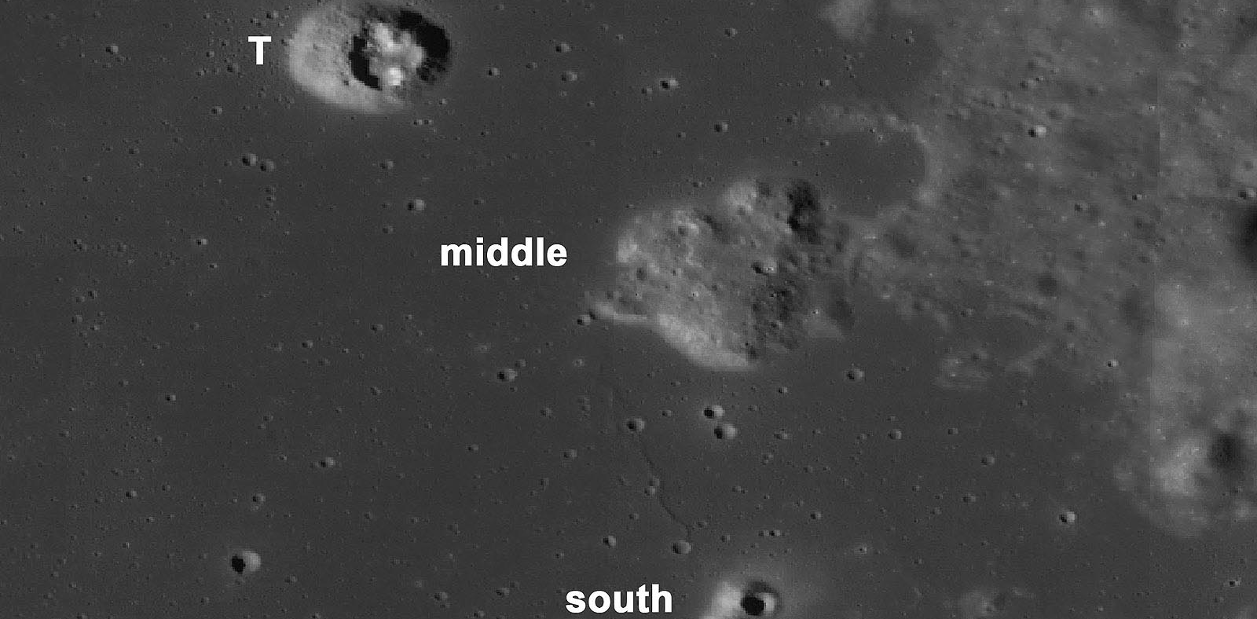
Volcanic constructs > nonmare dome

Slide 7
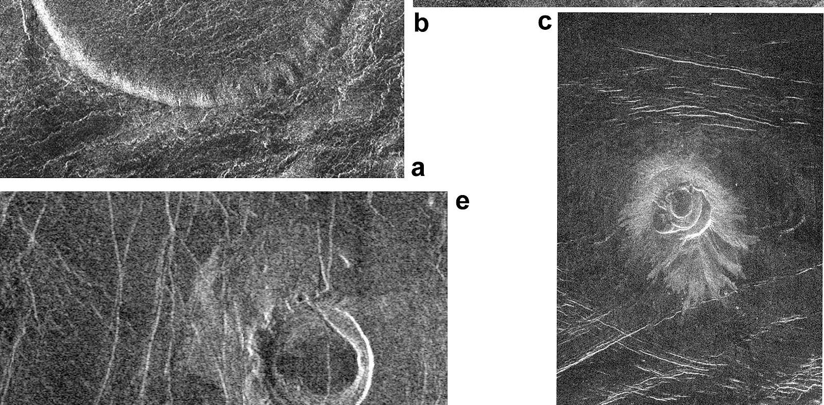
Volcanic constructs > intermediate volcano

Slide 8
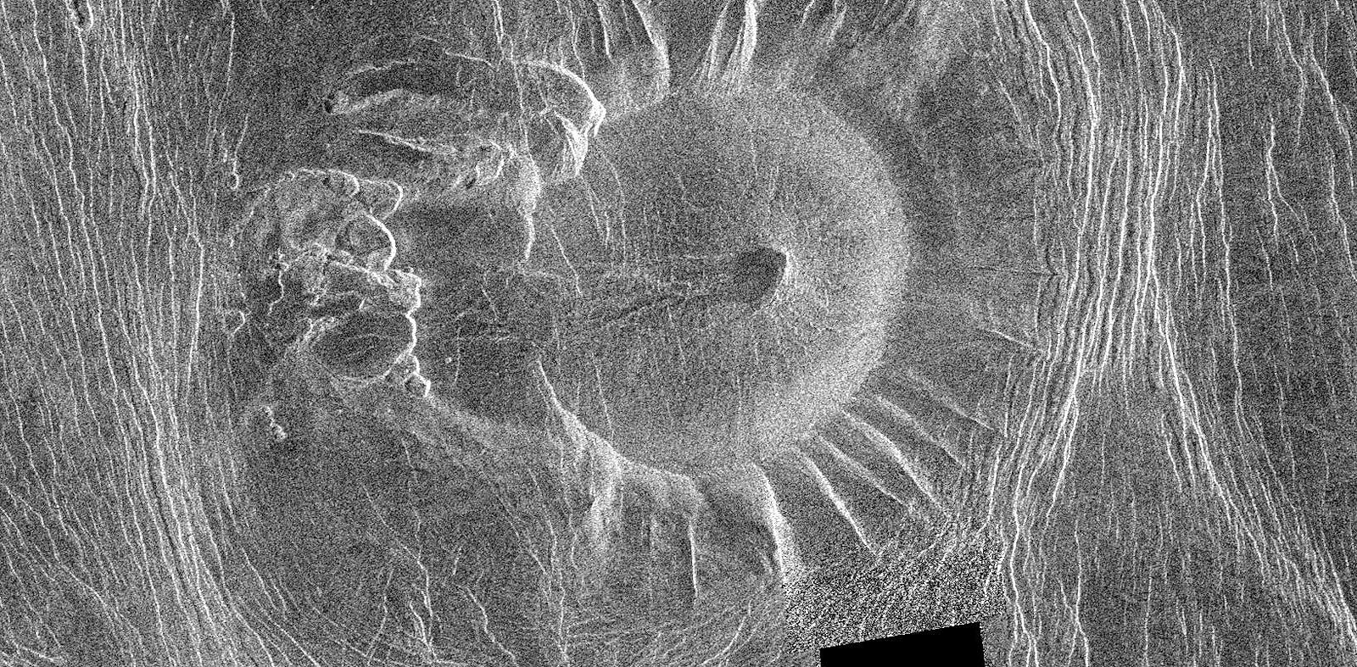
Volcanic constructs > scalloped margin dome / tick

Slide 9
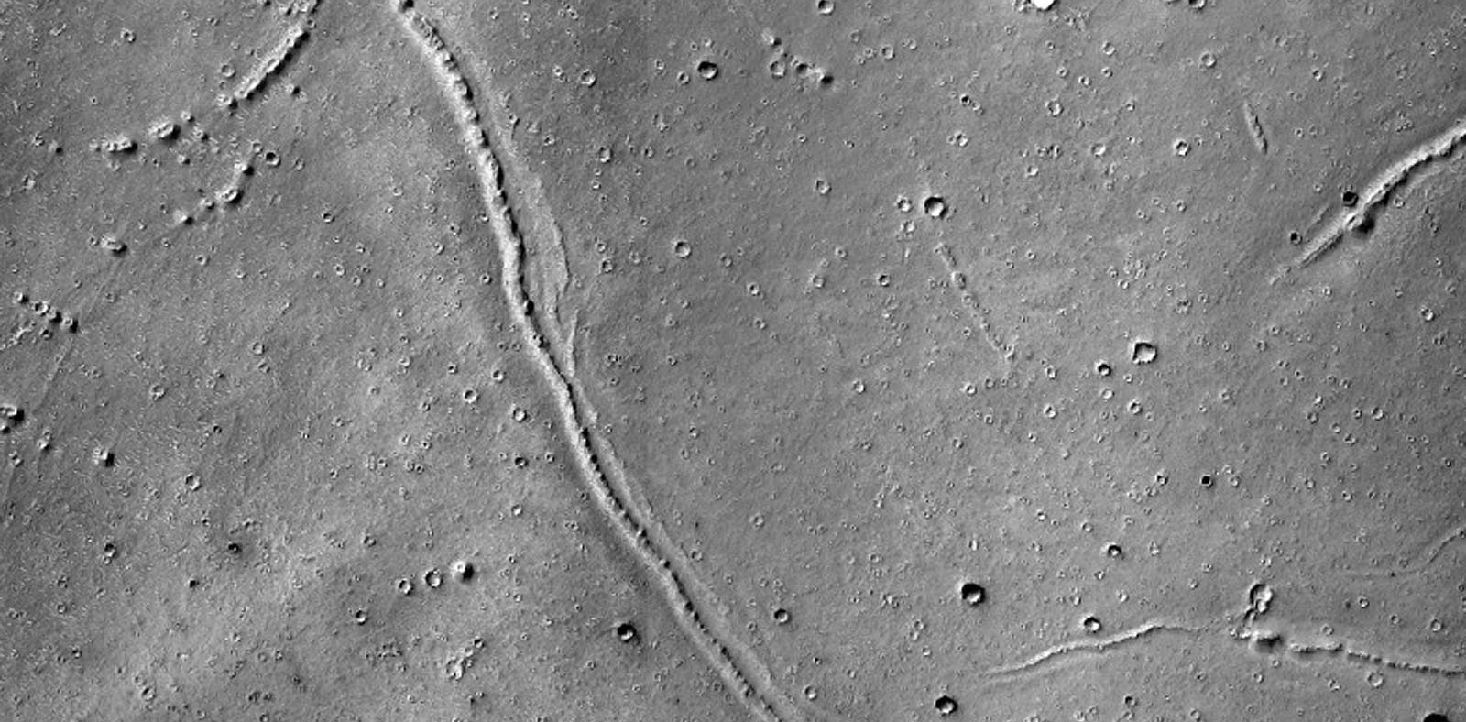
Volcanic constructs > thumbprint terrain

Slide 10
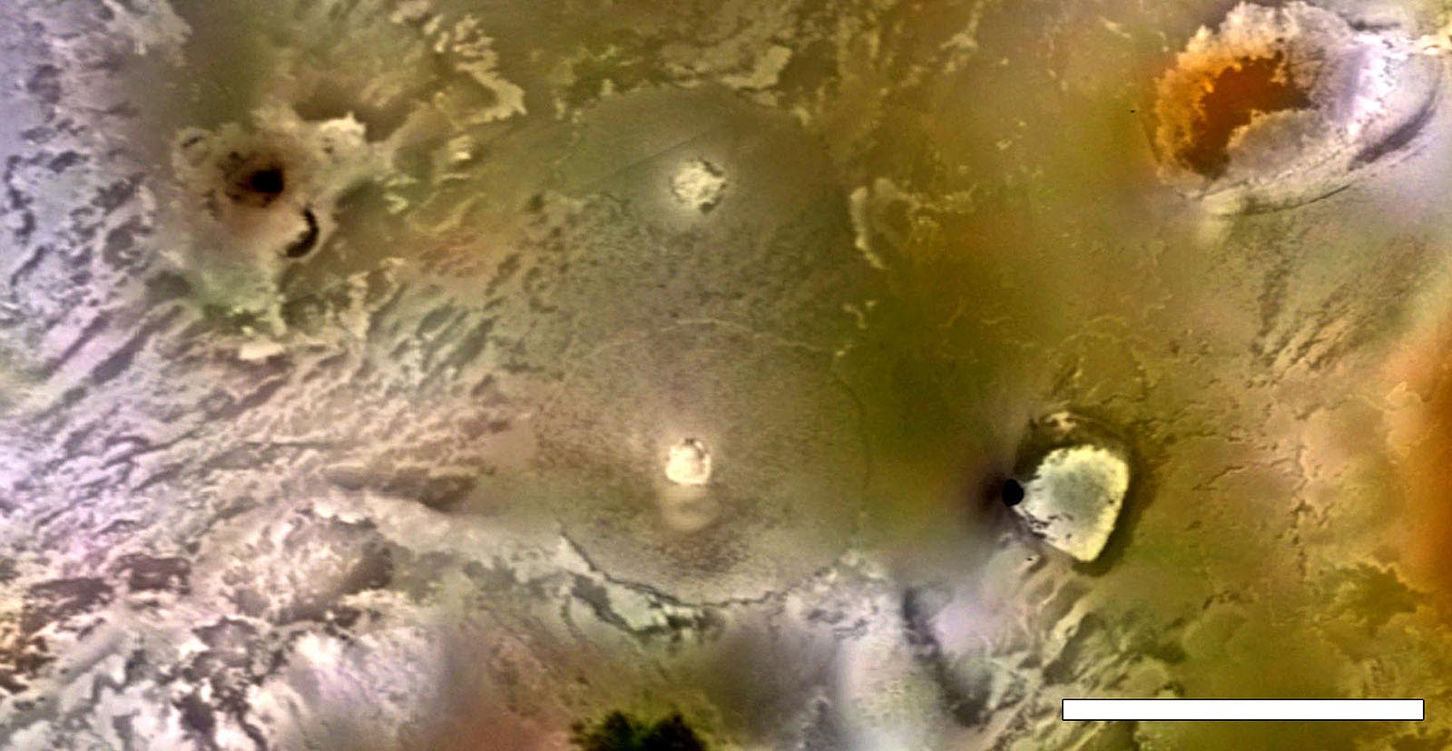
Volcanic constructs > steep sided dome

Slide 11
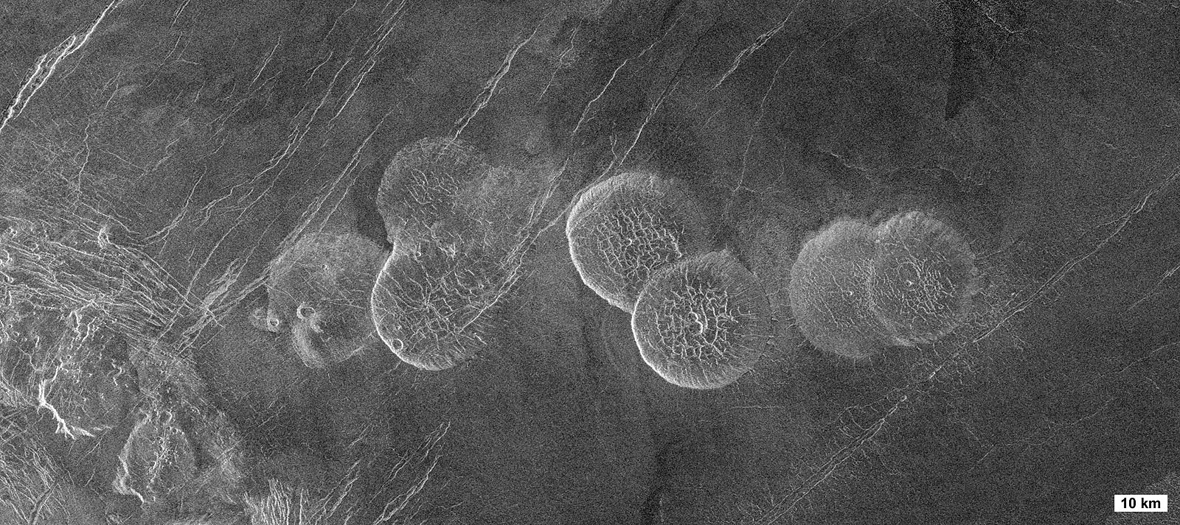
Volcanic constructs > steep sided dome

Slide 12
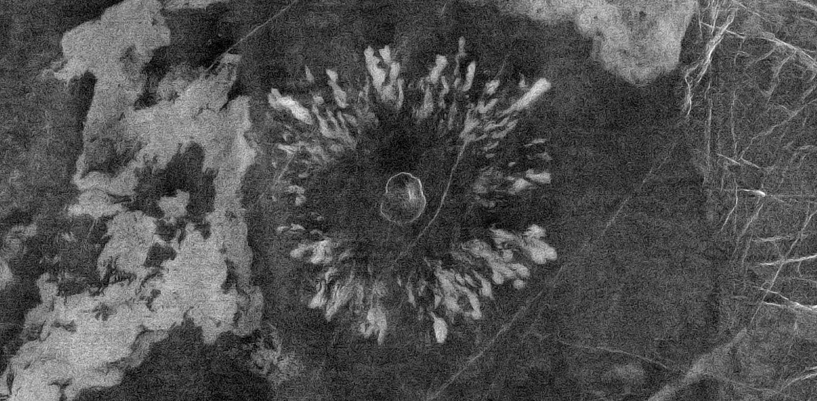
Volcanic constructs > radially patterned intermediate volcano / anemone

Slide 13
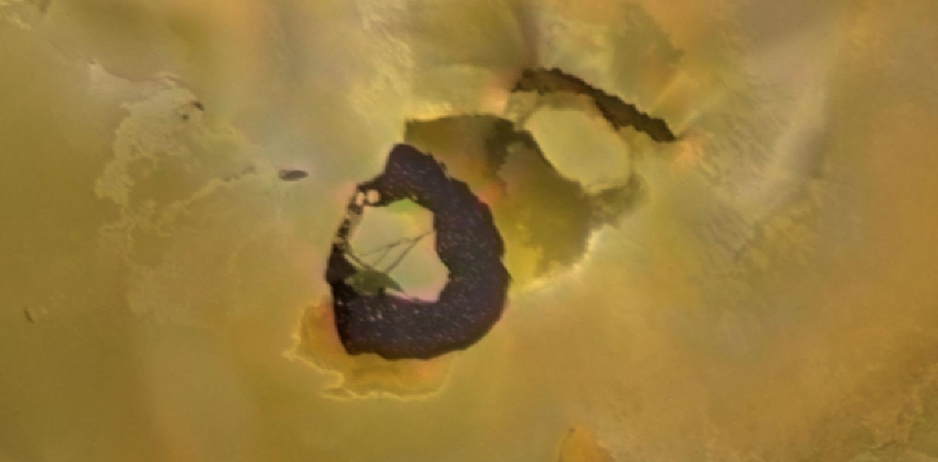
Ponding liquid > Lava lake

Slide 14
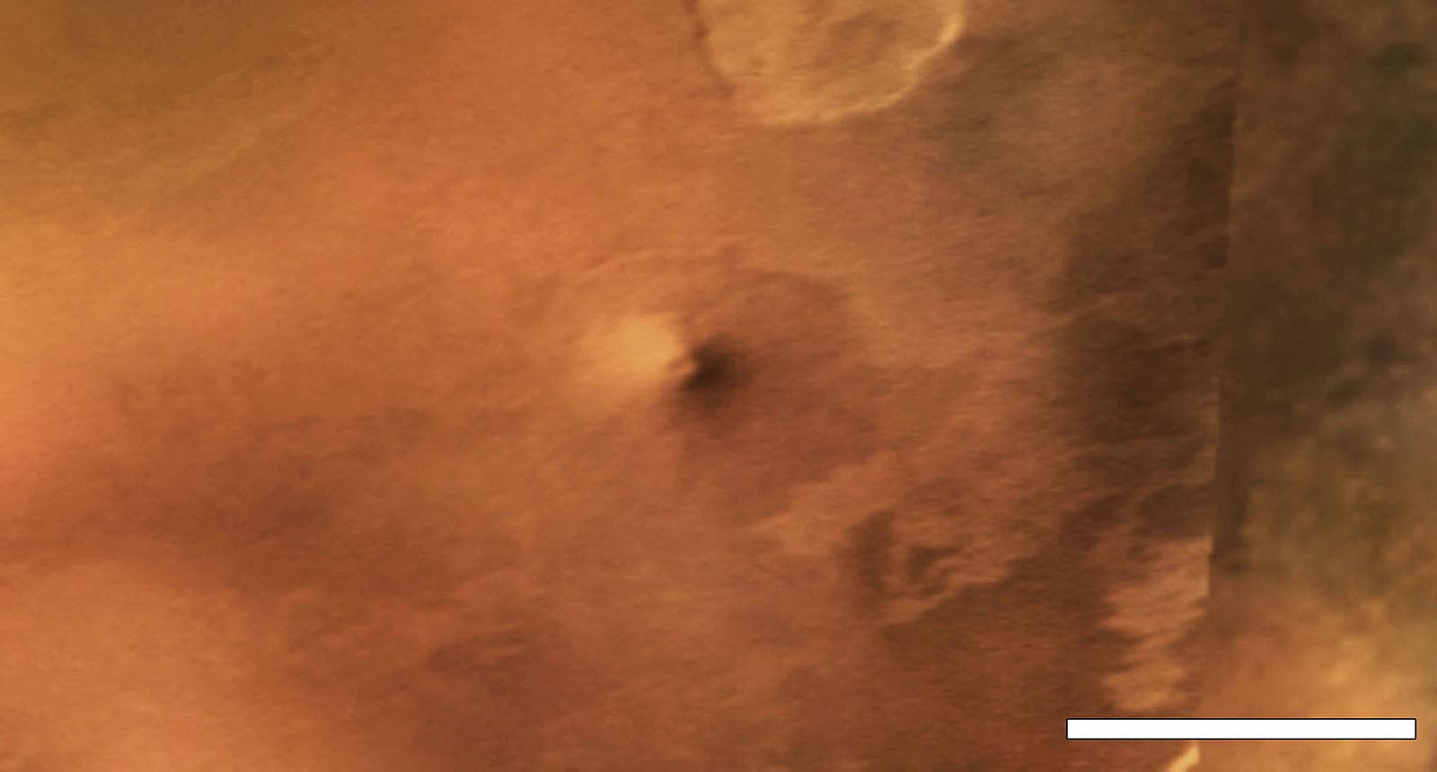
Volcanic constructs > Shield volcano

Slide 15
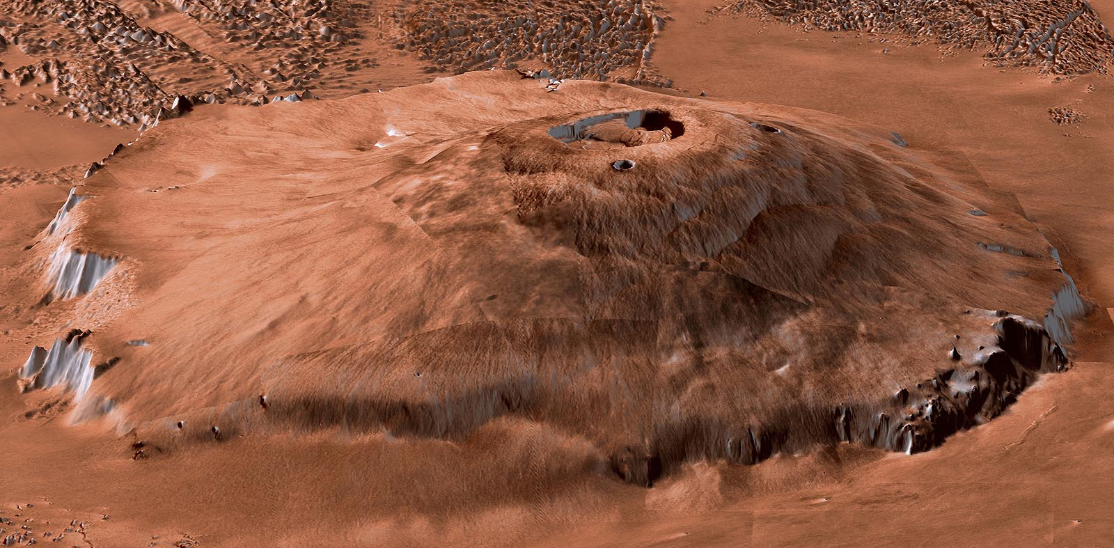
Volcanic constructs > shield volcano

Slide 16
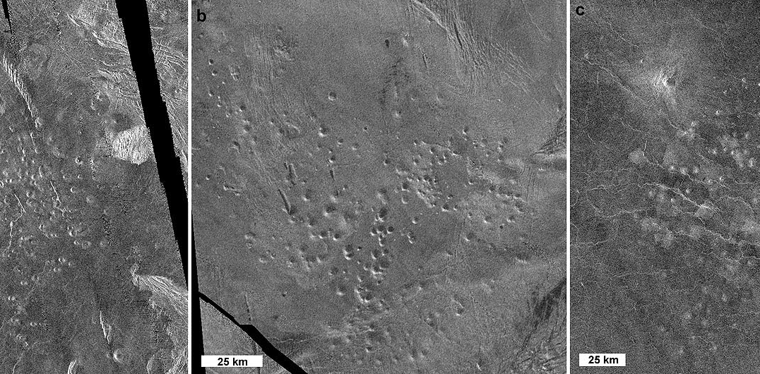
Volcanic constructs > shield field

Slide 17
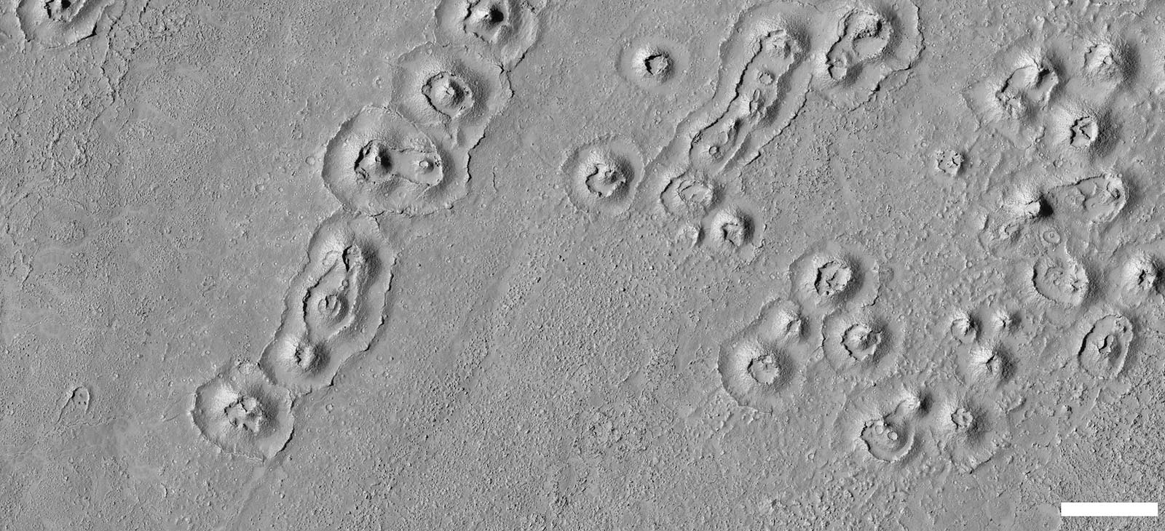
Volcanic constructs > basaltic ? ring

Slide 18
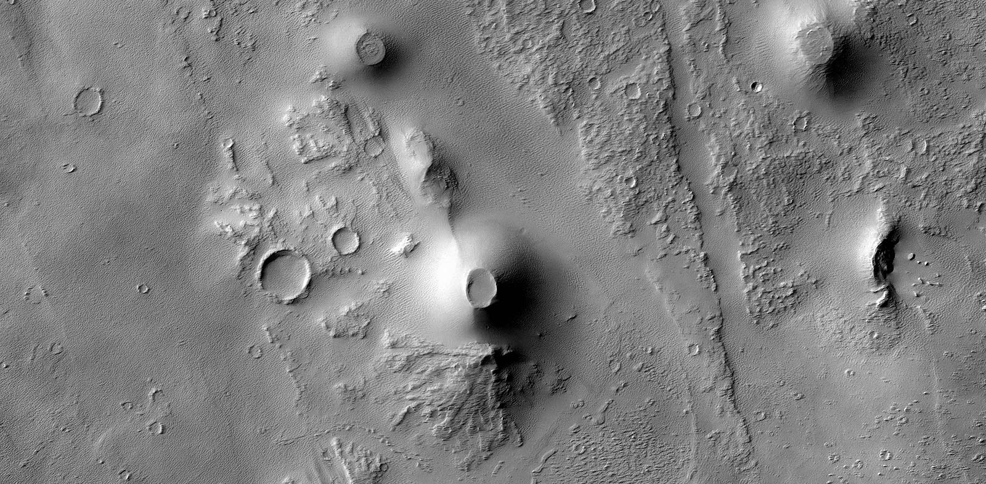
Volcanic constructs > Cinder cone

Slide 19
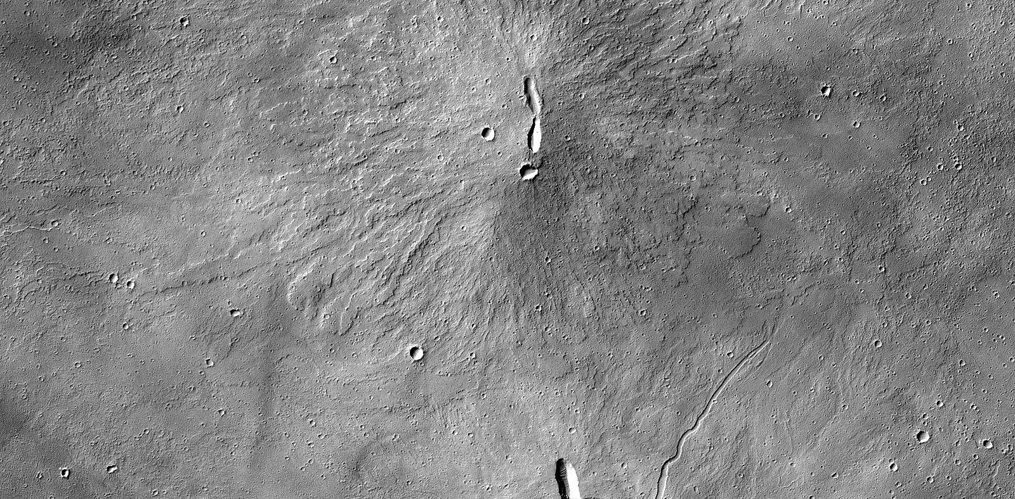
Volcanic constructs > low shield

Slide 20
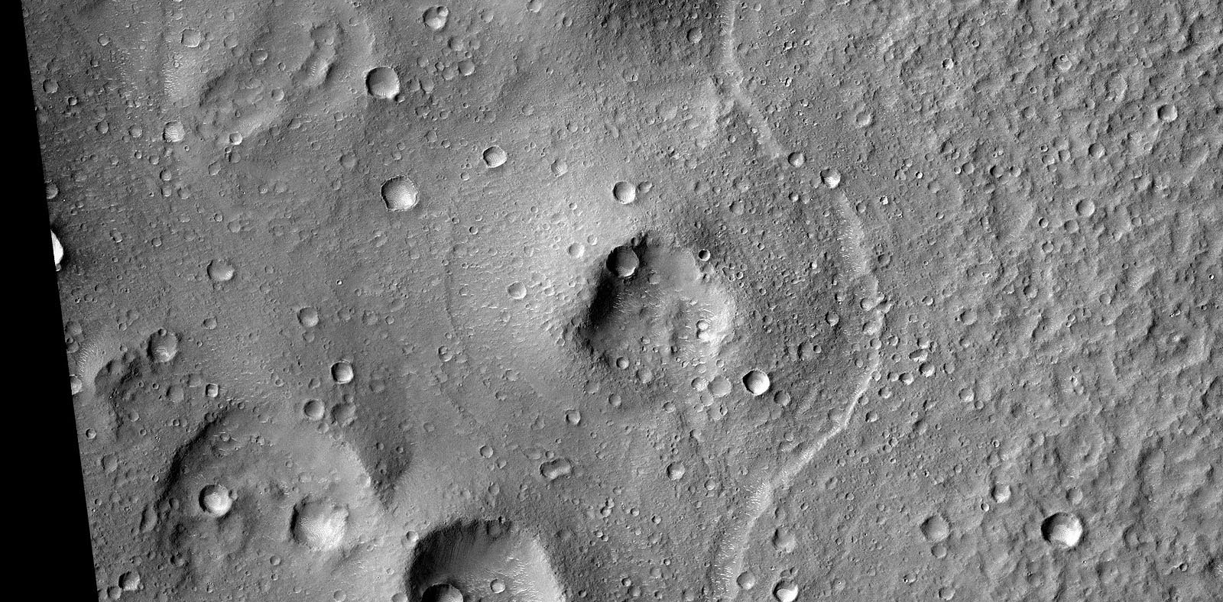
Volcanic constructs > tuff ring

Slide 21
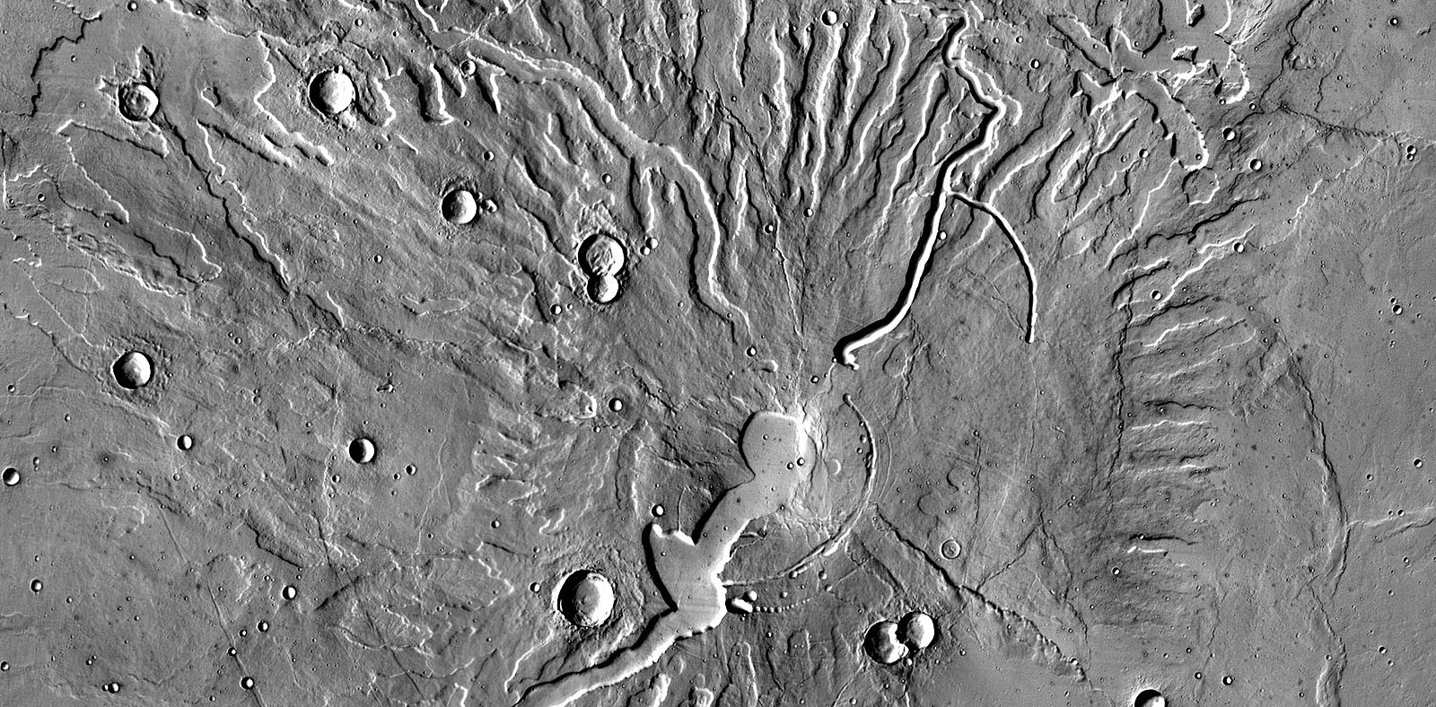
Volcanic constructs > highland patera

Slide 22
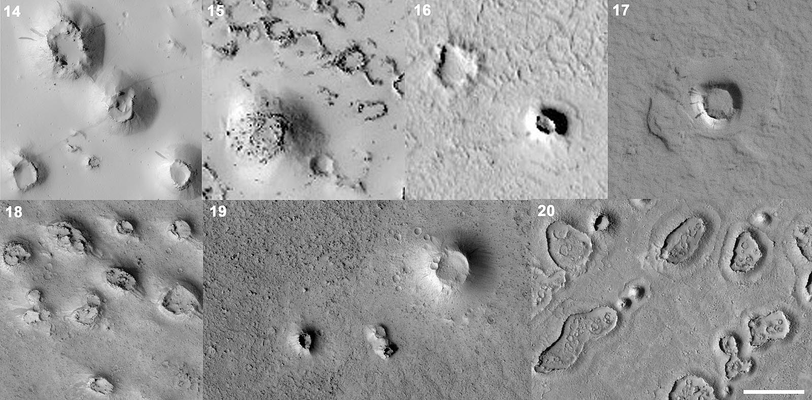
Volcanic constructs > rootless cones (?)

Slide 23
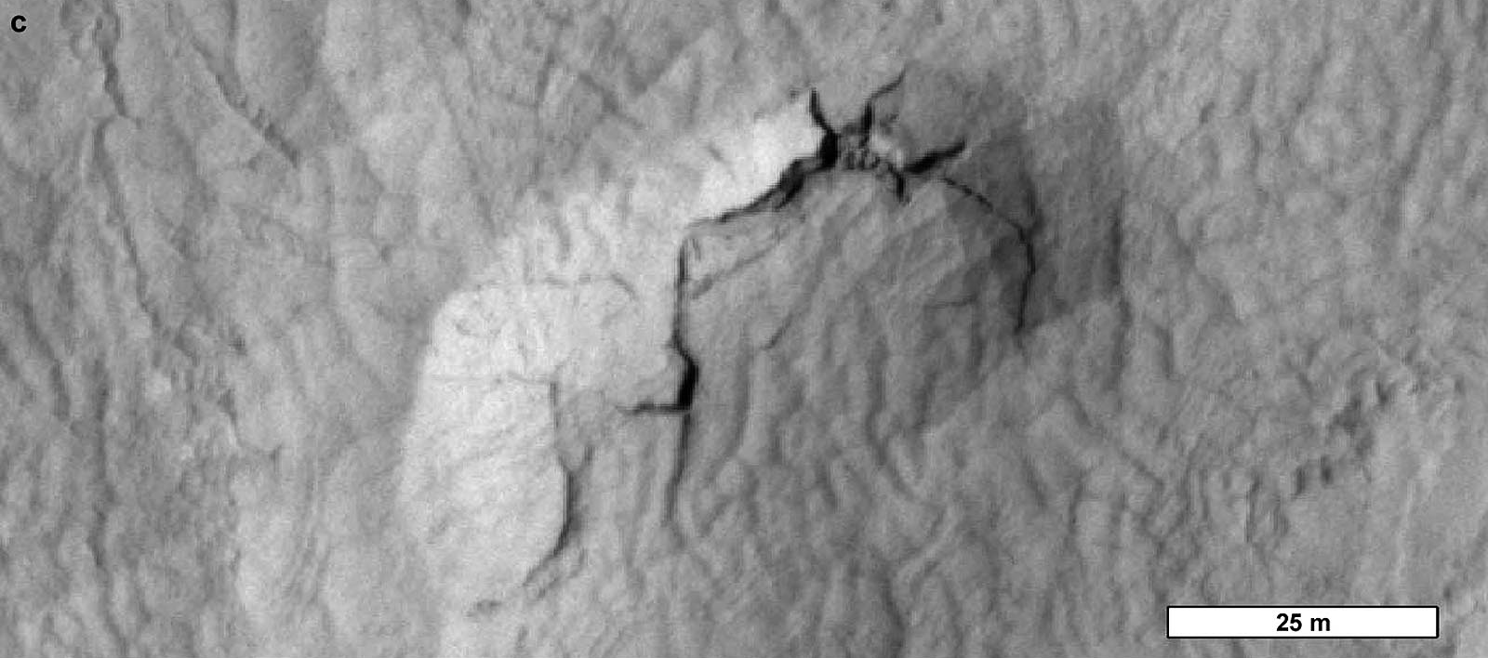
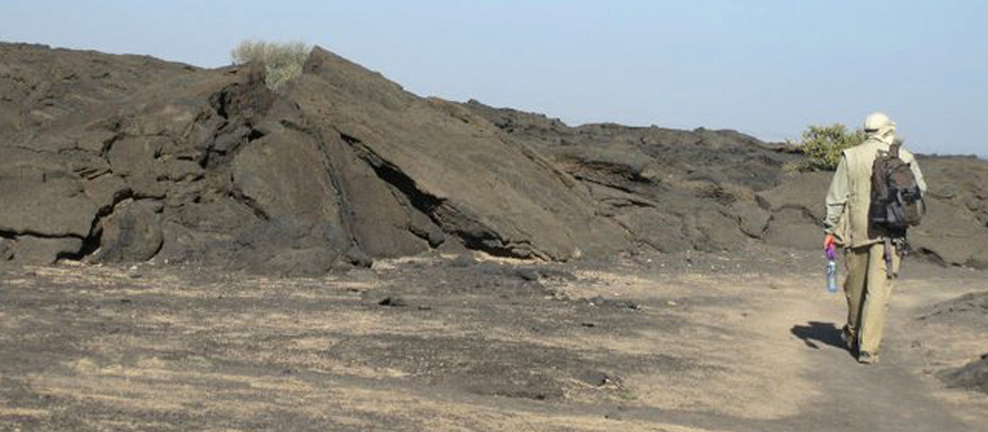
Volcanic constructs > Tumuli

Slide 24
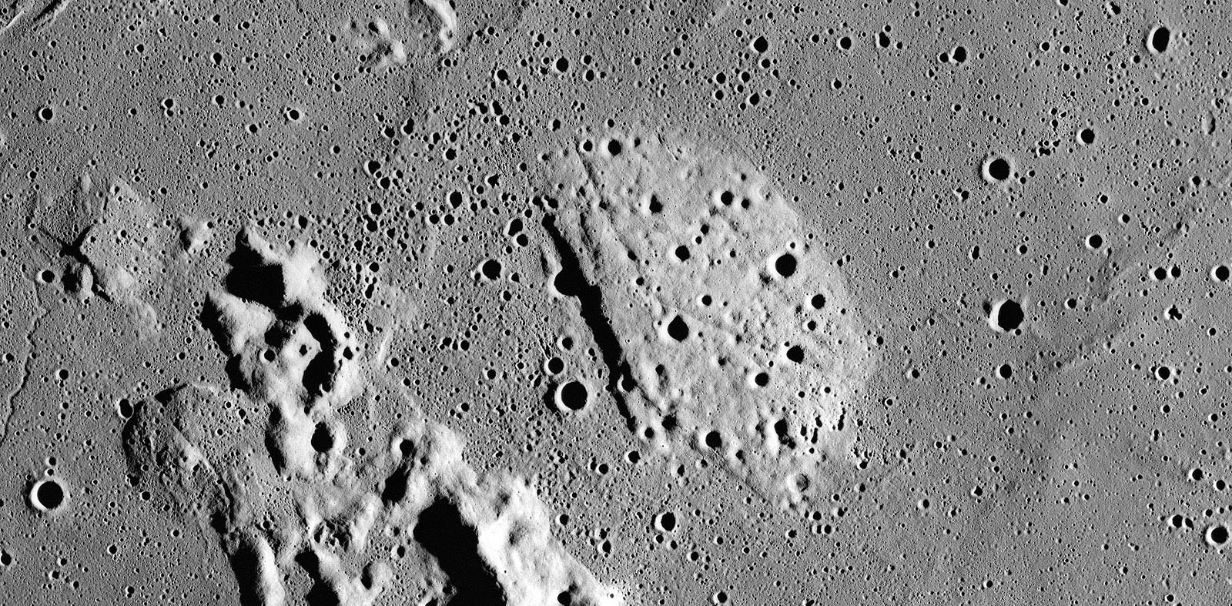
Volcanic constructs > kipuka

Slide 25
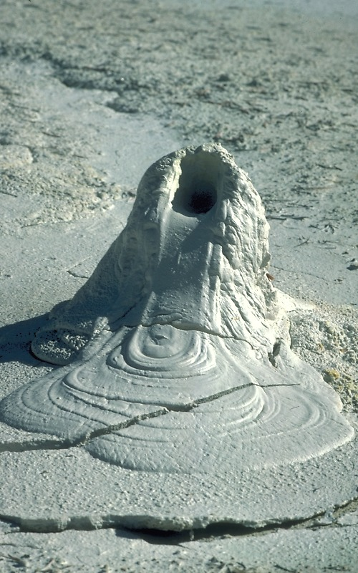
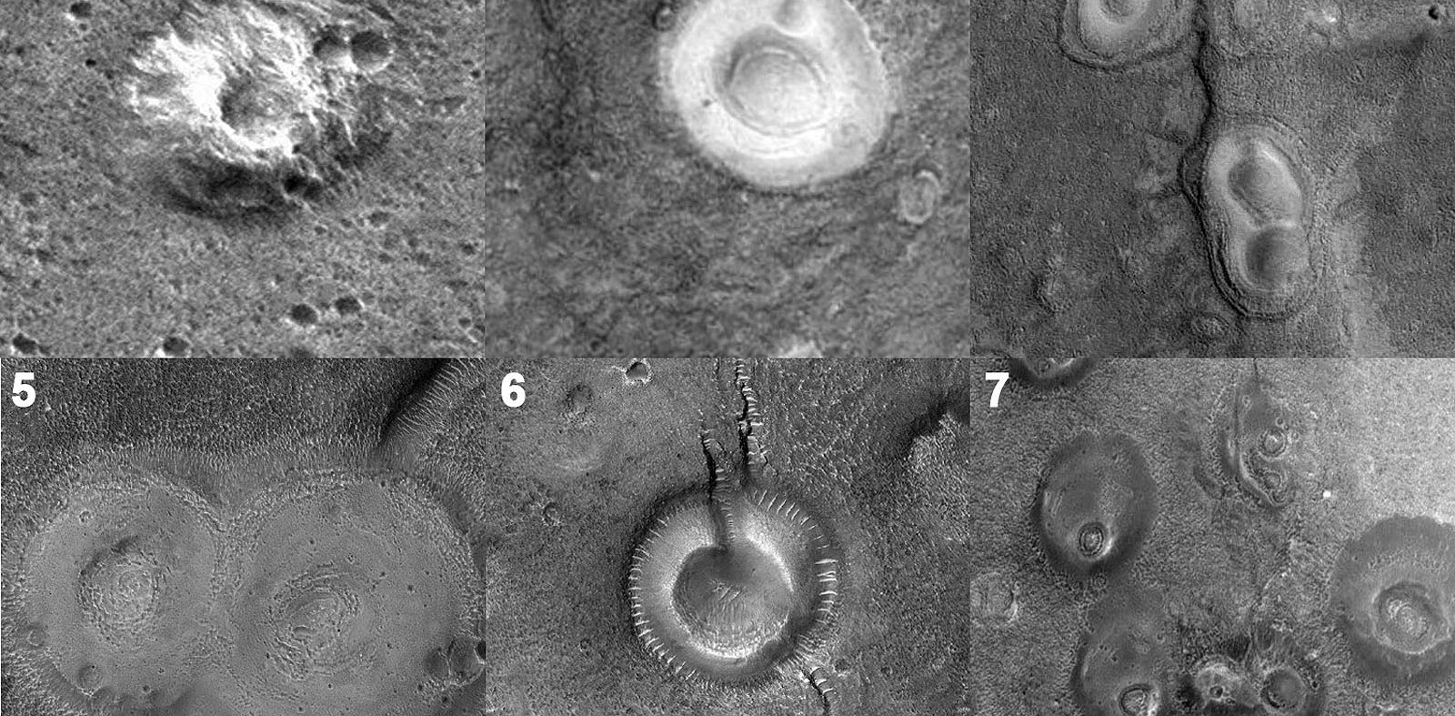
Volcanic constructs > Mud volcanoes ?

Slide 26
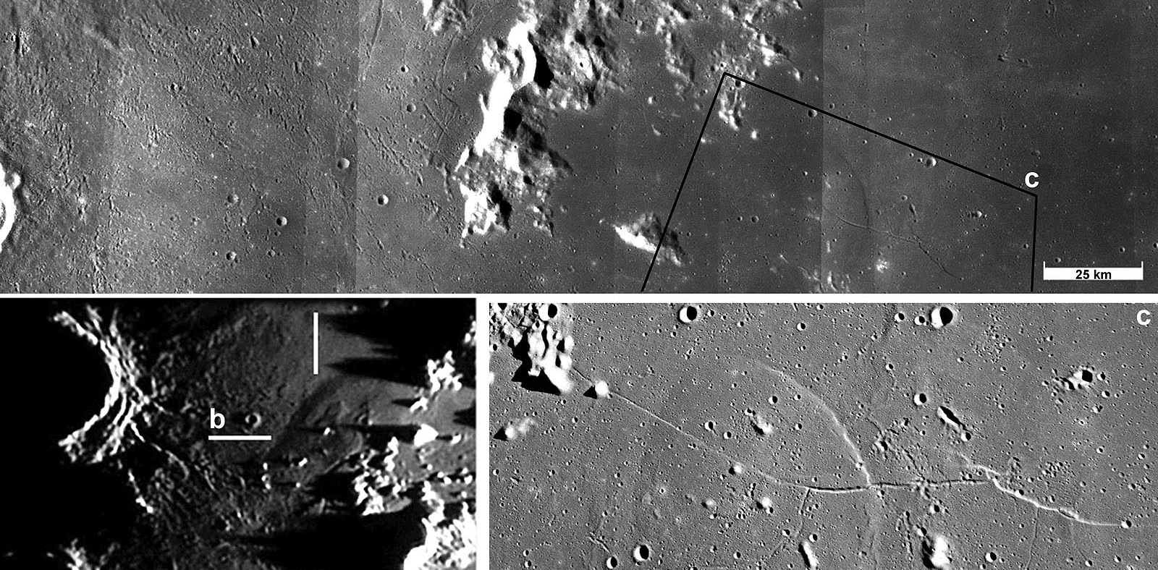
Volcanic, magmatic features > Magmatic intrusion structure

Slide 27
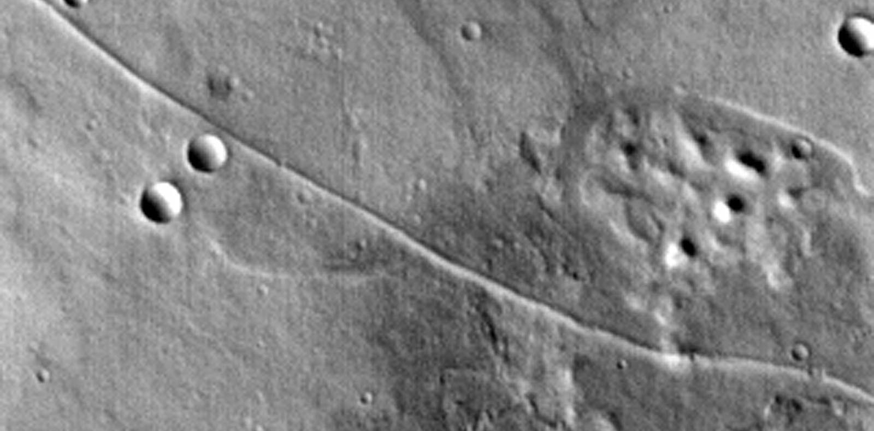
Volcanic, magmatic features > Dike

Slide 28
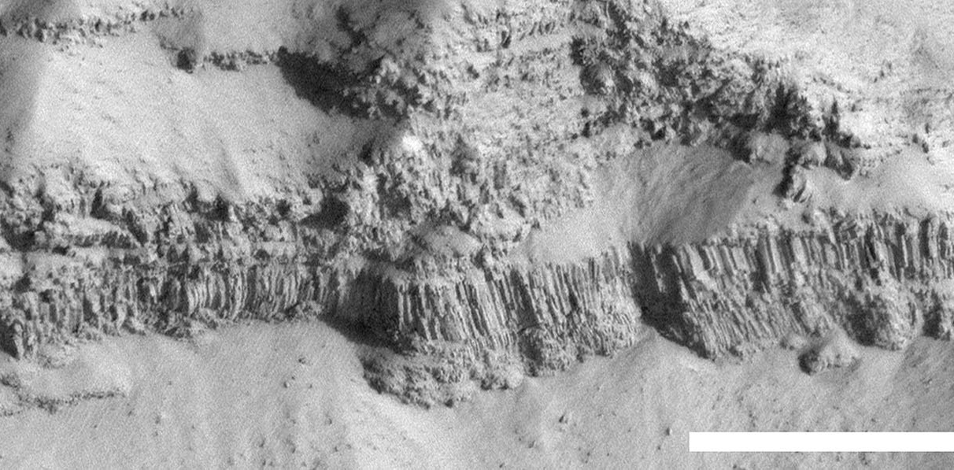
Volcanic, magmatic features > Columnar joint

Slide 29
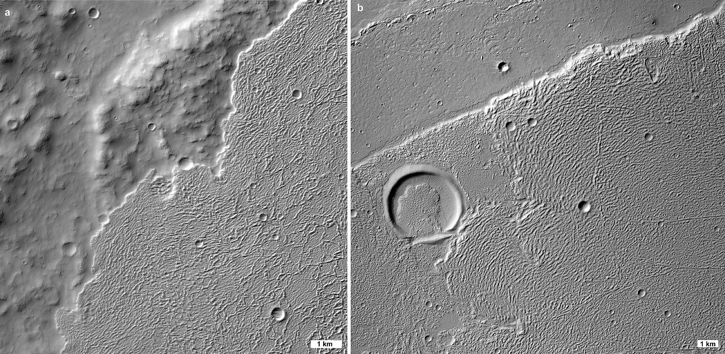
Volcanic, magmatic features > festoon

Slide 30
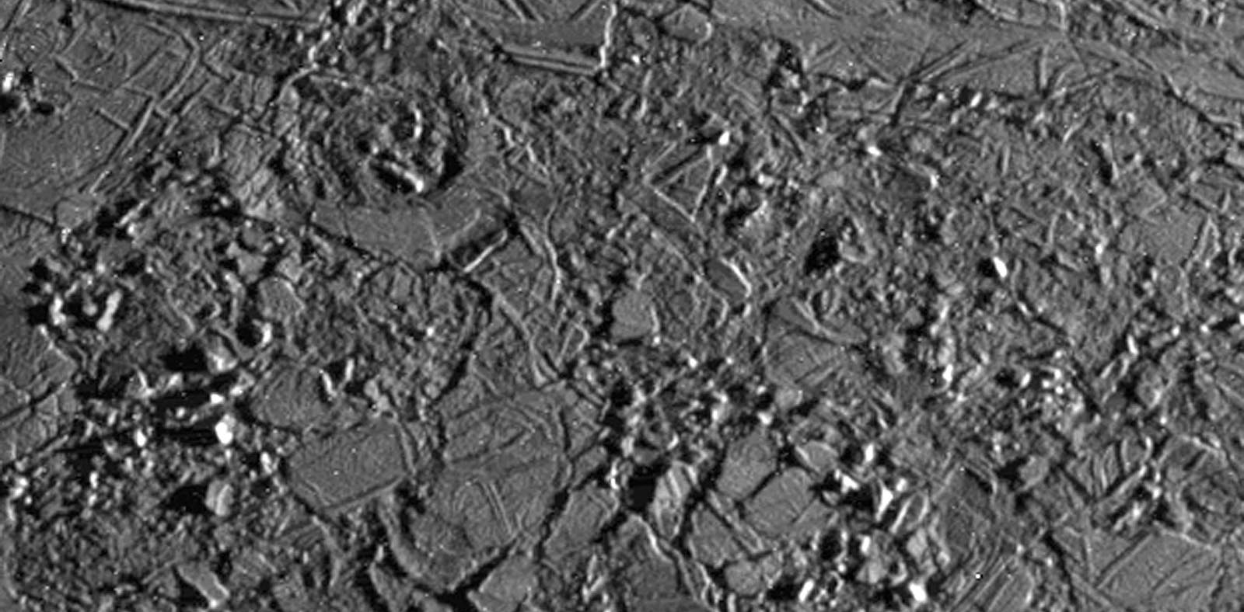
Volcanic, magmatic features > platy material

Slide 31
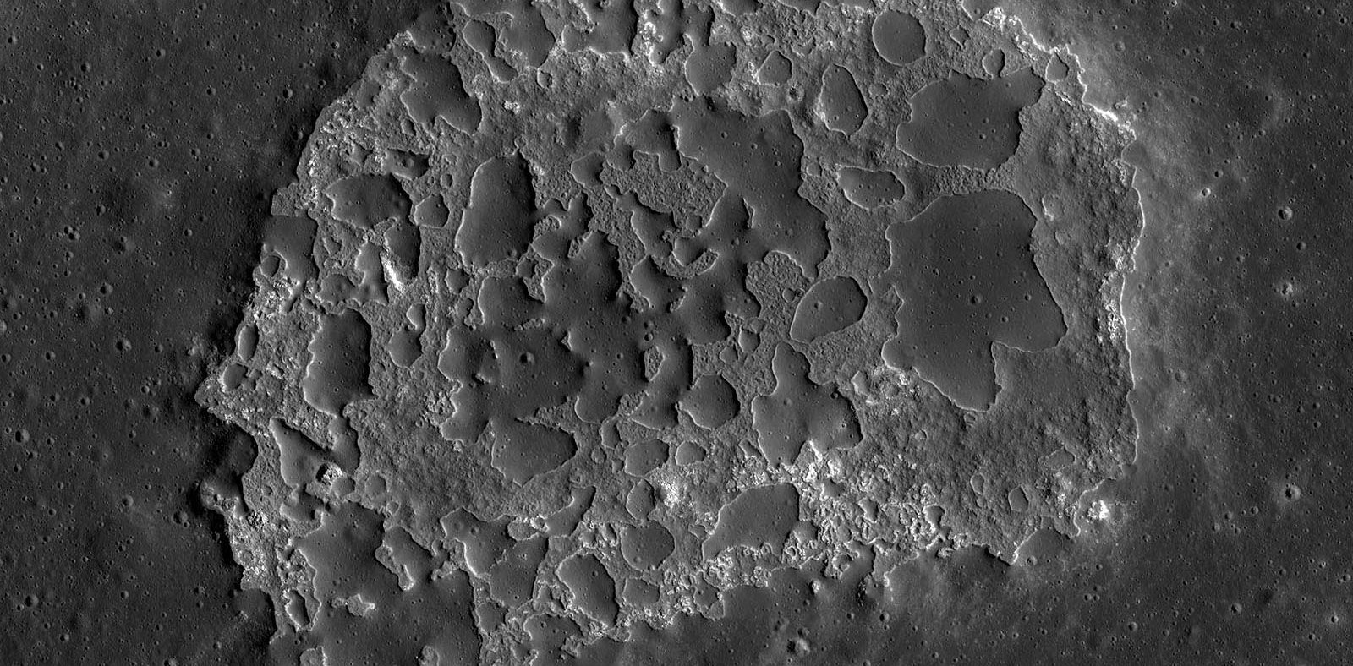
Volcanic, magmatic features > inflated lava flow

Slide 32
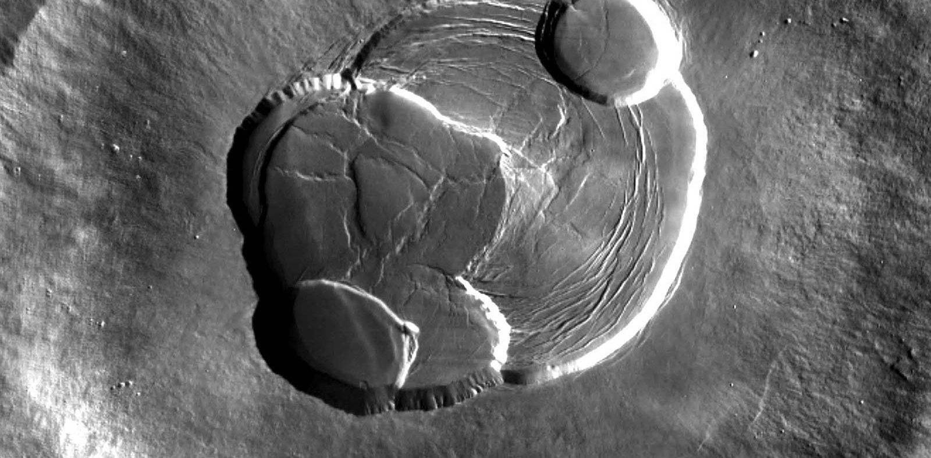
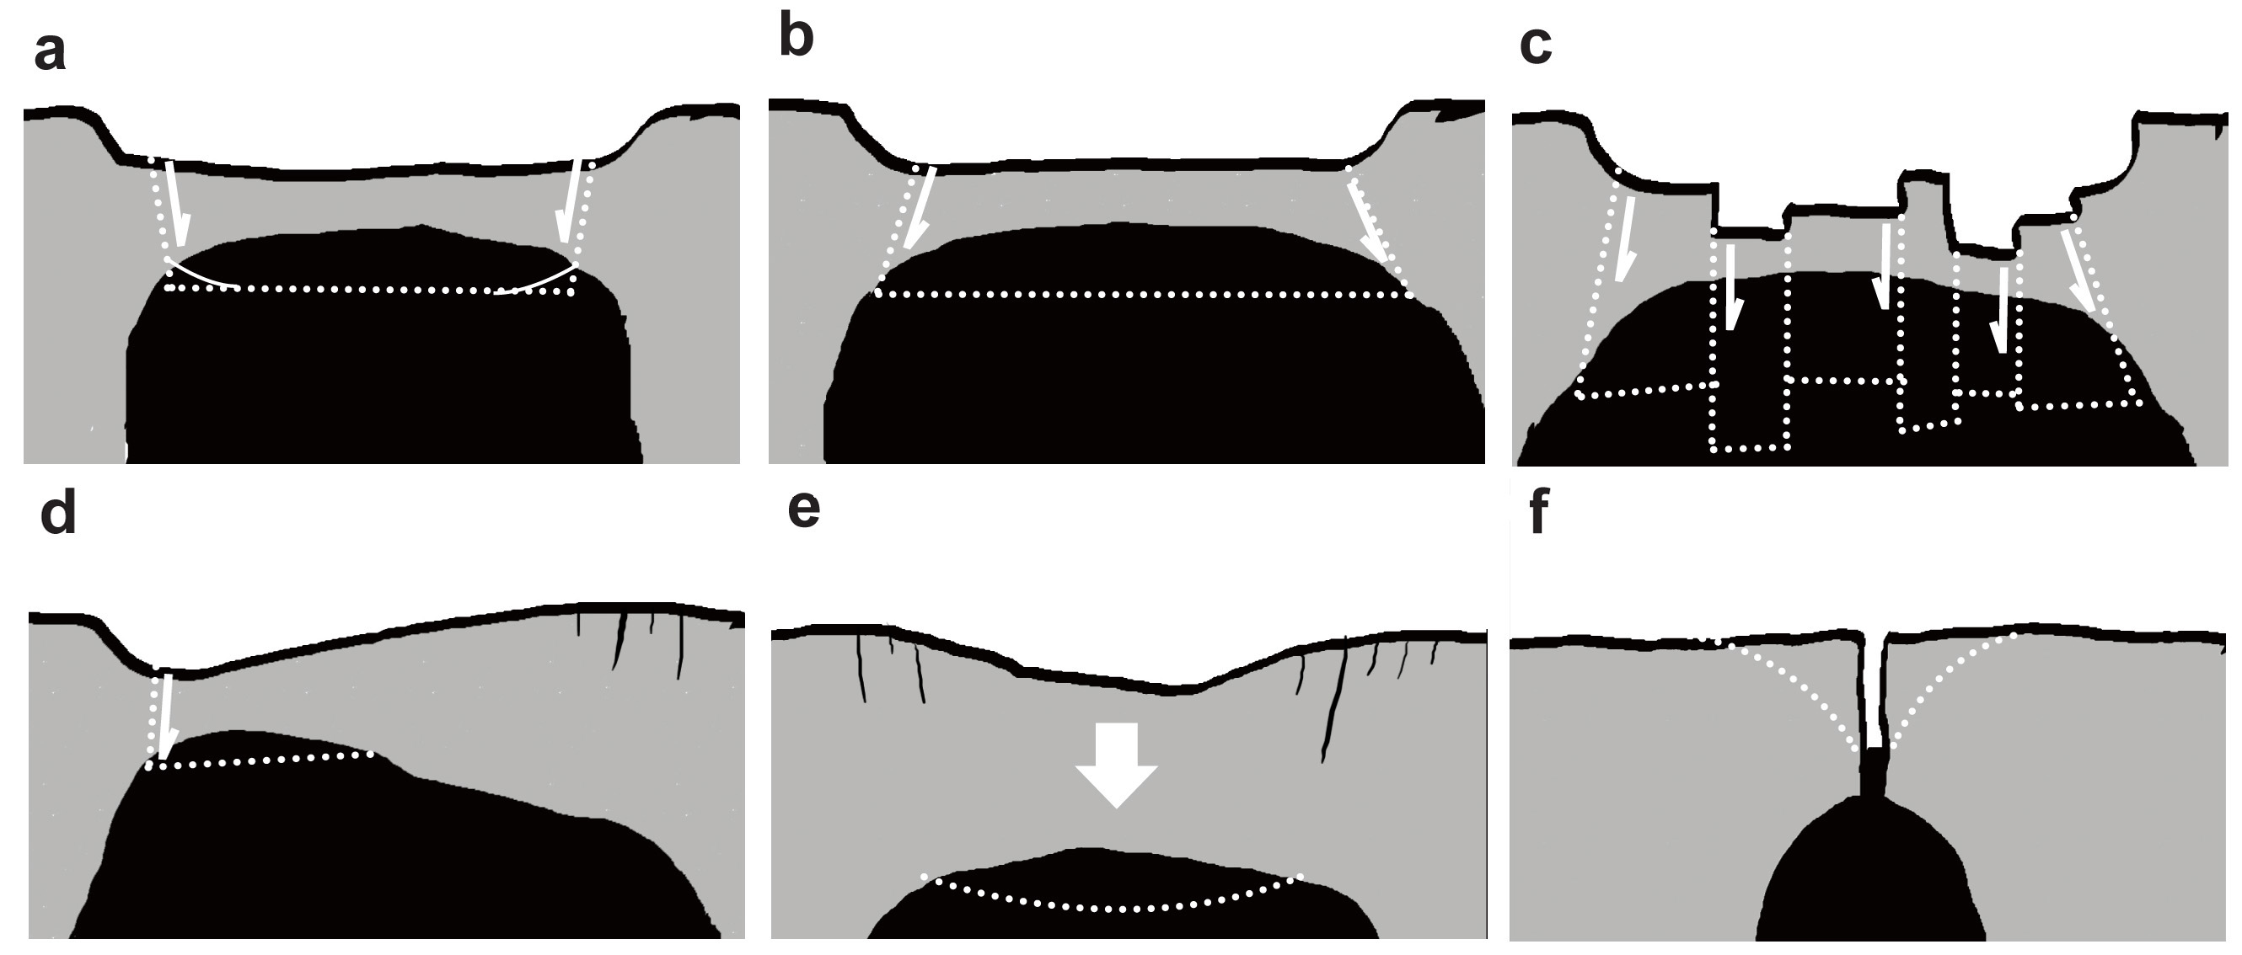
Volcanic, magmatic features >caldera

Slide 33
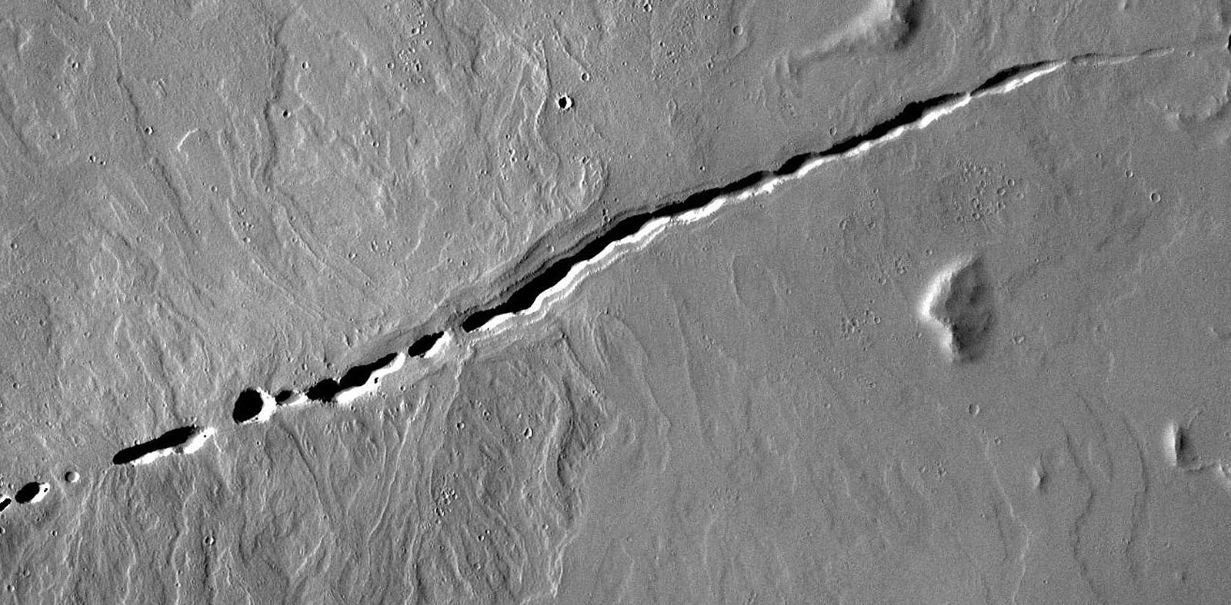
Volcanic, magmatic features > fissure vent

Slide 34
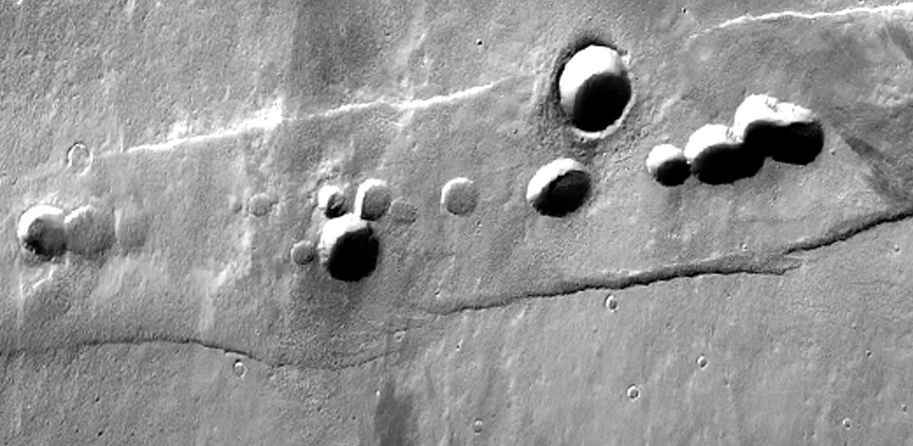
Volcanic, magmatic features > Pit crater

Slide 35
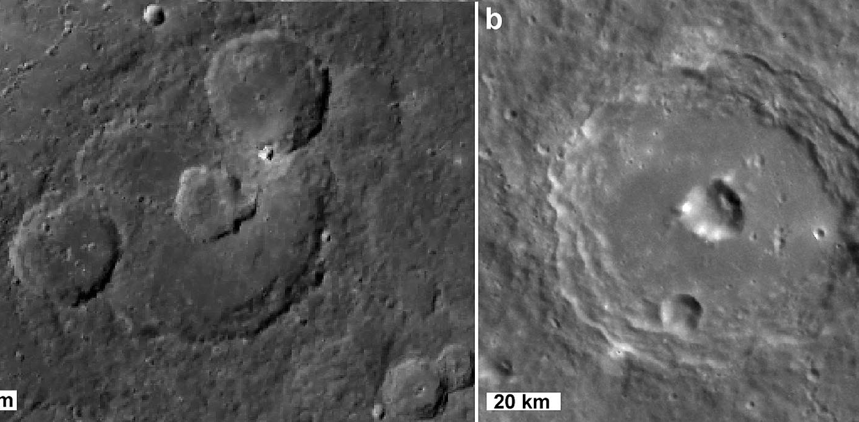
Volcanic, magmatic features > Pit floor crater

Slide 36
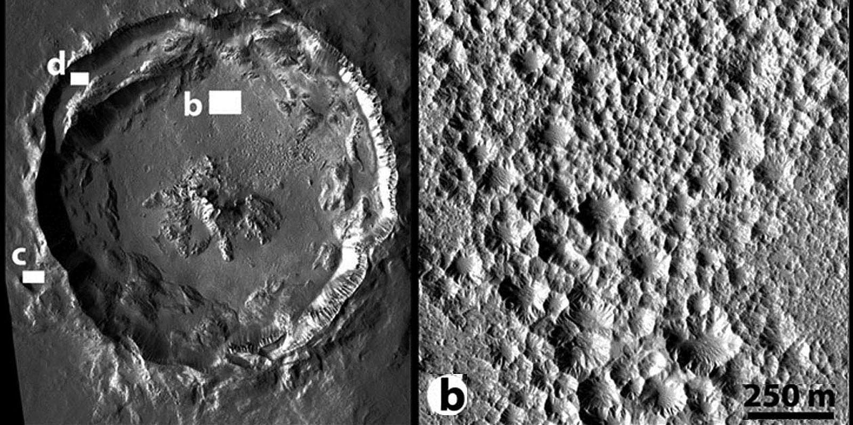
Volcanic, magmatic features > Pits on crater floor

Slide 37
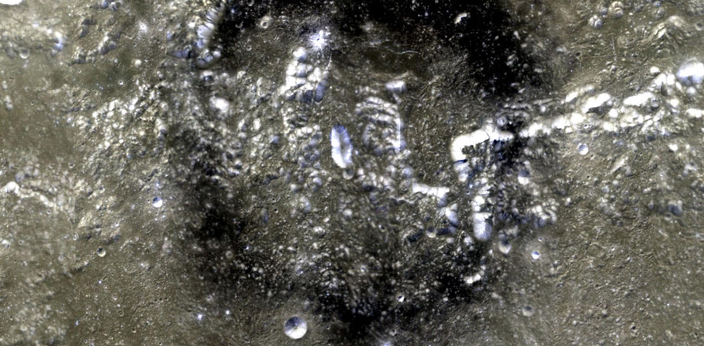
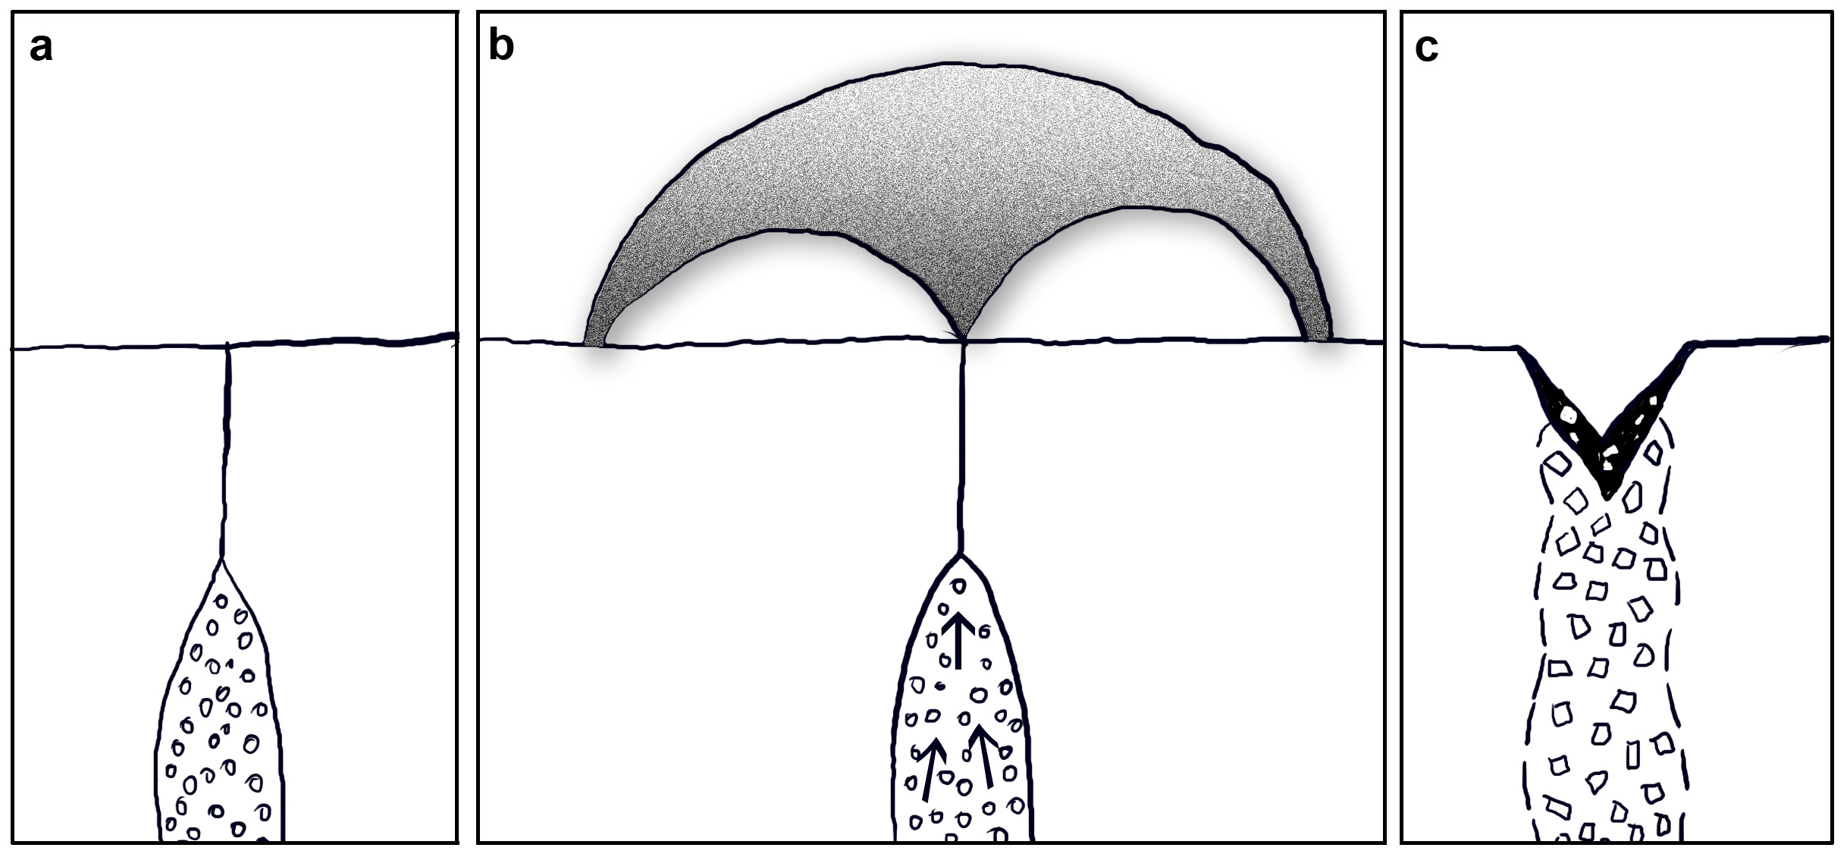
Volcanic deposits > Dark mantle deposit

Slide 38
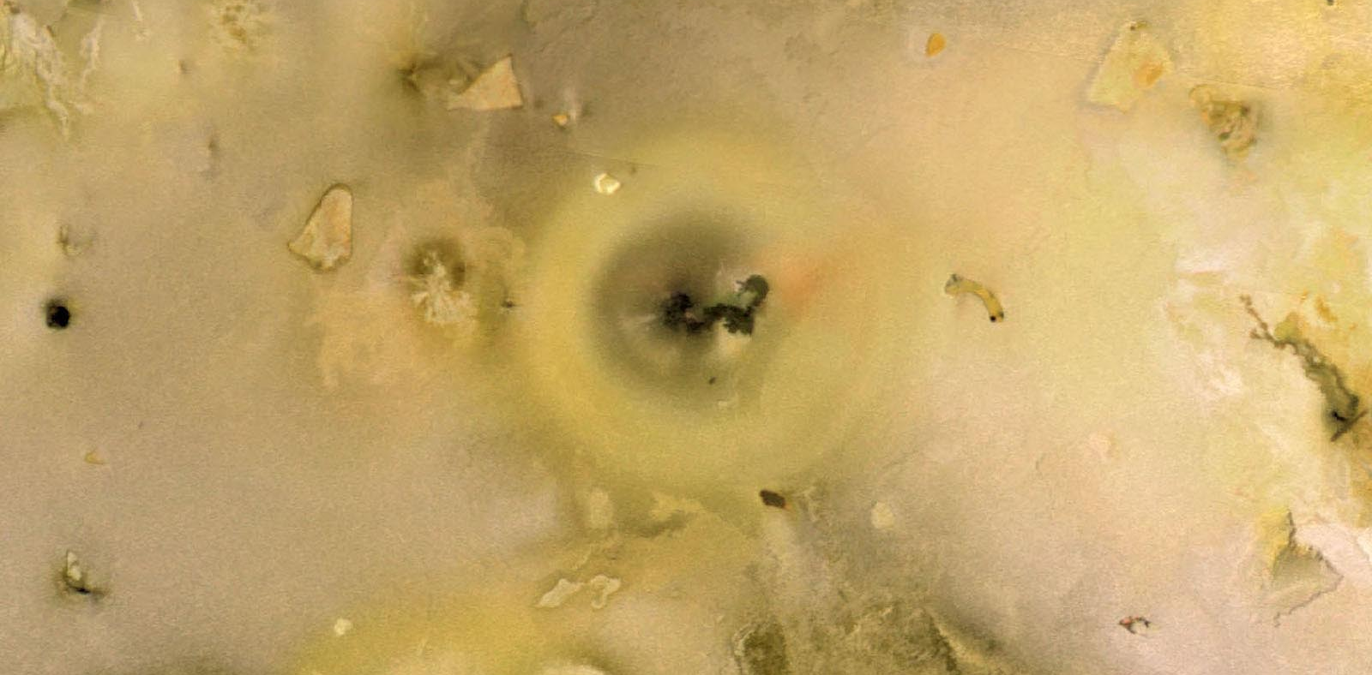
Volcanic deposits > Diffuse deposit

Slide 39
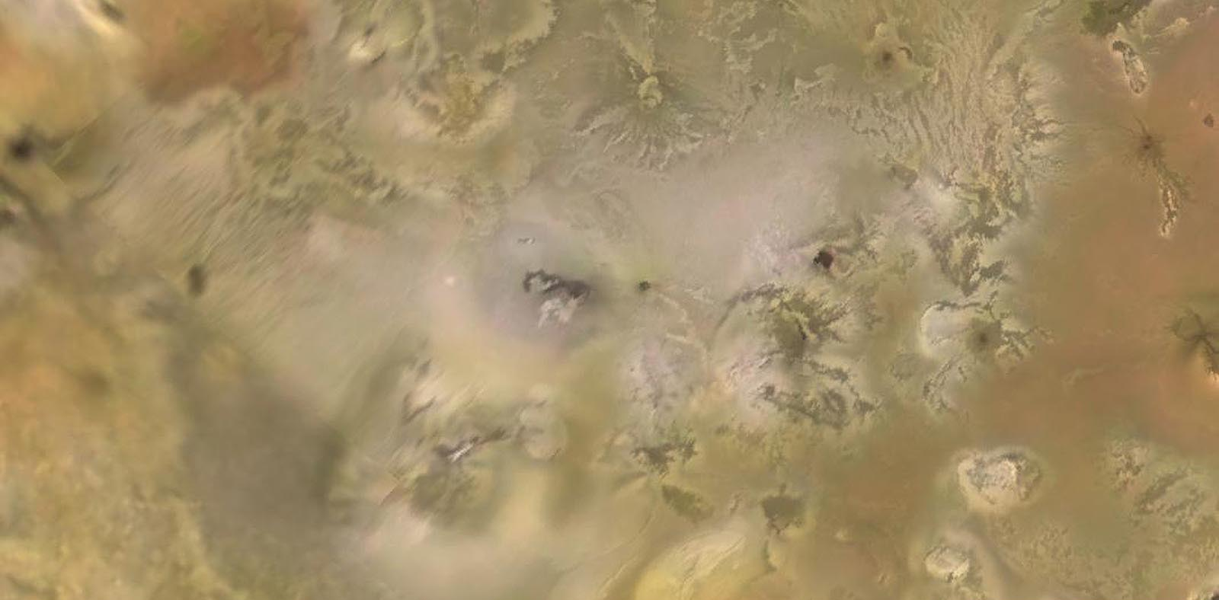
Volcanic deposits > Bright plains

Slide 40
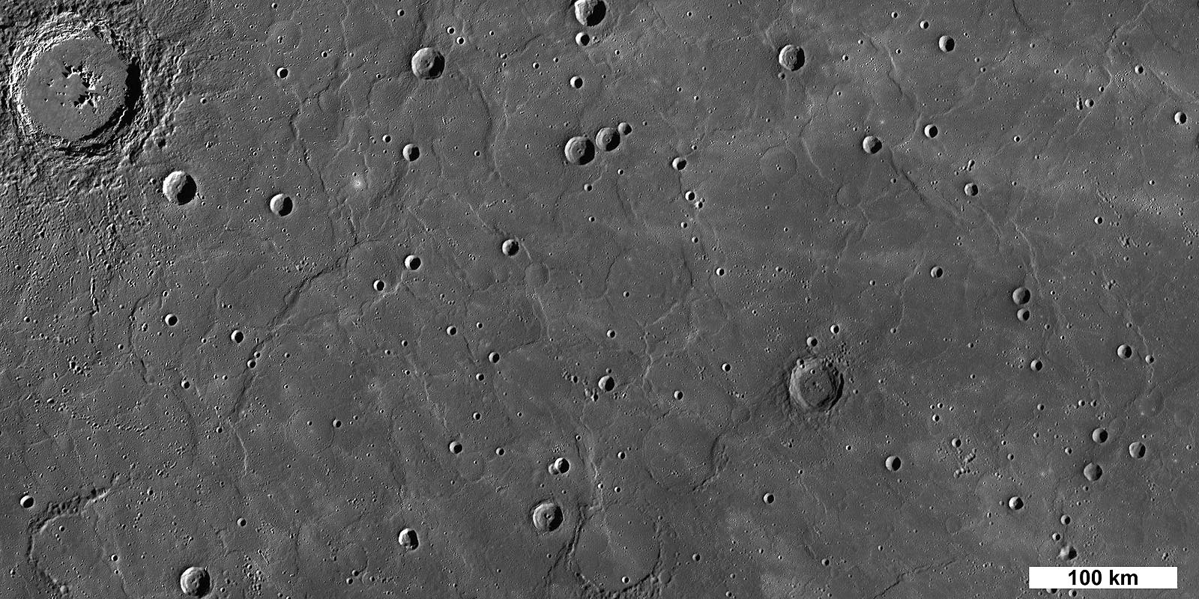
Volcanic deposits > Volcanic plain

Slide 41
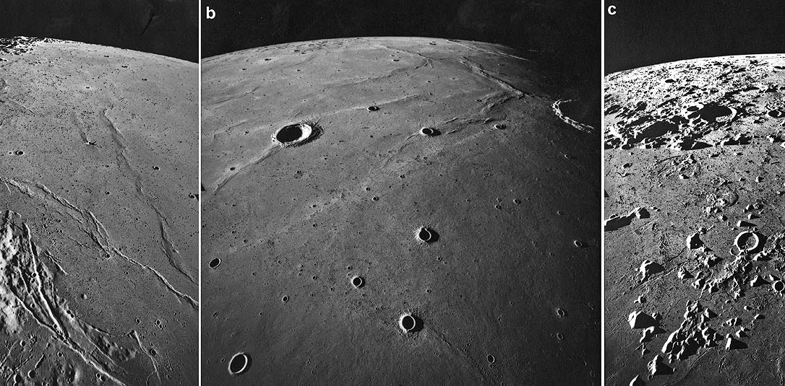
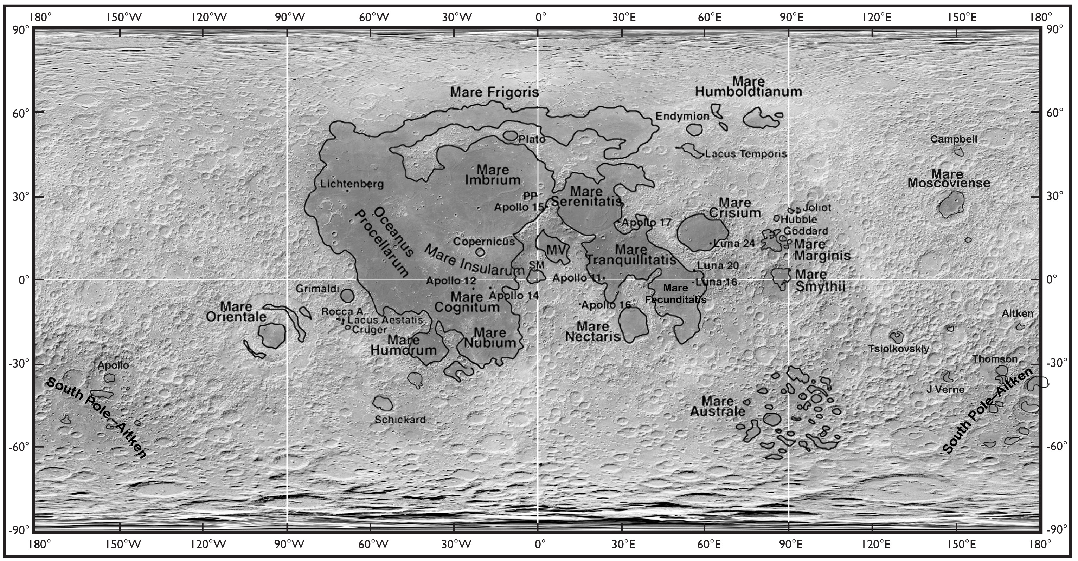
Volcanic deposits > Mare, Moon

Slide 42
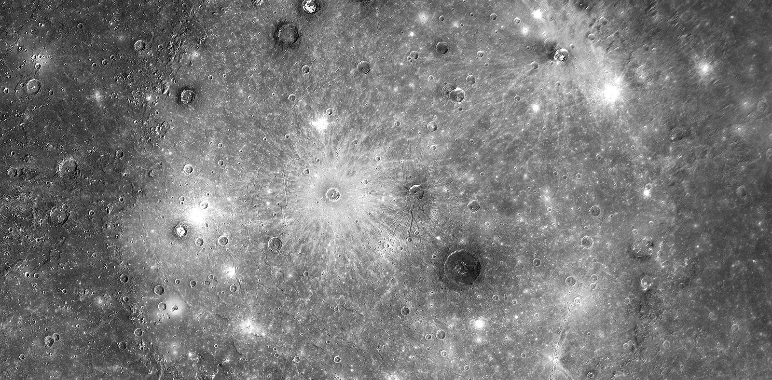
Volcanic deposits > High rflectance plains

Slide 43
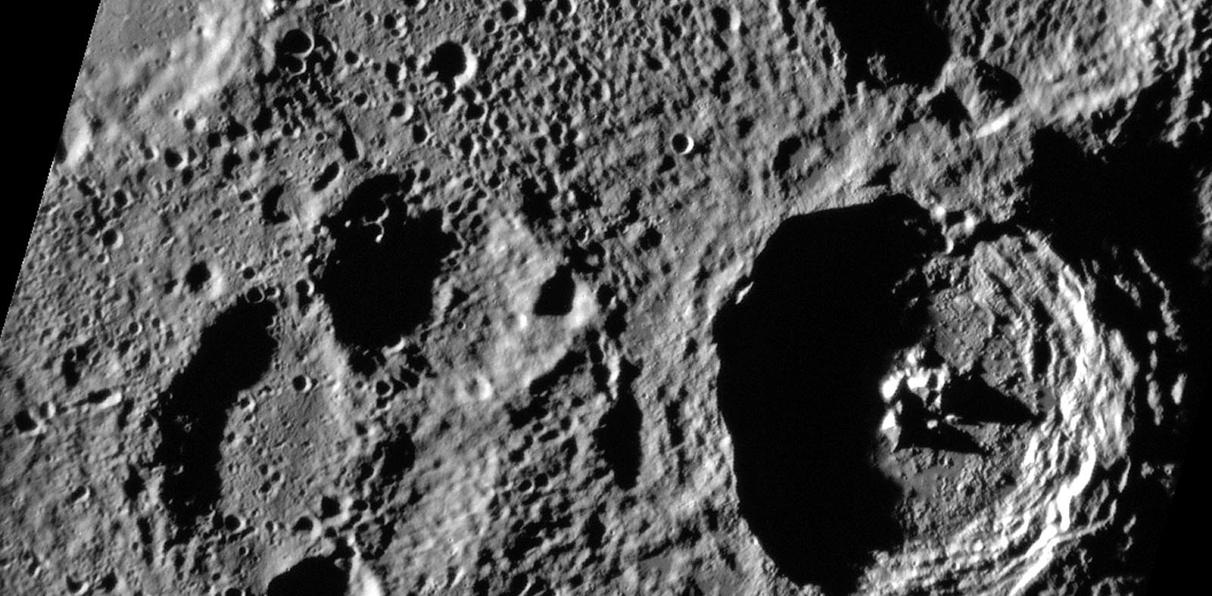
Volcanic deposits > Intercrater plains

Slide 44
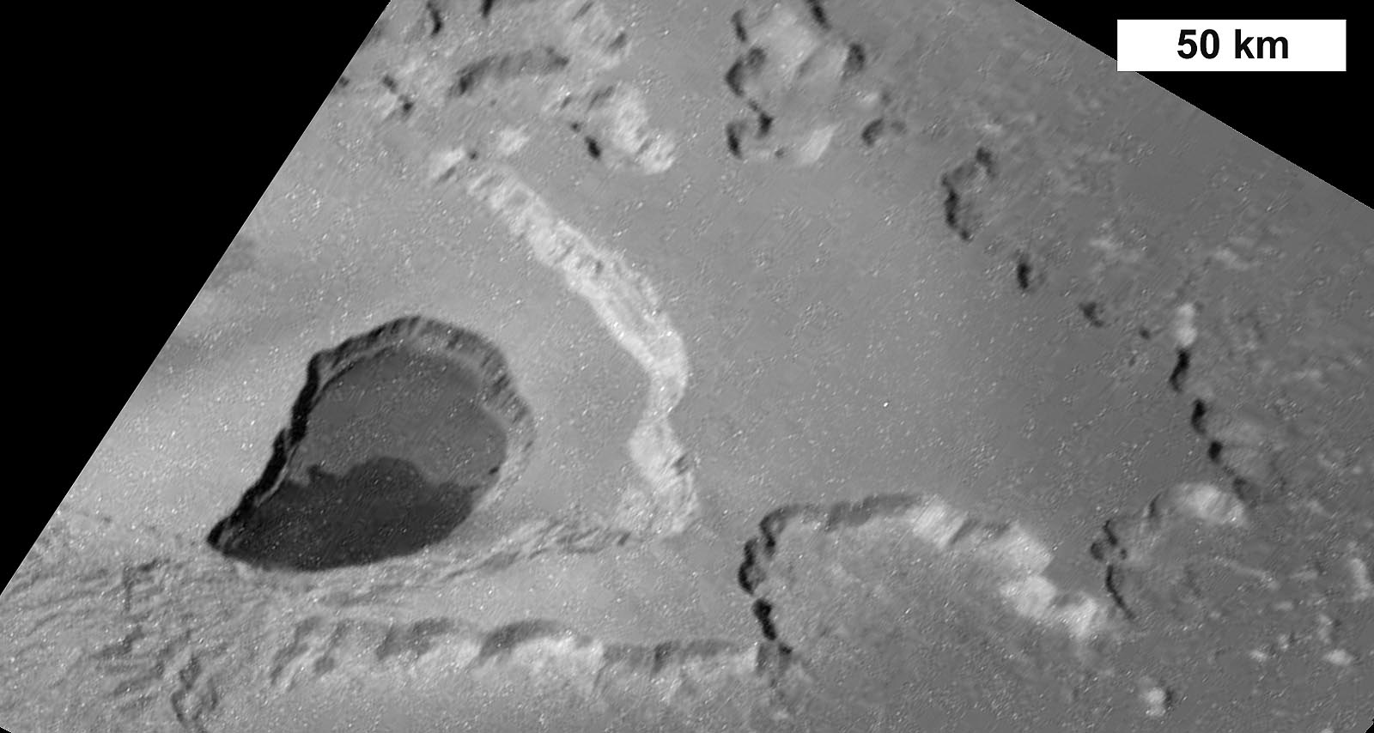
Volcanic > Layered plains

Slide 45
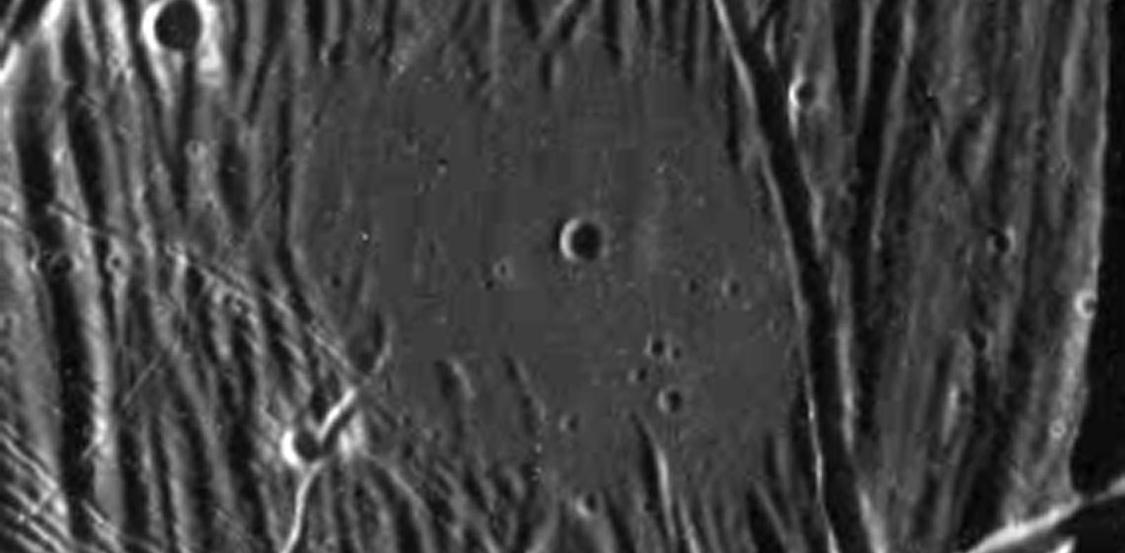
Ice related forms > Cryovolcano

Slide 46

Impact melts > Crater outflow

Slide 47


Volcanic > Pressure ridge

Slide 48

Volcanic > Lava coil

Slide 49

Volcanic > Levee

Slide 50

Volcanic > Channel

Slide 51

Volcanic > Lava channel

Slide 52

Volcanic > Sinuous rille

Slide 53

Erosional forms > Chaotic terrain Venus

Slide 54

Volcanic > Canali

Slide 55

Volcanic forms > Crevasse splay

Slide 56

Volcanic forms > Lava flow (delta)

Slide 57

volcanic > Theater channel Venus

Slide 58

Volcanic / Tectonic > Valley network Venus

Slide 59

Volcainc > Lava tube

Slide 60

Volcanic > Pit crater chain

Slide 61


Volcanic > Skylight

Slide 62

pit

Slide 63

Other > Cave

Slide 64
Key concepts
Volcanic forms are made of materials from below the surface
Materials include magma (lava on surface), pyroclastic fragments (solid) and gas
Forms include
  positive forms (cones, shields, rings)
  negative forms (channels, collapse pits, calderas)
  flat forms (lava plains, diffuse deposits)
  Lava flows may form
    lobate lava flows and
    channelized flows
      that may become a tunnel

