Slide 1
Planetary landforms
A visual introduction to planetary geomorphology
TECTONICS
HENRIK HARGITAI
2019
csplanetolg17em
FÖL/1/075E
Definitions in the Notes section

Slide 2
TECTONIC FORMS

Slide 3
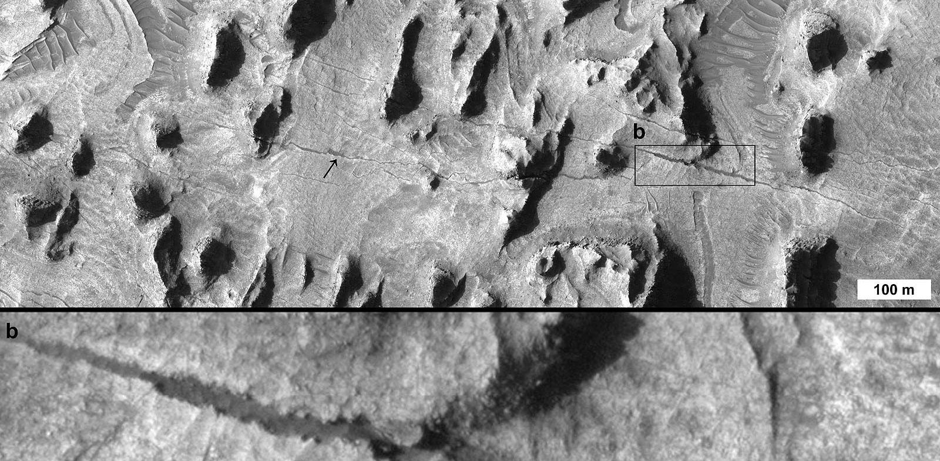
Tectonic forms > Joint

Slide 4
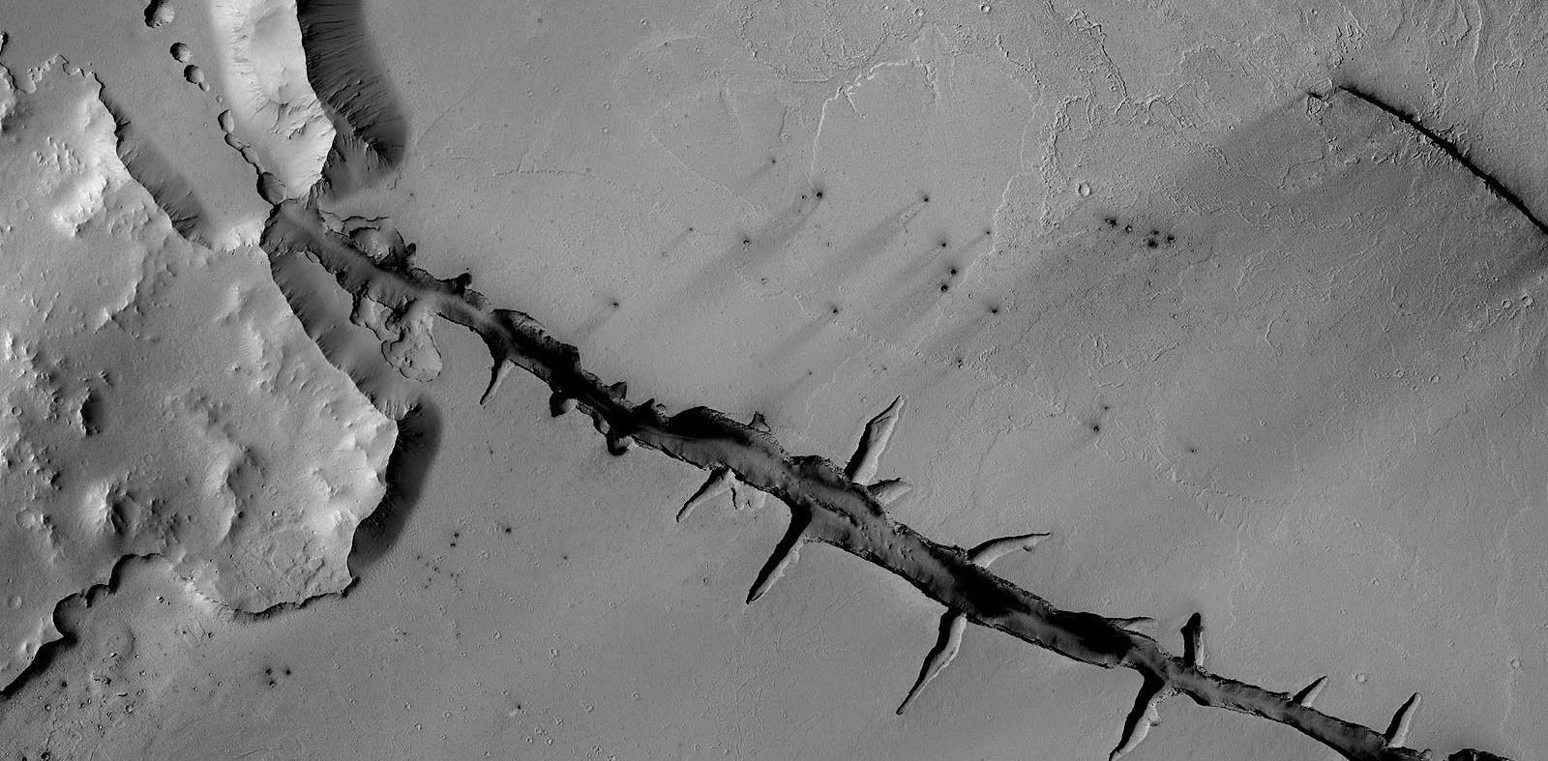
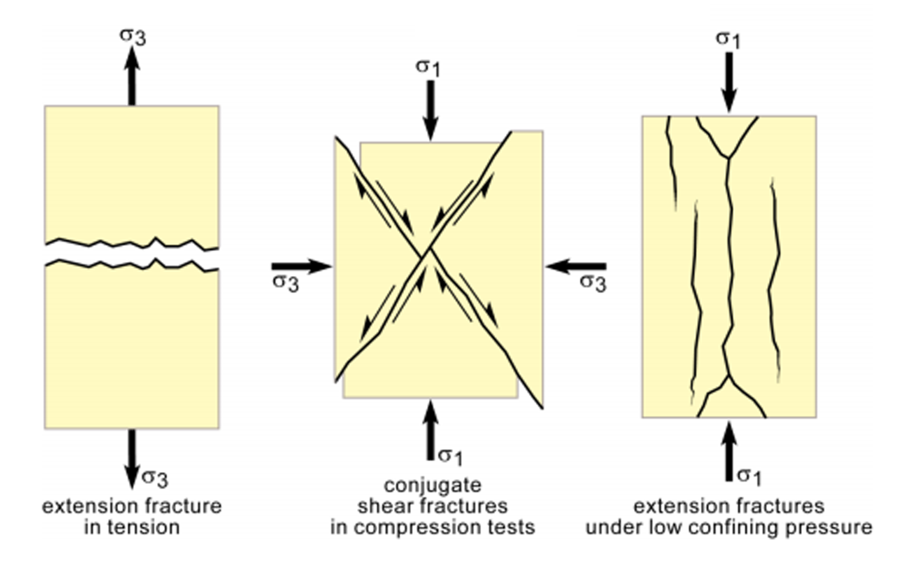
Tectonic forms > Fracture

Slide 5
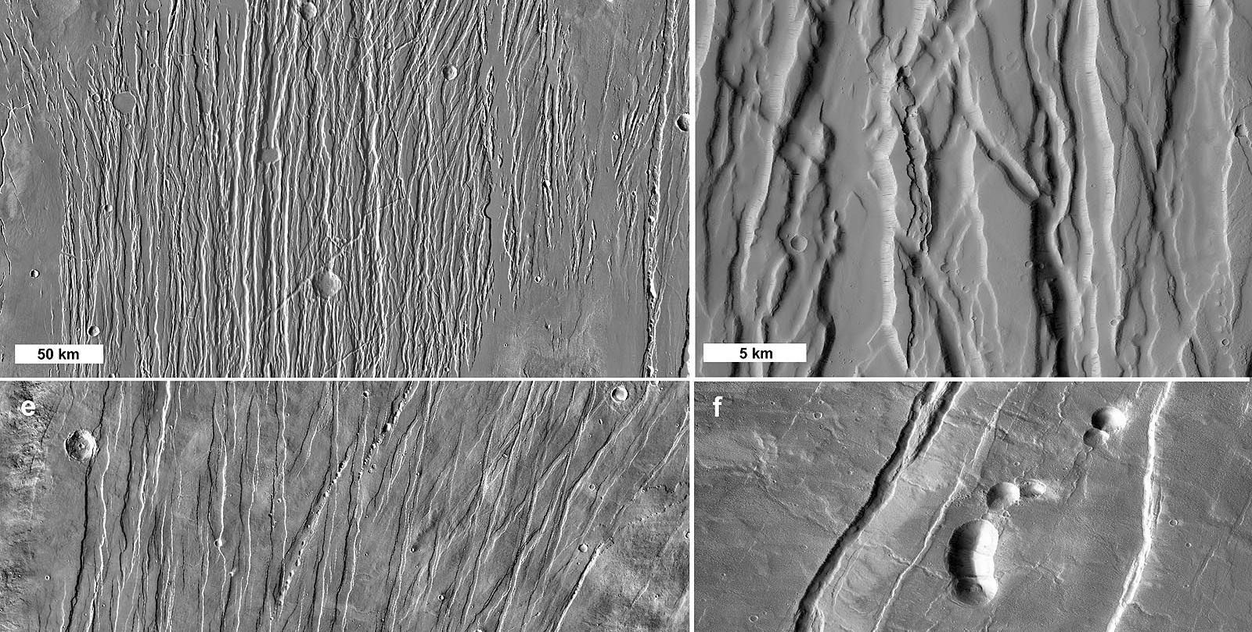
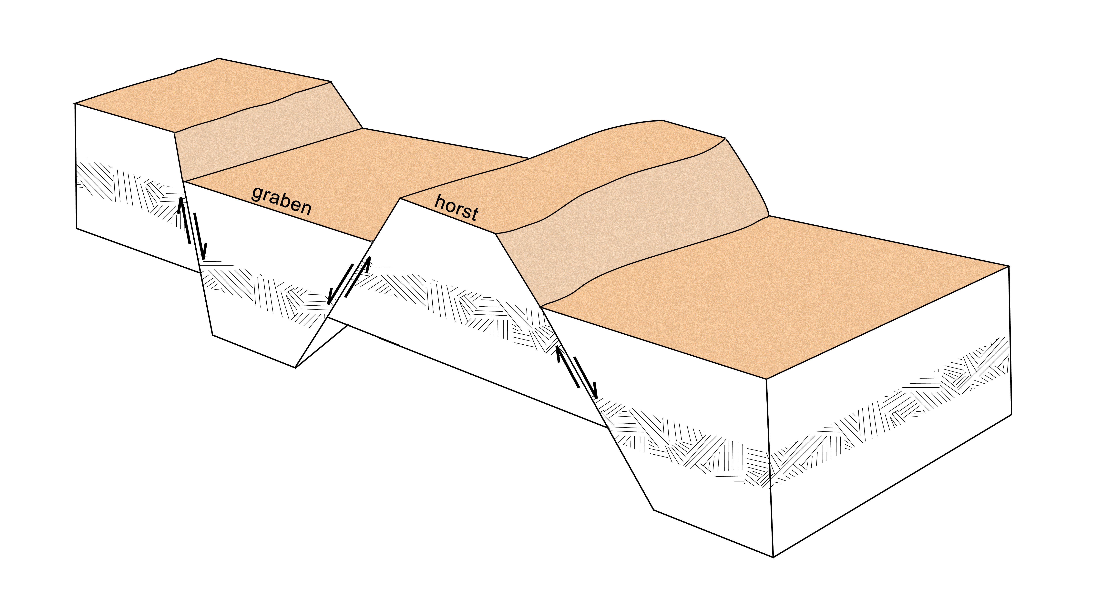
Tectonic forms > graben

Slide 6
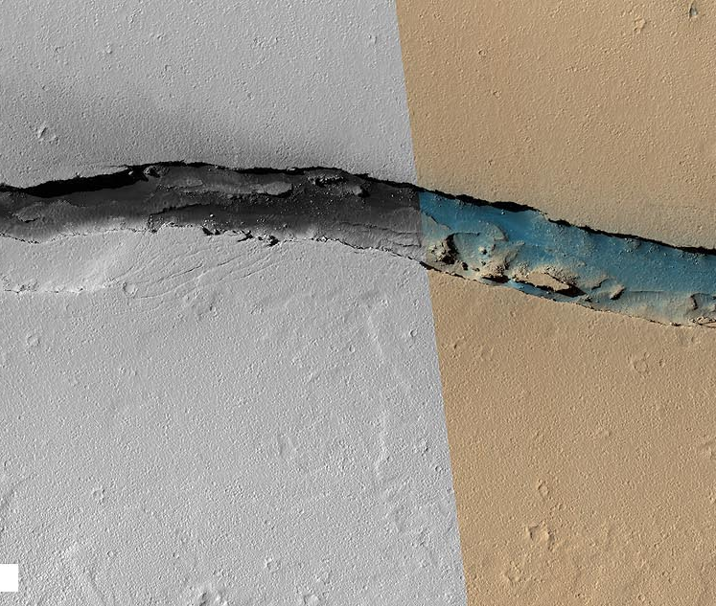
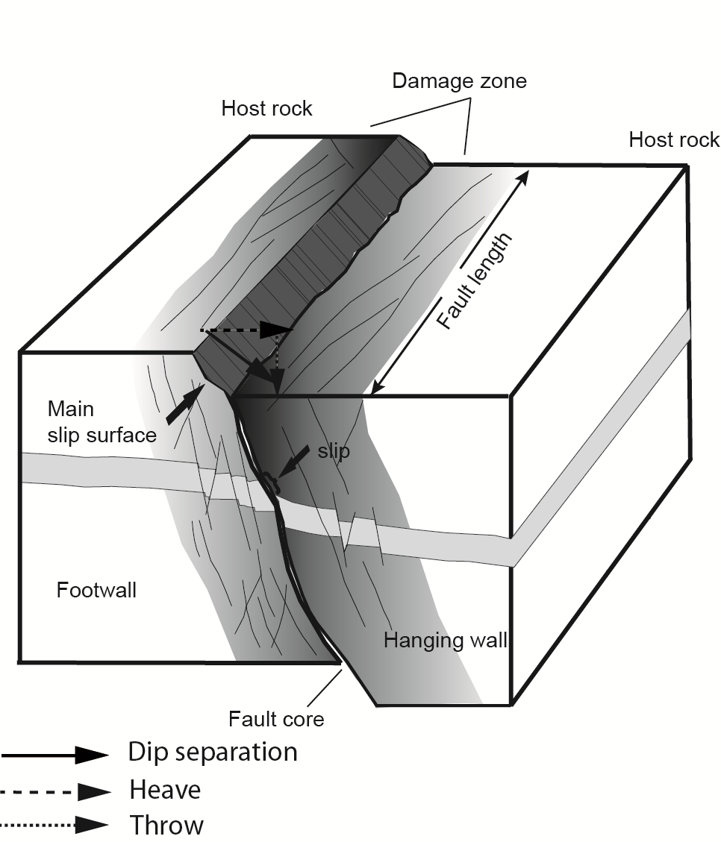
Tectonic forms > Normal fault

Slide 7
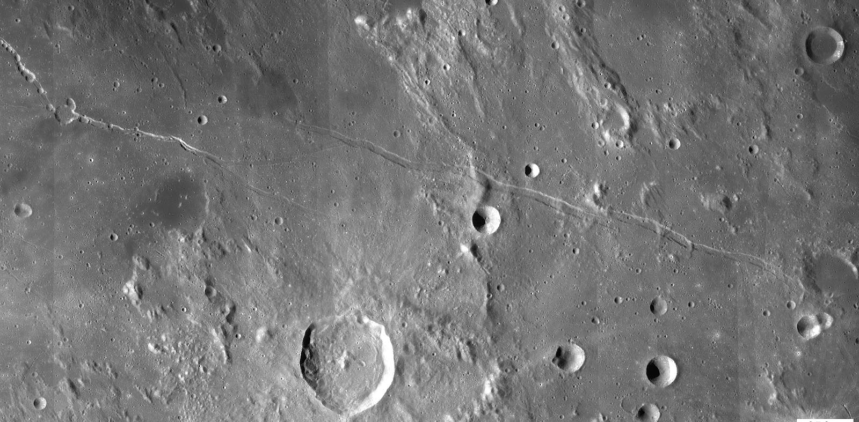
Tectonic forms > Straight rille

Slide 8
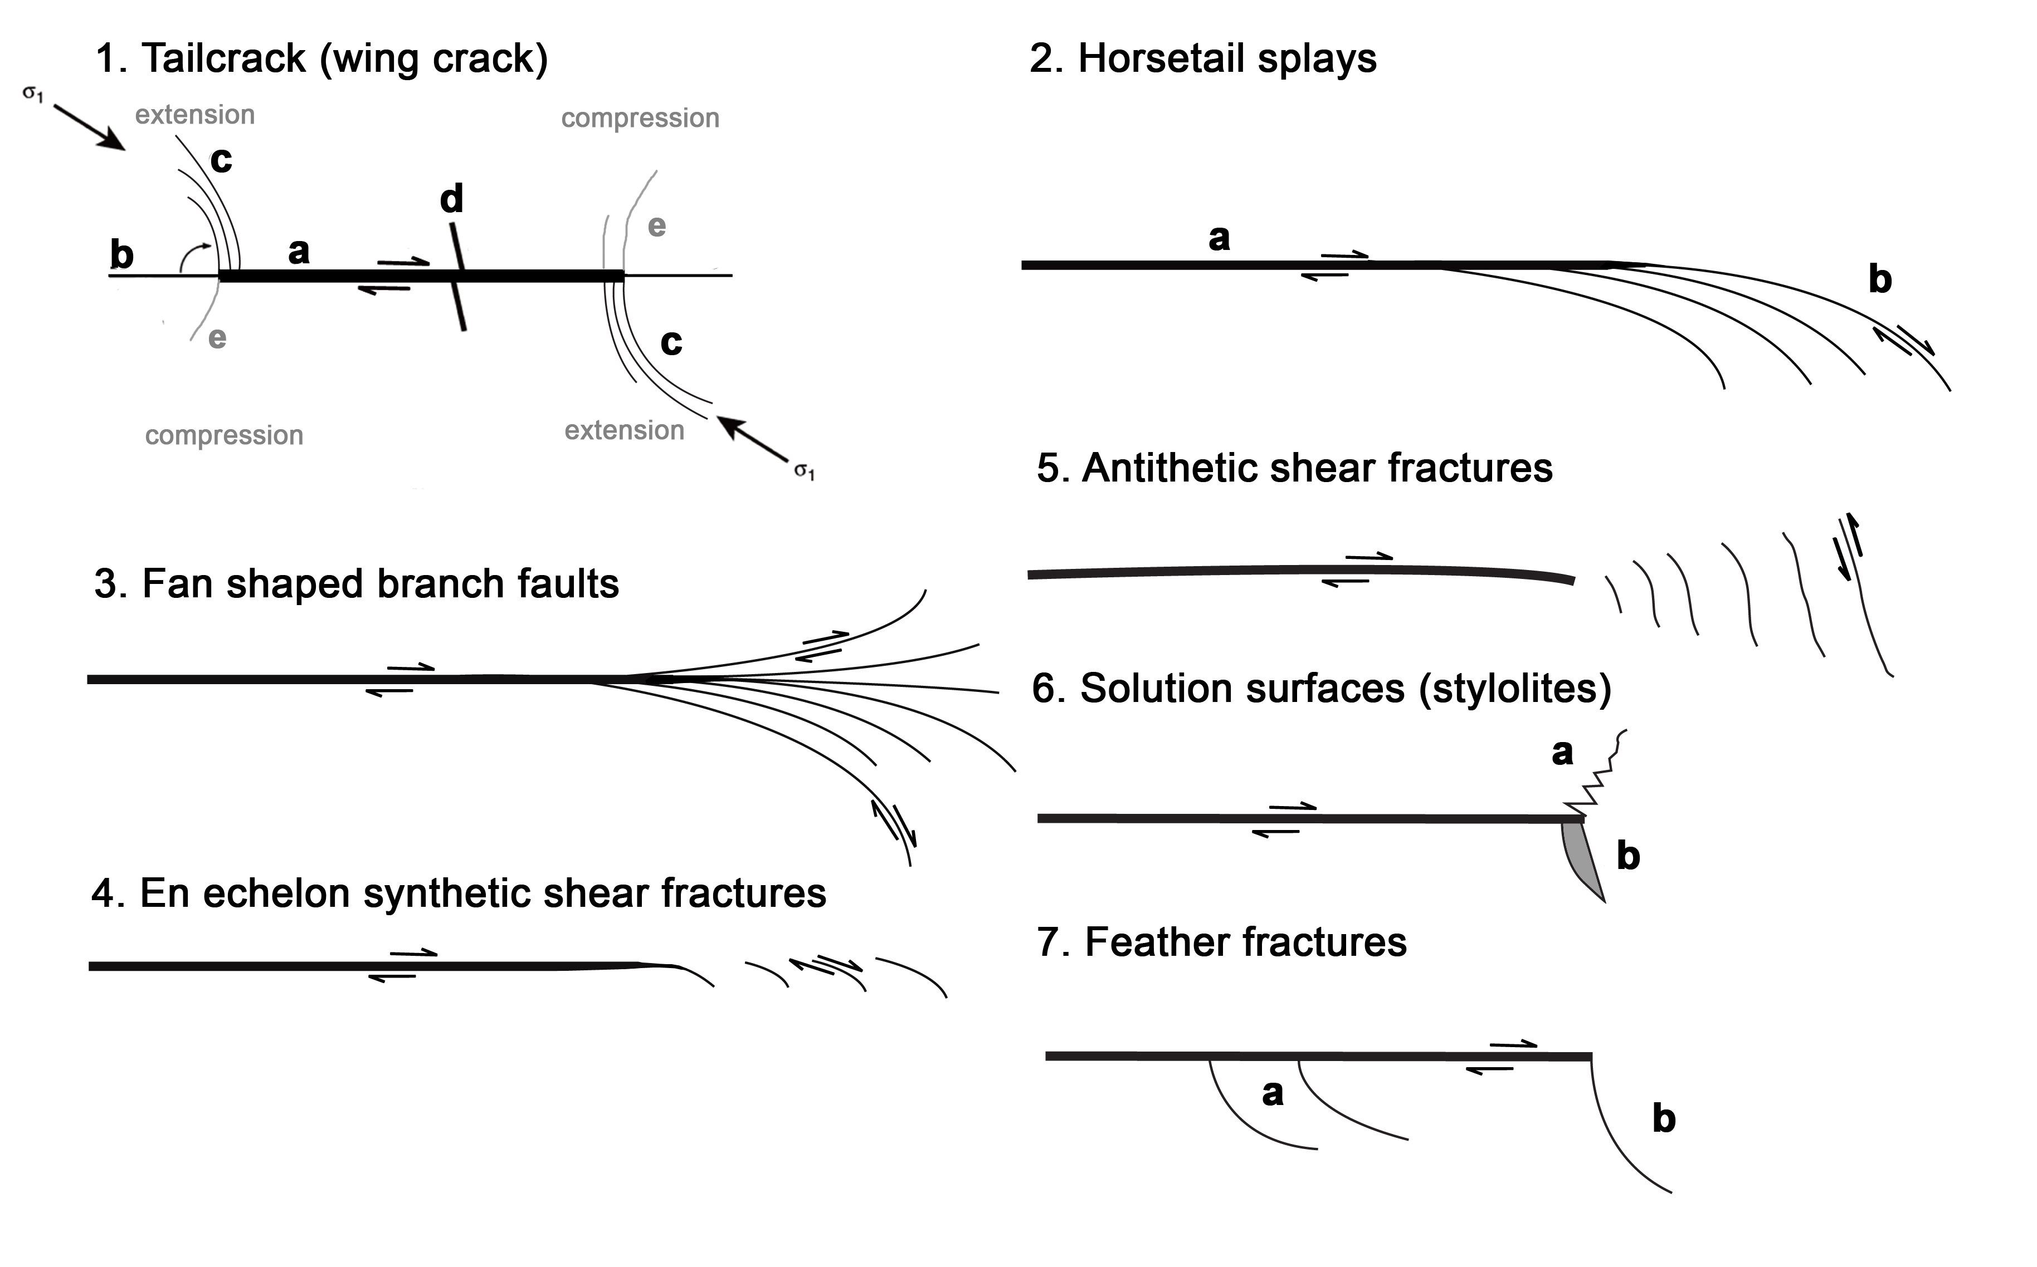
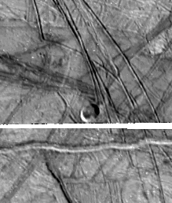
Tectonic forms > Secondary faults

Slide 9
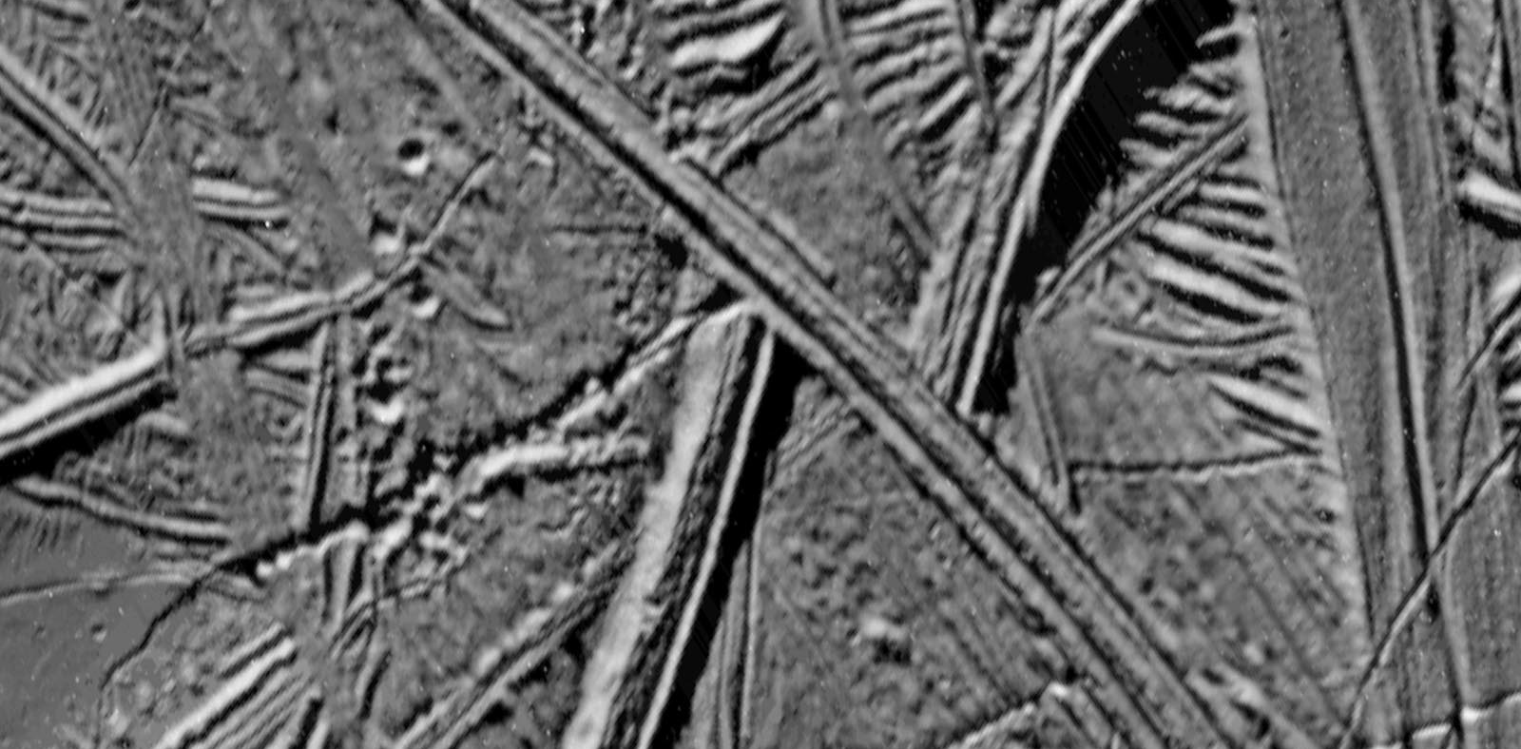
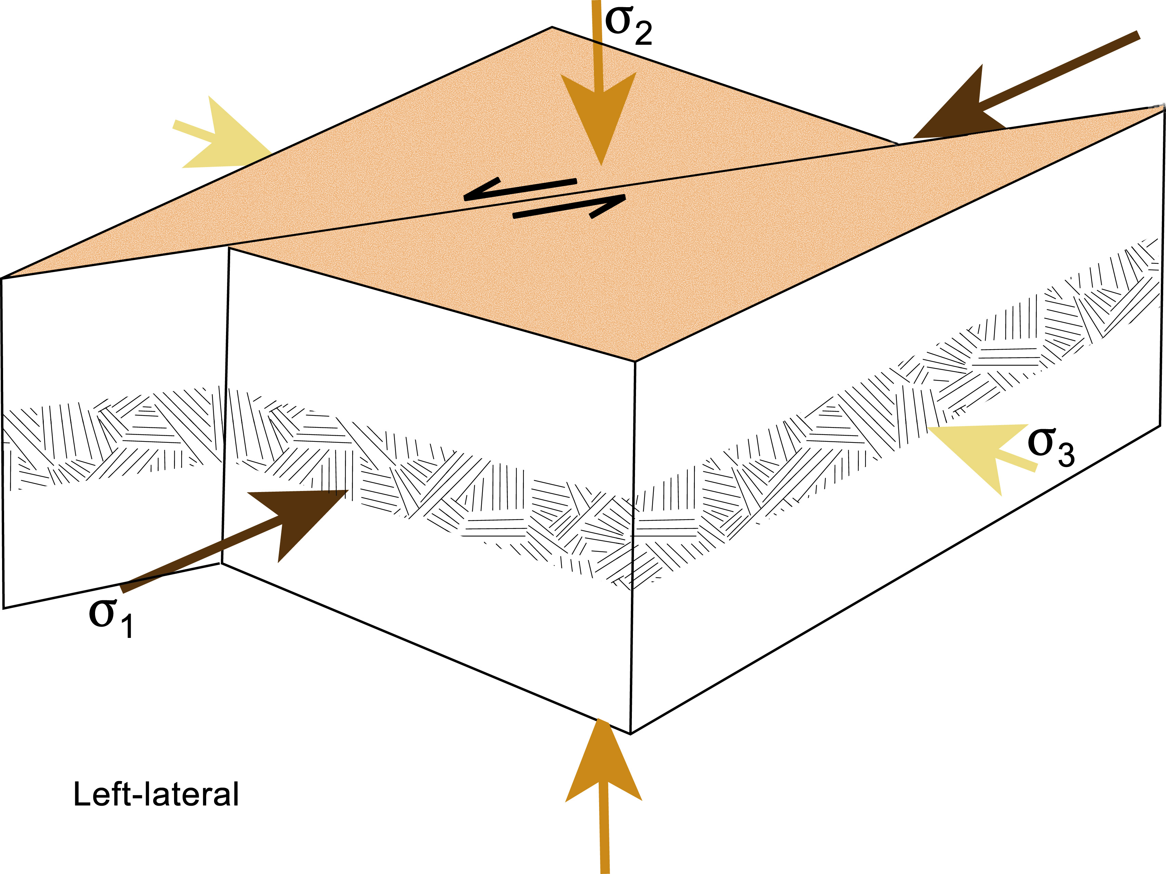
Tectonic forms > Strike slip fault

Slide 10
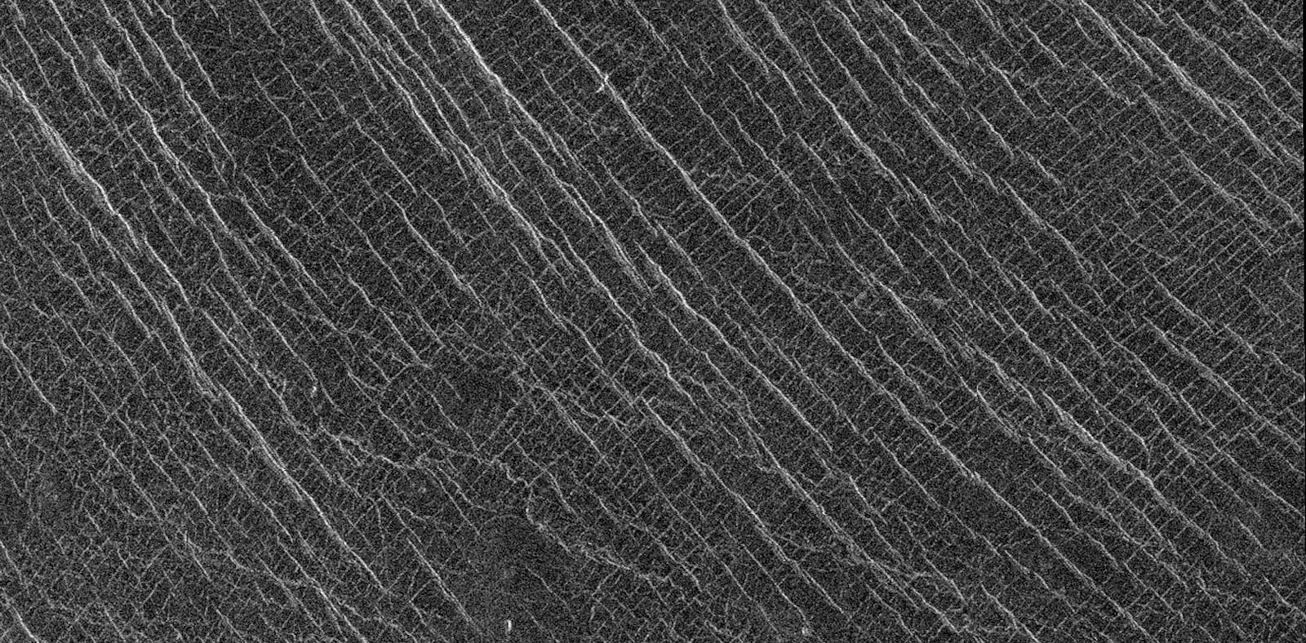
Tectonic forms > Gridded plains

Slide 11
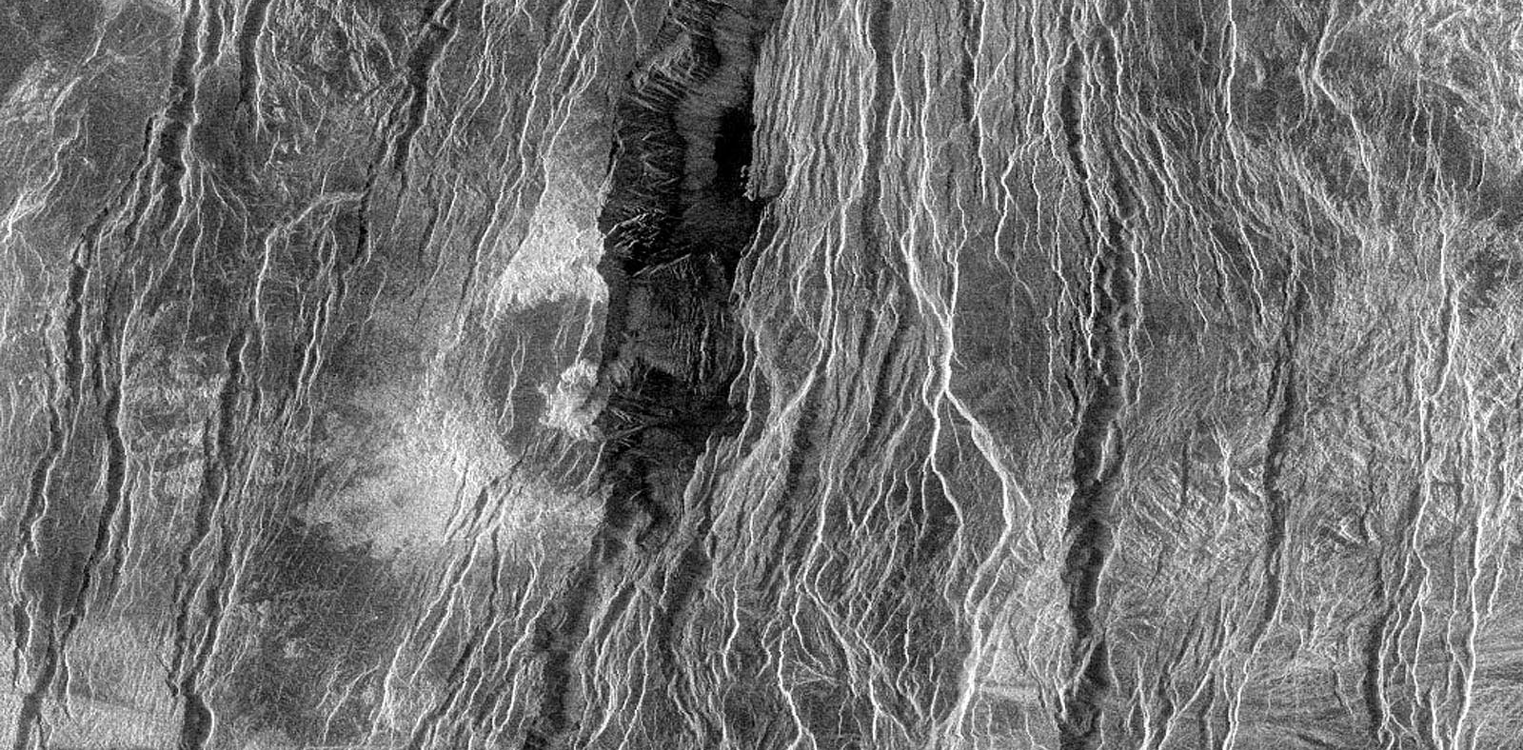
Other > Canyon

Slide 12
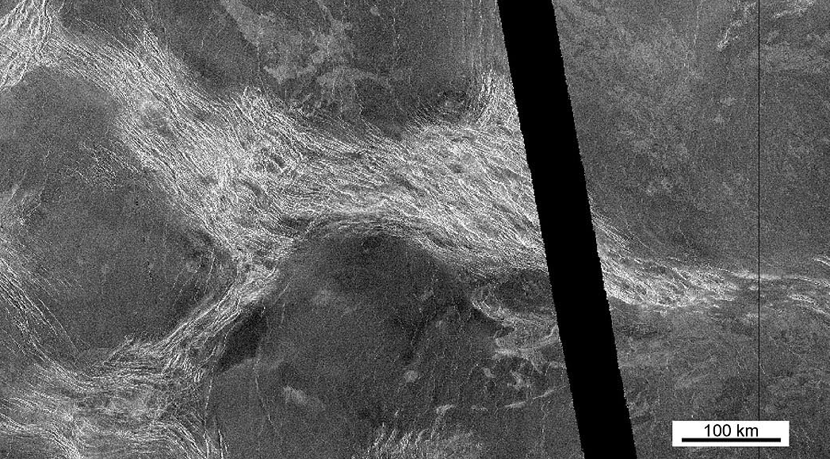
Tectonic forms > deformation belt

Slide 13
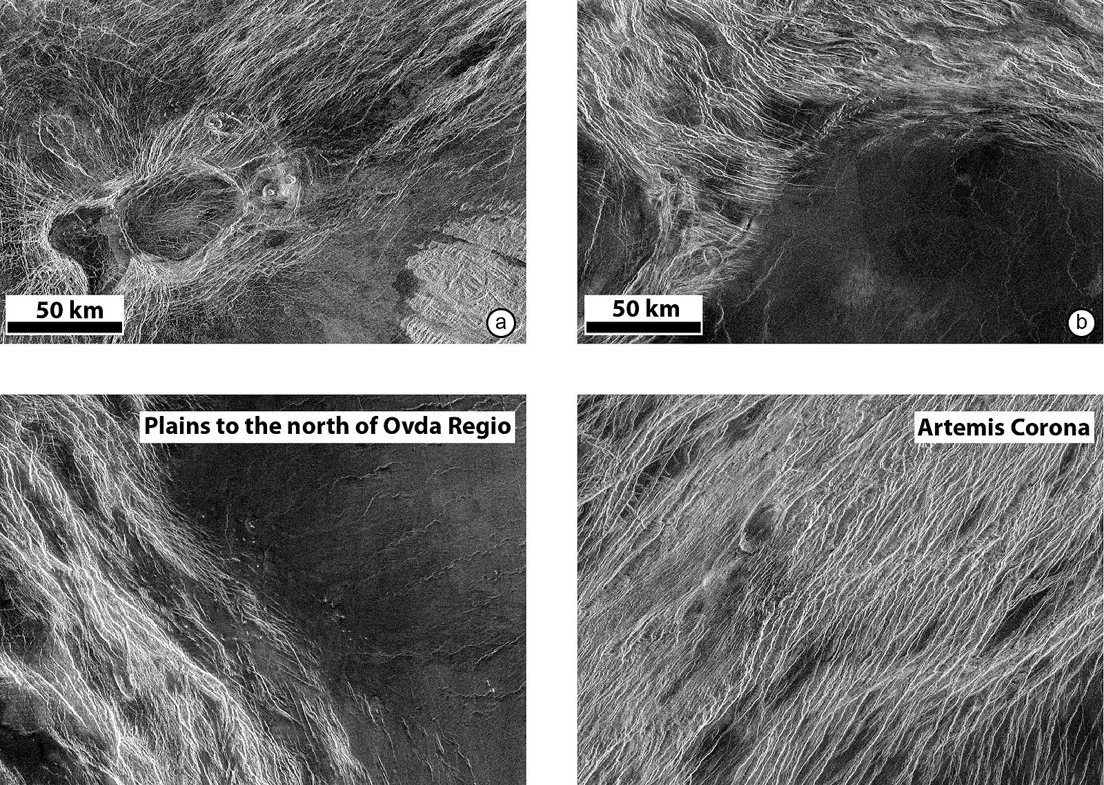
Tectonic forms > fracture belt

Slide 14
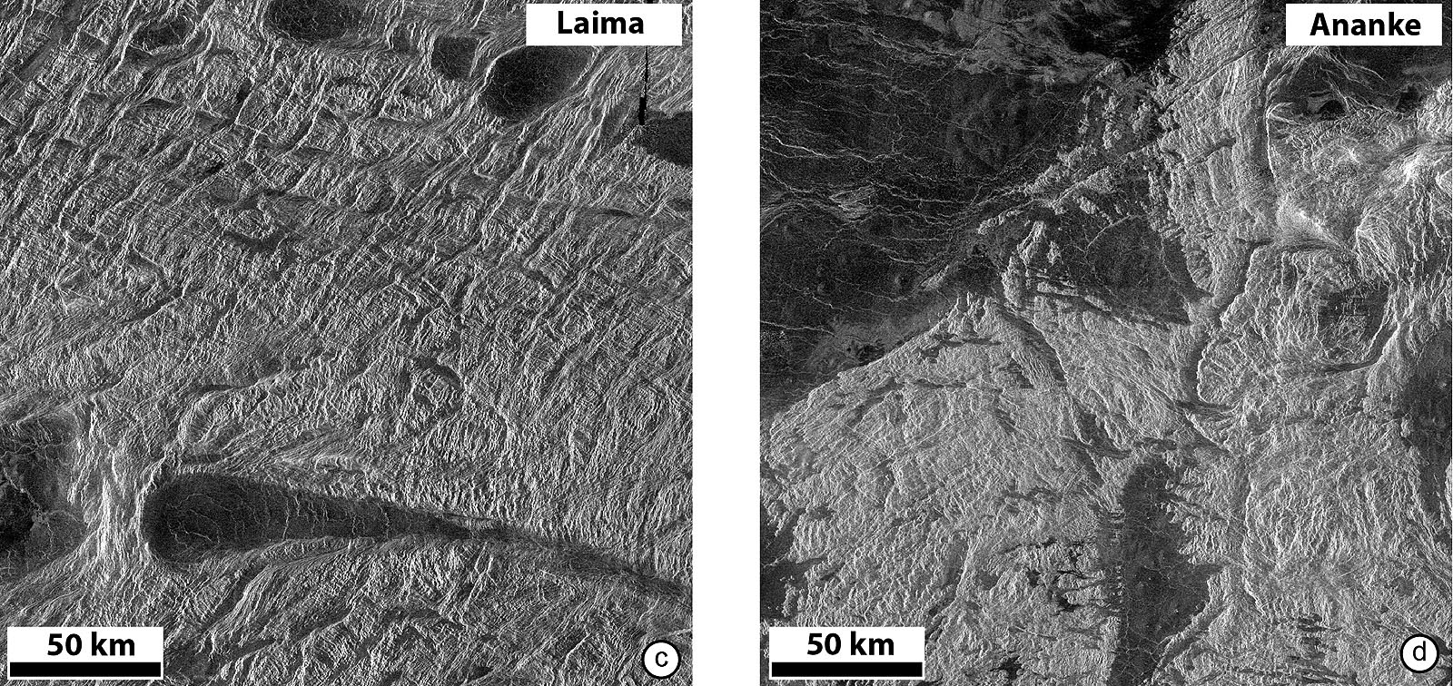
Tectonic forms >

Slide 15
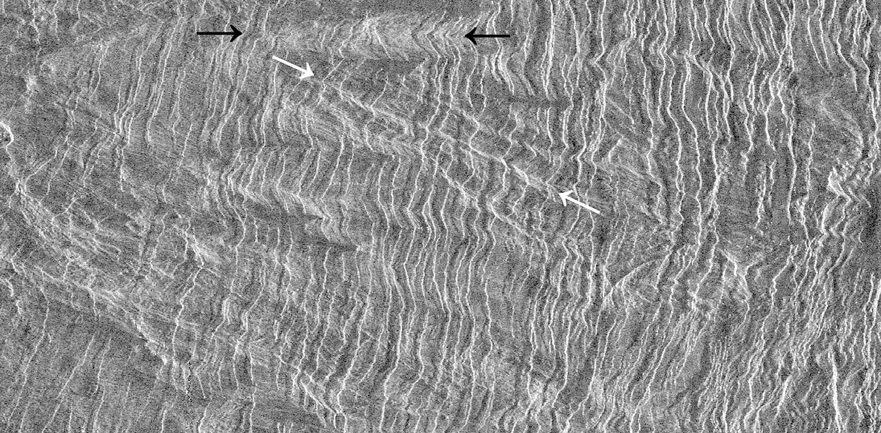
Tectonic forms > ribbon tessera

Slide 16
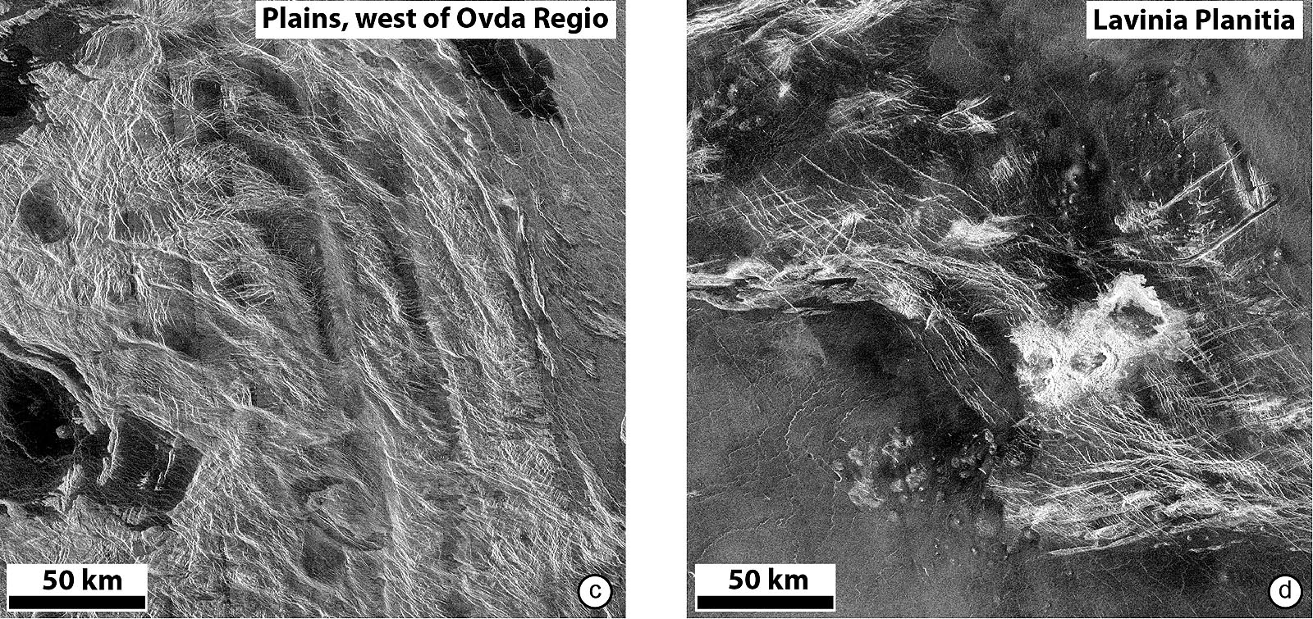
Tectonic forms > densely lineated plains

Slide 17
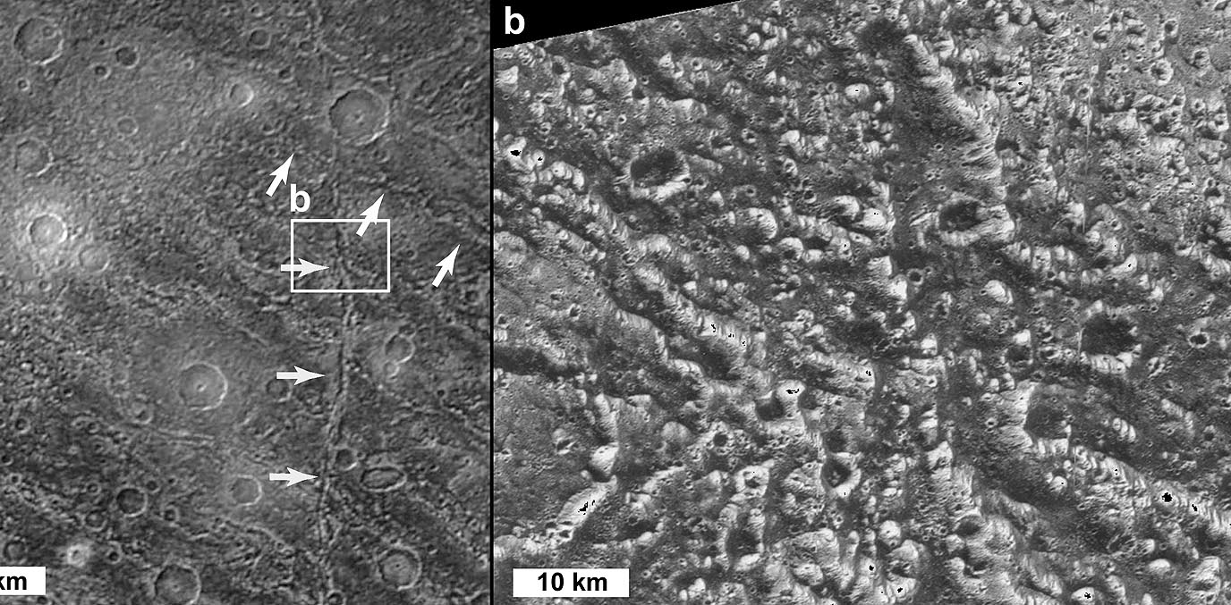
Tectonic forms > Furrow (Ganymede)

Slide 18
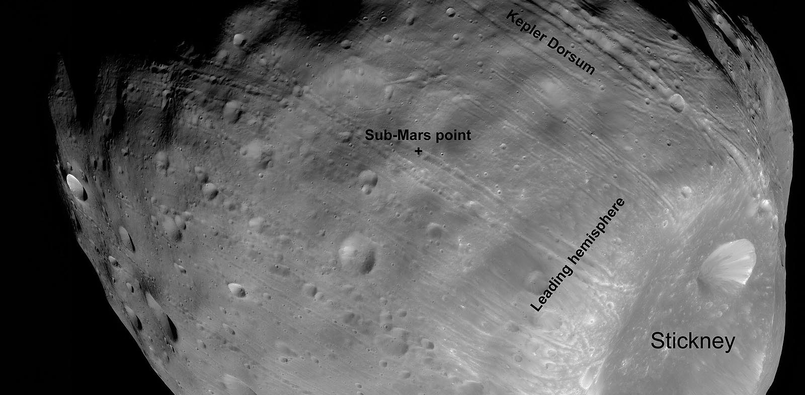
Tectonic forms > groove

Slide 19
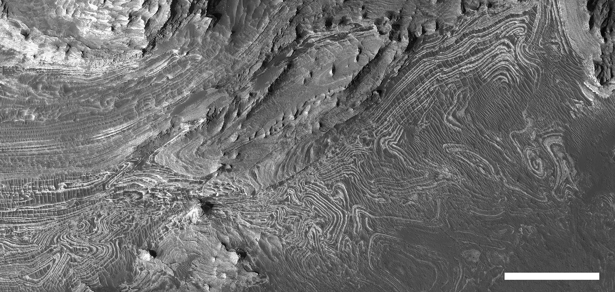
Tectonic forms > disharmonic fold

Slide 20
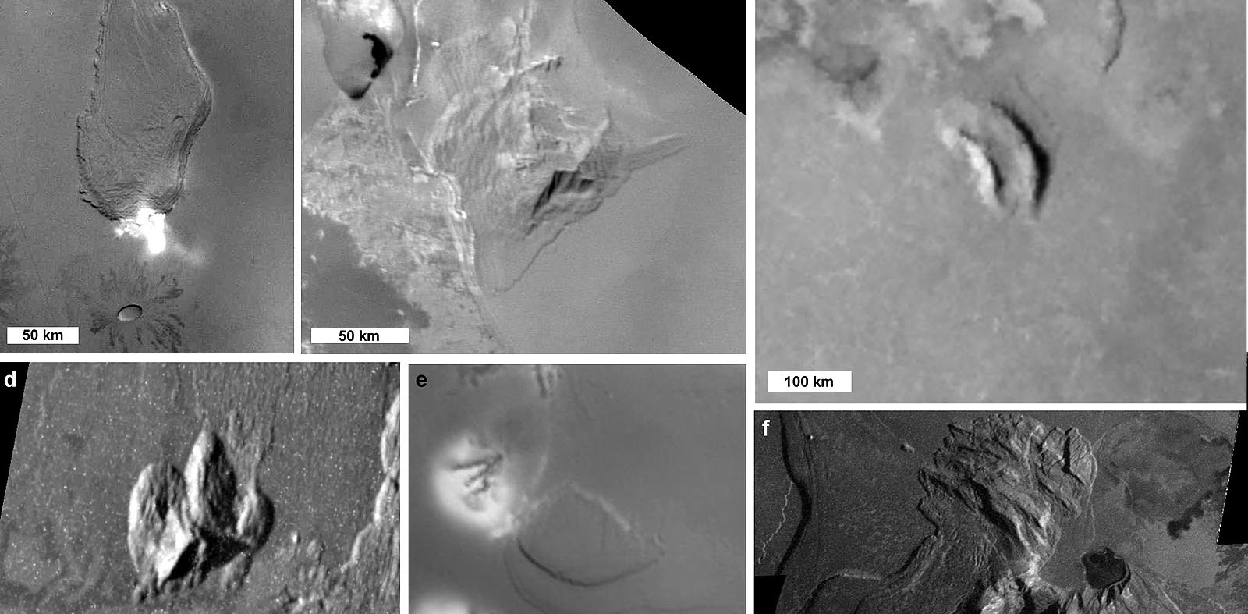
Tectonic forms > Block mountains (io)

Slide 21
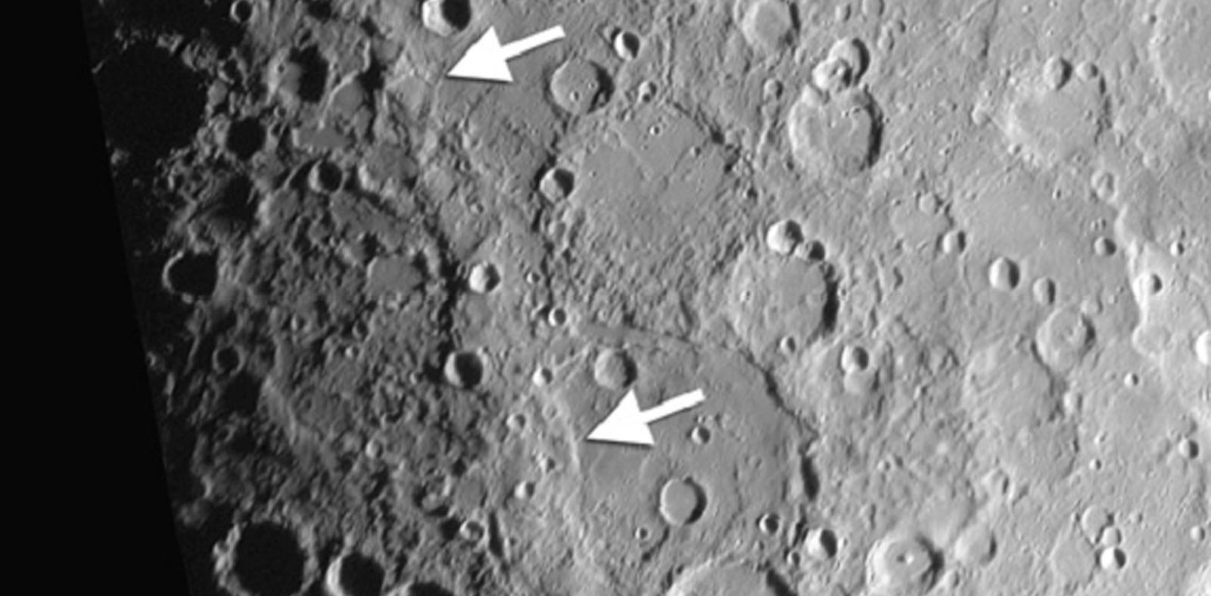
Tectonic forms > high relief ridge

Slide 22
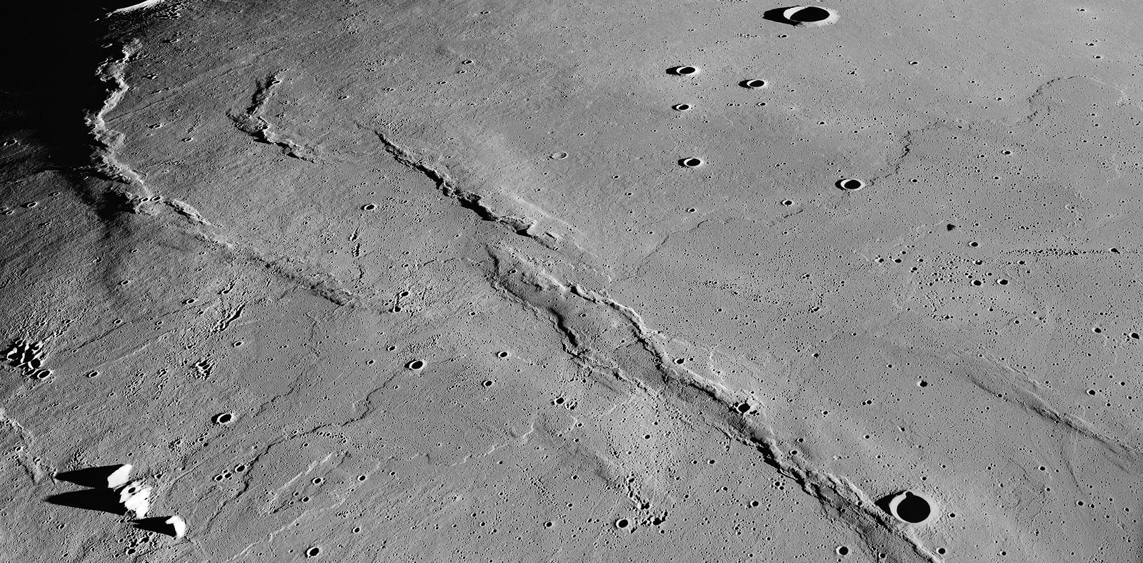
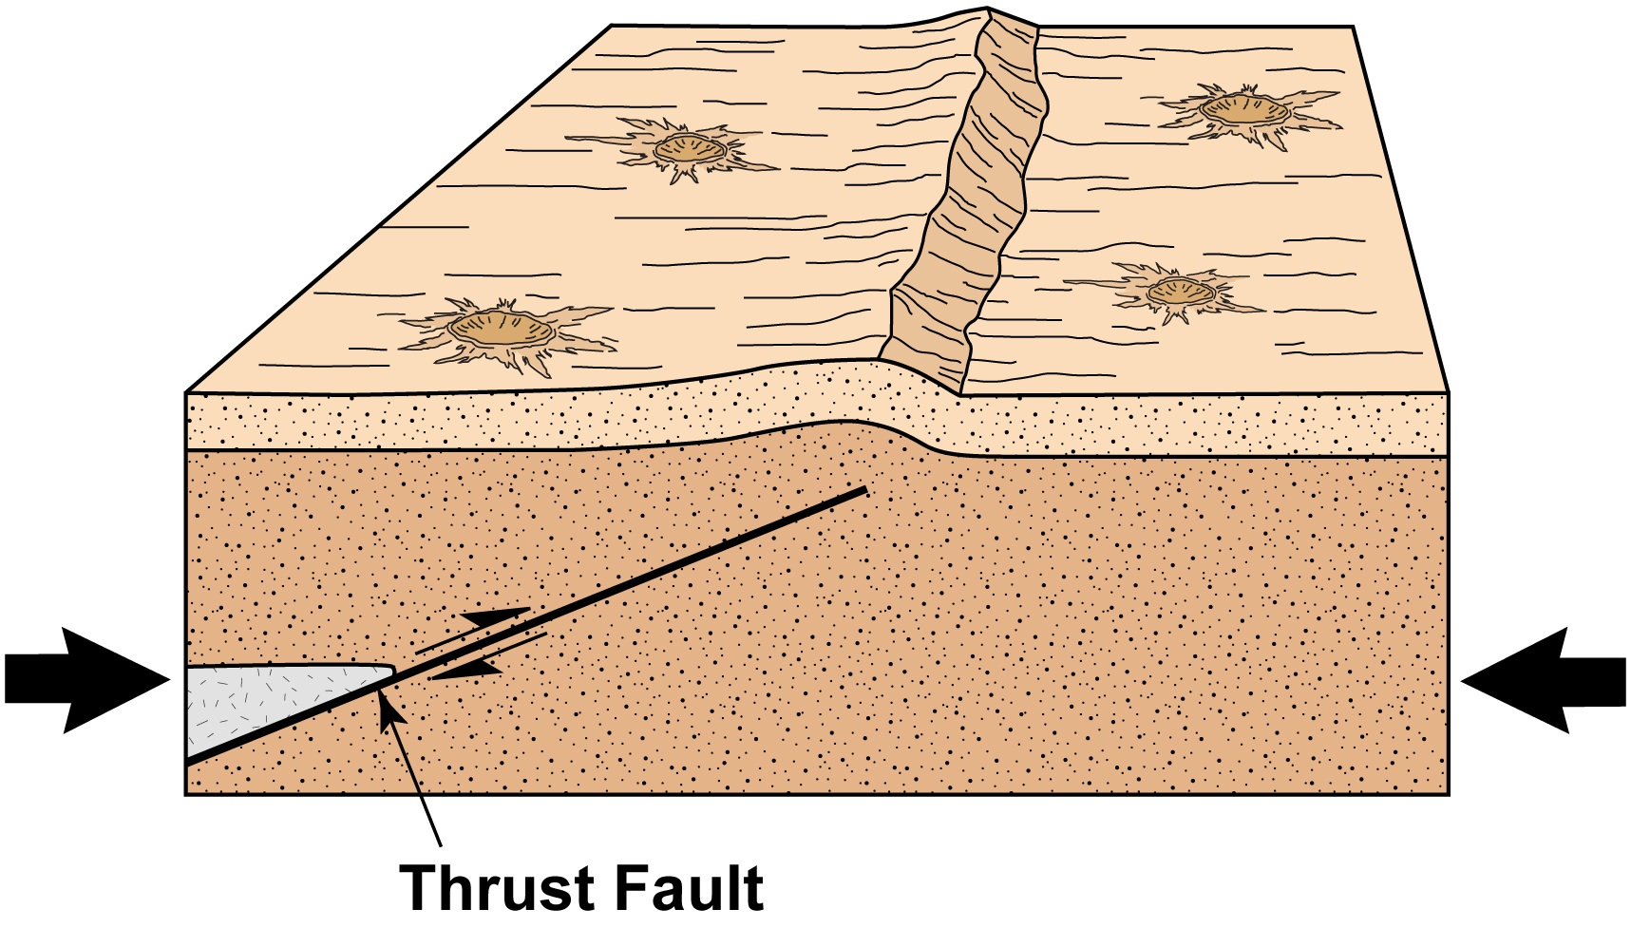
Lobte scarp /Watters 2010; figure by Susan Selkrik
Tectonic forms > wrinkle ridge

Slide 23
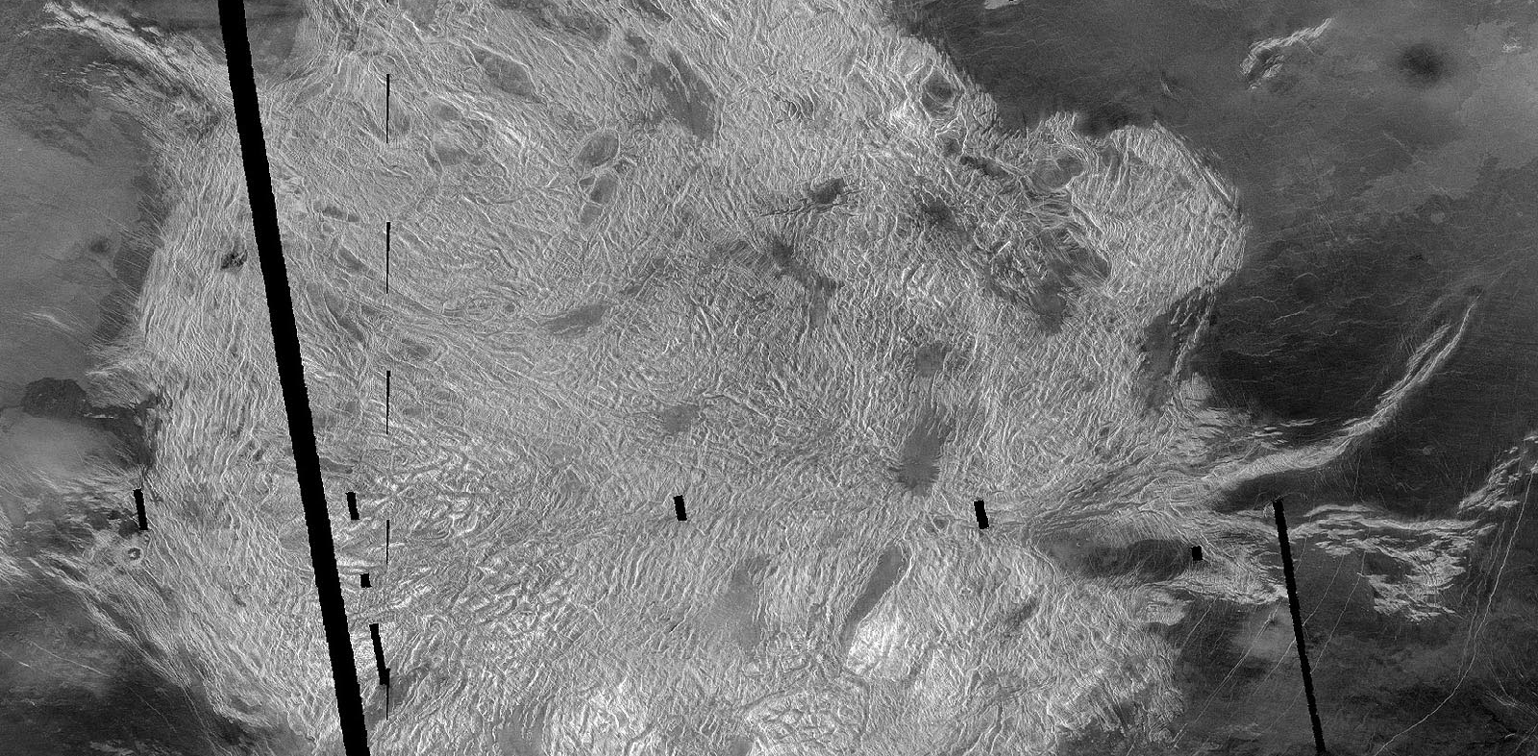
Tectonic forms > crustal plateau

Slide 24
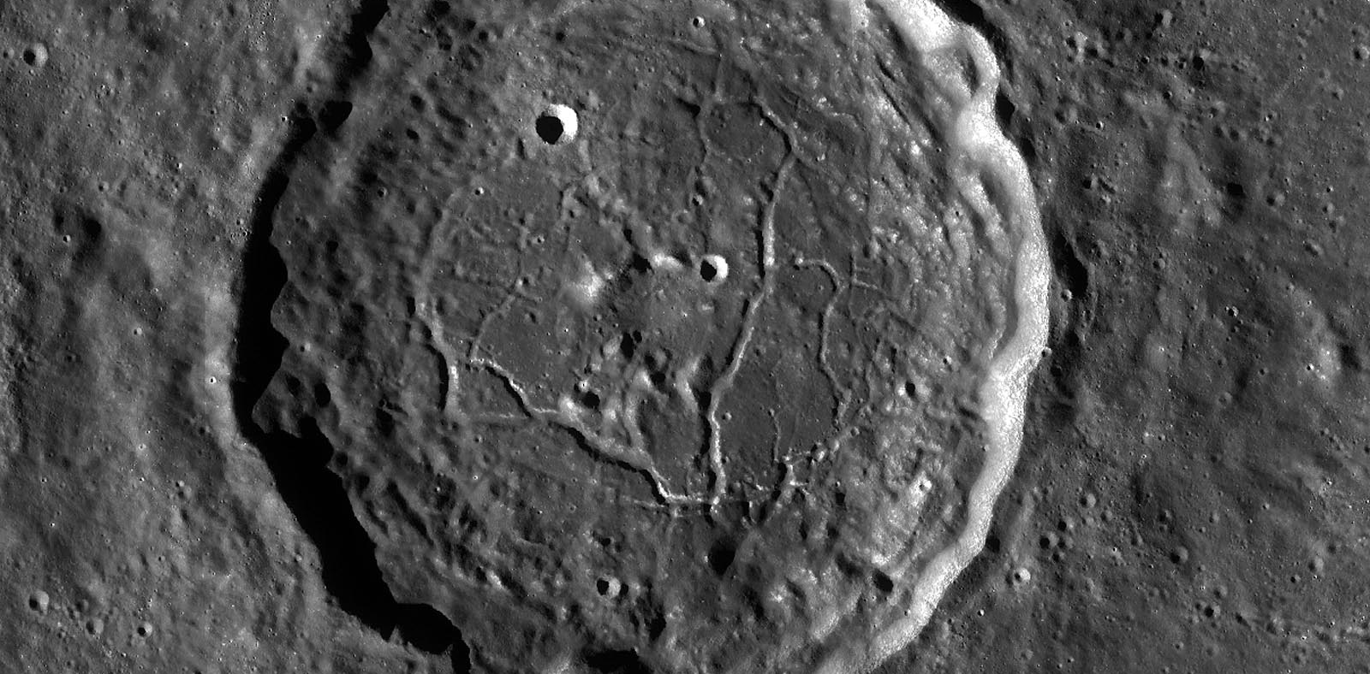
Tectonic forms > fractured crater floor

Slide 25
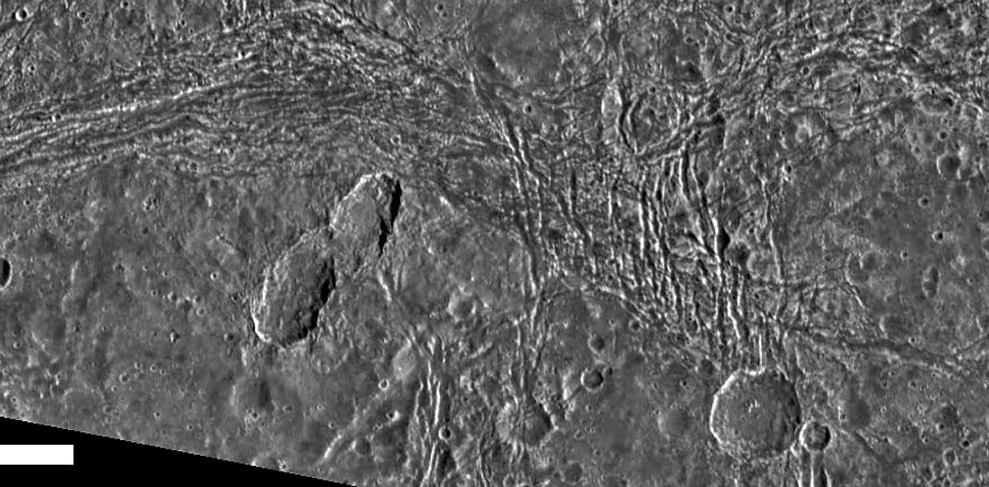
Tectonic forms > Deformed crater

Slide 26
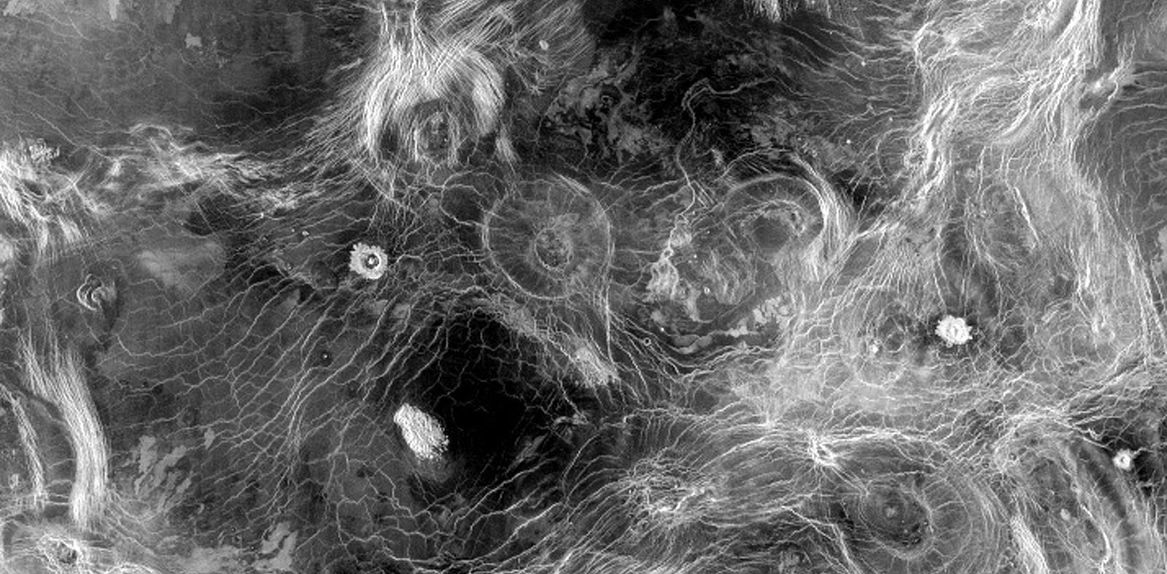
Volcanotectonic forms > Archnoid

Slide 27
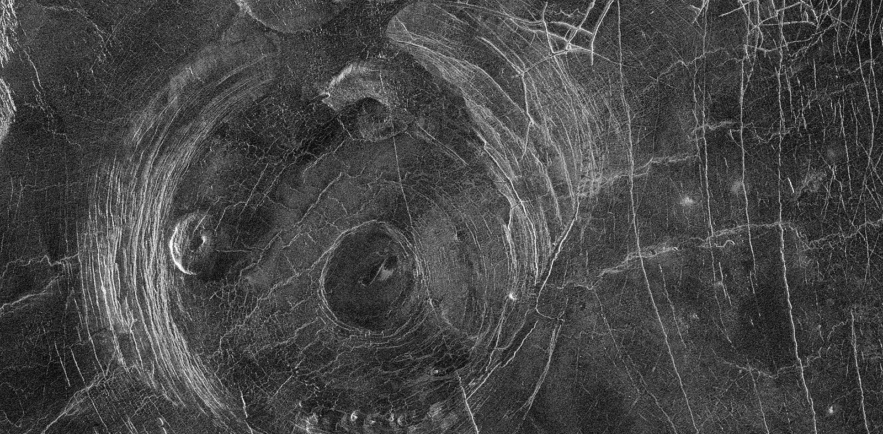
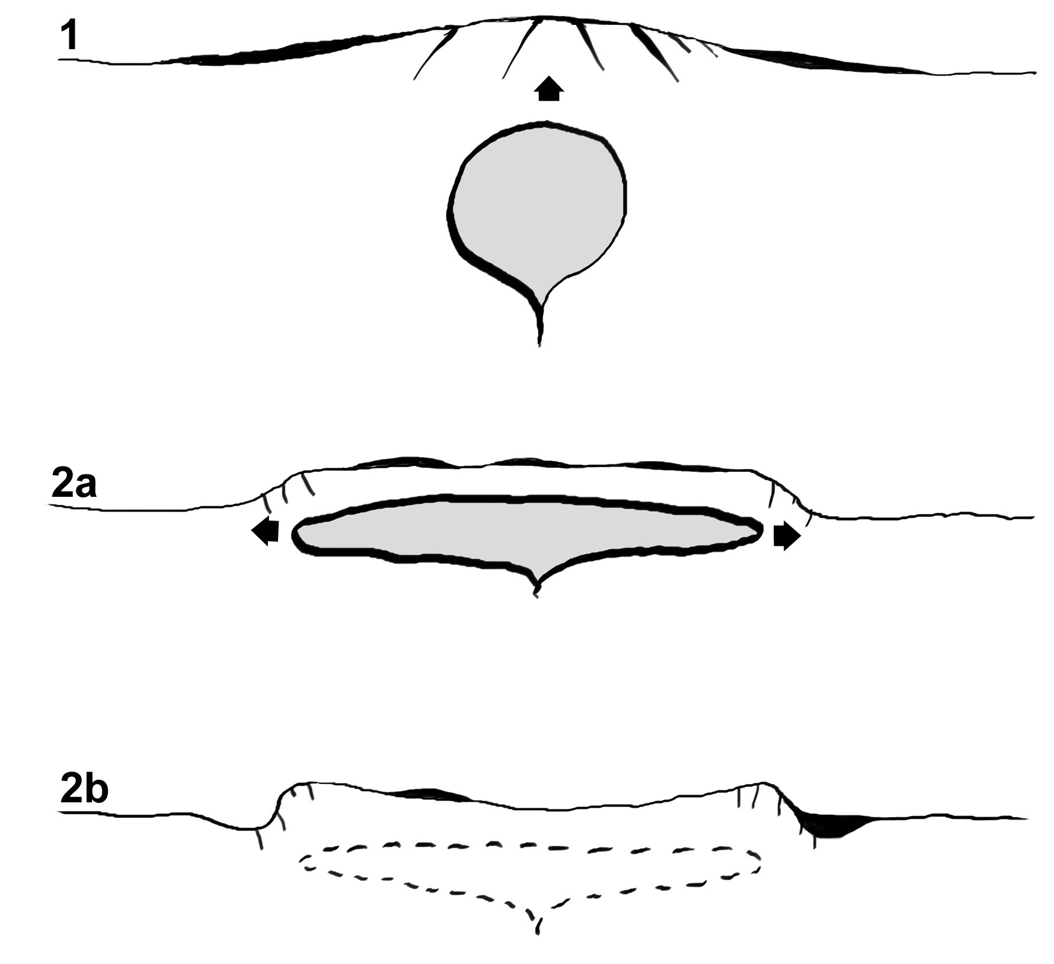
Volcanotectonic forms > corona

Slide 28
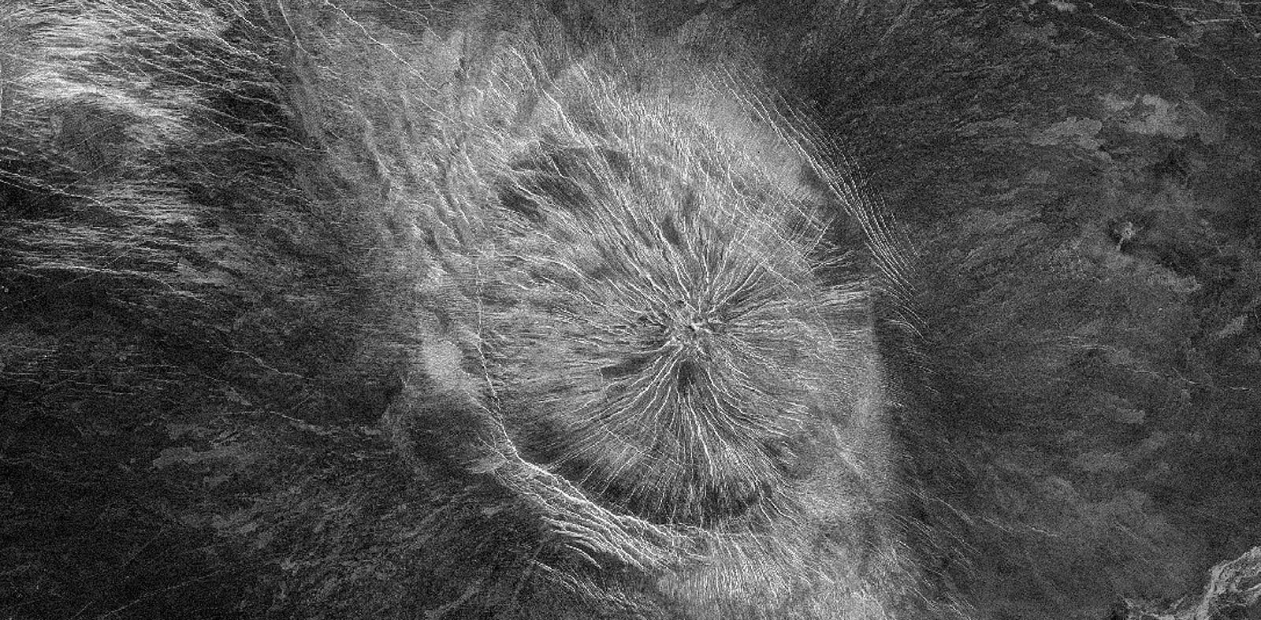
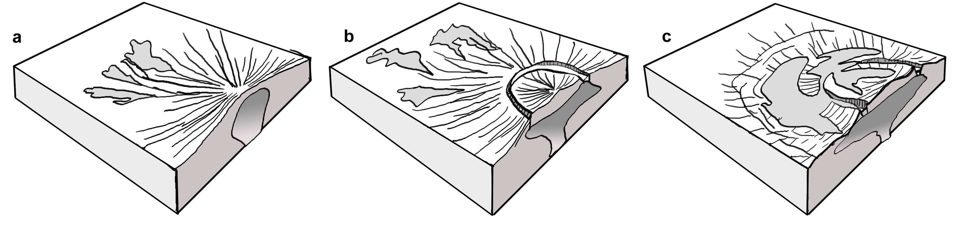
Volcanotectonic forms > corona-nova

Slide 29
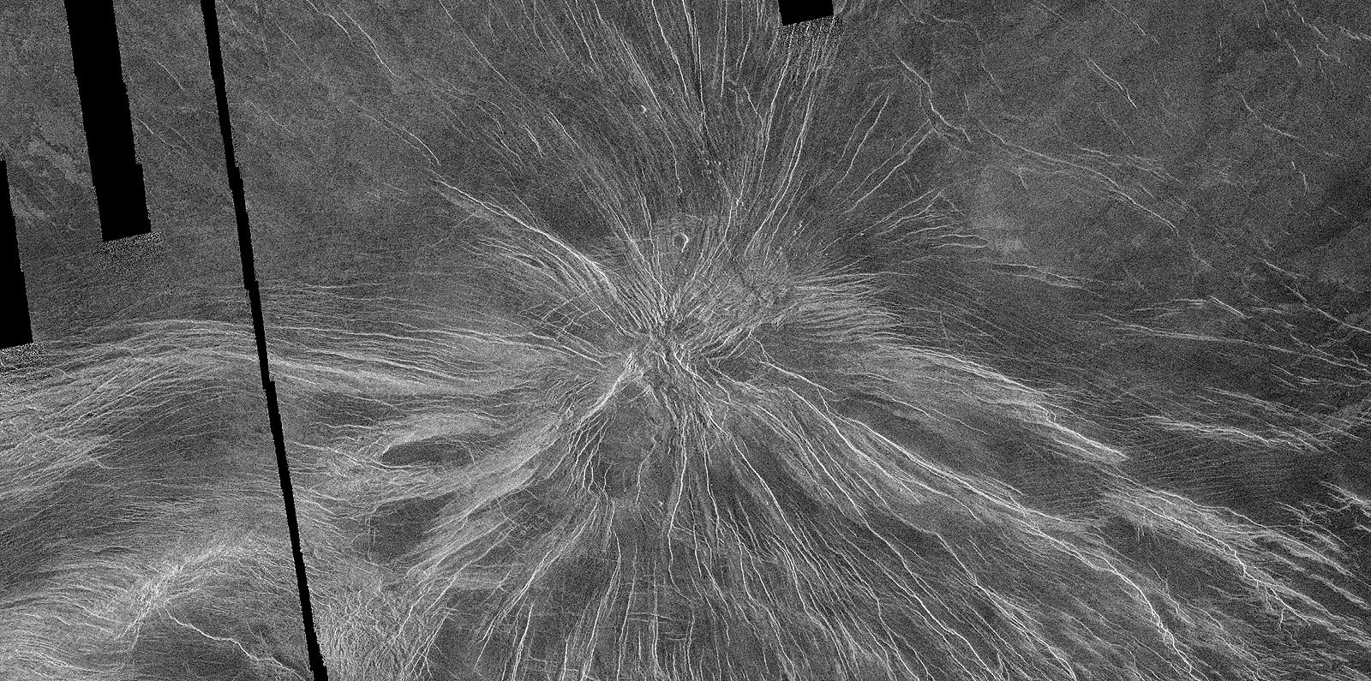
Volcanotectonic forms > Nova

Slide 30
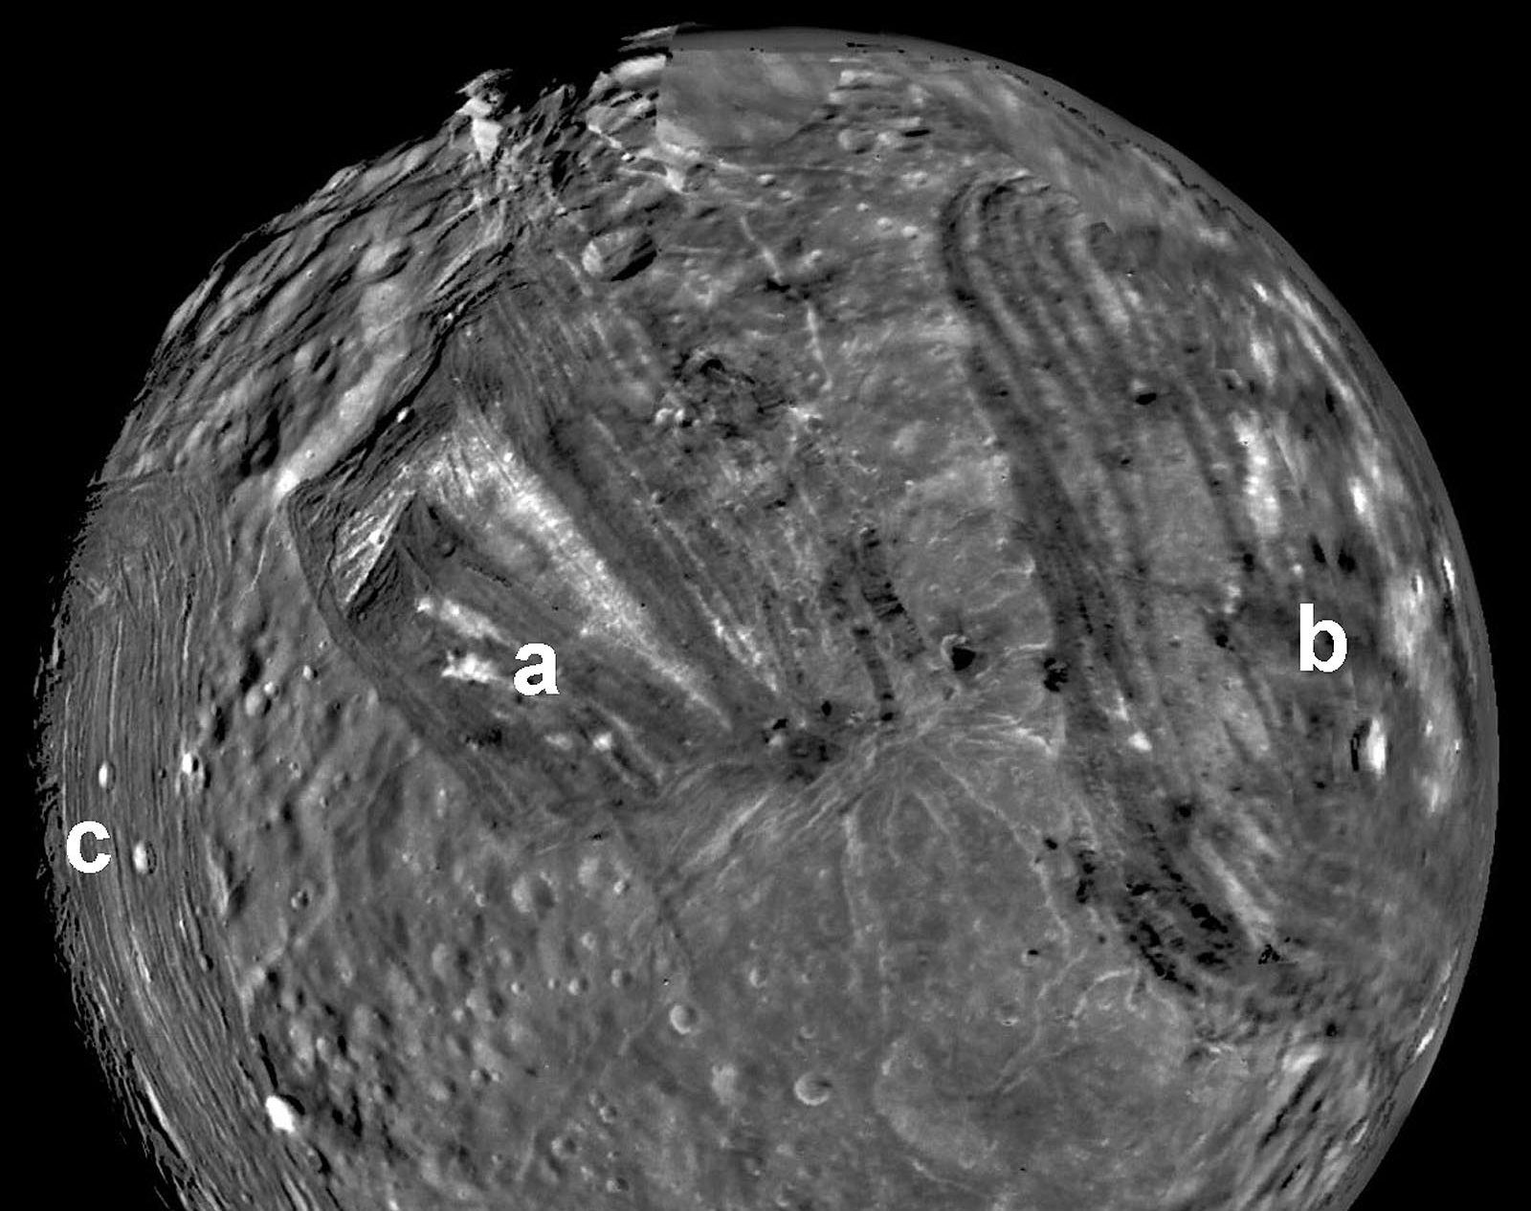
Volcanotectonic forms > Corona (Miranda)

Slide 31
Key concepts
Tectonic forms are fractures formed as a response to stresses in the crust
They are typically linear
They are either troughs or a series of troughs or the results of the motion of the curst along a crack
Contraction cracks may form as the surface cools and contracts

Slide 32
ICE TECTONICS

Slide 33
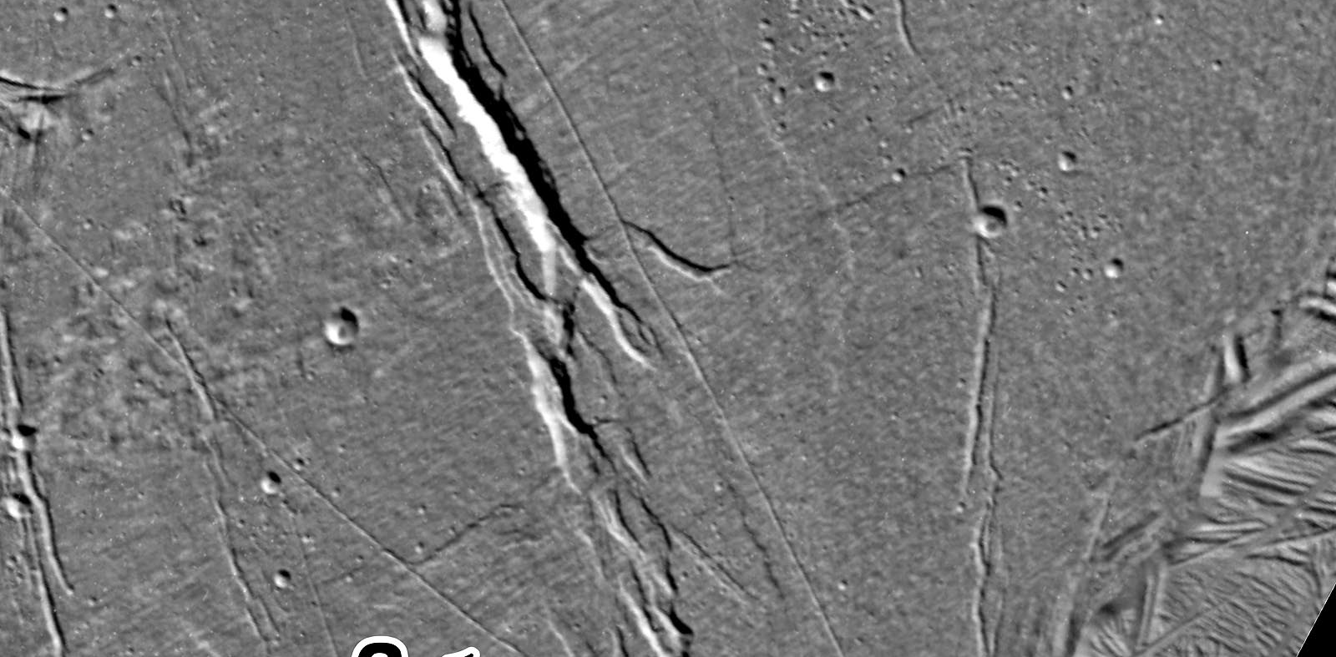
Ice tectonics > Fracture

Slide 34
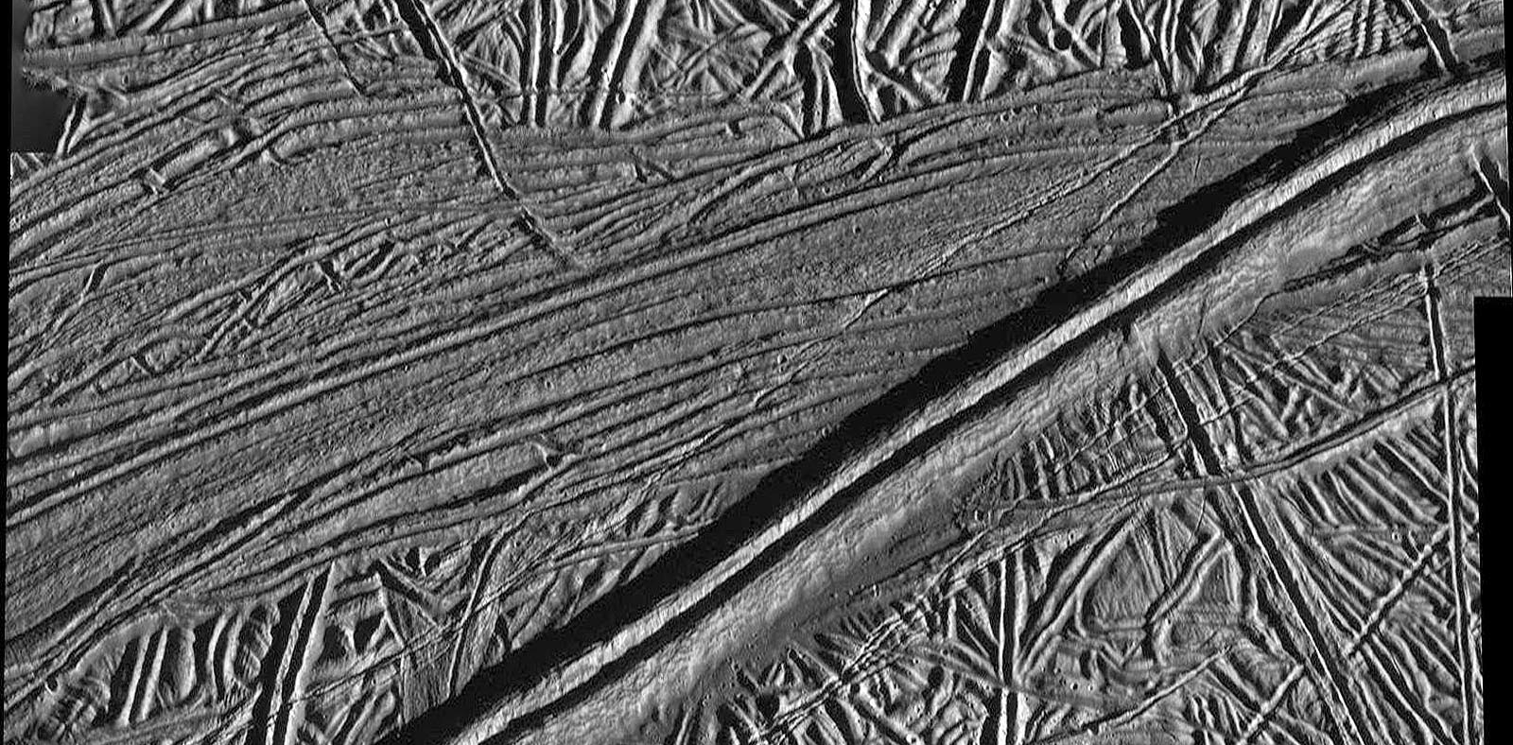
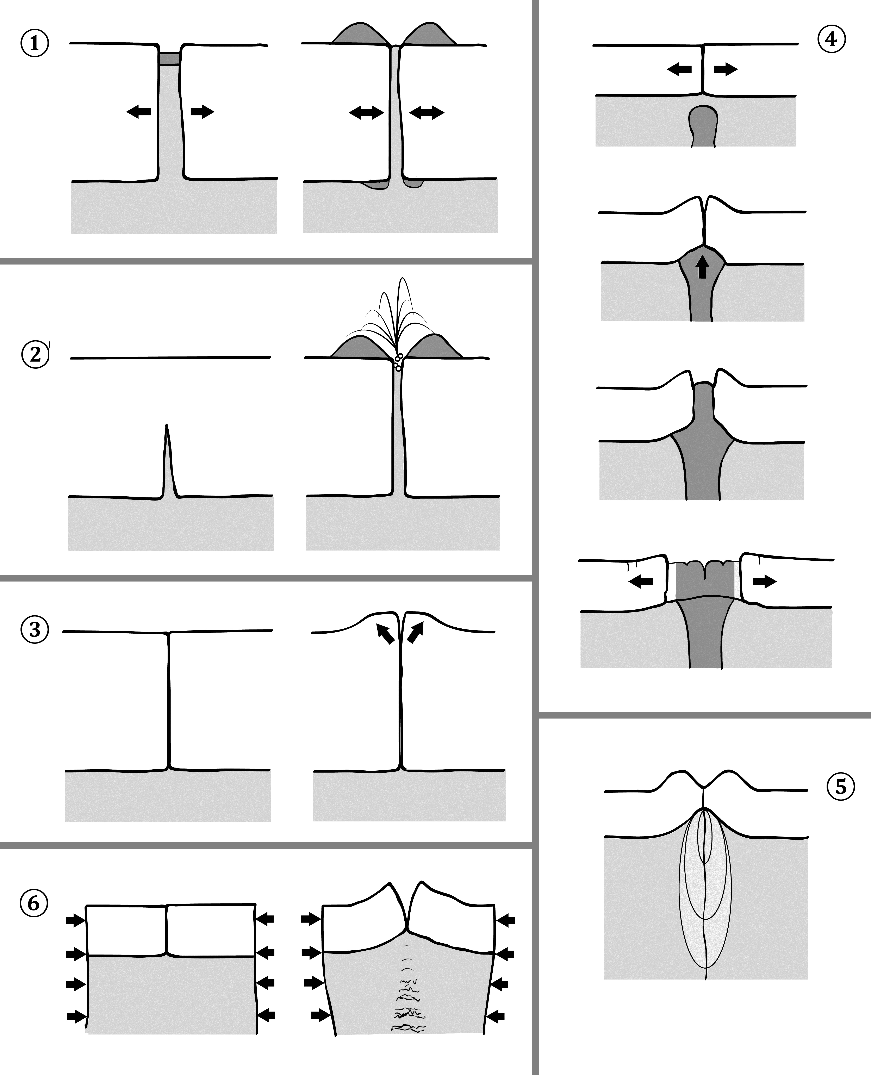
Ice tectonics > Double ridge

Slide 35
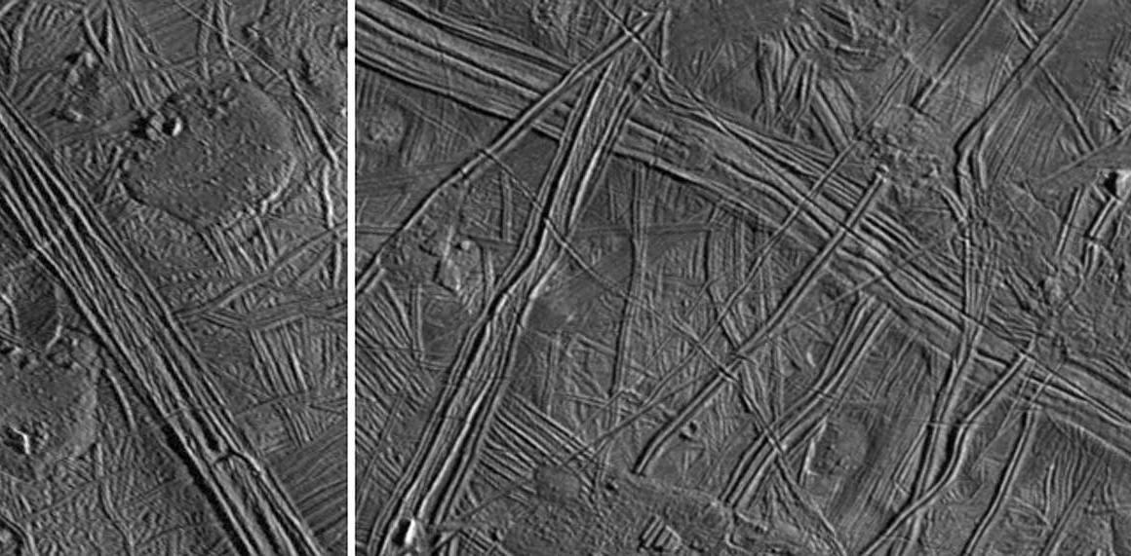
Ice tectonics > ridge complex

Slide 36
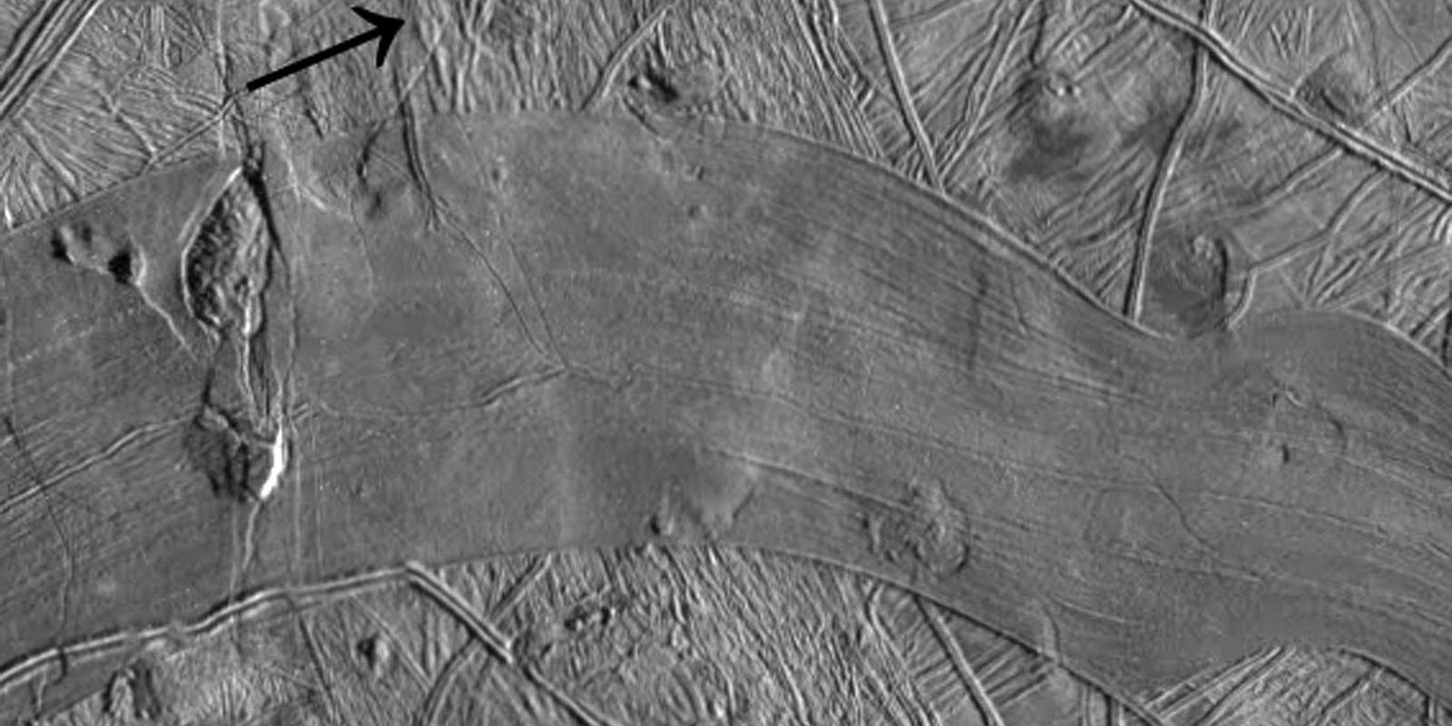
Ice tectonics > Ridged band

Slide 37
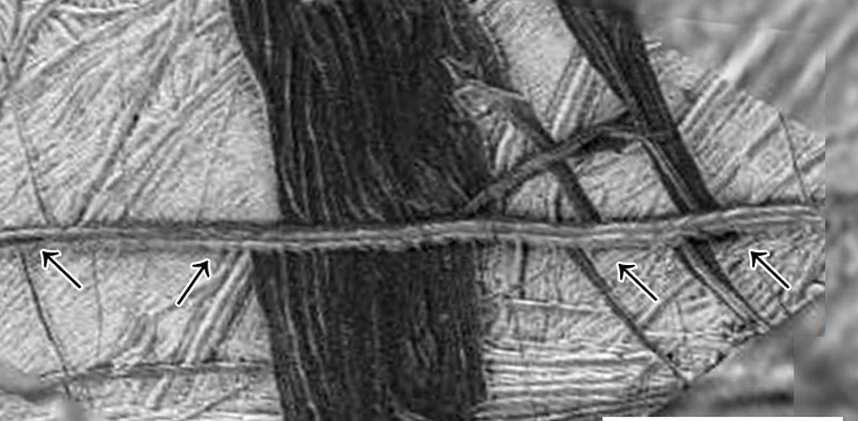
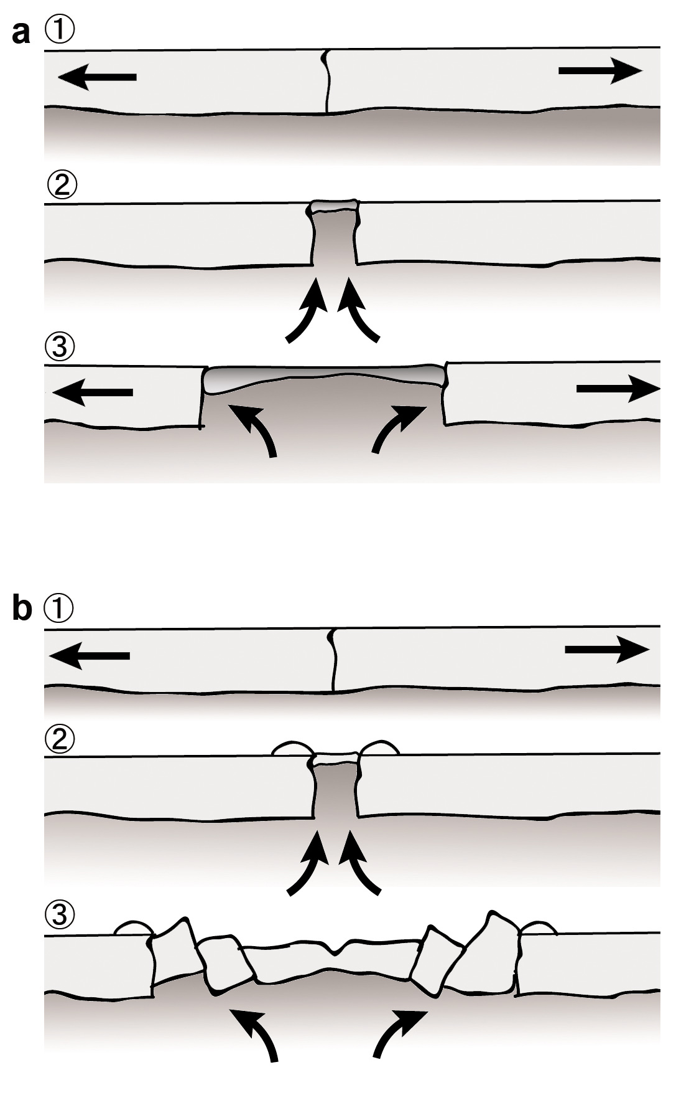
Ice tectonics > Band

Slide 38
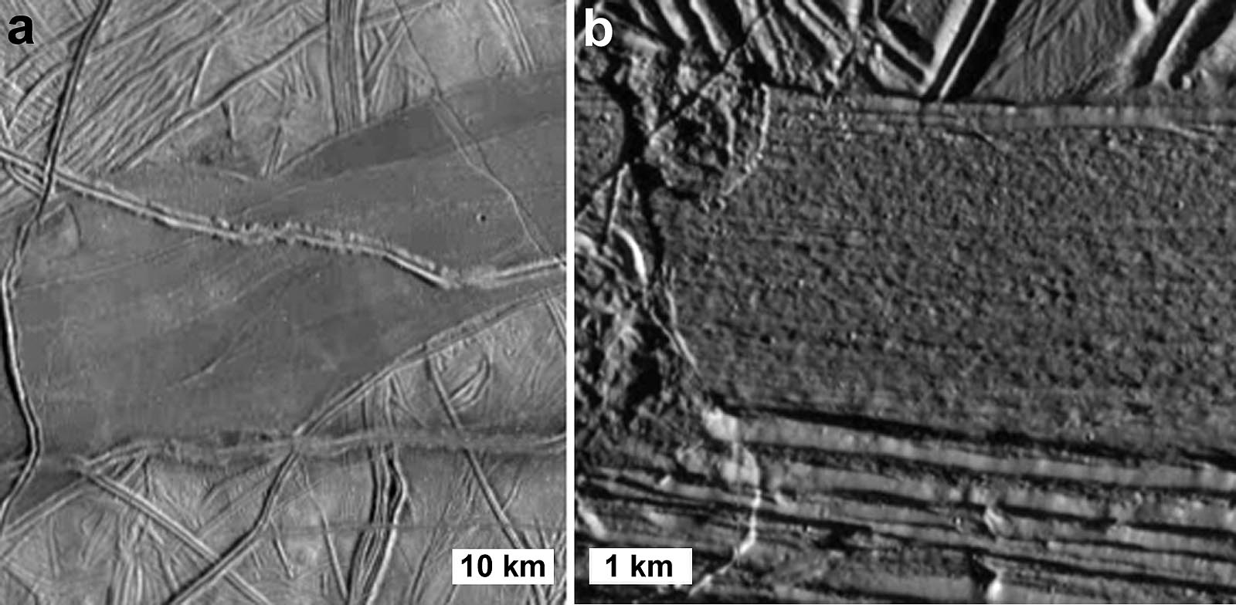
Ice tectonics > Smooth band

Slide 39
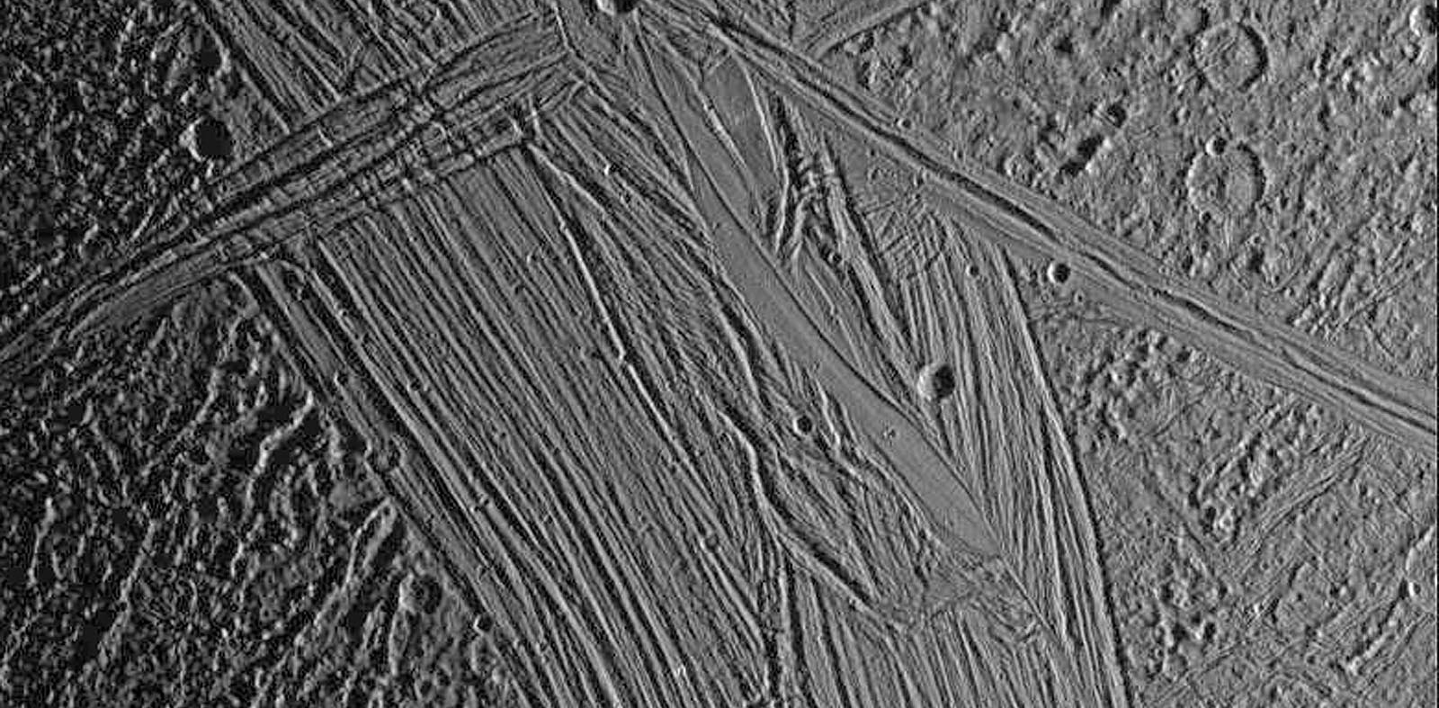
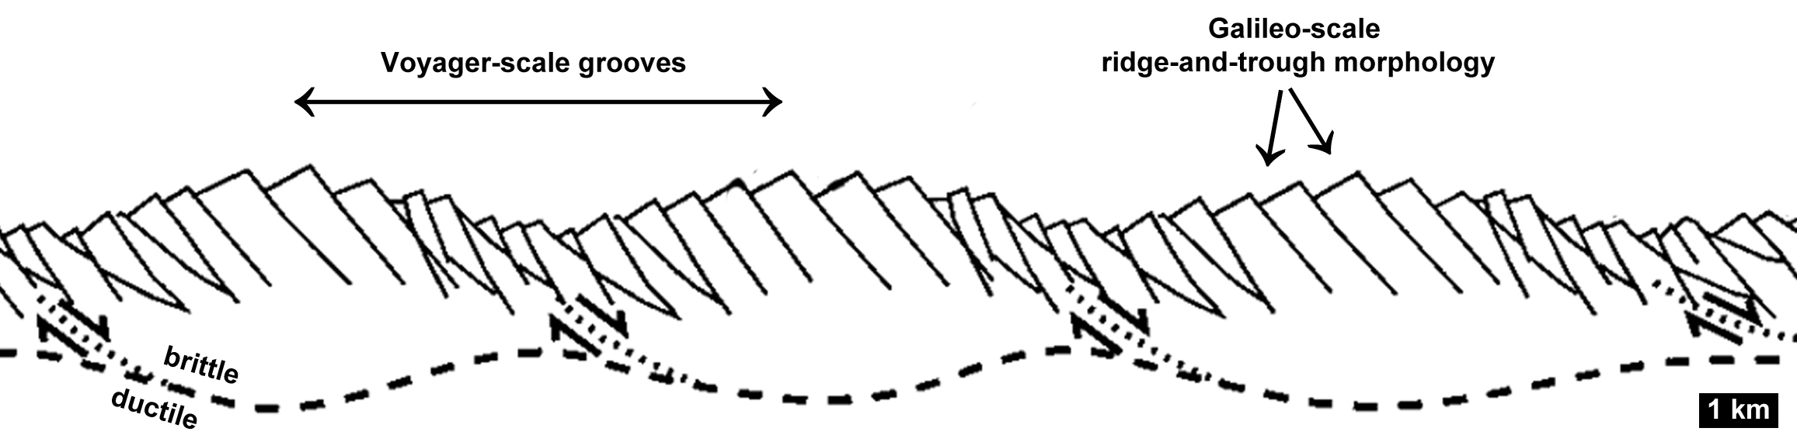
(Pappalardo et al. 1998).
Tectonic forms > groove Ganymede

Slide 40
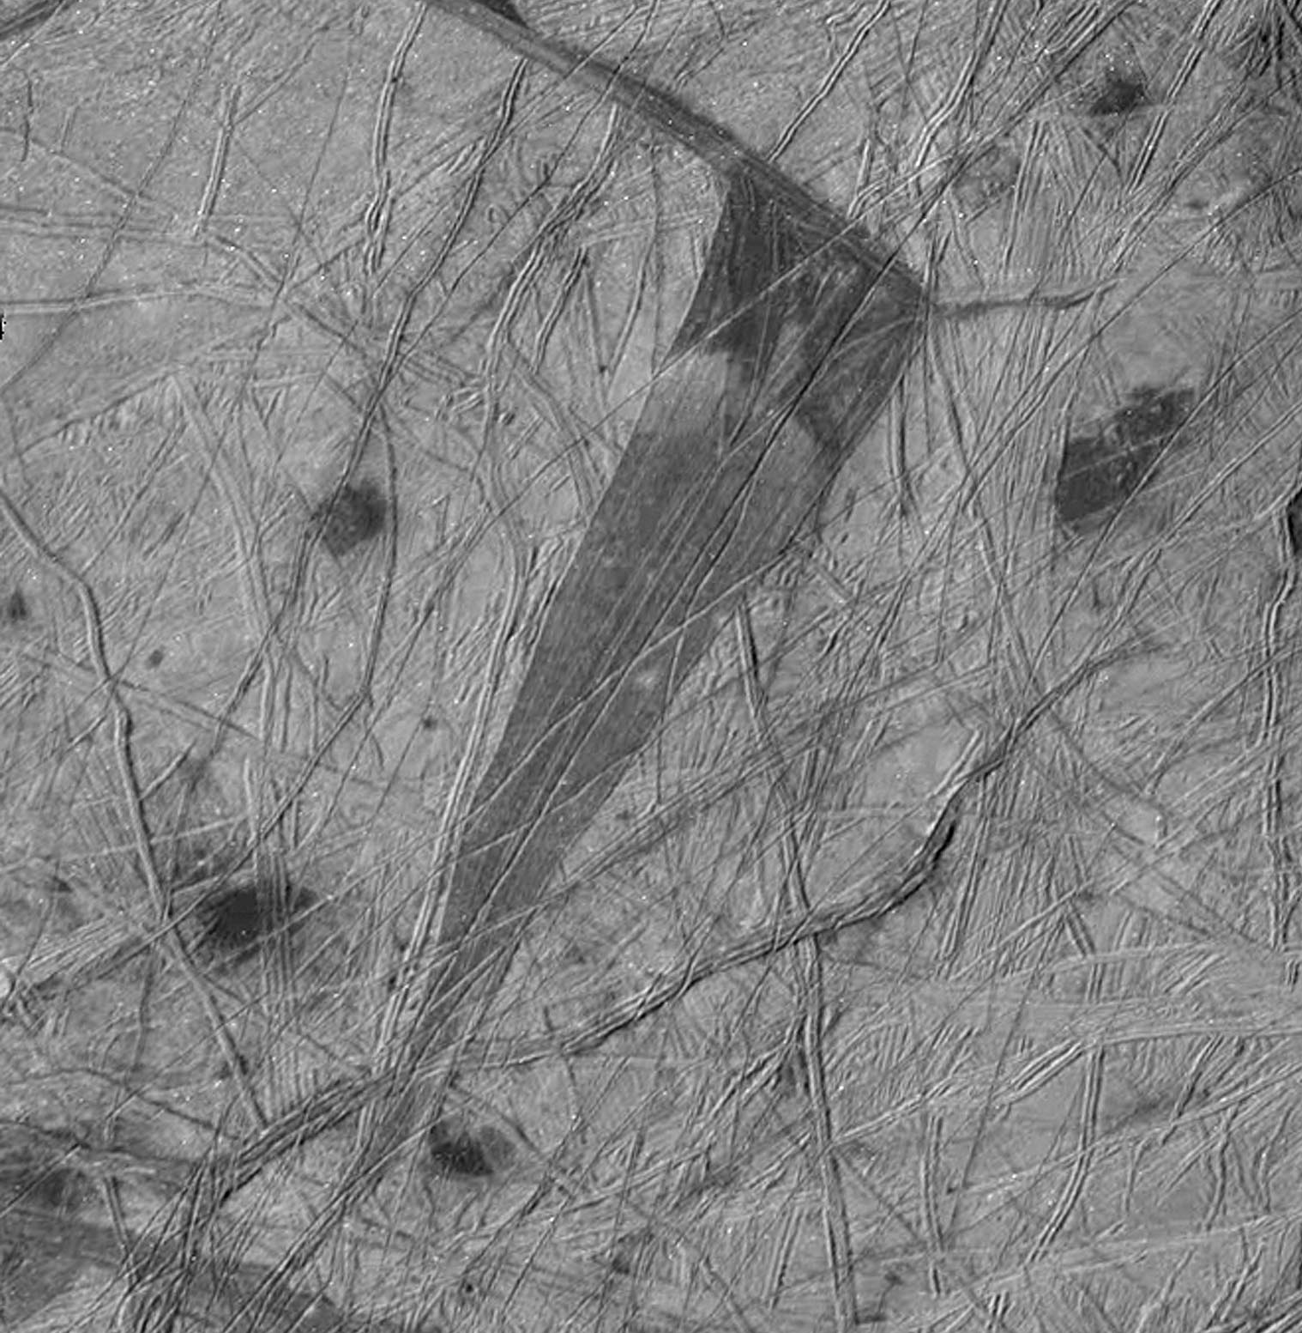
Ice tectonics > Wedge shaped band

Slide 41
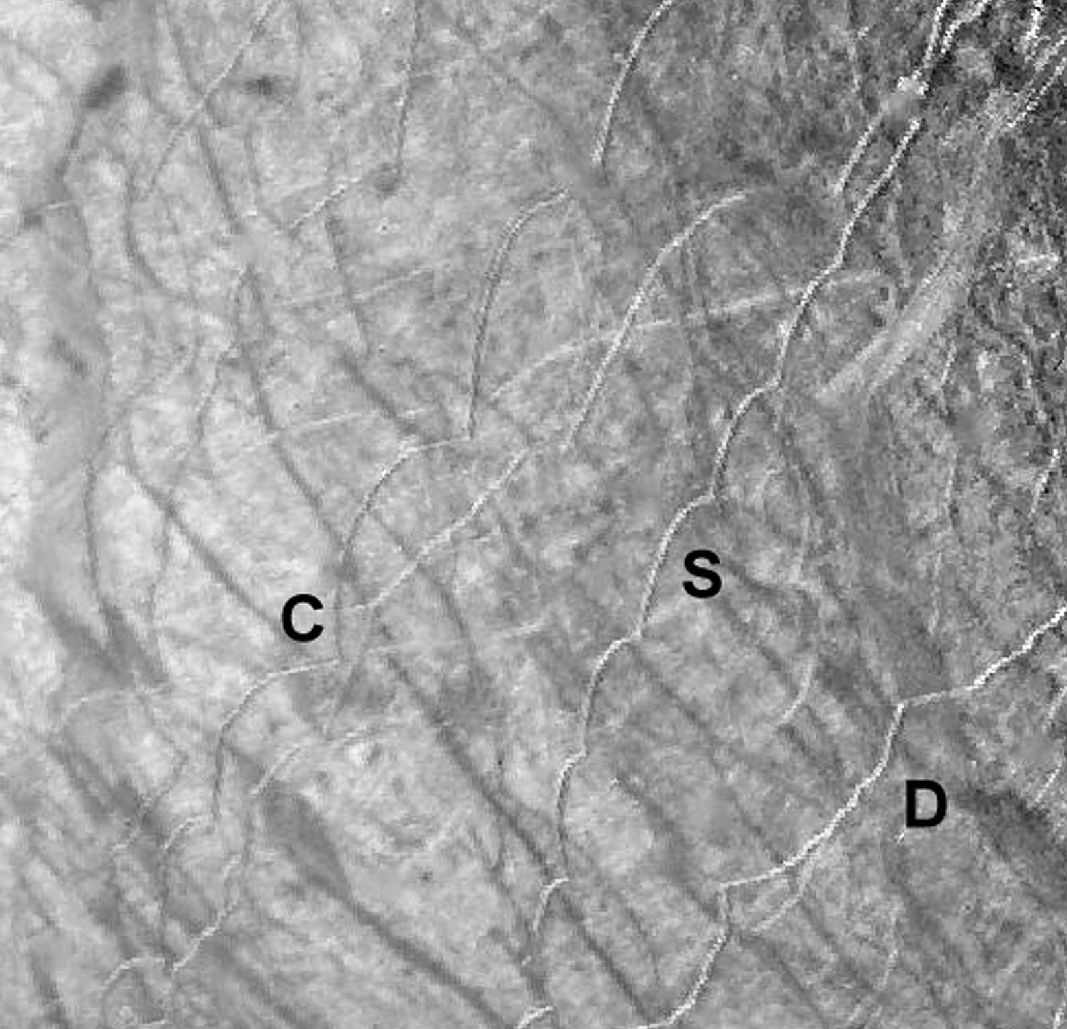
Ice tectonics > cycloid

Slide 42
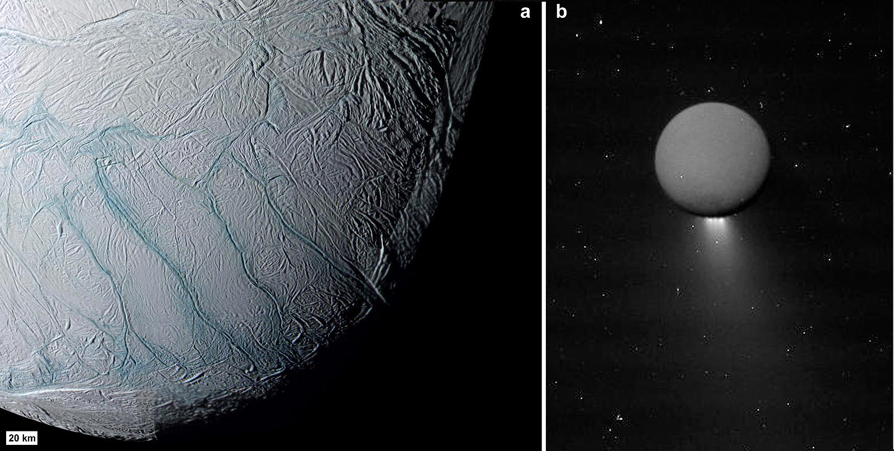
Ice tectonics > Tiger stripes

Slide 43
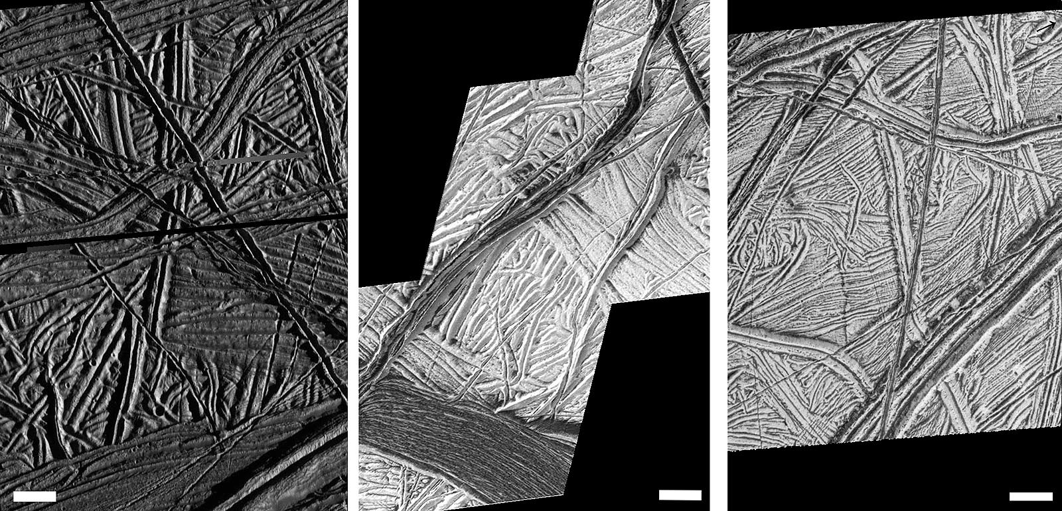
Ice tectonics > Bright plains (icy)

Slide 44

Ice tectonics > Horsetail splay

