Slide 1
Planetary landforms
A visual introduction to planetary geomorphology
ALBEDO+IMPACT
HENRIK HARGITAI
2019
csplanetolg17em
FÖL/1/075E
Definitions in the Notes section

Slide 2
ALBEDO FEATURES

Slide 3
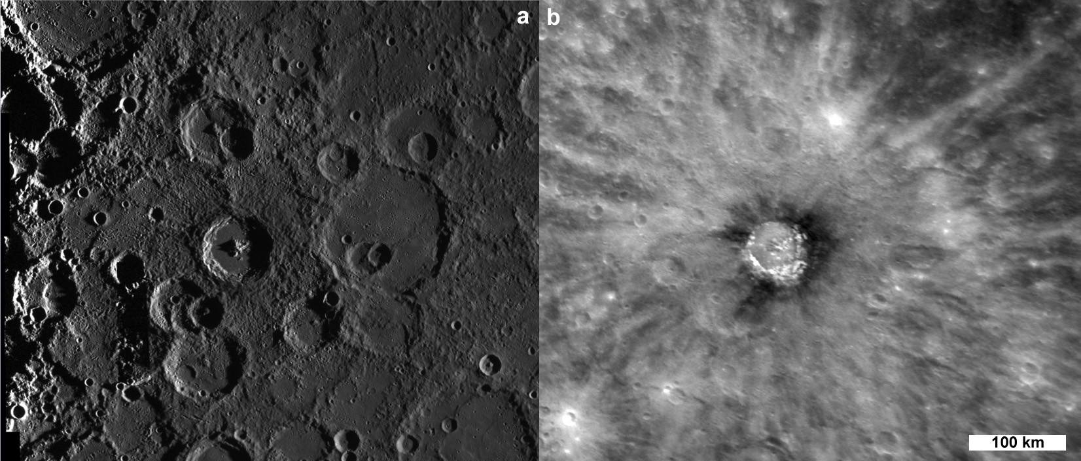
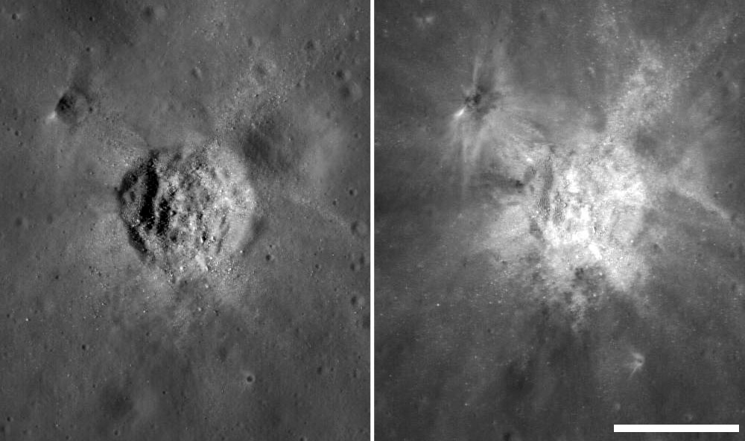

Slide 4
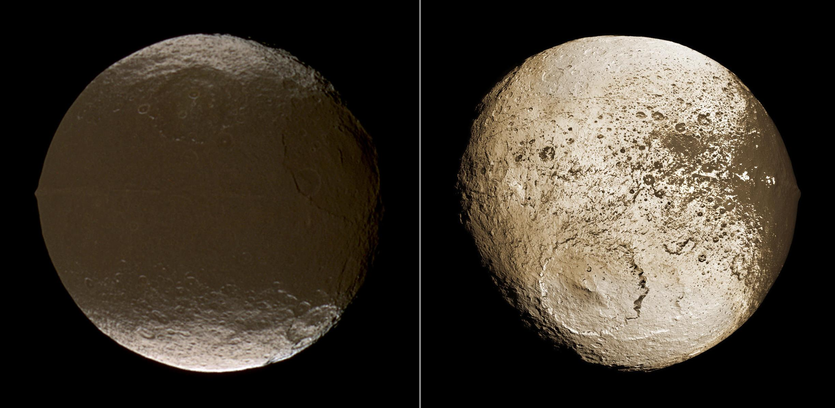
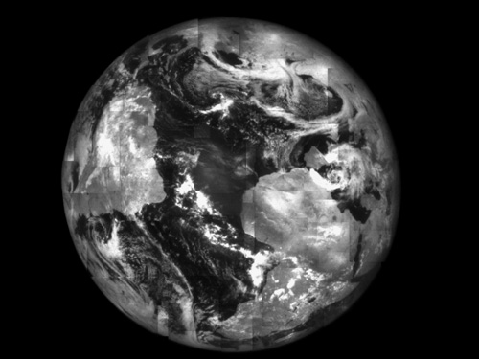
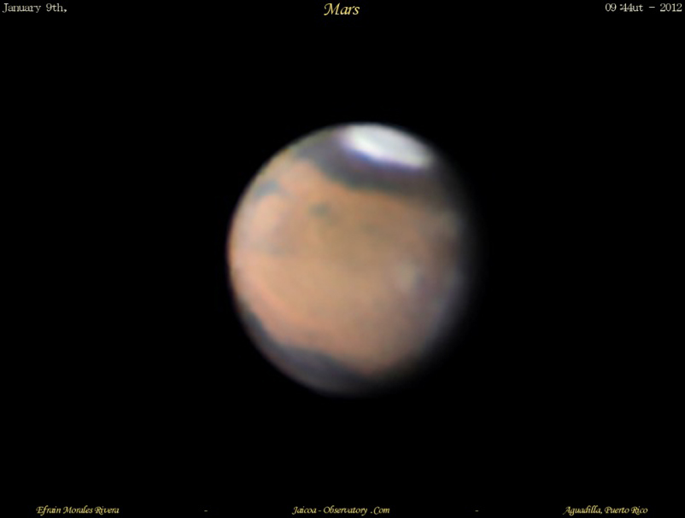
Geographic area distinguished by amount of reflected light
Albedo feature

Slide 5
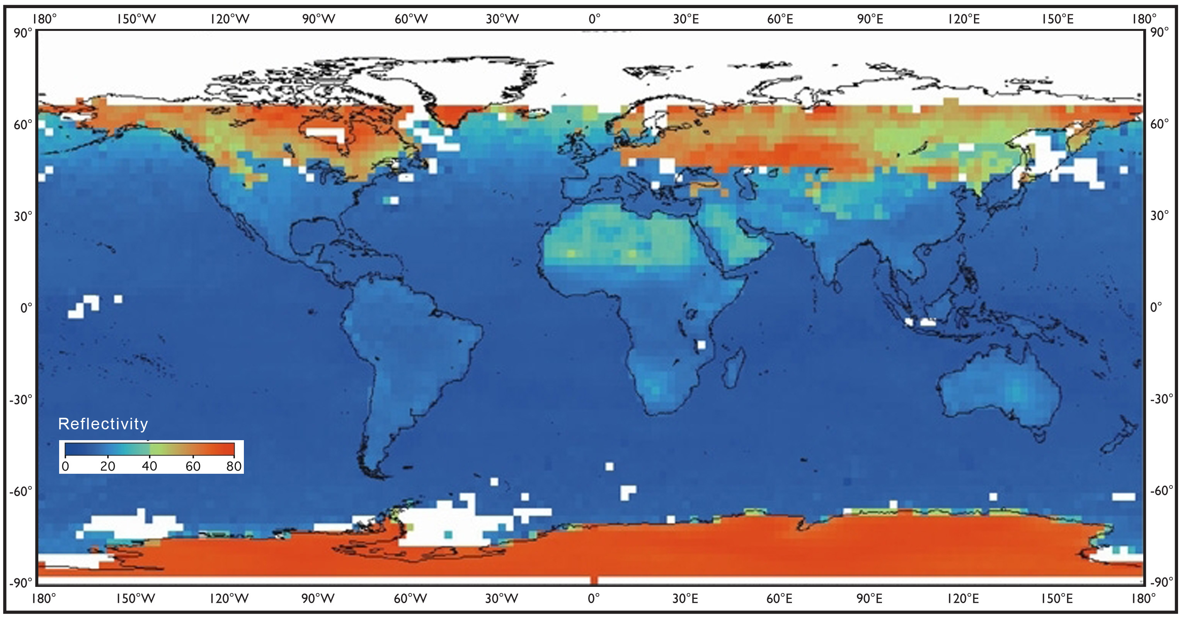
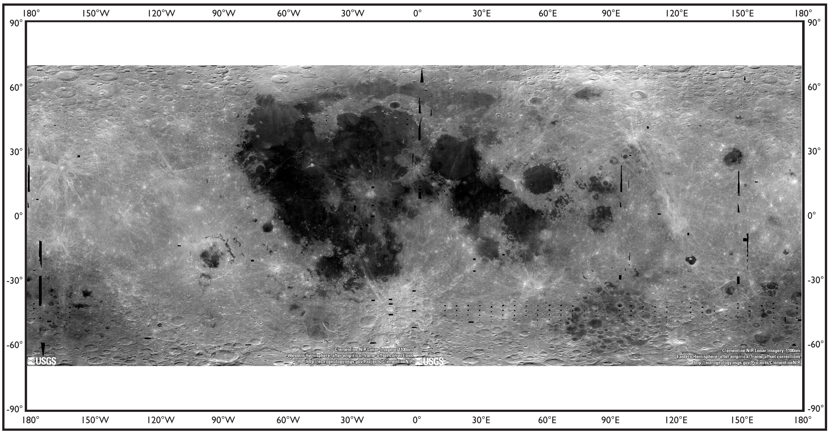
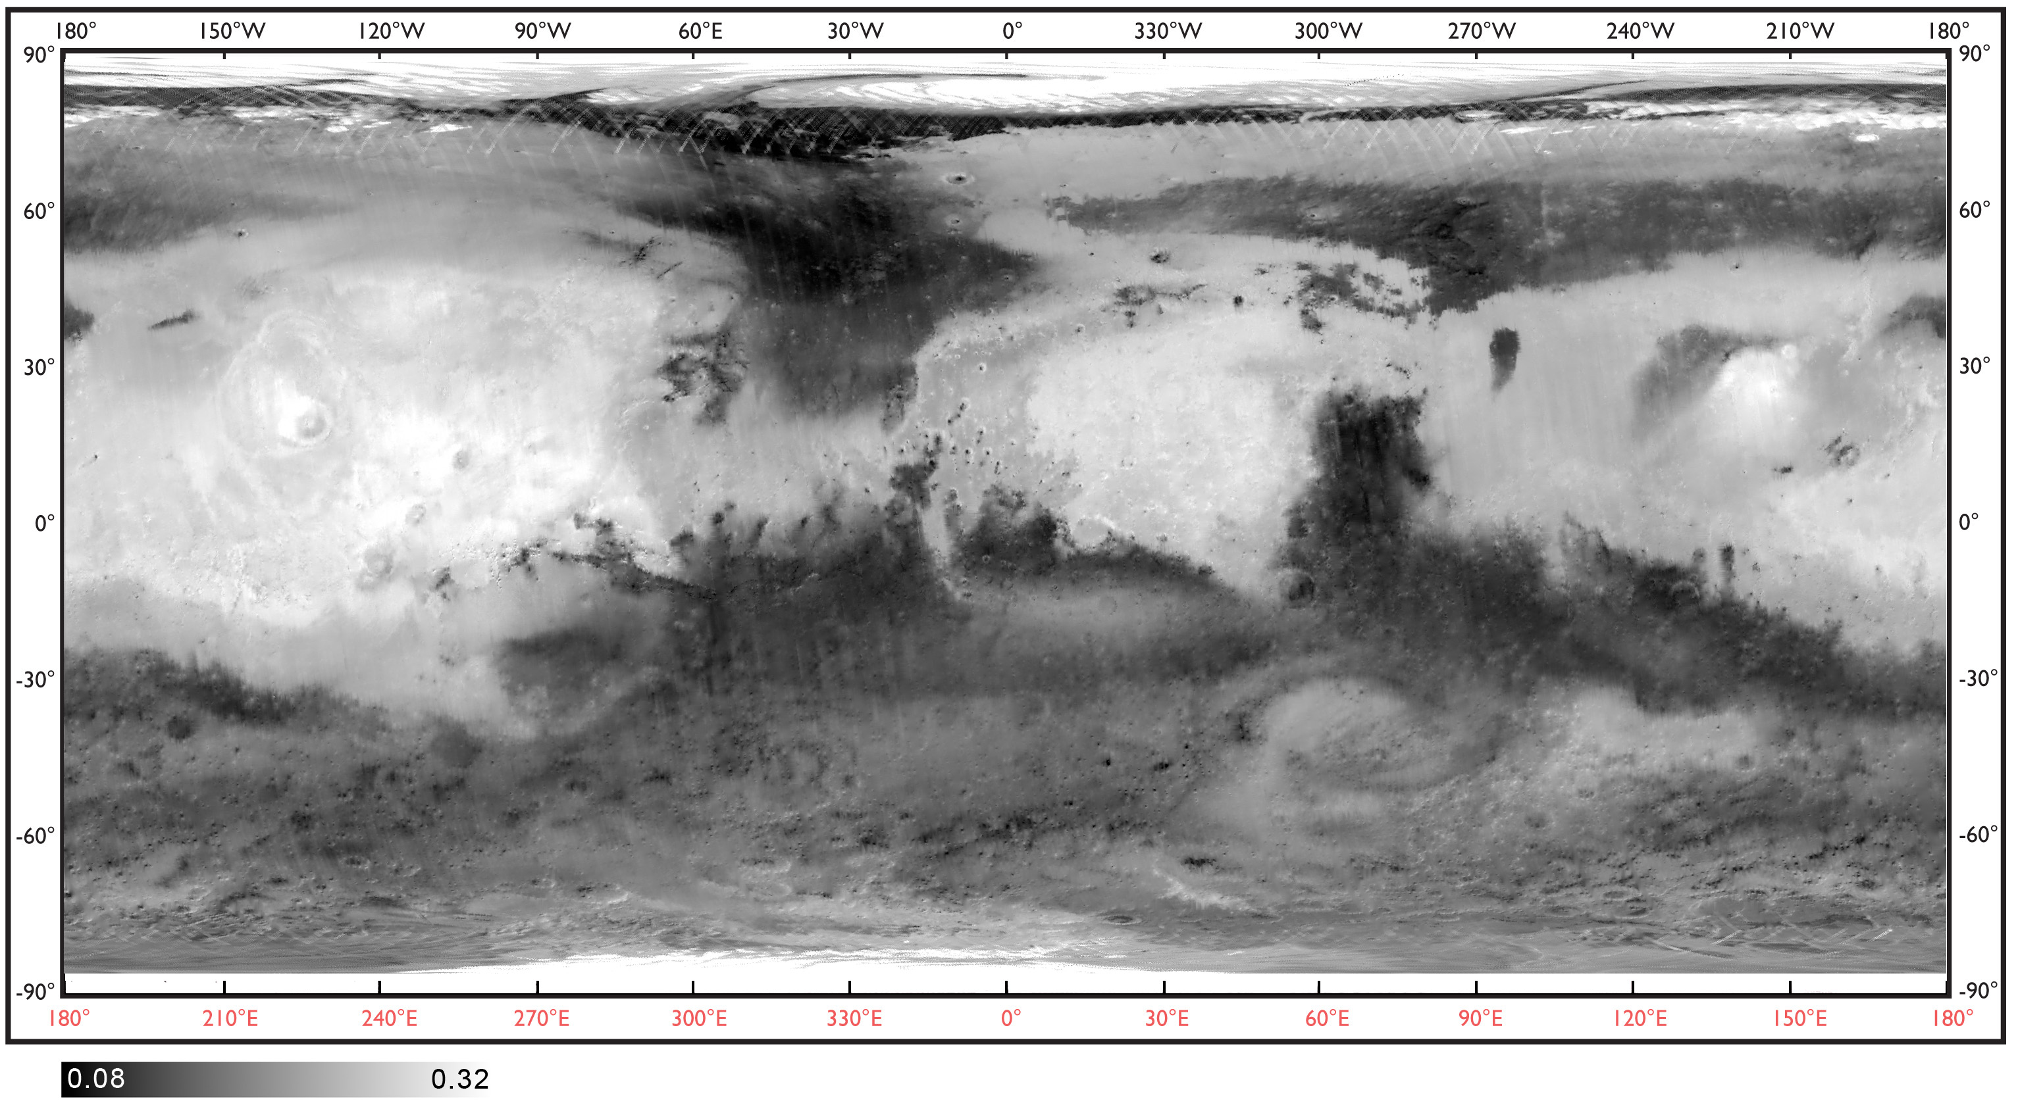
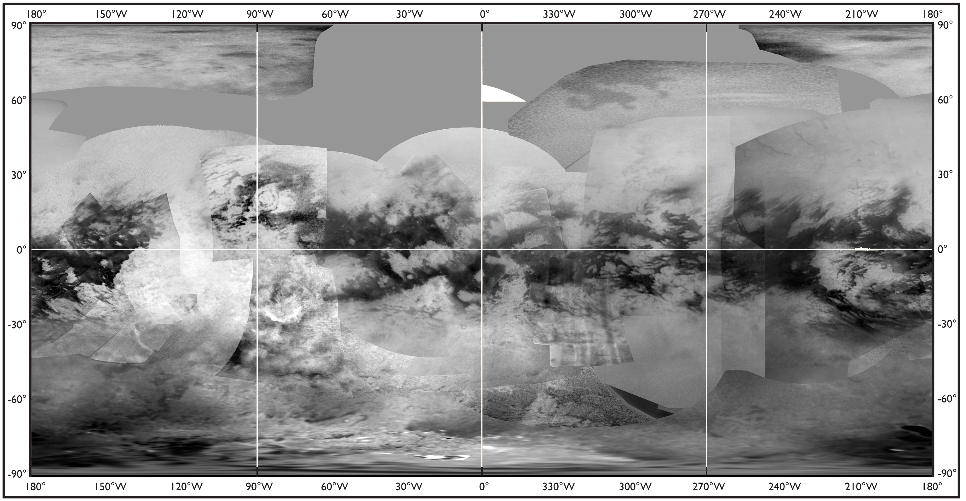
ALBEDO

Slide 6
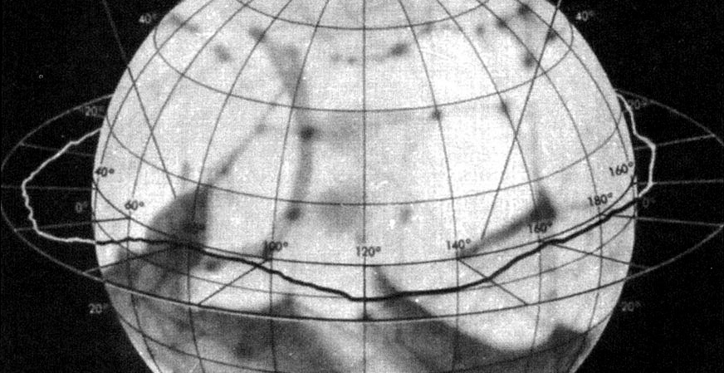
Canal

Slide 7
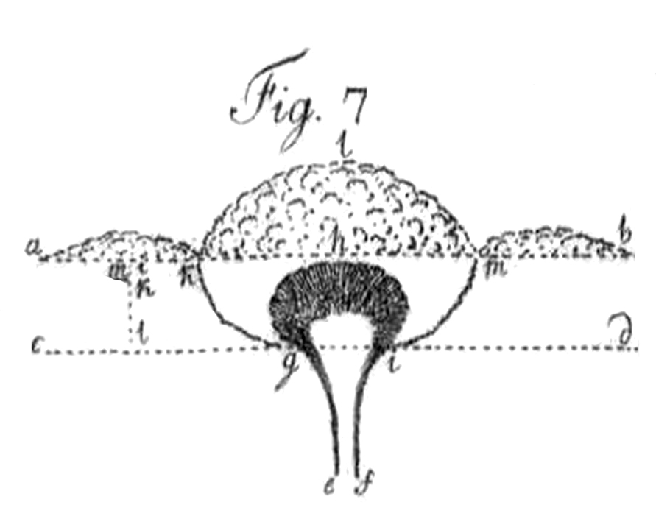
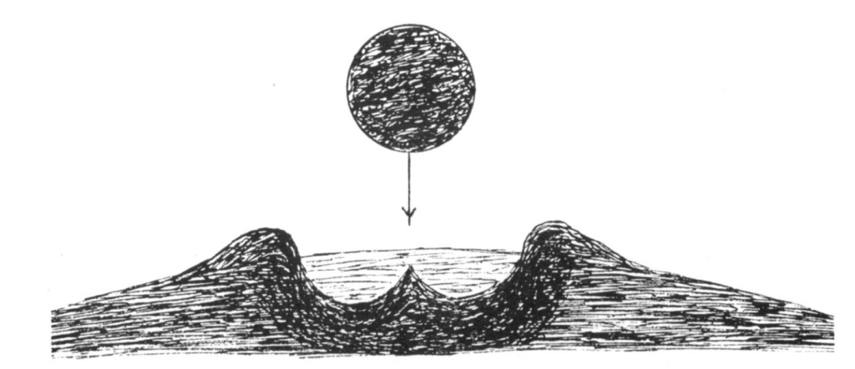
IMpact processes

Slide 8
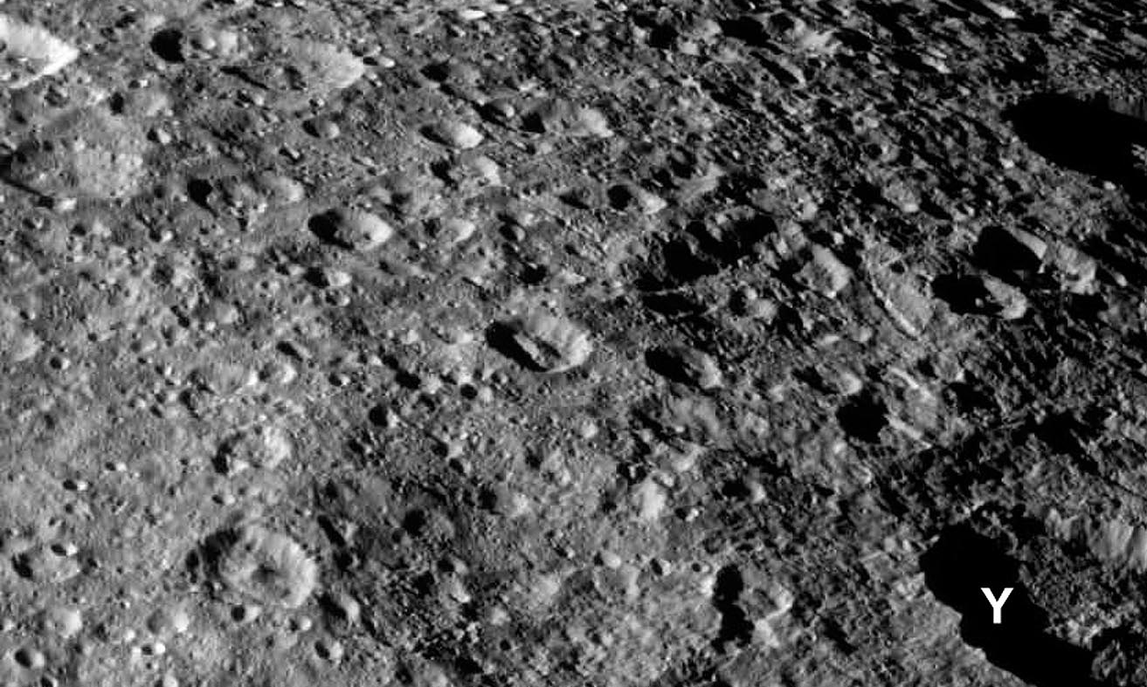
Impact landforms > Heavily Cratered terrain
Notes:
Heavily Cratered terrain - A region of planetary surface consisting of closely packed, overlapping craters

Slide 9
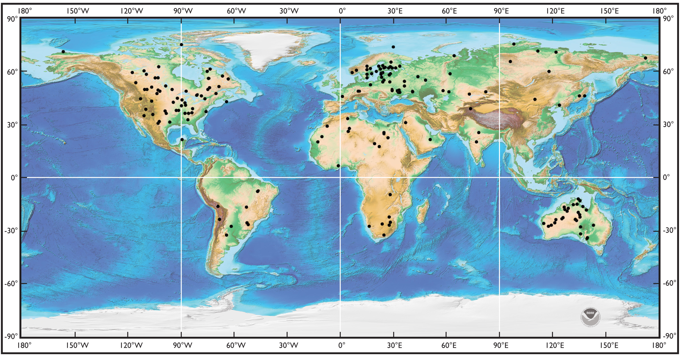

Slide 10
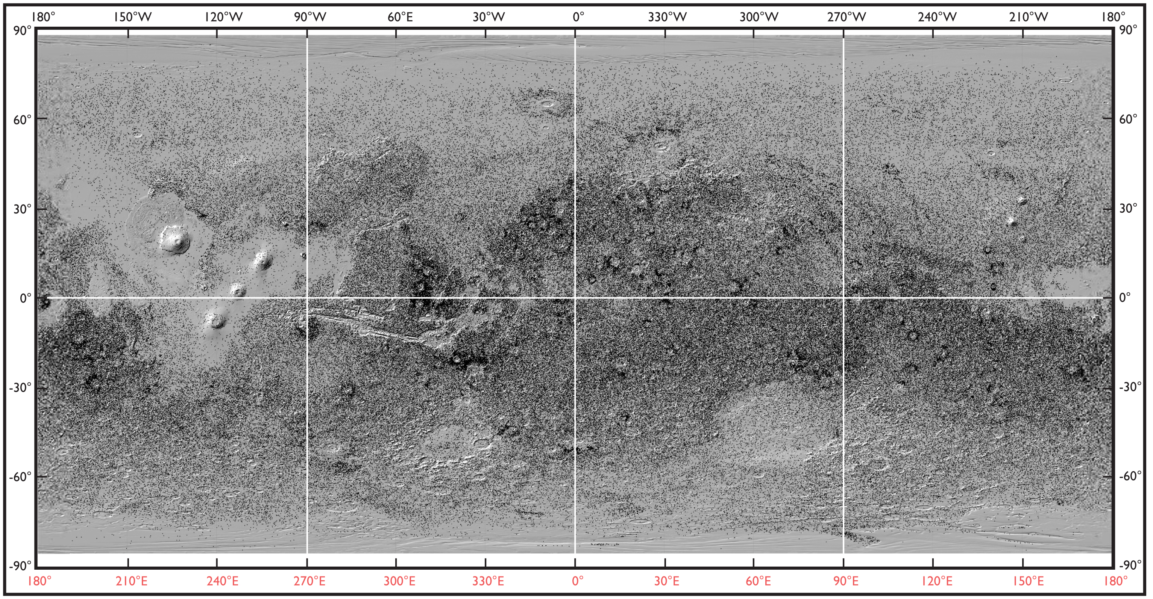

Slide 11
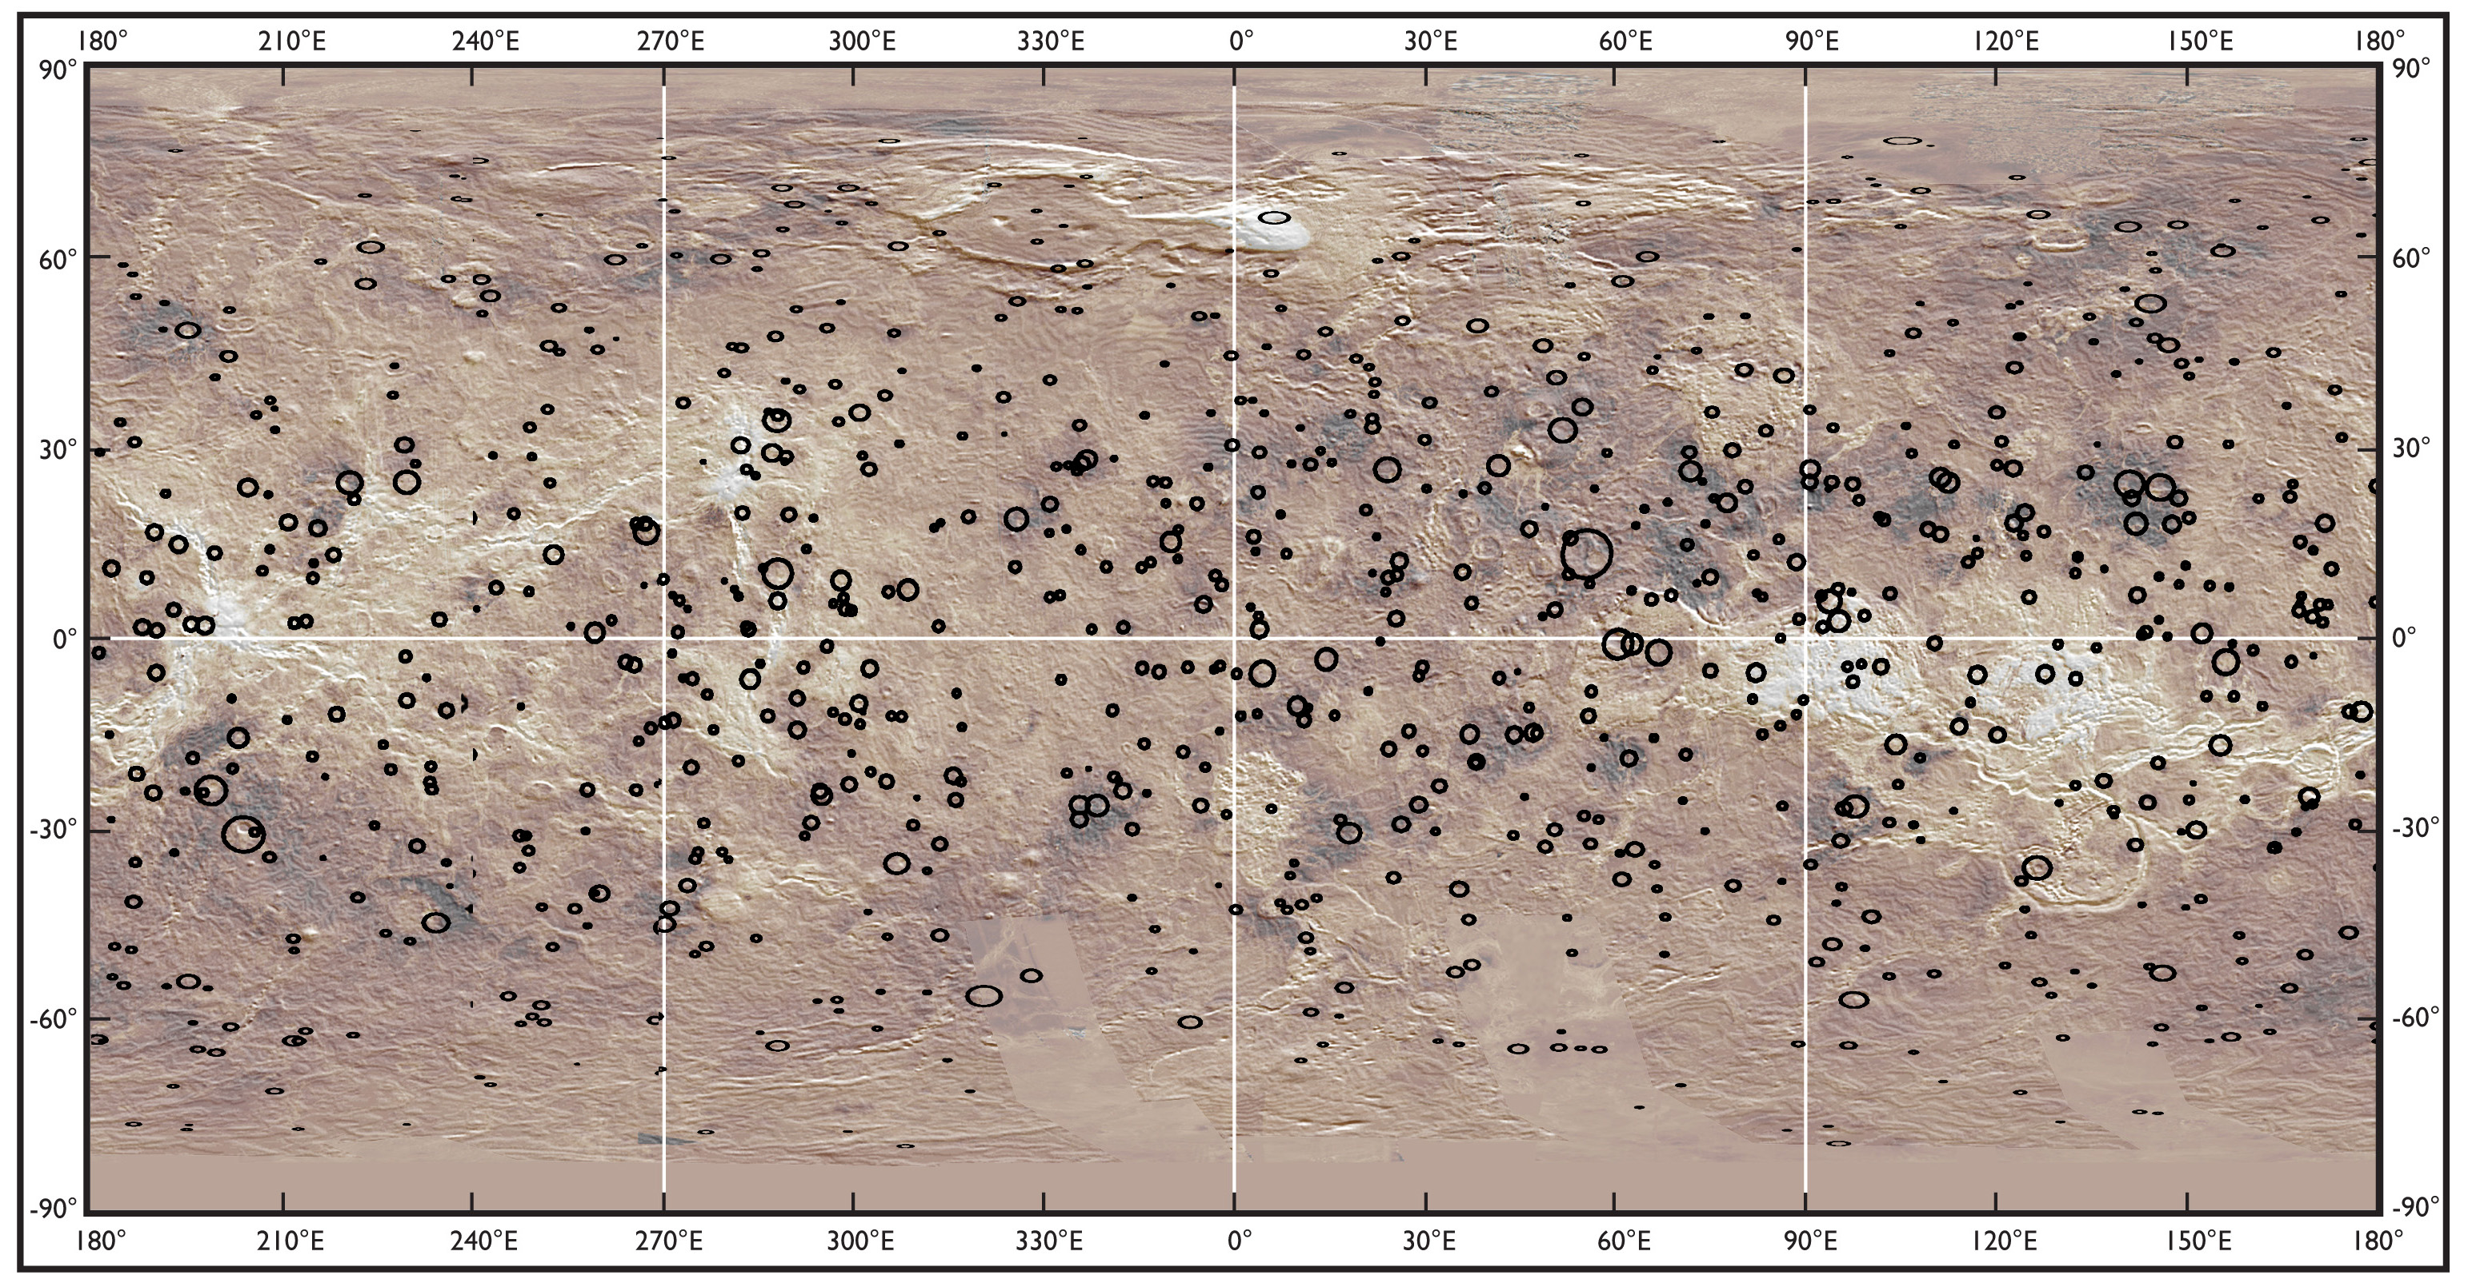

Slide 12
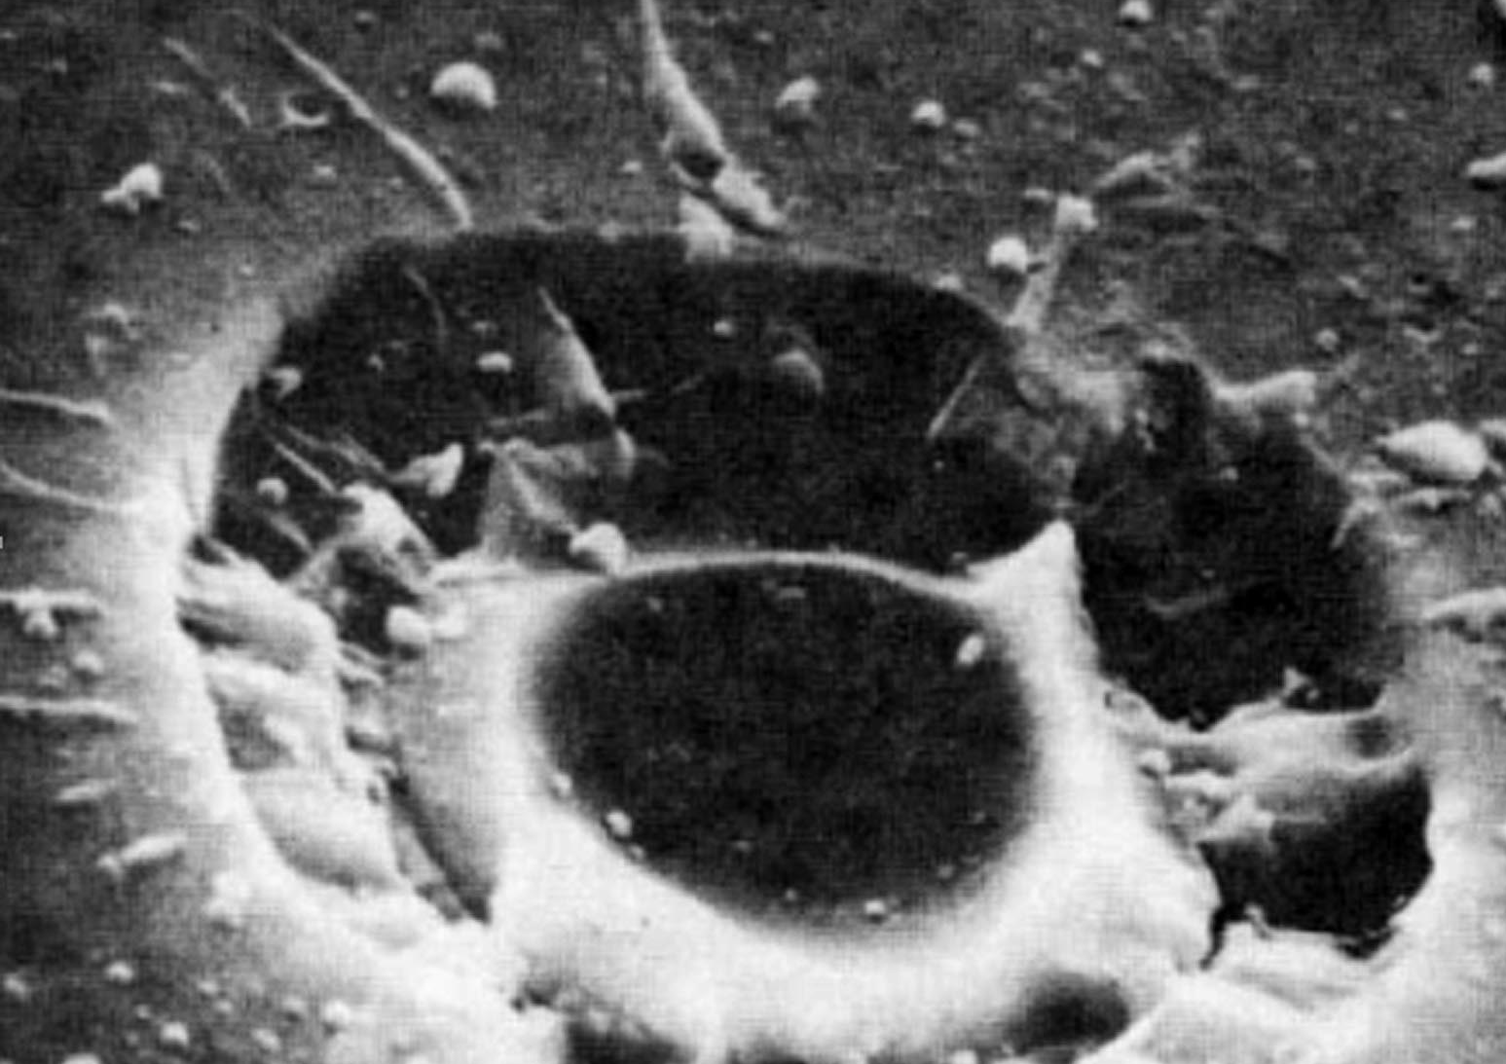
Impact landforms > Microcrater
Notes:
Microcrater - An impact crater of submillimeter size.

Slide 13
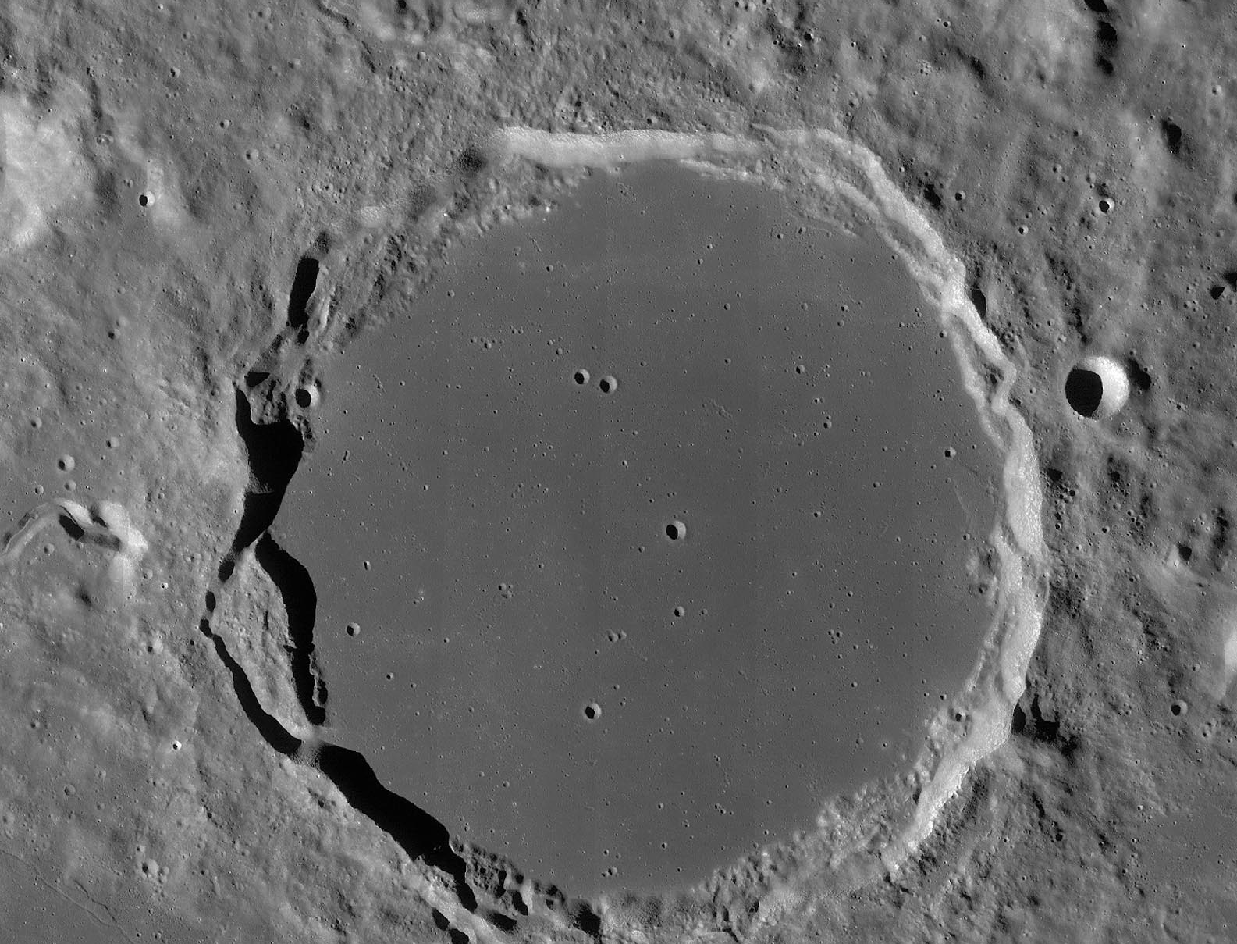
Impact landforms > Craterlet
Notes:
Craterlet - A small (arbitrary size <2 km) crater.

Slide 14
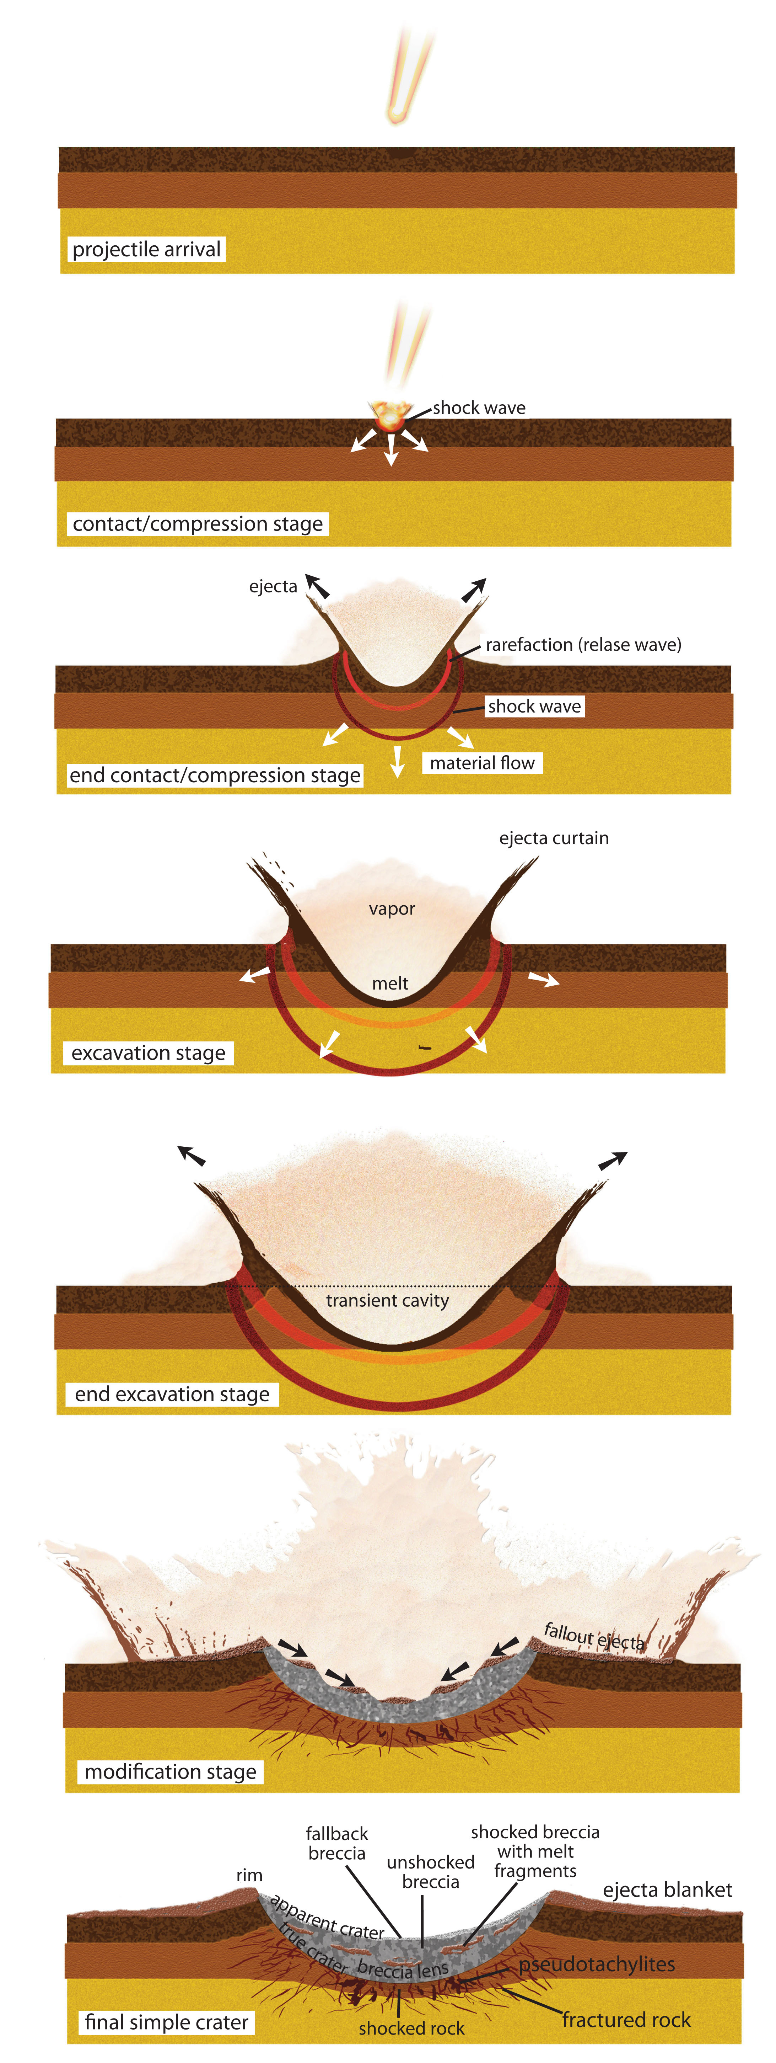
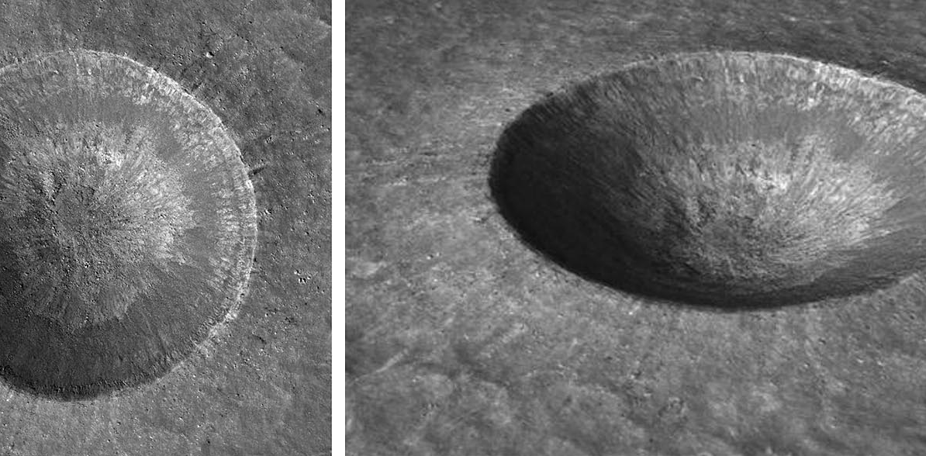
Impact landforms > Simple crater
Notes:
Craterlet - A small (arbitrary size <2 km) crater.

Slide 15
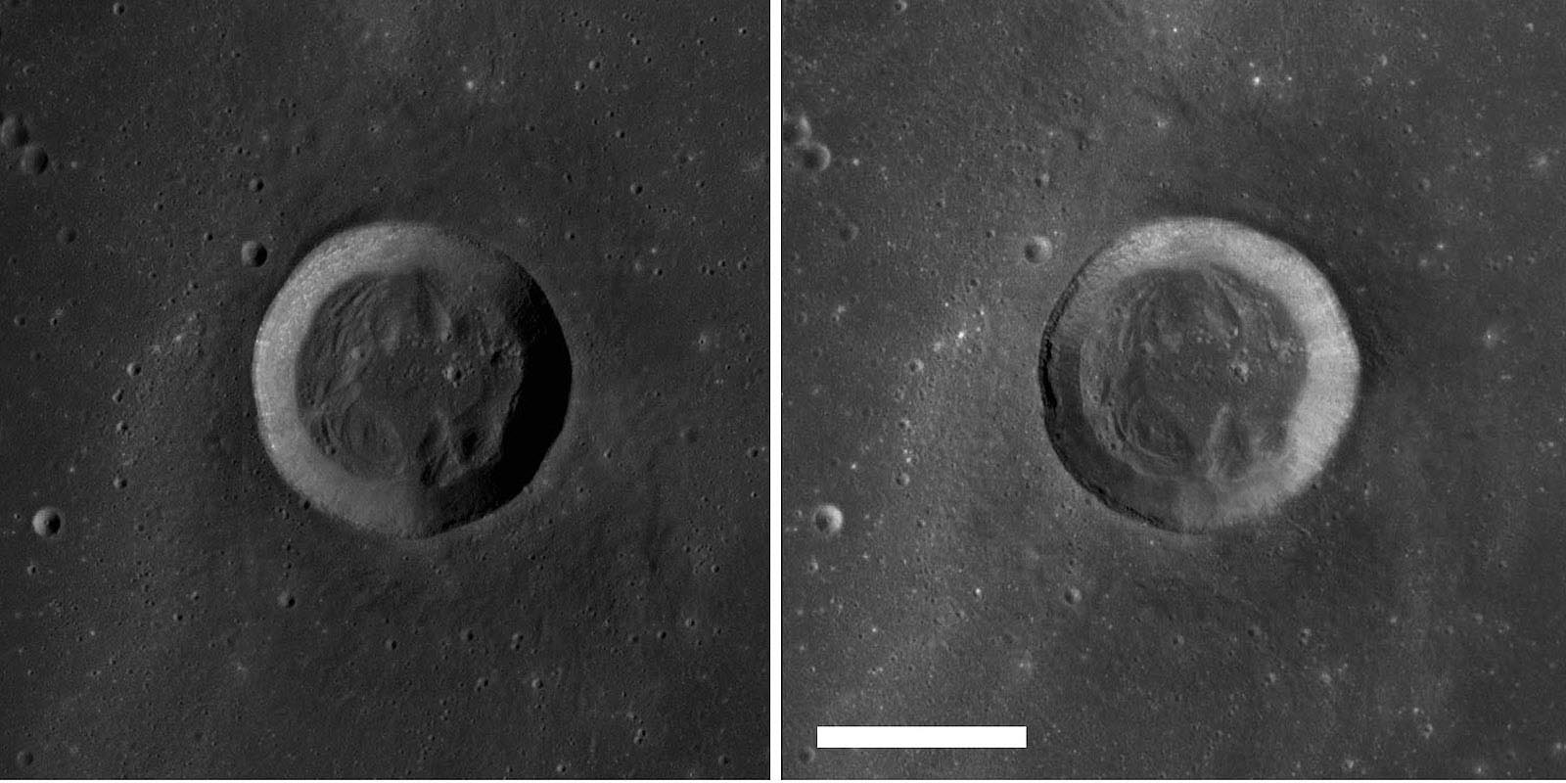
Impact landforms > Flat floored transitional
Notes:
Flat floored transitional crater - Crater characterized by relatively smooth walls and a floor partly or completely covered by debris slumped from the crater walls.

Slide 16
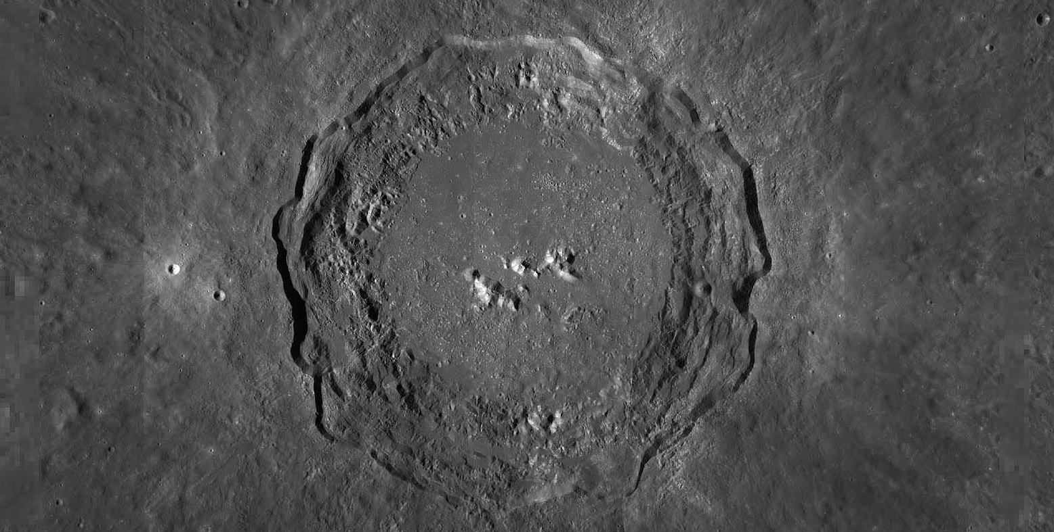
Impact landforms > Flat floored complex crater
Notes:
Complex crater - An impact structure larger than a simple crater displaying complex morphology

Slide 17
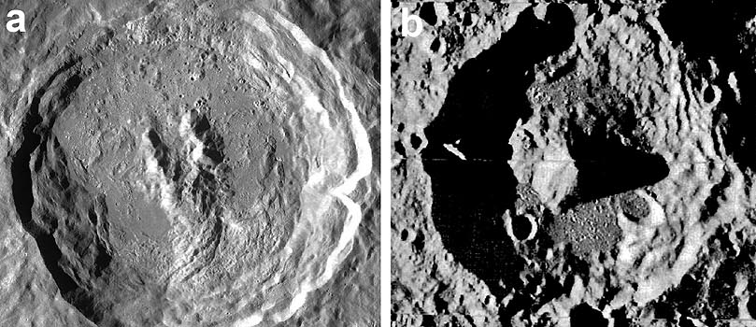
Impact landforms > Centrak Peak Crater
Notes:
Complex crater with a single central uplift, a tight cluster of peaks, or a tightly spaced ring-like arrangement of peaks

Slide 18
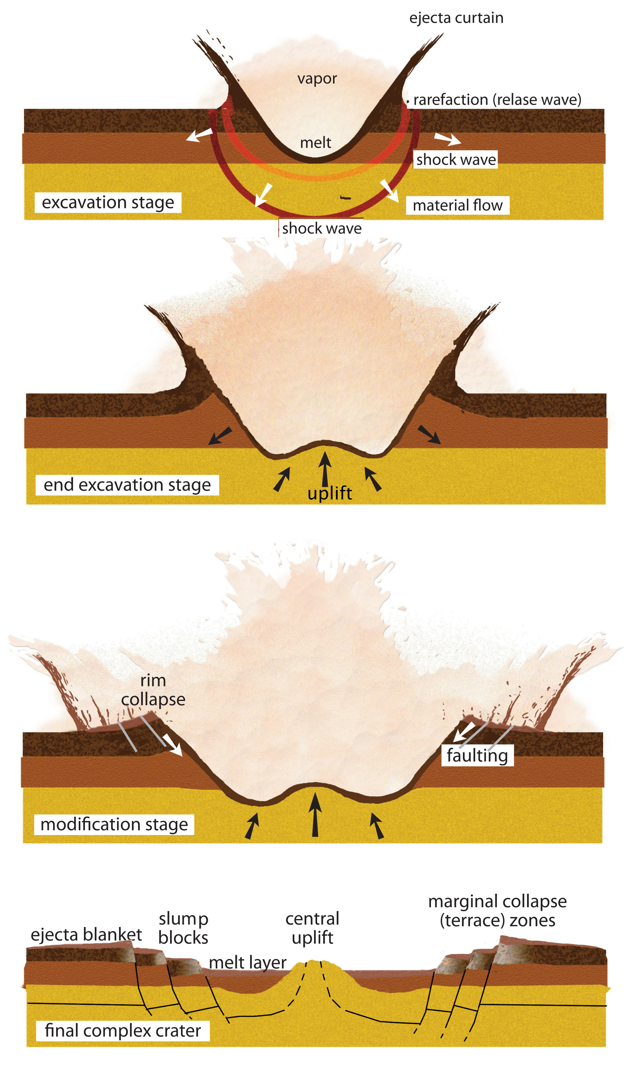
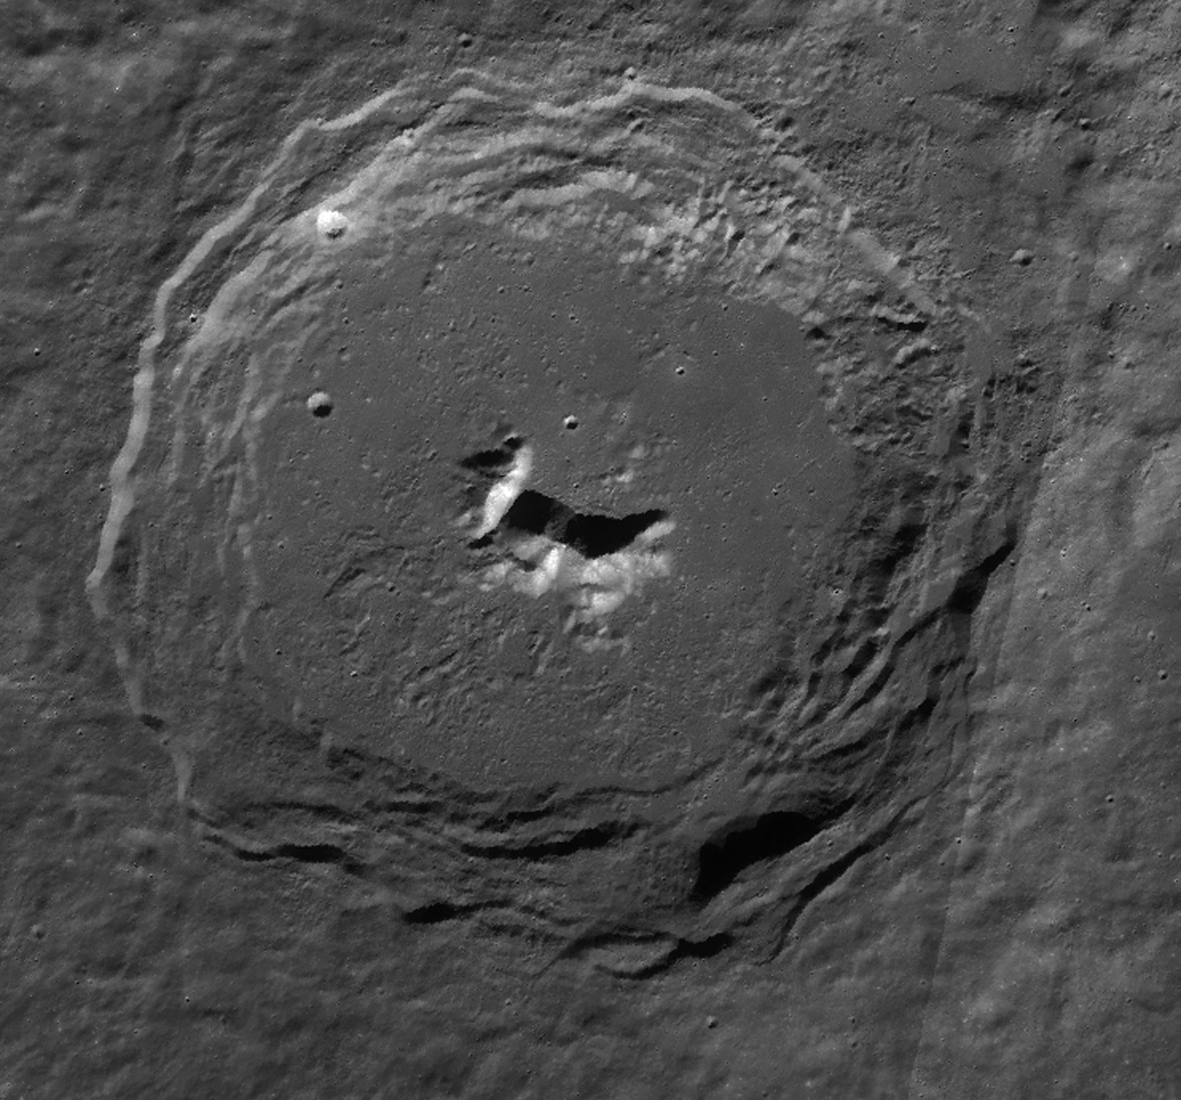
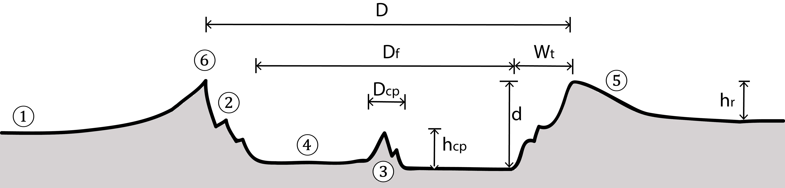
Impact landforms > Icy bodies > Central peak crater
Notes:
Complex crater with a single central uplift, a tight cluster of peaks, or a tightly spaced ring-like arrangement of peaks

Slide 19
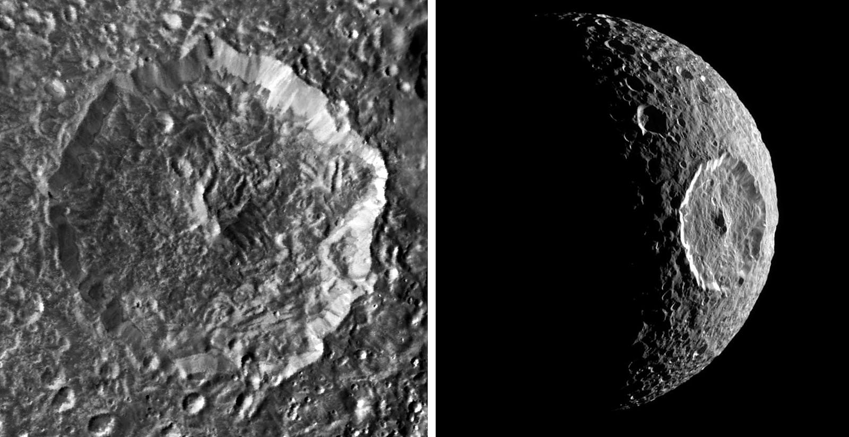
Impact landforms > Icy bodies > Central peak crater
Notes:
Complex crater with a single central uplift, a tight cluster of peaks, or a tightly spaced ring-like arrangement of peaks

Slide 20
Impact landforms > Ringed peak-cluster basin
Notes:
Complex impact crater that has a central ring of peaks.

Slide 21
Impact landforms > Protobasin
Notes:
Complex craters (or “basins”) which exhibit a rim crest and both an interior central peak and internal ring of massifs (peak ring)

Slide 22
Impact landforms > Peak ring basin
Notes:
Complex impact structure exhibiting a rim crest, a flat floor, and an interior ring or open cluster of peaks, possessing no central peak.

Slide 23
Impact landforms > Multiring basin – Orinetale type
Notes:
Large circular impact structure that possesses at least two concentric asymmetric scarps, one of which may be the original crater rim

Slide 24
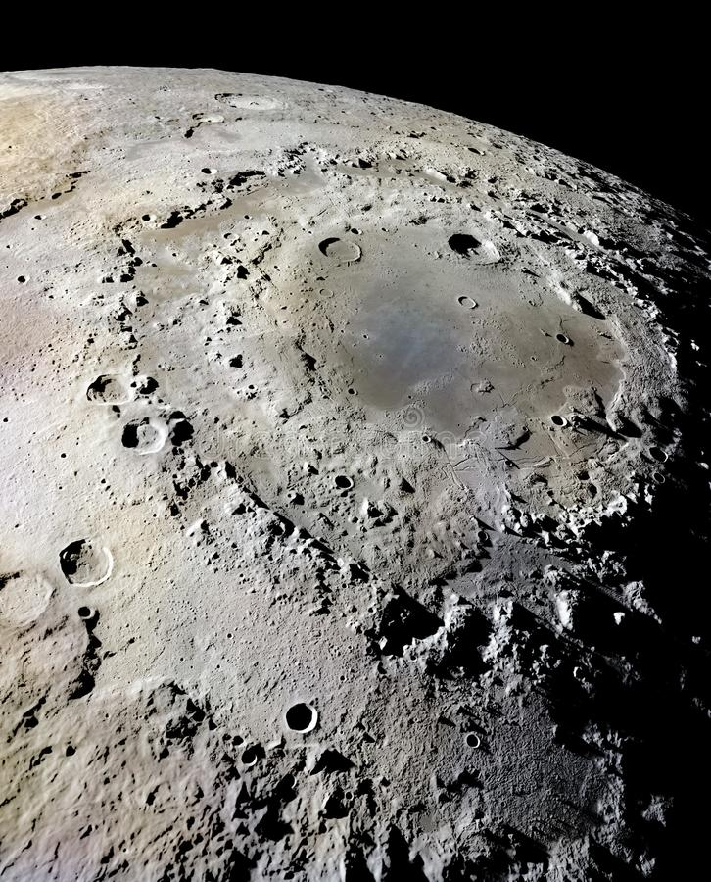
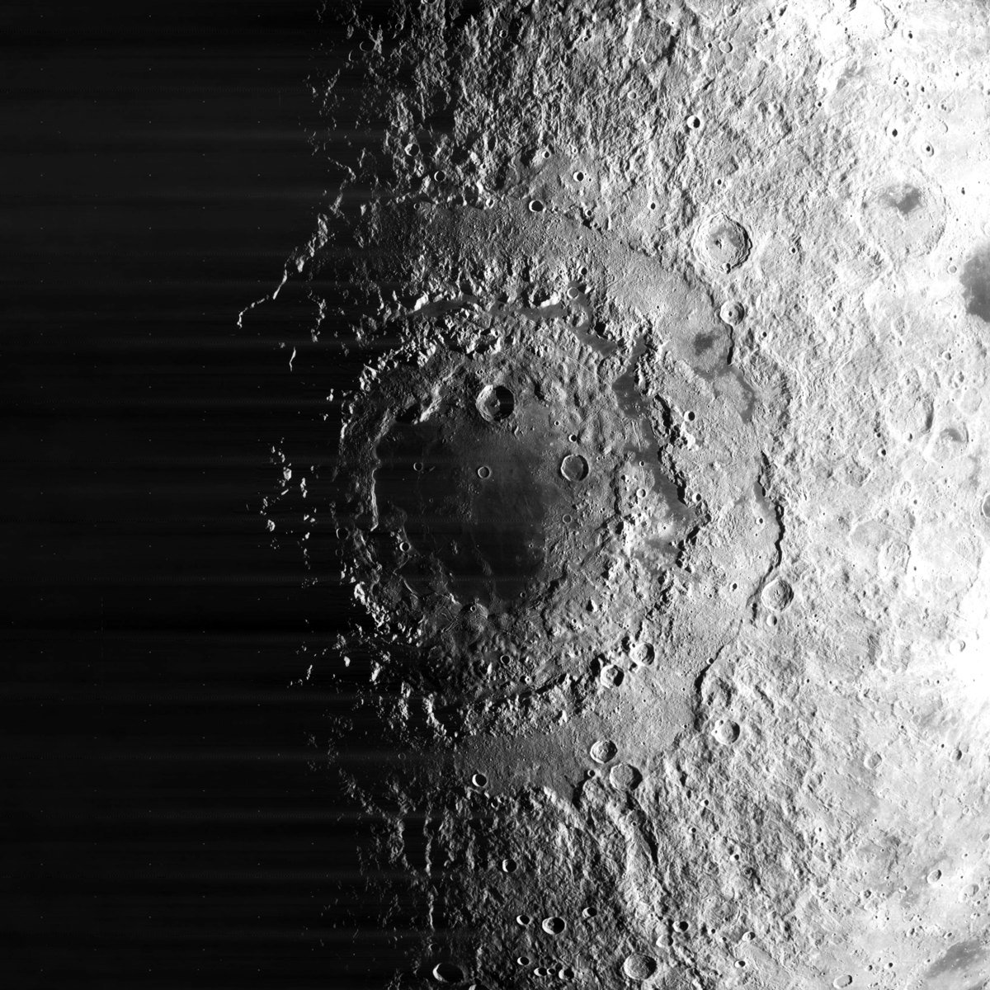
Impact landforms > Multiring basin – Orinetale type
Notes:
Large circular impact structure that possesses at least two concentric asymmetric scarps, one of which may be the original crater rim

Slide 25
Impact landforms > Multiring basin – Valhalla type
Notes:
An impact basin that characteristically exhibits a central high albedo patch surrounded by a system of concentric ridges and/or troughs.

Slide 26
Impact landforms > Multiring basin – Tranquillitatis type
Notes:
Irregular, shallow mare basin with relatively thin basalt fill.

Slide 27
Impact landforms > Icy bodies > Central Pit crater
Notes:
A complex impact crater hosting a central depression (pit) at or near its center.

Slide 28
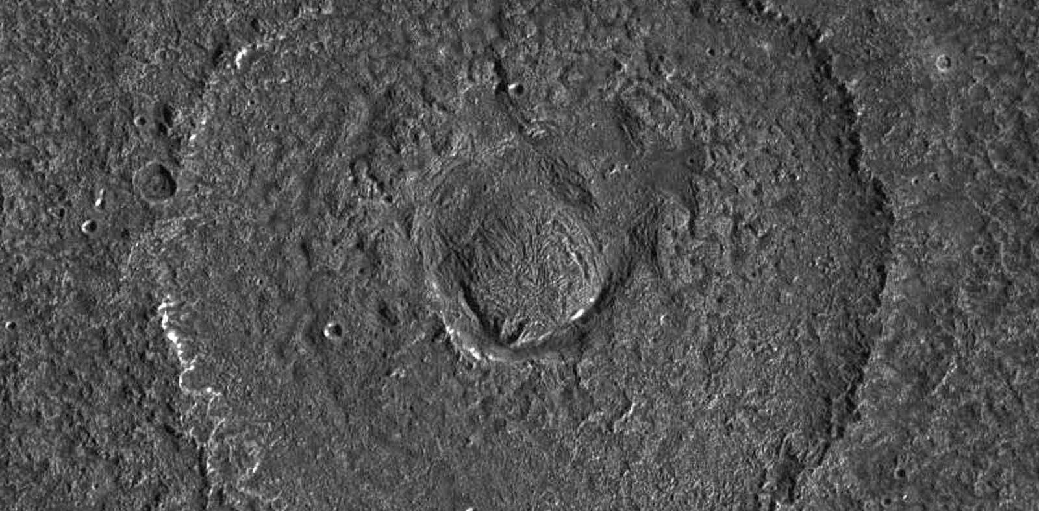
Impact landforms > Icy bodies > Central Dome crater
Notes:
A type of complex crater exhibiting a central complex comprised of a central depression partially filled by a dome.

Slide 29
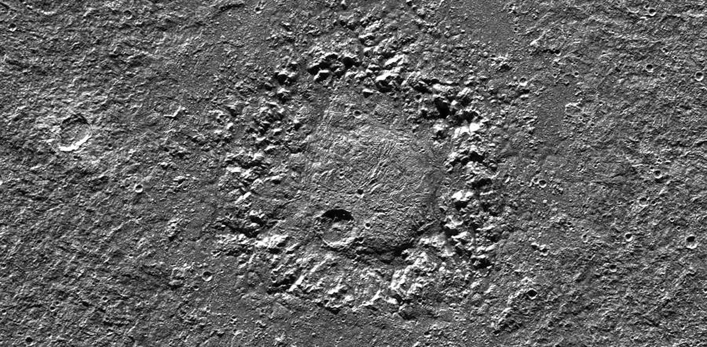
Impact landforms > Icy bodies > Anomalous Dome crater
Notes:
Anomalous dome craters are 50–250 km diameter complex craters on the icy Galilean satellites.

Slide 30
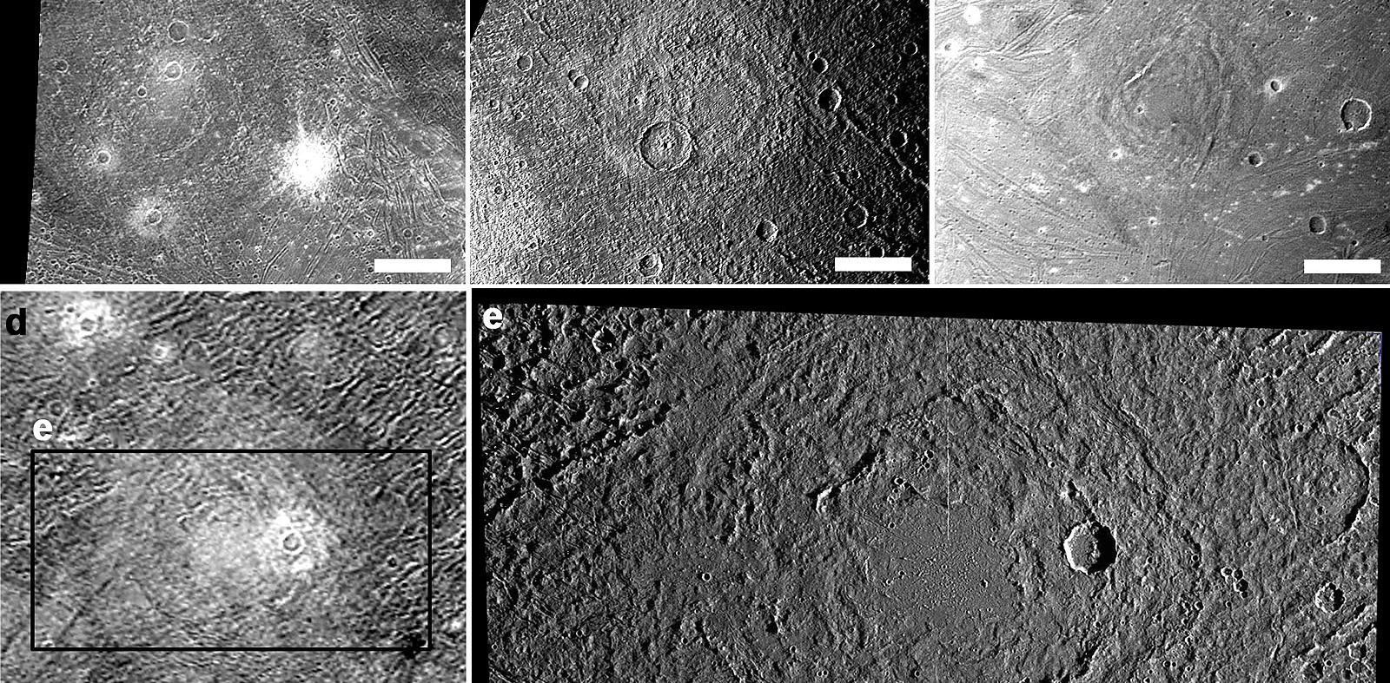
Impact landforms > Icy bodies > Penepalimpsest
Notes:
A degraded impact structure formed on icy satellites, noted for its low relief.

Slide 31
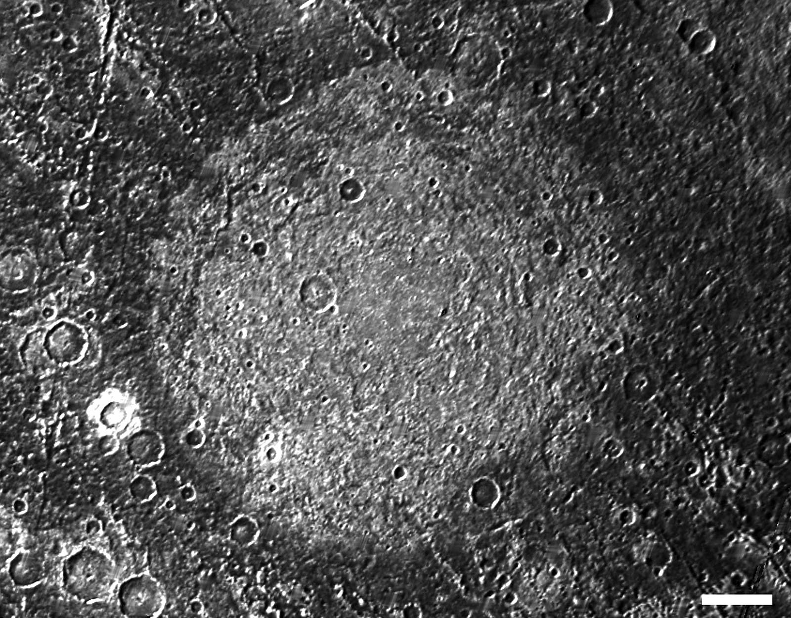
Impact landforms > Icy bodies > Palimpsest
Notes:
a very degraded complex crater found on icy satellites that formed very early in the satellite’s history, noted for its lack of relief.

Slide 32
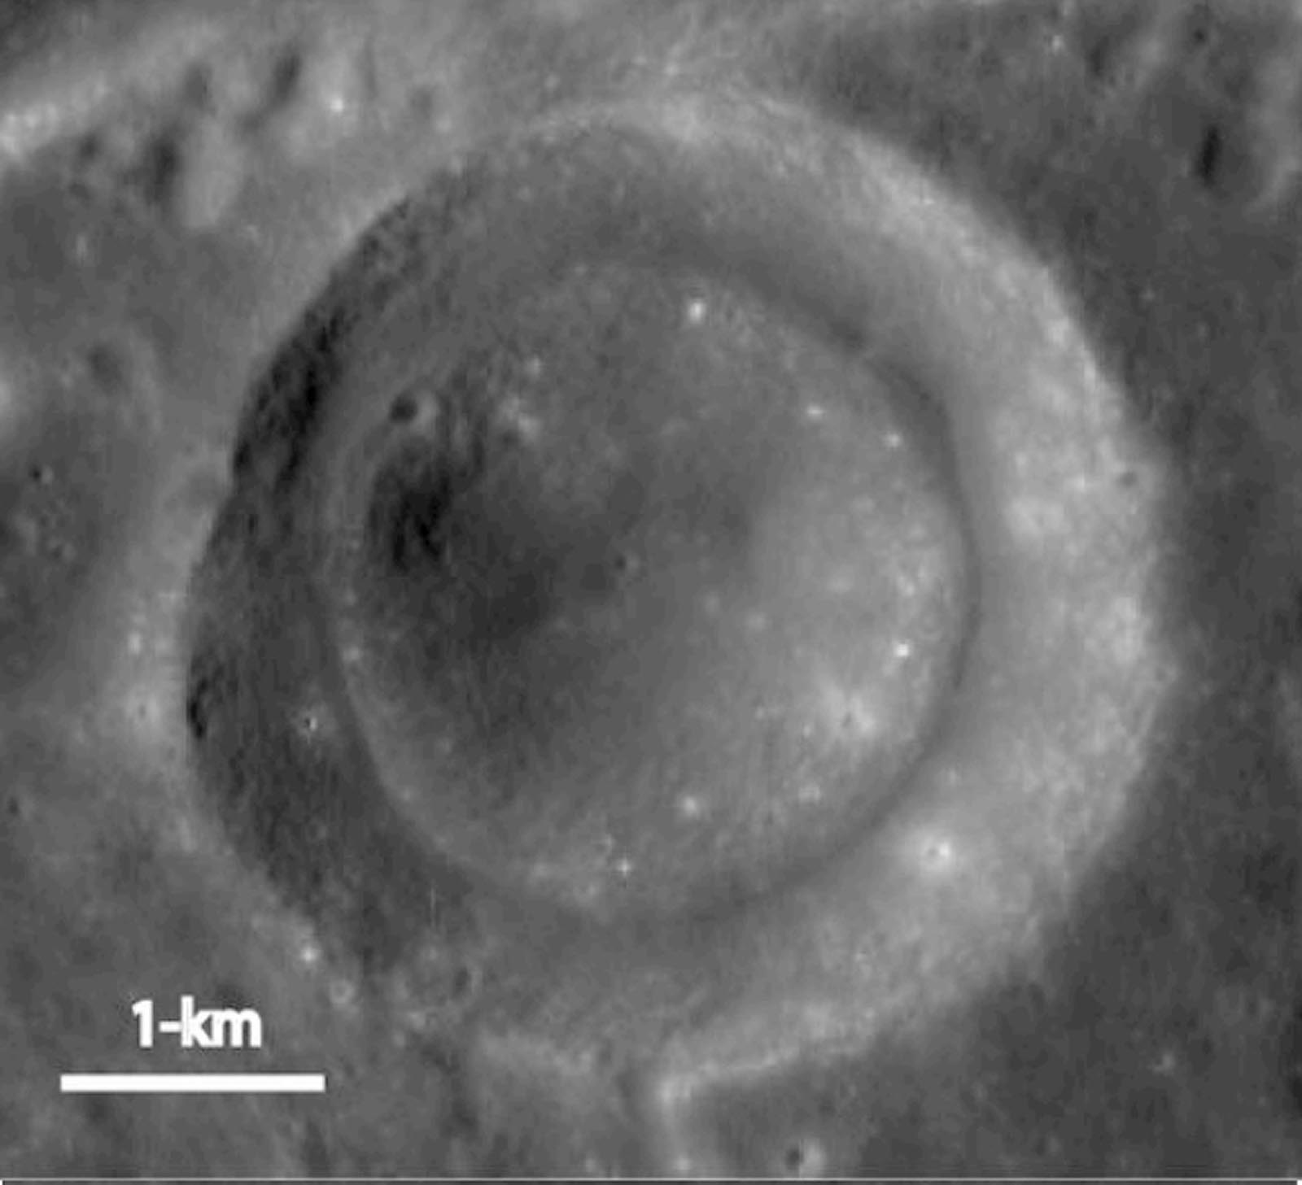
Impact landforms > Concentric crater
Notes:
An impact crater with one or more concentric ridges on the crater wall and/or crater floor with a central depression

Slide 33
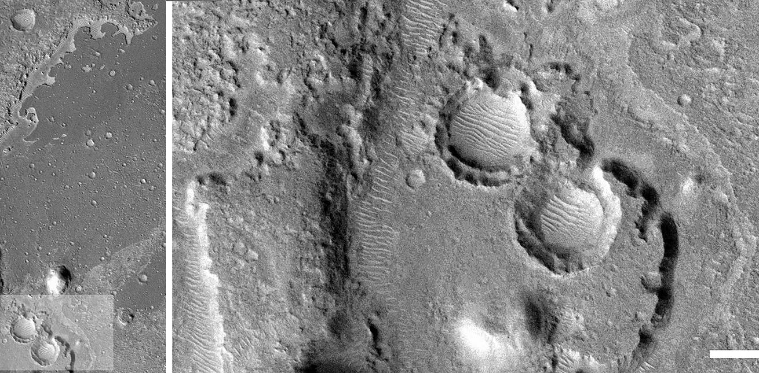
Impact landforms > Nested crater
Notes:
A crater within a crater where the inner crater is surrounded by a shallower outer crater, where both features lie below the elevation of the target surface.

Slide 34
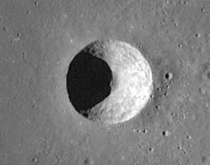

Impact landforms > Conical crater
Notes:
Simple impact crater exhibiting a conical shape.

Slide 35
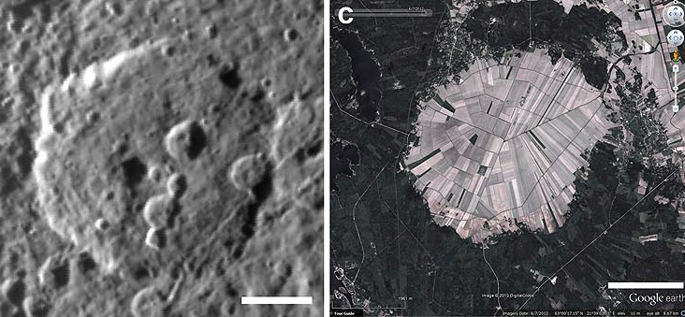
Impact landforms > Polygonal crater
Notes:
An impact crater having a polygonal rim shape in plan view.

Slide 36
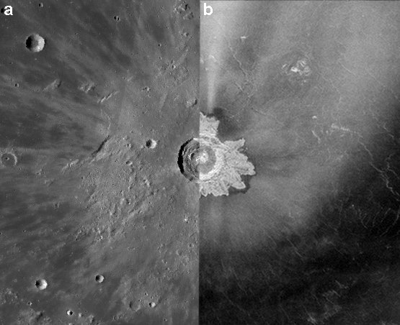
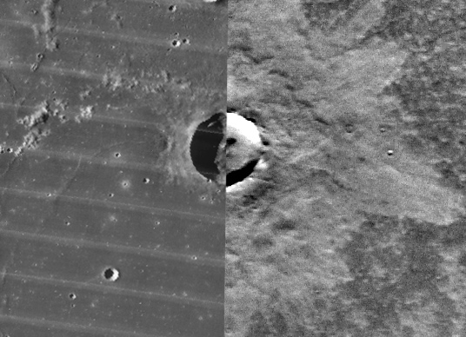
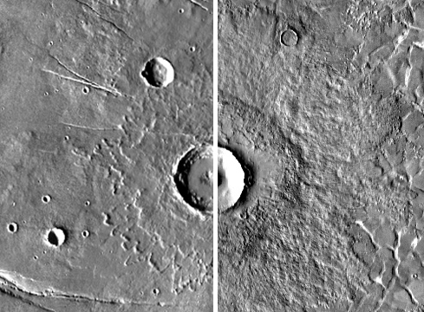
Impact landforms > Ejecta

Slide 37
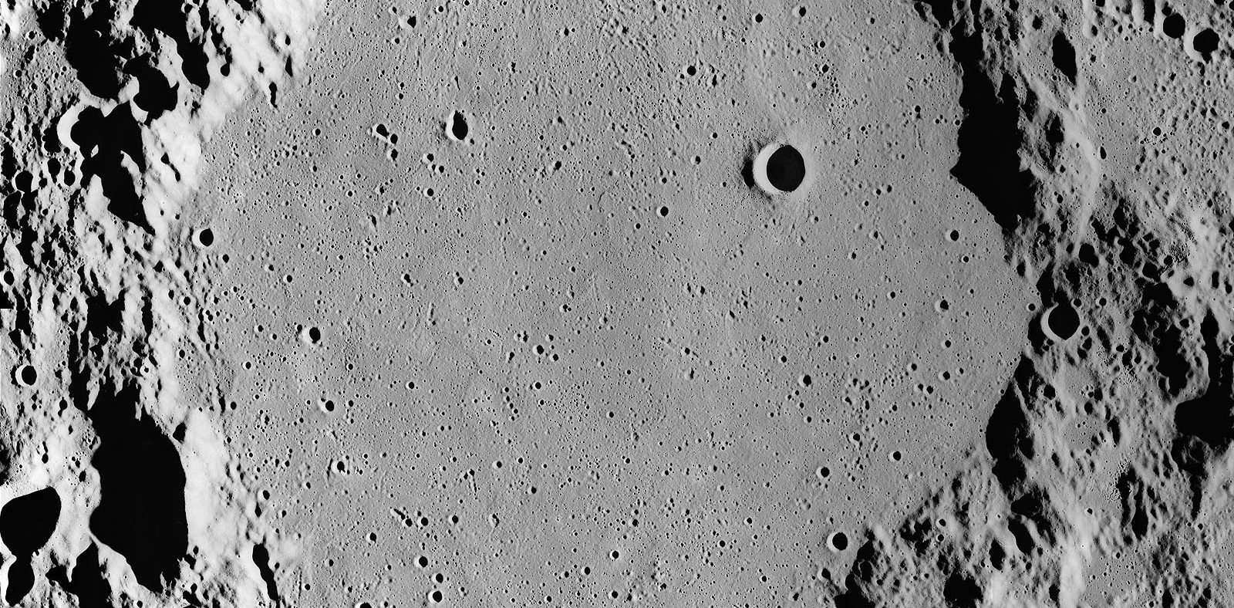
Impact Ejecta > Light plains

Slide 38
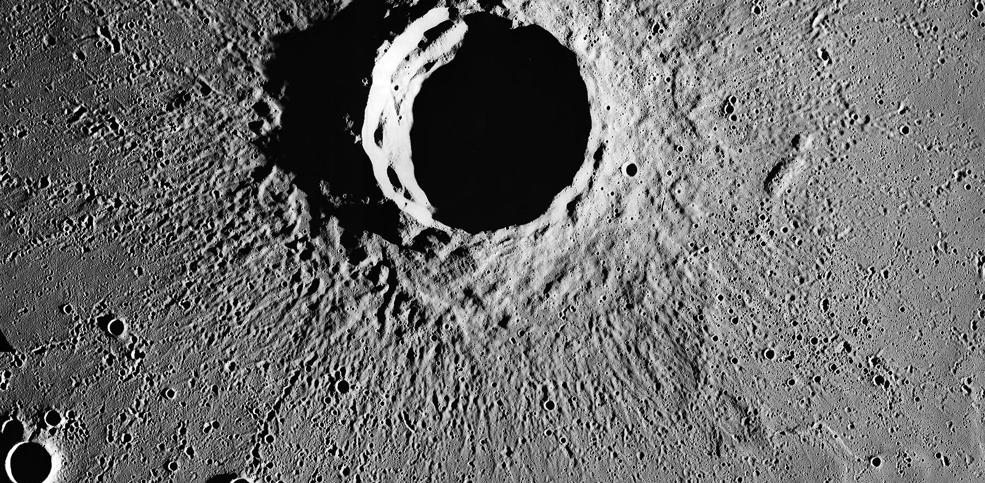
Impact Ejecta > Radial ejecta

Slide 39
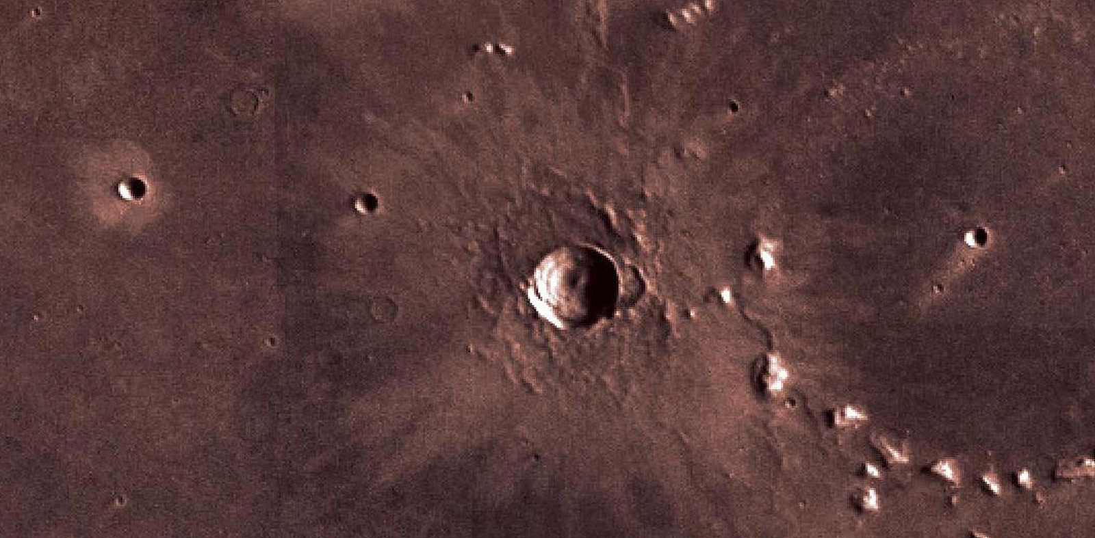
Impact Ejecta > Bright halo crater

Slide 40
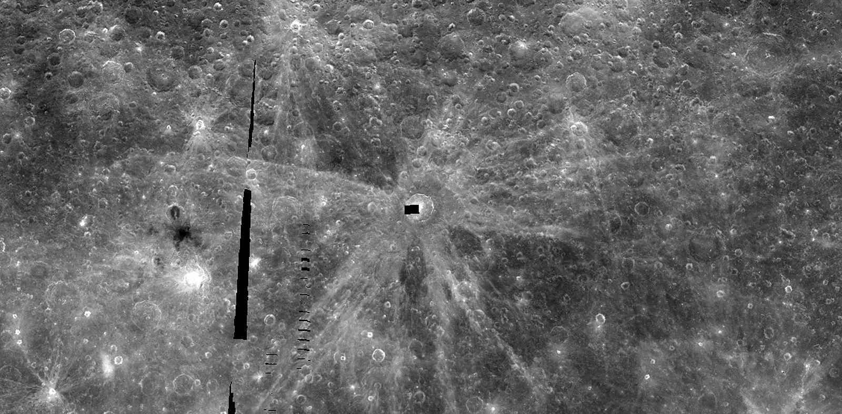
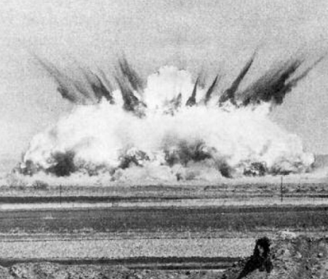
Impact Ejecta > Crater ray

Slide 41
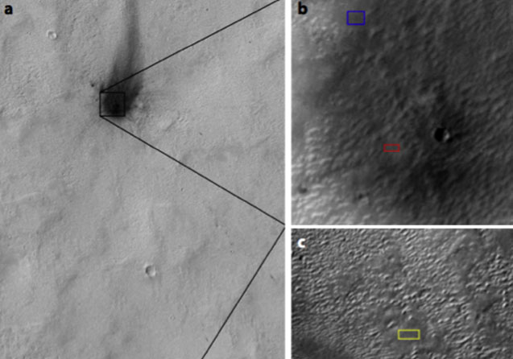
Atmospheric blast

Slide 42
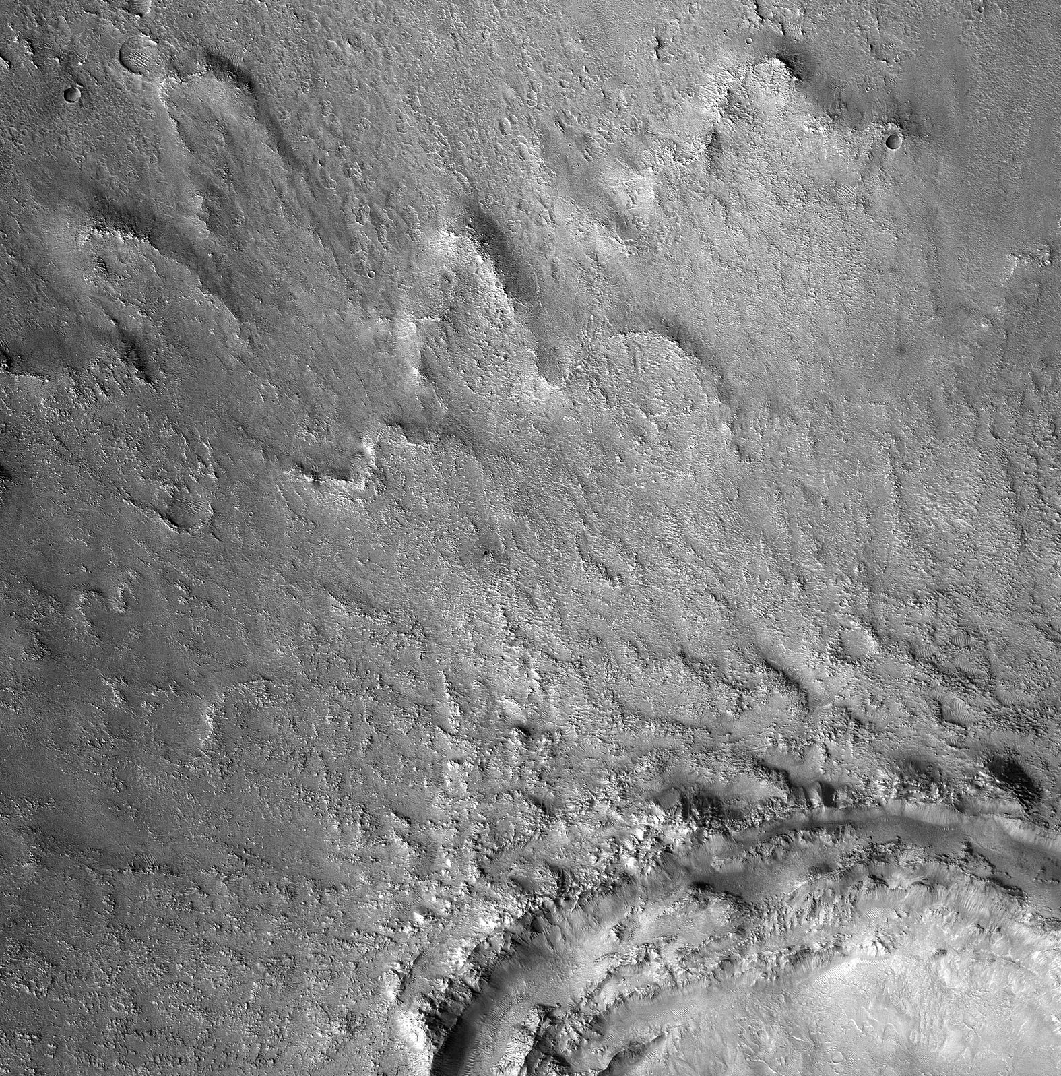
Impact Ejecta > Combination ejecta

Slide 43
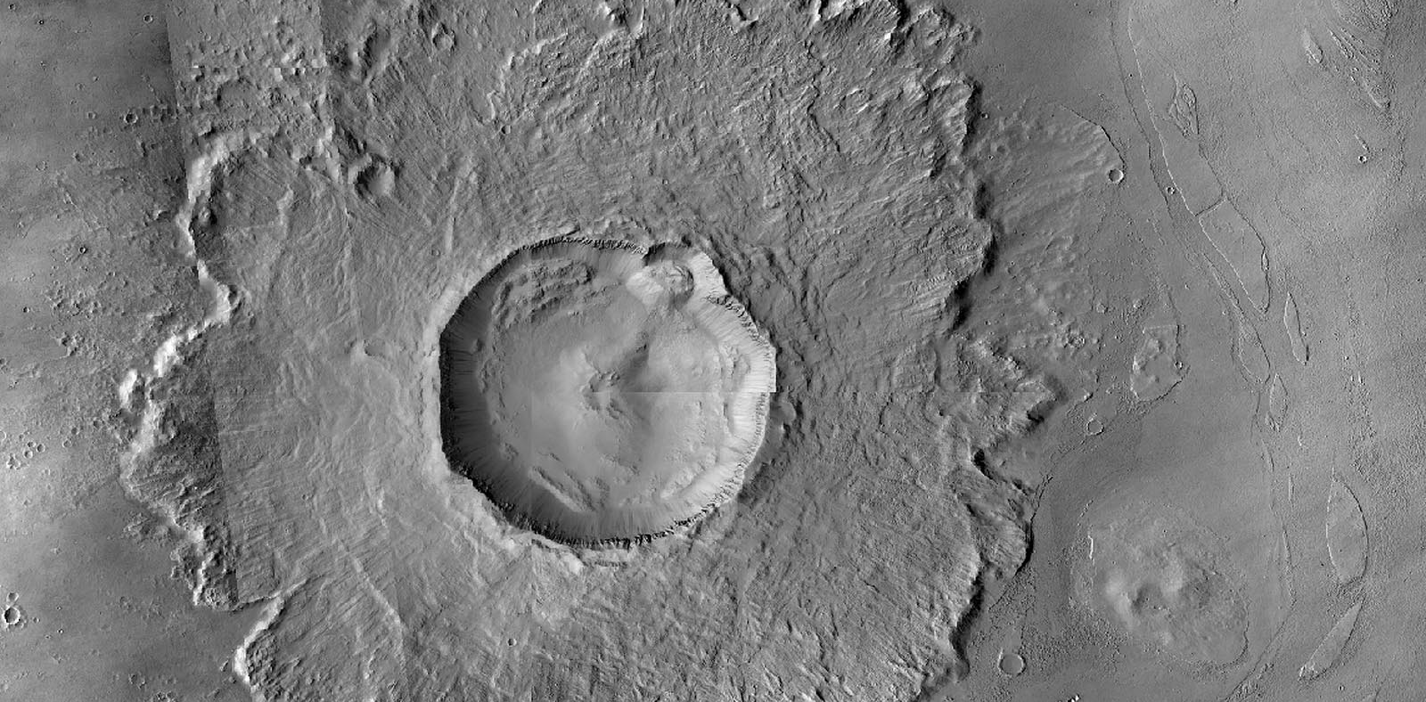
Impact Ejecta > Layered ejecta

Slide 44
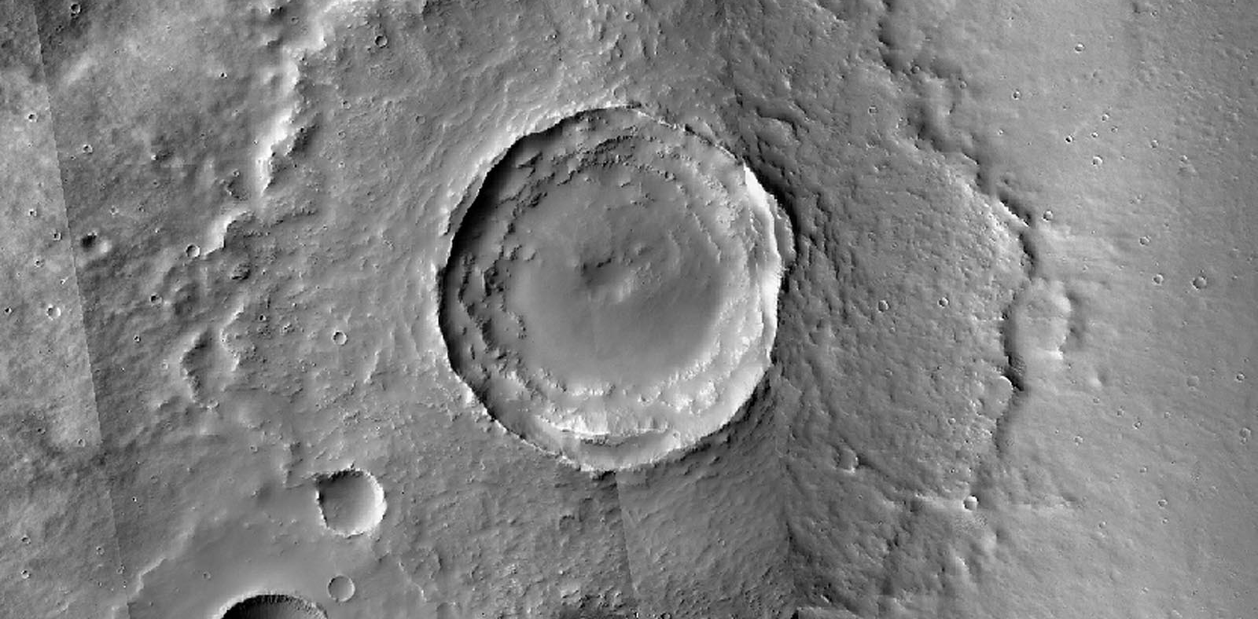
Impact Ejecta > Single layer ejecta

Slide 45
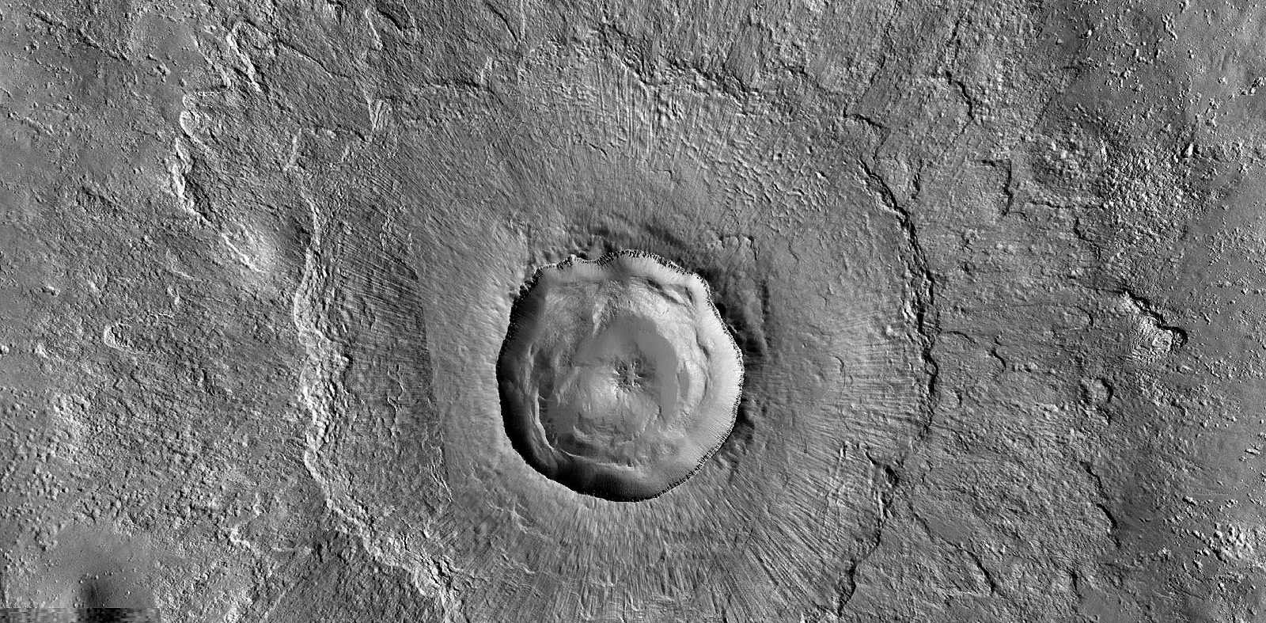
Impact Ejecta > Double layer ejecta

Slide 46

Impact Ejecta > Multiple ejecta

Slide 47
Valami > Valami

Slide 48

Impact Ejecta > Radially striated ejecta

Slide 49


Black and Stewart (2008)
Impact Ejecta > Excess ejecta

Slide 50

Impact Ejecta > Perched crater

Slide 51

Impact Ejecta > Pancake ejecta

Slide 52

Impact Ejecta > Pedestal crater

Slide 53

Impact Ejecta > Pitted pedestal crater ejecta

Slide 54


Impact Ejecta > Rampart ejecta

Slide 55

Impact Ejecta > Low aspect ratio layered ejecta

Slide 56

Impact Ejecta > Boulder halo crater

Slide 57

Impact Ejecta > Low angle impacts > Offset ejecta crater

Slide 58

Impact Ejecta > Low angle impacts > uprange forbidden zone

Slide 59


Impact Ejecta > Low angle impacts > Butterfly ejecta

Slide 60

Asymmetric craters

Slide 61


Impact Ejecta > Low angle impacts > Elliptical crater

Slide 62

Impact Ejecta > Low angle impacts > Bumblebee ejecta

Slide 63

Impact Ejecta > Multiple impact > Crater chain

Slide 64

Impact Ejecta > Multiple impact > Crater cluster

Slide 65

Impact Ejecta > Multiple impact > Doublet crater

Slide 66

Impact Ejecta > Multiple impact > Multiple crater

Slide 67
Impact Ejecta > Multiple impact > Ricochet crater

Slide 68

Impact Ejecta > Multiple impact > Septum

Slide 69

Impact Ejecta > Secondary impact > Secondary crater

Slide 70

Impact Ejecta > Secondary impact > Secondary crater chain

Slide 71

Impact Ejecta > Secondary impact > Secondary crater field

Slide 72

Impact Ejecta > Secondary impact > Secondary crater cluster

Slide 73

Impact Ejecta > Secondary impact > Herringbone crater

Slide 74

Impact Ejecta > Crater degradation > Filled crater

Slide 75


Impact Ejecta > Crater degradation > Inundated crater

Slide 76


Craddock and Maxwell 1990
Impact Ejecta > Crater degradation > Eroded crater

Slide 77

Impact Ejecta > Crater degradation > Ghost crater

Slide 78


Pedersen and Head 2010
Impact Ejecta > Crater degradation > Ring mold crater

Slide 79


Impact Ejecta > Crater degradation > Softened crater

Slide 80



Impact Ejecta > Crater degradation > Degraded basin / Circular Thin Area

Slide 81

Impact Ejecta > Low gravity impact > Compaction crater

Slide 82

Impact Ejecta > Low gravity impact > Complex low gravity crater

Slide 83


Impact Ejecta > Crater elements > Rim

Slide 84

Impact Ejecta > Crater elements > Wall

Slide 85

Ponding liquid >melt pond

Slide 86

Impact melt flow

Slide 87



(Malin et al. 2010)

Slide 88
Key concepts
Craters (including impact basins) are the most common landform on planetary bodies
Craters are made by hypervelocity impactors
Small and large craters are similar when produced
Projectiles may not reach the planetary surface, depending on atmosphere
Craters are produced by a shock wave
Crater ejecta is an indicator of subsurface / surface / atmospheric conditions at the time of impact
Crater flux was high in the early era but became ~constant after ca. 3.8 Ga
Old (>4Ga) surfaces are saturated with craters
Non-saturated surfaces indicate resurfacing due to dynamic interior or exterior processes
Craters are used to calculate surface model ages
Only lunar crater density is linked to radiocarbon dating

