Slide 1
Introduction to Planetary Geologic Mapping

Slide 2
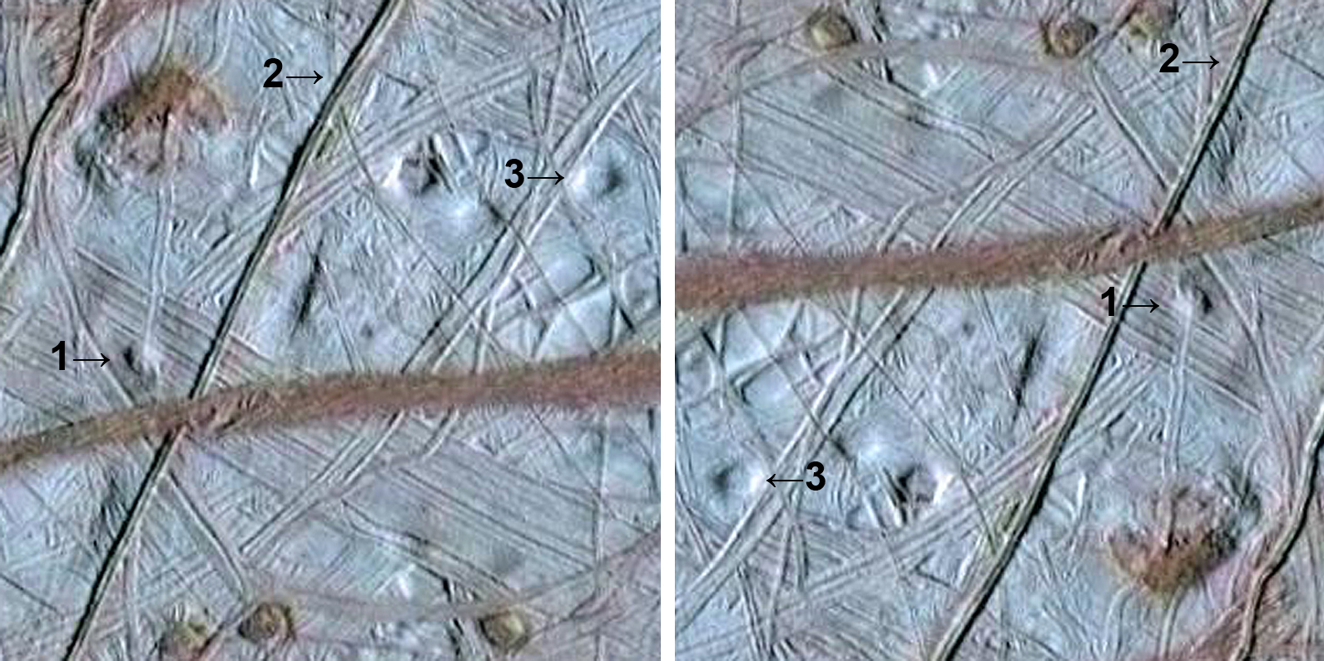
OPTICAL ILLUSION
Identify the topographic positions (negative or positive relief) of features 1, 2, and 3. Where does the Sun shine from?

Slide 3
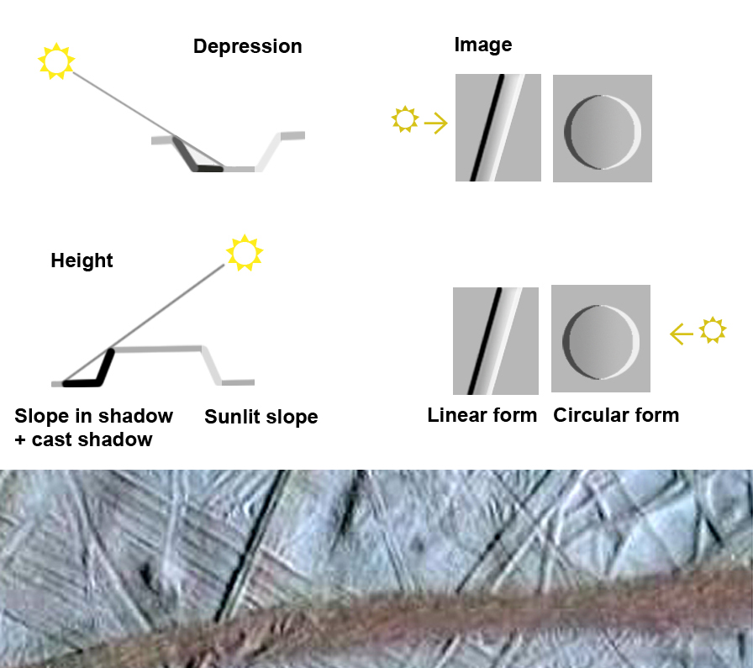

Slide 4
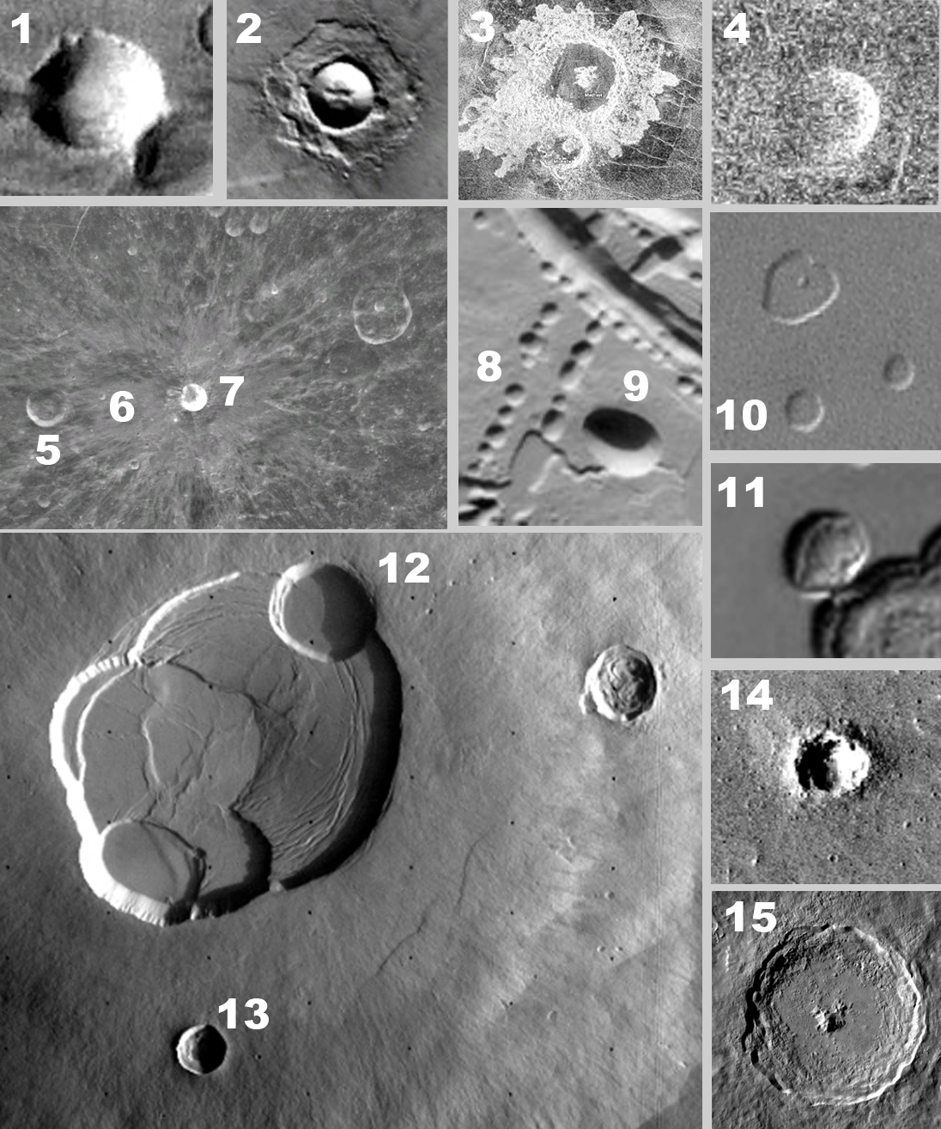
Impact craters, the most common planetary landform
Identify the numbered features. They may be impact craters, collapse pits, sublimation pits or domes.

Slide 5
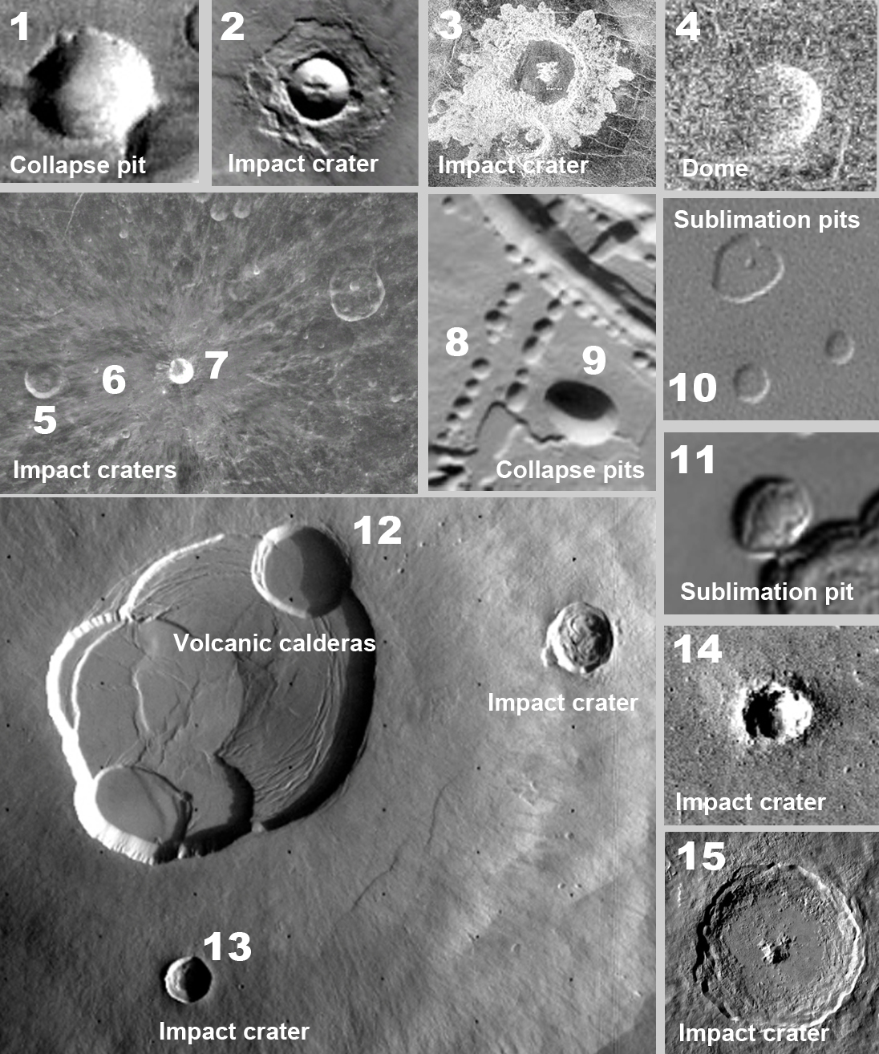
1: Collapse crater in NE Tharsis, Mars, volcanic terrain.
2. Lobate ejecta impact crater, Mars, Elysium.
3. Fluidized ejecta impact crater, Venus.
4. Volcanic dome (!), Venus. (cf. No1)
5. Large impact crater, Moon.
6. Large degraded impact crater, Moon (Byrgius).
7: Fresh impact crater with rays (Byrgius A, Moon).
8: Row of collapse pit craters on volcanic terrain (Ascraeus Mons).
9. Large collapse crater.
10-11. Small sublimation pits (“Swiss Cheese Terrain”) on ice on Mars’ polar terrain.
12: Volcanic calderas (Olympus Mons),
13: Impact crater.
14 Small impact crater with ejected rocks,
15. Large, central peak impact crater with terraces (Tycho, Moon)

Slide 6
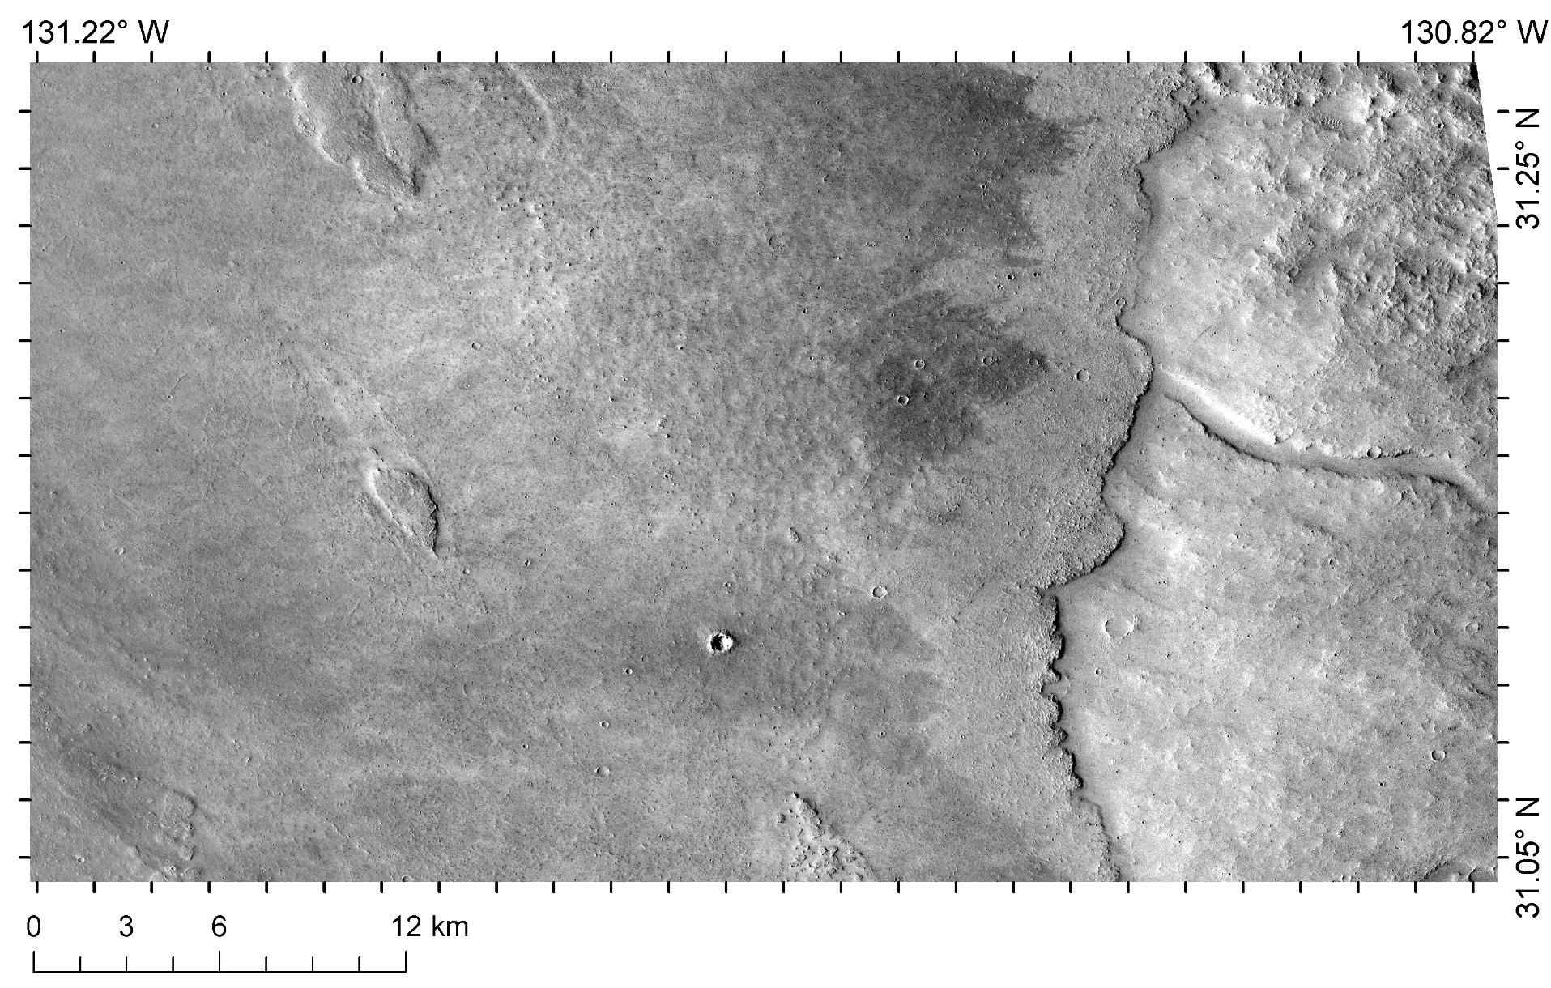
Age determination 1: Superposition
Which terrain is younger?

Slide 7
Age determination 1.: Superposition
Which terrain is younger?
The left hand side of the image has a thick layer emplaced upon the right hand side background terrain therefore the left hand side terrain is younger.

Slide 8
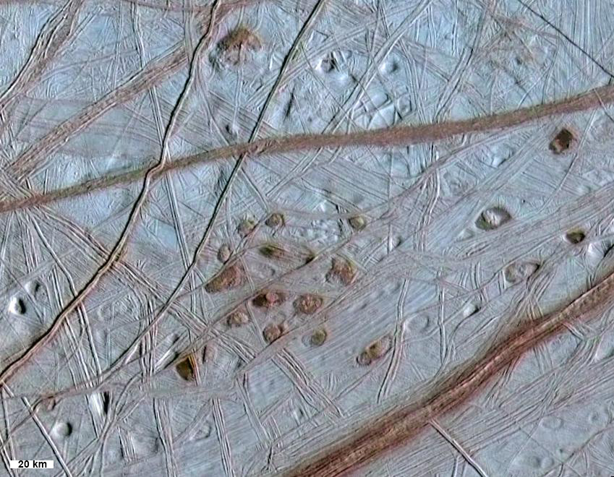
Age determination 2: Cross-cutting
Which crack is the youngest?

Slide 9
Age determination 2: Cross-cutting
Which crack is the youngest?
The crack that cuts though all others and is not cut by any other is the youngest feature.
It is also the deepest suggesting that older cracks become shallower.

Slide 10
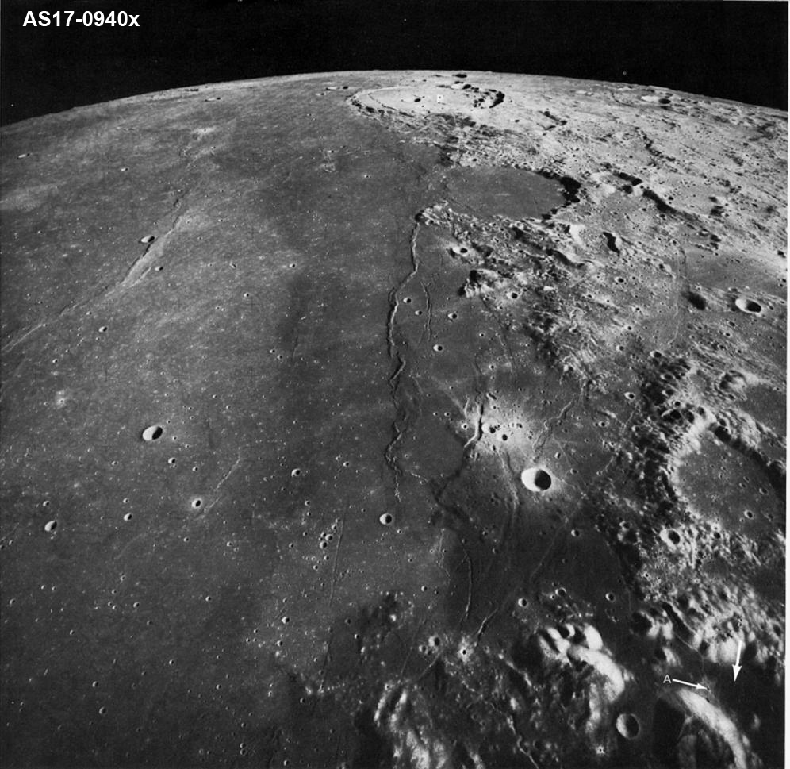
Age determination 3. Crater counting
Younger terrain has less craters and large craters are absent. This region is exposed to cratering for less time and has thinner or no layer of megabreccia
Older terrain has more craters and craters include larger ones. It has a thick layer of megabreccia.
On the Moon, maria are younger (ca. 3 Ga), highlands are older (ca. 4 Ga).
Young → Old
Few craters → Many craters

Slide 11
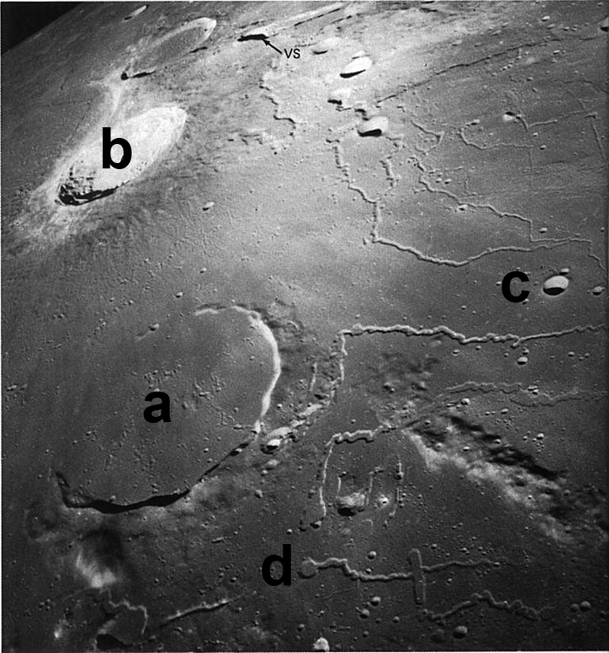
Age determination 4. Morphology
Younger craters are pristine, sharp features.
Old craters have subdued morphology and no ejecta blanket.
Which craters are young?
hrp42b

Slide 12
Age determination 4. Morphology
Younger craters are pristine, sharp features.
Old craters have subdued morphology and no ejecta blanket.
Which craters are young?
a – old, partially buried (flooded) crater
b – very young, complex crater (ejecta blanket visible)
c – young, small crater (ejecta blanket not visible)
d – not crater (source of lava flow, a collapse pit)

Slide 13
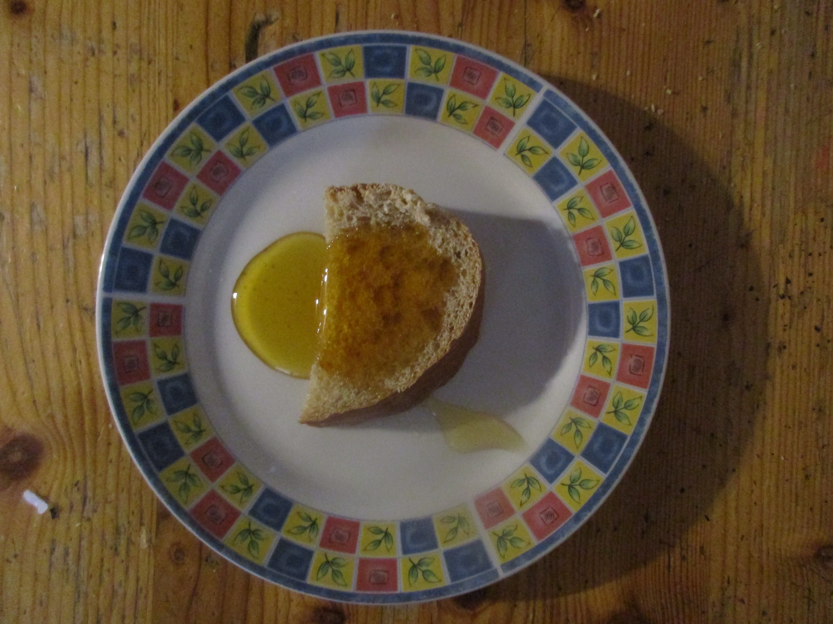
Checklist:
Illumination?
Feature types by
albedo
shape
relief
pattern.
Draw contact lines
Structure centerlines
Description?
Interpretation:
Formative process?
Material ?
Label (name) units
Ages? (youngest to oldest) Check:
superposition
crater counting
GEOLOGIC MAPPING

Slide 14
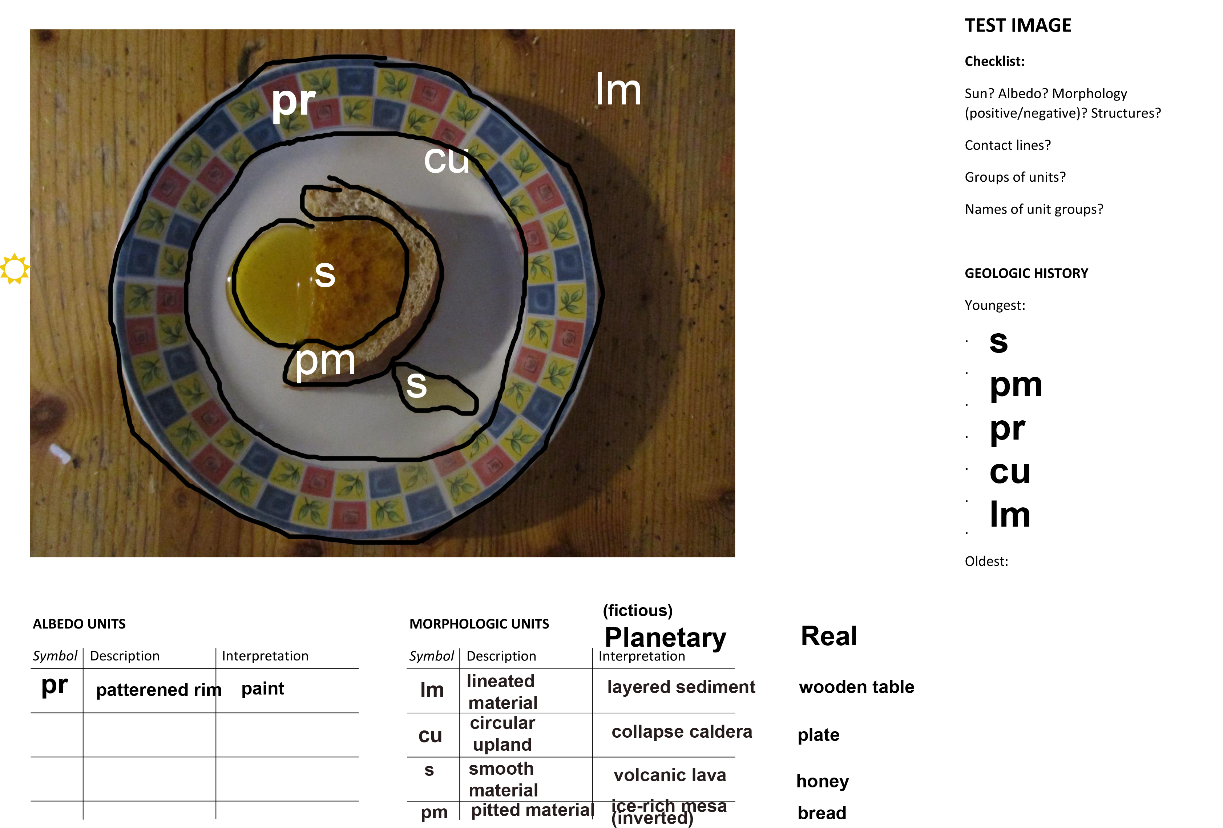

Slide 15
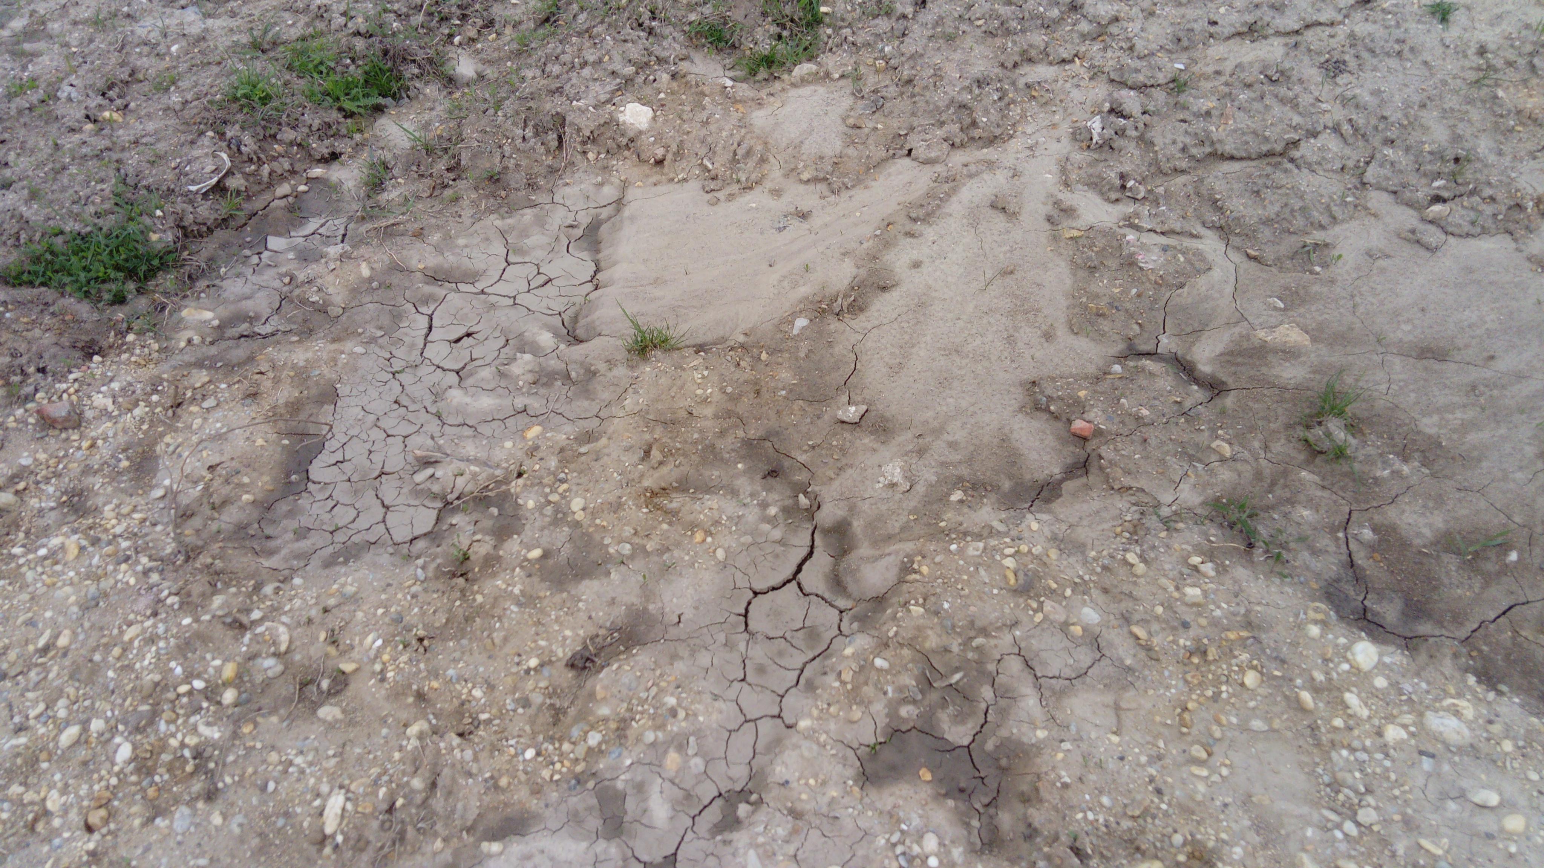

Slide 16
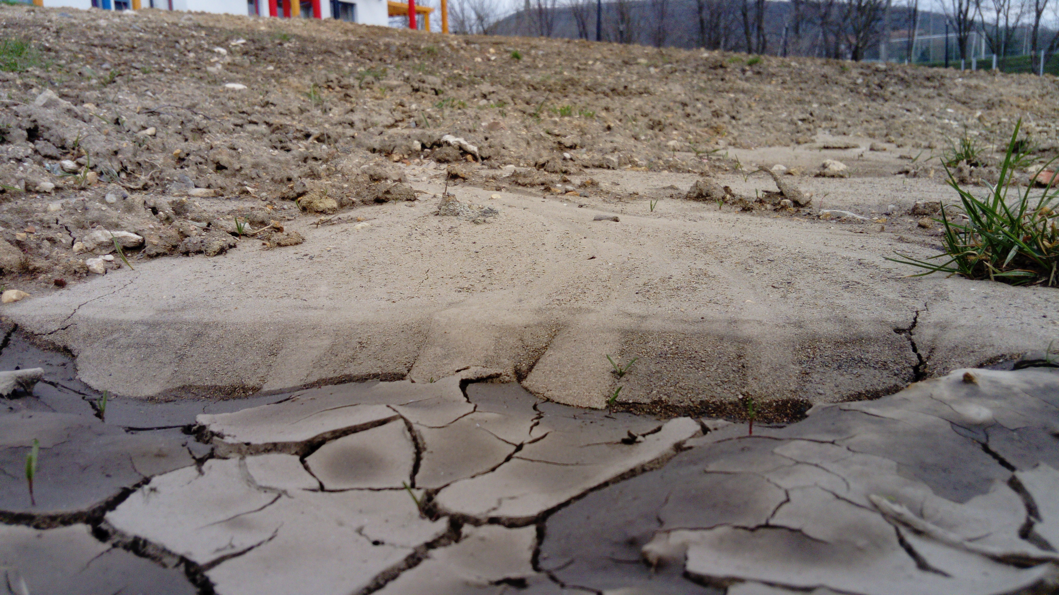

Slide 17
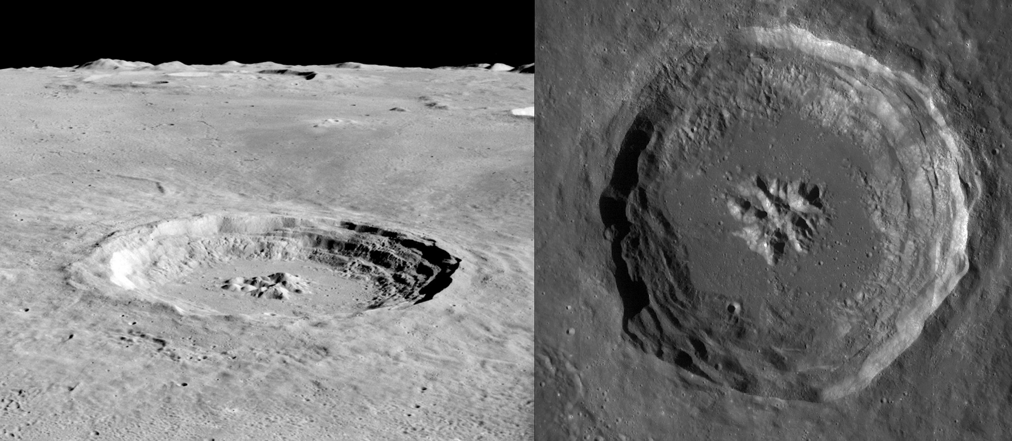

Slide 18
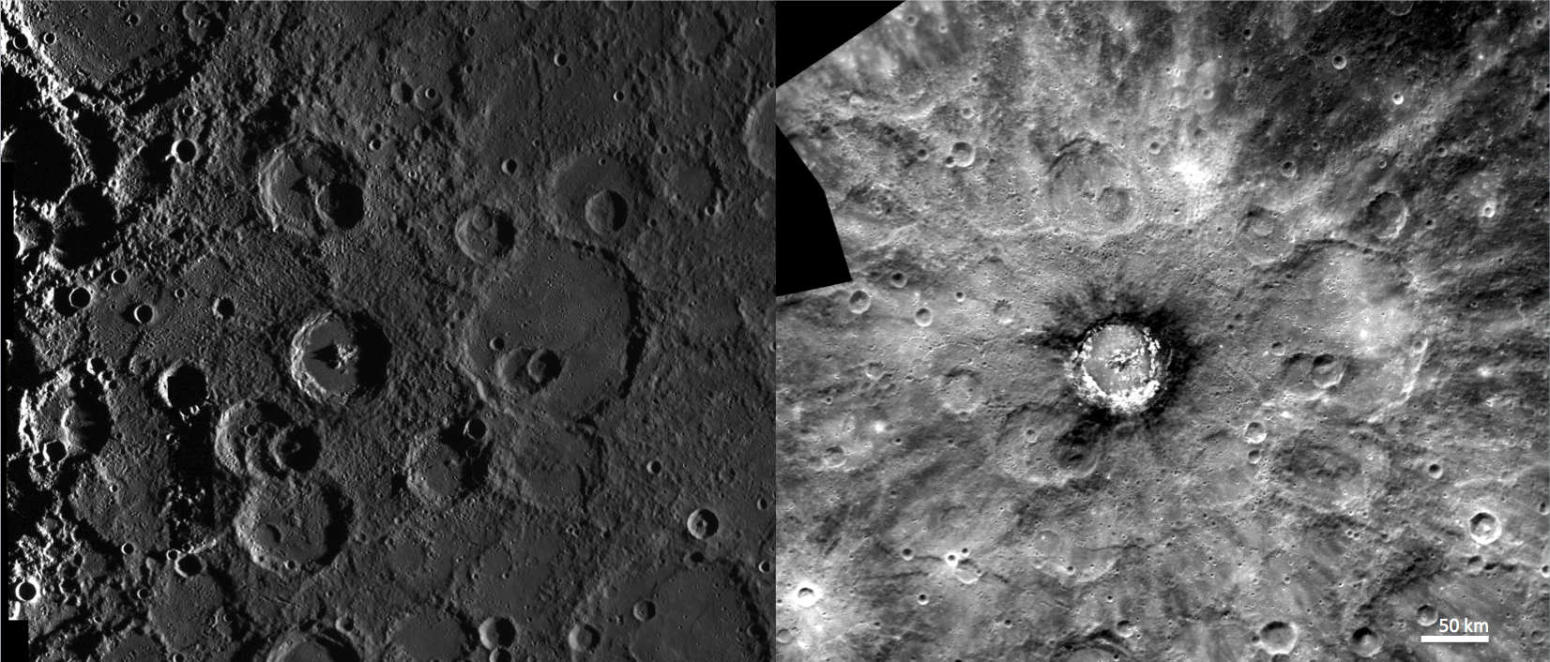

Slide 19
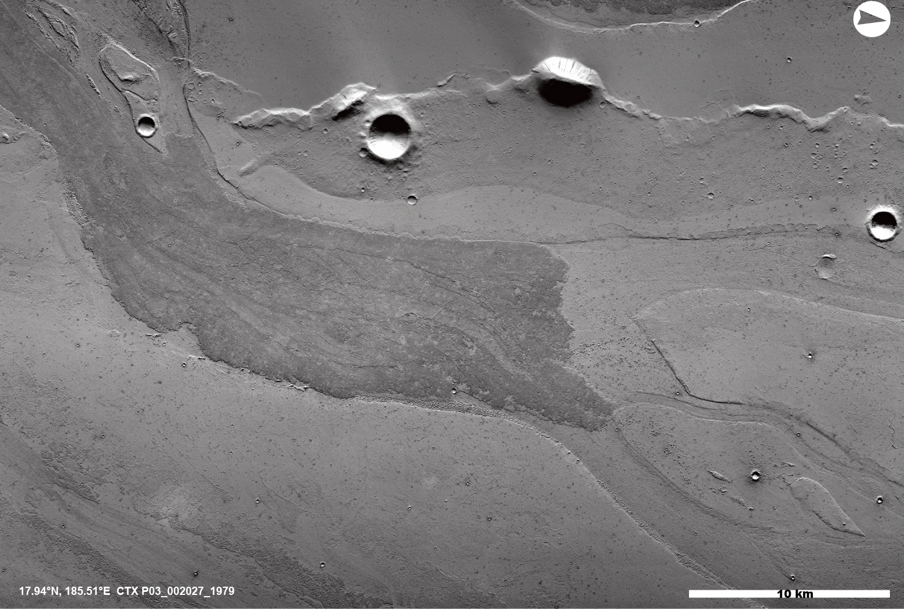
Checklist:
Illumination?
Feature types by
albedo
shape
relief
pattern.
Draw contact lines
Structure centerlines
Description?
Interpretation:
Formative process?
Material ?
Label (name) units
Ages? (youngest to oldest) Check:
superposition
crater counting

Slide 20
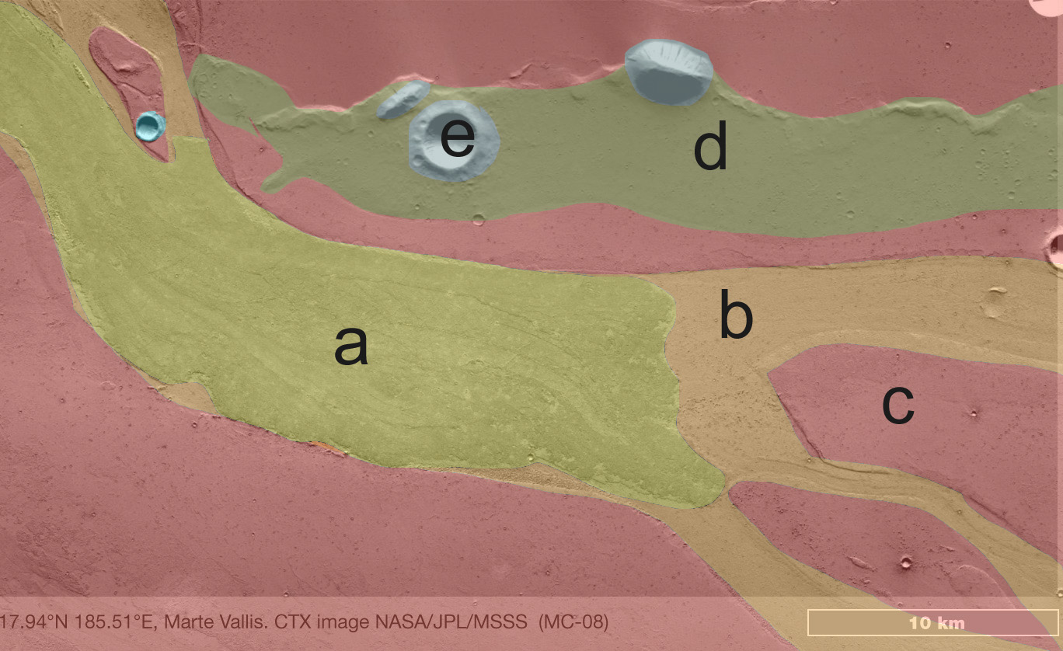

Slide 21
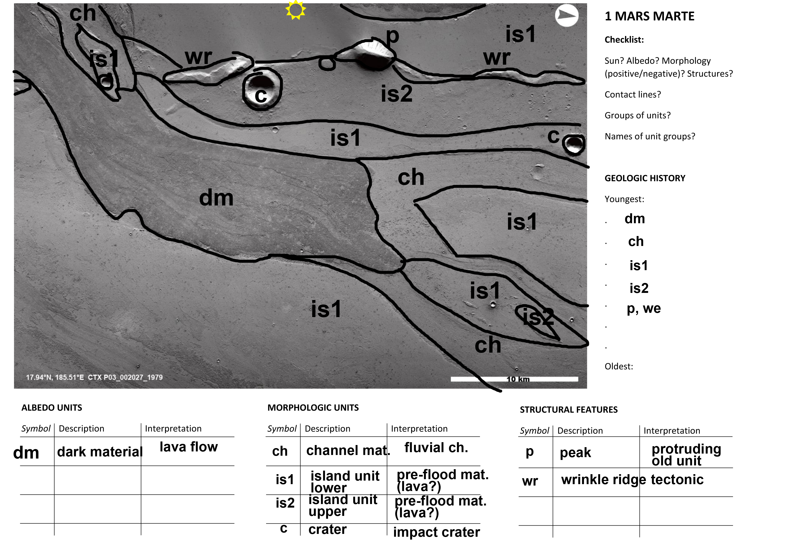
Marte Valles, Mars:
Lava flows into outflow channel with streamlined forms.
Evolution: peaks and wrinkle ridges protrude from the underlying old surface.
Crater rims may be also inundated by younger lavas that mask smaller craters.
In general, the units are young as shown by the lack of craters.
is2 is the most densely cratered and therefore the oldest unit.
It was partially flooded by is1 lavas into which am outflow channel was carved, leaving some islands (of is1 lavas) dry.
The latest event was when dark flood lavas flowed into the channels.

Slide 22
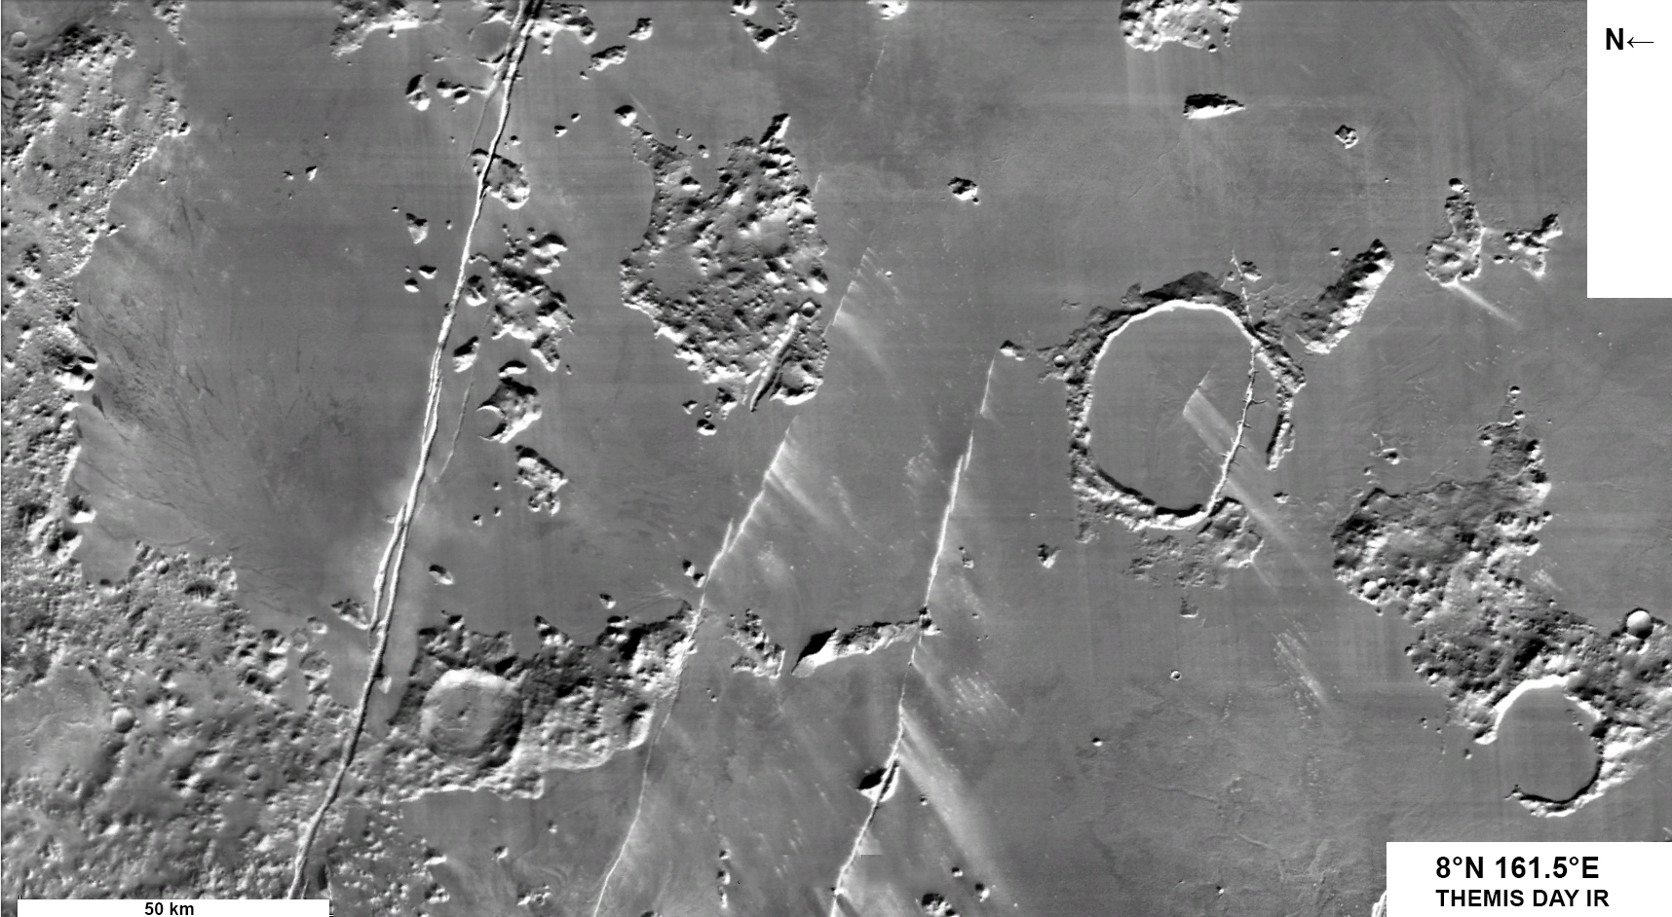

Slide 23
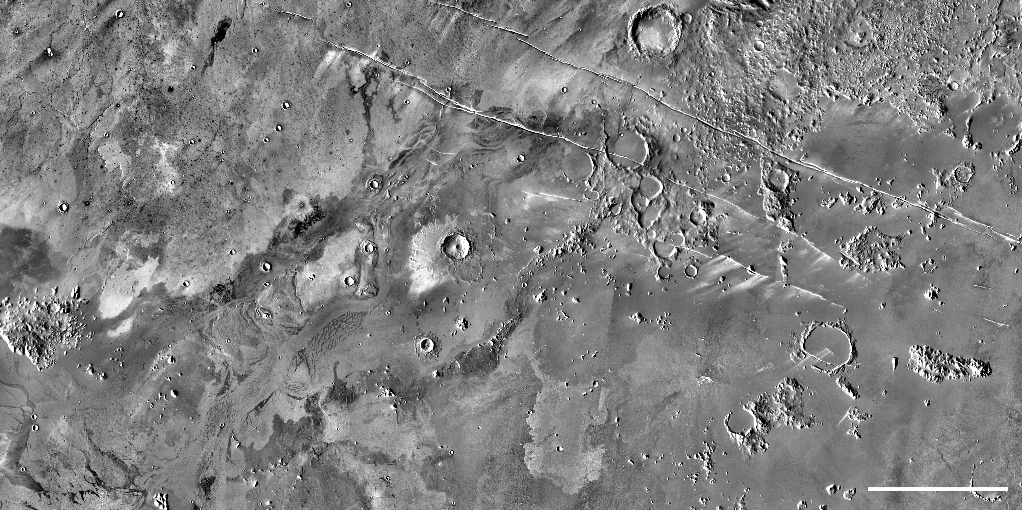

Slide 24
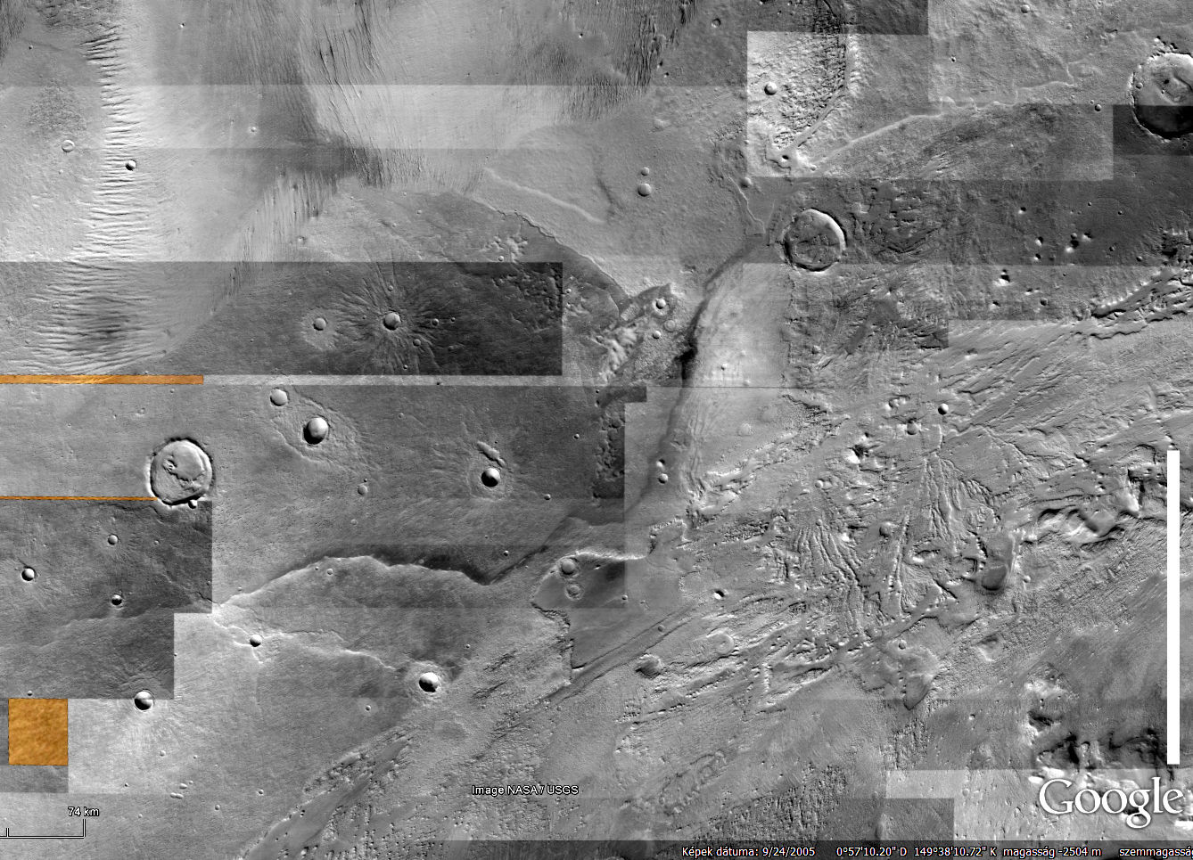

Slide 25
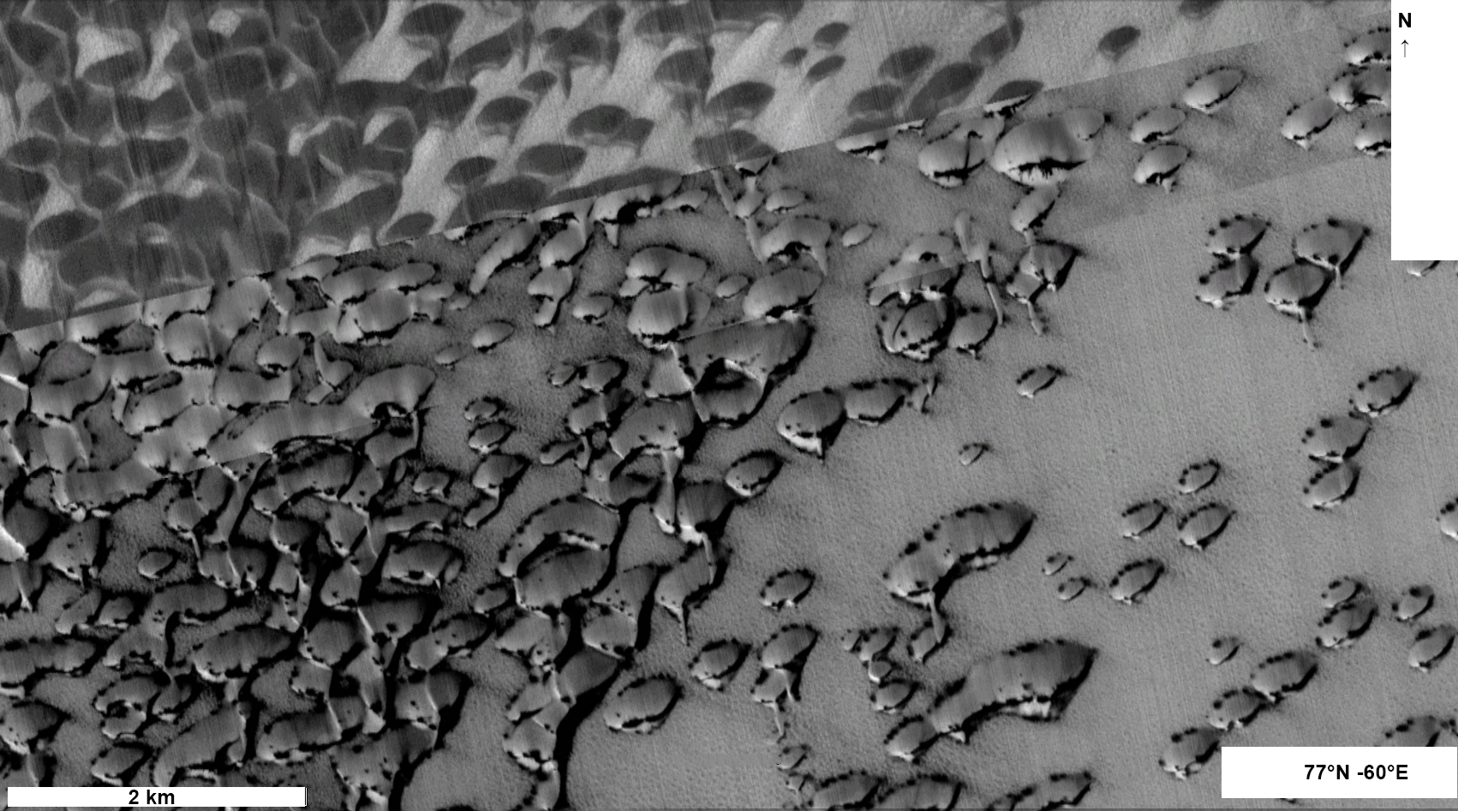

Slide 26
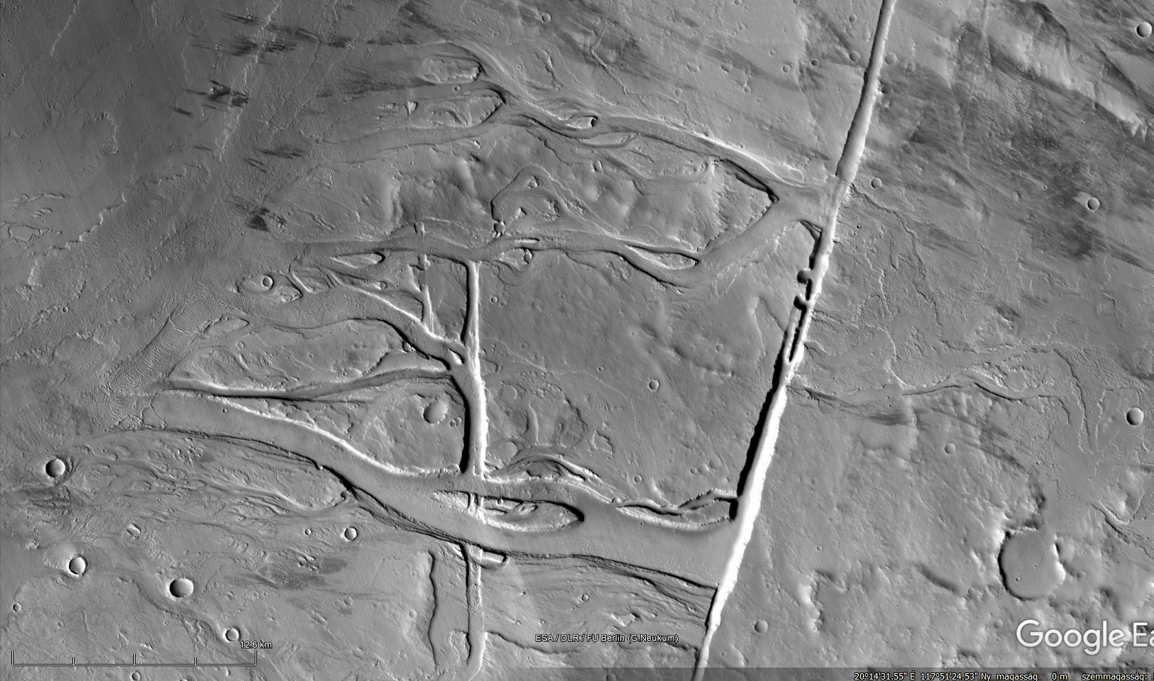

Slide 27
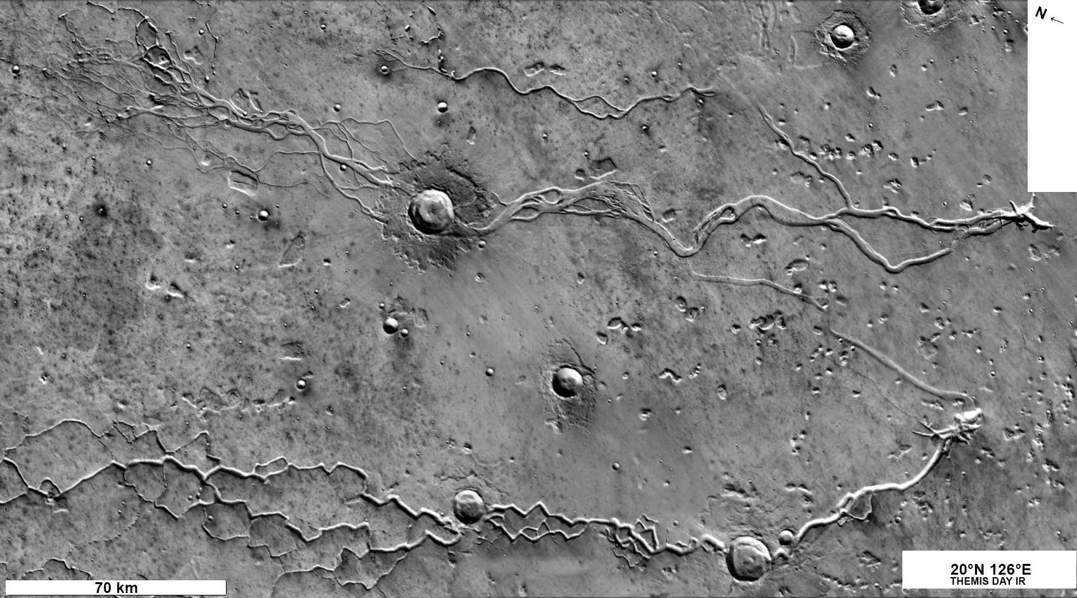

Slide 28
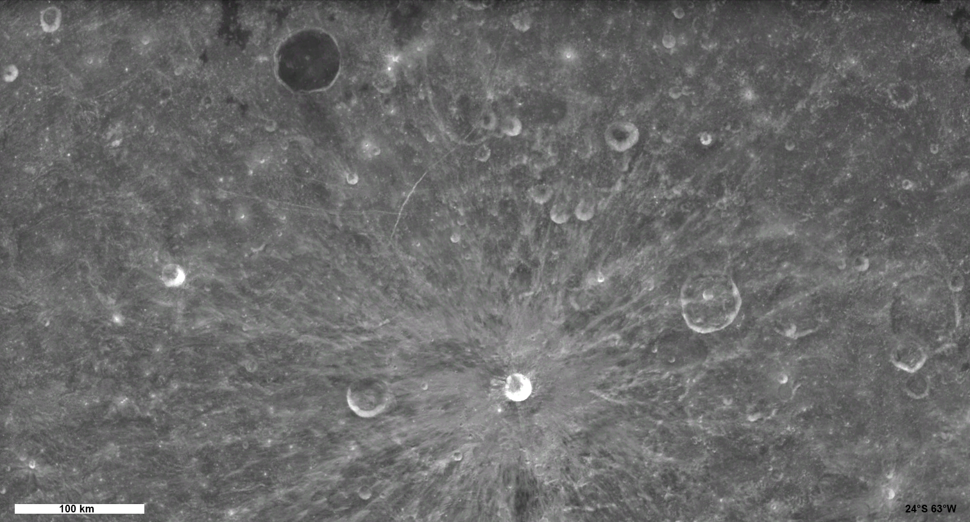

Slide 29
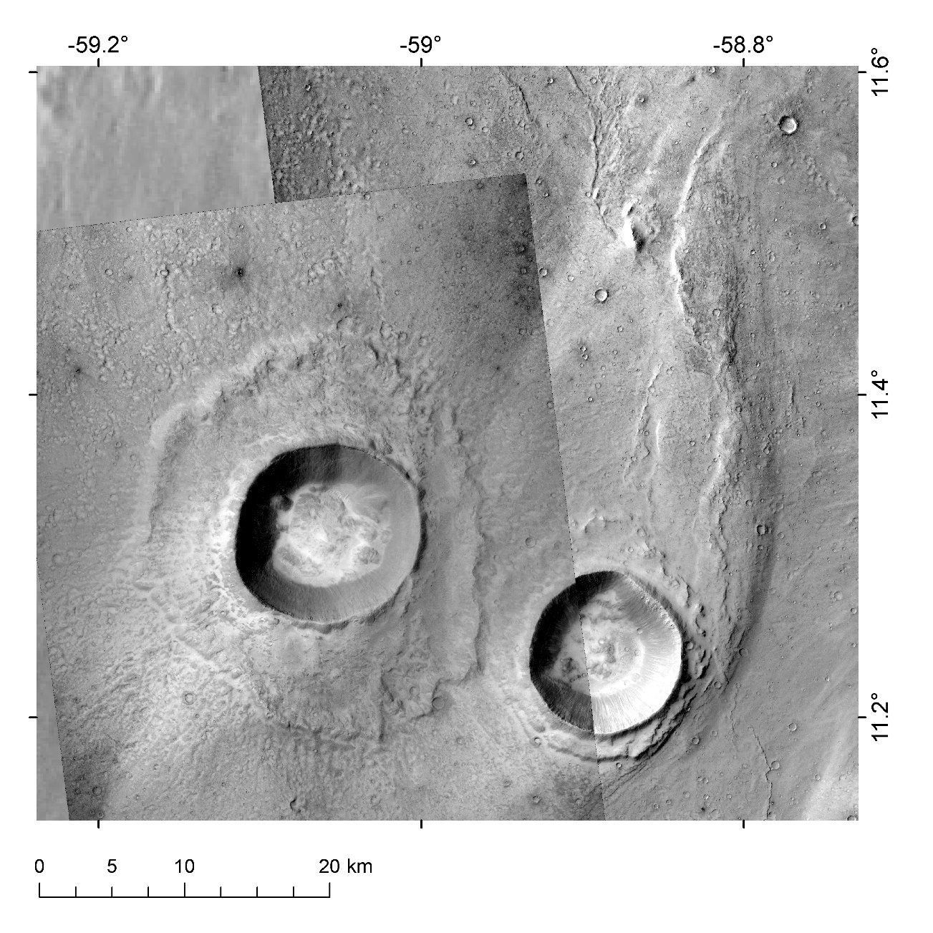

Slide 30
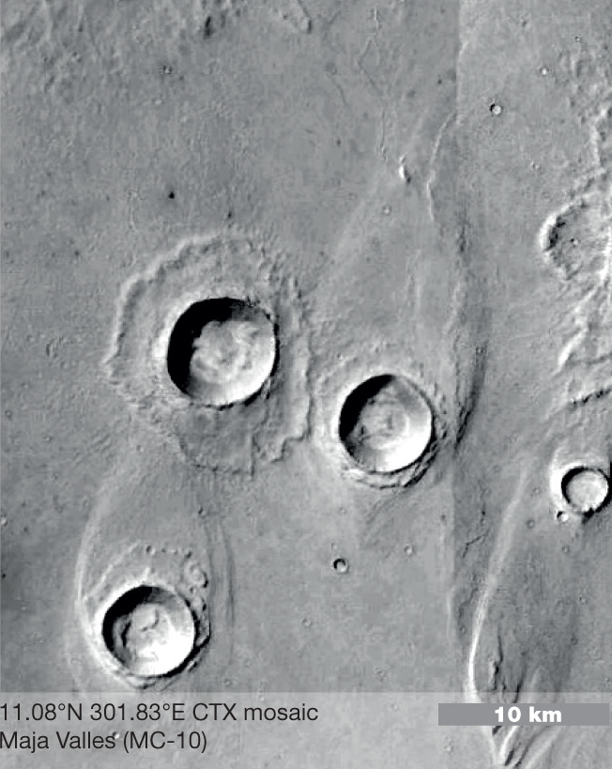
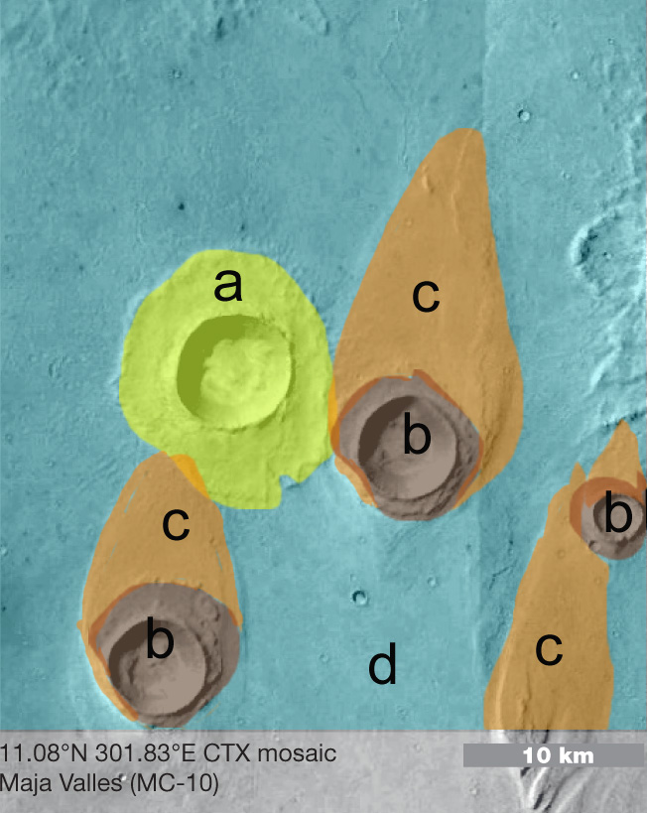

Slide 32
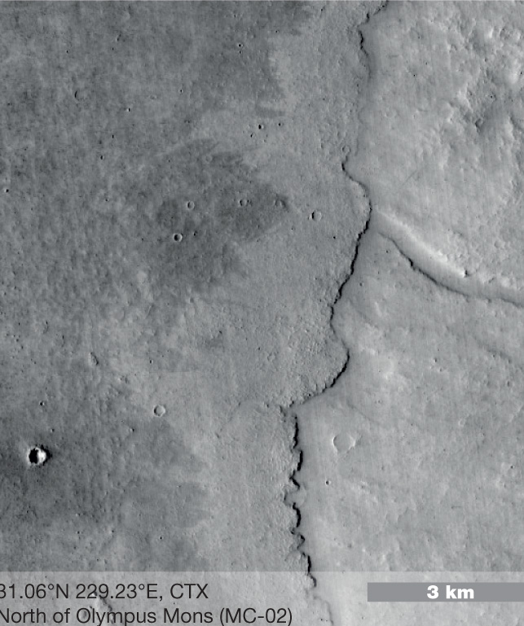
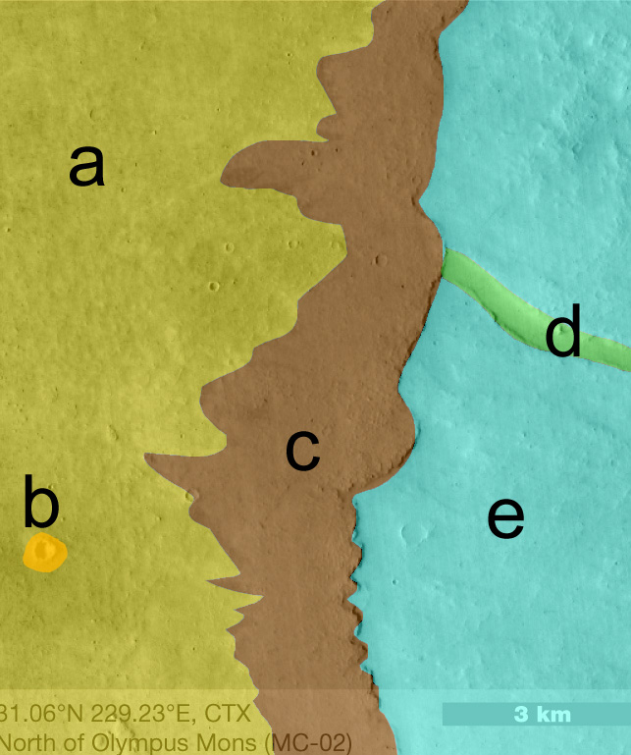

Slide 33
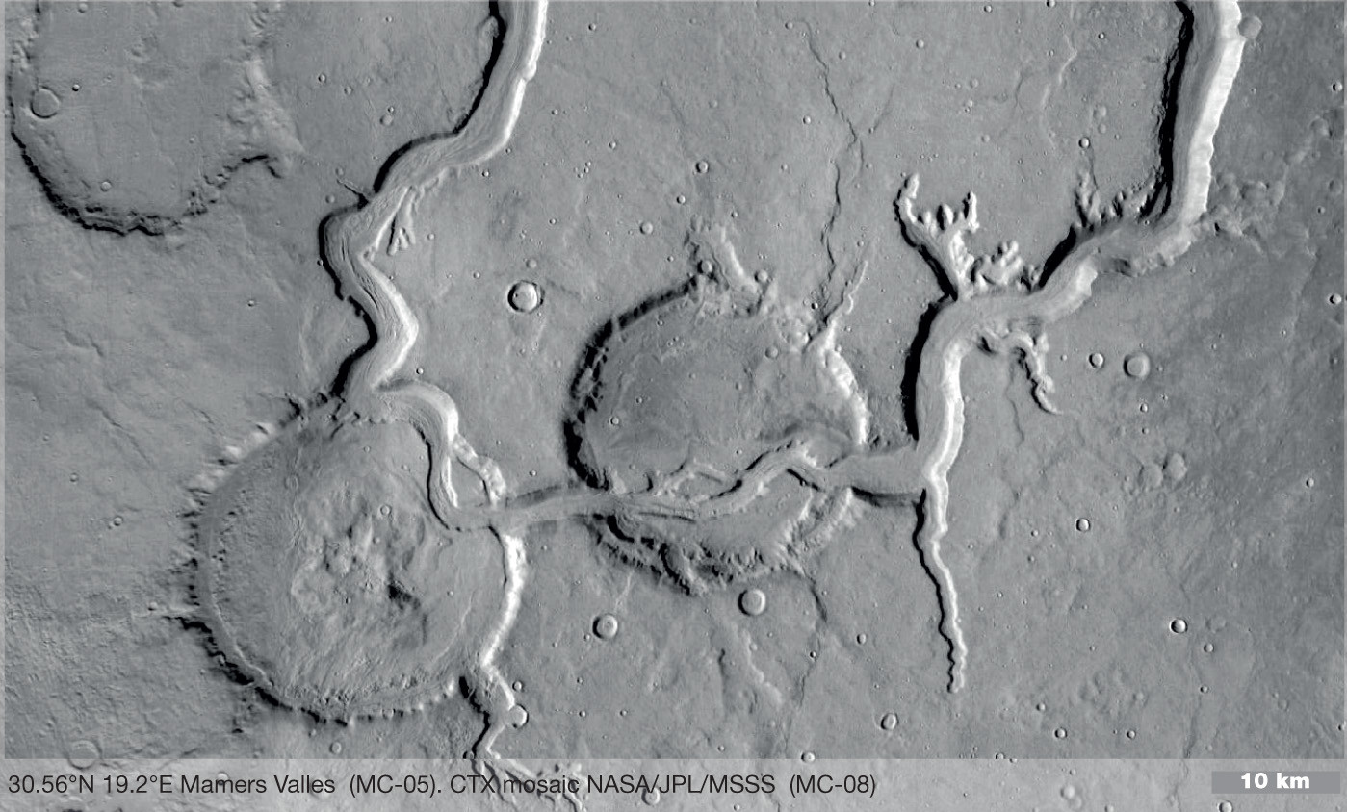

Slide 34
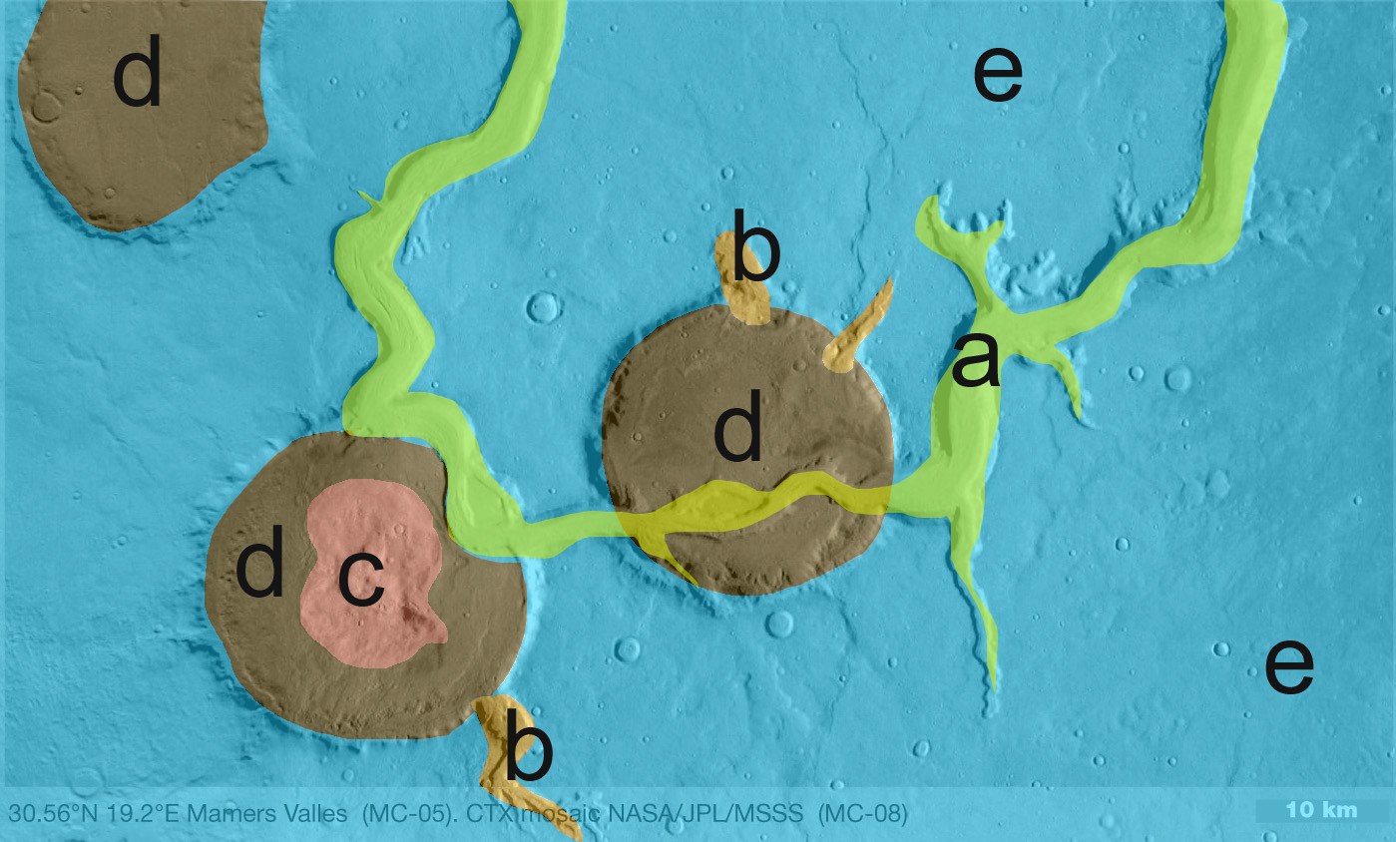

Slide 35
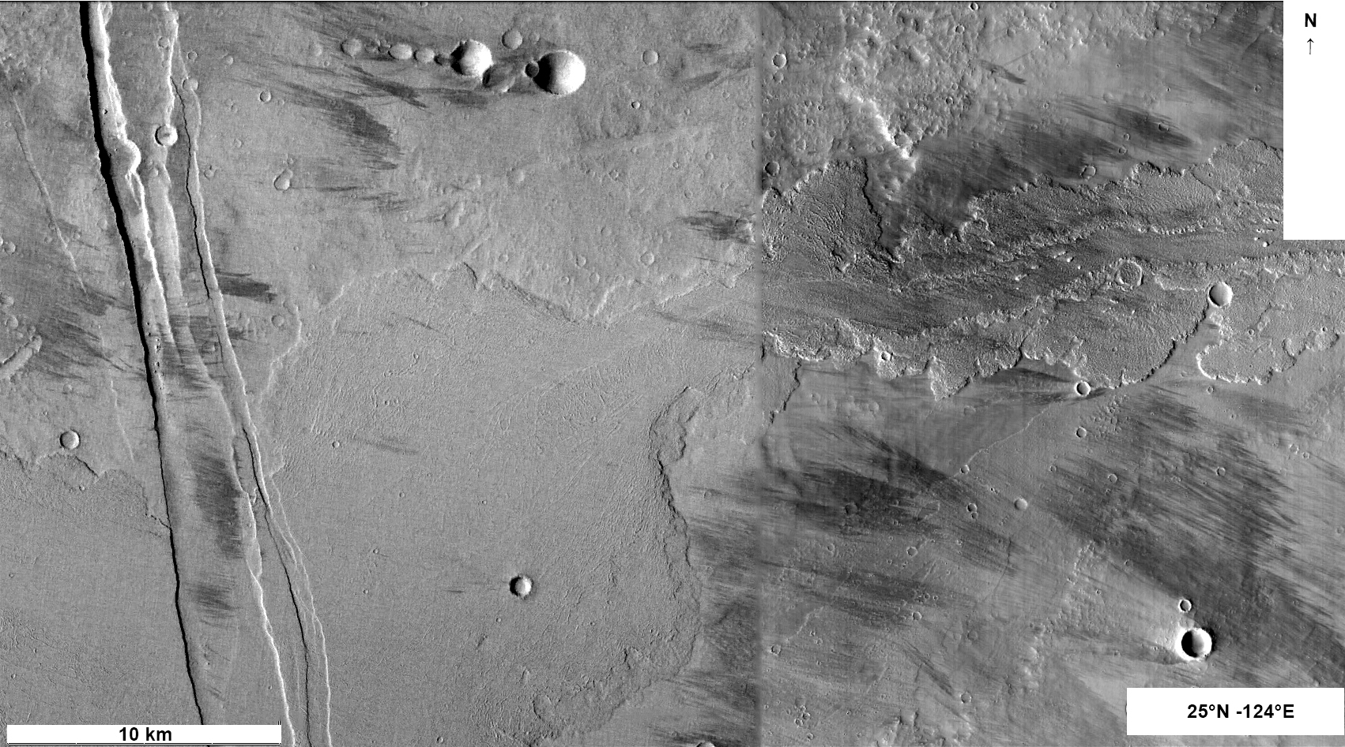

Slide 36
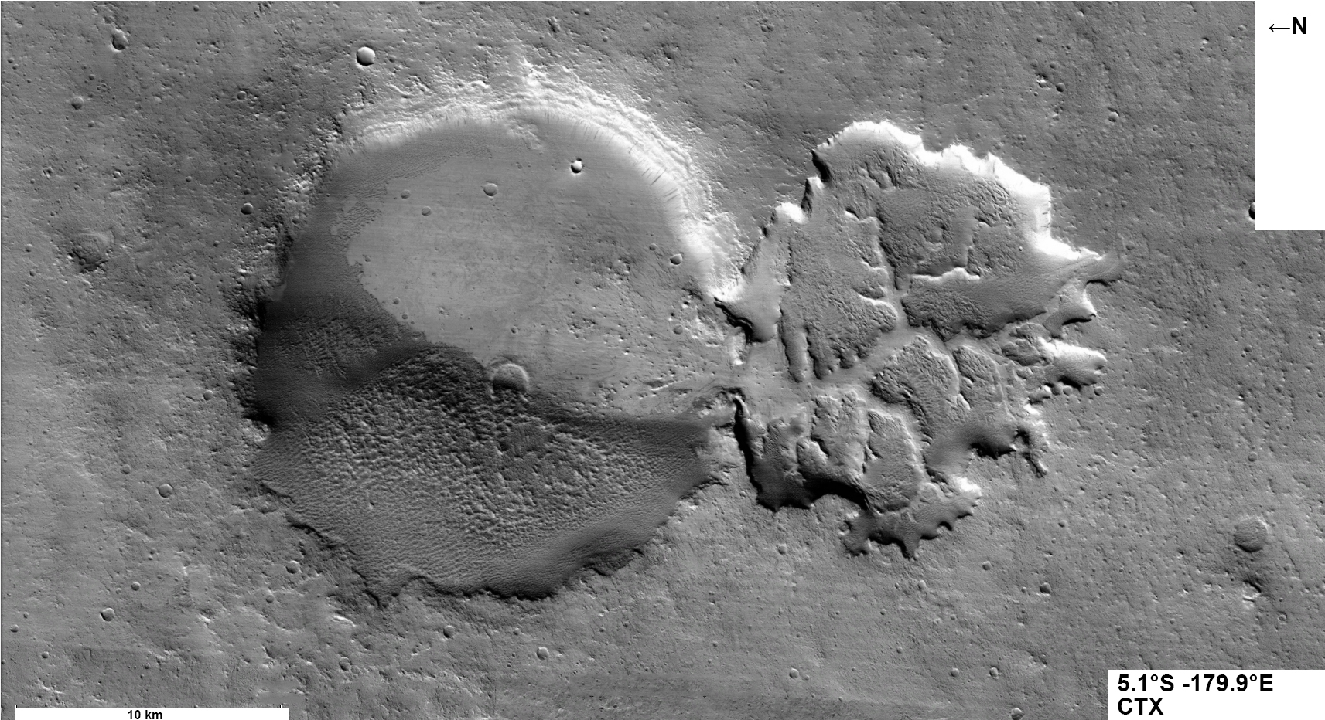

Slide 38
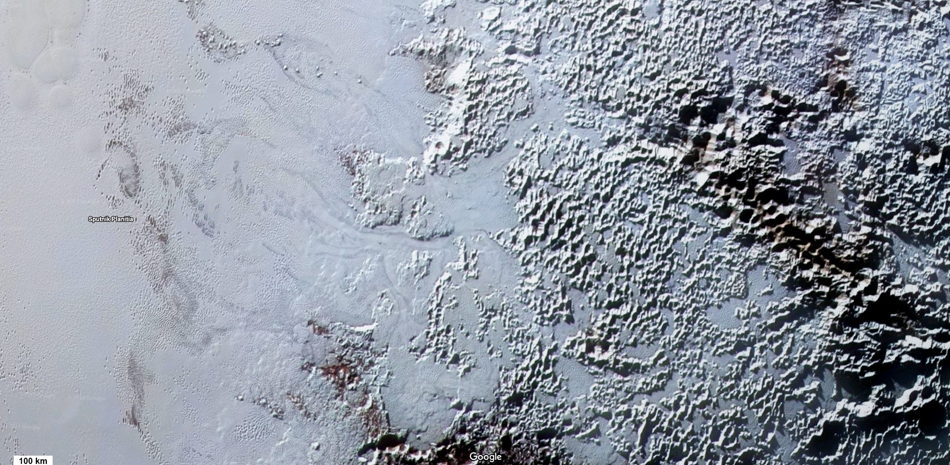

Slide 39
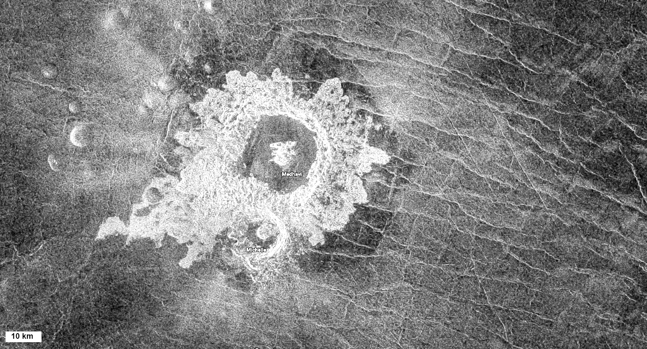

Slide 40
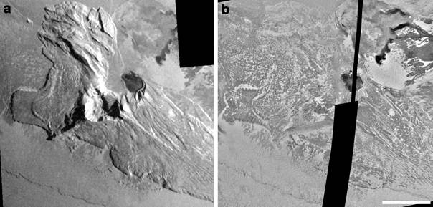

Slide 41
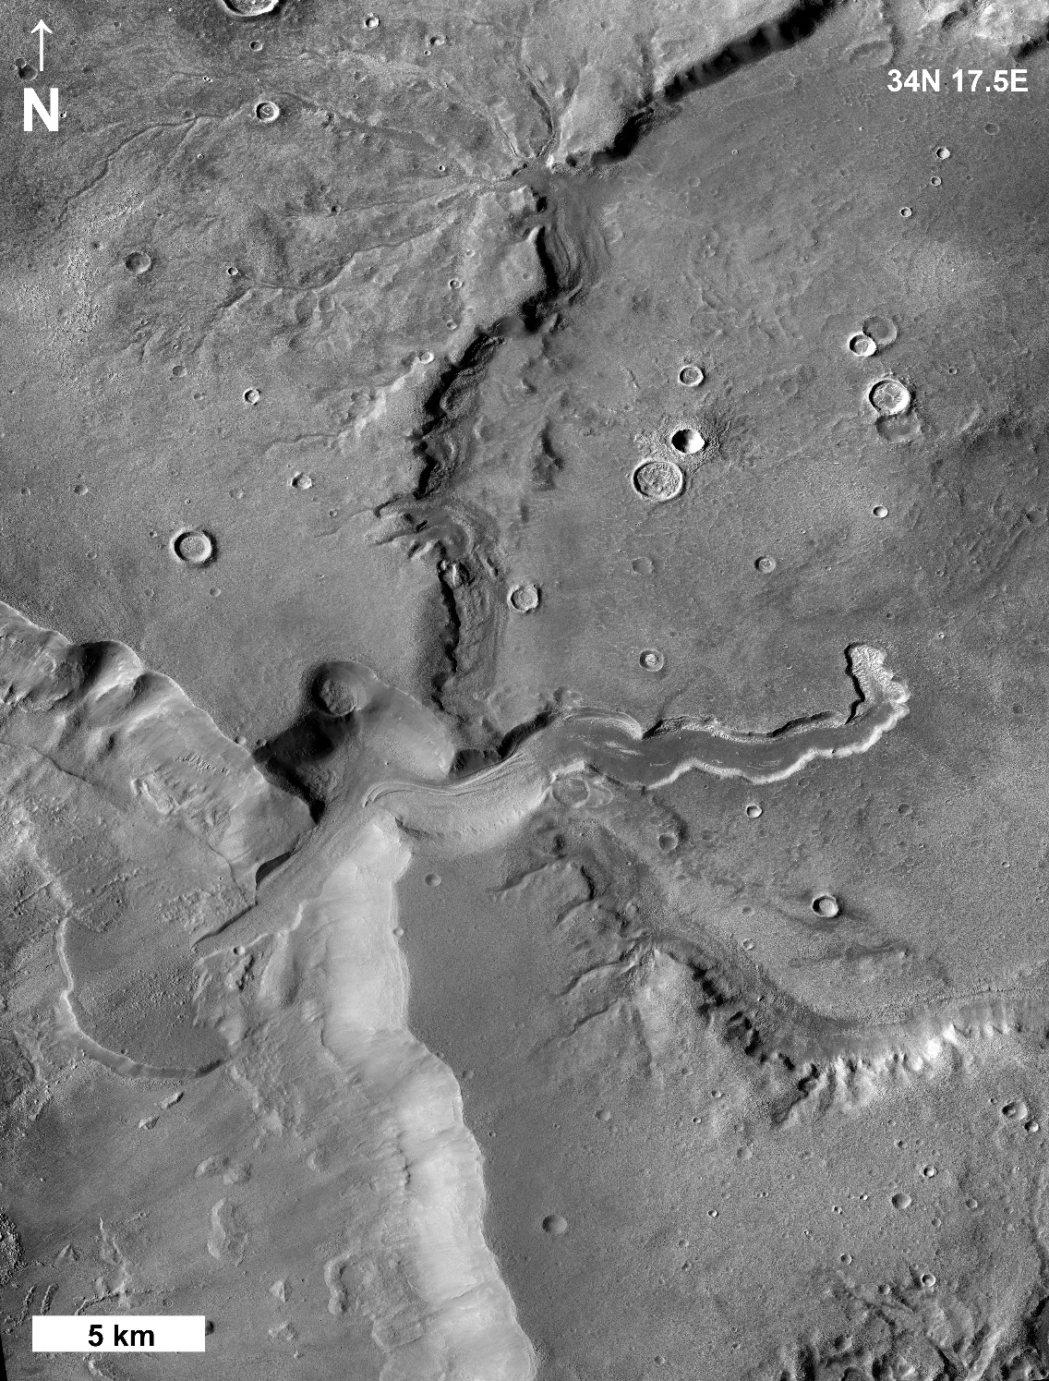

Slide 42
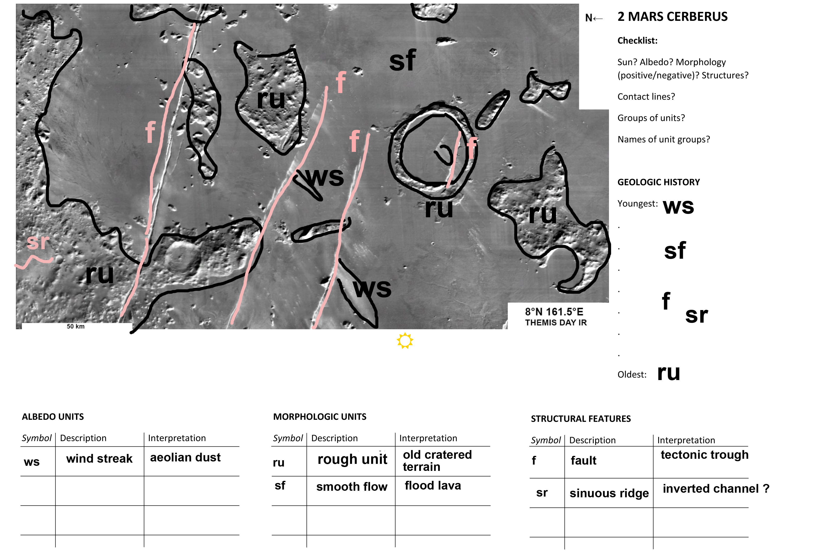

Slide 43
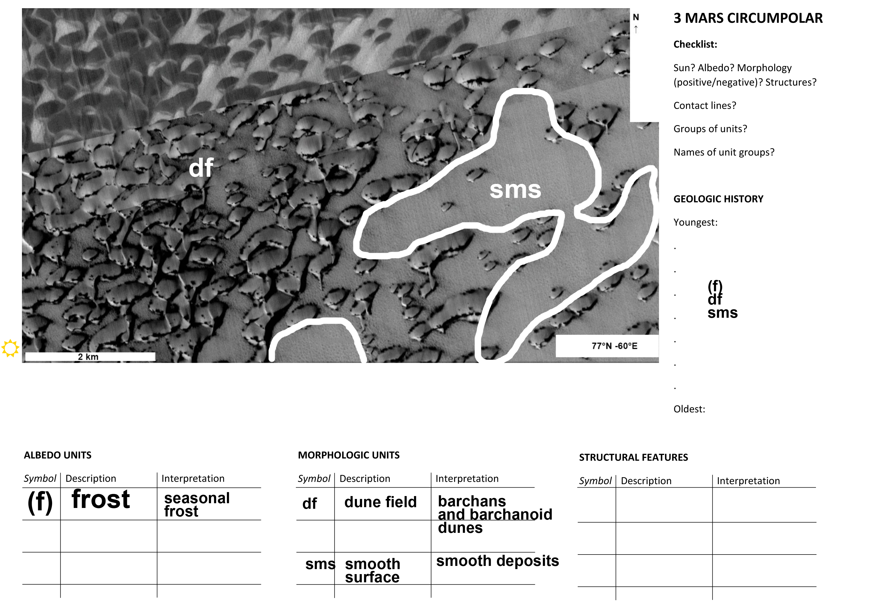

Slide 44
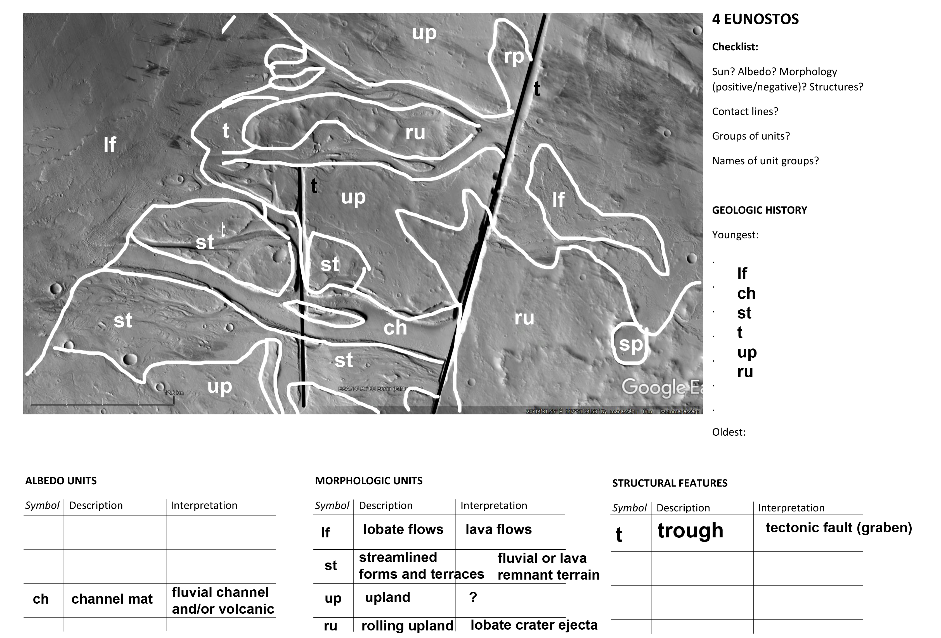

Slide 45
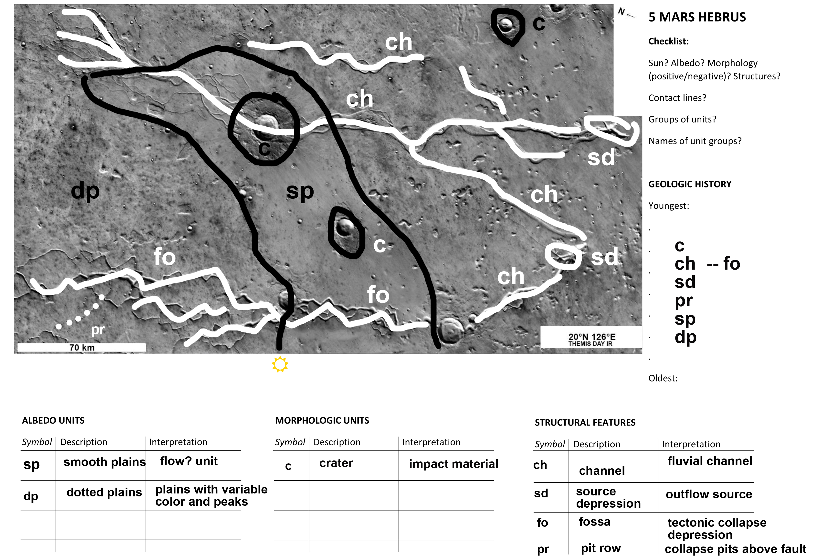

Slide 46
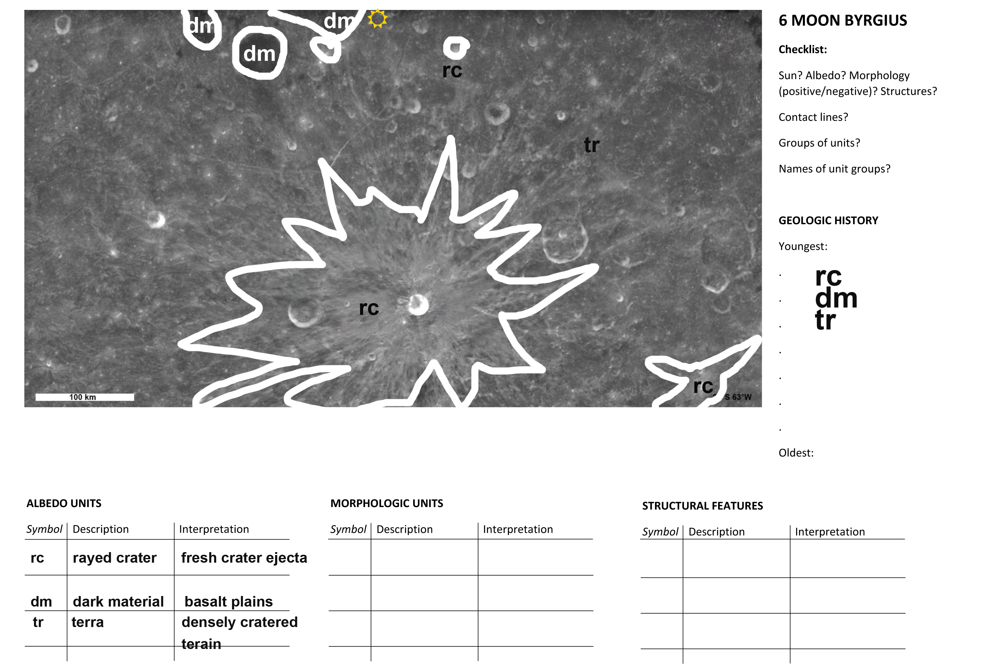

Slide 47
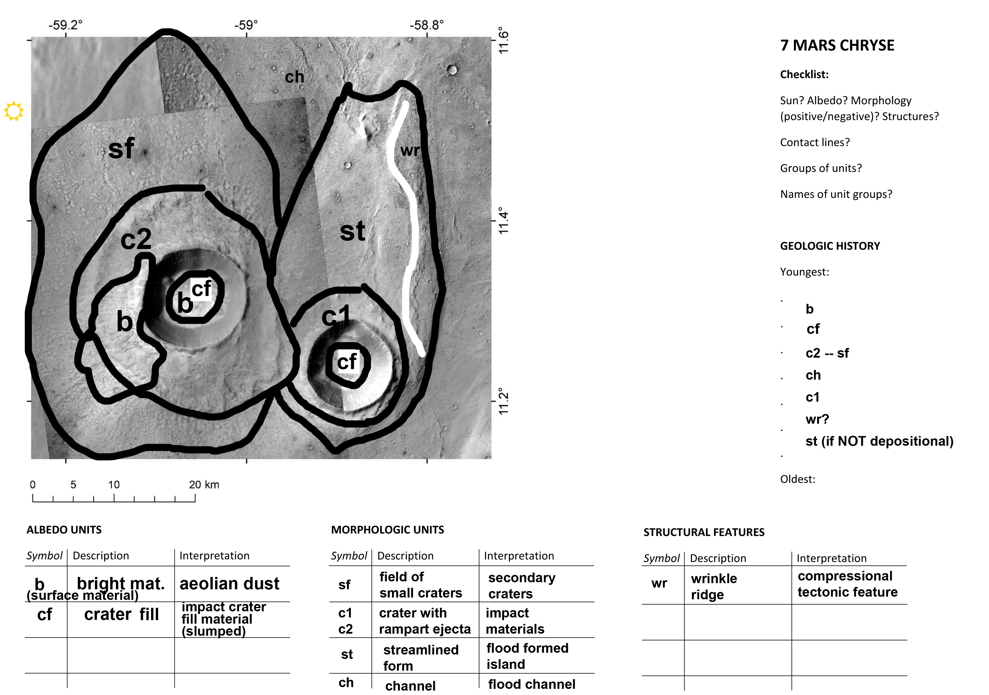

Slide 48
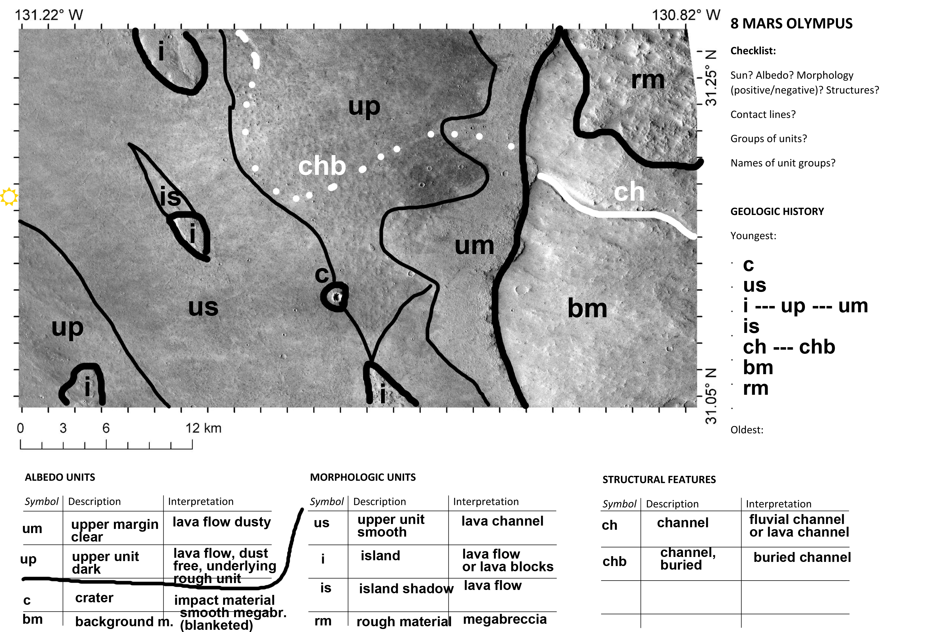

Slide 49
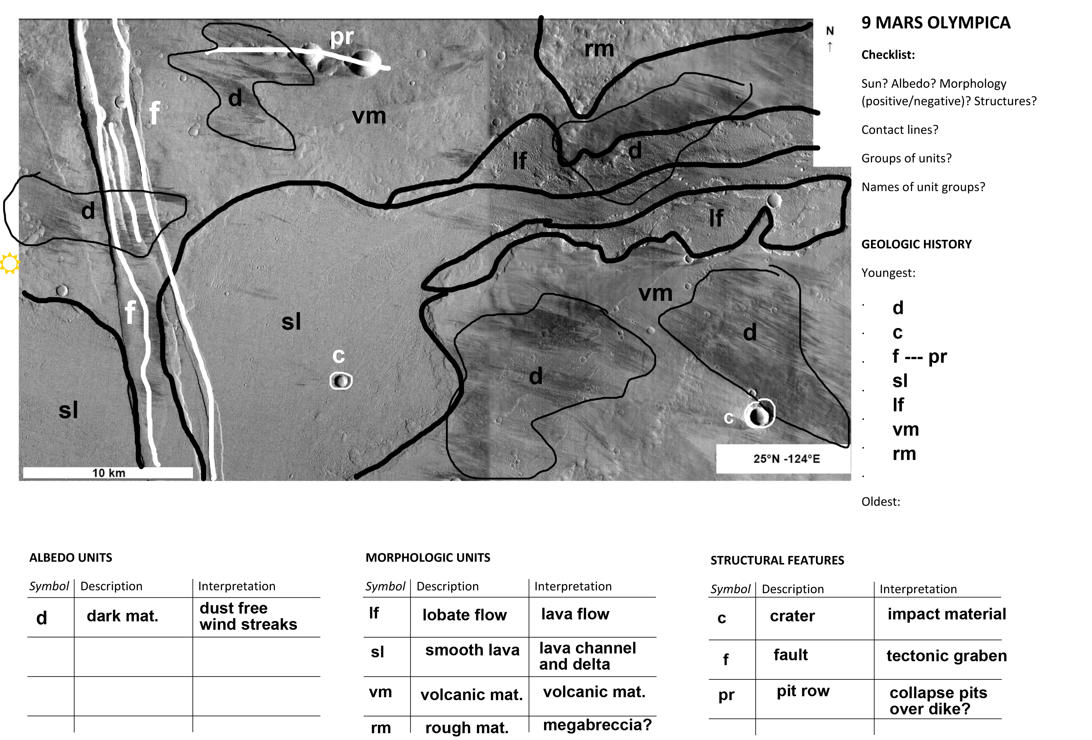

Slide 50
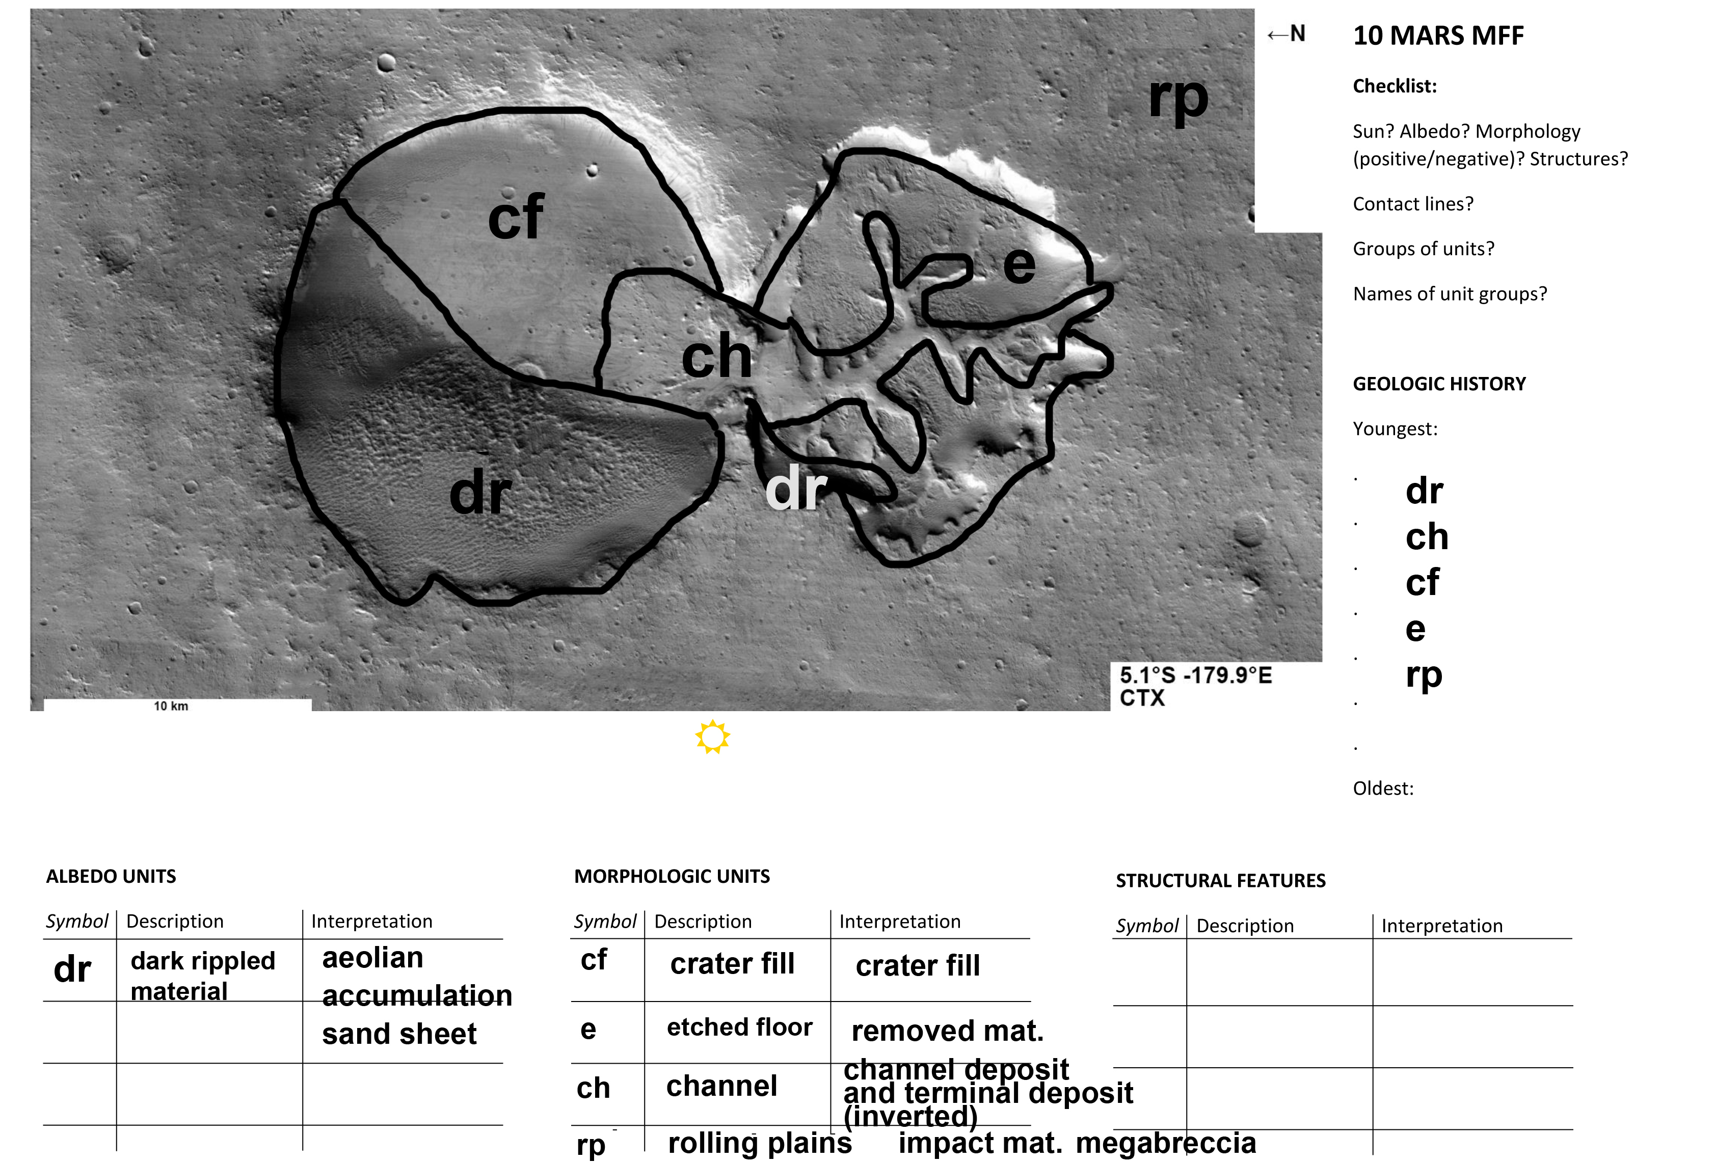

Slide 51
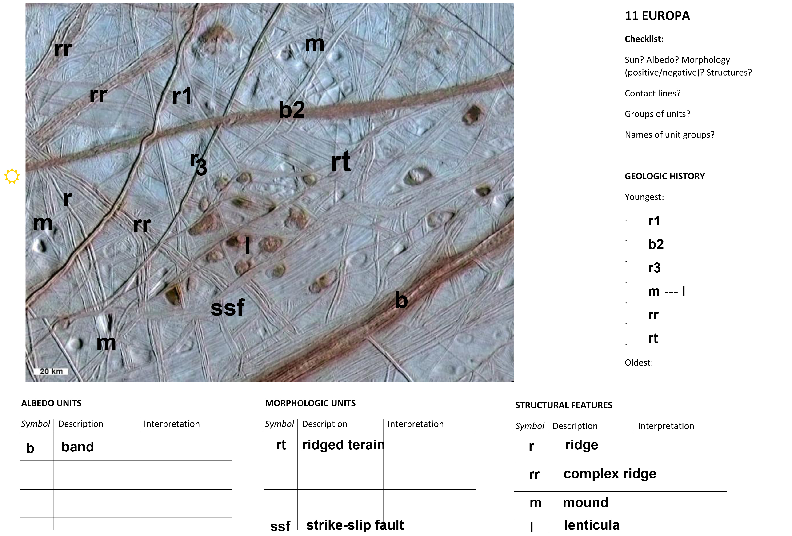

Slide 52
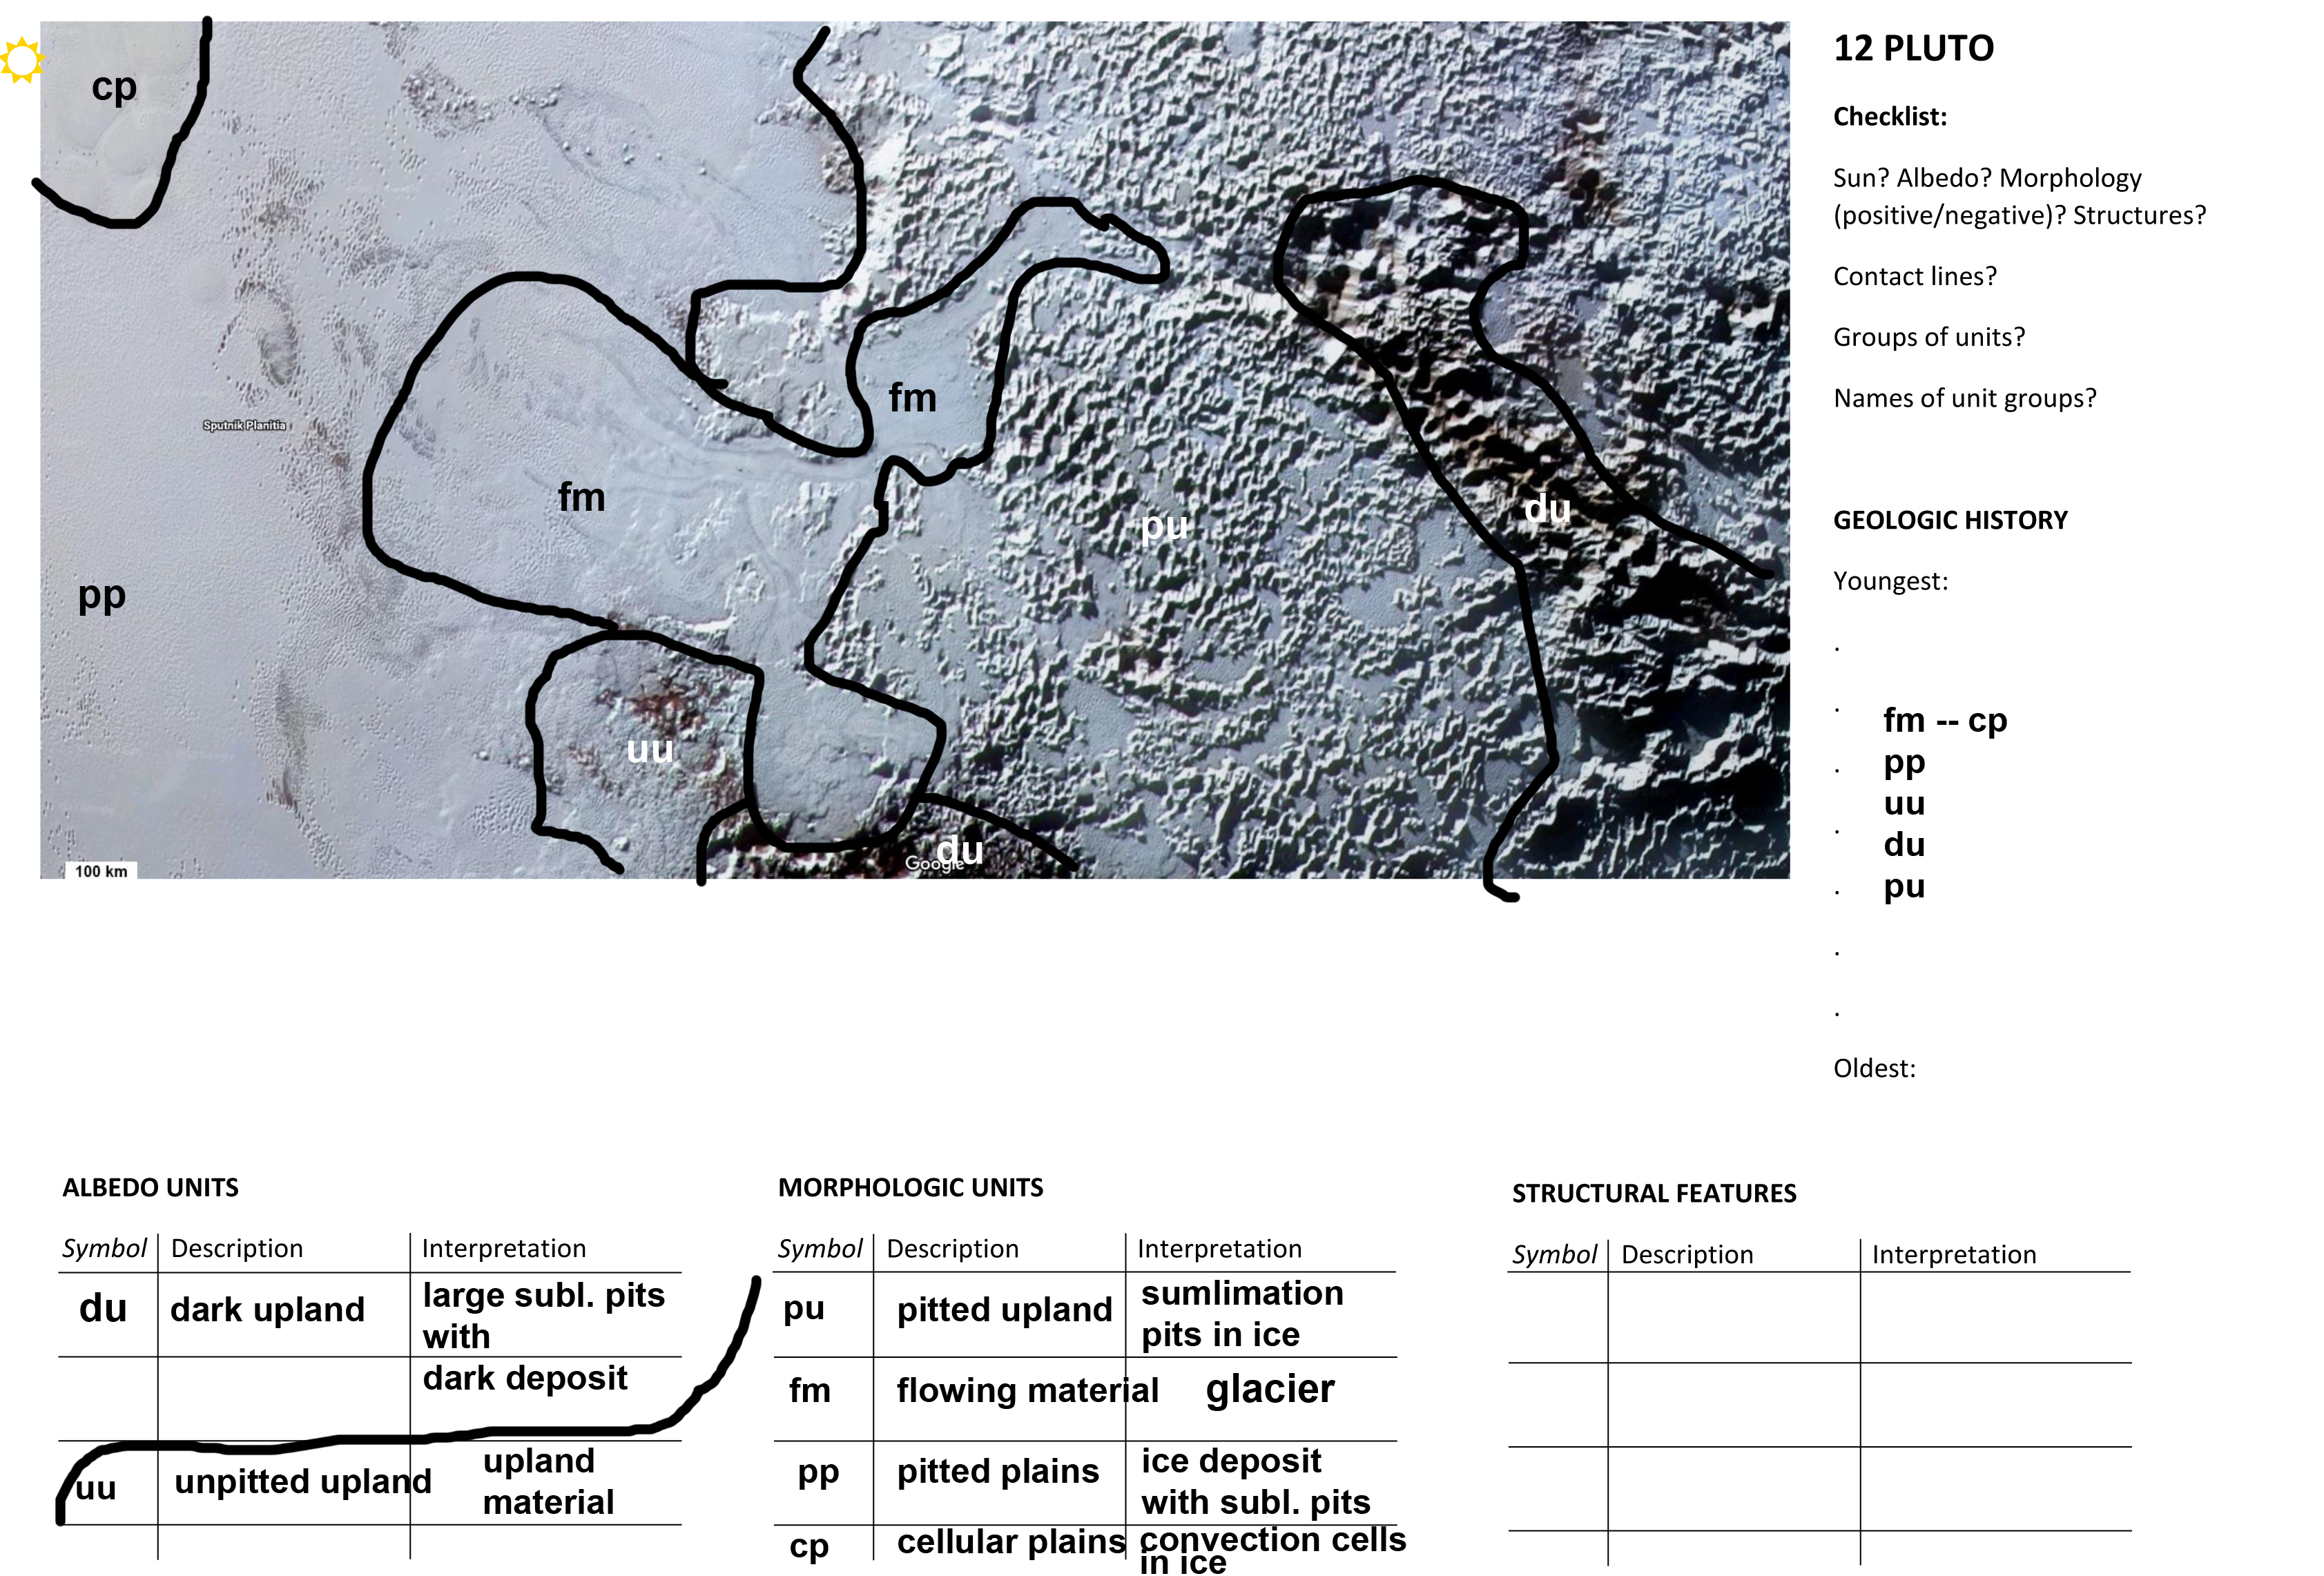

Slide 53
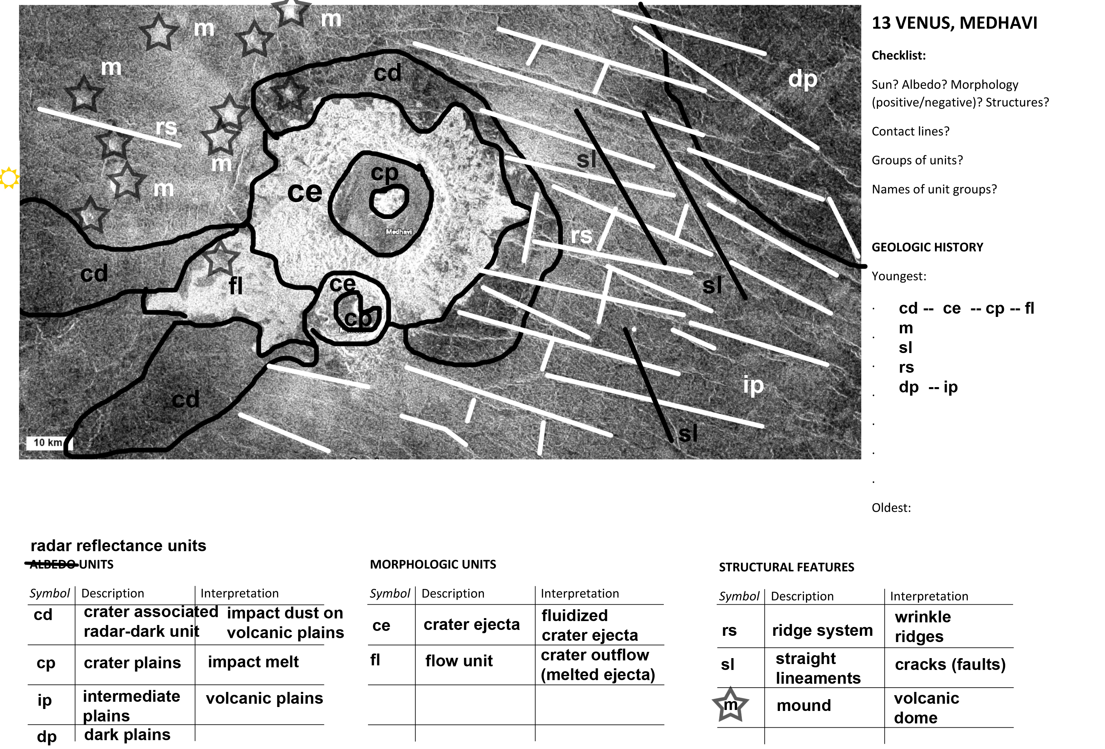

Slide 54
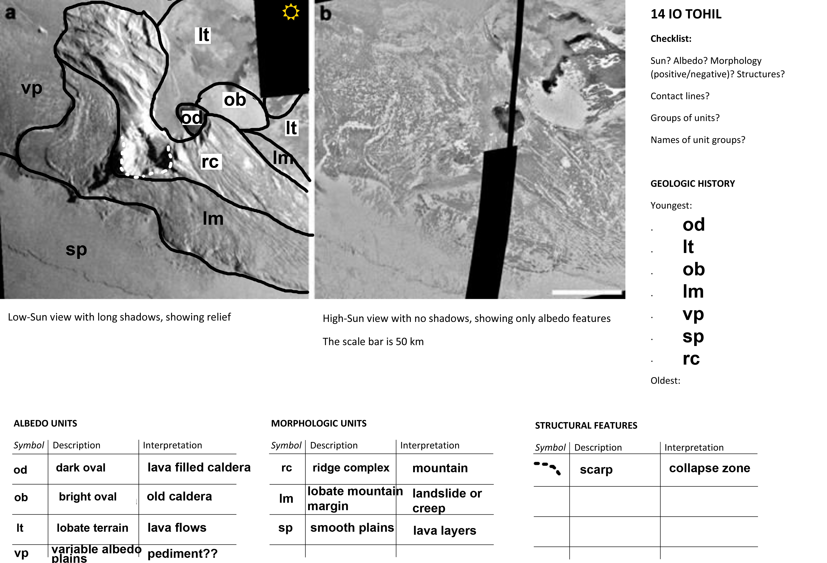

Slide 55


